Slide 1
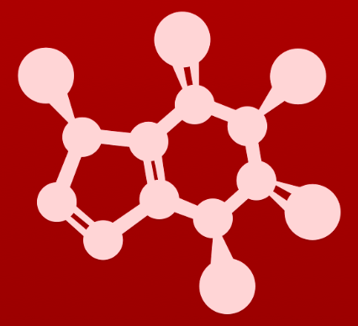
3. Conformation and stereochemistry
3.3: Chirality and stereoisomers

Slide 2
What is chiral?
Chiral objects don’t have an internal plane of symmetry, aka a mirror plane of
symmetry.
When superimposed, chiral objects don’t overlap perfectly.
Hands are a chiral, or handed.
What about:
Gloves?
Mittens?
Achiral examples?
Baseball bat
Coffee mug
Many socks

Slide 3
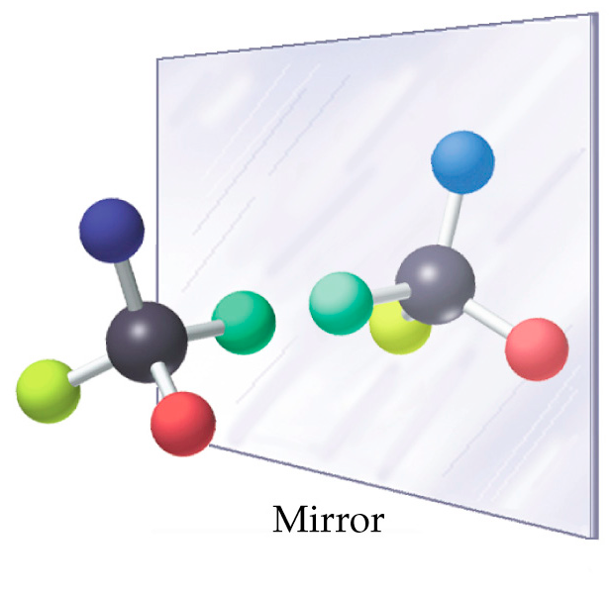
Chiral carbons
Chiral molecules also lack internal planes of symmetry, but there are some easier ways to identify them.
The two chiral molecules shown here (A and B) are mirror images of one another.
sp³ hybridized carbons (aka chiral carbons; chiral centers)
4 different substituents

Slide 4
Can’t be superimposed
Notice that the two mirror image molecules, A and B, cannot be superimposed even after one of them are rotated.
Stereoisomers: same molecular formula & connectivity but different 3D arrangement in space
Enantiomers: pair of stereoisomers that are mirror images of each other
Same physical and chemical properties.
Different biological properties.

Slide 5
Try this
Are C and D stereoisomers?
One quick clue that C&D don’t have chiral carbons is that two of their four substituents are identical.
Both molecules are achiral.
In fact, C&D are identical molecules.
One quick clue that C&D don’t have chiral carbons is that two of their four substituents are identical.

Slide 6
Try this
Is 2-butanol chiral? Does it have four different substituents?
chiral: 4 substituents
If any two groups of one enantiomer were switched with one another, the two models would now be identical.
2-butanol forms enantiomers.
One quick clue that C&D don’t have chiral carbons is that two of their four substituents are identical.

Slide 7
Try this:
Is 2-propanol chiral? Does it have four different substituents?
Two identical methyl groups, so achiral.
One quick clue that C&D don’t have chiral carbons is that two of their four substituents are identical.

Slide 8
Try this:
Can a small molecule with a central sp² hybridized carbon be chiral?
One quick clue that C&D don’t have chiral carbons is that two of their four substituents are identical.

Slide 9
Examples of enatiomeric pairs
Chiral carbons are shown as red dots.
*
*
*
*
*
*
*
*
Find the chiral carbons here.
One quick clue that C&D don’t have chiral carbons is that two of their four substituents are identical.

Slide 10
Examples of achiral molecules
Be sure that you can see that none of these molecules contains a chiral carbon.
Remember that dash-wedged carbons don’t necessarily correspond to chirality.
One quick clue that C&D don’t have chiral carbons is that two of their four substituents are identical.

Slide 11
Amines: sometimes chiral
The nitrogen of acyclic amines has four ‘substituents’, so why isn’t it chiral?
One substituent is a lone pair.
At room temperature, the orientation of the nitrogen inverts rapidly, preventing true chirality form occurring.
4 E10 inversions/second
https://chem.libretexts.org/Bookshelves/Organic_Chemistry/Book%3A_Basic_Principles_of_Organic_Chemistry_(Roberts_and_Caserio)/23%3A_Organonitrogen_Compounds_I%3A_Amines/23.06%3A_Stereochemistry_of_Amines
In small rings (<5 atoms), the inversion rates of N is much slower and chirality can occur at the N even with a lone pair.

Slide 12
Try this:
Locate all chiral centers; there may be more than one.
Remember that some hydrogen atoms aren’t shown explicitly.
*
*
*
*
*
*
*
*
*
*

Slide 13
Try this:
Draw enantiomers of mevalonate and serine.
How do you approach this problem?
Find and mark chiral centers.
Use dash-wedges to show both orientations at chiral centers:
switch dash-wedges!

Slide 14
Try this:
Both molecules shown here are 2-butanol. Are they enantiomers?
Nope. In both cases, the hydroxyl group comes forward and the hydrogen atom goes backwards.
Make models to convince yourself!

Slide 15
Can you?
(1) Define the term ‘chirality’ and give examples of chiral and achiral objects?
(2) Define the terms ‘stereoisomer’ and ‘enantiomer’, and draw enantiomers
using dash-wedge conventions?
(3) Identify chiral centers in molecular structures? Including amine Ns?
(4) Describe what you would have to change (or switch) to convert one
enantiomer to the other?

