Slide 1
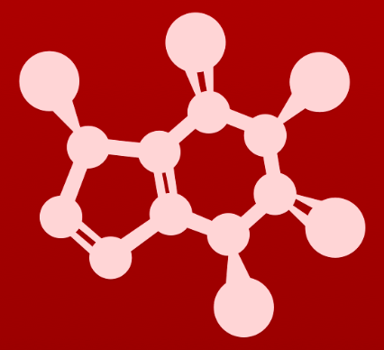
3. Conformation and stereochemistry
3.4: Labeling chiral centers

Slide 2
Cahn-Ingold-Prelog labeling: R or S
The Cahn-Ingold-Prelog labeling system allows us to identify stereoisomers by describing the 3D orientation of the four substituents of a chiral atom.
Steps:
Label substituents from highest (1) to lowest (4) priority by atomic number.
Build a model.
Hold the model so that substituent 4 faces away from you with 1-3 facing toward you.
As you follow substituents rom 1 to 3,
if you move clockwise the chiral atom has an ’R’ conformation.
If counterclockwise, then It’s an ’S’ conformation.
*

Slide 3
Try this:
Thalidomide was prescribed as a sedative and anti-morning sickness medication for pregnant women in the 1950s. Tragically, one enantiomer caused serious birth defects in children born to some of those women.
It’s now used to treat wasting sickness in patients with HIV and the aggressive blood cancer, multiple myeloma.
Which of these thalidomide enantiomers is R and which is S?
R
S
2
1
2
1
*
*
3
3
Note that the hydrogen (priority 4) is pointing at us, rather than away from us. Flipping the molecule over would ‘fix’ that and clockwise rotation would become anticlockwise.
While it’s believed that the S enantiomer causes the birth defects, an isomerase in the body will convert R to S, so birth defects aren’t prevented by giving purified R-form. Interactive model

Slide 4
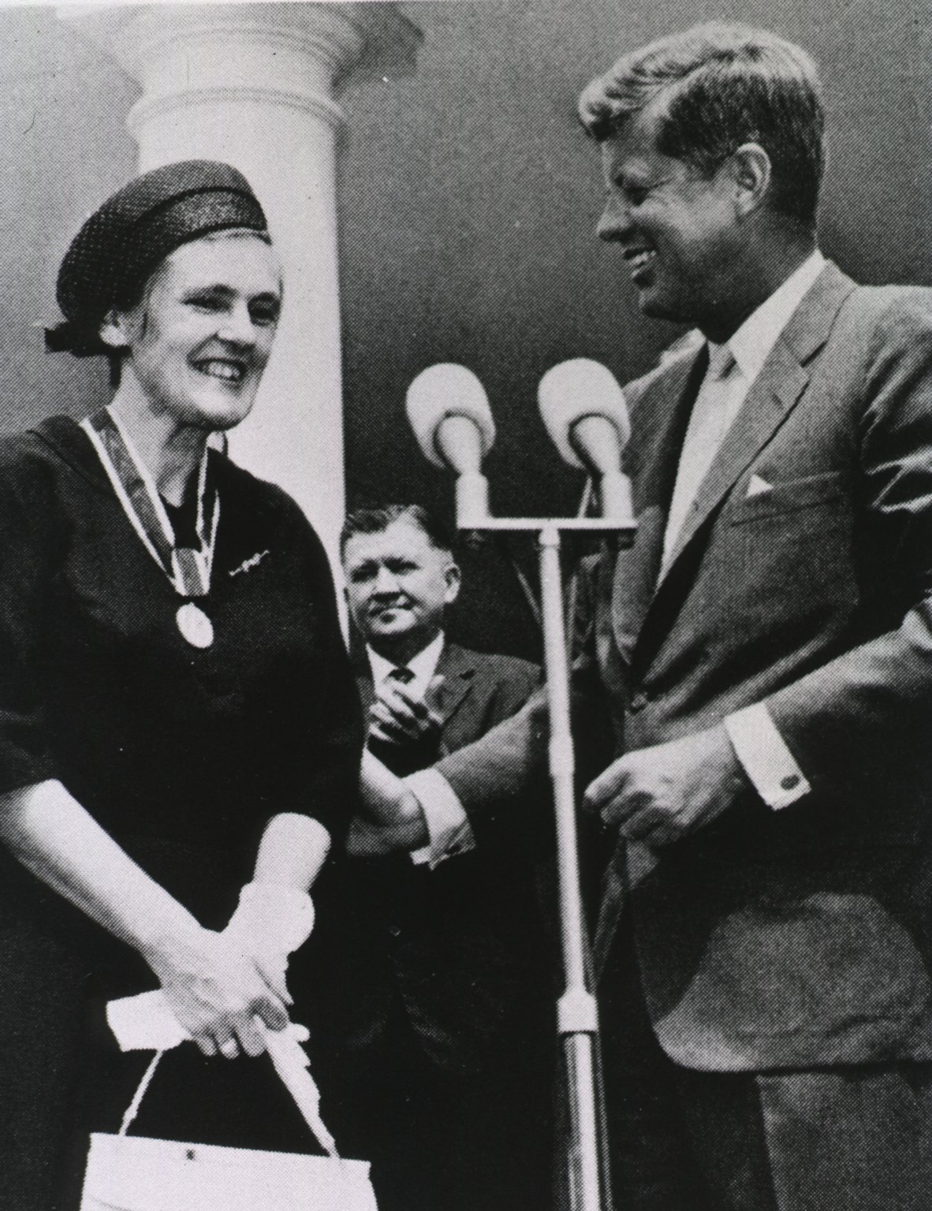
Regulation prevented more tragedy
In the US, thalidomide wasn’t approved for use because of the efforts of a pharmacist at the USDA. Frances Oldham Kelsey received the President’s Award for Distinguished Civilian Service in 1962.
Richardson-Merrell, the American distributor, demanded approval six times without supplying any test data.
Only 17 children were affected by free samples applied for ‘testing purposes’.
https://en.wikipedia.org/wiki/Thalidomide

Slide 5
Try this:
Identify the chiral centers in these biomolecules and determine whether conformation is R or S.
:
:
:
:
:
:
:
:
:
:
:
:
:
:
:
:
:
:
:
:
:
:
:
:
:
:
:
:
1
2
3
1
2
3
2
3
1
2
3
1

Slide 6
Try this:
Should the R enantiomer of malate have a dash or wedge for its C - O bond?
:
1
:
:
:
:
:
:
3
:
:
:
2
:
:
:
The C – OH bond should be ‘dashed’ for the R enantiomer.

Slide 7
Can you?
Describe the steps of Cahn-Ingold-Prelog prioritization and use it to determine configuration of chiral centers as R or S?
(2) Use dash-wedge diagrams to draw R or S forms of an organic molecule?

