Slide 1
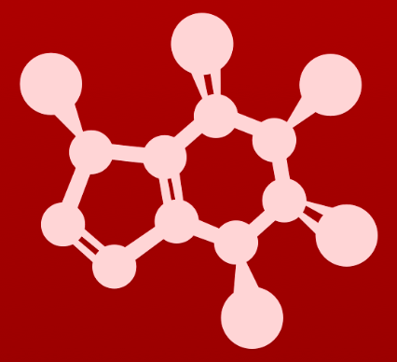
3. Conformation and stereochemistry
3.5: Optical activity

Slide 2
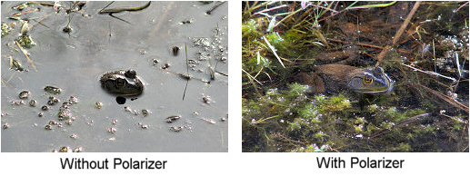
Plane polarized light
A beam of light is a collection of electromagnetic waves traveling through space.
The waves are randomly oriented, or nonpolarized.
:
A polarizing filter removes all light waves except those travelling in a single plane.

Slide 3
Chiral molecules rotate polarized light
When plane-polarized light is passed through a solution of chiral molecules the plane of the light is rotated.
This property is called ’optical activity’.
:
Dextrorotatry (D+): polarized light is rotated clockwise
Levorotary (L-): polarized light is rotated counterclockwise
D & L are not related to R & S.
A 50:50 mixture of R and S enantiomers, called a racemic mixture, does not appear to rotate plane-polarized light because the rotations are equal and opposite and cancel one another out.

Slide 4
Amino acids: L for ‘life’
19 of 20 amino acids have chiral ⍺-carbons, and in nature (or life) they are nearly all L, or levorotary.
Coincidentally, 18 of 19 are also (S).
:
S
3
3
R
Seems S, but the H projects forward, so the molecule (and rotation) have to be flipped.
2
2
1
1
Determine whether each of these amino acids is R or S.
D amino acids are rare in nature, but are used by some bacteria can be useful in biotechnology.

Slide 5
Can you?
(1) Define the term ‘plane-polarized light’?
(2) Describe the effect of chirality on plane-polarized light?
(3) Define the terms ‘levorotary’ and ‘dextrorotary’?
(4) Describe the relationship between L and D and R and S?
(5) Define the term ‘racemic mixture’ and explain why it has no apparent
optical activity?

