Slide 1
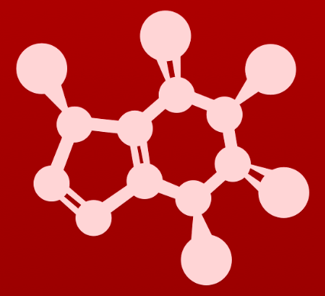
3. Conformation and stereochemistry
3.7: Meso compounds

Slide 2
Meso compounds
Meso compounds: have chiral centers with equal and opposite chirality, and an internal plane of symmetry that renders them achiral
Tartaric acid has 2 chiral carbons. It should have 4 stereoisomers. Here are its enantiomers.
:
:
:
:
:
:
:
:
:
:
:
:
:
:
:
:
:
:
:
:
:
:
:
:
Is this a second set of enantiomers?
:
:
This is actually one molecule as these ‘two’ forms are superimposable and identical.
Meso!
:
:
:
:
:
:
:
:
:
:
:
:
:
:
:
:
:
:
:
:
:
:

Slide 3
:
Seeing meso
Some meso compounds are obvious, but others are much easier to see if you build the model(s).
:
:
:
:
:
:
:
So the meso form is an achiral diastereomer of the R,R and S,S forms.
:
:
:
:
:
:
:
:
:
:
:
:
:
:
:
:
:
:
:
rotate to trans
rotate into cis
Some conformations make the internal mirror image more obvious.
:
:
:
:
:
:
:
:
:
:
:
:
And here flipping the molecule over converts S,R to R,S without making or breaking a single bond.
:
:
:
:
:
:
:
:
:
:
:
:

Slide 4
Try this:
Which of these compounds are meso?
Look for internal symmetry and opposite chirality.
You may want to build models to be sure!
:
:
:
:
:
:
:
:
:
:
:
:
:
:
:
:
:
:
:
:
:
:
:

Slide 5
Can you?
(1) Define the term ‘meso’ compound and explain how to test for it?
(2) Understand how the R/S configuration of a compound reflects the internal
symmetry characteristic of a meso compound?
(3) Describe the optical activity of a meso compound?

