Slide 1
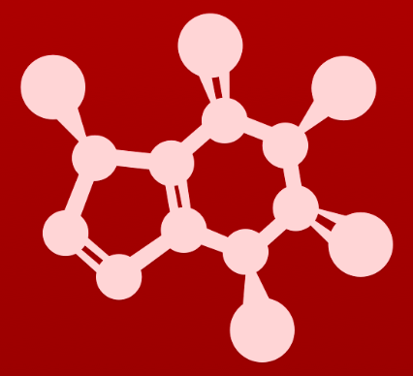
3. Conformation and stereochemistry
3.8: Fisher and Haworth projections

Slide 2
Fischer projections
Fisher projections: show the chirality of organic molecules in the open chain form and don’t use dashes and wedges
Horizontal axis points out of the plane, towards the viewer.
Vertical axis points back into the plane, away from the viewer.
:
:
:
:
:
:
:
:
:
:
:
:

Slide 3
Fischer projections: R or S?
To determine whether each carbon of a Fisher projection is R or S:
Assign priority to the four substituents;
Face the hydrogen back away from the viewer;
Determine whether 1 to 2 to 3 is clockwise or counterclockwise.
When the hydrogen atom (or whatever group is lowest priority) is on the horizontal axis, the molecule must be rotated on its vertical axis to swing the hydrogen to face away from the viewer.
That twists the other horizontal substitutent over to the other side.
Here the OH (1) ends up on the left.
Make a model and prove this to yourself.

Slide 4
Translating Fisher to zig-zag
It’s wise to determine whether each chiral carbon is R or S to be sure the two types of diagrams actually represent the same molecule.
Be sure that you can do that here.
Fischer
'line’ Fischer
zig-zag

Slide 5
Try this:
For this group of five-carbon sugars:
Label all chiral carbons.
Determine whether each is R or S.
:
:
:
:
:
:
:
:
:
:
:
:
:
:
:
:
:
:
:
:
:
:
:
:
:
:
:
:
:
:
:
:
:
:
:
:
:
:
:
:

Slide 6
Haworth projections (Fischer for rings)
The Haworth diagram shows stereochemistry like a Fischer diagram.
:
:
:
:
:
:
:
:
:
:
:
:
:
:
:
:
:
:
:
:
:
:
:
:
:
:
:
:
:
:
:
:
:
:
:
Chair (or boat) diagrams show both conformation and stereochemistry.
Most realistic.

Slide 7
Can you?
(1) Describe the conventions of a Fischer projection? How does it show 3D structure without dash-wedges?
(2) Determine whether chiral centers are R or S on Fischer projections?
(3) Convert Fischer projections to ‘zig-zags’ and dash-wedge diagrams?
(4) Describe how a Haworth projection is similar to a Fisher projection?

