Slide 1
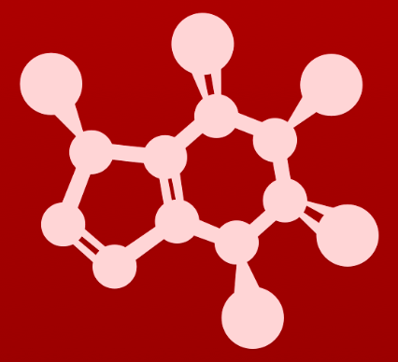
4. Overview of organic reactivity
4.1A: The acid-base reaction

Slide 2
Acid-base reactions (proton transfer)
Let’s look at a simple acid-base reaction from an organic chemistry perspective.
electron transfer
Spectator ions are not shown.
electron rich
electron poor
Electrons are transferred from the electron-rich reactant to the electron-poor reactant to create new products.
Reaction mechanism shows the movement of electron pairs using curved arrows.
The electron pairs are said to ‘attack’ as they move simultaneously.
Movement of of electrons from a bond breaks that bond.

Slide 3
Reaction transition states
Transition state: a very transient, short-lived form in which bonds are breaking and forming simultaneously
Highest energy state
Dipolar charges
reactants
transition state
products
Transition states are not shown for all reaction mechanisms, but they do help explain how reactions happen.

Slide 4
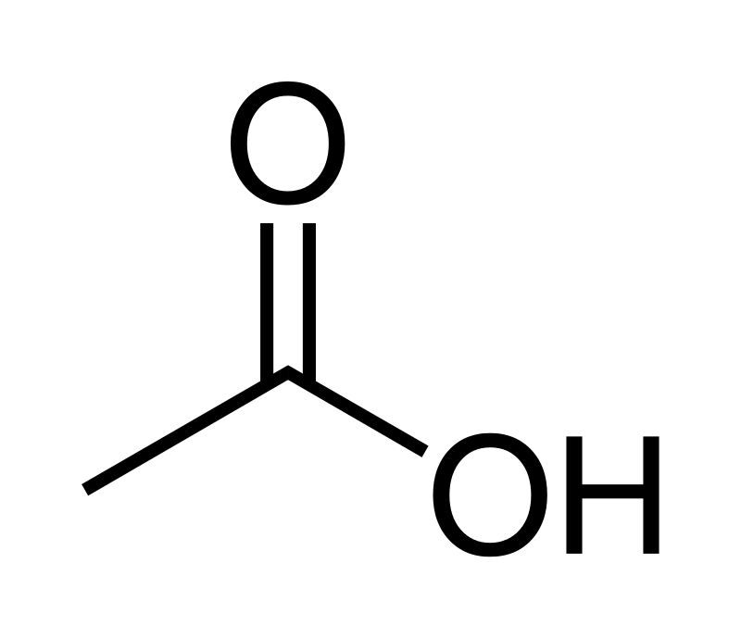
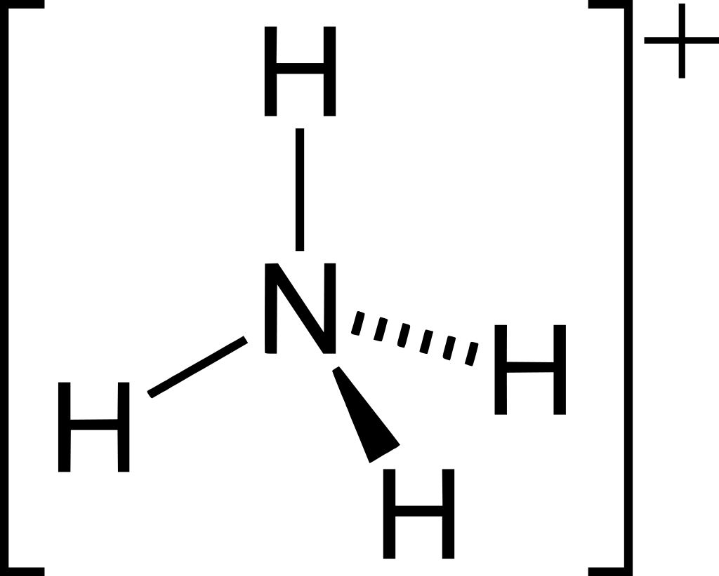
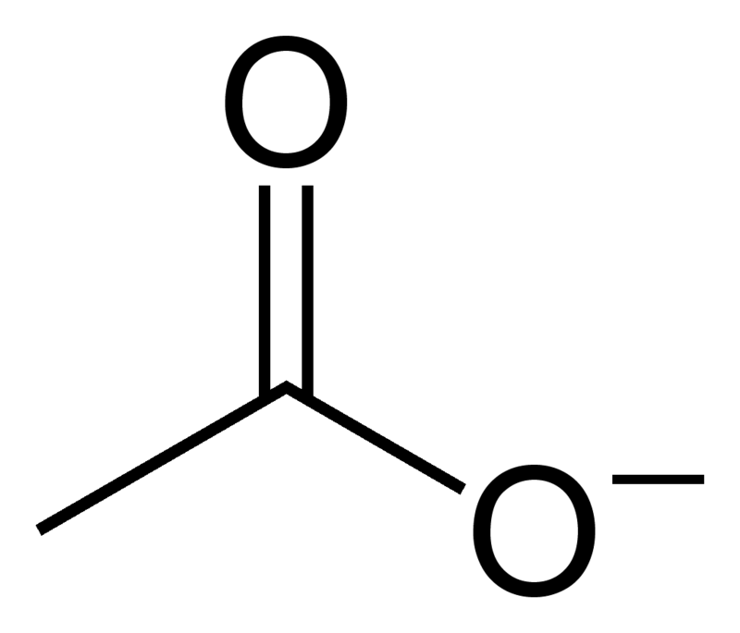
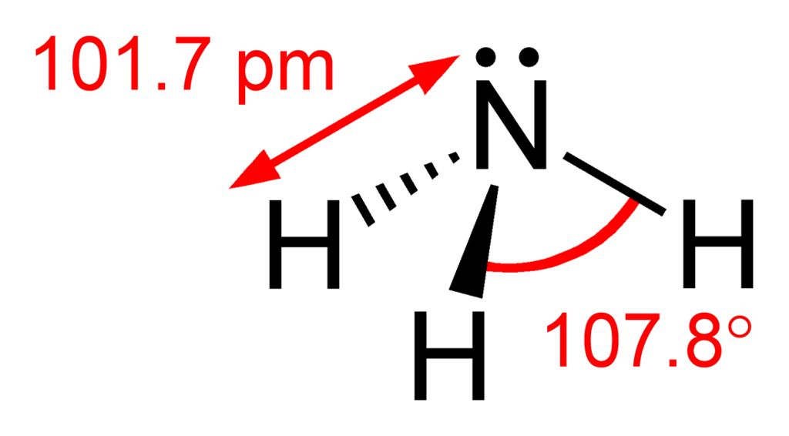
Try this
Draw a reaction mechanism for the acid-base reaction of acetic acid (CH3COOH) and ammonia (NH3).
Include all Lewis dot structures with formal charges.
Use curved arrows to show the movement of electrons.
Show the transition state.
reactants
transition state
products
:
:
:
:
:
:
:
:
:
:
:
:
:
Do the same for the reverse reaction!

Slide 5
4. Overview of organic reactivity
4.1B: One-step nucleophilic substitution

Slide 6
Carbon is the electron-poor target
In acid base reactions, a pair of electrons from an electron-rich reactant attacks an electron poor hydrogen.
In this one-step nucleophilic substitution reaction, a dipolar positive carbon takes the place of the acid’s hydrogen.
The polar C – Cl bond is reactive.
A lone pair from the electron-rich oxygen attacks the electron-poor carbon.
As the new bond forms between the oxygen and carbon a bond must break to prevent carbon from having more than an octet.
The chlorine takes the electron pair from its bond to carbon and leaves as chloride ion.
The OH nucleophile is substituted for Cl.

Slide 7
Adding some new terms
A new set of terms labels the reactants and products according to their motives and functions.
SN2 reaction
Nucleophile (Nu): an electron-rich reactant that seeks to react with a + charge
Has abundant : or a full – charge
Electrophile (E+): an electron-poor reactant that seeks to react with a – charge
Has a full or partial + charge
Leaving group (LG): an electronegative group that takes the electron pair of a bond and leaves the molecule it was part of
Has a - charge or is charge neutral

Slide 8
Try this
In each of the nucleophilic substitution reactions below, identify the
nucleophile, electrophile, and leaving group, and fill in the missing product.
:
:
:
:
:
:
..
Nu:-
:
:Cl:-
:
..
E+
LG
:
:
:
:
:
:
:
PO4⁻³
E+
:
:
:
:
:
:
:
:
Nu:-
LG
:
:
..
:
:Br:-
:
Nu:
..
E+
LG

Slide 9
4. Overview of organic reactivity
4.1C: Two-step nucleophilic substitution

Slide 10
Two-step nucleophilic substitution
Some nucleophilic substitution reactions use two steps.
SN1 is a variant of the one-step SN2 and it’s easy to identify the Nu:, E+ and LG.
Step 1: Loss of LG to form carbocation (slow)
SN1 rxn
LG
carbocation (transition)
Step 1: Resolution of the carbocation by nucleophilic attack (fast)
Nu:-
E+

Slide 11
Carbocation intermediates
The carbocation intermediate is a high-energy transition state.
Carbocations are slow to form, because the loss of the LG from a stable reactant creates a very unstable carbocation.
Carbocations are quick to react because they are so unstable.
Thus, the second step of SN1 is very fast as the carbocation reacts with the first nucleophile to come along.

Slide 12
Being able to see mechanism is critical
At this point in the course, you need to begin to see how reactants are related to products.
Where do electrons move to transform chemical structures?
Remember that curved arrows move electrons, not atoms. And practice using curved arrows properly.
Can you ‘see’ the curved arrows here?

Slide 13
Can you?
(1) Understand that bases are electron-rich and acids are electron-poor?
(2) Use a curved arrow to show that the : of bases attacks to the H of acids?
(3) Understand the concept of a transition state and why it is high-energy?
(4) Define the terms ’nucleophile’, ‘electrophile, and ‘leaving group’ and identify these elements in reactions?
(5) Recognize the basics of nucleophilic substitution and identify SN1 vs. SN2 reactions?
(6) Understand why carbocations are so highly and rapidly reactive?

