Slide 1
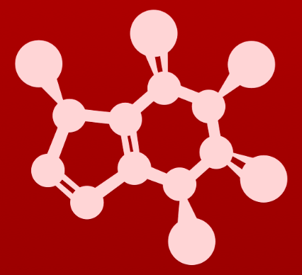
CHE 2060: Principles of Organic Chem
4. Overview of organic reactivity
Introduction: The $300 million reaction
4.1: A first look at some organic reaction mechanisms
4.1A: The acid-base reaction
4.1B: A one-step nucleophilic substitution mechanism
4.1C: A two-step nucleophilic substitution mechanism
4.2: A quick review of thermodynamics and kinetics
4.2A: Thermodynamics
4.2B: Kinetics
4.3: Catalysis
4.4: Comparing biological and laboratory reactions

Slide 2
4. Overview of organic reactivity
4.4: Comparing biological reactions to laboratory reactions

Slide 3
What are the differences?
Organic chemists are often working to approximate, or circumvent, biological reactions or biochemistry. So, it’s helpful to understand the differences between reactions that happen in cells and those done in chemistry labs.
Parameter | Biology | Chemical laboratory
catalyst | enzymes | acid, base, or other catalyst
solvent | water | variety: polar to nonpolar
reactant mixture | complex, low concentration | simple, high concentrations
temperature | narrow range (37C) | wide range
pH | usually 7.2 - 7.4 | wide range
Keq > 1
= 1
< 1

