Slide 1
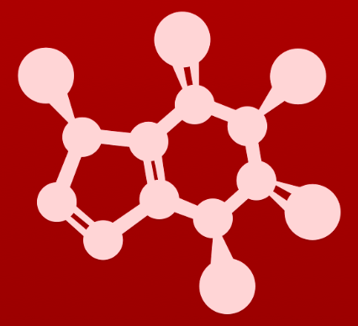
CHE 2060: Principles of Organic Chem
5. Acid-base reactions
5.1: Acid-base reactions
5.1A: The Brønsted-Lowry definitions
5.1B: The Lewis definitions
5.2: Comparing acid-base nature of functional groups (Ka)
5.2A: Defining Ka and pKa
5.2B: Using pKa to predict reaction equilibria
5.2C: Buffered solutions: Henderson-Hasselbach
5.3: Structural effects on acidity and basicity
5.3A: Periodic trends
5.3B: Resonance effects
5.3C: Inductive effects
5.4: Acid-base properties of phenols
5.5: Acid-base properties of N-containing functional groups
5.5A: Anilines
5.5B: Imines
5.5C: Pyrroles
5.6: Carbon acids
5.6A: The acidity of ⍺-protons
5.6B: Keto-enol tautomers
5.6C: Imine-enamine tautomers
5.6D: The acidity of terminal alkynes
5.7: Polyprotic acids
5.8: Effects of enzymatic microenvironment on acidity and basicity

Slide 2
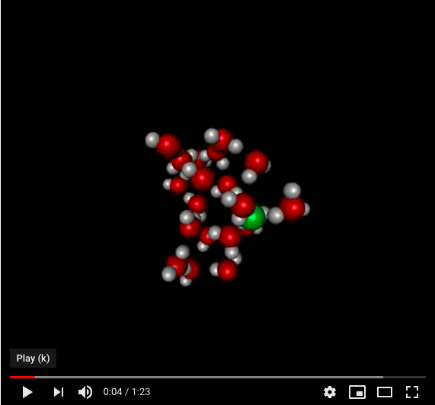
5. Acid-base reactions
Introduction: the Grotthuss mechanism explains the speed of acid-base reactions
https://www.youtube.com/watch?v=XbPmqnnr0jU

Slide 3
5. Acid-base reactions
5.1A: The Brønsted-Lowry definitions

Slide 4
Brønsted-Lowry definitions
In inorganic chemistry acids and bases are defined using the definitions developed by Brønsted and Lowry:
Acids: molecules that donate protons, or hydrogen ions (H⁺¹)
Bases: molecules that accept protons, or hydrogen ions (H⁺¹)
Conjugate acid-base pairs: molecules that differ by only one protons, or hydrogen ion (H⁺¹)

Slide 5
Look for the patterns
Here is the acid-base reaction between acetic acid and methylamine.
The reverse reaction is also an acid-base reaction.
Notice that the acid is the proton-donator.
Notice that the base must have an available lone pair.
Later, we will see that π electrons can also be used by bases.

Slide 6
Try this
Complete the reactions below - in other words, draw structures for the
missing conjugate acids and conjugate bases that result from the curved arrows provided.
-
:
:
+
:
:
:
:
:
:
3
:
:
:
:
:
:
:
:
:
:
:
:
:
:
:
:
:
:
:
-
H -
:
:
:
:
:
:
:
:
:
:
:
:
:
:
:
:
:
:
:
:
:
:
:
:
:

Slide 7
5. Acid-base reactions
5.1B: The Lewis definitions

Slide 8
Lewis definitions: better for o-chem
While the Brønsted-Lowry definitions of acids and bases are all about protons, the Lewis definitions are based on electron pairs.
Lewis acids: accept electron pairs
Lewis bases: donate electron pairs
Lewis acid
Lewis base

Slide 9
Can you?
(1) Compare and contrast the Brønsted Lowry and Lewis definitions of acids and bases?
(2) Define the terms ‘conjugate acid’ and ’conjugate base’?
(3) Use a curved arrow to show a : from the Lewis base attacking the hydrogen atom of the acid?
(4) Predict the products of an acid-base reaction? Of course it’s the conjugate acid-base pair!

