Slide 1
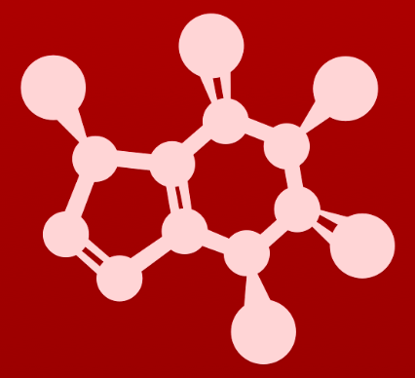
5. Acid-base reactions
5.2A: The acidity constant, Ka

Slide 2
Acidity constant ~ acid strength
The acidity constant (Ka): quantifies the strength of acids
In this example acetic acid (weak) is reacted with water.
The longer backwards arrow shows that reactants are favored.
Hydronium ion, the conjugate acid of water, is a stronger acid than acetic acid and drives the reaction backwards.
Note the energetics.

Slide 3
How is Ka calculated?
The acidity constant (Ka): quantifies the strength of acids
Start with the equilibrium constant, Keq:
The concentration of water is constant (55.6 M), so:
In general:

Slide 4
Ka values for common acids
acid | strength | Ka | dissociation?
acetic acid | weak | 1.75 E-5 | very little
sulfuric acid | strong | 1 E9 | nearly complete
hydrochloric acid | strong | 1 E7 | nearly complete
So, the larger the Ka value the stronger the acid.

Slide 5
pKa values: easier to work with
Because Ka values are very large, we usually work with pKa values:
pKa = - l0g [Ka]
Ka = 10^{-pKa}
The lower the pKa, the stronger the acid:
acid | pKa
hydronium ion | 0
protonated alcohol | 0
protonated carbonyl | 0
carboxylic acids | 5
protonated imines | 7
protonated amines | 10
phenols | 10
thiols | 10
alcohols, water | 15
⍺-carbon acids | 20
The organic acids of biological systems generally range between 5 and 20.
The stronger the acid, the weaker the conjugate base.
So hydroxide is a stronger base than ammonia because:
pKa
H2O 15.7
NH4⁺¹ 9.4
Weaker acid, so stronger base
Stronger acid, so weaker base

Slide 6
Try this
Which is the stronger base in each pair:
CH3O⁻¹ or CH3S⁻¹
Acetate ion or ammonia
(c ) Hydroxide ion or acetate ion
CH3OH pKa 15.54 stronger base
CH3SH pKa 10.0
acetic acid pKa 4.76
ammonium pKa 9.24 stronger base
water pKa 15.7 stronger base
acetic acid pKa 4.76

Slide 7
Using functional group pKas
How do we estimate the pKa of a large, complex molecule?
First, check the pKa values of its functional groups.
This molecule will start to react with bases using its phenol group, its most acidic group.
So it’s acid strength is roughly that of phenol, pKa ~10.

Slide 8
Try this
Identify the most acidic functional group on each of the molecules below,
and give its approximate pKa.
4.76
4.76
4.76
15.5
11
9.24
50
23
36
36
4.76
9.24
15.5

Slide 9
5. Acid-base reactions
5.2B: Using pKa to predict equilibria

Slide 10
pKa predicts equilibria
There are two ways to use pKa to predict the equilibria (direction) of acid-base reactions.
4.76
1. The stronger acid (lower pKa) pushes the reaction away from itself.
So here, the reaction is pushed forward, to products.
2. Keq = 10^{△pka}, where △pKa = (product acid pKa) – (reactant acid pKa)
So here △pKa = (10.6 – 4.8) = 5.8
Keq = 10^{5.8} = 6.31 E5
Strongly favoring products

Slide 11
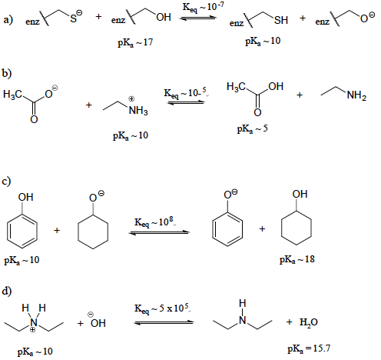
Try this
Show the products of the following acid-base reactions, and roughly
estimate the value of Keq.
4.76

Slide 12
5. Acid-base reactions
5.2C: Buffered solutions: Henderson-Hasselbalch

Slide 13
Buffers
Buffer: a solution of a weak acid and its conjugate base
Maintains a pH value by soaking up additions of acid (via the buffer’s conjugate base) and base (via the buffer’s weak acid).
4.76
Biological solutions and cells are buffered around pH 7.2 – 7.4.
Buffers made with equal amounts of weak acid & conjugate base have a pH that’s about equal to the pKa of the weak acid.
What is the pH of a buffer solution made with 30 mM acetic acid and 40 mM sodium acetate?
pH = 4.76 + log (40 mM/30 mM) = 4.76 + 0.125 = 4.88

Slide 14
Are functional groups protonated?
When working with biomolecules in buffers, it’s important to know whether the biomolecule’s functional groups are protonated or not.
The Henderson-Hasselbalch equation can be used to determine the protonation of functional groups at specific pH values.
4.76
Example:
A protein with an exposed aspartic acid (carboxylic acid functional group) is place in a buffer with a pH of 7.0.
7.0 = 4.76 + log carboxylate ion
carboxylic acid
7.0 - 4.76 = 2.24 = log carboxylate ion
carboxylic acid
antilog (2.24) = carboxylate ion =
carboxylic acid
174 So almost totally deprotonated
1
10^{2.24}

Slide 15
Try this
Now, let's use the equation again, this time for an amine functional group, such as the side chain of a lysine residue: inside a cell at neutral pH, are we likely to see a neutral amine (RNH2) or an ammonium cation (R-NH3+?)
4.76
NH4⁺¹ pKa
7.0 = 9.24 + log amine group
ammonium ion
7.0 – 9.24 = - 2.24 = log amine group
ammonium ion
antilog (- 2.24) = amine group = 0.006:1, so most is protonated
ammonium ion

Slide 16
Protonation of common groups at pH 7
In fact, at a physiological pH of about 7.2 to 7.4 the protonation state of common functional groups varies.
4.76
Functional group | Protonation state
carboxylic acids | deprotonated carboxylate
amines | protonated, ammonium ions
thiols | protonated, uncharged
phenols | protonated, uncharged
alcohols | protonated, uncharged
amides | protonated, uncharged
imines | mix of protonated (+) & unprotonated (neutral)
The mixed protonation state of imines (like histidine and imidazole) makes them especially useful buffers for neutral, physiological pH solutions.

Slide 17
Try this
The molecule below is not drawn in the protonation state that we would
expect to see it at physiological pH. Redraw it in the physiologically relevant
protonation state.
4.76
protonated
(+ charge)
deprotonated
(neutral)
deprotonated
(- charge)

Slide 18
Can you?
(1) Define the concepts of Ka and pKa and understand how they relate to acid strength?
(2) Mathematically convert Ka to pKa and vice versa?
(3) Understand that strong acids create weak bases and vice versa?
(4) Use the pKa values of functional groups to approximate the acidity of complex molecules?
(5) Use pKa values to predict the equilibrium and direction of acid base reactions? And to approximate Keq?
(6) Understand the concept of buffers and use the Henderson Hasselbach equation to calculate the pH of a buffered solution?
(7) Use the Henderson-Hasselbalch equation understand the protonation state of functional groups at physiological pH?

