Slide 1
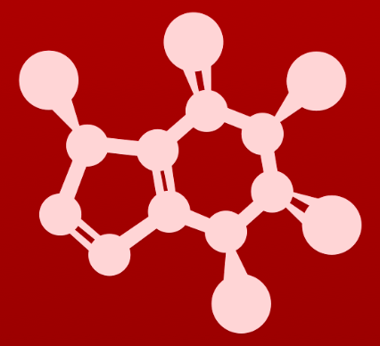
5. Acid-base reactions
5.5A: Acid-base properties of anilines

Slide 2
Uncharged N: base unless stabilized
As we’ve seen, N-containing groups can act as acids and bases.
In its usual bonding pattern, N: can act as a base.
Weaker when the lone pair is stabilized.
Here, the lone pair is stabilized by the resonance of an amide.
In fact, this stabilization makes the amide a tiny bit acidic.

Slide 3
What about anilines?
Anilines: the amine analog (version) of phenol
Less basic than amines
Aromatic resonance stabilizes the N’s lone pair, so it’s less available as a base.
If the lone pair is easily held, it won’t be donated as a base.

Slide 4
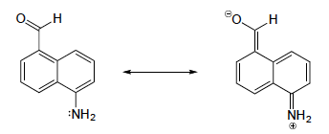
Try this
With anilines just as with phenols, the resonance effect of the aromatic
ring can be accentuated by the addition of an electron-withdrawing group, and diminished by the addition of an electron-donating group.
Which of the two compounds below is expected to be more basic? Use resonance drawings to explain your reasoning.
:
:
:
:
B: Similar resonance stabilization of the : of the amino group cannot occur.
A: Resonance stabilizes the : of the amino group to the aldehyde group. So the : is less available, reactive and basic.
:
:
:
:
:
:
:

Slide 5
5. Acid-base reactions
5.5B: Acid-base properties of imines

Slide 6
Imines
Imines: an sp2-hybridized N double-bonded to a C
Imines are a bit less basic than amines because:
The lone pair is in sp² rather than sp³.
Sp² orbitals are shorter, more spherical, than sp³ orbitals, so sp² electrons are more electronegative or tightly held to the nucleus.
So, sp² electrons are less likely to be donated and act as a base.

Slide 7
5. Acid-base reactions
5.5C: Acid-base properties of pyrroles

Slide 8
Pyrroles
Pyrrole: a five membered aromatic ring with four carbons and one nitrogen
In pyrroles, the N’s lone pair is part of the aromatic sextet (ring system).
This makes the N’s lone pair less available for donation as a base.
So pyrrole is a very weak base.
And so the pyrrole’s conjugate acid is very strong.

Slide 9
Summary of nitrogen bonding patterns
This summary is useful when trying to understand the very varied acid-base behavior of N-containing molecules.

Slide 10
Multiple N ‘personalities’
Here are examples of organic molecules that contain different types of Ns.
The pKa of imines (5-7) makes them particularly useful as buffers for biological systems because they can both absorb and release protons (act as acids and bases) near neutral pH.

Slide 11
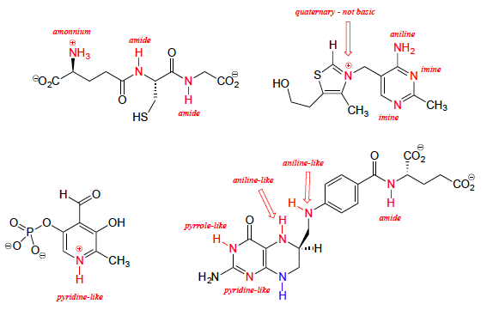
Try this
Below are the structures of four 'coenzyme' molecules necessary for
human metabolism.
(a) When appropriate, assign a label to each nitrogen atom using the basicity classifications defined in this section ('pyrrole-like', etc.).
(b) There is one nitrogen that does not fall into any of these types - is it basic? Why or why not? What would be a good two-word term to describe the group containing this nitrogen?

Slide 12
Try this
The ‘blue’ NH group can be considered an extended amine because resonance allows it to be +; weakly acidic, pKa 18-20.
[A bit aniline like because it’s in a ring, but amine characteristics are stronger.]

Slide 13
Can you?
(1) List and draw the wide variety of N-centered functional groups?
(2) Describe why N-functional groups often act as bases?
(3) Describe how the pKa of N-functional groups depends on their structures?
(4) Describe why imines are particularly effective as buffers?

