Slide 1
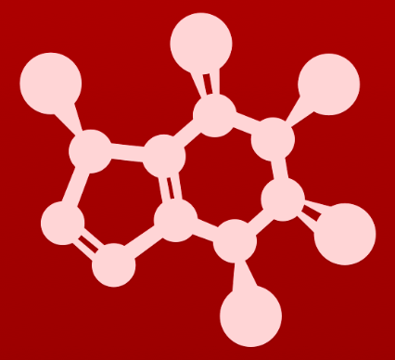
5. Acid-base reactions
5.6A: The acidity of ⍺-protons

Slide 2
Hydrocarbons aren’t acidic
Hydrogen atoms bound to carbons aren’t acidic or reactive.
The C – H bond isn’t polar or reactive.
C atoms hate carrying a charge or lone pair.

Slide 3
But resonance can change that
Carbon acids: the donated proton is bound to a carbon
The carbon atoms next to a carbonyl group can stand to lose a hydrogen atom because the resonance of the carbonyl group can stabilize the resulting carbanion.
The enolate anion is the stabilized version of the conjugate base or carbanion.
carbanion
Acetone is a very weak carbon acid.

Slide 4
⍺-carbons and ⍺-hydrogens
⍺-carbons: carbon atoms located next to carbonyl groups
⍺-hydrogens: hydrogen atoms bound to ⍺-carbons
⍺-hydrogens are somewhat acidic
not acidic
β
α
α
pKa ~20

Slide 5
Active methylenes
Active methylenes: methylene groups sandwiched between two carbonyl groups
The hydrogen atoms of an active methylene are more acidic than other ⍺-hydrogens…
...because more resonance stabilization is available.
active methylene

Slide 6
Carbon acids: common in biochemistry
from fatty acid oxidation
from carbohydrate metabolism

Slide 7
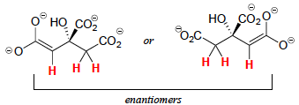
Try this
For each of these molecules:
(a) Show the location of all ⍺-protons.
(b) Draw the structure(s) of all possible enolate conjugate bases.
H⁺¹
H⁺¹
H⁺¹

Slide 8
5. Acid-base reactions
5.6B: Keto-enol tautomers

Slide 9
Enols
When ketones (carbonyl groups) are deprotonated (act as acids), resonance allows them to form stable enolate anions.
What happens if the enolate is reacted with an acid (H-A)?
1. The enolate is converted back to a ketone (H added back to the carbon).
2. The enolate is converted to an enol.
Enol: has characteristics of both an alkene and an alcohol

Slide 10
Keto-enol tautomers are common
Keto-enol tautomers: constitutional isomers that are rapidly and reversibly interconverted
Tautomerization is incredibly common in biochemistry.
lower overall energy
higher overall energy
Σ = 1478 kJ/mol
Σ = 1430 kJ/mol
Σ = 1478 kJ/mol

Slide 11
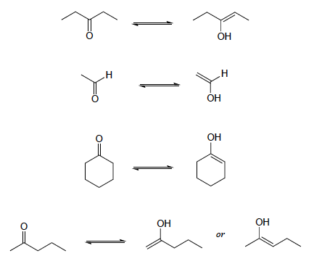
Try this
Draw all of the possible enol forms of the following aldehydes/ketones.
(a) 3-pentanone
(b) acetaldehyde (IUPAC name ethaldehyde)
(c) cyclohexanone
(d) 2-pentanone
Σ = 1478 kJ/mol

Slide 12
Try this
Draw three examples of aldehyde or ketone compounds for which there
is no possible enol form.
A few of the many possibilities:
Σ = 1478 kJ/mol

Slide 13
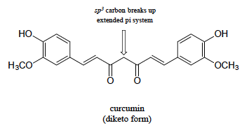
Try this
In some special cases, the enol form of a compound is more stable than
the keto form and thus predominates at equilibrium. Curcumin is the compound mainly responsible for the characteristic yellowish color of tumeric, a ubiquitous spice in south/southeast Αsian cuisine. The extended system of π bonds present in the enol form causes it to be lower in energy than the tautomer in which there are two ketone groups (called the diketo form). Draw the diketo form of curcumin, and explain how the conjugated π system is disrupted.
Σ = 1478 kJ/mol

Slide 14
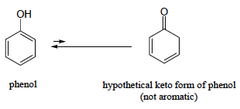
Try this
The phenol functional group can also be thought of a kind of enol.
(a) Draw the 'keto' form of phenol.
(b) The 'keto' form of phenol is highly disfavored compared to the 'enol' form – why?
The keto form isn’t aromatic while phenol is.
Aromatics are more stable and have a lower energy state.
Σ = 1478 kJ/mol

Slide 15
Keto-enol in biochemical reactions
Keto-enol tautomerization occurs in biochemical reactions, like glycolysis.
enol
keto
Σ = 1478 kJ/mol

Slide 16
5. Acid-base reactions
5.6C: Imine-enamine tautomers

Slide 17
Imine-enamine tautomerism
Imine-enamine tautomerization is the nitrogen equivalent of keto-enol tautomerism.
Imines are aka ‘Schiff bases’.
This is part of the degradation of the amino acid serine.
Σ = 1478 kJ/mol

Slide 18
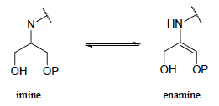
Try this
The structures below all contain either an imine or an enamine group.
For each, draw the structure of an alternate tautomer.
Σ = 1478 kJ/mol

Slide 19
5. Acid-base reactions
5.6D: Acidity of terminal alkynes

Slide 20
Terminal alkynes: a type of carbon acid
Terminal alkynes: alkynes in which the triple bond occurs at one end of the molecule
Terminal alkynes are more acidic than alkenes or alkanes because the carbon’s sp orbital is the most spherical of the hybridized orbitals, placing the electrons closest to the carbon’s nucleus and most tightly held.
The triple-bonded carbon keeps the electrons and donates the hydrogen.
very weak acid
Σ = 1478 kJ/mol

Slide 21
Try this
Hydrogen cyanide, HCN, is another example of a relatively strong
carbon acid, with a pKa of 9.2. Suggest a rationale for the acidity of this proton.
:
The carbon of hydrogen cyanide is sp hybridized.
The shape of this orbital places the : of the sigma bond to hydrogen close to the nucleus of the carbon and this allows the hydrogen to be released as a cation.
Σ = 1478 kJ/mol

Slide 22
Can you?
(1) Describe what α-carbons are and why they are acidic while hydrocarbons aren’t?
(2) Describe what active methylenes are and why they are important?
(3) Define the terms enol and enolate and explain how these molecules relate to ketones?
(4) Define the term tautomer?
(5) Describe imine-enamine tautomerism?
(6) Explain why terminal alkynes are acidic while most hydrocarbons are not?

