Slide 1
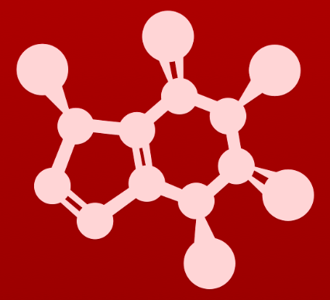
5. Acid-base reactions
5.8: Effects of enzyme microenvironment on acidity and basicity

Slide 2
Hydrophobic active site
Most biochemical reactions occur in enzyme active sites, not in bulk solution.
The active site microenvironment is often very different from water.
For example, in water the pKa of glutamic acid’s carboxylic acid R group is 3.9, so it’s a carboxylate at physiological pH.
glutamic acid
But if glutamic acid’s side chain is found in a hydrophobic enzyme active site (like that shown here), it may remain protonated because this microenvironment is different.
If water can’t enter the microenvironment, it can’t act as a base, accept a donated proton and allow glutamic acid to act as an acid.
Σ = 1478 kJ/mol

Slide 3
Increasing effective pKa
The proximity of two amino acids in an active site can affect one another’s typical chemistry.
Here, two aspartic acid side chains project into the same enzyme active site.
At physiological pH, R would be deprotonated and negatively charged.
aspartate
aspartic acid
aspartate
aspartate
The two negative charges would force the R groups apart.
To avoid that, one R group will remain protonated even at physiological pH.

Slide 4
Decreasing effective pKa
The proximity of two amino acids in an active site can affect one another’s typical chemistry.
Here an aspartic acid side chains interacts with a metal cation, perhaps required for enzymatic function.
Lewis acid
aspartate
The metal cation favors, and stabilizes the negatively charged, deprotonated carboxylate form of aspartate.
This can lower the effective pKa of aspartate’s side chain, causing it to lose it’s proton at pH values much less than its pKa of 3.90.
When water coordinates metal cations its pKa can be reduced from 15.7 to 7.0!
Σ = 1478 kJ/mol

Slide 5
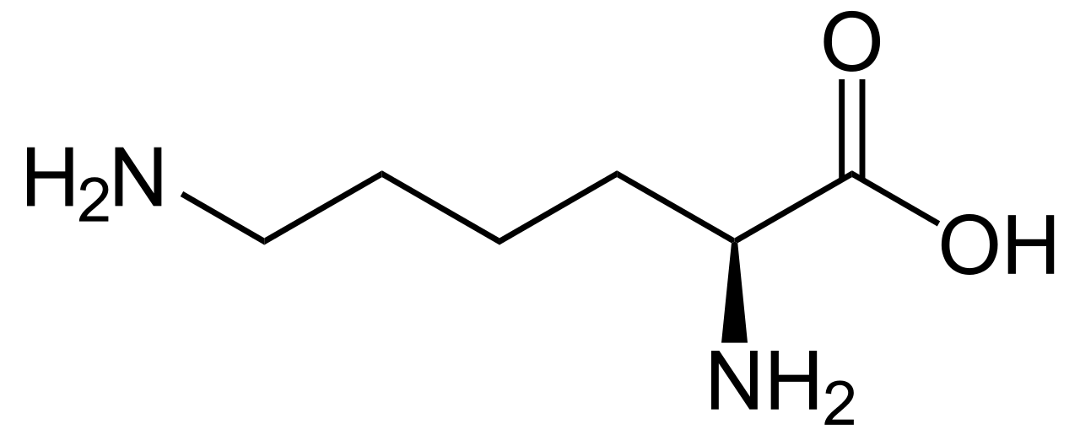
Try this
A lysine residue located deep in the interior of a protein is surrounded by
nonpolar residues. In what direction will this alter the 'normal' pKa of the lysine side chain, and why?
A nonpolar microenvironment will destabilized the cationic (ammonium) form of lysine, thus making it more favorable to donate a proton.
In other words, the microenvironment will lower the pKa of the side chain.
Σ = 1478 kJ/mol

Slide 6
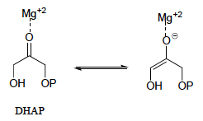
Try this
In many biochemical reactions which involve the formation of an enolate intermediate, the carbonyl oxygen of the substrate is coordinated to a divalent metal ion (usually zinc or magnesium) in the active site. Explain, with structural drawings, how this ion-dipole interaction effects the acidity of the ⍺-protons of dihydroxyacetone phosphate (DHAP), an intermediate compound in the glycolysis pathway.
The magnesium cation stabilizes the negative charge that develops on the carbonyl oxygen when an α-proton is abstracted. A more stable conjugate base, as we know, means a stronger acid, so the pKa of the α-protons is lowered by the magnesium
cation.
Σ = 1478 kJ/mol

Slide 7
Can you?
(1) Understand how hydrophobic environments, like enzyme active sites, can alter expected protonation state?
(2) Describe how the proximity of amino acids (or other functional groups) can alter expected protonation state?
(3) Describe how ion-dipole interactions of trace metals can stabilize the charge or protonation state of functional groups?

