Slide 1
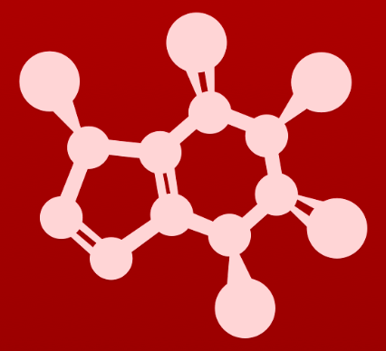
CHE 2060: Principles of Organic Chem
6. Nucleophilic substitution reactions
Introduction: Why aren't identical twins identical? Just ask SAM.
6.1: Two mechanistic models for nucleophilic substitution
6.1A: The SN2 mechanism
6.1B: The SN1 mechanism
6.2: All about nucleophiles (Nu:)
  What is a nucleophile vs. a base?
  Protonation state
  Periodic trends in nucleophilicity
  Resonance effects on nucleophilicity
  Steric effects on nucleophilicity
6.3: All about electrophiles (E+)
  Steric hindrance at the electrophile
  Carbocation stability
6.4: Leaving groups
6.5: Regiospecificity of SN1 reactions with allylic electrophile
6.6: SN1 or SN2? Predicting the mechanism
6.7: Biological nucleophilic substitution reactions
6.7A: A biochemical SN2 reaction
6.7B: A biochemical SN1 reaction
6.7C: A biochemical SN1/SN2 hybrid reaction
6.8: Nucleophilic substitution in the lab
6.8A: The Williamson ether synthesis
6.8B: Turning a poor leaving group into a good one: tosylates
optional sidebar

Slide 2
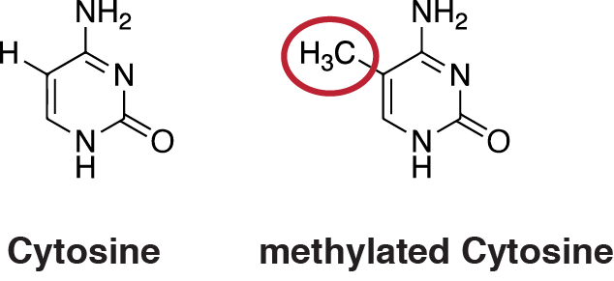
6. Nucleophilic substitution reactions
Introduction: Identical twins, epigenetics and SAM
https://en.wikipedia.org/wiki/DNA_methylation

Slide 3
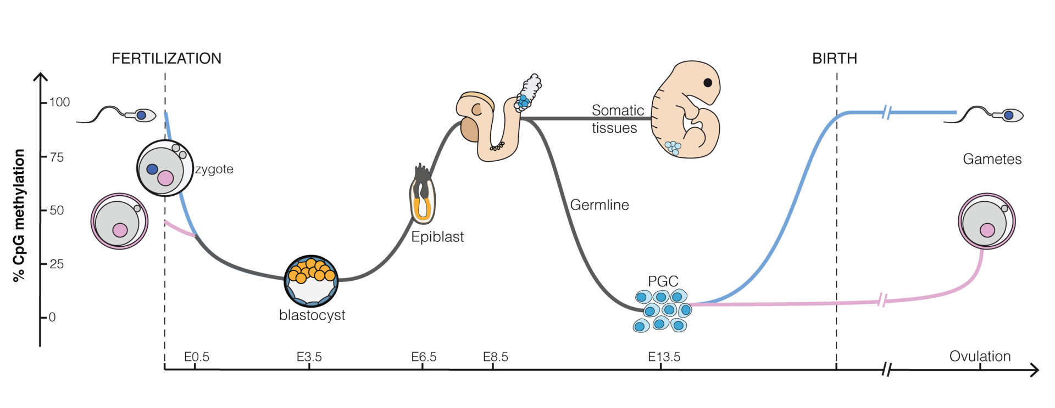
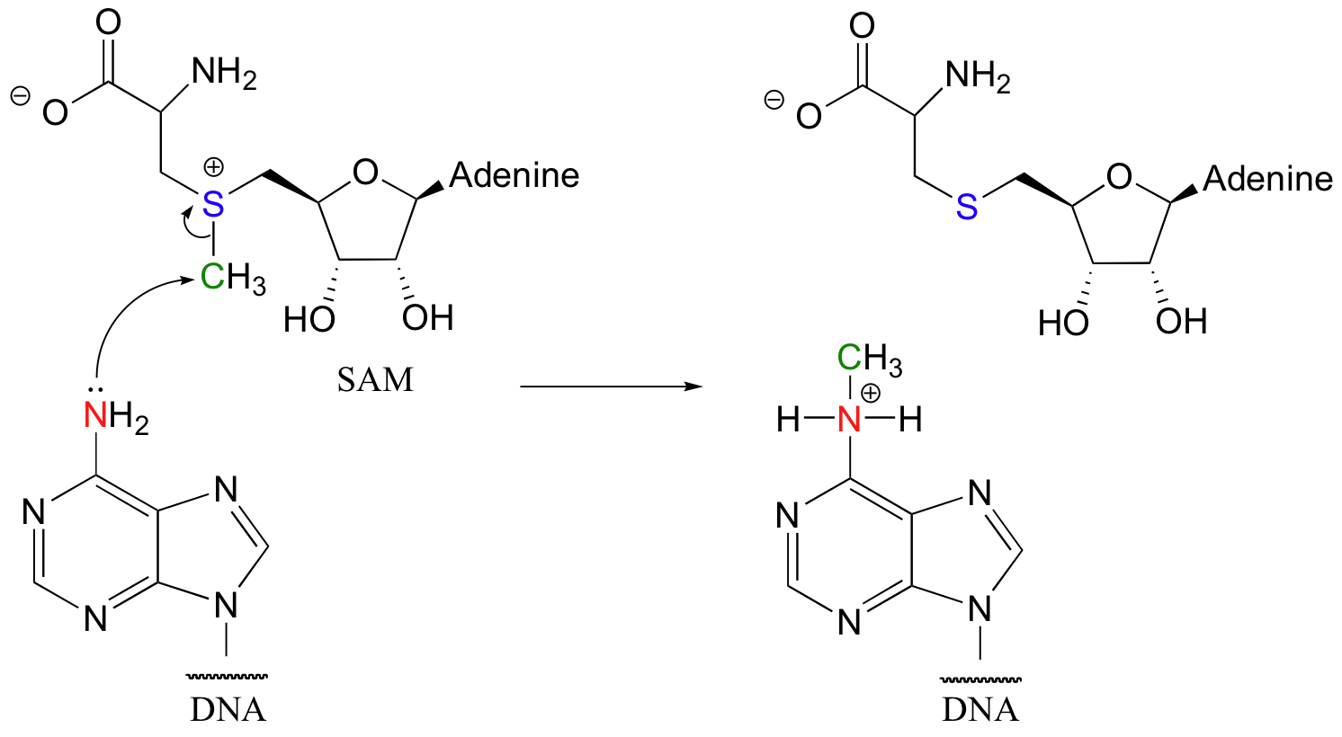
6. Nucleophilic substitution reactions
Introduction: Identical twins, epigenetics and SAM
https://en.wikipedia.org/wiki/DNA_methylation

Slide 4
6. Nucleophilic substitution reactions
Big ideas:
1. SN mechanisms depend on the strength of Nu:, stability of E+
and quality of LGs.
2. Carbocations are intermediates whose 'stability' depends on
their structures.

Slide 5
6. Nucleophilic substitution reactions
6.1A: The SN2 mechanism
Resources for students:
‘Guide (summary) comparing SN1 and SN2 reactions and mechanisms’
‘Diagnostic chart for substitution, addition and elimination reactions’
‘Substitution reaction mechanism animations’

Slide 6
SN2: a concerted mechanism
The one-step, or concerted, nucleophilic substitution mechanism is called SN2.
Bond are simultaneously broken and made.
sustitution nucleophilique 2
The ‘2’ in SN2 means that the reaction mechanism is bimolecular: depends on the collision rate of two molecules.

Slide 7
‘Backside’ attack
The orientation of the biomolecular collision of SN2 reactions is critical.
The Nu: must attack from the side opposite the E+’s LG.
  aka ‘attack from the back’
Analogy: executive pendulum

Slide 8
SN2 mechanism
Attack from the back by the Nu: and loss of LG are simultaneous.
  Single, concerted step.
TS is (trigonal) planar; Nu: and LG are partially bonded.
partial bonds
partial bonds
LG
Eδ+
Nu:-
TS
LG
product

Slide 9
SN2 inversion
Chiral inversion: if the substrate (E+) is chiral, SN2 reactions create a product with the opposite chirality
LG
Eδ+
Nu:-
TS
LG
product
Here two of the substrate’s hydrogen atoms have been replaced by hydrogen isotopes, deuterium and tritium, to create chirality.
Notice attack from the back places the substituting group on the side of the molecule opposite the leaving group.
Imagine the TS’s trigonal planar group as a sheet of paper.
  Nu:- attacks from behind and…
  … pushes the LG off of the other side.

Slide 10
6. Nucleophilic substitution reactions
6.1B: The SN1 mechanism
Resources for students:
‘Guide (summary) comparing SN1 and SN2 reactions and mechanisms’
‘Diagnostic chart for substitution, addition and elimination reactions’
‘Substitution reaction mechanism animations’

Slide 11
SN1 reactions
The two-step nucleophilic substitution mechanism is called SN1.
Nu: attack
sustitution nucleophilique 1
carbocation
slow
(rate-limiting)
proton polishing
NB: SN1 reactions don’t cause stereo-
chemical inversion.
The ‘1’ in SN1 means that the rate-limiting step is unimolecular: depends on a reaction happening in a single molecule.

Slide 12
SN1 stereochemistry
The stereochemistry of SN1 reactions is dictated by their trigonal planar carbocation intermediate.
The positive charge is ‘held’ in an unhybridized p orbital.
The Nu: can ‘attack’ the carbocation from either side.
If the substrate is chiral, both enantiomers are made.
What if the substrate isn’t chiral?
inversion
racemic mix
same chirality

Slide 13
SN1 reaction coordinate diagram
Each ’flat’ area represents a chemical species: reactant, intermediate or product.
Each hill is a step of the chemical reaction.
Nu: attack
LG loss
(rate-limiting)
proton polishing
Note that the carbocation
is the least stable, highest energy TS.
Here two of the substrate’s hydrogen atoms have been replaced by hydrogen isotopes, deuterium and tritium, to create chirality.

Slide 14
Hydrolysis (& solvolysis)
Hydrolysis: reactions in which water is used as the reactant to break a chemical bond
  Hydro = water
  Lysis = to break
Notice that the SN2 and SN1 reactions used as examples here are hydrolysis reactions.
Solvolysis: reactions in which the solvent (not necessarily water) is used as the reactant to break a chemical bond
  The solvent is often an alcohol.

Slide 15
Try this
Draw a mechanism for the SN1 solvolysis of tert-butyl chloride in
methanol. What new functional group has been formed?
The product is an ether!

Slide 16
Lab chemistry vs. biochemistry
In the lab, many reactions are performed without enzymes.
In these cases, if the substrate is chiral, both enantiomers are produced
But biochemical reactions use enzymes.
Enzymes themselves are chiral and can recognize only one chiral substrate.
And enzymes produce only one enantiomer.

Slide 17
Try this
(a) Draw a complete mechanism for this SN1 hydrolysis reaction.
(b) Draw dash wedge structures representing TS1 and TS2 in the reaction.
(c) What is the expected optical rotation of the product mixture?
(d) Could the two organic products be separated on a silica column
chromatography that requires different physical properties, specifically
different overall polarity?
(a) and (b)
(c) Racemic so not
optically active
(d) No, because
enantiomers
have the same
physical and
chemical
properties
Here two of the substrate’s hydrogen atoms have been replaced by hydrogen isotopes, deuterium and tritium, to create chirality.

Slide 18
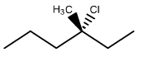
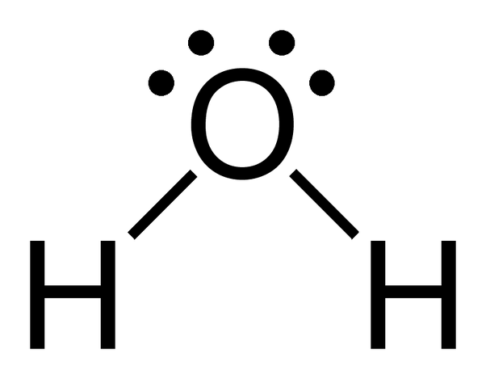
Try this
(a) Draw the product(s) of the SN2 hydrolysis of (R)-3-chloro-3-methyl heptane.
(b) What can you predict, if anything, about the optical rotation of the
product(s)?
..
v
:Cl:
+
v
CH3
v
..
CH3
inversion: (S)-3-methylheptan-3-ol

Slide 19
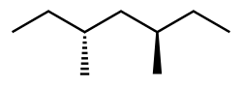
Try this
(a) Draw the product(s) of the hydrolysis of (3R,5R)-3-chloro-3,5-dimethyl
heptane.
(b) What can you predict, if anything, about the optical rotation of the
product(s)?
+
..
v
:Cl:-
:Cl:
v
..
..
v
+
H+
(3S,5R)
racemic
mixture
(3R,5R)

Slide 20
Can you?
(1) Explain what both SN reactions have in common?
(2) Differentiate between SN2 and SN1 reactions?
(3) Recognize SN2 vs. SN1 by looking at a reaction coordinate diagram?
(4) Explain how the chirality of products of SN1 and SN2 reactions differ?
(5) Draw mechanisms of SN1 and SN2 reactions?

