Slide 1
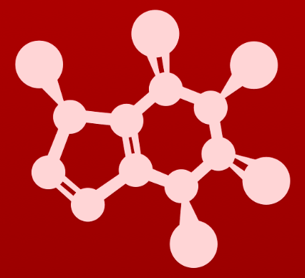
CHE 2060: Principles of Organic Chem
6. Nucleophilic substitution reactions
Introduction: Why aren't identical twins identical? Just ask SAM.
6.1: Two mechanistic models for nucleophilic substitution
6.1A: The SN2 mechanism
6.1B: The SN1 mechanism
6.2: All about nucleophiles (Nu:)
What is a nucleophile vs. a base?
Protonation state
Periodic trends in nucleophilicity
Resonance effects on nucleophilicity
Steric effects on nucleophilicity
6.3: All about electrophiles (E+)
Steric hindrance at the electrophile
Carbocation stability
6.4: Leaving groups
6.5: Regiospecificity of SN1 reactions with allylic electrophile
6.6: SN1 or SN2? Predicting the mechanism
6.7: Biological nucleophilic substitution reactions
6.7A: A biochemical SN2 reaction
6.7B: A biochemical SN1 reaction
6.7C: A biochemical SN1/SN2 hybrid reaction
6.8: Nucleophilic substitution in the lab
6.8A: The Williamson ether synthesis
6.8B: Turning a poor leaving group into a good one: tosylates
optional sidebar

Slide 2
6. Nucleophilic substitution reactions
Big ideas:
1. SN mechanisms depend on the strength of Nu:, stability of E+ and quality of LGs.
2. Carbocations are intermediates whose 'stability' depends on
their structures.

Slide 3
6. Nucleophilic substitution reactions
6.1A: The SN2 mechanism
Resources for students:
‘Guide (summary) comparing SN1 and SN2 reactions and mechanisms’
‘Diagnostic chart for substitution, addition and elimination reactions’
‘Substitution reaction mechanism animations’

Slide 4
6. Nucleophilic substitution reactions
6.2: All about nucleophiles
Resources for students: ‘Guide to strength of Nu:, E+ and LG’

Slide 5
What do you need to know about Nu: ?
1. How do you know whether a reactant is acting as a Nu: or a base?
By its actions: bases remove a H atom while Nu:s do more.
2. Who are Nu: ? Many Nu: use N, O and S atoms to hold lone pairs.
• Water
• Alcohols
• Phenols
• Amines
• Thiols
• Carbohydrates (aldehydes and ketones)
Nu: strength?
3. Negatively charged > neutral >>> positively charged (better deprotonated)
4. Rows: strength decreases going left to right.
5. Columns:
In protic solvents, Nu: strength increases ↓
In polar aprotic solvents, Nu: strength increases ↑
6. Resonance stabilization weakens Nu:s.
7. Steric hinderance weakens Nu:s.

Slide 6
1. Acting as a Nu: or a base?
Both bases and nucleophiles (Nu:) are characterized by lone pairs. And bases can act as Nu: and Nu: can act as bases. So, how can they be distinguished?
Functional test:
Bases remove only a hydrogen ion.
Nu: do more.
In SN reactions, Nu: are added to the reactant in place of the LG.
Acting as a base
Acting as Nu:

Slide 7
2. Who are Nu: ?
Many Nu: use N, O and S atoms to hold lone pairs.
Water
Alcohols
Phenols
Amines
Thiols
(Carbohydrates)
Laboratory Nu: also include halide ions and azide:
I⁻¹
Br⁻¹
Cl⁻¹
F⁻¹
N₃⁻¹ (azide)
Carbon Nu: are less common.
Enolate ions
Cyanide ions (CN⁻¹)

Slide 8
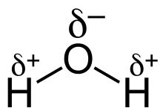
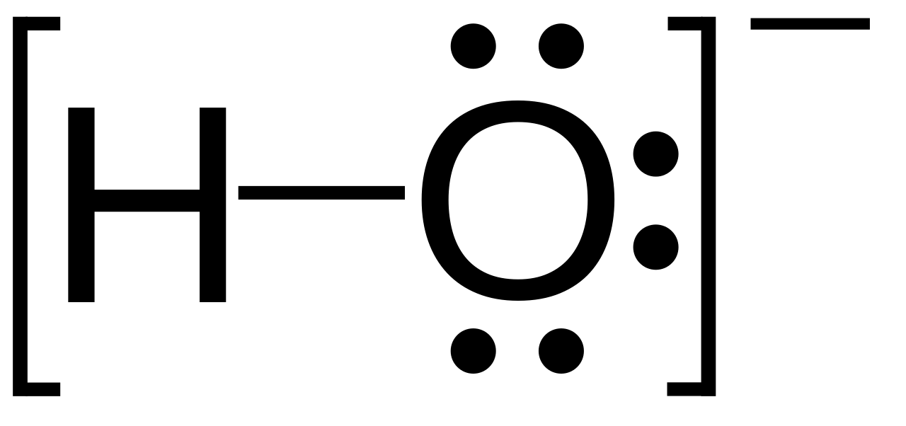
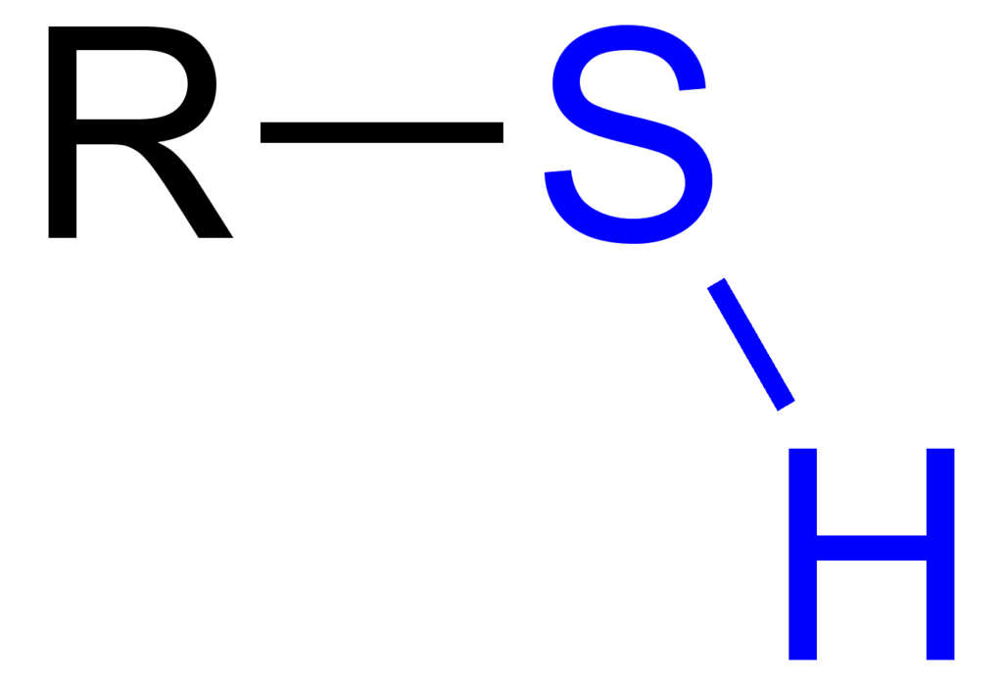
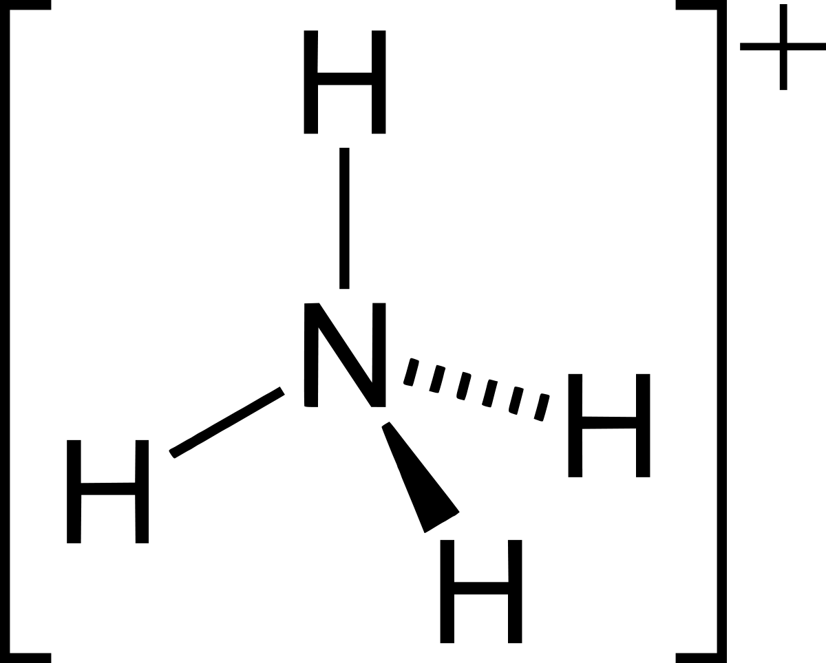
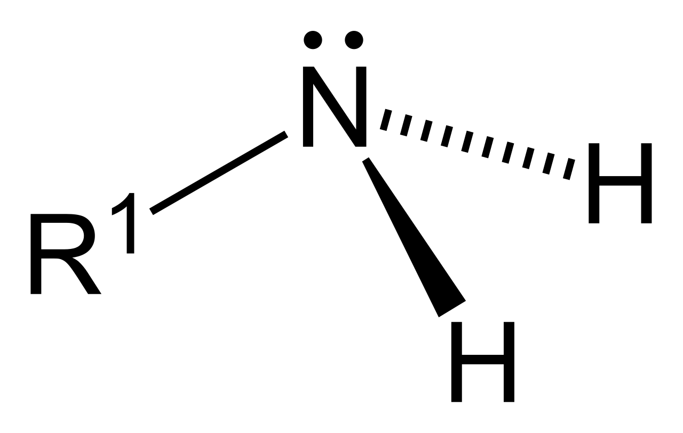
3. (-) charged Nu: are stronger
Negatively charged (deprotonated) Nu: (-) are several orders of magnitude stronger than uncharged (protonated) Nu:.
SN2 reactions require strong Nu:(-)
SN1 reactions can use weaker Nu:
stronger Nu:(-)
weaker Nu:
Often, negative charge indicates the stronger Nu:
Here lack of + charge makes the stronger Nu:

Slide 9
4. Nu: strength decreases across rows →
Within rows, trends in Nu: strength mirror trends in basicity.
Left to right, each element in a row has one more proton.
As atoms gain protons, they are less willing to donate electrons to form dative bonds (aka act as Nu:).

Slide 10
5. Nu: strength & columns
The strength of bases decreases down a column: larger ions have more surface are with which to accommodate lone pairs and are therefore more stable.
weak Nu:
strong base
Nu: strength in columns depends on the solvent.
Protic solvents: reactive, polar H (like water)
Aprotic solvent: no reactive, polar, H
strong Nu:
weak base
For protic solvents, Nu: strength increases ↓ columns.
Because protic solvents (acids) react with and ‘kill’ a Nu: that is also a strong base.
For polar aprotic solvents, Nu: and base strength increase ↑ columns.
Because aprotic solvents don’t react with (or ‘kill’) a Nu: that is also a base.

Slide 11
5. Example
For biochemical reactions it’s critical to remember that thiols are stronger Nu: than alcohols.
Weaker base ~ stronger Nu:
>
CoA:
Ubiquitous
Made from vit B5
Used in 4% of enzymatic rxns

Slide 12
6. Resonance stabilization weakens Nu:
Remember that for bases, resonance stabilizes anions and makes groups less likely to donate lone pairs; stabilization weakens bases.
This is also true of Nu: → stabilization weakens Nu:.

Slide 13
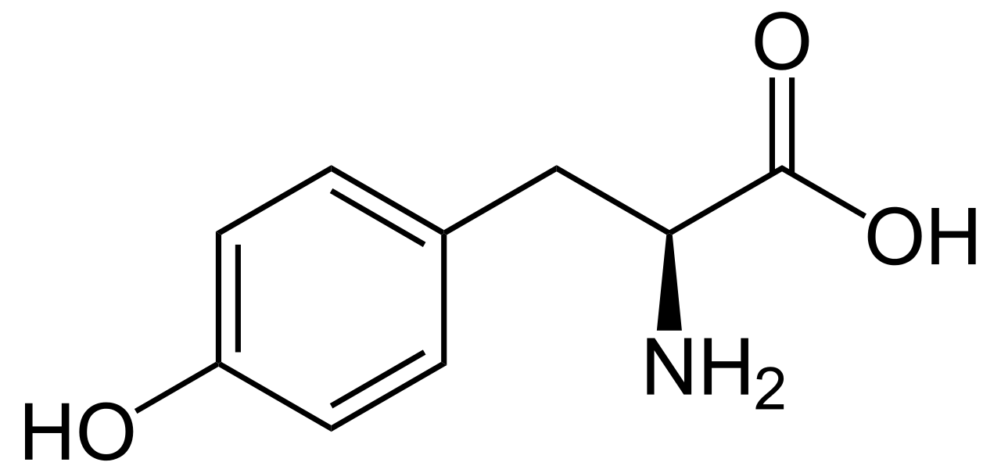
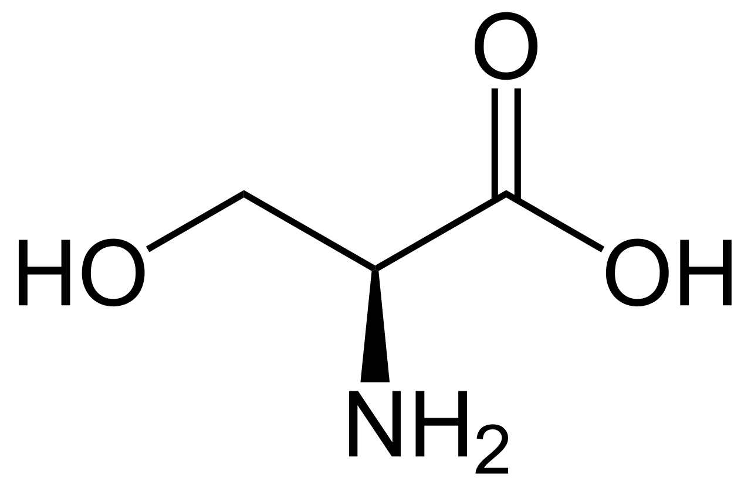
6. Try this
Which amino acid has the more nucleophilic side chain - serine or tyrosine? Explain.
serine
tyrosine
Serine is more nucleophilic than tyrosine: on tyrosine, the electron density on the oxygen atom is delocalized to some extent by resonance with the aromatic ring, making it less reactive (ie. less nucleophilic).
This is the same argument we used to explain why phenol is a stronger acid than ethanol - the phenolate ion is a weaker base (see section 7.4).
Steric effects (see below) also make tyrosine less nucleophilic than serine.

Slide 14
7. Steric hindrance weakens Nu:
Steric hindrance: crowding by bulky functional groups or molecules
Large or bulky groups tend to get in the way in reactions and slow or prevent reactions from happening.
So, while their OH functional groups are identical, the bulky tert-butyl alcohol is a weaker Nu: than the more compact methanol.

Slide 15
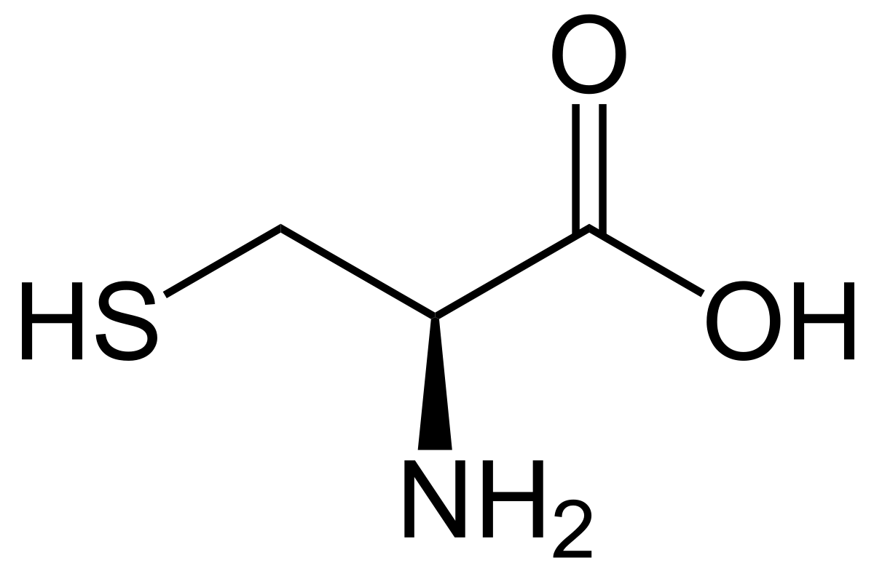
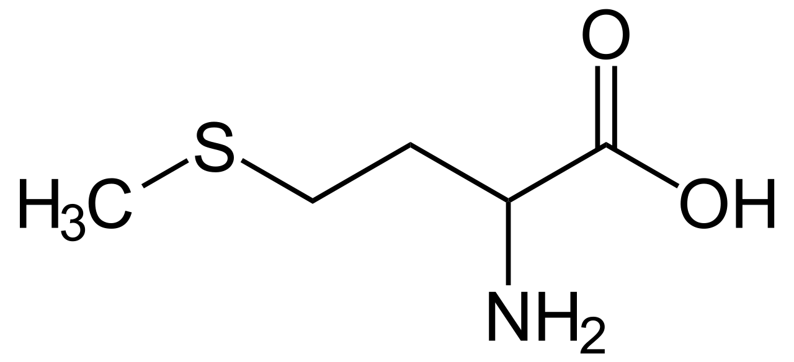
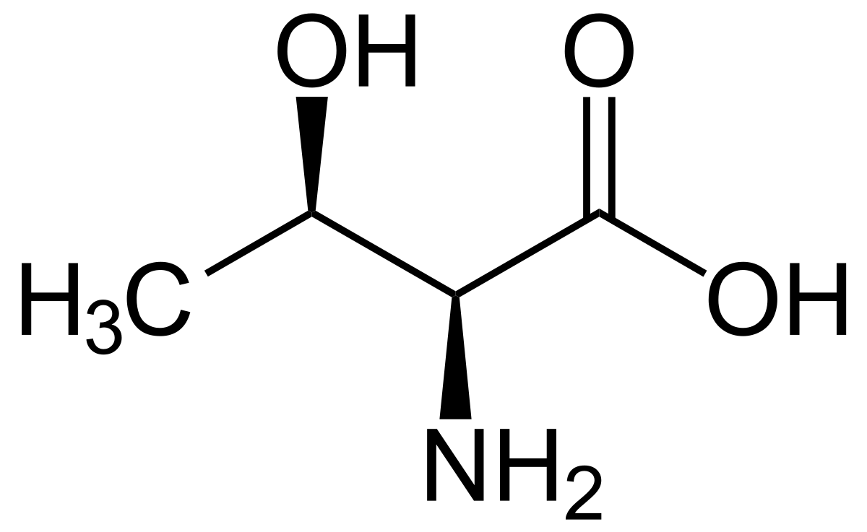
7. Try this
Which is the better nucleophile?
A cysteine side chain or a methionine side chain?
A serine or a threonine? Explain.
cysteine
methionine
Cysteine (a thiol) is more nucleophilic than methionine (a sulfide). The bulkier methyl carbon bonded to the methionine sulfur hinders nucleophilic attack.
serine
threonine
Serine (a primary alcohol) is more nucleophilic than threonine (a secondary alcohol) due to the steric hindrance of the extra methyl group on threonine.

Slide 16
All together! Try this
In each of the following pairs of molecules/ions, which is expected to
react more rapidly with CH3Cl in acetone solvent? Explain your choice.
phenolate (deprotonated phenol) or benzoate (deprotonated benzoic acid)?
(b) water or hydronium ion?
(c) trimethylamine or triethylamine?
(d) chloride anion or iodide anion?
(e) CH3NH- or CH3CH2NH2?
(f) acetate or trichloroacetate?
(g) aniline or 4-methoxyaniline?
(h) phenolate or 2,6-dimethylphenolate?
Phenolate is stronger base, and better nucleophile (phenol pKa ~10, benzoic acid pKa ~5)
Water: hydronium ion is positively charged, water is neutral.
Trimethylamine (steric effects: methyl less bulky than ethyl
Cl-: vertical trend in the context of polar, aprotic solvent [In protic water, I- more Nu]
CH3NH-: anion more nucleophilic than neutral amine
Acetate: stronger base & better Nu:- (Cls stabilize and thus weaken the base).
4-methoxyaniline: methoxy group is e- donating, making the N more basic and more Nu:
Phenolate is less hindered, thus the better nucleophile.

Slide 17
Can you?
(1) Understand why stronger bases are stronger Nu:?
(2) Distinguish between Nu: and base by their function (what they do)?
(3) Understand that stronger Nu: react more quickly?
(4) List atoms commonly, and uncommonly, that act as Nu:?
(5) Relate Nu: strength to state of protonation?
(6) Relate Nu: strength to state of protonation?
(7) Understand how and why protic solvents change Nu: strength?
(8) Describe a few aprotic solvents and explain why they are aprotic?
(9) Understand why resonance stabilization weakens Nu:?
(10) Understand why bulky Nu: react more slowly?

