Slide 1
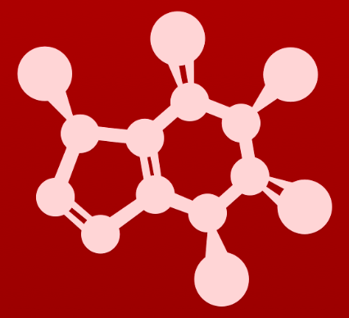
CHE 2060: Principles of Organic Chem
6. Nucleophilic substitution reactions
Introduction: Why aren't identical twins identical? Just ask SAM.
6.1: Two mechanistic models for nucleophilic substitution
6.1A: The SN2 mechanism
6.1B: The SN1 mechanism
6.2: All about nucleophiles (Nu:)
  What is a nucleophile vs. a base?
  Protonation state
  Periodic trends in nucleophilicity
  Resonance effects on nucleophilicity
  Steric effects on nucleophilicity
6.3: All about electrophiles (E+)
  Steric hindrance at the electrophile
  Carbocation stability
6.4: Leaving groups
6.5: Regiospecificity of SN1 reactions with allylic electrophile
6.6: SN1 or SN2? Predicting the mechanism
6.7: Biological nucleophilic substitution reactions
6.7A: A biochemical SN2 reaction
6.7B: A biochemical SN1 reaction
6.7C: A biochemical SN1/SN2 hybrid reaction
6.8: Nucleophilic substitution in the lab
6.8A: The Williamson ether synthesis
6.8B: Turning a poor leaving group into a good one: tosylates
optional sidebar

Slide 2
6. Nucleophilic substitution reactions
Big ideas:
1. SN mechanisms depend on the strength of Nu:, stability of E+
and quality of LGs.
2. Carbocations are intermediates whose 'stability' depends on
their structures.

Slide 3
6. Nucleophilic substitution reactions
6.3: All about electrophiles
Resources for students: ‘Guide to strength of Nu:, E+ and LG’

Slide 4
What do you need to know about E+ ?
Factors that affect E+ strength or speed or reaction:
1. Steric hindrance weakens E+ for SN2 but not SN1.
2. Structure:
  E+ must be sp³ for either SN1 or SN2.
  SN1 speed and likelihood of reaction: 3º > 2º 1º > methyl.
  SN2 speed and likelihood of reaction: methyl > 1º > 2º > 3º.
3. Electron withdrawing groups ↓ E+ stability (↓ SN1, ↑ SN2).
4. Resonance stabilizing carbocation charge ↑ stability (↑ SN1, ↓ SN2).
5. Electron donating groups in resonance with carbo+ stabilize it (↑ SN1, ↓ SN2).
6. Vinyl carbocations are not stable! (↓ SN1, ↑ SN2).

Slide 5
1. Steric hindrance weakens SN2 E+
What if the substrate (the E+) is bulky?
Bulkiness hinders the Nu: from accessing its carbon target in SN2 reactions.
no SN2
(SN1 only)
fast SN2
But for SN1 rxns, E+ bulkiness isn’t a factor because carbocations are only 2D!

Slide 6
1. Try this
Which would be expected to react more rapidly in an SN2 reaction with an
azide ion (N3⁻¹) nucleophile in acetone solvent?
  1-bromo-2,2-dimethylbutane
  1-bromo-3-methylbutane
1-bromo-3-methylbutane is the less hindered electrophile, and thus would react faster in an SN2 reaction.

Slide 7
2. Structure: methyl, 1º, 2º and 3º E+
Substrate (E+) carbons can be classified using one of these terms:
  Methyl
  Primary (1º)
  Secondary (2º)
  Tertiary (3º)
H substituents only
1 R substituent
2 R substituents
3 R substituents
increasing bulkiness
all
sp³
increasing stability
3º structure allows greater delocalization (sharing) of the carbocation’s + charge.
Thus ↑ stability.
Speed of SN2 reactions ↑ as bulkiness ↑ (Nu: access is hindered)
Methyl > 1º > 2º (no 3º)
Speed of SN1 reactions ↓ as stability ↑ (E+ exists long enough to meet Nu:)
3º > 2º (no 1º or methyl)
Think about dating: stability is attractive!

Slide 8
3. E- w/drawing groups
Addition of electron withdrawing groups destabilizes carbocations because they effectively increase the positive charge.
And as with all inductive effects, distance matters.
So, the closer the group, the greater the effect.
The destabilized carbocation ↓ SN1 and makes SN2 more likely.

Slide 9
4. Resonance stabilizing the E+
If resonance helps to delocalize the positive charge of the carbocation, then it increases carbocation stability.
So substrate (E+) resonance can ↑ the rate of SN1 reactions.
benzylic carbocation

Slide 10
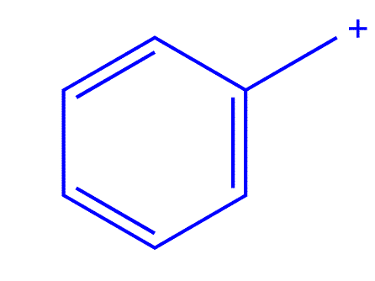
4. Try this
Fill in the missing numbers in this statement: The conjugated p system in
the benzylic carbocation above is composed of ______ p orbitals overlapping to share ______ π electrons.
7
6

Slide 11
5. E- donating groups
While N and O are generally electron withdrawing, they can be electron donating if in resonance with the carbocation.
Electron donating groups stabilize the carbocation by countering +
A more stable E+ would ↑ SN1 vs. SN2.

Slide 12
6. Vinylic carbocations are unstable!
Vinylic carbocations: the + is found on a double-bonded C
  Very unstable!!
Explain why vinylic carbocations are unstable.
(Hint: think about hybridization and electronegativity)
Recall that vinylic carbanions are more stable than single-bonded carbanions, because increased ‘s’ character in the hybrid orbitals (sp2 vs. sp3) makes the vinylic carbon more electronegative.
The same forces that stabilize a carbanion will destabilize a carbocation: the vinylic carbon is more electronegative, and thus is not able to bear a positive charge as well.

Slide 13
Combining factors?
Many of the factors that you’ve seen can be combined to affect the likelihood and speed for SN1 reactions.
Compare these two similar carbocations. Which is more stable?
+ shared over two 2º carbons
2º
2º
+ shared over one 2º carbon and one 3º carbon
2º
more stable
3º

Slide 14
Try this
Rank the following carbocations from most to least stable:
:
v
most stable
least stable
Resonance allows the O
to donate : and stabilize
the carbocation.
Resonance isn’t possible for A or C because the carbons between the O atom and the + charge have four bonds.
But the O is able to act as an electron-withdrawing group through inductive force, destabilizing the carbocation.
In C, e- withdrawing group is closer so destabilizes the carbocation more.

Slide 15
Try this
The carbocation below is an intermediate species in a reaction that is part
of the biosynthesis of a hallucinogenic compound in a fungus.
Draw a resonance contributor that shows how it is stabilized by resonance with the nitrogen atom.

Slide 16
Try this
(a) Draw a resonance structure of the crystal violet cation in which the positive
charge is delocalized to one of the nitrogen atoms.
(b) Notice that crystal violet is deeply colored. Explain why you could have
predicted this from looking at its chemical structure.
(c) The conjugated system of crystal violet consists of how many overlapping p
orbitals sharing how many π electrons?

Slide 17
Carbocation stability summary
(1) 3º > 2º > 1º > methyl
(2) Electron donating groups increase stability; distance matters.
(3) Resonance that delocalizes + stabilizes carbocations.
(4) Resonance that delocalizes + with lone pairs stabilizes carbocations.
less stable
more stable

Slide 18
Try this
State which carbocation in each pair below is more stable, or if they are
expected to be approximately equal. Explain your reasoning.
3◦
2◦
More distance from
e- withdrawing F
3◦
3◦,allylic
Resonance of N:
with + charge
3◦
2◦
+ delocalized over one
3◦ carbon, one 2◦ carbon.
+ delocalized over two
3◦ carbons.

Slide 19
Summary: SN1 wants stable carbocations
SN1 reactions:
methyl no SN1
1º SN1 only if very stabilized
2º ✓ SN1
3º ✓ SN1

Slide 20
Can you?
(1) Explain why bulky E+ react more slowly via the SN2 mechanism?
(2) Understand that SN2 reactions favor less bulky substrates: methyl > 1° > 2°?
(3) Understand that SN1 reactions like stable carbocations: 3° > 2° > 1° ?
(4) Explain why e- withdrawing substituents destabilize carbocations?
(5) Explain why resonance that delocalizes (+) stabilizes carbocations?
(6) Understand that e- donating groups in resonance can stabilize carbocations?
(7) Explain why vinylic carbocations are so unstable and don’t react via SN?
(8) Summarize the factors that increase carbocation stability?

