Slide 1
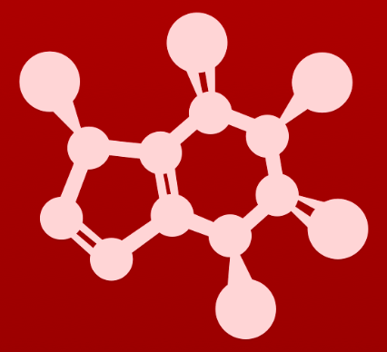
CHE 2060: Principles of Organic Chem
6. Nucleophilic substitution reactions
Introduction: Why aren't identical twins identical? Just ask SAM.
6.1: Two mechanistic models for nucleophilic substitution
6.1A: The SN2 mechanism
6.1B: The SN1 mechanism
6.2: All about nucleophiles (Nu:)
What is a nucleophile vs. a base?
Protonation state
Periodic trends in nucleophilicity
Resonance effects on nucleophilicity
Steric effects on nucleophilicity
6.3: All about electrophiles (E+)
Steric hindrance at the electrophile
Carbocation stability
6.4: Leaving groups
6.5: Regiospecificity of SN1 reactions with allylic electrophile
6.6: SN1 or SN2? Predicting the mechanism
6.7: Biological nucleophilic substitution reactions
6.7A: A biochemical SN2 reaction
6.7B: A biochemical SN1 reaction
6.7C: A biochemical SN1/SN2 hybrid reaction
6.8: Nucleophilic substitution in the lab
6.8A: The Williamson ether synthesis
6.8B: Turning a poor leaving group into a good one: tosylates
optional sidebar

Slide 2
6. Nucleophilic substitution reactions
Big ideas:
1. SN mechanisms depend on the strength of Nu:, stability of E+ and quality of LGs.
2. Carbocations are intermediates whose 'stability' depends on
their structures.

Slide 3
6. Nucleophilic substitution reactions
6.4: All about leaving groups
Resources for students: ‘Guide to strength of Nu:, E+ and LG’

Slide 4
What makes a good leaving group?
Weaker bases make the best leaving groups because they have to be greedy and keep lone pairs rather than donating them.
Best LG: I⁻¹ > Br⁻¹ > Cl⁻¹ >> F⁻¹
Notice how leaving group strength or ability is reflected in the speed of SN2 reaction of these substrates:
Fastest SN2: CH3I > CH3Br > CH3Cl >> CH3F
common lab LG

Slide 5
Try this
In each pair (A and B) below, which electrophile would be expected to
react more rapidly with cyanide ion nucleophile in acetone solvent? Explain.
Thiolates: weaker bases, better leaving groups (Thiol pKa ~10; alcohol pKa ~15+).
Sulfides are very weak bases, thus very good leaving groups.
HBr (pKa = - 9 vs. – 2.8) is a stronger acid, so Br-is a weaker base and better leaving group.
Both are LGs, but the inductive effect of Fs stabilizes LG - charge by inductive effects.

Slide 6
Can you?
(1) Explain why weak bases make the best leaving groups?
(2) Explain the halide trend in LGs?
(3) Explain why para-toluenesulfonic acid (tosyl, Tos) makes a great LG?

