Slide 1
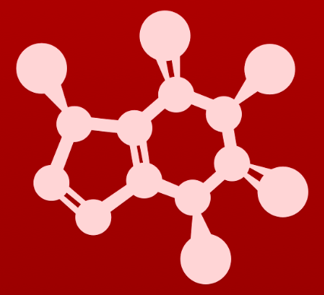
CHE 2060: Principles of Organic Chem
6. Nucleophilic substitution reactions
Introduction: Why aren't identical twins identical? Just ask SAM.
6.1: Two mechanistic models for nucleophilic substitution
6.1A: The SN2 mechanism
6.1B: The SN1 mechanism
6.2: All about nucleophiles (Nu:)
What is a nucleophile vs. a base?
Protonation state
Periodic trends in nucleophilicity
Resonance effects on nucleophilicity
Steric effects on nucleophilicity
6.3: All about electrophiles (E+)
Steric hindrance at the electrophile
Carbocation stability
6.4: Leaving groups
6.5: Regiospecificity of SN1 reactions with allylic electrophile
6.6: SN1 or SN2? Predicting the mechanism
6.7: Biological nucleophilic substitution reactions
6.7A: A biochemical SN2 reaction
6.7B: A biochemical SN1 reaction
6.7C: A biochemical SN1/SN2 hybrid reaction
6.8: Nucleophilic substitution in the lab
6.8A: The Williamson ether synthesis
6.8B: Turning a poor leaving group into a good one: tosylates
optional sidebar

Slide 2
6. Nucleophilic substitution reactions
Big ideas:
1. SN mechanisms depend on the strength of Nu:, stability of E+ and quality of LGs.
2. Carbocations are intermediates whose 'stability' depends on
their structures.

Slide 3
6. Nucleophilic substitution reactions
6.5: Regiospecificity of SN1 with allylic E+s

Slide 4
Regiospecificity
Regiospecificity: the preference for one carbocation and outcome when several are possible
Enzymatic reactions are far more regiospecific than chemical reactions.
Here SN1 chemical reaction of an allylic substrate produces three possible products. An enzymatic reaction would favor one product.

Slide 5
Can you?
(1) Define the term ‘regiospecific’?
(2) Explain why enzymatic reactions are more regiospecific than chemical reactions?

