Slide 1
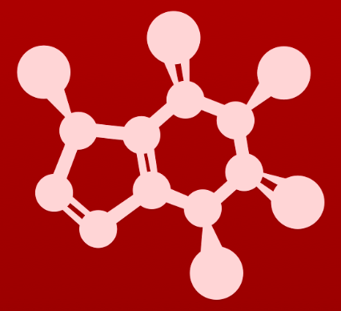
CHE 2060: Principles of Organic Chem
6. Nucleophilic substitution reactions
Introduction: Why aren't identical twins identical? Just ask SAM.
6.1: Two mechanistic models for nucleophilic substitution
6.1A: The SN2 mechanism
6.1B: The SN1 mechanism
6.2: All about nucleophiles (Nu:)
What is a nucleophile vs. a base?
Protonation state
Periodic trends in nucleophilicity
Resonance effects on nucleophilicity
Steric effects on nucleophilicity
6.3: All about electrophiles (E+)
Steric hindrance at the electrophile
Carbocation stability
6.4: Leaving groups
6.5: Regiospecificity of SN1 reactions with allylic electrophile
6.6: SN1 or SN2? Predicting the mechanism
6.7: Biological nucleophilic substitution reactions
6.7A: A biochemical SN2 reaction
6.7B: A biochemical SN1 reaction
6.7C: A biochemical SN1/SN2 hybrid reaction
6.8: Nucleophilic substitution in the lab
6.8A: The Williamson ether synthesis
6.8B: Turning a poor leaving group into a good one: tosylates
optional sidebar

Slide 2
6. Nucleophilic substitution reactions
Big ideas:
1. SN mechanisms depend on the strength of Nu:, stability of E+ and quality of LGs.
2. Carbocations are intermediates whose 'stability' depends on
their structures.

Slide 3
6. Nucleophilic substitution reactions
6.6: SN1 or SN2?

Slide 4
SN1 or SN2
A number of factors need to be considered.
factor | SN1 | SN2
number of steps | 3 | 1 (concerted)
E+ (substrate) | sterically hindered | unhindered
E+ stability | 3º, 2º or stabilized | 1º, 2ºº
Nu: | weak Nu: | strong Nu:(-)
LG | good | good
TS | carbocation | 5-bond trigonal planar
solvent | protic | polar aprotic
If chiral products? | enantiomers | chiral inversion

Slide 5
Can you?
(1) Create a list or matrix of the factors that determine whether nucleophilic substitution occurs via an SN1 or SN2 reaction mechanism?

