Slide 1
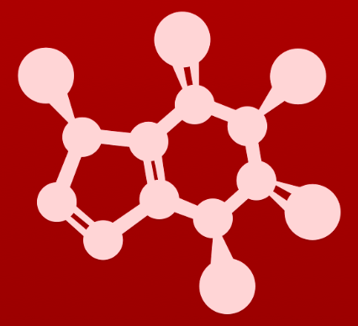
CHE 2060: Principles of Organic Chem
6. Nucleophilic substitution reactions
Introduction: Why aren't identical twins identical? Just ask SAM.
6.1: Two mechanistic models for nucleophilic substitution
6.1A: The SN2 mechanism
6.1B: The SN1 mechanism
6.2: All about nucleophiles (Nu:)
  What is a nucleophile vs. a base?
  Protonation state
  Periodic trends in nucleophilicity
  Resonance effects on nucleophilicity
  Steric effects on nucleophilicity
6.3: All about electrophiles (E+)
  Steric hindrance at the electrophile
  Carbocation stability
6.4: Leaving groups
6.5: Regiospecificity of SN1 reactions with allylic electrophile
6.6: SN1 or SN2? Predicting the mechanism
6.7: Biological nucleophilic substitution reactions
6.7A: A biochemical SN2 reaction
6.7B: A biochemical SN1 reaction
6.7C: A biochemical SN1/SN2 hybrid reaction
6.8: Nucleophilic substitution in the lab
6.8A: The Williamson ether synthesis
6.8B: Turning a poor leaving group into a good one: tosylates
optional sidebar

Slide 2
6. Nucleophilic substitution reactions
Big ideas:
1. SN mechanisms depend on the strength of Nu:, stability of E+
and quality of LGs.
2. Carbocations are intermediates whose 'stability' depends on
their structures.

Slide 3
6. Nucleophilic substitution reactions
6.7A: A biochemical SN2 reaction
……..sidebar…………….…...

Slide 4
SAM: S-adenosyl methionine
SAM (S-adenosyl methionine): a coenzyme used by enzymes to carry and donate methyl groups
……..sidebar…………….…...
SAM-dependent methyl transferases are enzymes that use SAM to carry a methyl group that they add to substrate molecules like DNA.
Methylation of DNA helps determine whether genes are expressed.

Slide 5
Methylation of DNA
SAM-dependent methyl transferases are enzymes that use SAM to carry a methyl group that they add to substrate molecules like DNA.
Methylation of DNA helps determine whether genes are expressed.
Deprotonation by the enzyme strengthens the DNA’s Nu:
Nu:(-) attacks SAM’s methyl group and takes it
SAM leaves
enzyme
aspartate
……..sidebar…………….…...
enz
asp

Slide 6
Methylation of DNA: mechanism, TS
If this is the likely transition state (TS) of the DNA methylation reaction, which nucleophilic substitution reaction is occurring?
This TS looks lie a concerted reaction with a trigonal planar intermediate.
……..sidebar…………….…...
SN2

Slide 7
Does the SN diagnostic chart work?
Try using the table to diagnose the mechanism of the DNA methylation.
factor | SN1 | SN2
number of steps | 3 | 1 (concerted)
E+ (substrate) | sterically hindered | unhindered
E+ stability | 3º, 2º or stabilized | 1º, 2º
Nu: | weak Nu: | strong Nu:(-)
LG | good | good
TS | carbocation | 5-bond trigonal planar
solvent | protic | polar aprotic
If chiral products? | enantiomers | chiral inversion
✓
methyl
✓
1º
✓
R-NH⁻¹
✓
……..sidebar…………….…...
stable sulfide
✓
✓

Slide 8
Termolecular mechanism
The DNA methylation uses a termolecular mechanism: a mechanism involving three molecules.
Catalytic base
Nu:
E+
enzyme aspartate
DNA
SAM
In a test tube getting those three molecules to come together in the perfect orientation would require high concentrations of all three molecules, lots of energy and a good dose of good luck.
……..sidebar…………….…...
An enzyme makes the reaction possible because it brings the three players together in the proper orientation.
Binding increases the effective concentration of all three molecules.
And the geometry of the enzyme’s active site sets up perfect orientation.

Slide 9
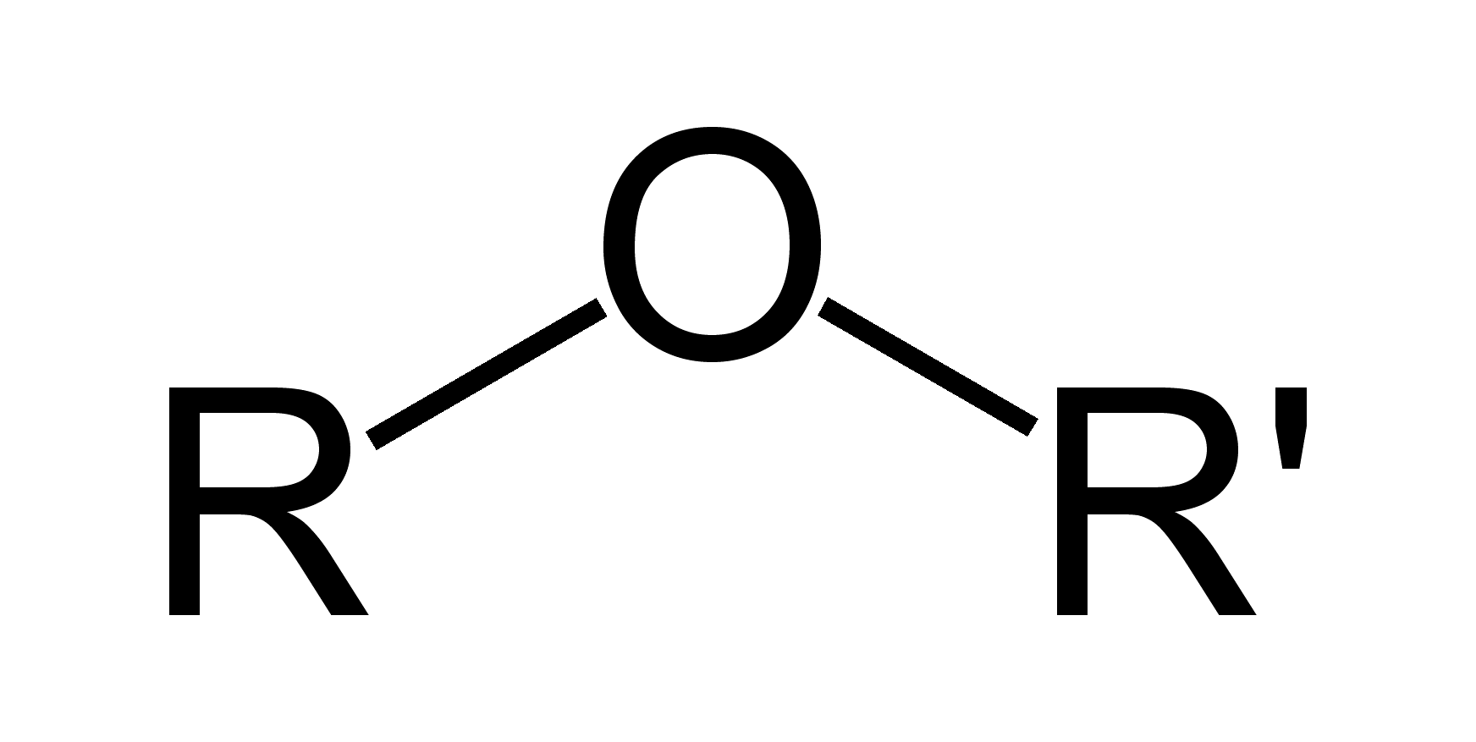
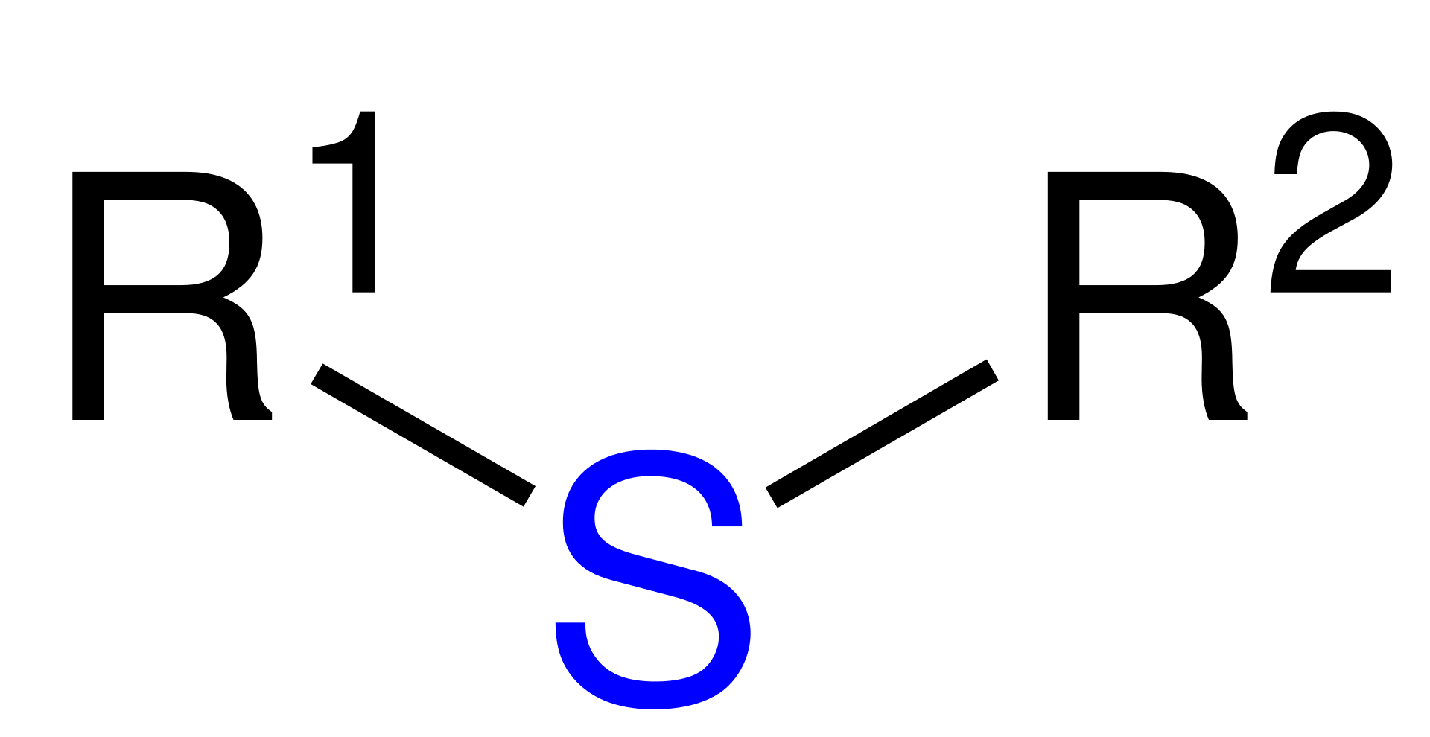
Try this
Think back to the acid-base chapter: the pKa of a protonated ether is
approximately zero, indicating that an ether is a very weak base.
Considering periodic trends in acidity and basicity, what can you say about the relative basicity of a sulfide (aka thioether)?
pKa ~0
The vertical periodic trend in acidity tells us that thiols (SH) are more acidic than alcohols (OH) because the larger anion is more stable (comfortable) carrying a negative charge, so thiolates (S: -) are weaker bases - and better leaving groups - than alkoxides (O: -).
By extension, sulfides are weaker bases than ethers. The sulfide in S- adenosylmethionine is an excellent leaving group, one of several factors making SAM a very effecting methyl group donor.
……..sidebar…………….…...

Slide 10
Catechol-O-methyltransfase
Catechol-O-methyltransferase also uses SAM to methylate epinephrine (aka adrenaline), tagging it for degradation.
……..sidebar…………….…...
What are the similarities and differences between the two reactions using SAM?

Slide 11
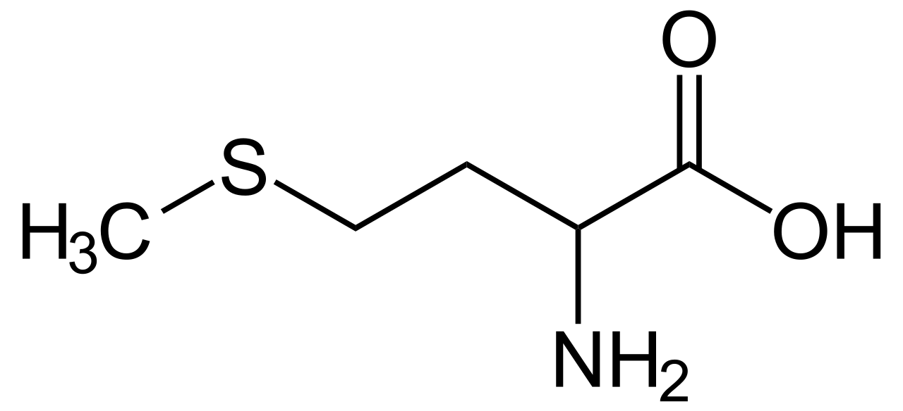
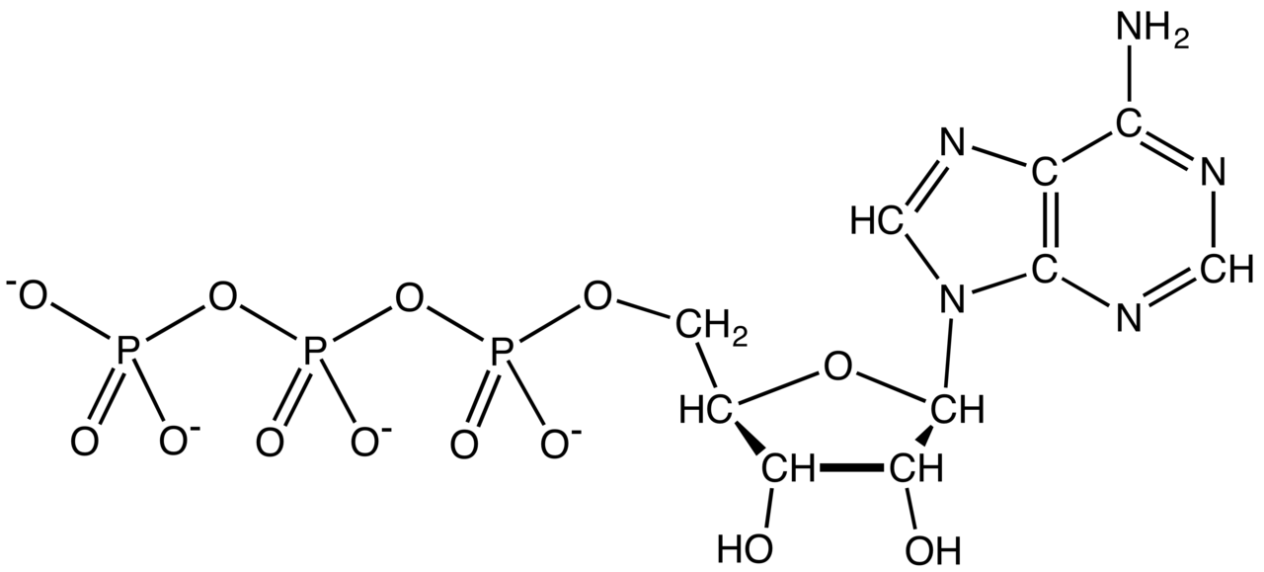
Try this
SAM is formed by a nucleophilic substitution reaction between
methionine and adenosine triphosphate (ATP).
Draw a mechanism for this reaction, and explain why you chose either an SN1 or and SN2 pathway.
SN2
……..sidebar…………….…...

Slide 12
6. Nucleophilic substitution reactions
6.7B: A biochemical SN1 reaction
……..sidebar…………….…...

Slide 13
SN1 in nucleotide biosynthesis
How many characteristics of an SN1 reaction can you identify?
……..sidebar…………….…...

Slide 14
Prior step: improving the LG
The substrate in the SN1 nucleotide biosynthesis reaction, ribose-5-phosphate, has a poor leaving group and wouldn’t undergo nucleophilic substitution.
Phosphorylation of ribose-5-phosphate by ATP creates a far better leaving group and allows the SN1 reaction to occur.
……..sidebar…………….…...

Slide 15
6. Nucleophilic substitution reactions
6.7C: A biochemical hybrid SN1/SN2 reaction
……..sidebar…………….…...

Slide 16
Adding a cell membrane anchor
Some proteins involved in cell signaling have to be located at the cell membrane in order to function. In order to create a hydrophobic anchor for those proteins, a 15-carbon isoprene group is added to a cysteine of the signaling protein. This reaction is called prenylation.
……..sidebar…………….…...
membrane: lipid bilayer

Slide 17
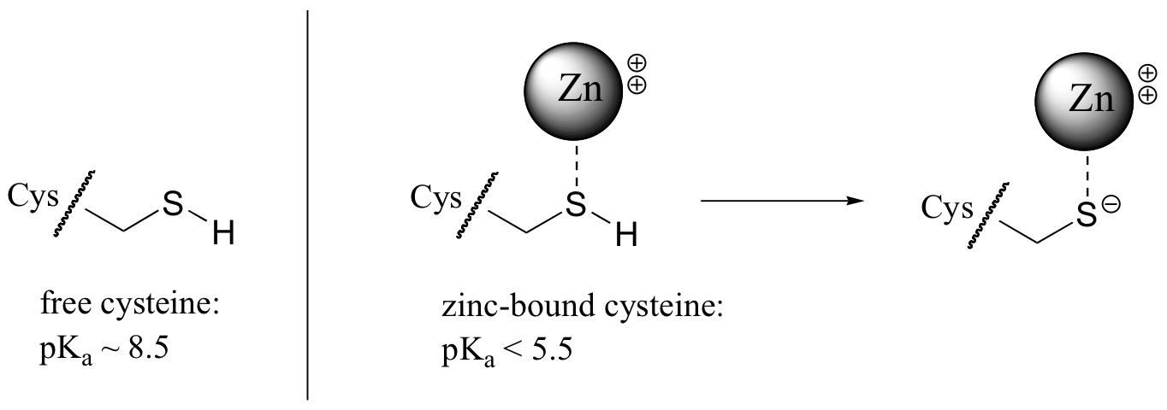
How does the enzyme add the anchor?
How does the enzyme lower the EA and add the isoprene anchor to the signaling protein?
Increase the strength of the thiol Nu: of the cysteine R of the substrate.
Decrease the basic strength of the diphosphate to make it a better LG.
……..sidebar…………….…...
A Zn ion in the enzyme’s active site forms a dipolar bond with the thiol group from the substrate’s cysteine.
Interaction with Zn stabilizes the S and lowers its pKa.
The sulfur donates its hydrogen converting the weak SH Nu: to a very strong charged sulfur Nu:(-).

Slide 18
How does the enzyme add the anchor?
How does the enzyme lower the EA and add the isoprene anchor to the signaling protein?
Increase the strength of the thiol Nu: of the cysteine R of the substrate.
Decrease the basic strength of the diphosphate to make it a better LG.
……..sidebar…………….…...
A number of the enzyme’s amino acids H-bond to the diphosphate, decreasing its basicity and making it a better LG.

Slide 19
So, is the reaction SN1 or SN2?
What do we know?
E+: primary allylic cation (stabilized) either SN1 or SN2
Nu:-: very strong SN1
Experimental evidence suggests that the reaction is mainly SN2 with elements of SN1.
A hybrid!
……..sidebar…………….…...
In reality SN1 and SN2 are models, or extremes.
Real nucleophilic substitution reactions may be SN1 or SN2 or fall in between.

Slide 20
Can you?
(1) Describe the function of S-adenosyl methionine (SAM)?
(2) Explain whether SAM acts as the Nu: or E+ and why?
(3) Understand why SAM reacts by the SN2 mechanism?
……..sidebar…………….…...
(4) Understand that the strength of LG can be improved?
(5) Understand that SN1 vs SN2 are ‘teaching paradigms’ and that
biological SN reactions are SN1/SN2 hybrids?

