Slide 1
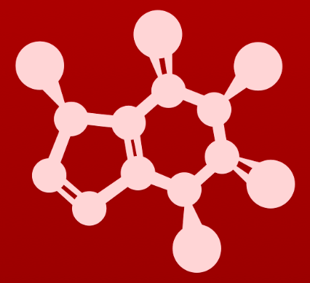
CHE 2060: Principles of Organic Chem
6. Nucleophilic substitution reactions
Introduction: Why aren't identical twins identical? Just ask SAM.
6.1: Two mechanistic models for nucleophilic substitution
6.1A: The SN2 mechanism
6.1B: The SN1 mechanism
6.2: All about nucleophiles (Nu:)
  What is a nucleophile vs. a base?
  Protonation state
  Periodic trends in nucleophilicity
  Resonance effects on nucleophilicity
  Steric effects on nucleophilicity
6.3: All about electrophiles (E+)
  Steric hindrance at the electrophile
  Carbocation stability
6.4: Leaving groups
6.5: Regiospecificity of SN1 reactions with allylic electrophile
6.6: SN1 or SN2? Predicting the mechanism
6.7: Biological nucleophilic substitution reactions
6.7A: A biochemical SN2 reaction
6.7B: A biochemical SN1 reaction
6.7C: A biochemical SN1/SN2 hybrid reaction
6.8: Nucleophilic substitution in the lab
6.8A: The Williamson ether synthesis
6.8B: Turning a poor leaving group into a good one: tosylates
optional sidebar

Slide 2
6. Nucleophilic substitution reactions
Big ideas:
1. SN mechanisms depend on the strength of Nu:, stability of E+
and quality of LGs.
2. Carbocations are intermediates whose 'stability' depends on
their structures.

Slide 3
6. Nucleophilic substitution reactions
6.8A: The Williamson ether synthesis

Slide 4
Williamson ether synthesis
The Williamson ether synthesis (1850) converts primary alcohols to ethers in two steps.
1. A strong base deprotonates the alcohol.
1. SN2: alkoxide substitutes for bromide.
Methyl bromide is used to carry the methyl group, acting a bit like SAM.
  These reactants wouldn’t work in a cell or in the body!

Slide 5
Williamson with 2º or 3º alkyl halides?
What would happen if 2º or 3º alkyl halides (the methyl carriers) were used as the substrate in a Williamson ether synthesis?
Rather than making ether by a substitution reaction, an elimination reaction would occur, producing an alkene.
And the original primary alcohol substrate would be reproduced.

Slide 6
Try this
A rookie organic chemist ran the reaction shown above, hoping to
synthesize an ether. Instead, he got the alkene shown.
What alkyl halide/alcohol combination should he have used instead to get the ether product he was trying for?
To make the desired ether product, he should have switches the roles of the nucleophile and electrophilic species, using a tertiary alcohol nucleophile and a primary alkyl bromide electrophile:

Slide 7
6. Nucleophilic substitution reactions
6.8B: Turning a poor leaving group into a good one - tosylates

Slide 8
Tosylates are great LGs
If an organic chemist wants to convert a hydroxide to a better LG, she can convert it to an organic tosylate: para-toluene sulfonate.
Para–toluene sulfonic acid is a strong acid with a pKa of 2.8, so its conjugate base is a weak base and makes a good LG.

Slide 9
Can you?
(1) Understand that the Williamson synthesis of ethers is a lab reaction?
(2) Understand that Williamson synthesis only works for 1◦ alcohol substrates?
(3) Understand that Williamson synthesis proceeds via a SN2 reaction?
(4) Understand why para-toluene sulfonic acid creates a good leaving group?
(5) Understand how tosylates can improve OH leaving groups?

