Slide 1
SSC 2030: Energy Systems & Sustainability
10. Remedies
10.1: Cleaning up fossil fuels
10.2: Geo-engineering options
10.3: Fuel cells & the fossil fuel hydrogen economy
10.4: Reducing energy demand
10.5: Renewable energy resources
Stabilization wedges: not a silver bullet strategy

Slide 2
10. Remedies
10.1: Introduction - how we got here… & how we might solve problems we’ve created

Slide 3
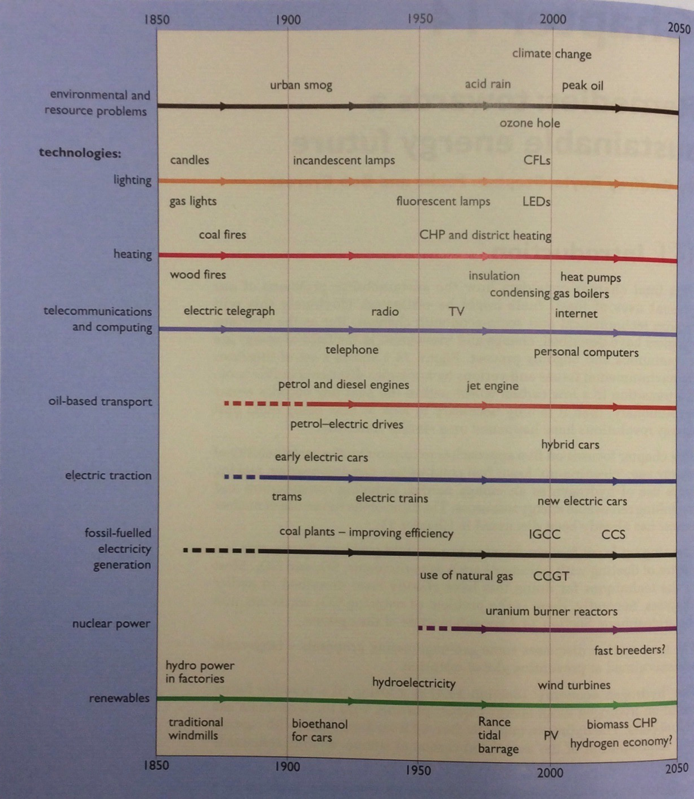
So….
Timeline of human:
development,
use of energy,
problems created,
technologies, &
potential solutions.
Renewable Energy, 2/e, Chapter 14

Slide 4
10. Remedies
10.2: Cleaning up fossil fuels

Slide 5
Problems posed by fossil fuels
Fossil fuels are cheap & abundant, but create problems, including effects on our environment, climate and health.
Particulate emissions
Sulfur dioxide
Nitrogen oxides
Carbon dioxide
Renewable Energy, 2/e, Chapter 14

Slide 6
Fuel switching
Advocates of ‘clean’ fossil fuels argue that switching to natural gas (NG) provides cleaner, yet still abundant fossil-fuel energy.
The global economy is already moving in this direction.
NG is still a finite resource.
And methane hydrates might be the next ‘clean’ fossil fuel.
‘In the context of an energy transition that may take decades the U.S. does not have 20 years for natural gas to kill coal and replace oil in power and transportation, respectively, followed by another 50 years needed to replace now-entrenched natural gas with renewables and/or nuclear power plants powering electric cars and trucks. The U.S. Environmental Protection Agency expects natural gas to be producing one-third of U.S. electricity in 2030 and technologies that might make natural gas near-zero carbon, like those that capture and store CO2, have yet to be tried or even tested on the gaseous fossil fuel.
For all these reasons, natural gas makes for a weak bridge to a zero-pollution future and truly clean power—one that cannot span more than a few decades. Still, a bridge made of gas is better than none at all.’
- Biello, Scientific American, 2015
https://www.scientificamerican.com/article/fact-or- fiction-natural-gas-will-reduce-global-warming-pollution/

Slide 7
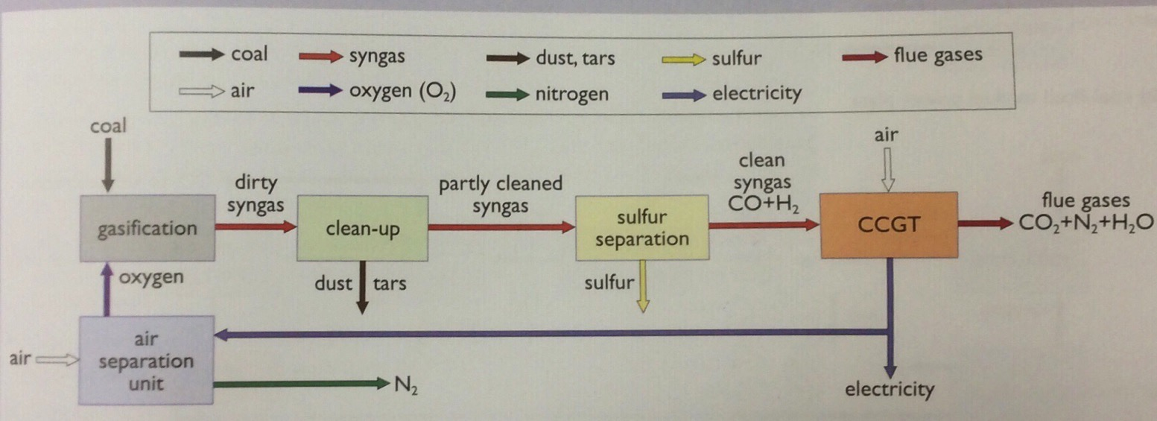
Clean coal via coal gasification
So, if NG can create a ‘weak bridge’ to the future, can we build that same bridge with coal?
Coal-based integrated gasification combined cycle (IGCC) power plants are designed to use the abundant energy of coal with fewer environmental, health & climate consequences.
Renewable Energy, 2/e, Chapter 14

Slide 8
Clean coal’s big hurdle: economics
So, if NG can create a ‘weak bridge’ to the future, can we build that same bridge with coal?
Technology | pence / kWh (2009)
Conventional coal | 6.41
Post-combustion coal + CCS | 13.57
Coal IGCC | 9.51
Coal IGCC + CCS | 14.21
NG CCGT | 6.53
NG CCGT + CCS | 11.04
As long as NG supplies are sufficient, coal can’t compete.
fuel | 2009 | 2016
Coal, US | $33.24/short ton | $36.91/short ton
NG, US | 4.93 $/Mcf | 2.99 4/Mcf
Renewable Energy, 2/e, Chapter 14; EIA
And while NG prices have fallen, coal prices have not.

Slide 9
10. Remedies
10.3: Geo-engineering

Slide 10
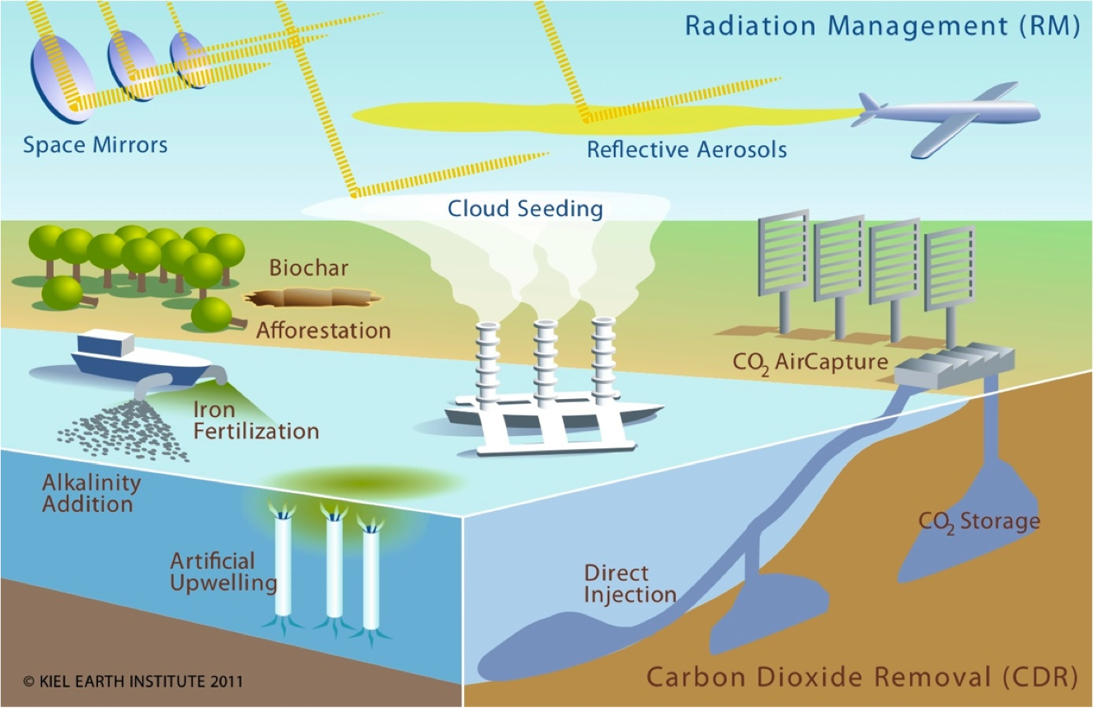
What is geo-engineering?
Geo-engineering (aka climate engineering or climate intervention) is is the deliberate and large-scale intervention in the Earth’s climatic system with the aim of affecting adverse global warming.
Renewable Energy, 2/e, Chapter 14
http://www.climate-engineering.eu/home-35.html

Slide 11
Geo-engineering strategies
Land-based:
Reforestation
Bioenergy with CCS
Biochar
Marine:
Fertilizing the oceans
Direct injection of CO₂ into the deep ocean
Solar radiation management:
Injection of sulfate into the atmosphere
Creation of cloud cover
Mirrors in space
Renewable Energy, 2/e, Chapter 14

Slide 12
CO₂ removal strategies (1)
Land-based methods:
Reforestation (technically, afforestation)
Growth of plant material, like trees, pulls CO₂ from the atmosphere.
Carbon is sequestered in plant growth as long as plant material is alive or not rotting.
IPCC estimates that afforestation could sequester 1.3 Gt of CO₂ per year at a 20007 cost of $20/tCO₂e.
This is only 4% of global CO₂ emissions.
Renewable Energy, 2/e, Chapter 14
https://www.pri.org/stories/2016-06-27/what-chinas-successful-reforestation- program-means-rest-world
It’s estimated that humans have removed 45% of the Earth’s original forest cover.
To date, reforestation has had mixed success. For example, China:
Restrictions on logging & farming have increased tree cover;
China now imports more wood, essentially off-shoring deforestation.

Slide 13
CO₂ removal strategies (2)
Land-based methods:
Bioenergy with carbon capture & storage (BECC):
Growth of plant material, like trees, pulls CO₂ from the atmosphere.
Carbon is sequestered in plant growth as long as plant material is alive or not rotting.
Using biomass to produce energy via the IGCC technology described for coal will be either:
Carbon neutral if biomass is grown at the same rate it is used; or
May be net carbon negative if used with CCS.
Critically, effective & sustainable use of biomass requires that new biomass is grown at a rate equal to, or great than, the rate with which biomass is used.
When growing trees, there is a significant time lag of 20-30 years or more.
Perennial grasses have a lower lag time.
Renewable Energy, 2/e, Chapter 14

Slide 14
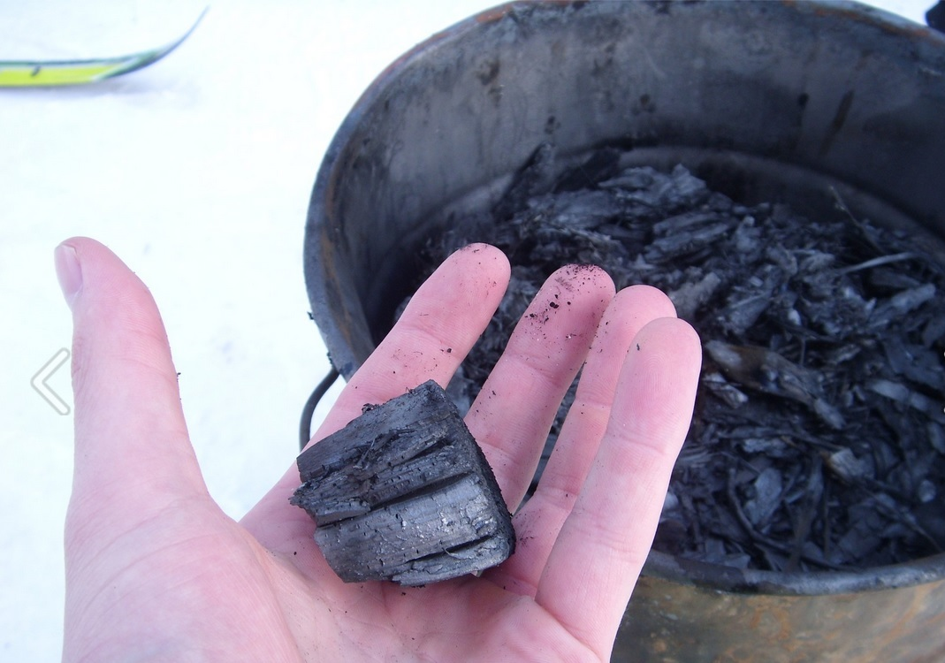
CO₂ removal strategies (3)
Land-based methods:
Biochar:
Biochar is a charcoal produced by incomplete pyrolysis (combustion in a low-oxygen atmosphere) of biological woody (cellulosic) materials.
Biochar is carbon.
Burying biochar may sequester its carbon.
Biochar holds water & nutrients in the soil and can improve the agricultural yield of poor soils.
Renewable Energy, 2/e, Chapter 14; https://en.wikipedia.org/wiki/Biochar;
The ability of biochar to sequester carbon is controversial.

Slide 15
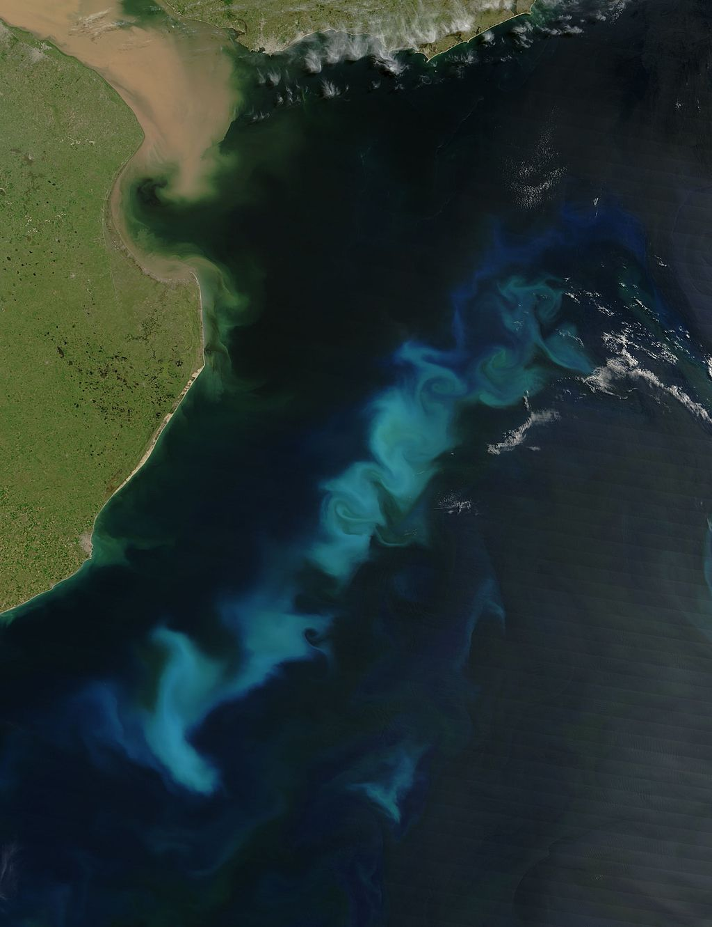
CO₂ removal strategies (4)
Marine methods:
Fertilizing the oceans to increase biological carbon sequestration:
Microscopic organisms called phytoplankton grow at the surface of the oceans, fed by nutrients and sunlight and incorporating atmospheric CO₂.
Nutrients often limit growth; phytoplankton thrive near land.
When (uneaten, 30%) phytoplankton die, they drift to the bottom of the ocean where they remain for long periods of time before being converted back to CO₂ by deep-sea bacteria.
Fertilizing the ocean with nutrients (and iron) could encourage the growth of phytoplankton, sequestering CO₂.
Renewable Energy, 2/e, Chapter 14
Fertilizing the ocean could create new dead zones and may change ocean ecology in ways that we have not anticipated.

Slide 16
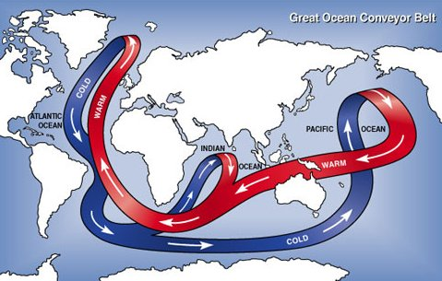
CO₂ removal strategies (5)
Marine methods:
Deep ocean injection of CO₂:
The deep oceans store massive amounts of CO₂: 37,000 Gt, or 50X atmospheric CO₂. The gas dissolves in surface water; currents move the water towards the poles where it cools; cold water sinks to the depths.
Thermohaline circulation (aka Great Ocean Conveyer Belt’)
1000 years later the deep waters rise & CO₂ is released.
Renewable Energy, 2/e, Chapter 14
https://enviroliteracy.org/water/oceans/the-great-ocean-conveyer-belt/
Again, we don’t know the long-term ecological effects.

Slide 17
Solar radiation mgt strategies (1)
Theory: If more solar radiation were reflected back out of the Earth’s atmosphere, global temperature could be reduced.
Reflecting 2% back would offset much warming…
... but is a massive project.
Sulfate aerosols:
SO₂ emissions form sulfate (SO₄)⁻² aerosols (fine mists) in the atmosphere to reflect sunlight back into space.
1991: the volcano at Mt. Pinatubo, Phillipines spewed 10 million tonnes of sulfur into the atmosphere. Global temperatures cooled by 0.5°C for several years.
Sulfate aerosols can also seed the formation of clouds.
We can spray sulfuric acid aerosol into the upper atmosphere to mimic this effect.
Potential downside: sulfate aerosols may combine with atmospheric water creating sulfuric acids (acid rain)
We are already seeing increased levels of atmospheric moisture due to increasing frequency of big storms.
Renewable Energy, 2/e, Chapter 14

Slide 18
Solar radiation mgt strategies (2)
Altering cloud cover:
Clouds, mainly water vapor, have multiple roles:
They shade earth’s surface &reflect sunlight into space; &
They insulate earth & prevent heat from radiating into space.
Marine cloud brightening:
Using remote control boats & fairly simple technology, a fine mist of sea water can be sent into the lower atmosphere where evaporation of water produces fine salt particles. Models show that albedo should increase, reflecting sunlight.
https://www.scientificamerican.com/article/salt-spray-may-prove-most-feasible-geoengineering/
https://www.technologyreview.com/s/511016/a-cheap-and-easy-plan-to-stop-global-warming/
Seeding the atmosphere with dust or salts to create thinner clouds:
Could increase the particle size of ice in cirrus clouds causing thinner cloud cover allowing more heat to radiate into space.
Natural experiment? Huge dust storms can blow dust from central Asia east. Monitoring clouds & rain that result (or don’t) could provide data.
Potential downsides: If theories are wrong, altering clouds could exacerbate warming rather than relieve it.

Slide 19
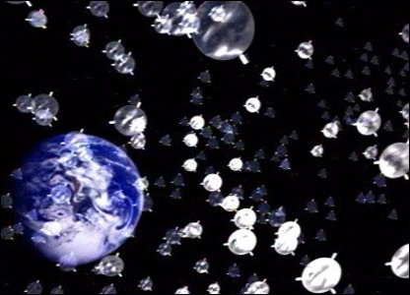
Solar radiation mgt strategies (3)
Physical shading from space:
Place a physical barrier between the sun & the earth to decrease the amount of sunlight reaching earth.
Most obvious means myriad tiny mirror or satellites.
Some have suggested that low-orbit solar PV parasols could provide ‘shade’ while beaming PV power to earth.
http://www.bbc.com/future/story/20160425-how-a-giant-space-umbrella-could-stop-global-warming
Potential downsides: Shading might even out global temperatures; tropics would be cooler & poles would be warmer.

Slide 20
Should we geo-engineer?
Not surprisingly opinions, scientific to political, are mixed.
“It’s meant to give you a feeling that we really understand what we would be doing. It’s a way to increase comfort levels with this crazy idea. What we’re really talking about is hacking the planet in a case where we don’t really know what it is going to do.”
“[It’s] barking mad.”
- Raymond Pierrehumbert, geophysicist, University of Chicago
A 2009 report from The Royal Society recommended geo-engineering should be used as a last resort, but that research & conversations about governance – who decides whether humanity should hack the planet – happen now.
https://www.technologyreview.com/the-download/609431/gop-embraces-geoengineering-which-
terrifies-geoengineering-researchers/
https://www.technologyreview.com/s/511016/a-cheap-and-easy-plan-to-stop-global-warming/
Note that politicians who deny climate change, like congressman Lamar Smith (R), now advocate use of geo-engineering:
“Instead of forcing unworkable and costly government mandates on the American people, we should look to technology and innovation to lead the way to address climate change.”

Slide 21
10. Remedies
10.4: Fuel cells & a fossil-fuel based hydrogen economy

Slide 22
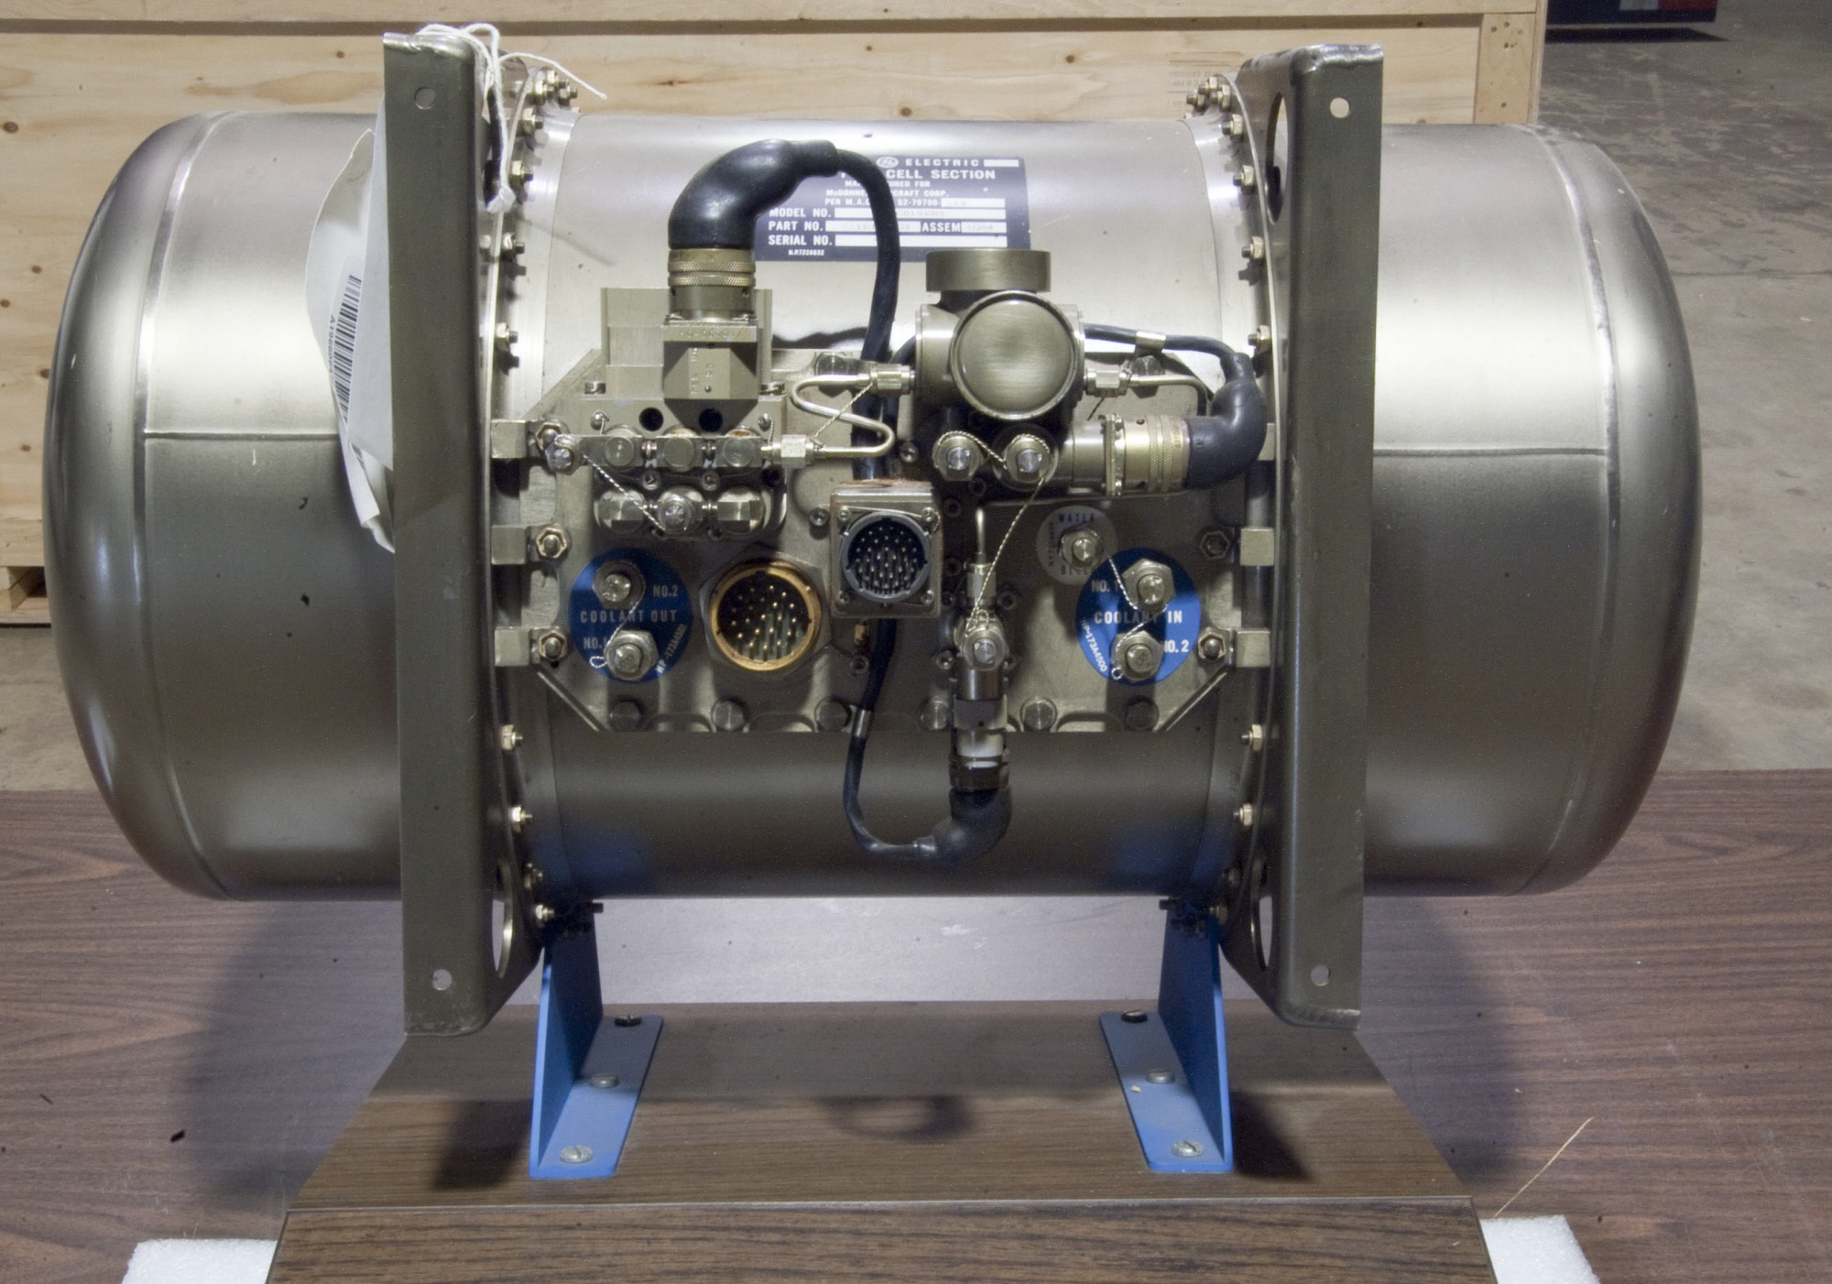
Hydrogen fuel cells
The hydrogen fuel cell was invented by Grove in the 1840s.
In the 1950s, Bacon improved the hydrogen fuel cell.
First practical use on the Gemini & Apollo spacecraft where fuel cells were used to make electricity & water.
Renewable Energy, 2/e, Chapter 14;
https://airandspace.si.edu/collection-objects/fuel-cell-gemini-3

Slide 23
Fuel of the future?
What do you do when you run out of fossil fuel?
‘And what will they burn instead of coal?’
‘Water,’ replied Harding.
‘Water!’ cried Pencroft, ‘water as fuel for steamers and engines! Water to heat water!’
‘Yes, but water decomposed into its primitive elements.’ replied Cyrus Harding, ‘and decomposed doubtless, by electricity, which will then have become a powerful and manageable force, […] Yes, my friends, I believe that water will one day be employed as fuel, that hydrogen and oxygen which consisitute it, used singly or together, will furnish an inexhaustible source of heat and light, of an intensity of which coal is not capable. Some day the coalrooms of steamers and the tenders of locomotives will, instead of coal, be stored with those two condensed gases, which will burn in the furnaces with enormous calorific power.’
- Jules Verne, The Myterious Island, 1874
Renewable Energy, 2/e, Chapter 14

Slide 24
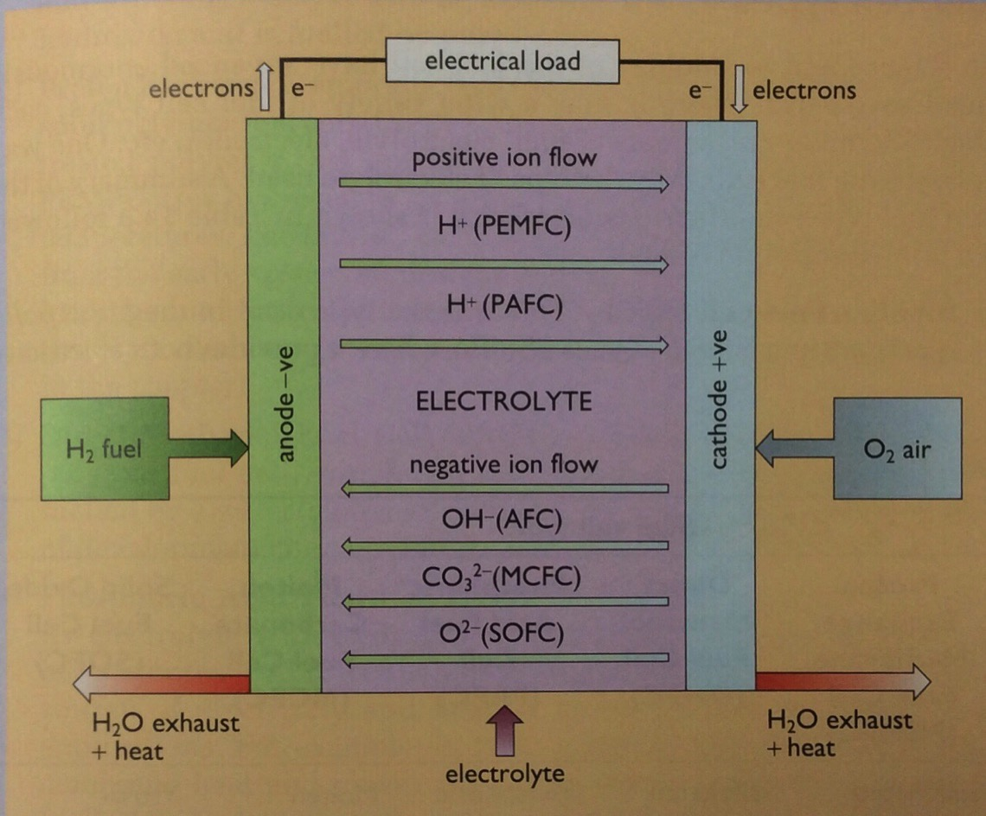
Fuel cells
H₂ flows into the porous anode & O₂ flows into the porous cathode.
Catalyst splits H₂ into H⁺¹ ions & electrons.
Electrons flow towards the cathode through the electric load, providing electricity.
H⁺¹ ions flow through the electrolyte to the cathode.
At the cathode, H⁺¹ ions combine with O⁻² ions created when electrons flowing to the cathode reduce oxygen gas to O⁻².
Water & heat are produced.
Fuel must be pure.
Renewable Energy, 2/e, Chapter 14

Slide 25
Making fuel & storing energy
Could fuel cells be used to make & store fuel? Yes!
Fuel cells can be run in reverse, using electricity to create fuels which can be stored for later use.
This isn’t yet done at commercial scale.
Renewable Energy, 2/e, Chapter 14

Slide 26
Hydrogen as common fuel
XXX
Renewable Energy, 2/e, Chapter 14

Slide 27
Hydrogen: energy carrier
Hydrogen gas could be energy storage or currency.
Sources?
Electrolysis of water by renewable electricity;
Conversion of fossil fuels to H₂ and CO₂; the CO₂ could be stored.
It’s easier to separate & capture the CO₂ before combustion.
Conversion of hydrogen to energy is more efficient & produces less pollution (and no CO₂).
Hydrogen can be used as transportation fuel.
So, a common hydrogen infrastructure could serve many energy purposes.
Production?
Worldwide production: 500 b cubic meters (6.5 EJ) in 2010.
Most made via reforming NG; less expensive than electrolysis.
Renewable Energy, 2/e, Chapter 14
Transportation?
Pipeline made of special steel alloys.

Slide 28
Safety?
There have been concerns about the safety of hydrogen gas since the destruction of the Hindenburg zeppelin in 1937.
Filled with hydrogen gas.
But the skin was painted with very flammable compounds.
Hydrogen is now transported safely.
While hydrogen burns hot, it also burns quickly.
Renewable Energy, 2/e, Chapter 14; https://en.wikipedia.org/wiki/Hindenburg_disaster
Hydrogen is very light and dissipates quickly when it escapes.
Only explosive at greater than 4%.

Slide 29
10. Remedies
10.5: Reducing energy demand through efficiency

Slide 30
Efficiency: reducing demand
Increasing efficiency is essential to reducing energy use & carbon emissions.
Simple steps have large effects.
In Europe efficiency occurs more easily because inefficient products aren’t sold or are highly taxed.
Smaller… nearly everything
Efficient heating & cooling
Weatherization
Mass transportation
Electric transportation
Efficient lighting
Human behavior – the biggest challenge!
Renewable Energy, 2/e, Chapter 14

Slide 31
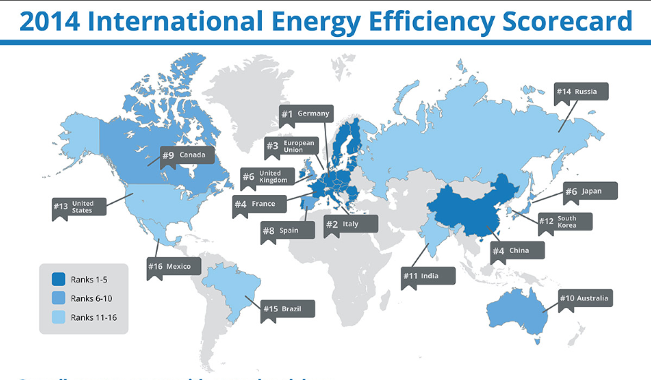
Efficiency: reducing demand
https://cleantechnica.com/2014/07/21/germany-1-world-energy-efficiency/

Slide 32
10. Remedies
10.6: Implementing renewable energy

Slide 33
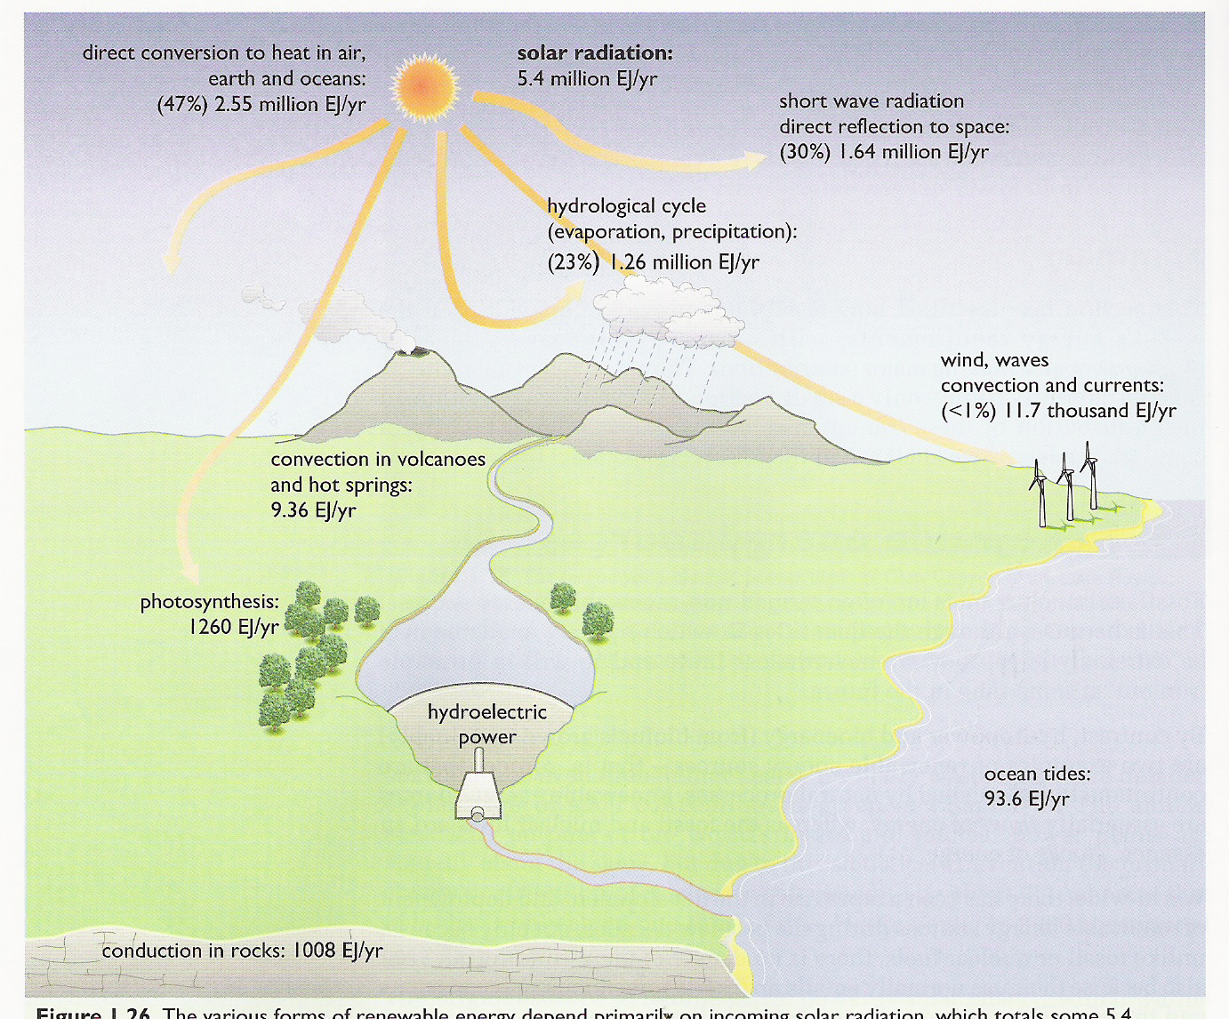
Renewable energy technologies
Solar energy
Solar thermal
Solar electricity: PV & thermal
Biomass
Traditional
Modern
Biofuels
Hydropower
Wind energy
Wave power
Tidal power
Barrages
Tidal stream
Geothermal
Renewable Energy, 2/e, Chapter 14

Slide 34
RE: reasons for optimism (Gore, TED 2016)
In 1980, AT&T was curious how many people would adopt “big, clunky” cell phones in upcoming decades, so they commissioned a McKinsey study to forecast cell phone use by the year 2000.
Their projection: 900,000 users.
“That did happen,” says Gore, “in first three days.”
They hugely underestimated because they didn’t account for the fact that the quality would improve and the cost would come down, both things happening with renewable energy.
https://blog.ted.com/why-al-gore-feels-optimistic-about-climate-change/

Slide 35
RE: reasons for optimism (1)
Al Gore, TED 2016
In 2000, the best projections said that the world would be able to install 30 GW of wind energy capacity by 2010.
“We beat that mark by 14 and a half times over,” says Gore.
As for solar power, projections 14 years ago said that we could install one GW per year by 2010.
“We beat that mark by 17 times over,” says Gore.
Last year, we beat it 58 times over. And this year, it looks like that will bump up to 68 times over.
The point: solar power is increasing exponentially.
https://blog.ted.com/why-al-gore-feels-optimistic-about-climate-change/

Slide 36
RE: reasons for optimism (2)
Al Gore, TED 2016
The cost of renewable energy has come down 10 percent per year for 30 years.
“We are close to reaching grid parity — that line, that threshold below which renewable is cheaper than electricity from burning fossil fuels,” he says.
“This is the biggest new investment opportunity in the history of the world.”
https://blog.ted.com/why-al-gore-feels-optimistic-about-climate-change/

Slide 37
RE: reasons for optimism (3)
Al Gore, TED 2016
On December 26, 2015, Germany got 81 percent of its energy from renewables, mainly solar and wind.
And then there’s the fact that on December 12, 2015, 195 governments came together in Paris, under the United Nations, and decided to intentionally change the course of the global economy in order to protect the earth, as described by Christiana Figueres.
The year before that 400,000 people marched in New York in support of climate change advocacy.
https://blog.ted.com/why-al-gore-feels-optimistic-about-climate-change/
The US has now withdrawn, and is the only nation not to be a party to the Paris climate accord.

Slide 38
RE: reasons for optimism (4)
Al Gore, TED 2016
“When any great moral challenge is ultimately resolved into a binary choice between what is right or what is wrong, the outcome is preordained because of who we are as human beings,” says Gore.
“The will to act itself is a renewable resource.”
https://blog.ted.com/why-al-gore-feels-optimistic-about-climate-change/

Slide 39
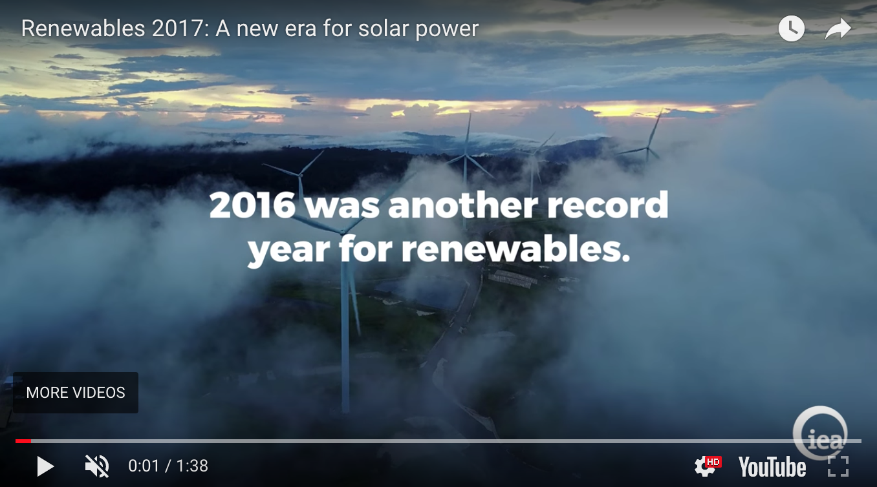
2016: a record year for RE
In 2016, RE accounted for nearly 2/3 of all new electric generation with 165 GW of new capacity installed.
Solar PV led the way due to falling prices & policy.
Grew by 50% to 74 GW.
Prices as low as 3¢/kWh.
https://www.iea.org/publications/renewables2017/

Slide 40
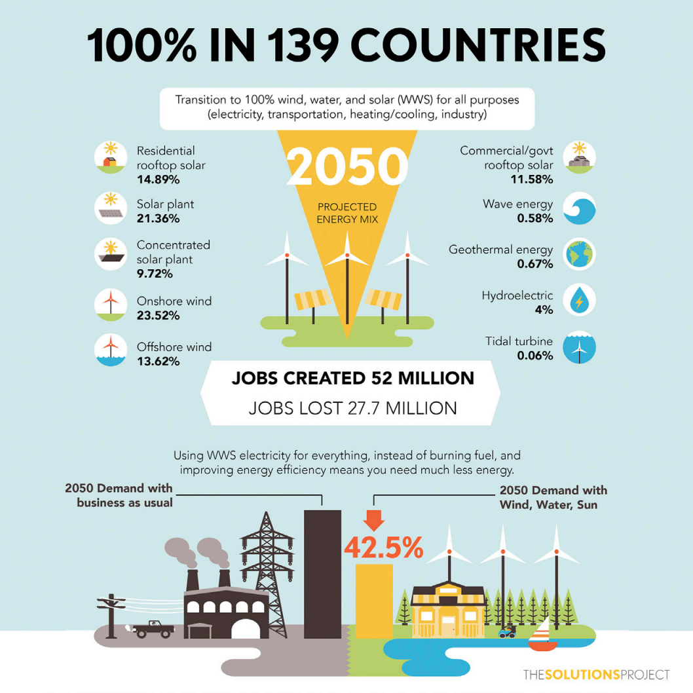
Could 100% renewables work?
A recent paper by Jacobson et al., (2015) asserts that the world could be transitioned to 100% renewable energy by 2050.
https://web.stanford.edu/group/efmh/jacobson/Articles/I/CountriesWWS.pdf

Slide 41
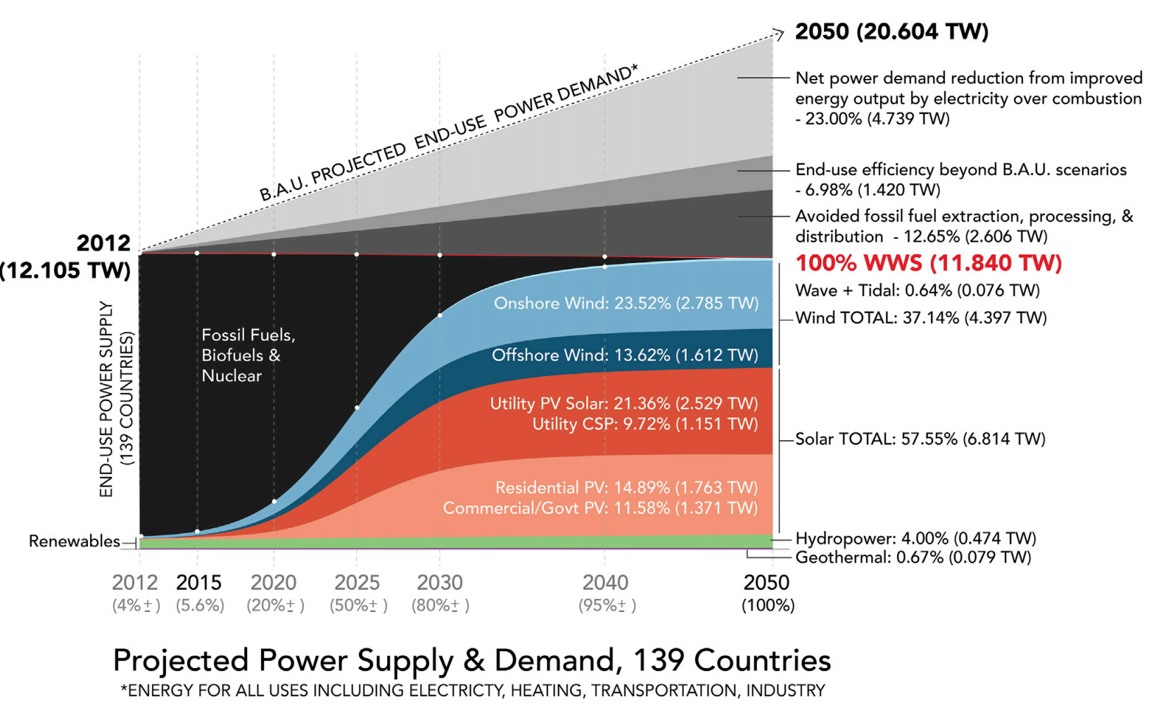
Could 100% renewables work?
https://web.stanford.edu/group/efmh/jacobson/Articles/I/CountriesWWS.pdf

Slide 42
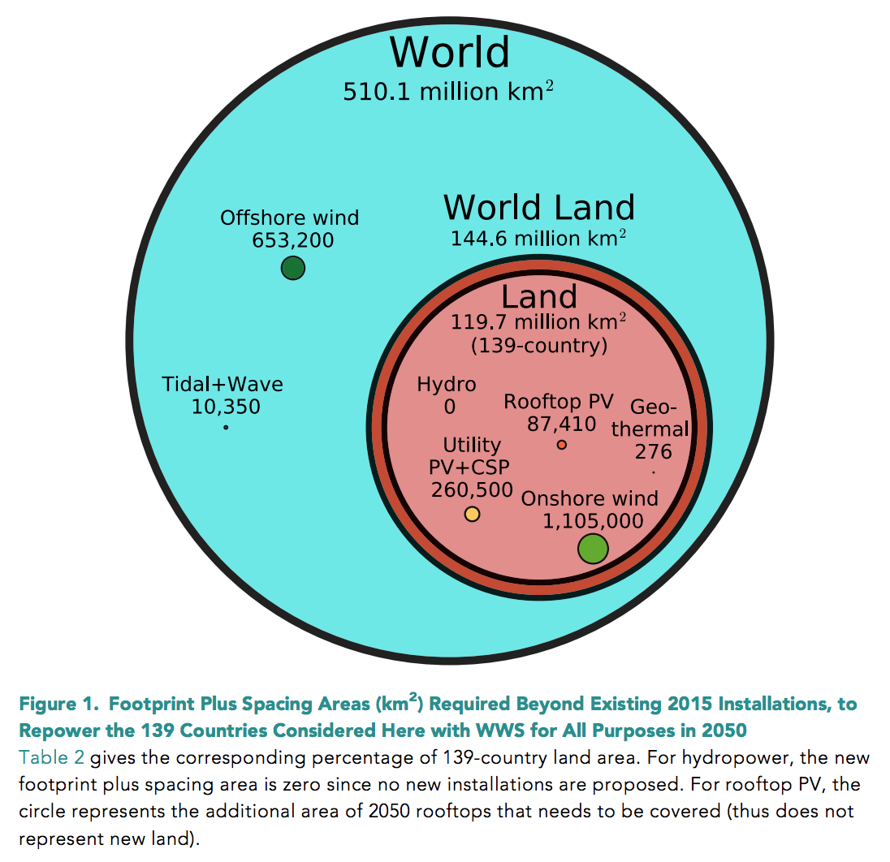
Could 100% renewables work?
https://web.stanford.edu/group/efmh/jacobson/Articles/I/CountriesWWS.pdf

Slide 43
Could 100% renewables work?
Jacobson’s assertion has come under a great deal of criticism from researchers who are proponents of sustainable energy.
The critics worry that overly optimistic expectations & policies will lead to disappointment & a backlash against renewable energy or climate change work in general.
“Other models, including Kammen’s, do show that the U.S. can transition to nearly 100 percent zero-emissions energy technologies. But the established view among energy researchers is that it would require making use of nearly every major technology available and that the transition, particularly getting the last 20 percent or so of the way there, would be prohibitively expensive using existing technologies. One of the key missing pieces is affordable grid-scale storage that can efficiently power vast areas for extended periods when wind and solar sources aren’t available.”
“The authors of [the] rebuttal were quick to stress that cutting emissions as quickly as possible is a crucial goal.”
https://www.technologyreview.com/s/608126/in-sharp-rebuttal-
scientists-squash-hopes-for-100-percent-renewables/

