Slide 1
SSC 2030: Energy Systems and Sustainability
10. Wind energy
10.1: History and global use
10.2: Wind and wind resources
10.3: The physics of wind power and siting
10.4: Wind turbines designs and components
10.5: Economics of wind power
10.6: Onshore wind project scale
10.7: Offshore wind – the real powerhouse
10.8: Downsides of wind power
10.9: Public attitudes toward wind power
10.10: Role of wind power in energy transition
Main source: Boyle, Godfrey (ed) (2004) Renewable Energy: Power for a Sustainable Future, 2/e, Oxford University Press, UK

Slide 2
Module 10. Wind energy
10.1: History and current use
Renewable Energy, 2/e, Chapter 7

Slide 3
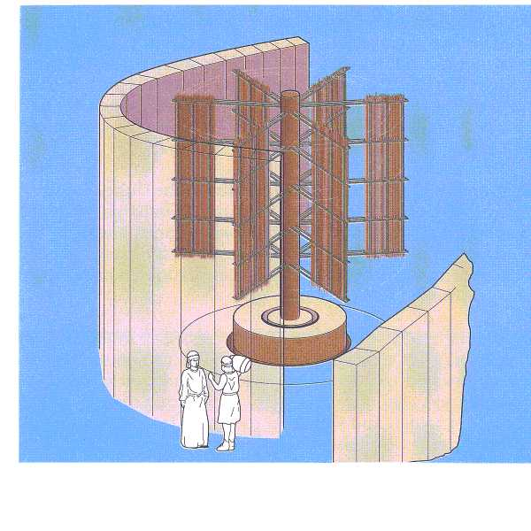
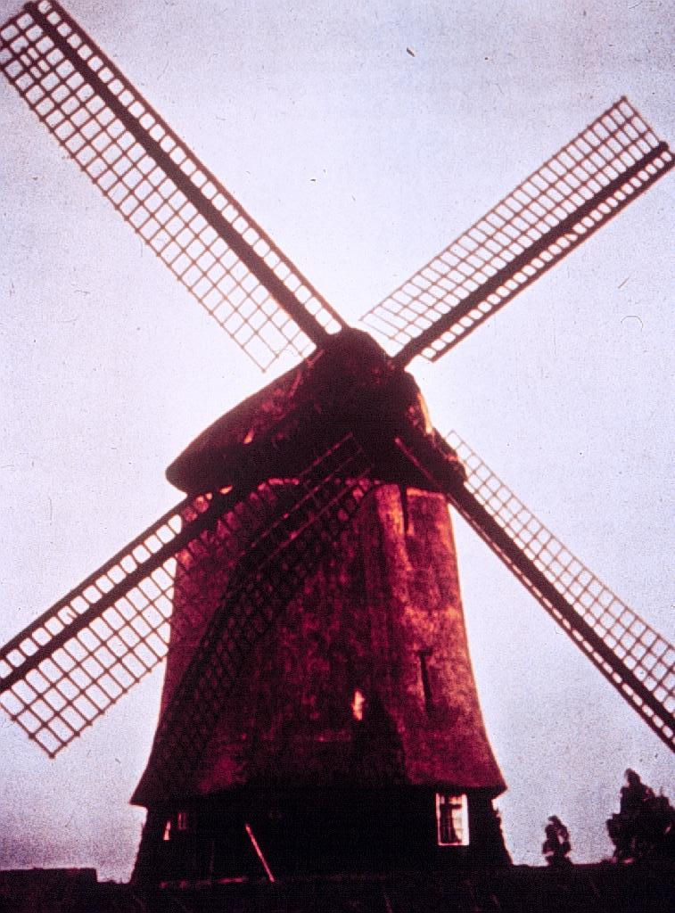
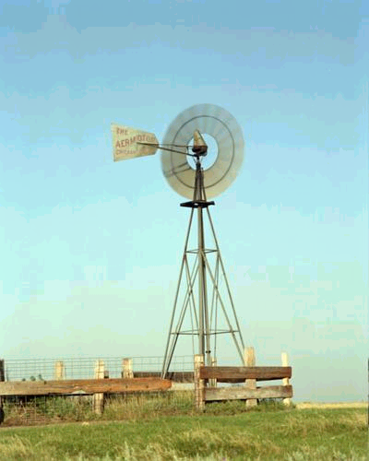
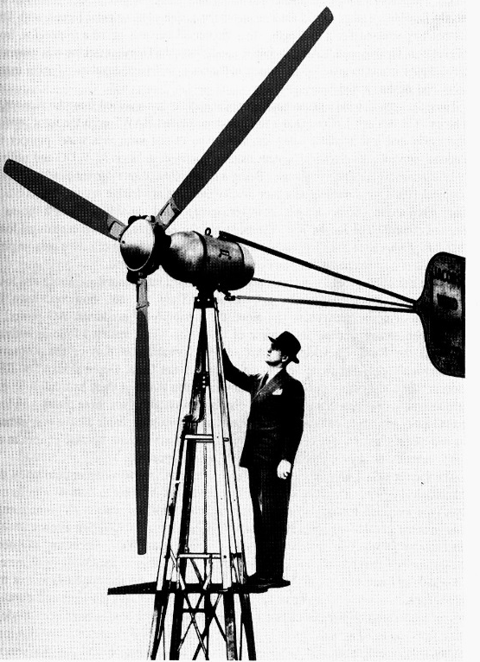
Wind: ancient and reinvented
140 years ago in the US
70 years ago electric power
~ 1800 years ago, in the Middle East
800 – 900 years ago in Europe
NREL

Slide 4
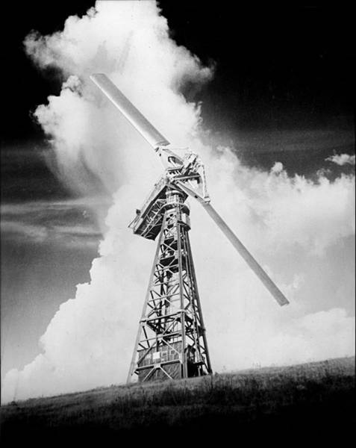
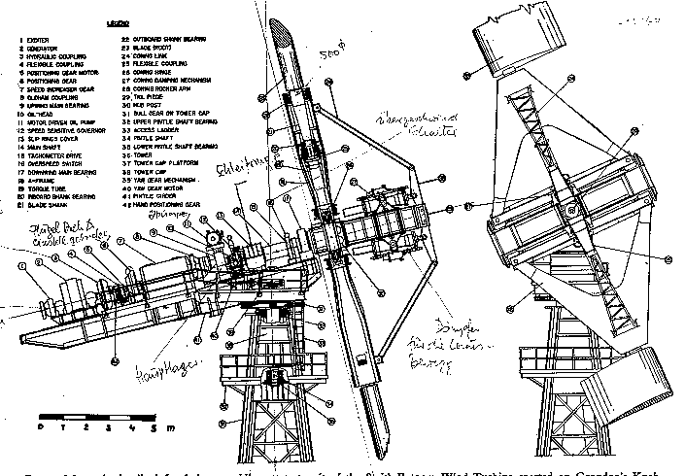
Vermont: an early wind power leader!
1941: Rutland VT, Grandpa’s Knob
1.25 MW Smith Putman Turbine
First grid-connected turbine in U.S.
World’s first MW-scale wind turbine
https://en.wikipedia.org/wiki/Smith-Putnam_wind_turbine

Slide 5
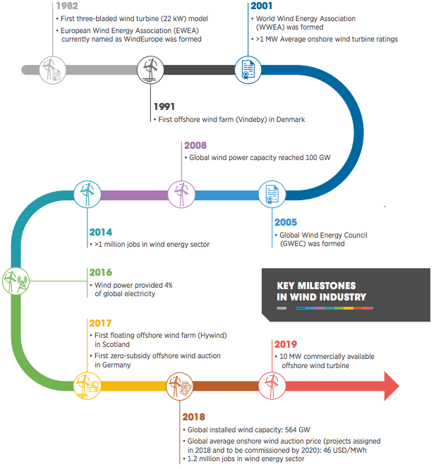
Wind milestones
https://www.irena.org/-/media/Files/IRENA/Agency/Publication/2019/Oct/IRENA_Future_of_wind_2019.pdf

Slide 6
Global wind milestones
https://www.irena.org/-/media/Files/IRENA/Agency/Publication/2019/Oct/IRENA_Future_of_wind_2019.pdf

Slide 7
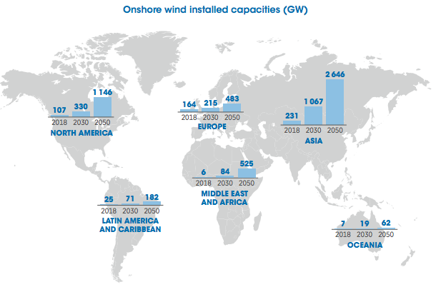
Global onshore wind deployment
Global total 542 GW (2019)
https://www.irena.org/-/media/Files/IRENA/Agency/Publication/2019/Oct/IRENA_Future_of_wind_2019.pdf

Slide 8
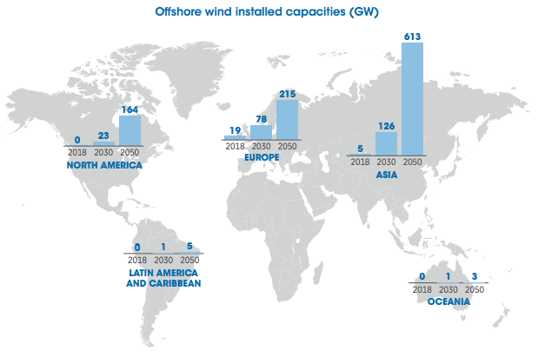
Global offshore wind deployment
Global total 23 GW (2019)
https://www.irena.org/-/media/Files/IRENA/Agency/Publication/2019/Oct/IRENA_Future_of_wind_2019.pdf

Slide 9
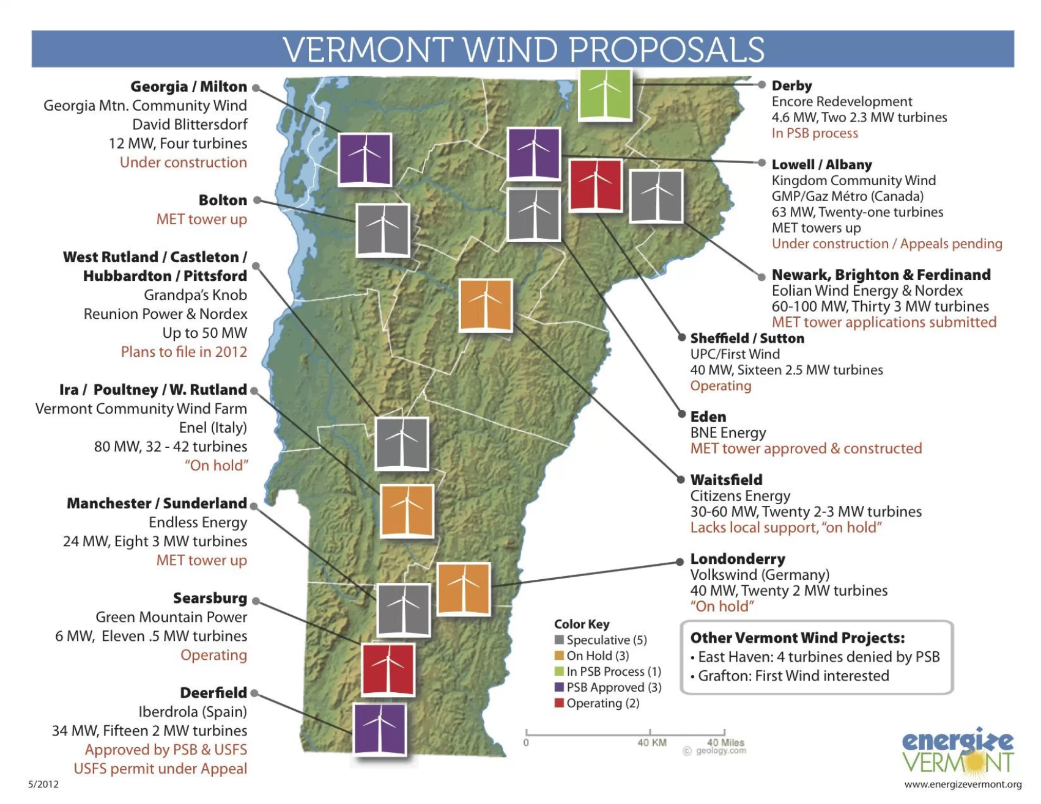
Wind power in Vermont today
149 MW of wind power
(vs. 335 MW of solar)
5 – 6 million MW theoretical capacity
There are no large-scale wind projects in serious planning or development.
Current state government (2020) favors a moratorium on big wind.
2012

Slide 10
Module 10. Wind energy
10.2: Wind resources
Renewable Energy, 2/e, Chapter 7

Slide 11
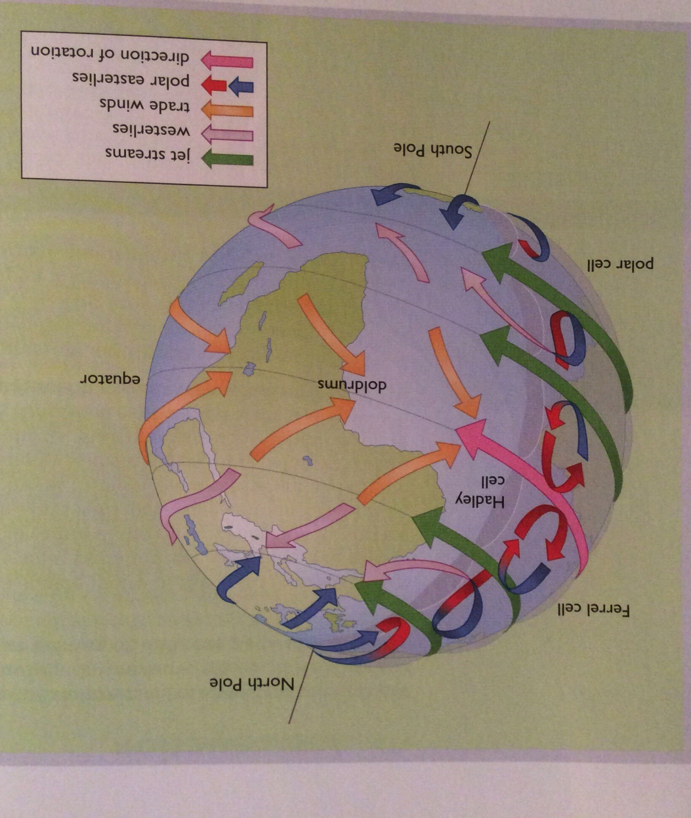
What is wind?
Wind is movement of atmospheric air masses that result from variations in atmospheric pressure. The variations in pressure result from solar heating of different parts of the earth’s surface.
Because the density of sunlight is highest at the equator and falls towards the poles, equatorial regions are warmer and poles cooler.
This difference in atmospheric temperatures causes the atmosphere to move.
Renewable Energy, 2/e, Chapter 7

Slide 12
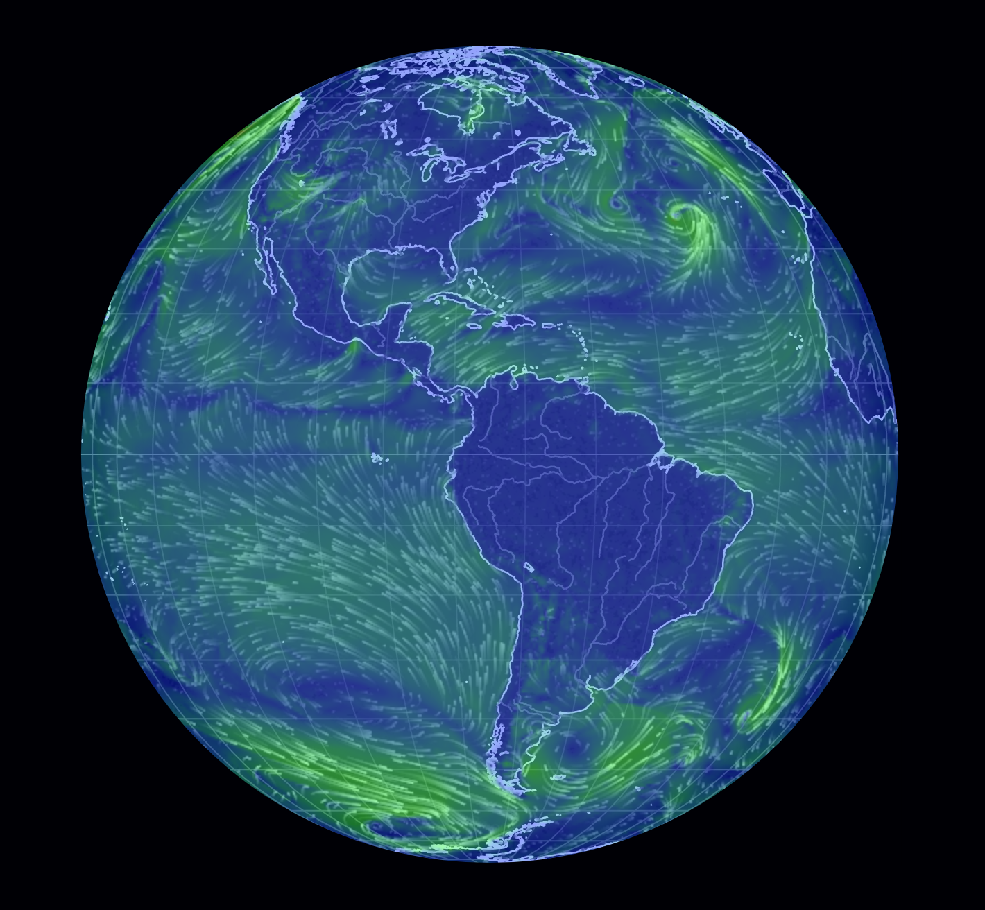
Global? Predictable overall patterns... mostly
Notice wind patterns.
Offshore wind and current are fairly predictable.
Where is wind most powerful?
https://earth.nullschool.net/
https://www.youtube.com/watch?v=i4mBYwBNULk
https://www.youtube.com/watch?v=XOxXEvTDC1g

Slide 13
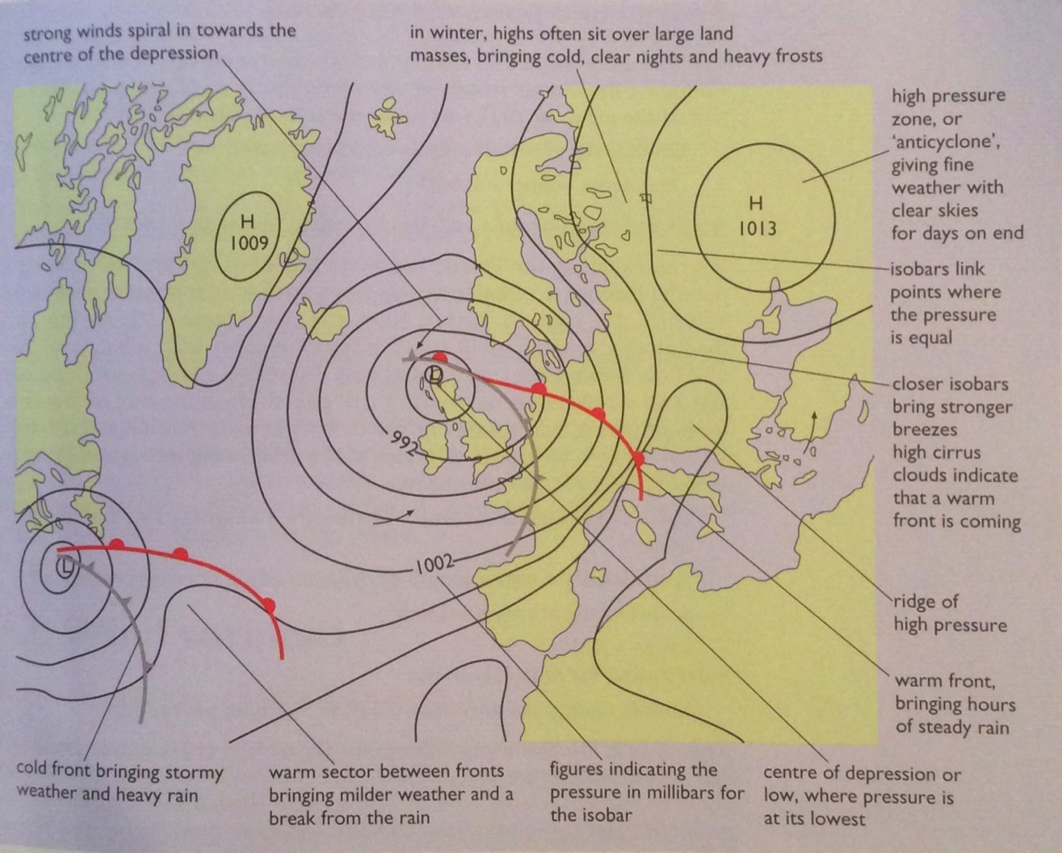
Pressure predicts weather and wind
High pressure predicts good (clear) weather while low pressure indicates changing, windy weather and precipitation.
Renewable Energy, 2/e, Chapter 7

Slide 14
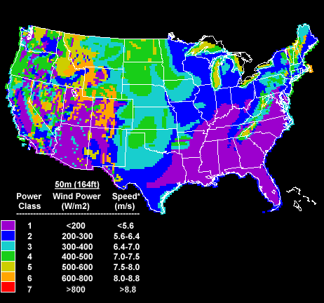
US wind resources
Wind resources vary, but wind power has been installed in most state.
http://www.nrel.gov/wind/wind_potential.html

Slide 15
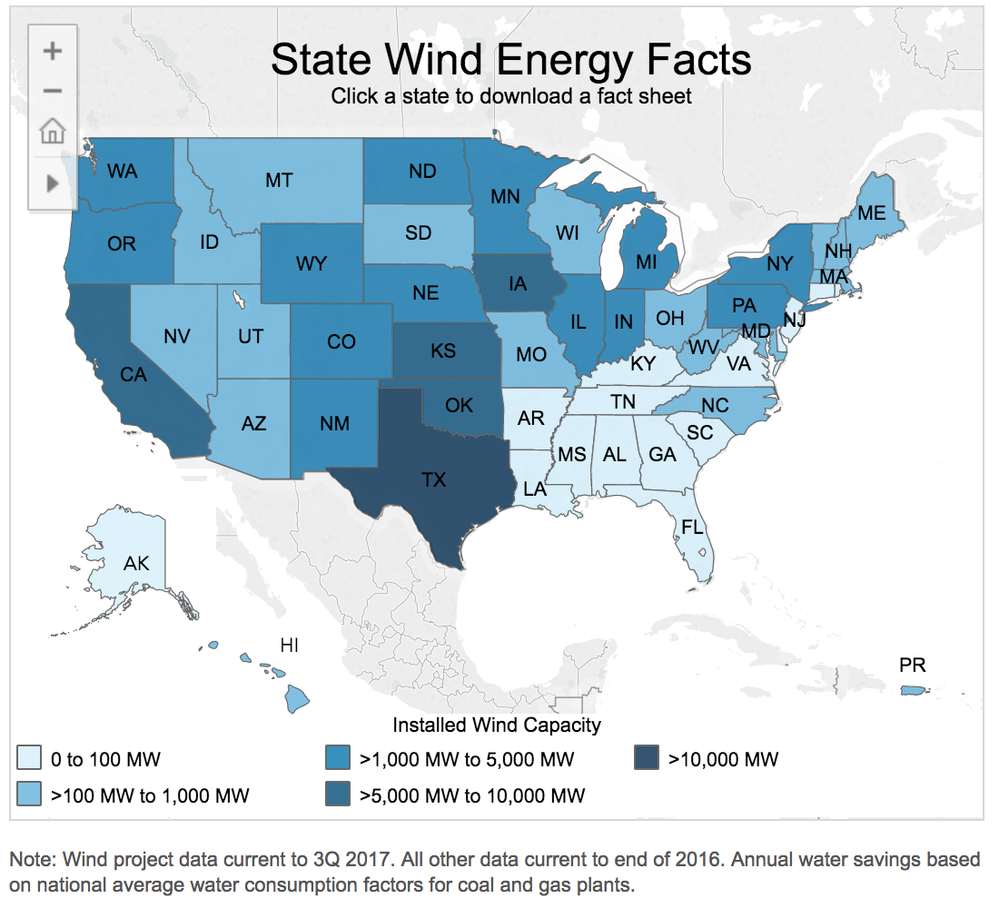
Installed wind power by state – correlation?
Wind resources aren’t everything.
Policy can drive installation.
Wind is now economical even where resources aren’t optima.
Note that Texas and Iowa don’t have optimal wind resources but are the national leaders in wind power.
Why Texas and Iowa? Think about what those states are known for.
https://www.awea.org/state-fact-sheets

Slide 16
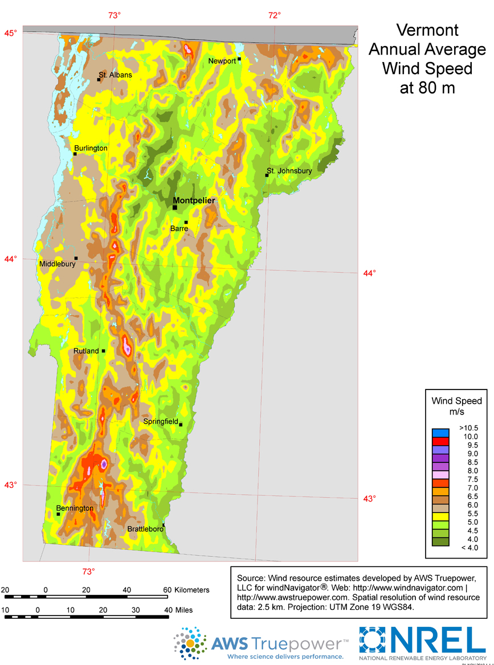
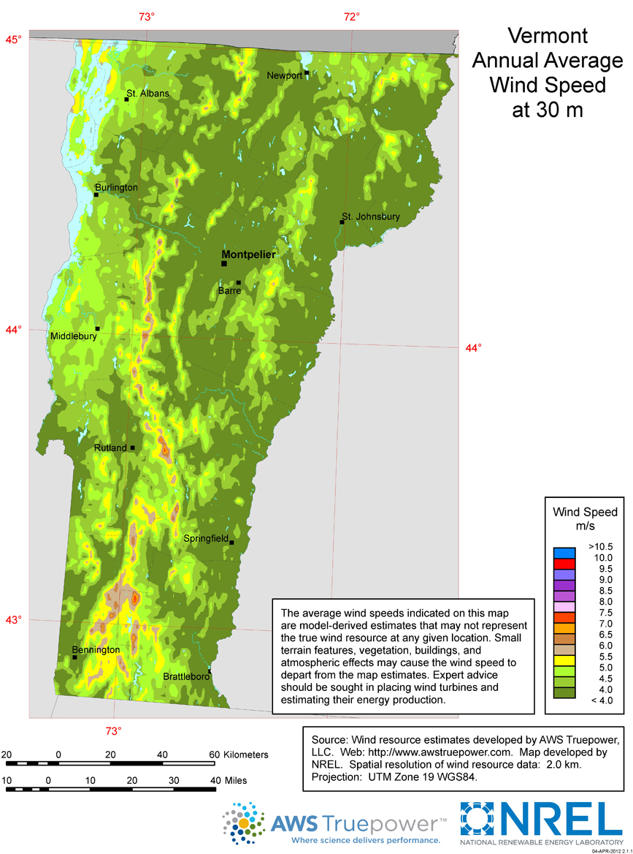
Vermont wind resources
utility-scale wind map
residential-scale wind map
Dartmouth study: total VT capacity
5-6 million MW
https://windexchange.energy.gov/maps-data/130

Slide 17
Local winds
Sea breezes: result from differing heat capacities of land and water
Mountain-valley winds: from convection as warm air rises upslope
Renewable Energy, 2/e, Chapter 7

Slide 18
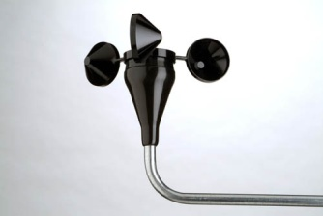
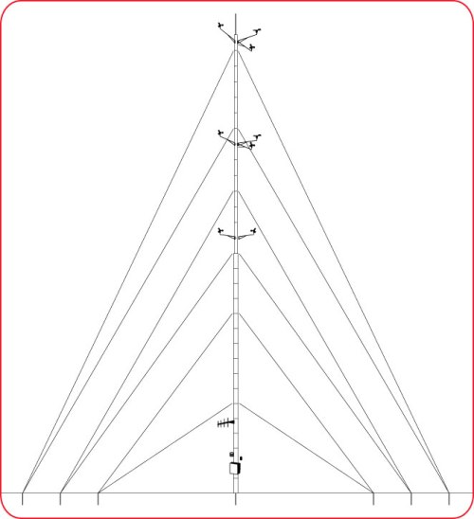
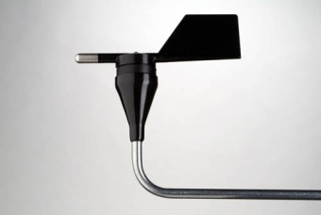
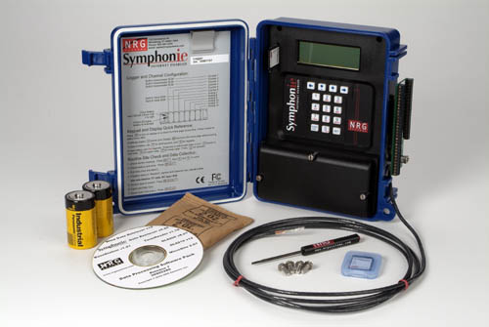
Wind prospecting on site
NRG Systems (Hinesburg, VT) is a world leader.
cup
anemometer
vane
data logger
US D.O.E

Slide 19
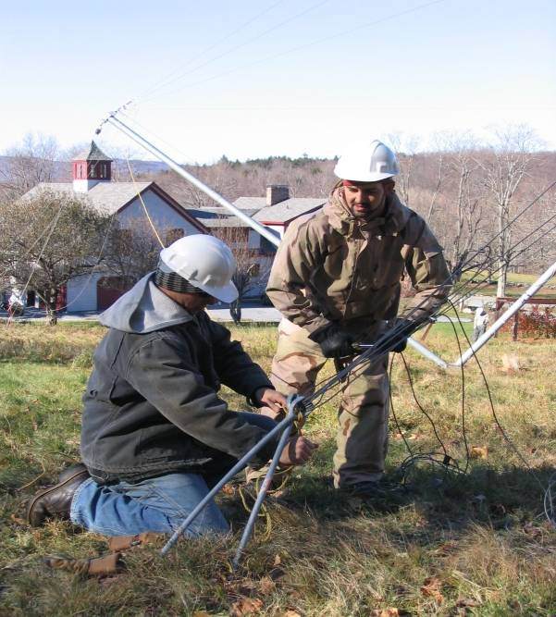
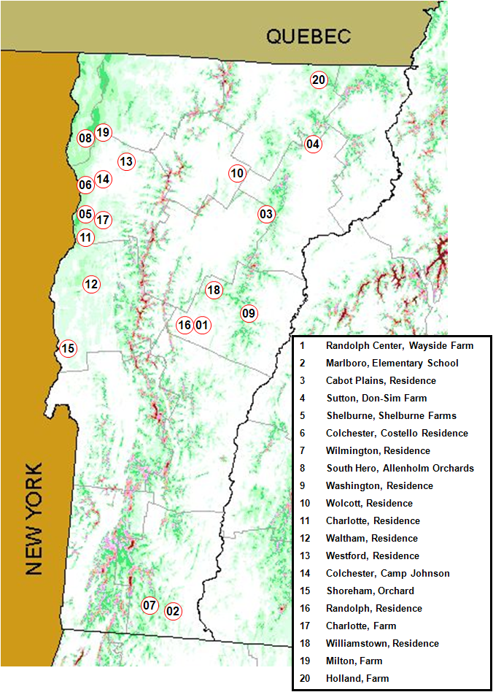
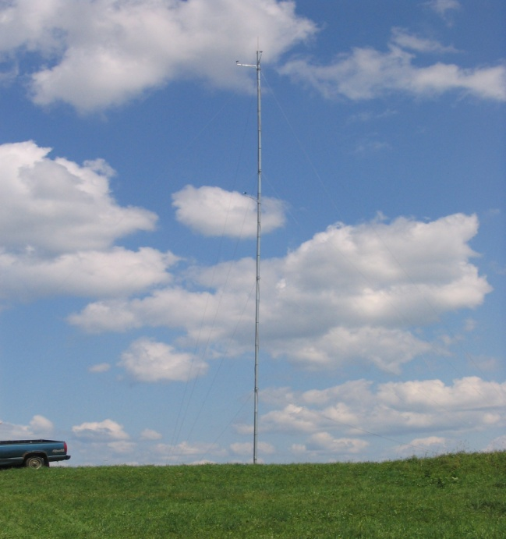
VT anemometer loan program
Residential-scale wind data?
It’s wise to measure wind resources at a site before installing a turbine.
30-m anemometer towers owned by the Vermont Tech.
Set up by students, faculty and staff.
Data made public.
http://web.vtc.edu/users/jnk06190/VTALP/index_files/Page348.htm

Slide 20
Winds are more powerful and consistent offshore
Winds offshore are stronger and more consistent.
80% of global offshore wind potential is in waters > 60 m deep.
Floating wind could power 12 million homes in Europe by 2030.
A 2017 study showed that there is enough wind power over the oceans to power the world at current capacity, if that power could be harvested.
http://www.pnas.org/content/114/43/11338.full.pdf?with-ds=yes
https://www.equinor.com/en/what-we-do/floating-wind.html

Slide 21
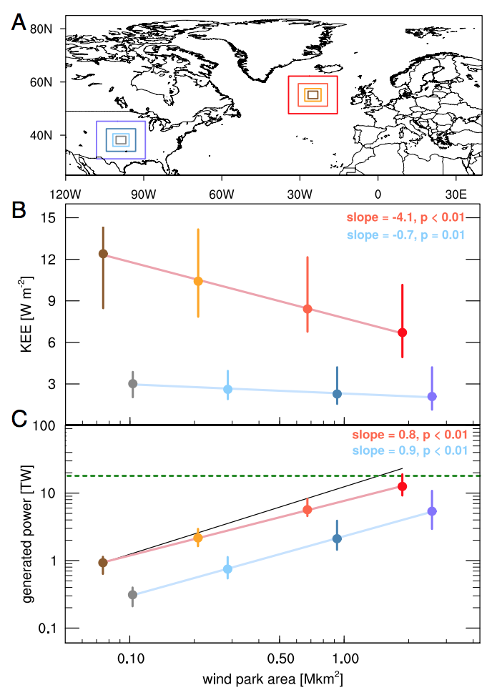
Potential of deep ocean wind
A 2017 study showed that there is enough wind power over the oceans to power the world at current capacity, if that power could be harvested.
“Nevertheless, even in the relative calm of summer, the upper geophysical limit on sustained wind power in the North Atlantic alone could be sufficient to supply all of Europe’s electricity. On an annual mean basis, the wind power available in the North Atlantic could be sufficient to power the world.”
- Posner and Caldeira (2017)
https://www.theguardian.com/environment/2017/oct/15/wild-is-the-wind-the-resource-that-could-power-the-world
http://www.pnas.org/content/114/43/11338.full.pdf?with-ds=yes

Slide 22
Module 10. Wind energy
10.3: Wind turbine designs
Renewable Energy, 2/e, Chapter 7

Slide 23
Horizontal axis wind turbines
Horizontal because the axis is horizontal; parallel to the wind.
Renewable Energy, 2/e, Chapter 7

Slide 24
Vertical axis wind turbines
Axis is vertical, or
perpendicular to the ground.
Renewable Energy, 2/e, Chapter 7

Slide 25
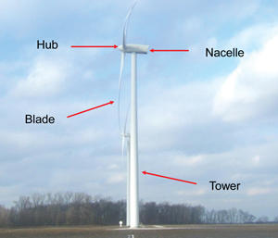
Wind power components (HAWT)
Renewable Energy, 2/e, Chapter 7

Slide 26
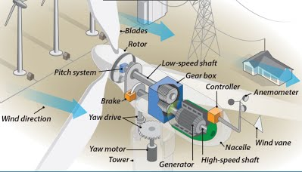
Wind power components
Renewable Energy, 2/e, Chapter 7

Slide 27
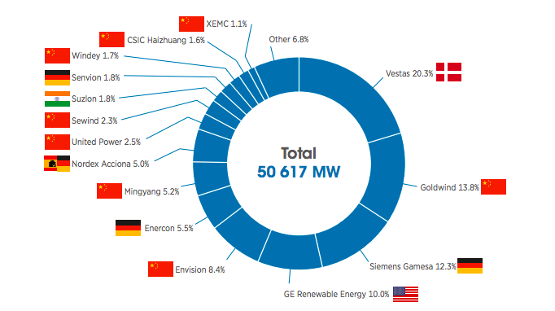
Biggest manufacturers in big wind
China: 37.6%
Denmark: 20.3%
Germany: 19.6%
US: 10%
https://www.irena.org/-/media/Files/IRENA/Agency/Publication/2019/Oct/IRENA_Future_of_wind_2019.pdf

Slide 28
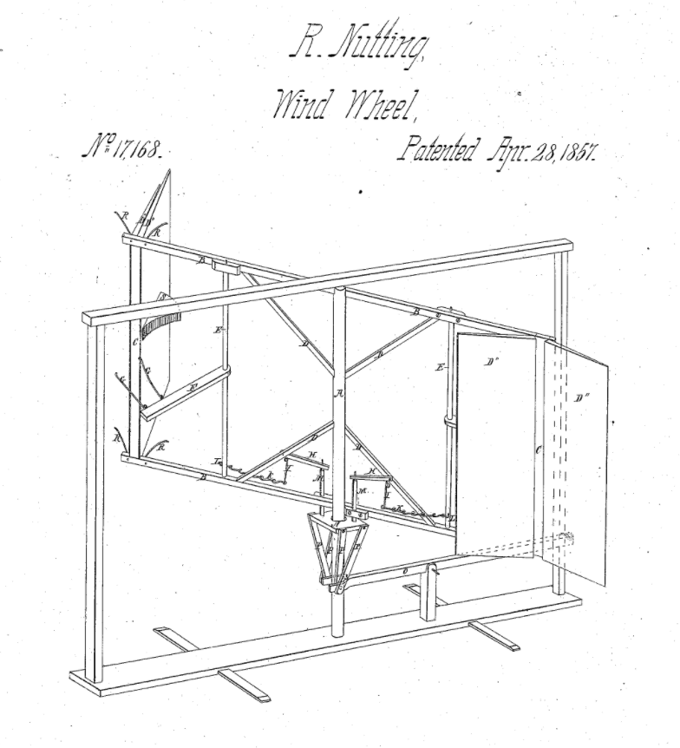
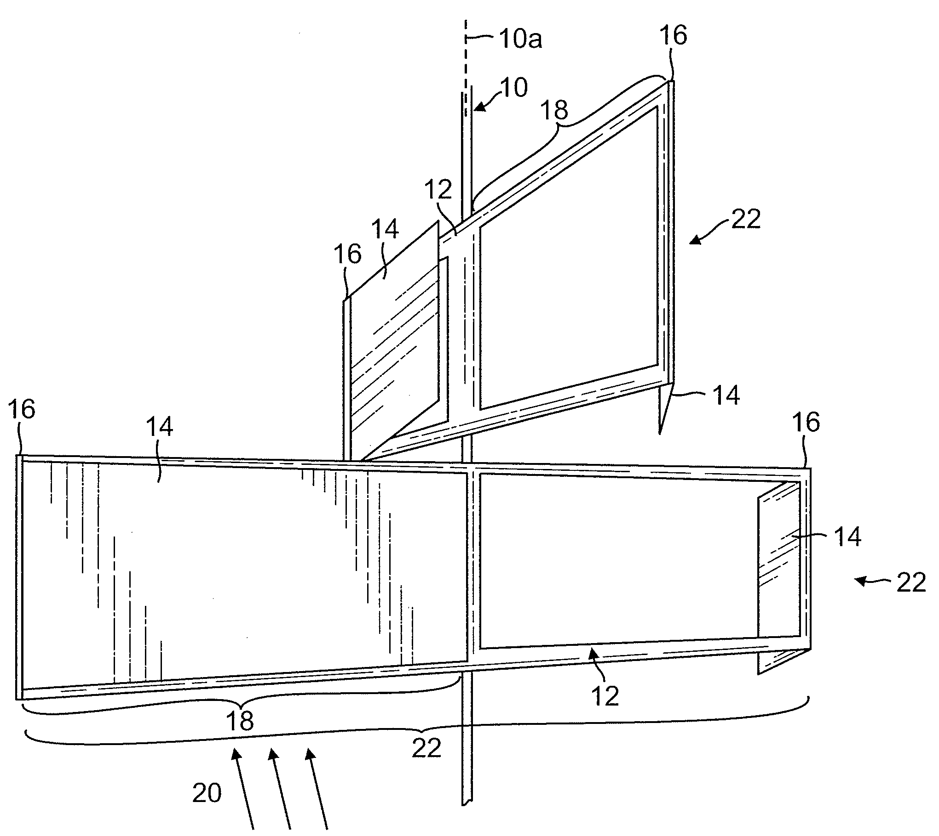
Nutting’s invention
Rufus Nutting of Randolph Center
(Nutting Hall-related)
Patent granted 1857
https://www.google.com/patents/US20090169382

Slide 29
Module 10. Wind energy
10.4: The physics of wind power and siting
Renewable Energy, 2/e, Chapter 7

Slide 30
Energy and power of wind
Wind energy is kinetic, the energy of motion.
KE = (1/2)(m)(v²)
(m/s²)
where m = ρAV
J/s = W = (1/2)(ρ)(A)(V³)
(kg/m³)
(m²)
Wind’s power depends on:
Density (ρ)
Higher at lower altitude
Higher when colder
Swept area = area of wind contact
Cube of velocity
Renewable Energy, 2/e, Chapter 7

Slide 31
Physics of wind power
swept area, A
Wind speed, v
Air density, r
C_{p ,} performance coefficient
(efficiency)
power in wind P = (½)(r)(A)(v³)
wind turbine power P = (½)(C_{p})(r)(A)(v³)
Cp – Power coefficient (efficiency)
Physical Limitation – Betz Law maximum C_{p} =0.59
Maximum of 59% of kinetic power in the wind can be converted by a wind machine
Renewable Energy, 2/e, Chapter 7

Slide 32
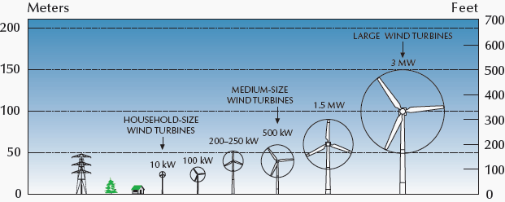
Wind power: scale, height and area
Wind power can be effective at many scales and heights, but:
Wind resources are steadier (more reliable) as height increases;
Larger turbine blades ‘harvest’ a larger area and more power;
Economy of scale so utility-scale most efficient, cost effective.
Renewable Energy, 2/e, Chapter 7

Slide 33
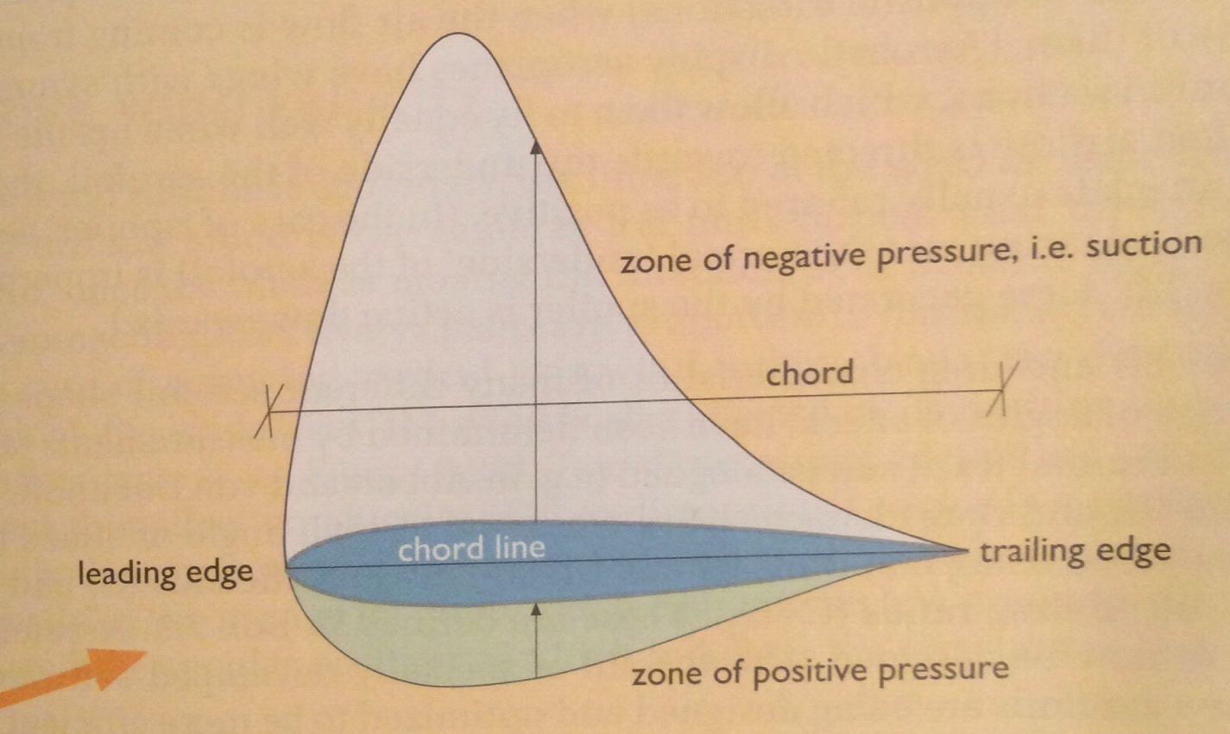
The Bernoulli effect
The Bernoulli effect can be maximized by adjusting the shape and contours of an object and optimizing its attack angle relative to the air stream.
Increasing ‘suction’ lifts or moves the object vertically relative to the air stream.
The faster the object moves, the greater the effect.
Renewable Energy, 2/e, Chapter 7

Slide 34
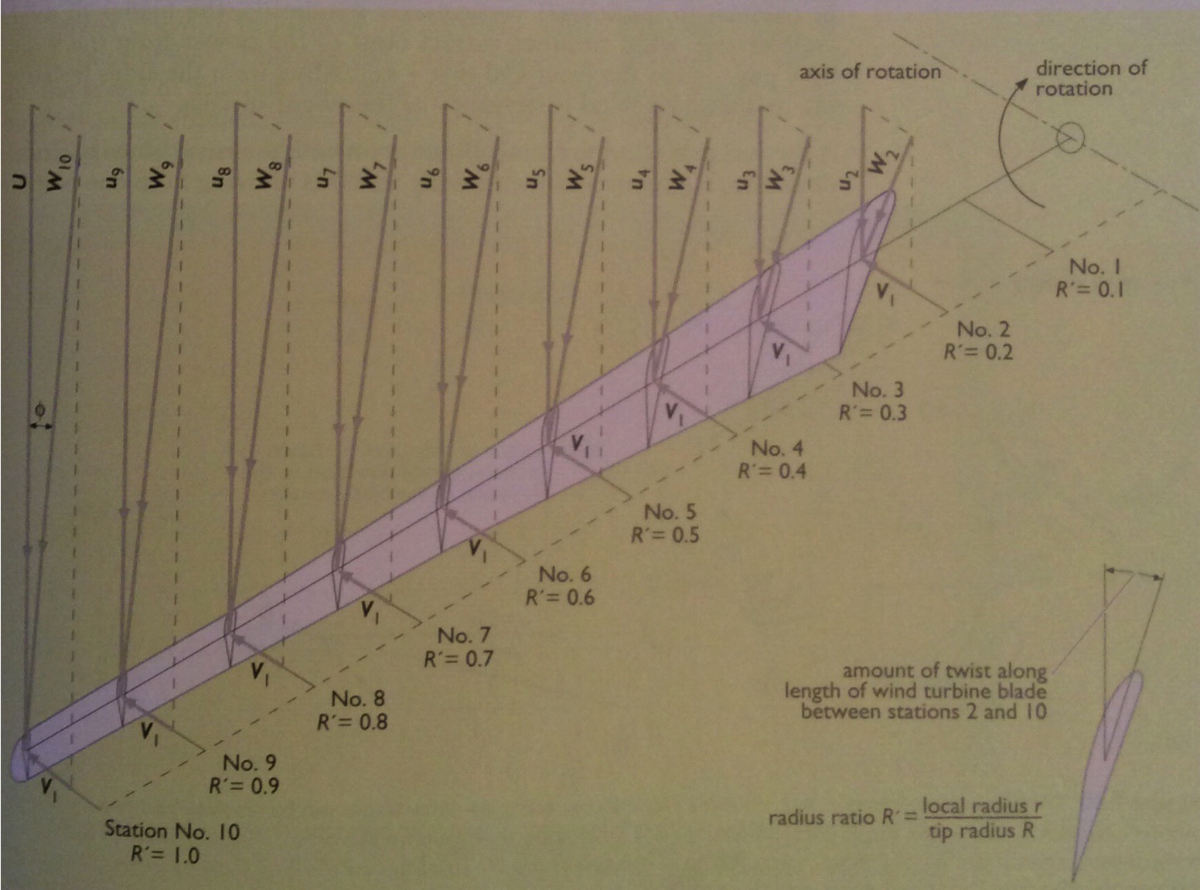
Progressive twist
In large wind, everything must be optimized for efficiency:
Creating a progressive twist along the length of turbine blades allows the blade to maintain a constant angle of attack relative to the decreasing tangential speed of the wind as it travels from blade tip toward the hub.
Renewable Energy, 2/e, Chapter 7

Slide 35
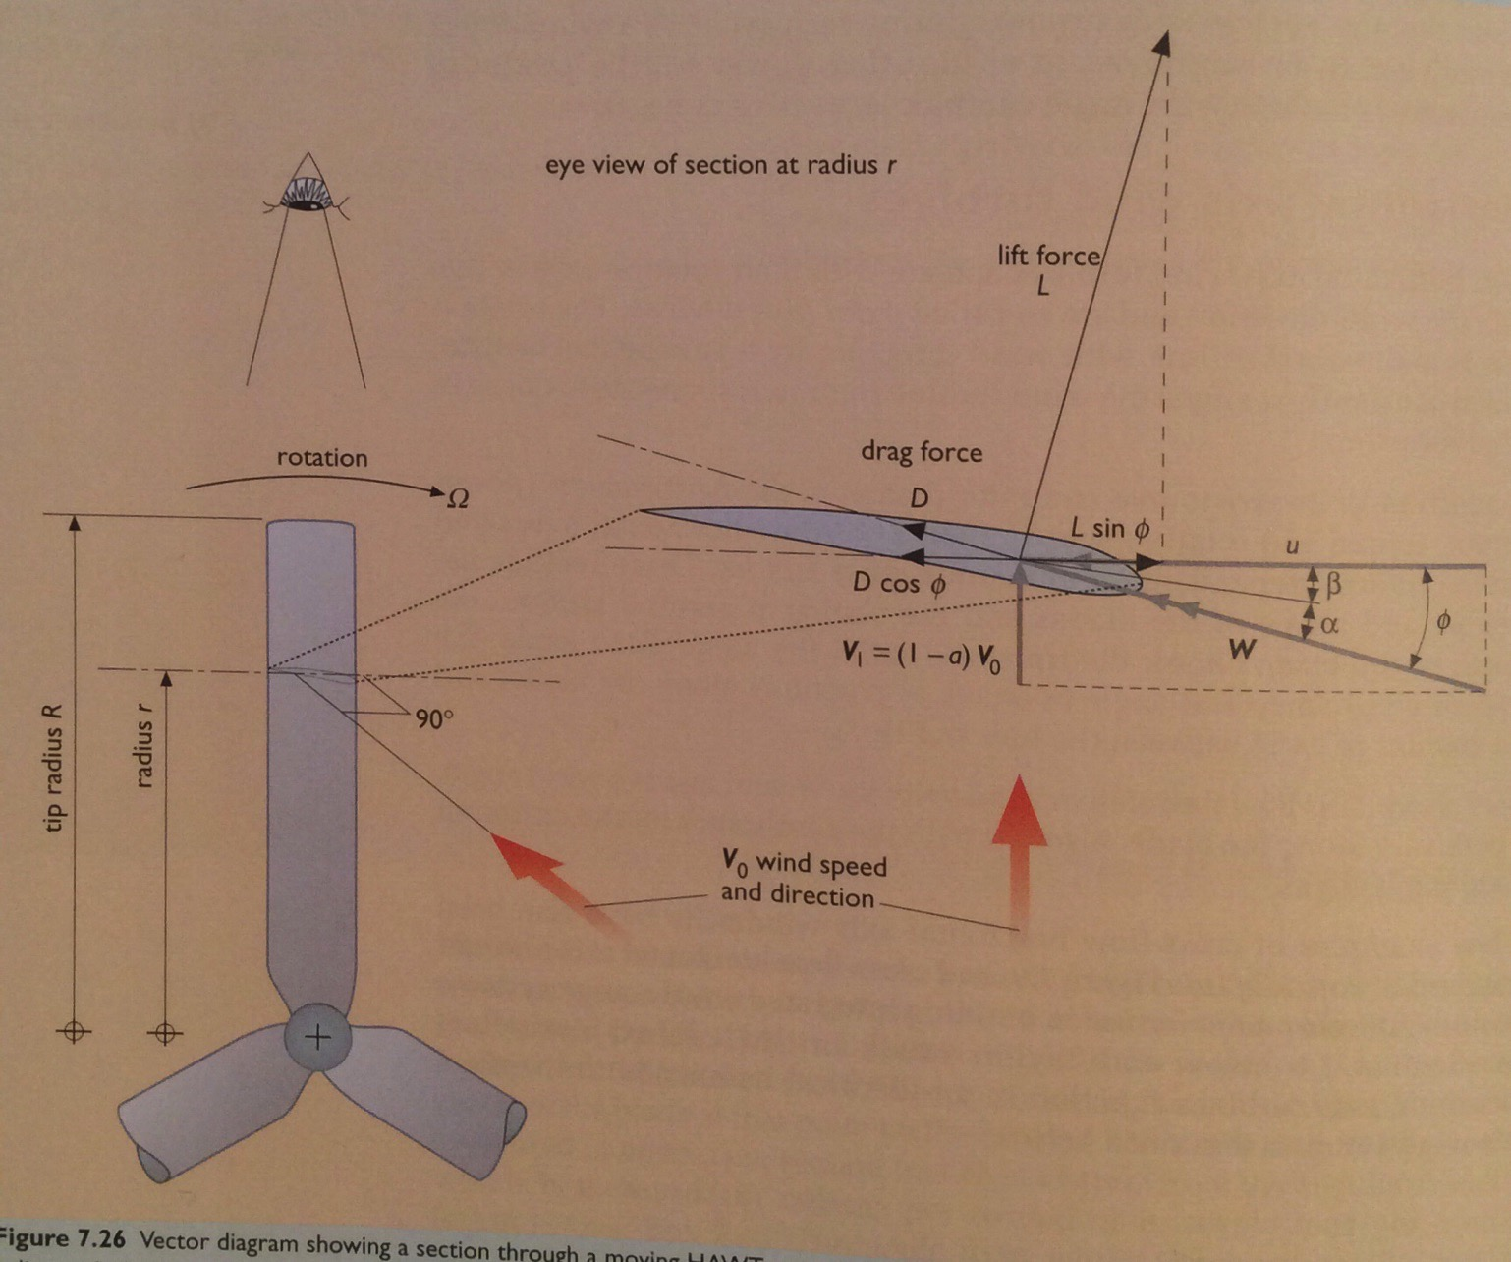
HAWT blades
A yawing mechanism keeps the horizontal axis of the rotor in line with wind direction.
Turbine performance depends on:
Wind speed; and
Blade
Length
Blade number
Blade shape and aerodynamic factors
Renewable Energy, 2/e, Chapter 7

Slide 36
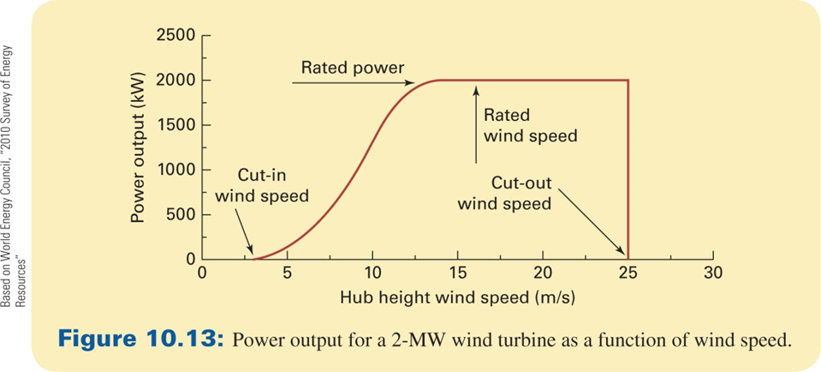
Turbine designs have unique power curves
Renewable Energy, 2/e, Chapter 7

Slide 37
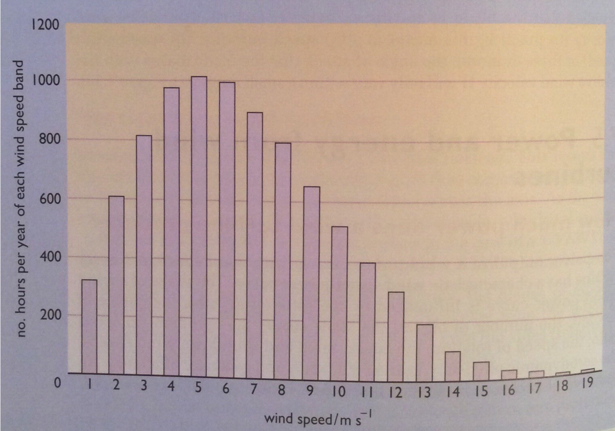
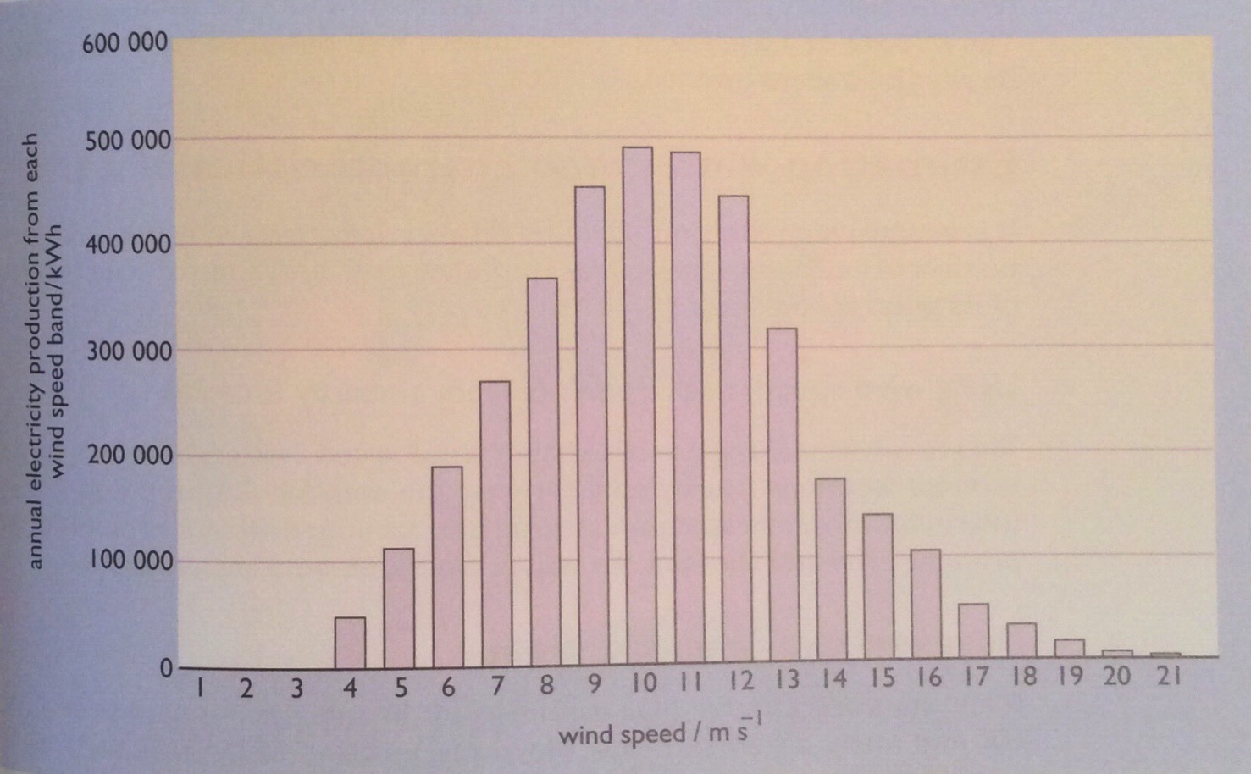
Estimating power production
If the annual wind speed at a site has been measured, estimated or modeled, a rough estimate of power generation can be made:
Annual electricity production = (K)(Vm³)(At)(T)
number turbines
3.2
swept area (m2)
annual wind speed (m/s)
Renewable Energy, 2/e, Chapter 7

Slide 38
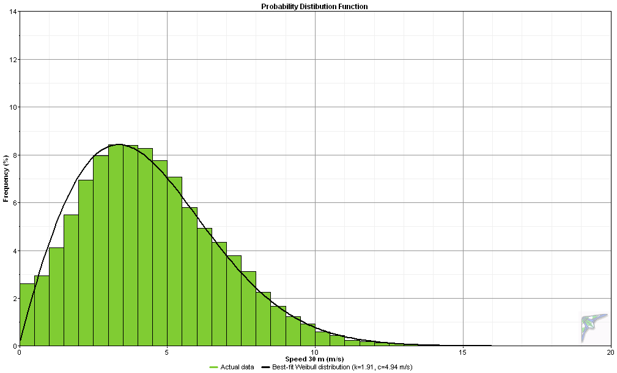
Turbine design must be tuned to local wind
South Hero, VT 2006-2007
Average wind speed at 30 m is 4.4 m/s = 9.8 mph
Frequency (% of time)
Wind Speed (meters per second)

Slide 39
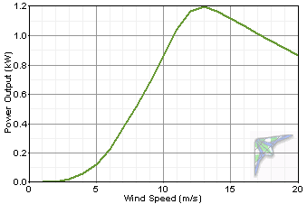
Power curve should be a match for the site
Power curve for a Bergey XL1, rated at 1 kW
South Hero: not a great match

Slide 40
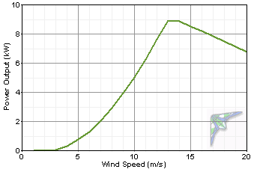
Aligning power curves, wind speed
power curve
10 kW Bergey
1.5 kW
wind speed distribution
South Hero, VT
Frequency %
5% of the hours in a year = 0.05 x 8760 hr = 438 hrs
438 hr x 1.5 kW = 657 kWh
5% of the time

Slide 41
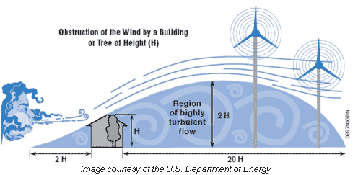
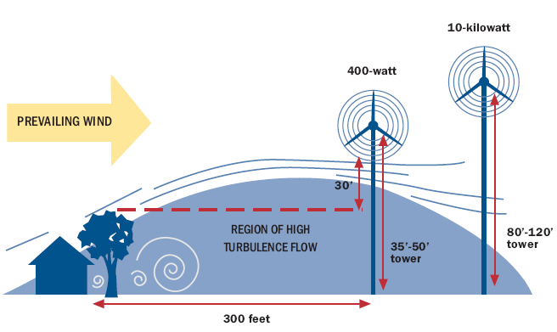
Siting, turbulence and height affect power output
Turbulence intensity: the standard deviation of wind speed divided by the mean wind speed.
This value allows for an overall assessment of a site’s turbulence.
Low levels indicated by values less than or equal to 0.10, moderate levels to 0.25, and high levels greater than 0.25.
US D.O.E

Slide 42
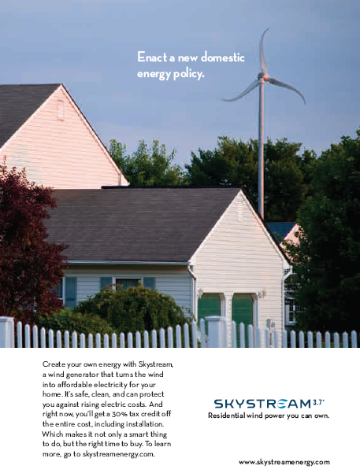
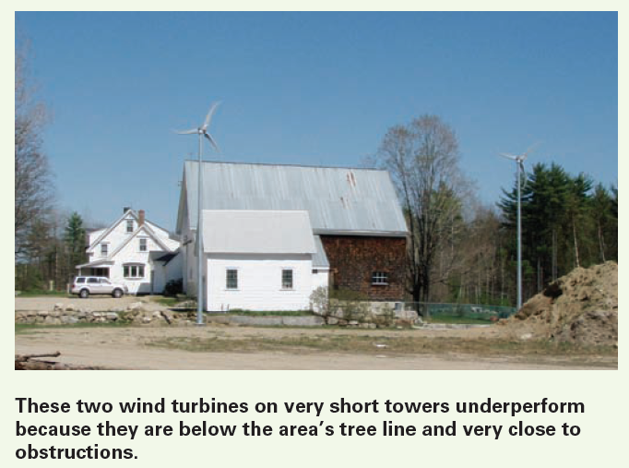
Small wind: installation is critical

Slide 43
Module 10. Wind energy
10.5: Economics of wind power
Renewable Energy, 2/e, Chapter 7

Slide 44
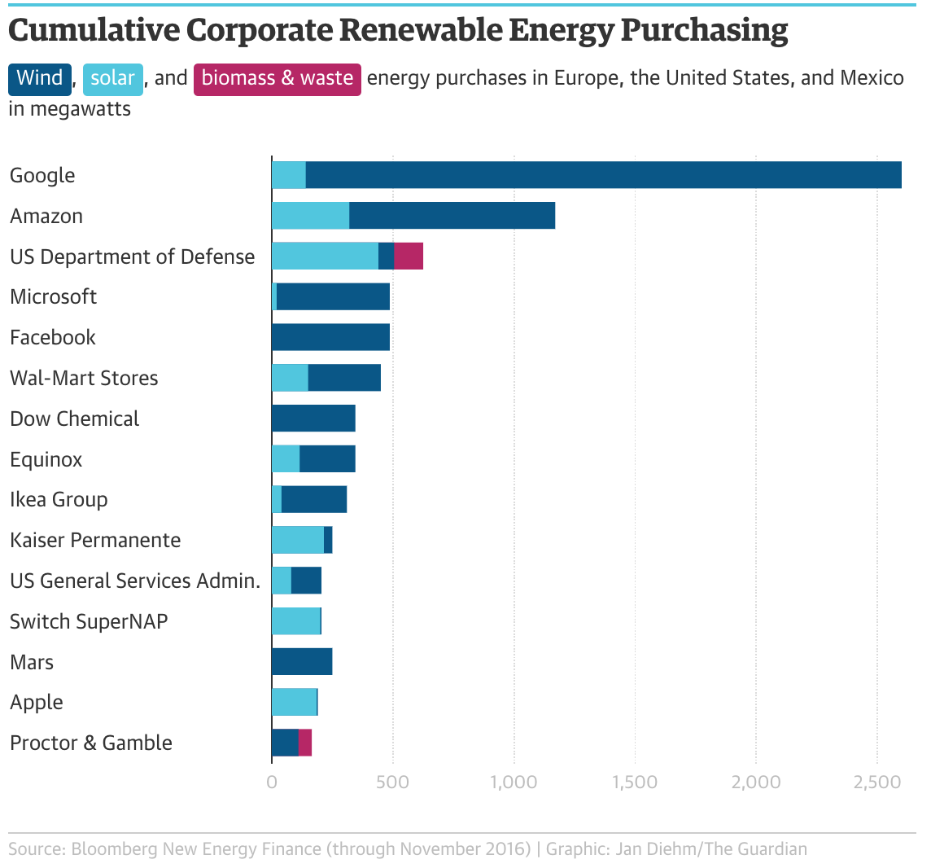
Wind is the hottest form of RE
Corporate customers prefer wind to solar when meeting renewable energy standards.
https://www.theguardian.com/sustainable-business/2016/dec/21/
solar-wind-energy-renewables-google-microsoft-amazon

Slide 45
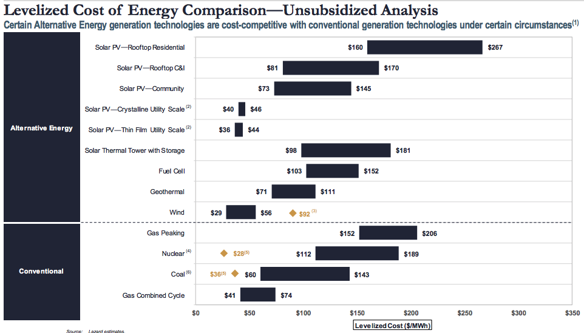
Wind is cost competitive
https://www.lazard.com/media/450784/lazards-levelized-cost-of-energy-version-120-vfinal.pdf
offshore wind

Slide 46
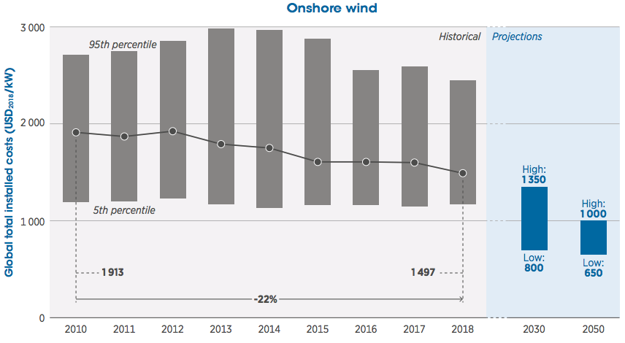
Wind’s cost has fallen and that should continue
https://www.irena.org/-/media/Files/IRENA/Agency/Publication/2019/Oct/IRENA_Future_of_wind_2019.pdf

Slide 47
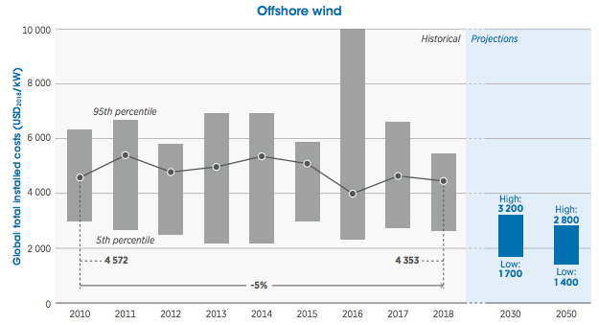
Offshore wind’s cost has fallen more modestly
https://www.irena.org/-/media/Files/IRENA/Agency/Publication/2019/Oct/IRENA_Future_of_wind_2019.pdf

Slide 48
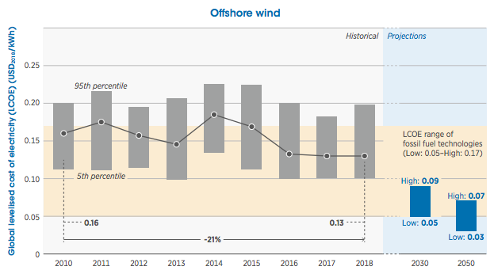
2050: offshore wind should beat fossil fuels
https://www.irena.org/-/media/Files/IRENA/Agency/Publication/2019/Oct/IRENA_Future_of_wind_2019.pdf

Slide 49
Module 10. Wind energy
10.6: Onshore wind project scale
Renewable Energy, 2/e, Chapter 7

Slide 50
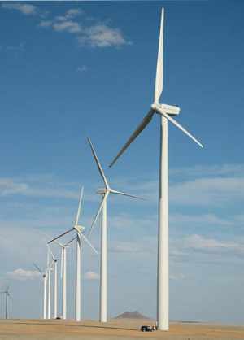
Wind power: scale
Utility-scale wind
> 1 MW
community wind
50 kW – 500 kW
small wind
1-10 kW
Renewable Energy, 2/e, Chapter 7

Slide 51
Turbine capacity and size: projected increases
As turbine size rises, capital and operational costs should continue to decrease and power production should rise.
utility scale
https://www.irena.org/-/media/Files/IRENA/Agency/Publication/2019/Oct/IRENA_Future_of_wind_2019.pdf

Slide 52
Scale of utility/commercial wind farms?
Wind farms vary dramatically in size. The largest are sited on non-arable land in remote areas.
Biggest planned onshore wind farm: Gansu Wind, Inner Mongolia, China
20 GW planned capacity
7,000 turbines
2010: 3,500 turbines; 5 GW
non—arable land
Biggest in US: Alta Wind Energy Centre (Mohave Wind farm), Tehachapi, CA
1,550 MW planned capacity
600 turbines
3,200 acres (non-arable)
Small commercial scale wind?
See Vermont (6 MW smallest project)
https://www.irena.org/-/media/Files/IRENA/Agency/Publication/2019/Oct/IRENA_Future_of_wind_2019.pdf

Slide 53
Wind power in Vermont
Georgia Mtn:
4 x 2.75 MW
11 MW total
4,200 households
Kingdom:
21 x 3 MW
63 MW total
20,000 households
Searsburg:
11 x 550 kW
6 MW total
1,600 households

Slide 54
Can VAWT increase wind farm density?
Some propose adding rows of shorter vertical-axis wind turbines (VAWT) beneath massive conventional, horizontal-axis turbines (HAWT)in wind farms in arid, non-agricultural areas.
Proposal could add 150 – 200 MW of VAWT to a 32-MW wind farm.
https://www.windpowerengineering.com/harvest-plentiful-low-level-winds-existing-wind-farms/

Slide 55
Module 10. Wind energy
10.7: Offshore wind, the real powerhouse
Renewable Energy, 2/e, Chapter 7

Slide 56
Block Island Wind (Rhode Island)
First offshore wind farm in the US, 3.8 miles off Block Island
Operations began in December of 2016
5 turbines with total 30 MW capacity (125,000 MW/year)
Includes a wildlife tracking station operated by US Fish & Wildlife, URI & UMass
Power sold to National Grid for $0.244/kWh
http://dwwind.com/project/block-island-wind-farm/

Slide 57
Floating wind is where the real potential lies
https://www.irena.org/-/media/Files/IRENA/Agency/Publication/2019/Oct/IRENA_Future_of_wind_2019.pdf

Slide 58
Hywind, Scotland: deep ocean wind
2017, Project of Statoil (since renamed to Equinor)
25 km (16 miles) off Peterhead in Aberdeenshire, Scotland at Buchan Deep
5 floating turbines
30 MW installed capacity (power for ~ 20,000 households)
https://www.statoil.com/en/what-we-do/new-energy-solutions/our-offshore-wind-projects.html

Slide 59
Equinor’s deep ocean wind technology
https://www.equinor.com/en/what-we-do/floating-wind.html

Slide 60
Equinor’s next project? Powering oil with wind
Equinor evolved from Norway’s state oil company, Statoil. While they are using Norway’s sovereign wealth fund to move into renewables, particularly deep ocean wind, they aren’t abandoning fossil fuels.
Test project for further development
140 km (87 miles) out
11 floating turbines to produce 88 MW
33% of the energy needed for 5 oil platforms
200,000 tons of CO₂ emissions avoided
https://www.equinor.com/en/what-we-do/floating-wind.html

Slide 61
Offshore turbines are expected to grow in size
https://www.irena.org/-/media/Files/IRENA/Agency/Publication/2019/Oct/IRENA_Future_of_wind_2019.pdf

Slide 62
Deep ocean wind is looked to as the big powerhouse
“Nevertheless, even in the relative calm of summer, the upper geophysical limit on sustained wind power in the North Atlantic alone could be sufficient to supply all of Europe’s electricity.
On an annual mean basis, the wind power available in the North Atlantic could be sufficient to power the world.”
- Posner & Caldeira (2017)
https://www.theguardian.com/environment/2017/oct/15/wild-is-the-wind-the-resource-that-could-power-the-world
http://www.pnas.org/content/114/43/11338.full.pdf?with-ds=yes

Slide 63
What developments would boost offshore wind?
https://www.irena.org/-/media/Files/IRENA/Agency/Publication/2019/Oct/IRENA_Future_of_wind_2019.pdf

Slide 64
Module 10. Wind energy
10.8: Downsides of wind power
Renewable Energy, 2/e, Chapter 7

Slide 65
Barriers to the growth of wind?
https://www.irena.org/-/media/Files/IRENA/Agency/Publication/2019/Oct/IRENA_Future_of_wind_2019.pdf

Slide 66
Environmental effects of wind
Noise: is a local concern for residents living within a kilometer or so of the wind turbine. Infrasonic sound has been raised as an issue.
2. Effect on wildlife
3. Effect on land use
4. Aesthetics: a concern associated with virtually all energy production methods.
5. Accidents: can result from turbine failure e.g. generator fires, tower collapse or blade breakage (or a combination of these).
6. Carbon footprint: Is it really zero?
7. What about waste and recycling?
Renewable Energy, 2/e, Chapter 7
http://www.ucsusa.org/clean-energy/renewable-energy/environmental-impacts-wind-power#.WiWxvbQ-eHo

Slide 67
Effects on wildlife?
In operation, wind turbines can kill birds that fly through them.
2020 2-year Danish study found that 99.9% of geese and cranes took evasive action.
The study’s wind farm is located in a nature reserve with high bird populations.
Estimates of wind power kills are 20,000 – 573,000 bird kills per year.
Oil fields: 1 million /year
Building like skyscrapers: 1 billion / year
Ridge-top wind installations can degrade a rare and special habitat for animals like bear and moose or birds like the hermit thrush.
Roads to construction sites fragment large habitat blocks and can lead to more development.
1 black blade cuts bird deaths by 70%
NREL
https://arstechnica.com/science/2020/08/black-paint-on-wind-turbines-helps-prevent-bird-massacres/#:~:text=According%20to%20a%20study%20conducted,the%20number%20of%20bird%20deaths
https://group.vattenfall.com/contentassets/36627206e80942949cf3f5e1ab2a7601/klim-vindmollepark_monitering-af-kollisioner_endelig-rapport_resume_160120.pdf

Slide 68
Wind’s carbon footprint?
In operation, wind turbines emit no carbon while producing power.
Of course, production and disposal of wind power equipment does have a carbon footprint.
90X less than coal
40X less than NG
NREL
g CO₂/kW

Slide 69
Land use
Wind turbines require more land per MW than solar energy:
Wind: 30 – 141 acres / MW
Solar PV: ~8 acres / MW
Wind’s footprint is large (more so on flat land) because turbines need to be separated by 5-10 rotor diameters.
<1 acre / MW for the turbine.
<3.5 acres / MW disturbed in installation.
‘Free’ land within the wind farm can be used for other purposes:
Agriculture, transportation, recreation
More resilient farm income and rural communities
Renewable Energy, 2/e, Chapter 7
http://www.ucsusa.org/clean-energy/renewable-energy/environmental-impacts-wind-power#.WiWxvbQ-eHo

Slide 70
Do turbines increase crop growth?
Agricultural researchers are studying co-farming of wind and crops in the Midwest to determine whether the presence of turbines affects crops.
There is reason to think that wind power might help crops:
Turbines create wakes, or movement and mixing of air.
Wakes may:
Push consistent CO₂ to crops;
Dry humid air or dew, discouraging fungi and pests;
Cooler daytime; and
Warmer night time temperature.
http://www.noaanews.noaa.gov/stories2011/images/vattenfall-image_300.jpg
https://news.nationalgeographic.com/news/energy/2011/12/111219-wind-turbines-help-crops-on-farms/
https://ace.illinois.edu/sites/ace.illinois.edu/files/JMP_V6_upload_V2_0.pdf

Slide 71
Not all farmers like wind
In Iowa wind produces 36% of electricity and it’s still growing. Many farmers are affected, and some aren’t happy. The unhappy tend to be:
Neighbours of wind farms; or
Tenant farmers with wind.
In Iowa, 97% of wind is owned by utilities and large developers.
Only 3% is community wind.
Complaints?
Heavy equipment brought in to install turbines breaks drainage tiles, damaging crops or making it hard to crop.
Towers interfere with crop dusting.
Worry about catastrophic turbine failure
Wind turbine syndrome
Wind operators seem more like overlords then neighbours.
Easements restrict what can be done on farms and properties.
http://www.slate.com/articles/technology/future_tense/2017/08/why_farmers_in_iowa_hope_wind_energy_will_blow_over.html

Slide 72
Wind does affect (local) climate
Both direct evidence and models suggest that large wind farms have slight effects on local, and to some extent, regional climate.
The effects appear to be tiny in comparison to GGC.
Direct measurement of temperatures within a large Texan wind farm showed a 0.5° increase in night-time temperatures.
Several modeling studies of large wind farms have come to similar conclusions.
Models were run many times both with & without wind farms.
Wind farms caused winds to divide & flow around the wind farm. This diversion caused:
about 0.5° temperature increases (to the north) and deceases (to the south); and
A few percent changes in precipitation.
Q: What mix of sustainable energy technologies will cause the least change to our climate?
theconversation.com/wind-power-affects-climate-cooling-and-warming-regions-around-farms-studies-claim-22988

Slide 73
Offshore wind effects on oceans?
The bases of offshore wind have the most immediate impact on ocean ecosystems.
German researchers have shown beneficial impacts on marine ecosystems.
One tower can support the growth of 4 tonnes of blue mussels which filter water.
Wind towers introduce a population of mussels (~20% of coastal populations) at sea
Longer-term results?
Mussels will concentrate nutrients and provide a foundation for a more complex ecosystem.
Towers ‘protect’ their locales from drag fishing.
But, ‘new’ biodiverse ecosystems may provide habitat for alien species.
https://www.technologyreview.com/s/608930/first-evidence-that-offshore-wind-farms-are-changing-the-oceans/

Slide 74
Wind’s waste stream
While about 85 – 90% of a wind turbine’s mass can be recycled (steel, copper), the blades are made of mixed composite materials (resin and fiberglass) and present a huge recycling challenge.
720,000 tons of blades must be recycled over the next 20 years
https://www.wind-watch.org/news/wp-content/uploads/2020/05/28085540-8294057-image-a-4_1588793478933.jpg
https://www.npr.org/2019/09/10/759376113/unfurling-the-waste-problem-caused-by-wind-energy

Slide 75
Recycling and next-gen blade material
Today:
Blades are landfilled;
Blades are crushed and used as fuel in cement plants in place of fossil fuels; or
Crushed, processed and used a component of recycled EcoPoly pellets for manufacturing.
Solutions?
Enact policy that requires blade recycling;
Scale-up recycling and provide incentives to make it pay; and
Fund and require materials science R&D to create blades that are easier to recycle into new blades or other RE infrastructure.
NREL: working on next-gen thermoplastic blades which can be recycled by heating
https://energypost.eu/recyclable-wind-turbine-blades-thermoplastic-next-generation/
https://www.evwind.es/2020/05/26/strategies-for-the-recycling-of-wind-turbine-blades/74876
https://www.npr.org/2019/09/10/759376113/unfurling-the-waste-problem-caused-by-wind-energy

Slide 76
Module 10. Wind energy
10.9: Public attitudes towards wind power?
Renewable Energy, 2/e, Chapter 7

Slide 77
Most Americans favor more wind power
While Americans can have pretty NIMBY attitudes towards many things the vast majority favor increased use of solar and wind power.
https://pv-magazine-usa.com/2019/11/26/92-percent-of-americans-want-moar-solar-power/

Slide 78
Vermont’s attitude to wind power
Solar is popular and only the largest projects are opposed on the grounds that they look large and industrial & may occupy agricultural lands.
A 2016 survey showed that 75% of Vermonters want more solar in their communities.
Democrats: 87%
Independents: 67%
Republicans: 56%
Wind is a bit less popular.
A 2013 survey showed that 66% of Vermonters support ridgeline wind development. Support was age dependent:
18 - 34: 73%
35 - 54: 68%
55 → : 61%
Support for government subsidies for RE split politically:
Democrats: 77%
Independents: 67%
Republicans: 49%
vtdigger.org/2016/02/19/survey-shows-75-percent-of-vermonters-want-more-solar/
www.castleton.edu/about-castleton/the-castleton-polling-institute/poll-results/castleton-poll-examines-vermonters-views-on-wind-power/

Slide 79
Vermont: Who should decide?
A Vermont Public Radio poll asked who should make decisions about large wind power development.
67% trust the Public Service Board (PSB)
12% say that the PSB should have final say on locating turbines
Is that contradictory? Not necessarily….
"It's just that their preference would be to have the decisions more local. Vermonters tend to think very well of their state government. But if you look there, they prefer the local to the state.” - Rich Clark, pollster
So who should make the final decision?
39% say landowners should decide
34% say communities should vote
← But 59% of Republicans
← But 42% of ‘left leaning’
PSB support depends on location and likelihood of local big wind.
Chittenden county more strongly supports PSB (local wind not likely)
Southern Vermont (large wind target) supports the PSB less.
http://digital.vpr.net/post/vpr-poll-large-scale-wind-vermonters-are-split-over-local-control#stream/0

Slide 80
Wind stirs passion in Vermont
‘People who hate wind power in Vermont really hate wind power. That is a statement I will ask you to remember.’
A woman broke into the property of a wind developer (caught on camera) and left a deer’s head at the gate. The developer saw this as a threat.
‘Deer wind developer, we hate you, with a burning passion."
August 2015: Pownal fire department planed a 150-kW solar array, sited on on a 5-acre brownfield, to power a pumping station.
30 people ‘stormed’ the a project meeting demanding records.
They were concerned that the arrays would leach toxins into water.
Ironically, it was soon discovered that all wells in Pownal were contaminated… with PFOA from manufacture of coated wire.
https://cleantechnica.com/2017/05/24/whats-wind-power-vermont/

Slide 81
Causation: turbines or opponents?
Studies of the effects of wind turbines on human health have not conclusively shown an effect. More and better work is needed.
However, several studies suggest that worry and anxiety about the possible health effects of wind can cause human health problems.
Example:
Sham-controlled, double-blind study of 54
Exposed to 10’ of infrasound or sham infrasound…
... After exposure to audio or internet presentations that suggested infrasound was either safe or hazardous
Results:
Those who were exposed to materials that suggested infrasound was dangerous experienced more frequent and intense symptoms when exposed to either infrasound or sham infrasound.
Those told that infrasound was not hazardous did not experience symptoms after exposure to infrasound or sham infrasound.
https://cleantechnica.com/2017/05/24/whats-wind-power-vermont/
http://psycnet.apa.org/record/2013-07740-001

Slide 82
Utilities aren’t buying new wind
In 2015 - 2017, Vermont’s utilities, Green Mountain Power (GMP) and Vermont Electric Cooperative declined to sign contracts for new wind power developments.
Why?
Felt they had enough wind in their power portfolios, and enough energy for customers.
Focused on small-scale generation close to need.
Buying more Vermont wind would force them to buy less from Hydro Quebec, a less expensive source.
Perhaps unwilling to take on projects with local opposition?
Developers may resort to PURPA, the federal Public Utilities Regulatory Act, which requires utilities to buy power from qualified developers at long-term contracts equal to prices the utility would pay elsewhere.
www.sevendaysvt.com/vermont/power-struggle-vermont-utilities-dont-want-new-wind-energy/Content?oid=2933555
www.wind-watch.org/news/2017/03/01/kidder-hill-wind-gmp-vec-dont-want-wind-power-now/

Slide 83
Small wind? Starwind turbines (Dorset, VT)
Can small wind overcome opposition in Vermont?
SWT 12, 24, & 36 kW models
full feathering articulating blades
low noise
efficient low-wind performance
hydraulic wind turbine tower

Slide 84
Offshore controversy: Cape Wind
The Cape Wind project was one of the first offshore wind projects proposes in the US.
130 turbines at 3.6 MW each
486 MW potential
$2.6 b
State, local and federal approvals were a struggle but were obtained 2005 – 2011.
Controversy involved aesthetics and environmental impact. Opposition:
Walter Cronkite (changed his mind)
Ted, Robert Kennedy Jr. (not Joe Jr.)
John Kerry
Mitt Romney
Bill Koch
Some argued that opposition… involves a powerful, privileged minority imposing their will on the majority. As a whole MA and even sometimes the cape were in favor.
Funding had been secured but fell through due to opposition.
https://en.wikipedia.org/wiki/Cape_Wind

Slide 85
Module 10. Wind energy
10.10: What role might wind play in energy system transition?
Renewable Energy, 2/e, Chapter 7

Slide 86
The potential of wind to mitigate GCC?
Some argue that wind could displace 27% of current global carbon emissions.
Requires 6,000 GW of wind power (up from out current 500 GW)
https://www.irena.org/-/media/Files/IRENA/Agency/Publication/2019/Oct/IRENA_Future_of_wind_2019.pdf

Slide 87
Onshore deployment would have to increase X5
https://www.irena.org/-/media/Files/IRENA/Agency/Publication/2019/Oct/IRENA_Future_of_wind_2019.pdf

Slide 88
Offshore deployment would increase exponentially
To meet energy goals, offshore wind would have to increase:
6X by 2030
10X by 2050.
https://www.irena.org/-/media/Files/IRENA/Agency/Publication/2019/Oct/IRENA_Future_of_wind_2019.pdf

Slide 89
Investments in wind would also have to rise
https://www.irena.org/-/media/Files/IRENA/Agency/Publication/2019/Oct/IRENA_Future_of_wind_2019.pdf

Slide 90
Non-wind investments would also be needed
https://www.irena.org/-/media/Files/IRENA/Agency/Publication/2019/Oct/IRENA_Future_of_wind_2019.pdf

Slide 91
Redesigned power system to integrate more RE
https://www.irena.org/-/media/Files/IRENA/Agency/Publication/2019/Oct/IRENA_Future_of_wind_2019.pdf

Slide 92
Module 10. Wind energy
Summary
Renewable Energy, 2/e, Chapter 7

Slide 93
Wind power summary
Wind turbines extract energy from moving air and convert it into electrical energy
Power from system is proportional to wind speed (to v³).
Different wind turbine geometries have different efficiencies
Available wind energy depends on location
Wind power systems can be residential, community, or utility scale
Large differences in the smaller and larger systems
Wind metrology is critical for site assessment – months or years
Generally available wind energy increases with altitude and distance offshore
Wind farms combine numerous turbines placed to optimize power production

