Slide 1

SSC 2030: Energy Systems and Sustainability
Module 11. Electricity, grids and storage
11.1: Development of electricity in the 19th century
11.2: Electrify everything (transportation, heating)
11.3: Current transmission and distribution;
11.4: Modernizing the grid – integrated macrogrid
11.5: Modernizing the grid – smart microgrids
11.6: Modernizing the grid – Denmark vs. US vs. Vermont
11.7: Global electricity generation
11.8: Electricity storage – the holy grail for intermittent RE

Slide 2
Module 11. Electricity, grids and storage
  11.1: Development of electricity in the 19th century

Slide 3
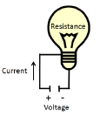
Electrical energy - a quick review
Current: flow of electrons (Amp, A; I)
Voltage: electrical pressure (Volts, V)
Resistance: acts like friction, slows flow (Ohms, Ω; R)
Property of electric material or device.
Governs how much current will flow when a voltage is applied.
Transmission wire has resistance.
V = (I)(R)
I = V/R
power (P) = (V)(I) = I²R
Energy Systems and Sustainability, 2/e, Chapter 9

Slide 4
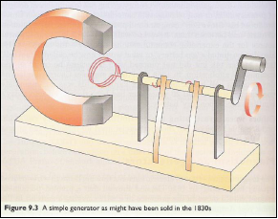
Electric motors and generators
Electric current is induced by the change of the magnetic field in a coil.
The crank moves the coil in the field produced by the magnet.
The metal springs that contact the
rotating shaft pick up the current
and allow it to be harvested.
This device makes alternating
current (AC).
Addition of a commutator allows
production of direct current (DC).
Energy Systems and Sustainability, 2/e, Chapter 9

Slide 5
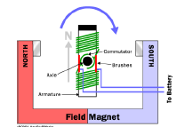
Generator vs. motor?
What’s the difference between a generator and a motor?
Generator: rotating coils of wire through a magnetic field induces a current in the wire, producing electricity
Motor: running a current through a wire produces forces that can cause rotation, or mechanical motion, thus work
generator
So generators produce electricity while motors do work.
Energy Systems and Sustainability, 2/e, Chapter 9

Slide 6
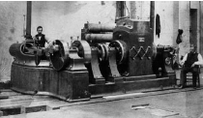
Mains electricity
Thomas Edison developed:
The electric light bulb; and
Steam-powered dynamos capable of converting mechanical energy into electrical energy.
Mains electricity: the general purpose electric supply
Edison set up the first power distribution system using DC current.
Used batteries to meet peak power demand.
Energy Systems and Sustainability, 2/e, Chapter 9

Slide 7
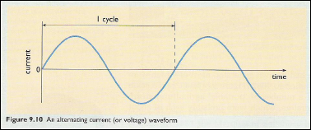
Alternating current (AC) vs. direct current (DC)
Direct current: current that runs continually in a single direction
  Example: from a battery or fuel cell
  Championed by Edison and the early US standard
  **Not easily converted to higher and lower voltages
Alternating current: reverses direction a number of times per second; US = 60/s (Hz)
  Can be converted to different voltages using a transformer.
  Championed by Nikola Tesla and George Westinghouse
‘War of the currents’ in the 1890s.
AC won.
DC is making a comeback for
more efficient long-distance transmission.
Energy Systems and Sustainability, 2/e, Chapter 9; https://energy.gov/articles/war-currents-ac-vs-dc-power

Slide 8
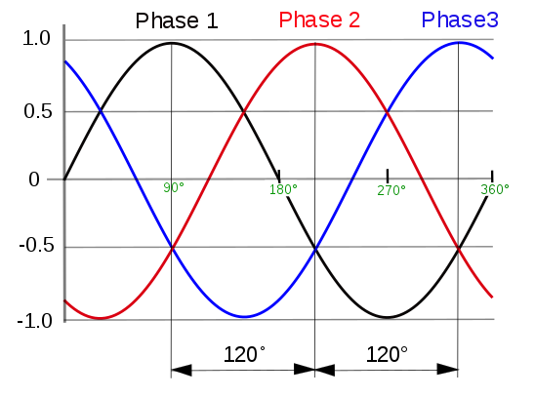
AC and three-phase power
Three-phase power: a poly-phase power distribution used for AC power generation, transmission and distribution
Late 1880s
Uses less conductor material
Consistent supply of power (average peak)
Generated and transmitted at high voltage and then stepped down for local use.
Energy Systems and Sustainability, 2/e, Chapter 9;
wikipedia

Slide 9
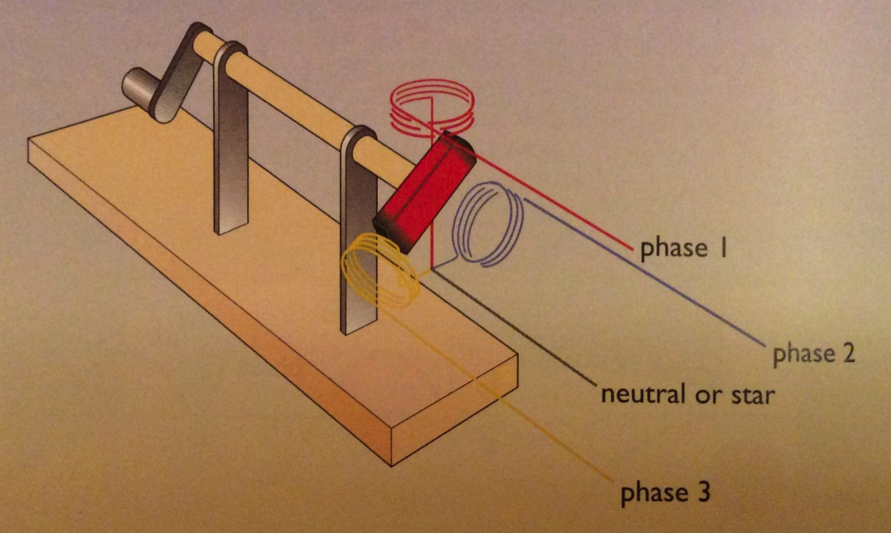
Three-phase power: generation
Alternator: three coils of wire are placed around a rotating magnet;
each coil will produce a cycling voltage as the magnet passes it.
The three voltages will be ‘out of phase’ with one another.
Energy Systems & Sustainability, 2/e, Chapter 9

Slide 10
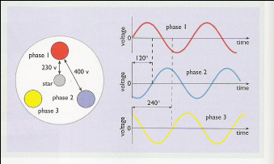
Three-phase power: uses
Three-phase power is used for ‘heavy’ uses of electricity:
Long-distance transmission of electricity;
Industrial motors;
Some household uses
Energy Systems and Sustainability, 2/e, Chapter 9

Slide 11
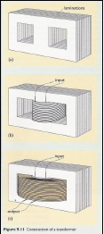
Transformers change voltage
Transformer: an electrical device that transfers energy between two or more circuits through electromagnetic induction
Transformers have two sets of ‘windings’.
A magnetic field in one set of windings produces voltage in the second set of windings.
Voltage is ‘stepped’ up or down.
Vs = Ns
Vp Np
Vs = voltage in secondary windings
Ns = number turns in secondary windings
Vp = voltage in primary windings
Np = number of turns in primary windings
Energy Systems and Sustainability, 2/e, Chapter 9

Slide 12
Transformers play a critical role in distribution
Transmission of electricity is more efficient and less expensive at higher voltages: smaller wire is needed and loss still leaves useful power.
DC power can’t be stepped up and down, so must be transmitted at the voltage needed by the end user.
  This would take a very thick cable.
  Distance of transmission limited to about 2 km.
AC power can be stepped up and down with transformers so it can be distributed at > 400 kV more efficiently and only stepped down at the point of use.
US: overhead transmission at 220 kV; underground at 132 kV
  Very long-distance transmission uses 800 kV or more
Energy Systems and Sustainability, 2/e, Chapter 9

Slide 13
Module 11. Electricity, grids and storage
  11.2: Electrify everything (transportation, heat)

Slide 14
Electrifying everything: we’ll need far more power
Saul Griffith’s ‘Rewiring America’ plan shows how much electricity we’ll have to generate and move.
biggest new loads:
transportation
heating
biggest new loads:
transportation
heating
biggest new loads:
transportation
heating
Rewiring America

Slide 15
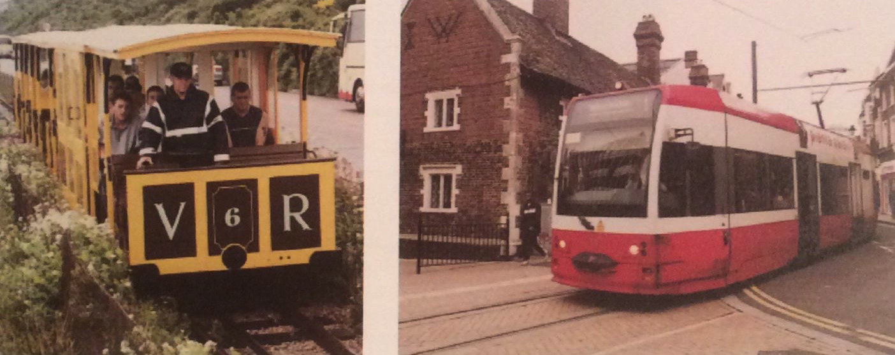
Electric transportation: electric trams
The first electric supply systems (grids) were built to supply lighting. But while lighting was used mainly at night, electricity had to be generated all day in order to serve the system.
What to do with electricity produced during daylight hours?
Transportation in cities!
Electric transportation cut down on horse pollution.
Horse-draw trams were electrified in the 1880s through early 1914.
Petro-fueled buses have replaced some electric systems.
Energy Systems and Sustainability, 2/e, Chapter 9

Slide 16
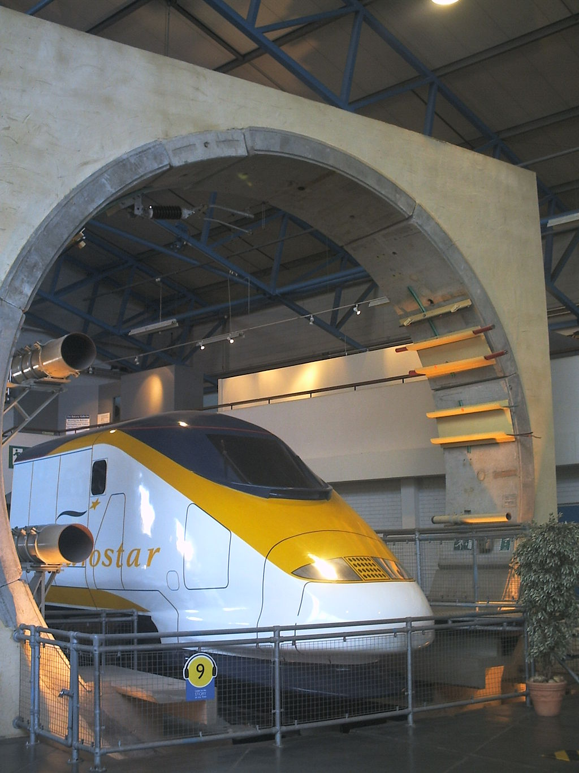
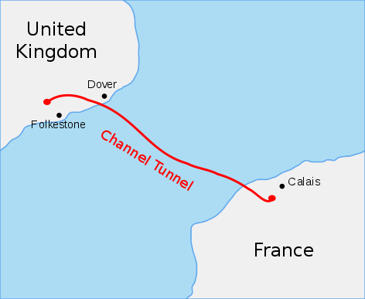
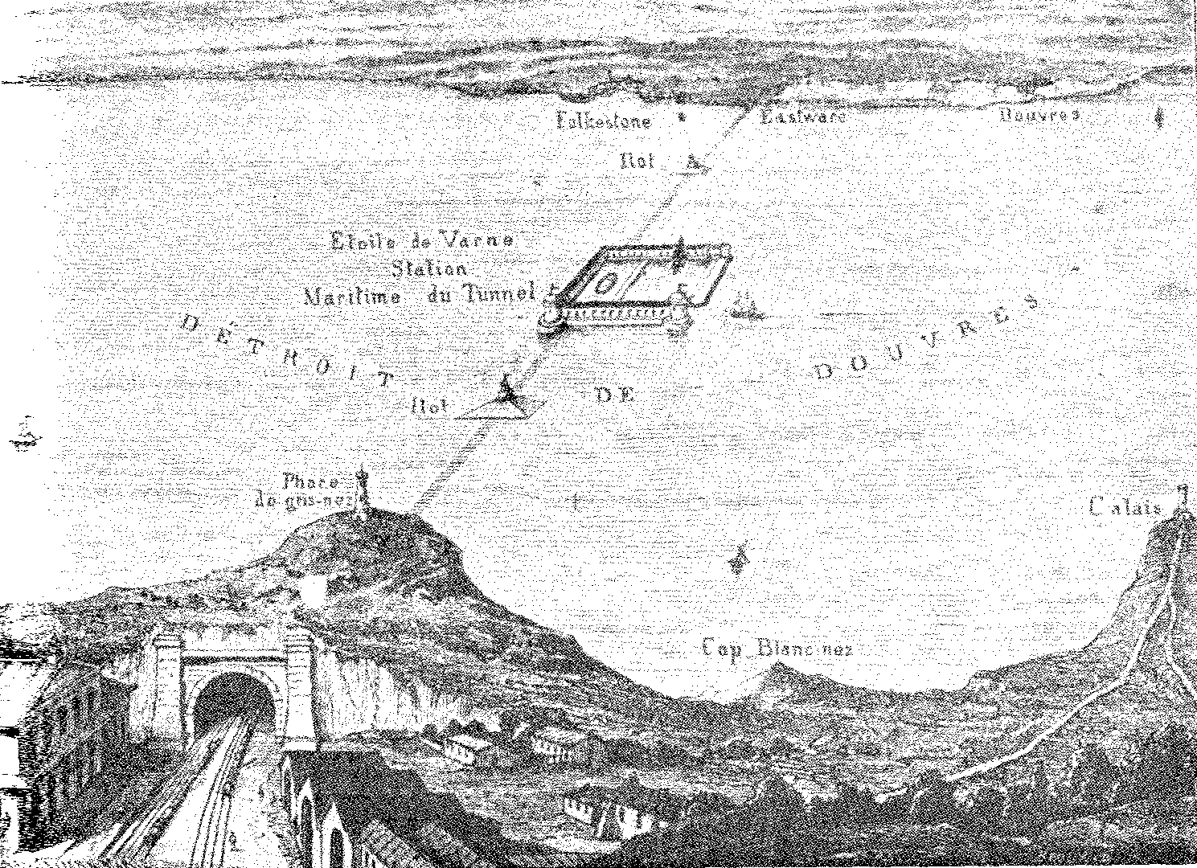
Electric trains
Mains electricity and powerful electric motors allowed trains to be run underground where coal and steam emissions would be impossible.
Chunnel is a good example.
1856
https://en.wikipedia.org/wiki/Channel_Tunnel

Slide 17
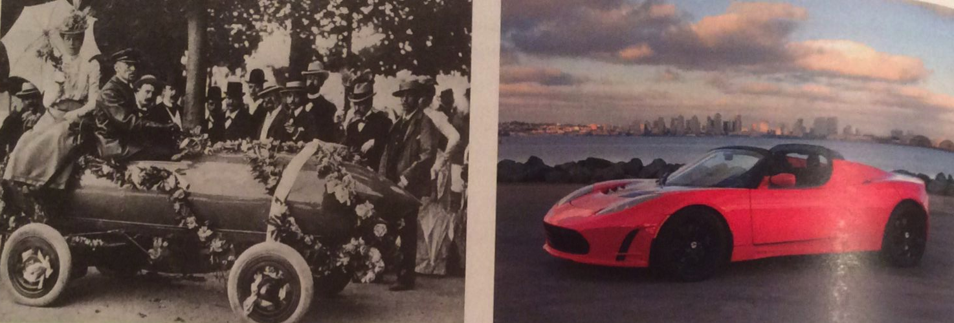
Battery-powered vehicles
1899: Jenztzy created a 1.5 tonne car powered by a 50 kW motor and lead-acid batteries
1900-20: Battery-electric buses and taxis
Recently: improvements in magnets, motor / generators, batteries and regenerative braking have created the modern electric or hybrid vehicle.
Energy Systems and Sustainability, 2/e, Chapter 9

Slide 18
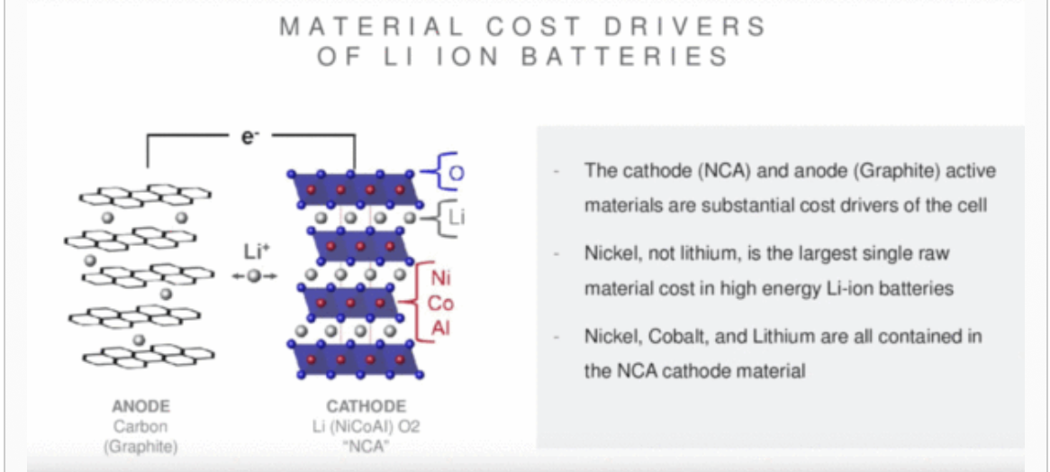
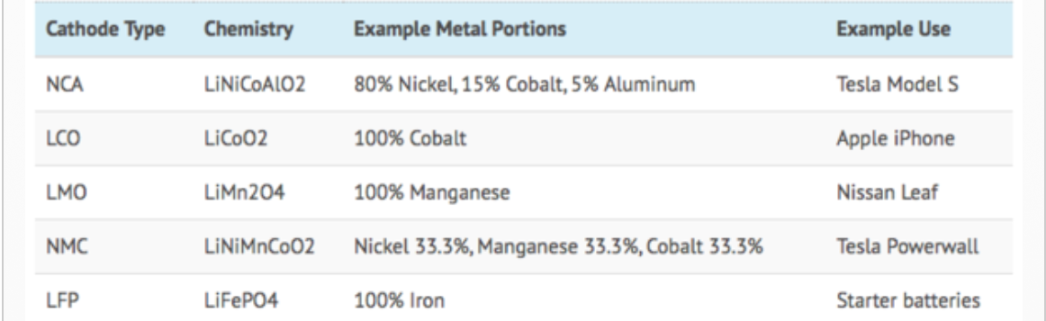
Lithium-ion batteries
https://evannex.com/blogs/news/making-batteries-better-
how-tesla-could-improve-electric-vehicle-lithium-ion-battery-technology

Slide 19
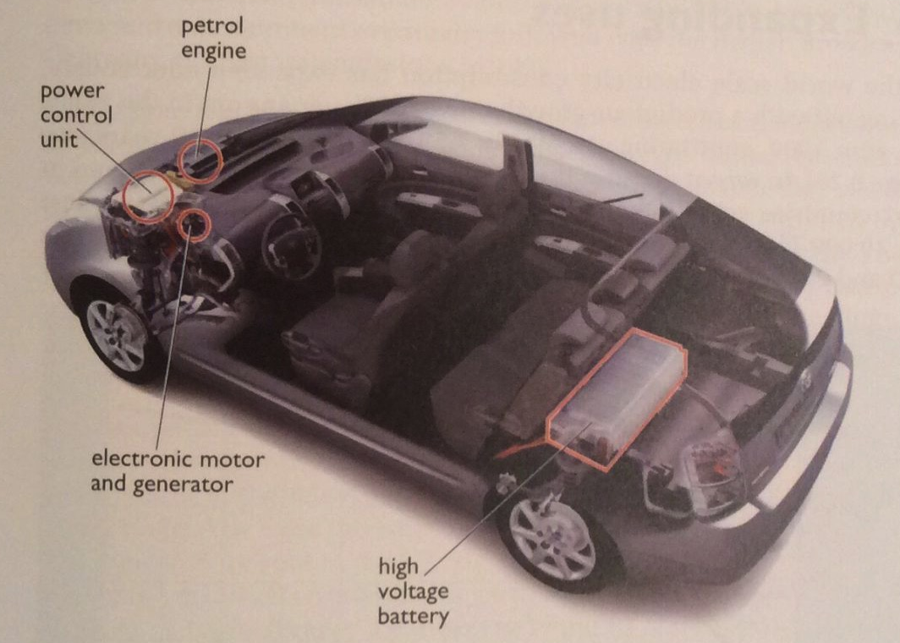
Hybrid electric vehicles
The idea of petro engines with electric transmission isn’t new:
1890s: French railways used steam-electric system in the 1890s.
1905: diesel-electric buses
Toyota Prius uses parallel-hybrid drive (either or both motors), 58 mpg:
1.8-L engine
60-kW motor
regenerative breaking
@ higher speeds; recharges battery
@ slow speeds
Plug-in hybrids get most of their power from the grid.
Petro increases range.
Energy Systems and Sustainability, 2/e, Chapter 9

Slide 20
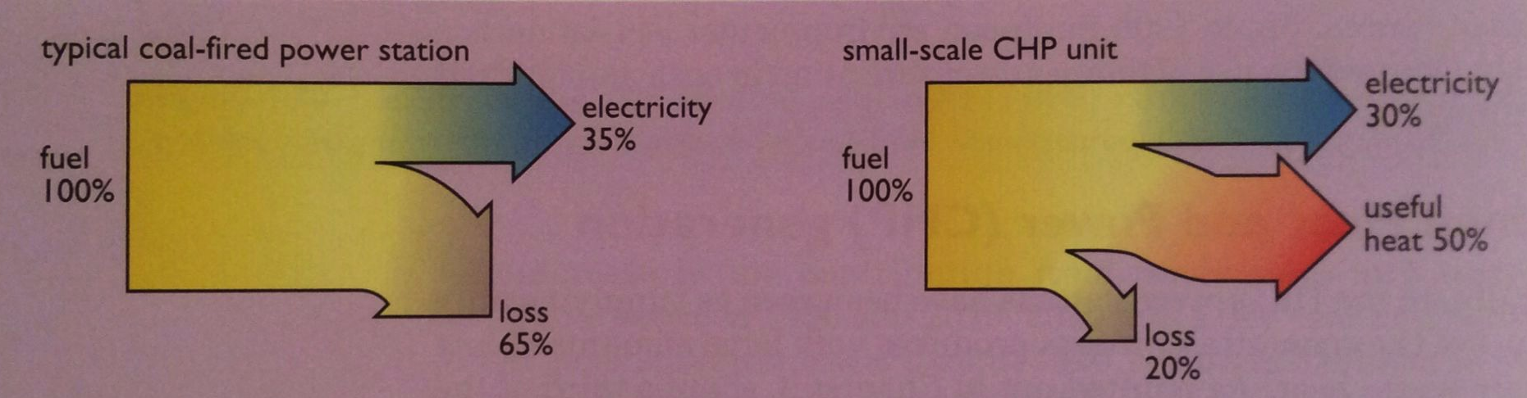
Combined heat and power (CHP)
CHP (combined heat and power) plants make electricity like other generating stations, but also use their waste heat, dramatically increasing their efficiency to ~80%.
Autoproducers are plants that make their electricity.
2009: UK had 5500 MW of CHP, mostly industrial.
Small-scale CHP are usually between 100 kW – 1 MW and powered by NG.
Large institutions: hotels, hospitals, schools..
Energy Systems & Sustainability, 2/e, Chapter 9

Slide 21
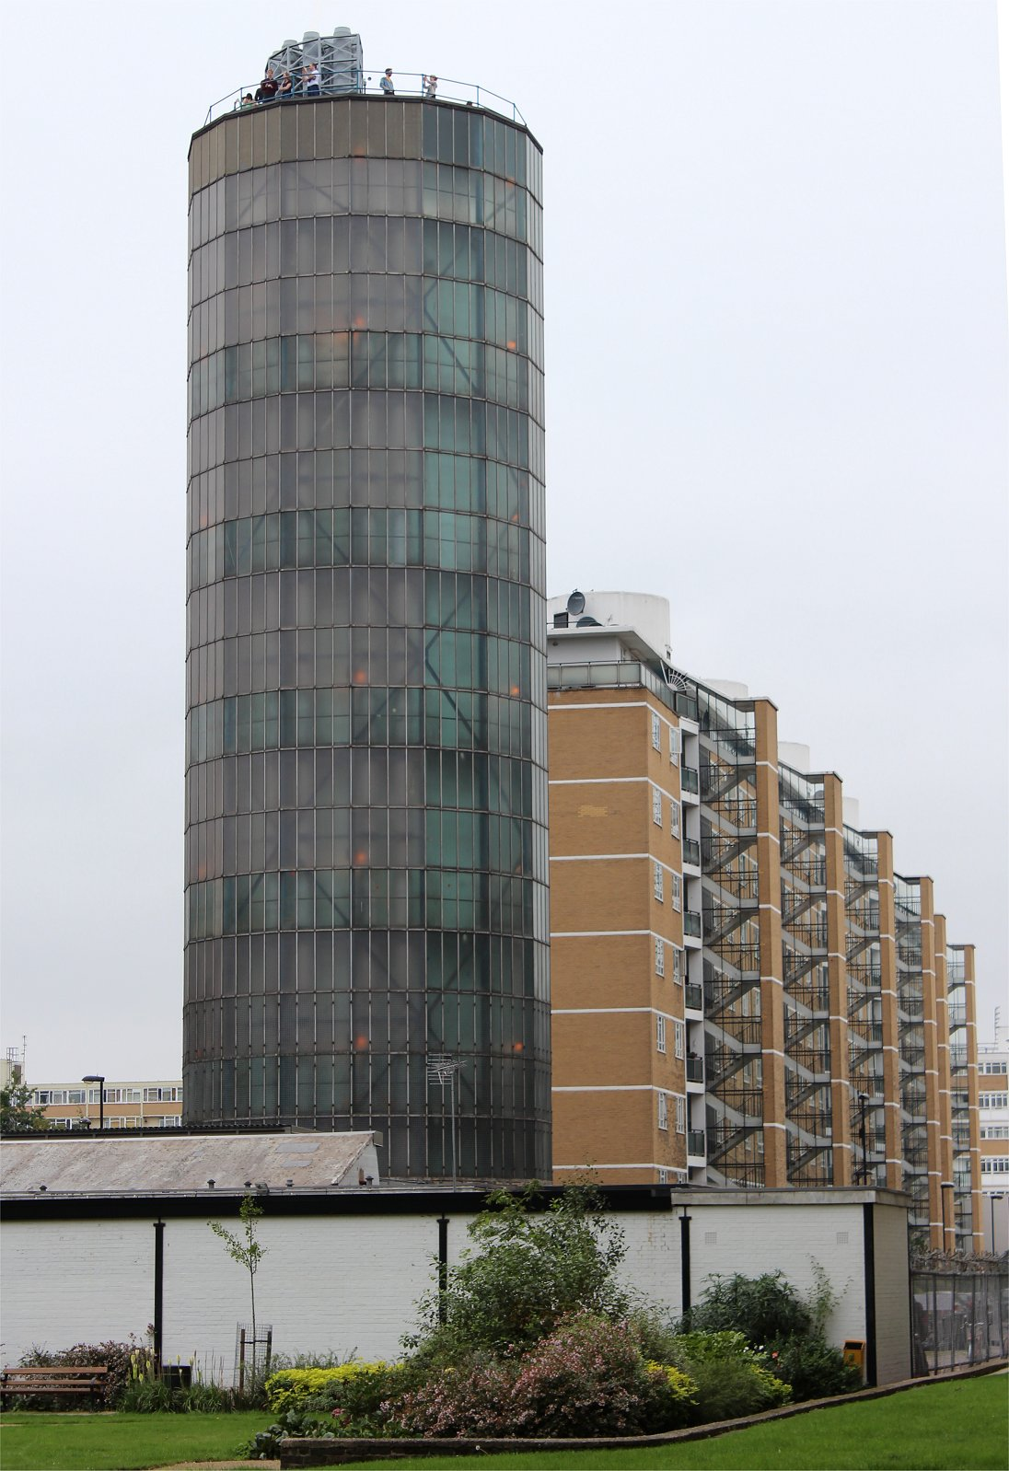
Large-scale CHP and community heating
Larger-scale CHP can produce enough heat for a community of buildings. Heat is distributed as:
Low-pressure steam at < 50°C; or
Hot water at 85-95°C.
This type of district-heating is widely used in Scandinavia, currently less so in the UK.
2002 study: CHP district heat could produce 18 GW heat 5 million UK homes, 2.5 GW in London alone.
The Pimlico District Heating system, London (1951)
Today powered by a 3.1 MW NG CHP plant.
3000 residences and 50 commercial customers.
‘Accumulator’ tank holds 1-days worth of heat.
Energy Systems and Sustainability, 2/e, Chapter 9
https://folkestonejack.files.wordpress.com/2013/09/pdhu_12.jpg

Slide 22
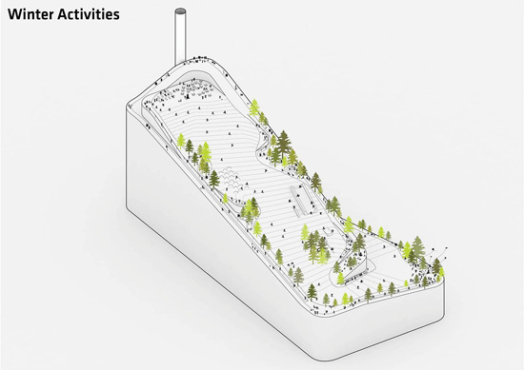
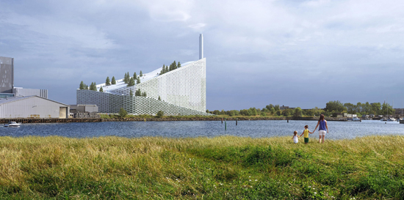
Denmark’s large-scale CHP
Copenhagen’s Avedore plants provide electricity and district heating.
Newest is biomass waste only and will heat 60,000 homes….
...And provide a ski slope in winter.
http://www.volund.dk/Waste_to_Energy/References/ARC_Amager_Bakke_Copenhagen

Slide 23
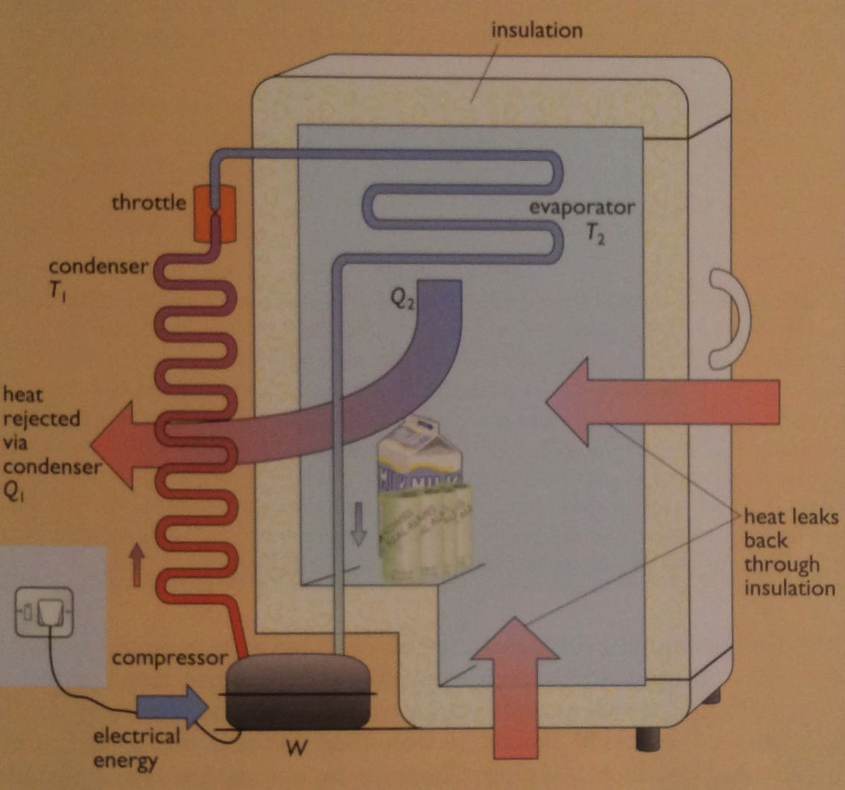
Heat pumps (refrigerant cycle)
The refrigeration cycle takes heat from cooler region and moves it to warmer regions using work / energy. Refrigerants (isobutane) have
low boiling points (-12°C).
4. Condensed liquid refrigerant is forced into a spray by the throttle and moved into the evaporator where heat causes the liquid to evaporate into a gas, absorbing heat.
3. As condensation occurs, the latent heat of vaporization is released, heating the space around the condenser.
2. Rising pressure increases the refrigerant’s boiling point to above room temperature causing the gas to condense to liquid in the condenser.
1. Low-pressure refrigerant is compressed by a compressor (doing work).
Energy Systems and Sustainability, 2/e, Chapter 9

Slide 24
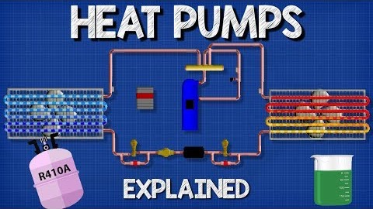
How heat pumps work

Slide 25
COP: efficiency of heat pumps
The COP (coefficient of performance) of refrigerant cycles measures the efficiency of heat transfer devices
COP = Q₂
W
maximum flow of heat
work (electric power input)
COP_{max} = ____T_{hot}_ where temperature is Kelvin
T_{hot} – T_{cold}
European testing uses these values:
T_{hot} = 35°C (95°F or 308°K)
T_{cold} = 0°C (32°F or 273°K)
COP_{max} = ___308_ = 8.8
(308 - 273)
In practice, maximal COP is about 4.5.
In extreme cold, COP is reduced to about 1.
Annual averages are about 3.5.
https://en.wikipedia.org/wiki/Coefficient_of_performance

Slide 26
Module 11. Electricity, grids and storage
  11.3: Current electric transmission and distribution

Slide 27
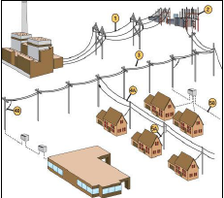
Transmission vs. distribution
Transmission lines: use high voltage to minimize electrical loss
Distribution lines: use lower voltage since power loss is less of an issue
Sub-stations: use transformers to step down voltage where transmission lines meet distribution lines
Additional transformers on distribution lines step power down to the 120 V or 240 V needed for household use.
Energy Systems and Sustainability, 2/e, Chapter 9

Slide 28
Transmission loss increases with decreasing V
Consider a power plant producing (P) of 50 MW (50 E6 W).
What is the current transmitted at a voltage of 25,000 V?
What is the current transmitted at 400,000 V?
I = P/V = 50 E6 W / 25,000 V = 2,000 A
I = P/V = 50 E6 W / 400,000 V = 125 A
Energy Systems and Sustainability, 2/e, Chapter 9

Slide 29
UK grid evolution: competition vs. scale
Early electric generating stations were small and local as DC power limited their distance from consumers.
  Municipally owned and operated
  Laissez-faire capitalism caused lack of standardization or combination
In the UK, WWI caused the nation to realize the system was a crazy quilt that was difficult to expand quickly in response to the needs of war.
1926: UK created a National Grid:
  Connected existing grids
  Specified power output (50 Hz) and centralized control
  Stations were still privately owned, though the small and inefficient were closed.
In 1947, after WWII, utilities were nationalized.
  230 V standard was adopted
1950: 60 MW station standard → 1970: 600 MW stations
Energy Systems and Sustainability, 2/e, Chapter 9

Slide 30
In response, the UK National Grid was created
In 1926 the concept of the UK’s National Grid was formalized with specifications:
AC only
50 Hz
The last DC supply in London wasn’t disconected until 1962.
There was resistance to:
Centralized (aka governmental) control;
Placement of high voltage lines & towers
While a large, interconnected grid supplies resilient power supply, problems can be as widespread as supply.
Blackouts have occurred in the UK, NY City, Auckland NZ for several weeks.
And suppliers are not always producers.
  Southern England (London) imports electricity from the north.
Energy Systems and Sustainability, 2/e, Chapter 9

Slide 31
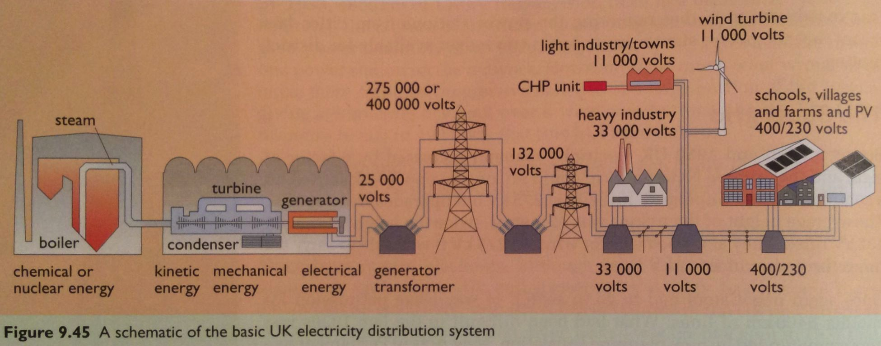
UK: upgraded to the ‘supergrid’
UK electric demand increased X8 between 1926 and 1950.
Construction on a new supergrid carrying a voltage of 275 kW (upgradable to 400 kV) was begun in 1964.
42-m towers
Much thicker transmission lines
Putting lines underground solves many objections but is up to 20 times as expensive as overhead lines.
Energy Systems and Sustainability, 2/e, Chapter 9

Slide 32
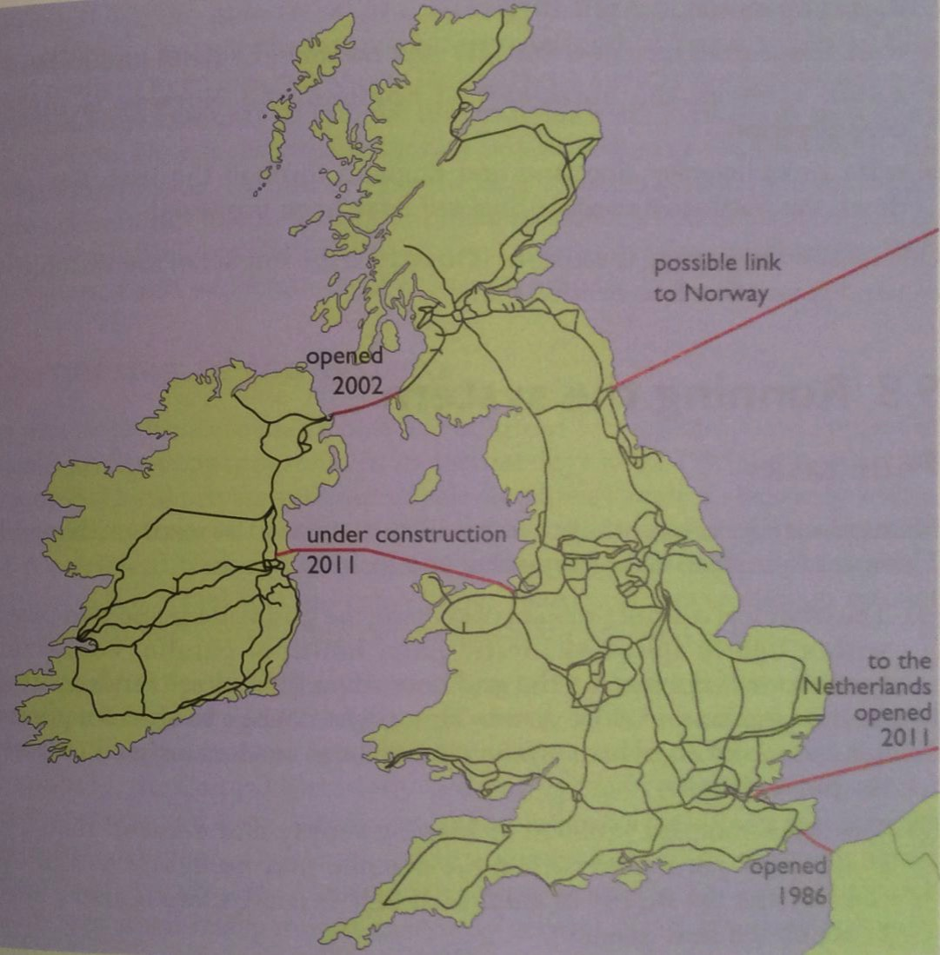
UK today: part of an international distributed grid
Replaced in 1986 with 2000 MW cable that imports 3% of UK power.
Energy Systems and Sustainability, 2/e, Chapter 9

Slide 33
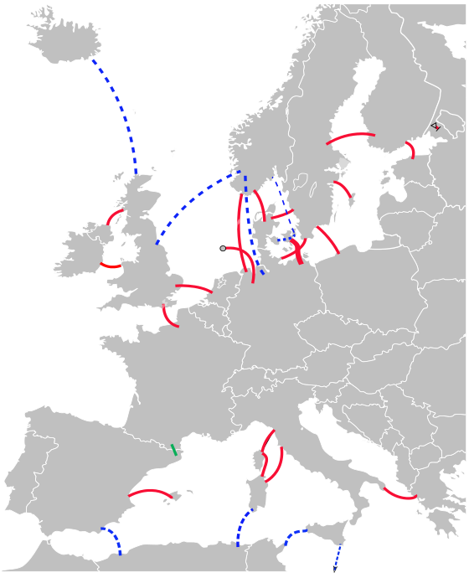
HVDC: long-distance without ‘taps’
HVDC (high-voltage direct current) is now (and increasingly) used for moving power between asynchronous grids.
Cost can be lower then for AC transmission
Losses can be lower
Used in Europe and South America
Most often when the generator and user are separated by long distance and there are no ‘taps’ between the generator and user.
existing
European HVDC
under construction
proposed
Energy Systems and Sustainability, 2/e, Chapter 9
https://en.wikipedia.org/wiki/High-voltage_direct_current

Slide 34
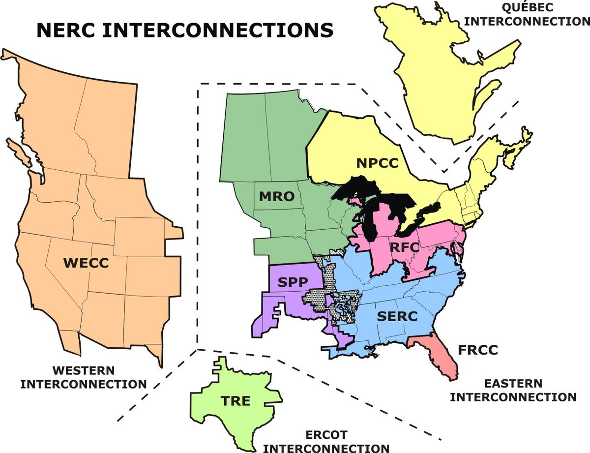
US grid is three slightly interconnected power grids
The three US grids operate almost independently and share very little power.
950 GW
So the abundant wind energy produced in Texas is hard to move to other regions.
1 GW
A truly integrated macro-grid is needed to transform our energy system.
https://www.vox.com/energy-and-environment/2020/6/20/21293952/renewable-energy-power-national-grid-transmission-microgrids

Slide 35
Module 11. Electricity, grids and storage
  11.4: Modernizing the grid
  An integrated macrogrid

Slide 36
’Rewiring America’: acceleration on steroids
Saul Griffith’s plan to ‘electrify everything’ would require increasing electric generation four-fold and doing so with ‘grid neutrality’.
Grid-neutrality: treating all producers and consumers of electricity with equity.
We’ll need a huge grid that doesn’t give anyone special advantages.
Distributed batteries will make the grid more robust.
Going off-grid doesn’t contribute to a more robust and resilient community grid.
“We earlier found out we are going to need 1500–1800GW of electricity to power America carbon–free, and that we can get the majority of it from renewables. It is worth reminding yourself that this means generating and delivering 3–4 times as much
electricity as we currently do.
This is not a tune–up of the old grid, this is a demolition and rebuilding with new 21st–century rules and Internet–like technology.”
Rewilding America

Slide 37
Balancing demand and supply
To get a feeling for this have a look at demand within a single home.
Demand is periodic and uneven
Demand isn’t
synchronized
with least
expensive
supply, like
daytime PV.
More demand
creates more
resilient supply.
Rewilding America

Slide 38
Resilience and reliability through storage
Our current fossil fuel-based energy system has massive built-in fuel storage.
NG stored in underground caverns.
Oil stored in scores of massive tanks.
Coal plants with a month of fuel stored in piles.
250 million cars could store 20 TWh
Balance daily fluctuations
Storing electricity is more challenging, but it’s possible.
Chemical batteries
Batteries of electric cars
Thermal energy storage
Pumped hydro (95% of our current storage)
Bio-energy (wood and waste streams) to bridge seasonal gaps
Heat water, chill freezers when energy is abundant, cheap
3 TWh nationally
And build an excess 20% generating capacity!
Rewilding America

Slide 39
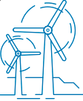
Resilience and reliability through sharing
Community sharing: since households within a community are unlikely to use appliances and electricity at exactly the same time in the same way, the average load of the community is more balanced than any individual load (or demand).
Long distance sharing of demand and supply via long-distance transmission:
Placing distributed generation of many many types (wind vs. solar vs. hydro) in each region and time zone makes it likely that sufficient power will be produced to balance the total load.
Idaho
North Carolina
California
Texas
Baseload power, like nuclear, can fill gaps that still pop up.
Sharing grid with Canada and Mexico will create even more resilience.
Rewilding America

Slide 40
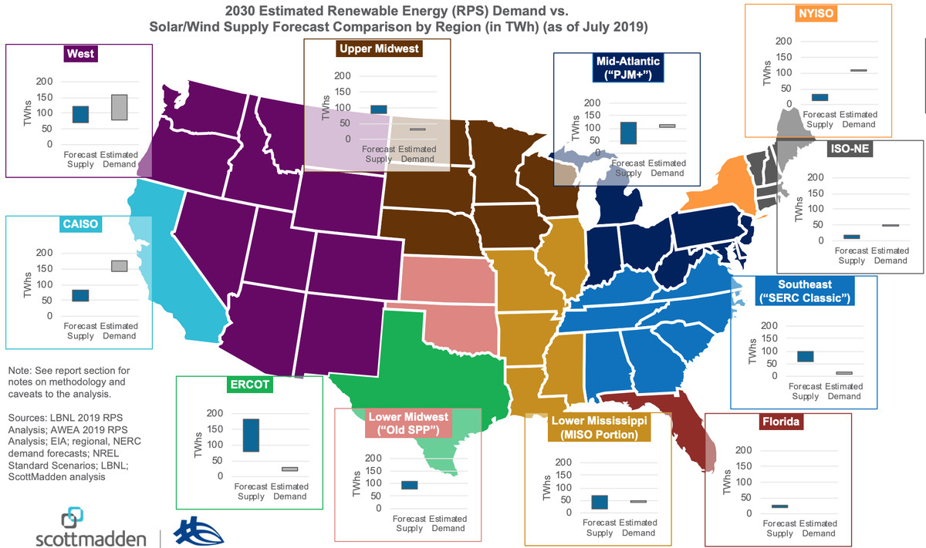
1. Unlocking RE potential
Connections will match RE supply and demand across the US.
https://www.vox.com/energy-and-environment/2020/6/20/21293952/renewable-energy-power-national-grid-transmission-microgrids

Slide 41
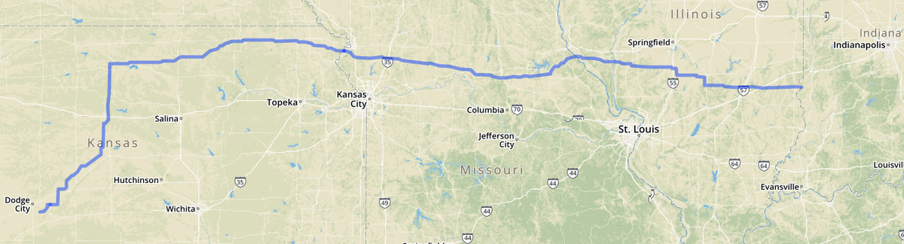
1. Unlocking RE potential
Example: the Grain Belt Express
780-mile transmission line to carry 4 GW of RE from Kansas to 1.6 million customers
Will allow construction of $7 billion of RE projects
https://www.vox.com/energy-and-environment/2020/6/20/21293952/renewable-energy-power-national-grid-transmission-microgrids

Slide 42
2. Reduce GHG emissions
2016 study showed that energy system transition using existing technologies could reduce GHG by 80% from 1990 levels by 2030 without increased LCOE
But an interconnected and integrated national grid with high-current DC transmission will be required.
https://www.vox.com/energy-and-environment/2020/6/20/21293952/renewable-energy-power-national-grid-transmission-microgrids

Slide 43
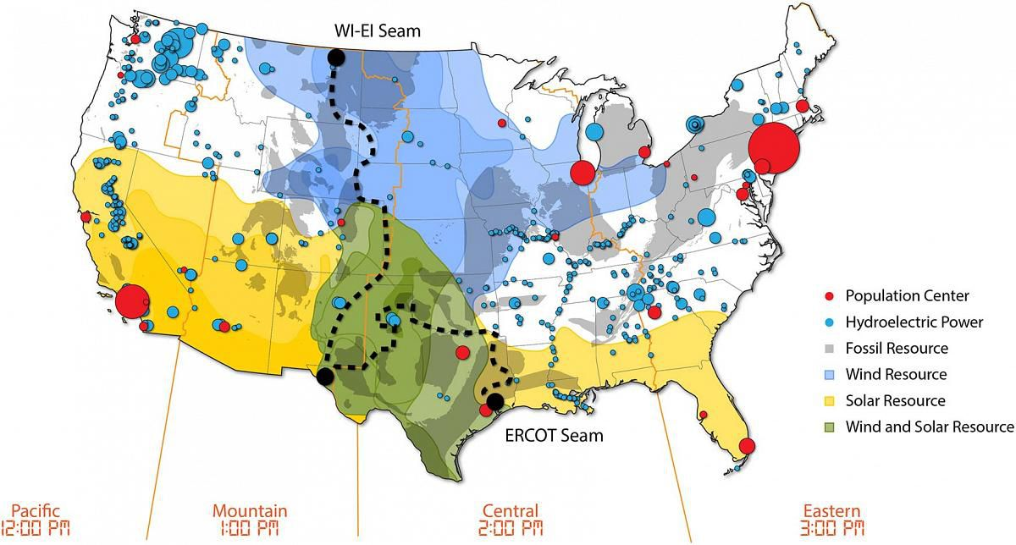
3. Save money for consumers
Consumers would save $47.2 billion per year in efficiency and lower energy costs.
For every $1.00 invested, $2.50 would be saved.
https://www.vox.com/energy-and-environment/2020/6/20/21293952/renewable-energy-power-national-grid-transmission-microgrids

Slide 44
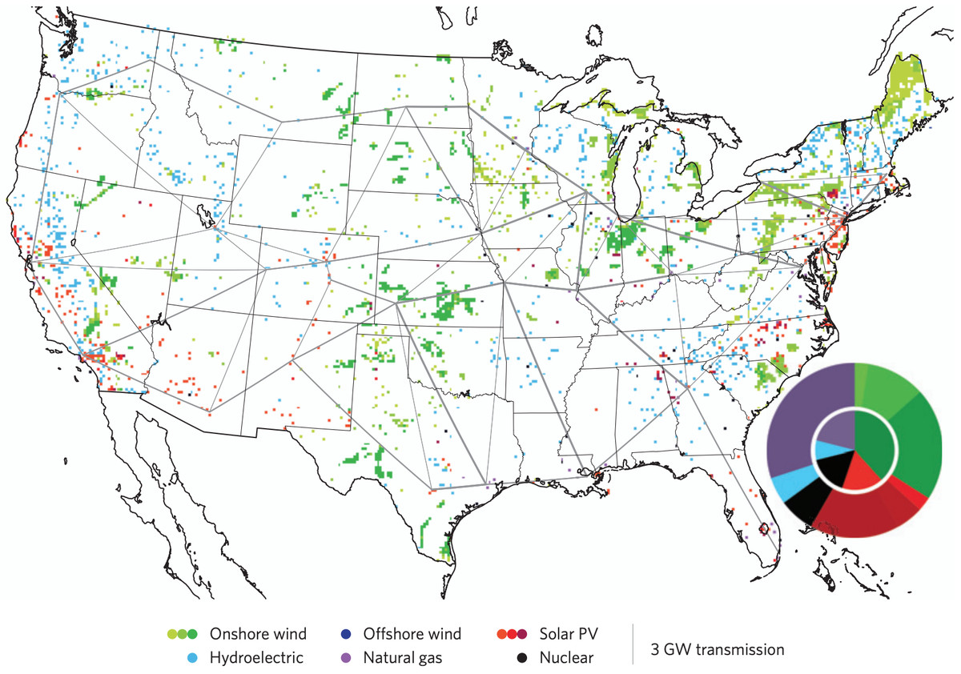
4. Grid reliability will be increased
Interconnection helps regions share power resources.
Already working where interconnection is strong.
https://www.vox.com/energy-and-environment/2020/6/20/21293952/renewable-energy-power-national-grid-transmission-microgrids

Slide 45
5. Job creation
Thousands of construction and maintenance jobs would be required to build a well-connected national grid.
This is slow work and would probably require a decade.
Saul Griffith’s ‘Rewiring America’ plan would create an estimated 25 million jobs.
Even in the complex world of energy policy and politics, placing new transmission lines is a gordian knot. “The transmission issue is a hybrid of a federal issue and a state issue, which makes it challenging from the standpoint of policy, because you have different jurisdictions for different things,” says David Hurlbut, a policy and economic researcher at the National Renewable Energy Laboratory.
https://www.vox.com/energy-and-environment/2020/6/20/21293952/renewable-energy-power-national-grid-transmission-microgrids
https://www.vox.com/podcasts/2020/8/27/21403184/saul-griffith-ezra-klein-show-solve-climate-change-green-new-deal-rewiring-america
https://www.wired.com/story/real-challenge-green-new-deal-isnt-politics/

Slide 46
Consider this
Two European companies are planning massive underground transmission lines to transmit Iowa wind power to Chicago, a $2.5 billion investment.
  Underground transmission is twice as expensive, so why do it?
Underground transmission avoids NIMBY opposition. Is that significant?
In Wyoming, a billionaire investor wants to build a 3,000 MW wind farm and overhead transmission lines to sell the power to Las Angeles.
  Funding isn’t an issue.
  But permits to build transmission across intervening states have been pursued for 10 years to date and not all permits have been secured.
https://www.wired.com/story/real-challenge-green-new-deal-isnt-politics/

Slide 47
Module 11. Electricity, grids and storage
  11.5: Modernizing the grid
  Smart microgrids

Slide 48
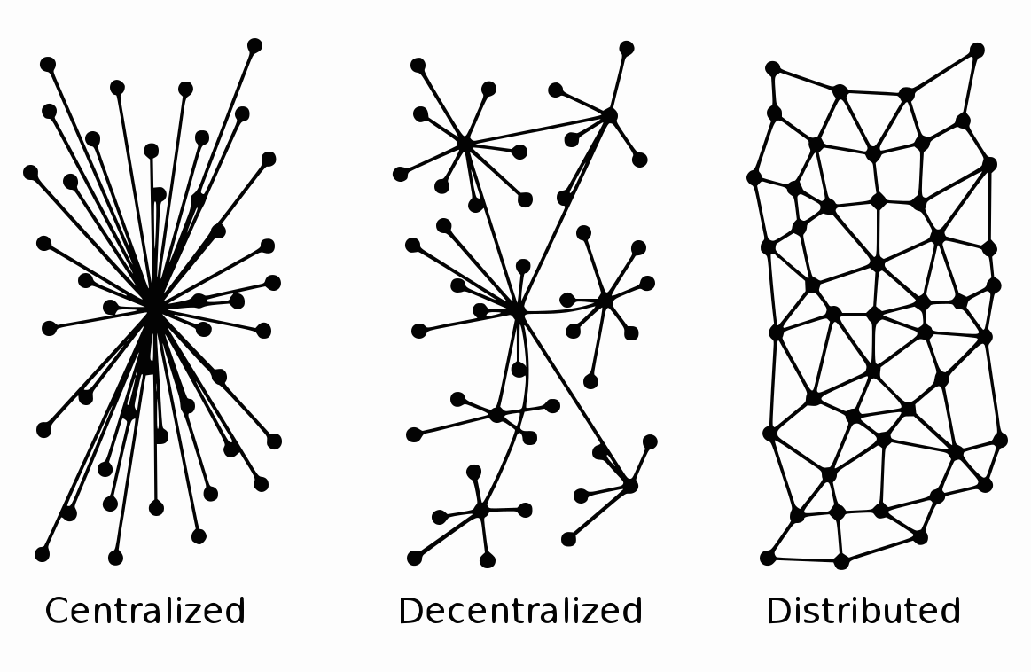
Modernizing the grid
The US grid is centralized. Decentralized or - better yet – distributed grids are more efficient, resilient and able to integrate renewable energy and energy storage.
big users
(spokes)
central generating plants
(hub)
located near fuel…
…and cooling water
West: coal mines
NW: hydropower

Slide 49
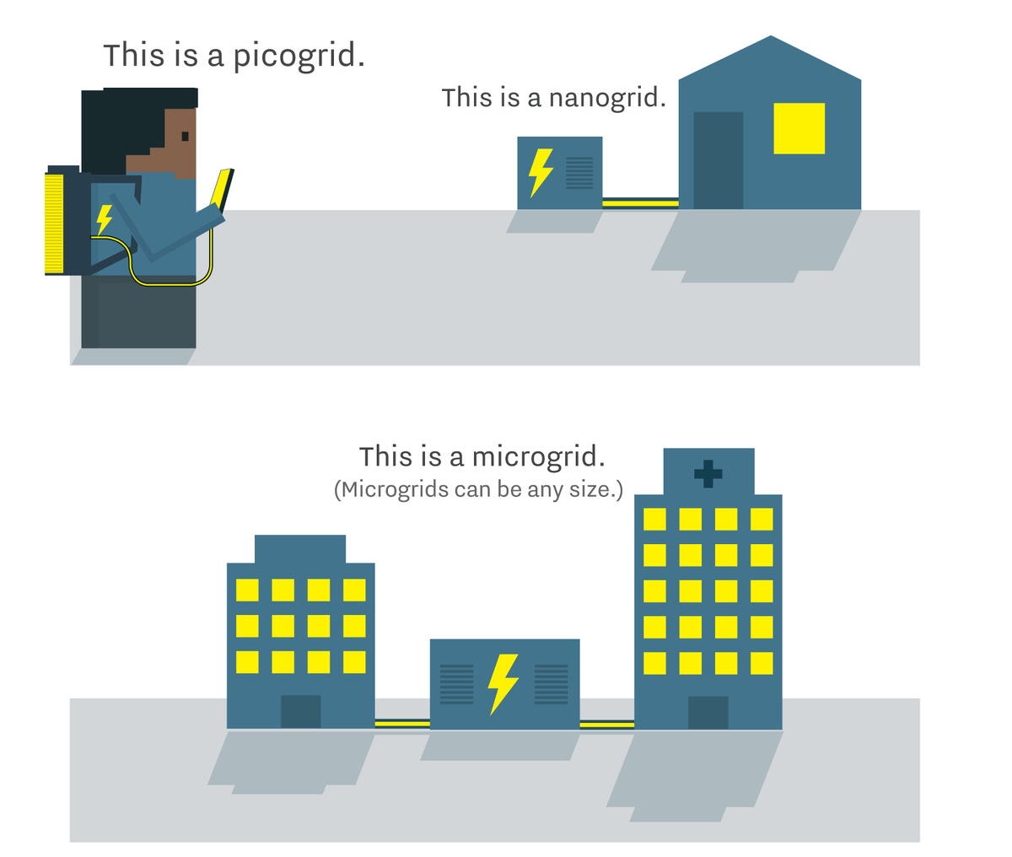
What is a microgrid?
Microgrids: small grids that connect a college campus, a business, or even a house, allowing it to act as a semi-independent island within the larger grid
Microgrids help support the growth of distributed energy, with power generation, storage, and management taking place on the customer side of the power meter.
https://www.vox.com/energy-and-environment/2020/6/20/21293952/renewable-energy-power-national-grid-transmission-microgrids

Slide 50
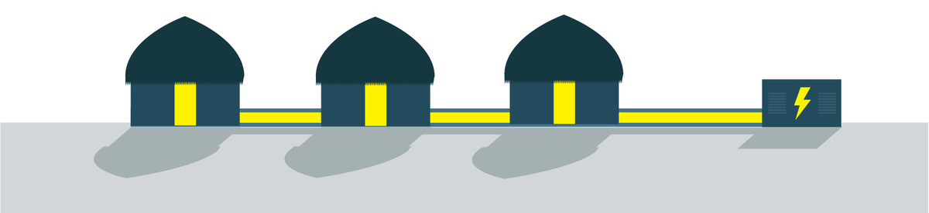
Microgrids can spring up where large grids aren’t
Uses for isolated microgrids?
Rural areas not connected to a larger grid
Islands
https://www.vox.com/energy-and-environment/2020/6/20/21293952/renewable-energy-power-national-grid-transmission-microgrids

Slide 51
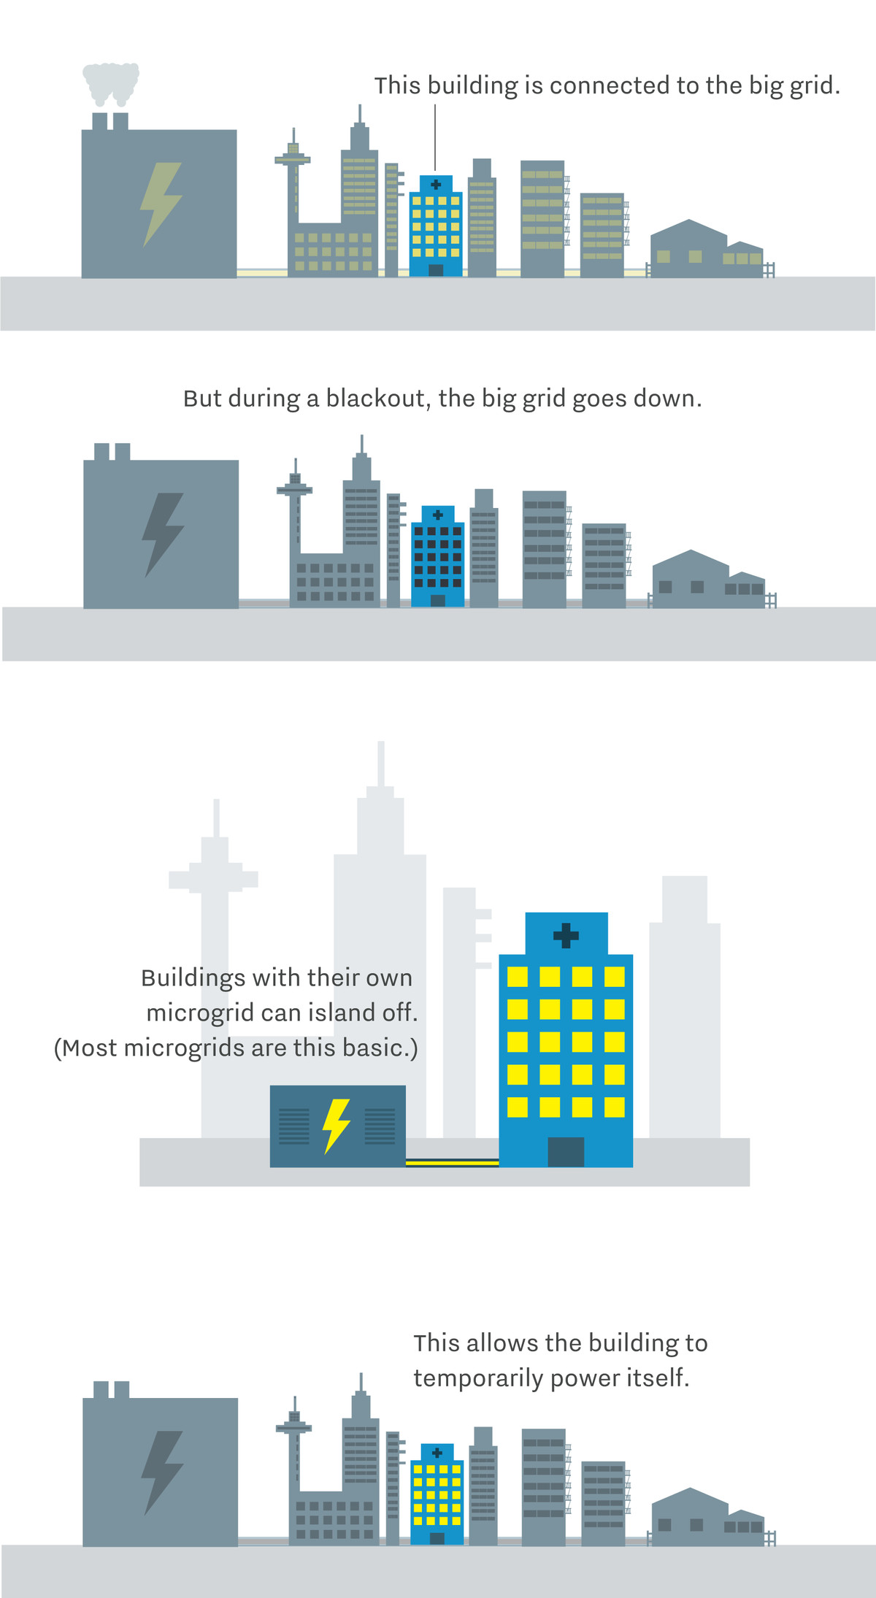
Connected microgrids provide resilience
Uses for connected microgrids?
Energy insurance for institutions that can’t lose power:
  Hospitals, emergency shelters, etc.
Users who can produce their own power during times of peak demand, reducing pressure on the rest of the grid
CHP allows microgrids to produce heat and power
https://www.vox.com/energy-and-environment/2020/6/20/21293952/renewable-energy-power-national-grid-transmission-microgrids

Slide 52
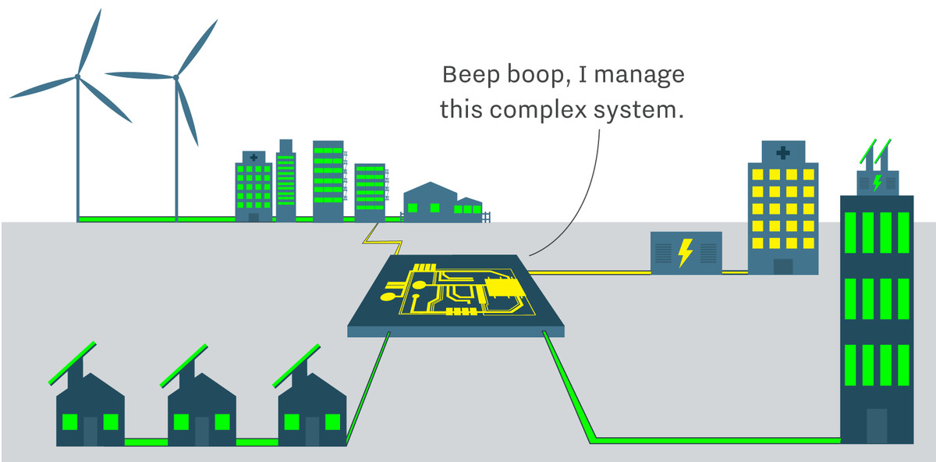
Next? Green and integrated microgrids
Smart: communicate with the big grid for most efficient use; AI or machine learning
Low-carbon fuels and operation; CHP where heat is needed
Integrated storage for intermittent RE and to lower grid demand
https://www.vox.com/energy-and-environment/2020/6/20/21293952/renewable-energy-power-national-grid-transmission-microgrids

Slide 53
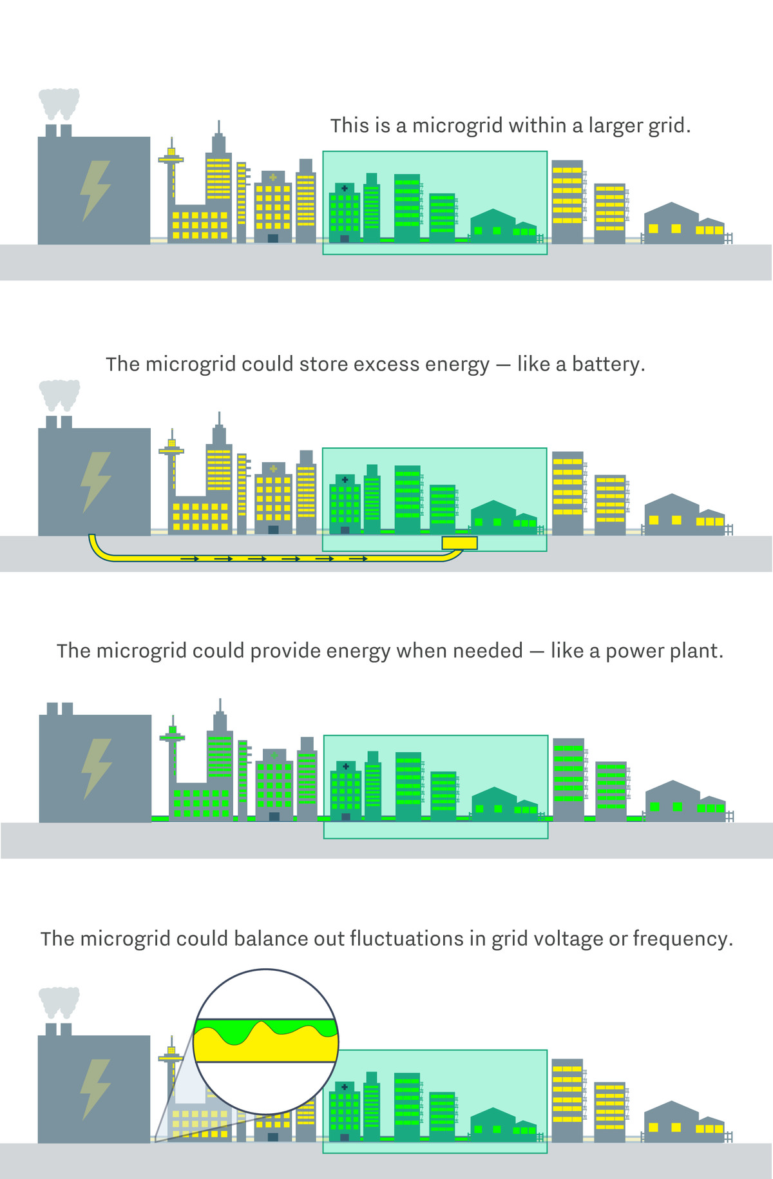
Grids within grids to create a large, flexible grid
…even a grid that is someday composed of networked microgrids. This kind of “modular architecture,” with multiple semi-autonomous nodes operating in parallel, is more secure and efficient than a centralized system with a few, large points of failure.
https://www.vox.com/energy-and-environment/2020/6/20/21293952/renewable-energy-power-national-grid-transmission-microgrids

Slide 54
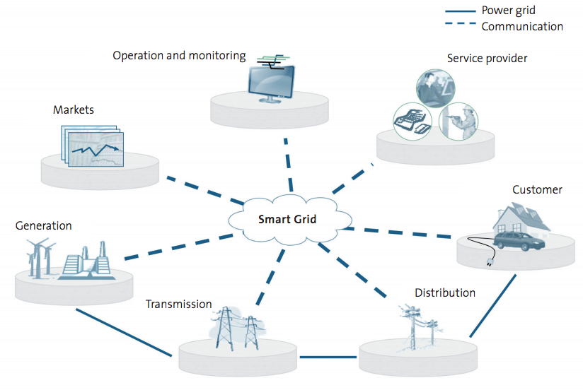
Smart grids
Smart grid: uses two-way energy data collection and
communication;
Acts as a virtual
power plant by
controlling supply
and matching
and adjusting
demand.
Energy Systems and Sustainability, 2/e, Chapter 9

Slide 55
Module 11. Electricity, grids and storage
  11.6: Modernizing the grid
  Denmark vs. US vs. Vermont

Slide 56
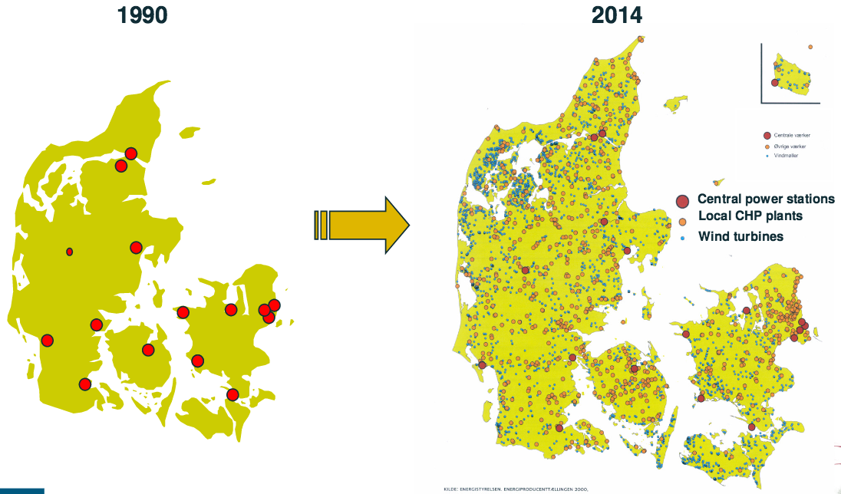
Demark goes distributed grid
Denmark’s energy supply is highly distributed, yet the most reliable in Europe
Ten times as reliable as the US grid.
https://www.vox.com/2016/3/12/11210818/denmark-energy-policies

Slide 57
Denmark’s grid
Fun facts about Denmark’s smart and distributed grid
166,000 km of distribution lines (four times around the globe)
3.25 million meters and customer relationships
800,000 cable cabinets
70,000 transformers
14% of household energy bills cover distribution
57% go to the government
Operating costs have fallen 40% over the last decade
US system is 9,170,000 km
US is 228 X larger than Denmark
If as large, Denmark would have 37,800,000 km of grid
So, Denmark’s grid is 4X as dense as ours.
Denmark’s electricity transitioned from 100% coal to 56% RE in 30 years.
https://www.danskenergi.dk/sites/danskenergi.dk/files/media/dokumenter/2017-11/DSO_Magazine_210x297_ENG_V10.pdf

Slide 58
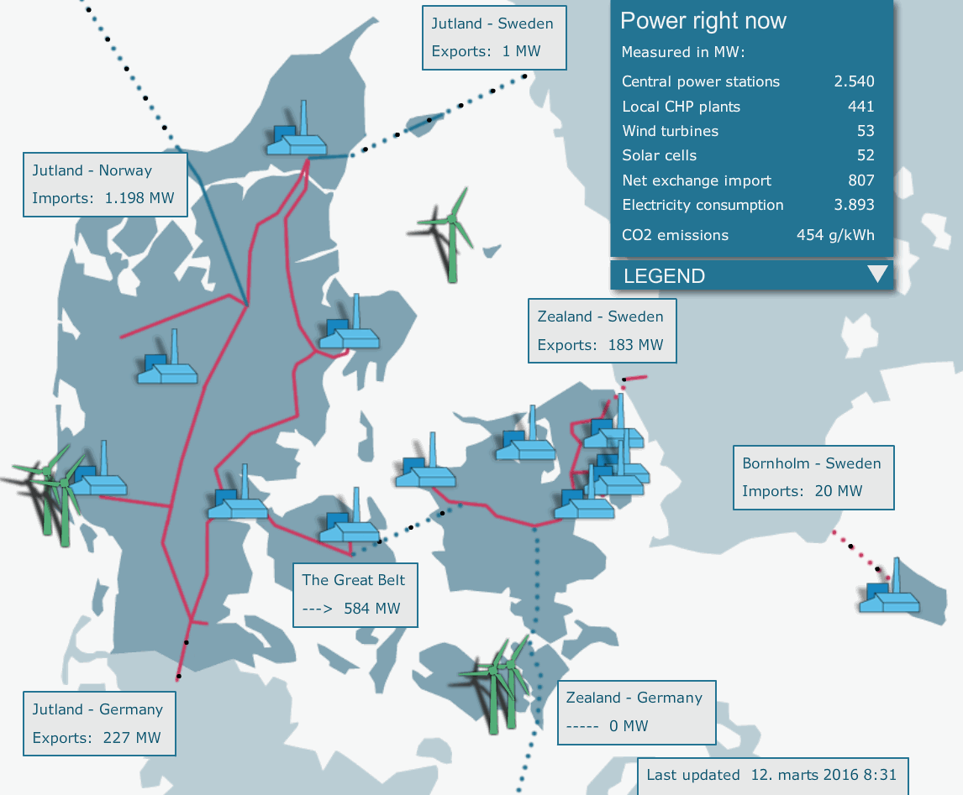
Denmark’s smart and interconnected grid
Demark exports when the wind blows.
And imports hydro when the wind is still.
Timing and communication
are critical.
https://www.vox.com/2016/3/12/11210818/denmark-energy-policies

Slide 59
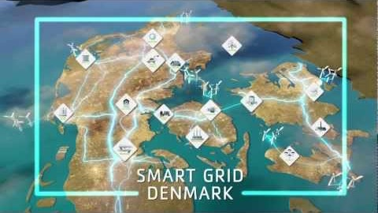
A closer look at Denmark’s smart and distributed grid

Slide 60
Can the US grid handle RE?
A two-year study by the DOE (2012) found that RE could supply up to 80% of US energy reliably with a properly managed grid.
Changes needed?
Connect regional grids to broaden sources
More transmission lines
More electricity storage
  At least a 5X expansion in battery use by 2050
A smart grid that shifts use (demand) to times of high supply
Utility strategies and policies need to adapt to allow transition
Former Energy Secretary Rick Perry’s 60-day study concluded that RE is degrading the reliability of the US grid and our energy supply.
https://e360.yale.edu/features/forget-the-naysayers-the-grid-is-increasingly-ready-for-renewable-energy

Slide 61
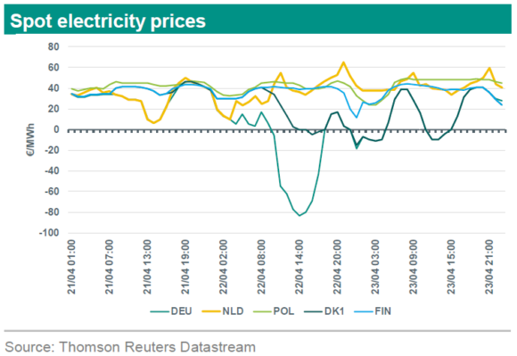
What happens when RE outmatches the grid?
Germany has aggressively created RE energy systems and is working to upgrade its grid, but modernizing the grid is lagging behind a bit.
Winter 2019
Awesome offshore wind resources produced record amounts of electricity
Grid couldn’t move this power to demand in Southern Germany
This caused a local excess of power
  Negative energy prices
    Pay consumers to use extra electricity
  Neighboring generators had to stop production to avoid overwhelming the grid
We can avoid this, but only if we don’t ignore the need to update the grid in coordination with transitioning energy generation.
https://www.forbes.com/sites/davidblackmon/2020/09/30/renewables-wont-save-us-if-the-electric-grid-is-not-ready/?sh=40ffd1737abf
https://insights.abnamro.nl/en/2019/04/german-spot-electricity-prices-went-negative/

Slide 62
Current state of US grid expansion modernization?
14 August 2018, NREL presented the $1.6 million Interconnection Seams Study showing that improved connection between the US eastern and western grids would (1) allow expansion of RE, (2) lower reliance on coal, (3) help mitigate GCC, and (4) save consumers billions of dollars.
That day, WH appointee at US DOE’s Office of Electricity e-mailed DOE HQ that the Seams study was anti-coal.
22 August 2018, internal DOE firestorm resulted, as evidenced by 900 pages of documents and e-mails.
  Reached the second-in-command to the Secretary of Energy.
The NREL scientists who did the Seams study were grounded and forbidden to discuss the study.
  Information was pulled from the website and publication blocked.
  Even before the block the study was severely edited.
The story was only revealed by Freedom of Information Act requests.
https://www.theatlantic.com/politics/archive/2020/08/how-trump-appointees-short-circuited-grid-modernization/615433/

Slide 63
Challenges to New England’s grid?
New England’s grid is operated by ISO New England which coordinates demand and supply across the region. Our regional grid faces a number of challenges.
Reliance on NG to meet peak demand (67% in 2017)
NG is brought into NE by ship and some pipeline, limiting supply. During the winter heating demand for NG surges competing for electric generation.
Increasing integration of rapidly increasing RE
RE requires transmission from distributed producers, advanced weather forecasting and smart meters to match demand and supply.
Changing daily load: the duck curve!
Voltage control for power quality control; technological solutions must be deployed
Evolution of storage: utility-scale and residential distributed batteries
Future electric loads are likely to grow as we electrify heating and transportation
https://www.tdworld.com/grid-innovations/generation-and-renewables/article/20972778/challenges-of-an-evolving-electric-grid

Slide 64
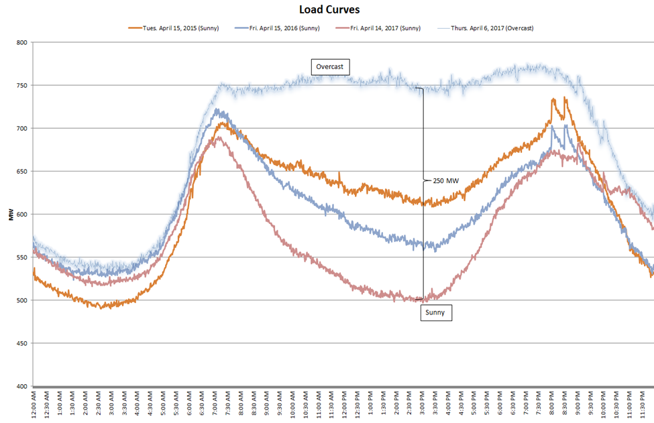
New England’s load curve keep getting ‘duckier’
Apr 2015
Apr 2016
Apr 2017
https://www.tdworld.com/grid-innovations/generation-and-renewables/article/20972778/challenges-of-an-evolving-electric-grid

Slide 65
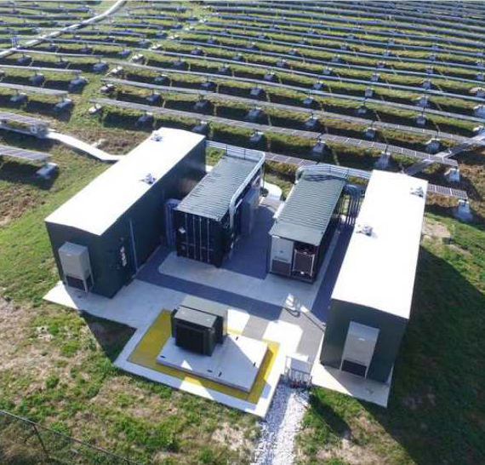
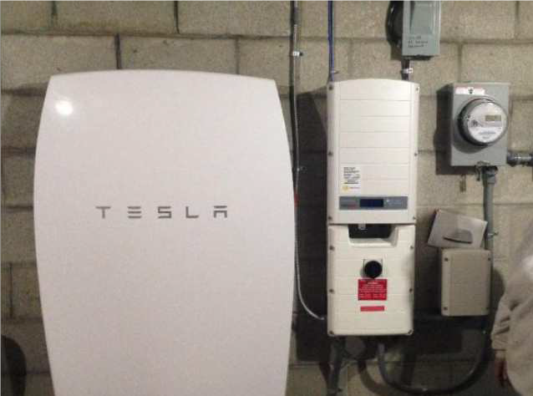
The answer? Batteries … happening in Vermont
Stafford Hill solar
Rutland, VT
4 MW battery
Tesla Powerwall
battery
https://www.tdworld.com/grid-innovations/generation-and-renewables/article/20972778/challenges-of-an-evolving-electric-grid

Slide 66
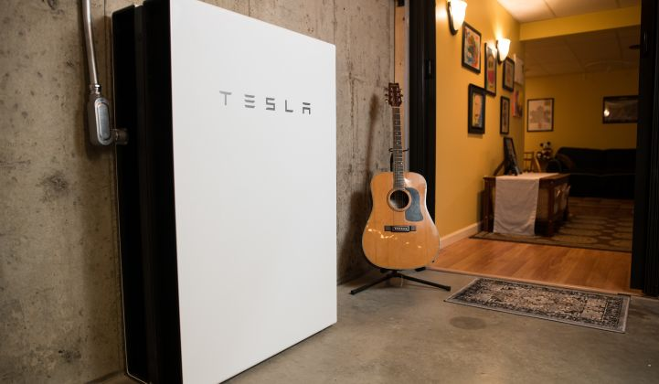
Battery storage in Vermont: benefits already
Halloween 2019: a huge rain and windstorm struck Vermont and left 115,000 customers without power.
But 1,100 customers didn’t go without power due to their home battery systems.
Average 9-hour coverage
Longest was 82 hours.
Home batteries saved GMP money:
$600,000 in 2018 in avoided peaking charges from ISO NE
$900,000 in a single hour in 2019 as battery capacity had increased to 10 MW
https://www.greentechmedia.com/articles/read/green-mountain-power-kept-1100-homes-lit-up-during-storm-outage

Slide 67
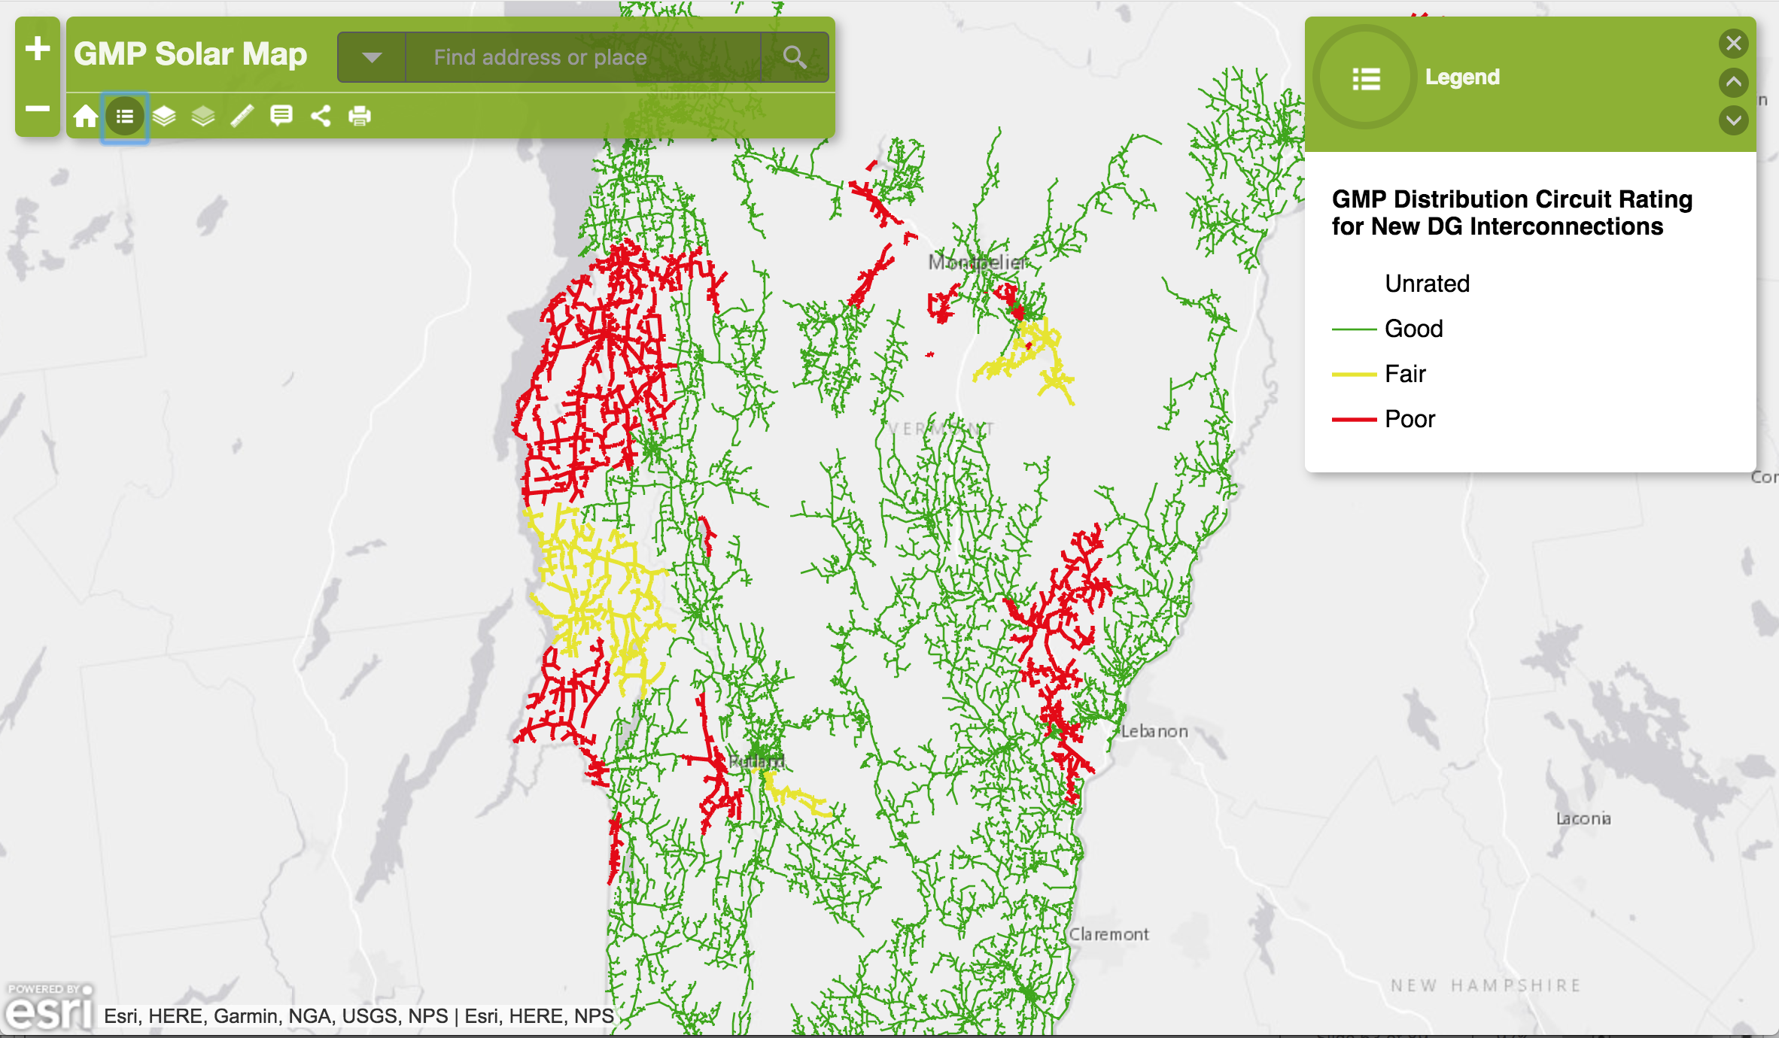
Vermont’s power distribution grid
http://gmp.maps.arcgis.com/apps/Viewer/index.html?appid=546100cc60c34e8eb659023ea8ae03f3

Slide 68
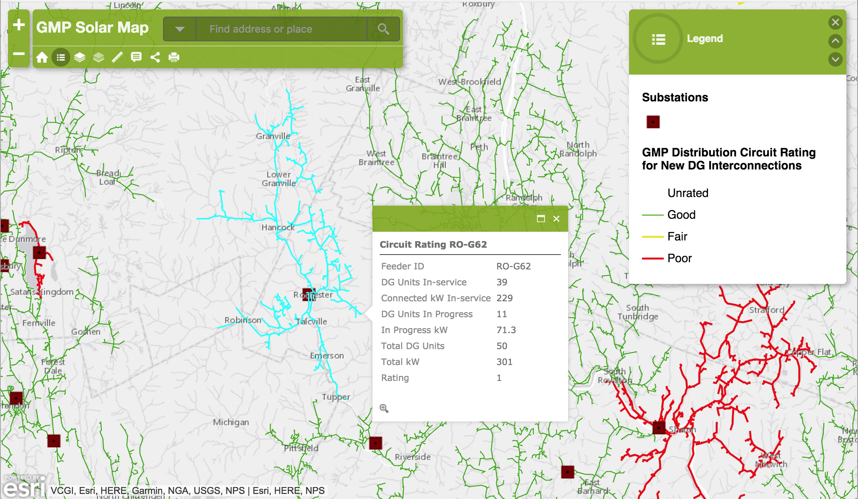
Microgrid ready sections
http://gmp.maps.arcgis.com/apps/Viewer/index.html?appid=546100cc60c34e8eb659023ea8ae03f3

Slide 69
Old grid: power flows ‘downhill’ to the user
Think of each small grid as centered on one substation.
The substation supplies power to users with loads.
Transformers step power down to 120 V for users.
Power only flows outward (or downhill) from the generator to the user.

Slide 70
Each area of the grid has a load
One spur of the distribution line has a load of 0.5 MW.
If the grid serves only to distribute, then it’s easy to understand total need.

Slide 71
Renewable energy complicates control
These folks all decide solar is a great idea and install more than they use: 1.0 MW.
Is this a problem for the grid?
What happens in winter when solar production drops and these consumers need to pull power from the grid?

Slide 72

Mapping renewable installations
http://gmp.maps.arcgis.com/apps/Viewer/index.html?appid=546100cc60c34e8eb659023ea8ae03f3

Slide 73
Smart technology improves the grid
Smart technology – collection of data about outflow and inflow of power as well as the controls that allow the flow of power to be controlled – could essentially upgrade our existing grid and allow it to work as a micro-grid.
DG power could be managed and used by all.

Slide 74
Distributed storage does too
Batteries – like the Tesla Powerwall – installed by users throughout the grid would allow the grid to store power when consumption is low and then send that power back into the grid as power demand peaks.
This could replace the need for additional large, base-load production.

Slide 75

Resiliency?!
Smaller grids can be linked together using transmission lines vs. distribution lines.
http://gmp.maps.arcgis.com/apps/Viewer/index.html?appid=546100cc60c34e8eb659023ea8ae03f3

Slide 76
Module 11. Electricity, grids and storage
  11.7: Running an electric generation and distribution system

Slide 77
Power grid control
Electric generators (power plants) fall into three functional categories:
1. Baseload power plants: run all the time to meet minimum power loads
Nuclear plants work well for base-load power since they are most stable at full power output.
2. Peaking power plants: run only when needed to meet ‘peak’ (max) power loads
Generally the most expensive
Often small, older plants using coal or oil
Gas turbines and hydro can also be used
3. Intermediate power plants: run to meet intermediate power loads
Gas turbines can be tuned to changing power loads.
Energy Systems and Sustainability, 2/e, Chapter 9

Slide 78
Four tasks of running the system
Technical control
Matching supply and demand in real time
Keep the lights on
Optimize
Keep voltage and frequency within specified limits.
  Constant adjustment of many connected generators operating in parallel.
Both locally and across different parts of the country.
If CHP is involved then heat demands must also be considered.
Basic operations
Black start if grid failure occurs
Resources
Operations and maintenance
Economics
Externalities like environmental impacts
Energy Systems and Sustainability, 2/e, Chapter 9

Slide 79

Balancing supply and demand
Given two different types of power generators:
600 MW coal-fired station is 40% efficient but takes 8 hours to reach maximum output; and is less efficient at less than full load.
30 MW gas turbine station is only 30% efficient but reaches full power in minutes.
And demand that varies with time:
Demand varies over 24 hours vs. weekday vs. weekend…
… also varies seasonally.
Energy Systems and Sustainability, 2/e, Chapter 9

Slide 80
Using bidding for who runs when
National Grid computer system continuously projects power need for the next hours or days.
Computers at each power station then bid to produce that power by offering a price.
Stations of < 1 MW aren’t constrained and receive a constant price.
Generally
Systems with the lowest fuel and operating costs supply baseload power.
  Renewables
As demand rises, systems with higher costs come online and the cost of electricity increases.
  Nuclear
  Gas and coal
Peak demand uses the systems with most rapid uptime.
  Hydro
  Gas
Metrics here?
Cost
Convenience
Carbon? GHG?
Energy Systems and Sustainability, 2/e, Chapter 9

Slide 81

Peak demands
Peak demands are sudden surges in electric demand. Predictable?
TV commercials cause predictable rush for bathrooms and tea kettles.
Pumped storage can generate huge amounts of electricity at a moment’s notice, though only for a relatively short period of time.
Perfect for peak.
UK has three pumped storage plants with combined capacity of 2 GW.
Energy Systems and Sustainability, 2/e, Chapter 9

Slide 82
Renewable energy is variable
Renewable energy technologies tend to produce power predictably but not continuously, so matching demand and supply can be challenging.
  wind
  PV
  tidal
Strategies?
Demark produced 19% of electricity by wind in 2009. They fill in with hydropower from Norway and Sweden transmitted by cable.
As the UK develops more wind, they could increase pumped storage and connect to Scandinavia.
Wind tracks from west to east, so connecting across Europe from Ireland through Scandinavia would produce a more resilient system.
  As wind power slows in the west it will be picking up in the east.
Energy Systems and Sustainability, 2/e, Chapter 9

Slide 83
Smart meters and grids
Two-way communication between electricity generators and producers makes it easier to match demand and supply.
Energy monitoring:
Clear general energy use information would allow consumers to understand when they were using, how use relates to rates and to make real-time decisions to change behavior and use.
Peak demand tariffs could then discourage heavy use at peak hours decreasing demand and the need for more generation.
California has reduced peak demand by 13% using monitoring and communication.
Remote scheduling of loads involves spreading electric use out over time where possible, avoiding peak use times, loads and costs.
Energy Systems and Sustainability, 2/e, Chapter 9

Slide 84
Module 11. Electricity, grids and storage
  11.7: Global electricity generation

Slide 85
Primary energy sources for US electricity
In 2019, US electricity was generated from these sources:
energy source | % total US electric generation
NG | 38.4
coal | 23.5
nuclear | 19.7
renewable energy | 17.5
hydro 6.8%
wind 7.3%
biomass 1.4%
solar 1.8%
geothermal 0.4%
petroleum | 0.5
other non-renewable | 0.3
pumped storage hydro | -0.1*
* Use more electricity than they produce annually.
https://www.eia.gov/tools/faqs/faq.php?id=427&t=3

Slide 86

Comparing sources and consumption
Energy Systems and Sustainability, 2/e, Chapter 9

Slide 87
Comparing sources and consumption
UK:
Consumption flat from 1995 – 2009 because of efficiency campaigns.
Gas rising and replacing coal, but North Sea reserves are running low.
Nuclear power declining as plants are retired.
Nuclear by wire as UK imports 3% of power from French nuclear plants.
Plan to cut 80% of CO2 emissions by 2050.
30% achieved by 2010.
Energy Systems and Sustainability, 2/e, Chapter 9

Slide 88
Comparing sources and consumption
USA:
Consumption twice that of UK.
Now 31% from coal (2017).
Nuclear was 20% but falling as plants retire.
US and Canada have 25% of world hydro.
Great potential for RE.
State control of utilities.
Grid seen as weak and vulnerable.
Energy Systems and Sustainability, 2/e, Chapter 9

Slide 89
Comparing sources and consumption
France:
High consumption for Europe.
Exports electricity.
Domestic demand is high since electricity is used for heat.
Electricite de France is a recently privatized company with vertical integration of production, grid management and distribution.
Energy Systems and Sustainability, 2/e, Chapter 9

Slide 90
Comparing sources and consumption
Demark:
Consumption doubled from 1975 to 2009 but without more primary energy consumption: efficiency.
Early 1970s electric production was nearly all oil.
Transitioned to coal and CHP; 53% CHP by 2010.
North Sea gas used for some CCGT.
19% wind power
8% biomass CHP
Grid links to Norway and Sweden to trade hydro for wind; increase reliability.
Small municipal and coop structure facilitate CHP.
Energy Systems and Sustainability, 2/e, Chapter 9

Slide 91
Comparing sources and consumption
India:
Small but growing consumption.
20% used in agriculture; mainly irrigation.
Vast grid with 80% of villages having mains power, though 400 m lack power.
29% distribution losses with some theft.
16% short of energy supply at peak.
Nationalized utilities that are in debt.
Coal for electric production is high ash, producing air pollution.
Interest in thorium nuclear.
Renewable, wind, solar, biomass are coming on strong.
Energy Systems and Sustainability, 2/e, Chapter 9

Slide 92
Comparing sources and consumption
China:
Demand rose by 6X from 1990 – 2009.
Most use still industrial.
Agriculture uses 3.5%, mainly irrigation.
Millions still lack access.
Significant hydropower.
Strong investment in renewables.
Energy Systems and Sustainability, 2/e, Chapter 9

Slide 93
Module 11. Electricity, grids and storage
  11.8: Electricity storage -
  a holy grail for intermittent RE

Slide 94

High-speed flywheels
At low electricity demand, motors accelerate a cylinder (flywheel) spinning in a vacuum-sealed case which reduces friction. When demand rises, kinetic energy is quickly converted to electricity.
Pros: Nearly instant response to need.
Cons: Good for short bursts of power, ~15’.
http://discovermagazine.com/2015/july-aug/26-power-stash

Slide 95

Pumped storage hydropower
At low electricity demand, huge volumes of water are pumped from a low
reservoir to an upper one. When demand rises, water is released to flow down through turbines, producing electricity.
95% of current grid storage
Pros: High capacity (10,000 MWh)
    long-lived infrastructure
Cons: Requires the right site.
    High initial (capital) costs.
http://discovermagazine.com/2015/july-aug/26-power-stash

Slide 96

Vehicle-to-grid
Electric vehicles serve as distributed batteries for the grid when they are plugged in to recharge. They can store power when demand is low and serve as power sources when demand is high.
Pros: Double duty use of an existing resource.
    Owners credited.
Cons: Could shorten battery life.
    Coordination required
    to assure batteries
    maintain enough charge.
GMP is offering to install Tesla batteries in customer’s homes at a steep discount for this purpose…
… without the car.
http://discovermagazine.com/2015/july-aug/26-power-stash

Slide 97

Rail energy storage
Electric trains loaded with ballast travel up a hill when demand is low. When demand rises the cars roll down the hill and regenerative braking generates electricity.
Pros: Proven, rapid response.
Cons: Need the right site and infrastructure.
http://discovermagazine.com/2015/july-aug/26-power-stash

Slide 98

Solid electrochemical battery
Batteries store and release energy using reduction-oxidation reactions.
Pros: Proven, rapid response, reliable, portable.
Cons: Expensive, limited capacity
Safety issues with fire and hazardous chemicals.
http://discovermagazine.com/2015/july-aug/26-power-stash

Slide 99

Flow batteries
Flow batteries operate on the same principle as solid-state batteries but can store much larger amounts of energy since redox reactants are stored in massive tanks.
Pros: Proven, rapid response.
Cons: Less reliable than solid state.
    Risk of pollution from leaks.
Biological molecules called quinones, used for photosynthetic redox, have been used to create flow batteries.
‘Rhubarb battery’
http://discovermagazine.com/2015/july-aug/26-power-stash

Slide 100

Molten salt storage
At low demand, mirrors focus sunlight on tanks of molten salt, heating them to nearly 1,000 F. When demand rises, the salt’s heat is used to produce steam, driving turbines to make electricity.
Pros: Proven and in use.
Cons: Space needed for tanks.
http://discovermagazine.com/2015/july-aug/26-power-stash

Slide 101

Thermal energy storage
At low demand, electricity is used to freeze or cool tanks of liquid. When demand rises, the cold water is used for cooling
Pros: Simple, cheap, reliable
Cons: Cools but does not heat or produce electricity
http://discovermagazine.com/2015/july-aug/26-power-stash

Slide 102


Hydrolysis to create hydrogen gas
At low demand, electricity is used for hydrolysis, breaking water into hydrogen and oxygen gases. Hydrogen gas is then used to power a fuel and produce electricity or transported in NG lines and combusted.
Pros: Simple, cheap, reliable
Cons: The gas is small and can be hard to store.
    Fuel cells not yet economic.
https://en.wikipedia.org/wiki/Power-to-gas
https://www.technologyreview.com/s/530331/germany-and-canada-are
-building-water-splitters-to-store-renewable-energy/
Containerized power to gas unit.

Slide 103

Graphene supercapacitor
At low demand, electricity is used for hydrolysis, breaking water into hydrogen and oxygen gases. Hydrogen gas is then used to power a fuel and produce electricity or transported in NG lines and combusted.
Pros: Simple, cheap, reliable
Cons: The gas is small and can be hard to store.
    Fuel cells not yet economic.

Slide 104

The future of energy storage?

Slide 106
Batteries and ‘chemical’ electricity (1)
Sir Humphry Davy (1778-1829)
Described the basic properties of a battery.
  Voltage would occur between two ‘dissimilar’ metals connected by wire and dipped in an electrolytic solution.
Used a 2000-cell battery to power a carbon arc lamp: long spark arcs between two carbon electrodes in proximity.
  A stream of white-hot carbon particles carries the stream of electrons between electrodes.
    Later evolved into the fluorescent tube
Worked with electrolysis to smelt metals directly, making pure metals from dilute solutions of salt
Energy Systems and Sustainability, 2/e, Chapter 9

Slide 107
Batteries and ‘chemical’ electricity (2)
More advanced primary cell battery designs (non-rechargeable):
1839 William Grove: Zn / Pt battery using acid solutions as electrolytes.
  Developed commercially and powered the telegraph
Grove also developed a H / O ‘gas battery’ (aka fuel cell) though he didn’t try to commercialize it.
1868 Georges Leclanché developed a Zn / C dry cells battery that became widely used as alkaline batteries were in the 20th century
Energy Systems and Sustainability, 2/e, Chapter 9

Slide 108
Electromagnetism and production of current
1820: Andre-Marie Ampere founded the science of electromagnetism
When a wire carrying a current is placed parallel to a second conducting wire, a force is exerted between the wires.
  He called the force the ampère (aka amp).
Electromagnets could be made by using iron as the core of a coil of copper wire.
  Used to attract or repel other magnets and cause motive force.
1831: Michael Faraday showed that movement of a magnet through a coil of wire produced amps, a current or flow of electricity.
Developed the dynamo (generator) that produced continuous electric current by moving a coil of wire in a magnetic field.
Energy Systems and Sustainability, 2/e, Chapter 9

Slide 109

US transmission lines
The US grid consists of a web of transmission lines with a range of voltages.
Energy Systems and Sustainability, 2/e, Chapter 9

