Slide 1
SSC 2030: Energy Systems & Sustainability
6. Nuclear power
6.1: Nuclear power: an introduction
6.2: Nuclei: a brief summary
6.3: Radioactivity
6.4: Nuclear fission
6.5: Thermal fission reactors
6.6: Types of thermal fission reactors
6.7: Nuclear fuel cycles
6.8: Fast neutron reactors
6.9: Newer nuclear reactor designs
6.10: Nuclear power in Vermont
6.11: Power from fusion

Slide 2
6. Nuclear power
6.1: Nuclear power introduction

Slide 3
Use of nuclear to generate electricity
2017: Nuclear power generation in:
30 countries
449 reactors
60 new plants under construction in 15 countries
Country | nuclear as % power
France | 72.3
Slovakia | 54.1
Ukraine | 52.3
Belgium | 51.7
Hungary | 51.3
Sweden | 40.0
Slovenia | 35.2
Bulgaria | 35.0
Switzerland | 34.4
Finland | 33.7
Armenia | 31.4
South Korea | 30.3
Czech Republic | 29.4
Total global nuclear generation:
2,476,671.2 GWh
Total US nuclear generation:
805,327.2 GWh
99 plants
19.7% of national generation
Nuclear Energy Institute; https://www.nei.org/Knowledge-Center/Nuclear-Statistics/World-Statistics

Slide 4
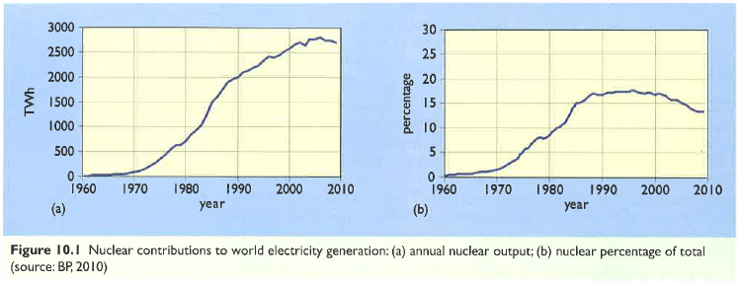
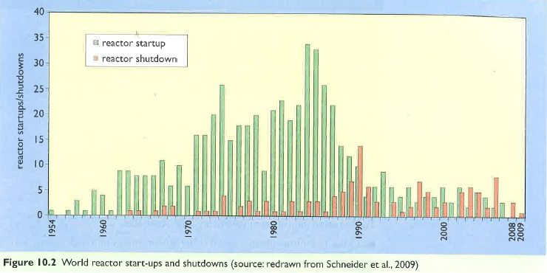
Time-line of nuclear power use
While the first nuclear plants were built in the 1950s, implementation really boomed in the 1960s & 1970s.
In the 1990s shutdown of aging (or problematic) nuclear plants outpaced construction.
Energy Systems & Sustainability, 2/e, Chapter 10

Slide 5
6. Nuclear power
6.2: Nuclei - a brief summary

Slide 6
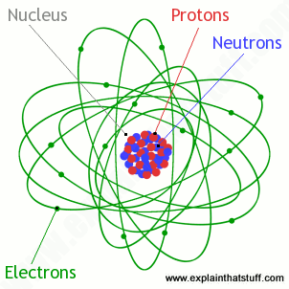
Atoms & nuclei
Atomic nuclei: dense, central conglomeration of protons & neutrons
Protons: heavy, positively charged particles [# is unique atomic identifier]
Neutrons: heavy, uncharged particles [# varies in isotopes]
Atomic mass: ~ sum of protons + neutrons
Strong atomic force: holds protons & neutrons together in nucleus
Energy Systems & Sustainability, 2/e, Chapter 10;
https://cdn4.explainthatstuff.com/atom.png

Slide 7
6. Nuclear power
6.3: Radioactivity

Slide 8
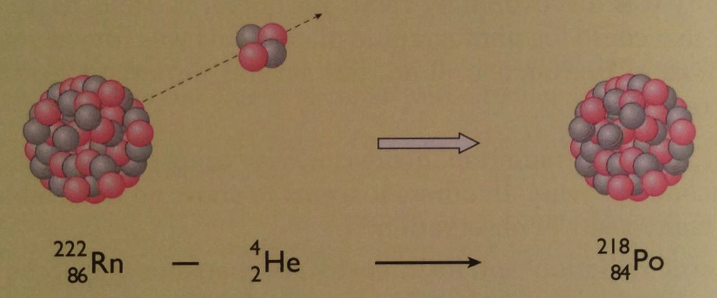
Heavy elements & radioactivity
The light elements in the upper four rows (or periods) of the periodic table have roughly equal numbers of protons & neutrons.
But heavier elements found in lower rows have far more neutrons than protons.
zB: Mercury (Hg) has 80 protons but 120 neutrons
The additional neutrons may add strong nuclear force needed to hold the large number of protons together (fighting repulsive force).
But beyond bismuth (Bi, 92) nuclei become unstable.
Elements beyond bismuth are radioactive: their nuclei emit high energy charged particles & thus become different elements
Energy Systems & Sustainability, 2/e, Chapter 10

Slide 9
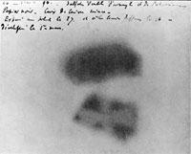
Radioactivity: caught on film
Henry Becquerel described radioactivity in 1896.
He found that uranium salts exposed a photographic plate (caused it to blacken) when the plate was completely protected from light.
The energy (radioactivity) given off by the uranium acted like light.
Uranium emits beta radiation.
Each element has its own characteristic type of radioactivity.
Physical & chemical changes to a radioactive element have no effect on its radioactivity.
Energy Systems & Sustainability, 2/e, Chapter 10

Slide 10
Radioactive elements
Marie & Pierre Curie found two more radioactive elements:
Polonium;
Radium
The Curies coined the term radioactivity and isolated large enough amounts of radioactive elements to allow detailed study.
Sadly, this extensive exposure to radioactivity for many years ultimately proved fatal.
The Nobel Prize was awarded to the Curies and Becquerel in 1903.
Energy Systems & Sustainability, 2/e, Chapter 10

Slide 11
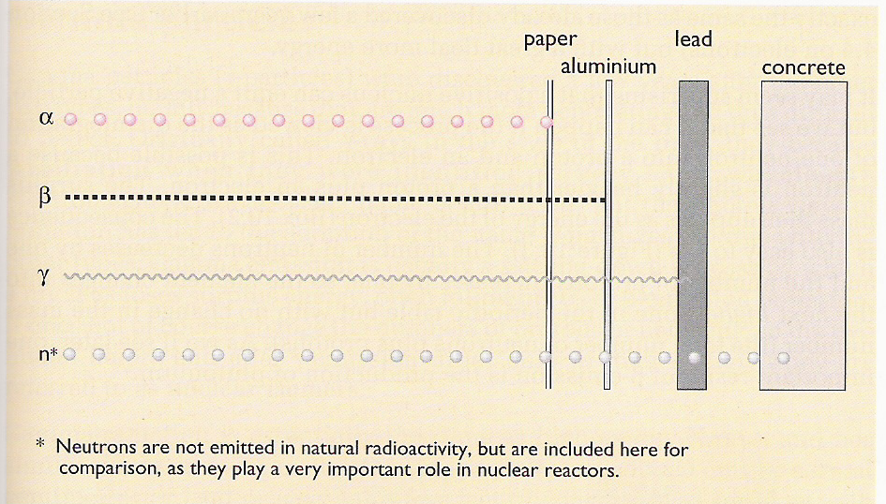
Types of radioactivity
Higher levels of activity allow radiation to penetrate more materials.
2+ nuclei
- electrons
energy w/o mass
neutrons
Energy Systems & Sustainability, 2/e, Chapter 10

Slide 12
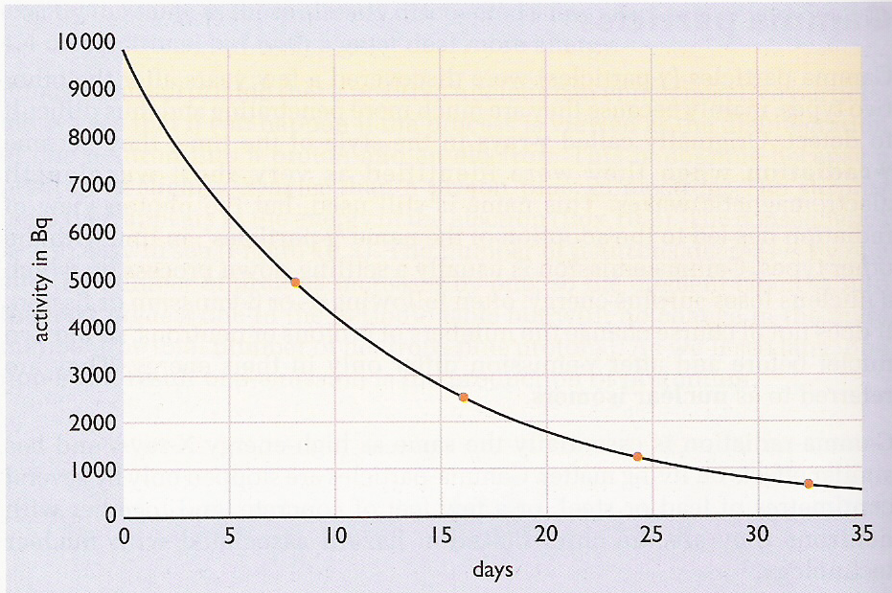
Radioactive decay
Rate of decay: rate at which the number of radioactive atoms decreases; proportional to the number present at any moment.
The half-life (time for half of the activity to decay) of elements involved in nuclear power and nuclear weapons is very long.
Energy Systems & Sustainability, 2/e, Chapter 10

Slide 13
Half-life
Half-life: the time required for half the sample to decay
Isotope | U-238 | U-235 | Pu-239 | Sr-90 | I-131
particle | α | α | Α | β | β
Half-life | 4.5 E9 years | 7.0 E8 years | 24,000 years | 28 years | 8.1 days
1 g | 12,000 Bq | 79,000 Bq | 2,300 MBq | 5.3 TBq | 4,600 TBq
10 kBq | 0.81 g | 0.13 g | 4.3 μg | 0.0019 μg | 2.2 pg
Energy Systems & Sustainability, 2/e, Chapter 10

Slide 14
6. Nuclear power
6.4: Nuclear fission

Slide 15
Playing with radioactivity
Radioactivity became a tool that scientists could use to investigate atoms and atomic structure. Soon physicists were bombarding every known element with radioactive particles or neutrons.
Neutrons had the advantage of neutrality.
1930s: Enrico Fermi found that bombarding uranium with neutrons caused emission of β-particles as neutrons were changed into protons.
This creation of new protons created heavier elements, transuranic actinoids.
1938: Otto Hahn et al. found that Fermi’s bombardment of uranium had created a smaller element, barium.
Meitner realizes that the unstable uranium nucleus was split by the neutron’s impact: kernspaltung (nuclear fission).
Energy Systems & Sustainability, 2/e, Chapter 10

Slide 16
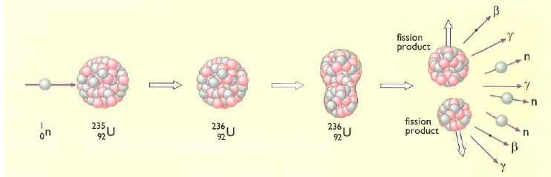
Kernspaltung
1939: (year that WWII began) Fermi realizes that fission will release free neutrons which will be able to split more atoms, releasing more neutrons → rinse, repeat
This is the nuclear chain reaction.
Slow neutron strikes U-235 & is absorbed to produce unstable U-236.
U-236 splits (=fission), due to instability & electrostatic repulsion.
Two new radioactive nuclei (& atoms) are produced, along with,
Energy!
More neutrons
Energy Systems & Sustainability, 2/e, Chapter 10

Slide 17
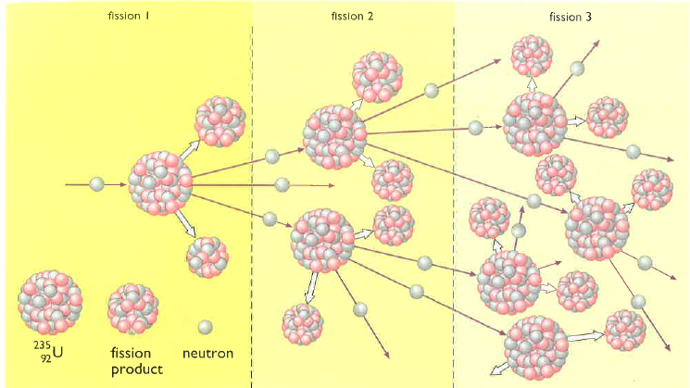
The fission chain reaction
Chain reaction: neutrons released by each fission event create new fission reactions.
Exponential amplification
Energy Systems & Sustainability, 2/e, Chapter 10

Slide 18
Fission products?
U-235 undergoes fission, producing two new nuclei.
If one is barium:
What is the other?
How many ‘surplus’ neutrons are produced?
Nucleus | # protons | # neutrons
U-235 | 92 | 143
Ba-138 | 56 | 82
Kr-86 | 36 | 50
Ba + Kr | 92 | 132
surplus |  | 11 + 1
However, the Ba & Kr produced are usually heavy isotopes, with more neutrons than average. This means that fewer of the surplus neutrons are actually free.
Generally 3-4 free neutrons are produced per fission event.
And the Ba & Kr are also radioactive, emitting β-particles.
Energy Systems & Sustainability, 2/e, Chapter 10

Slide 19
How much energy is released?
Calculations showed that, on average, fission of one atom of U-235 results in the loss of 0.21 amu.
E = (m)(amu)(931) = (1)(0.21 amu)(931) = 200 MeV [m = atoms]
E = 200 MeV = 3.2 E-11 J / atom
So how much energy would be released from fission of 1 kg of U-235?
Each atom has a mass of 235 amu.
One amu = 1.660 E-27 kg.
1 kg 1 amu 1 atom = 2.5 E24 atoms / kg U-235
1.660 E-27 kg 235 amu
(2.5 E24 atoms / kg U-235)(3.2 E-11 J / atom) = 80 E12 J / kg
= 80 TJ / kg U-235
Energy: 1 kg U-235 = 3000 tonnes of coal
Energy Systems & Sustainability, 2/e, Chapter 10

Slide 20
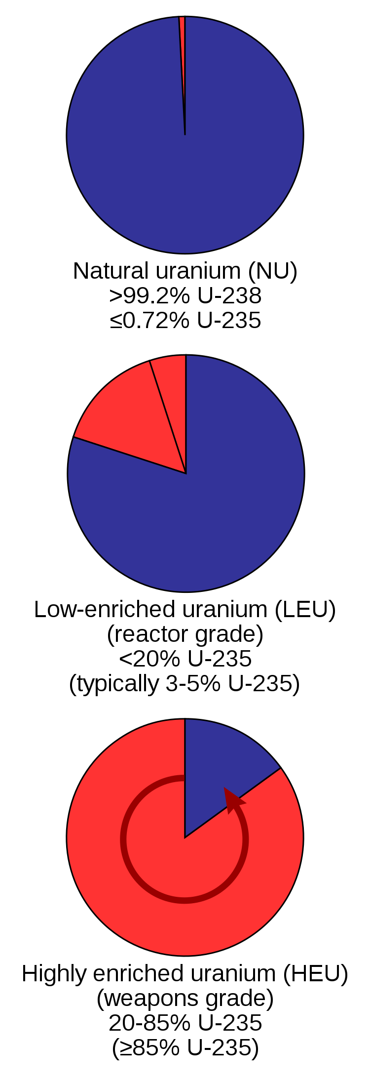
U-235 must be ‘enriched’
For every atom of U-235, uranium has 140 atoms of U-238.
If fission occurs in this unenriched uranium, U-238 will absorb most of the freed neutrons but will not undergo fission.
Chain fission won’t occur.
<1%
To make fission possible, uranium must be enriched for U-235.
Creating a critical mass of enriched uranium also helps fission to occur, as freed neutrons have a greater chance of causing another fission event when they travel through more uranium.
20%
Slowing the fast neutrons by colliding them with carbon (graphite) also increases the chance of more fusion events.
Graphite is a moderator of neutron speed.
85%
Energy Systems & Sustainability, 2/e, Chapter 10; https://en.wikipedia.org/wiki/Enriched_uranium

Slide 21
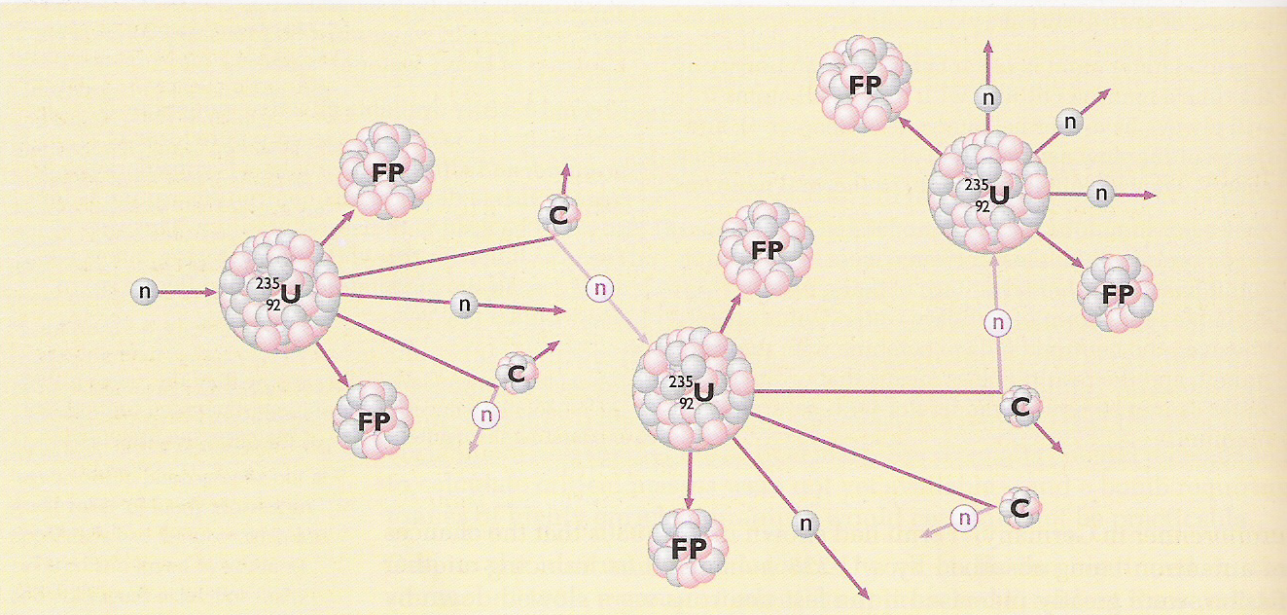
Controlling fission chain reactions
Graphite is added to the uranium; its carbon atoms don’t undergo fission.
When neutrons hit the carbon atoms they slow & the chain reaction occurs but is less amplified.
The slowed neutrons are warmed as kinetic energy is dissipated, so reactors that use moderators are called thermal fission reactors.
Energy Systems & Sustainability, 2/e, Chapter 10

Slide 22
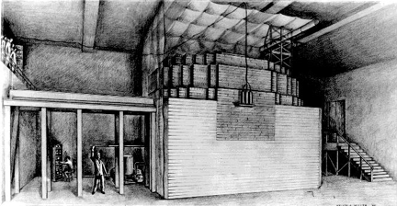
Fission, weapons & power
1941 Enrico Fermi develops a nuclear reactor (‘Fermi’s pile) at the University of Chicago
Oct 1941 US President Roosevelt commits huge resources to the development of an atomic bomb
Dec 1941 Japanese attack Pearl Harbor
1942 Fermi’s team demonstrates controlled chain reaction (fission)
1954 USSR claims the first nuclear power plant
Energy Systems & Sustainability, 2/e, Chapter 10;
http://static.newworldencyclopedia.org/c/c4/Atompile.gif
Fermi’s nuclear reactor

Slide 23
New elements produced by fission
Bombardment of natural uranium with neutrons caused β-emission converting either one or two neutrons into new protons & creating new elements:
93 neptunium
94 plutonium
the 2nd fissile element
U-239 & Np-239 have short half-lives, but Pu-239 has a longer half-life of 25,000 years & accumulates.
U-238 reactors that create Pu-239 are thus called breeder reactors.
Breeder reactors use fast (rather than slow) neutrons.
Energy Systems & Sustainability, 2/e, Chapter 10

Slide 24
Thorium breeding
Thorium (element 90) exists as the isotope Th-232:
Radioactive
Long half-life
fertile
β
β
Th-232
Pa-233
U-233
n
fissile
Energy Systems & Sustainability, 2/e, Chapter 10

Slide 25
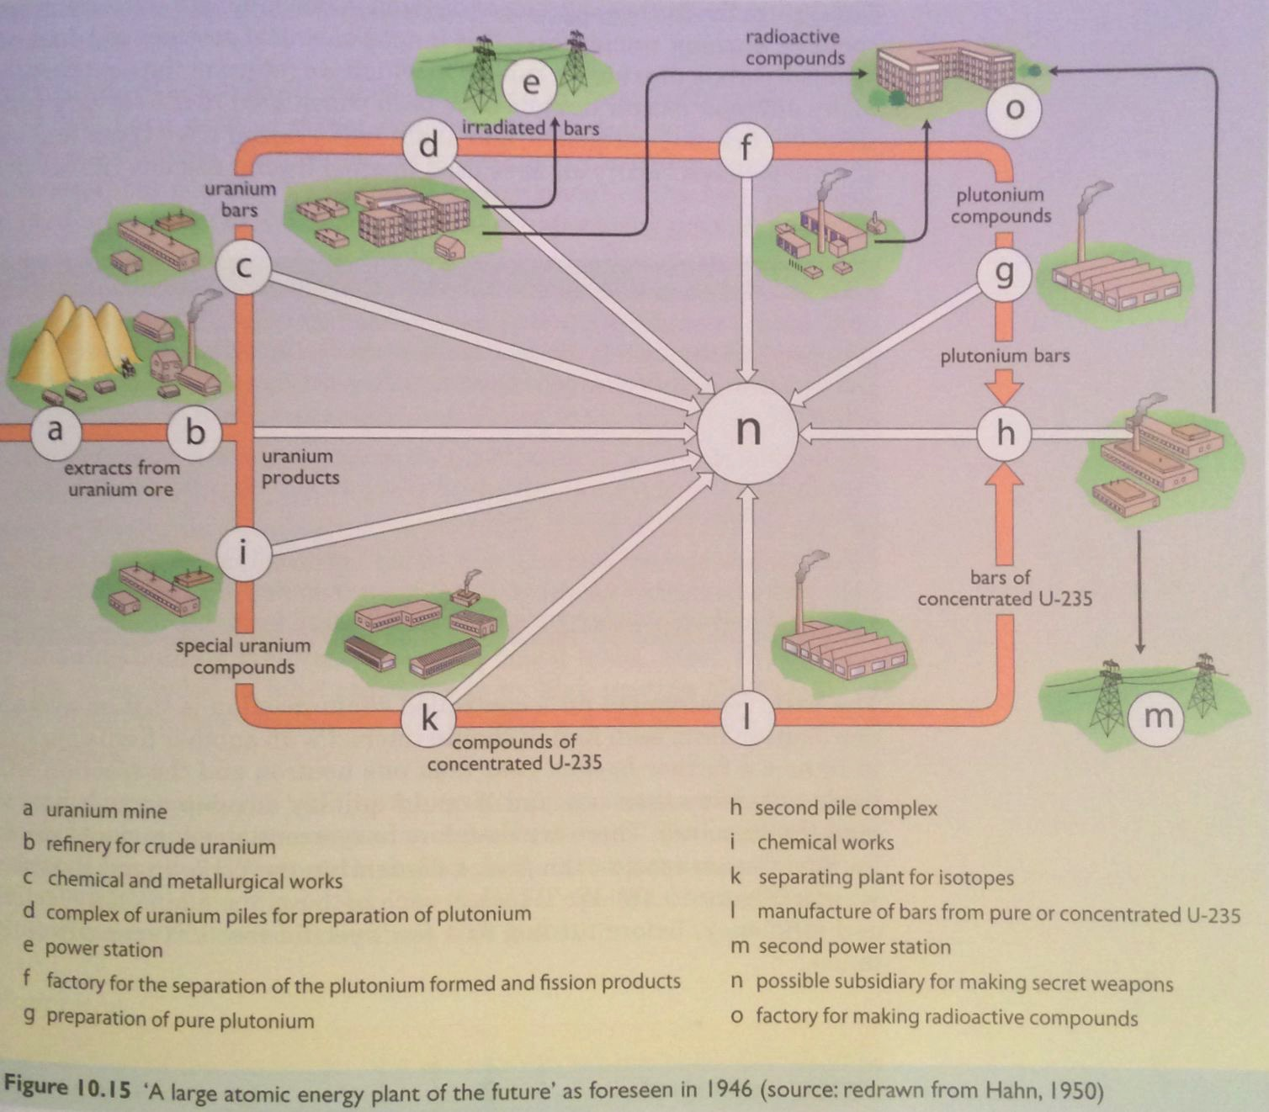
Nuclear power
All fission processes produce heat as a by-product. The heat can be used to create steam, drive stream turbines & generate electricity.
Russia: first reactor in 1954
Energy Systems & Sustainability, 2/e, Chapter 10

Slide 26
6. Nuclear power
6.5: Thermal fission reactors

Slide 27
Thermal fission reactors?
Nuclear reactors don’t burn fuel, rather their uranium undergoes fission giving off heat in the process. That’s one type of thermal.
There are two basic types of nuclear reactors:
Thermal reactors use moderators like graphite to slow neutrons & allow controlled chain reactions
The slowed neutrons carry lost energy as heat.
Fast neutron reactors don’t need moderators so the neutrons aren’t ‘thermalized’.
Energy Systems & Sustainability, 2/e, Chapter 10

Slide 28
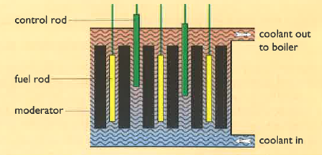
Thermal fission reactors: 4 essentials
Thermal fission reactors have four essential components:
Fuel = uranium;
Moderator, usually graphite;
Coolant to pick up and transfer heat; &
Control system.
Energy Systems & Sustainability, 2/e, Chapter 10

Slide 29
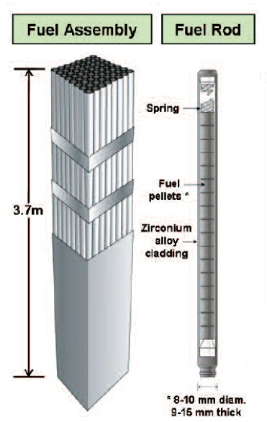
Fuel rods
Early nuclear plants used natural uranium, but recent plants use enriched uranium with 2-5% U-235.
Plutonium produced in breeder plants can be reprocessed & used as fuel.
Thorium can also be used as fuel.
Uranium oxide (UO₂) is a hard ceramic that can be formed into pellets.
Pellets are held in metal tubes.
The metal must not absorb neutrons.
Fuel rods are replaced every 12-18 months.
100 tonnes of fuel per reactor:
2-3 GW of heat
600 – 1000 MW of electricity
Energy Systems & Sustainability, 2/e, Chapter 10;
https://i.pinimg.com/originals/ae/a7/02/aea702d2b7bfdf48ae724853261c2456.jpg

Slide 30
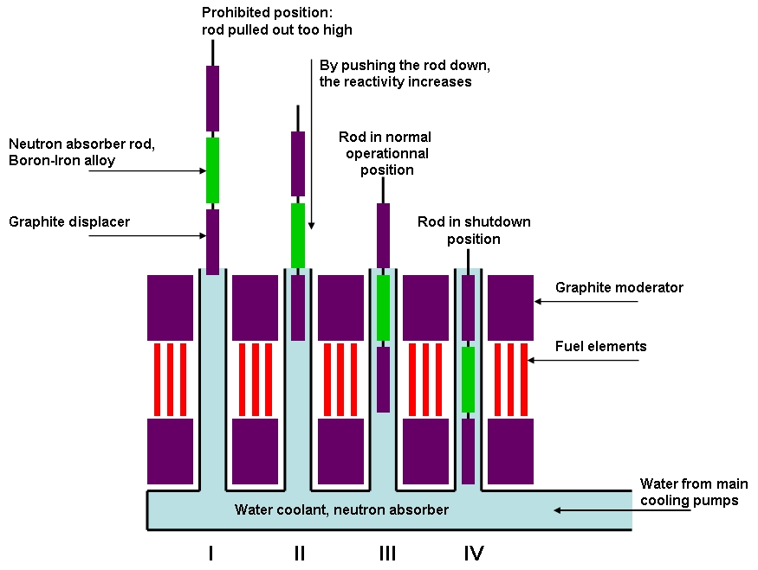
Moderator
Three types of moderator are common:
Light water (H₂O)
Heavy water (D2O)
Graphite (a form of carbon)
Remember that moderators are needed for fission to happen.
Energy Systems & Sustainability, 2/e, Chapter 10;
http://consumedland.com/images/Control%20Rods_en.jpg

Slide 31
Coolants & control systems
Coolants absorb heat released by decaying fuel pellets & carry the heat to the steam generator.
Liquid moderators like light & heavy water can also act as the coolant.
Gas coolants like carbon dioxide can also be used.
Control rods are made of material that absorbs freed neutrons & slow or stop fission from continuing.
Good neutron absorbers:
Cadmium
Boron
When control rods are inserted between fuel rods fission is dampened or stopped.
Energy Systems & Sustainability, 2/e, Chapter 10

Slide 32
Nuclear plant safety
Design of a nuclear plant must store & use fuel at the correct densities & must have a robust coolant system that will continue to function under the most adverse circumstances.
Lack of cooling can cause the fuel in the reactor core to meltdown.
Shielding is needed to protect operators from radiation in the core.
1E12 times the safe limit.
Safe distance without shielding would be 8 km.
Concrete & steel both absorb gamma radiation.
Containment is needed deal with high pressure & radioactive gases produced in the plant.
Energy Systems & Sustainability, 2/e, Chapter 10

Slide 33
Accidents
Most accidents result from loss of control of the nuclear chain reaction resulting in too much heat.
Water used as moderator or coolant can be turned to steam, react with the zirconium alloy fuel rods & produce explosive hydrogen gas.
Loss of cooling is a problem even if the fusion chain reaction is stopped because the fuel will continue to decay & produce heat. This can melt the fuel which can then escape containment.
Three Mile Island (1979, PA)
Fukushima (2011, Japan)
Loss of control would allow a runaway fission chain reaction.
Chernobyl (1986, Ukraine)
Passive response cause plants to safely shutdown if power or coolant systems failed.
Shutdown would be triggered without operator action.
Energy Systems & Sustainability, 2/e, Chapter 10

Slide 34
6. Nuclear power
6.6: Types of thermal fission reactors

Slide 35
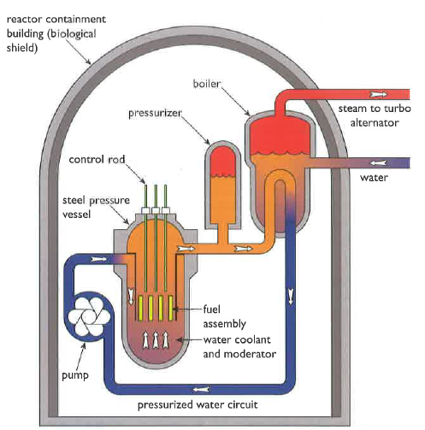
Light water pressurized water reactor
Most nuclear plants are pressurized water reactors (PWRs) developed in the US, or water-water-energy-reactors (VVER) from Russia.
Core:
100 fuel assemblies
Each 100s of UO₂ fuel rods
Water coolant/moderator flows through fuel at high pressure
Boiler:
Heated water (300°C) is pressurized to 100 atm to ensure that it remains liquid & can work as coolant.
Heat exchange in the boiler produces steam for electric generation.
Containment & safety:
Pressure vessel
Emergency coolant system
Energy Systems & Sustainability, 2/e, Chapter 10

Slide 36
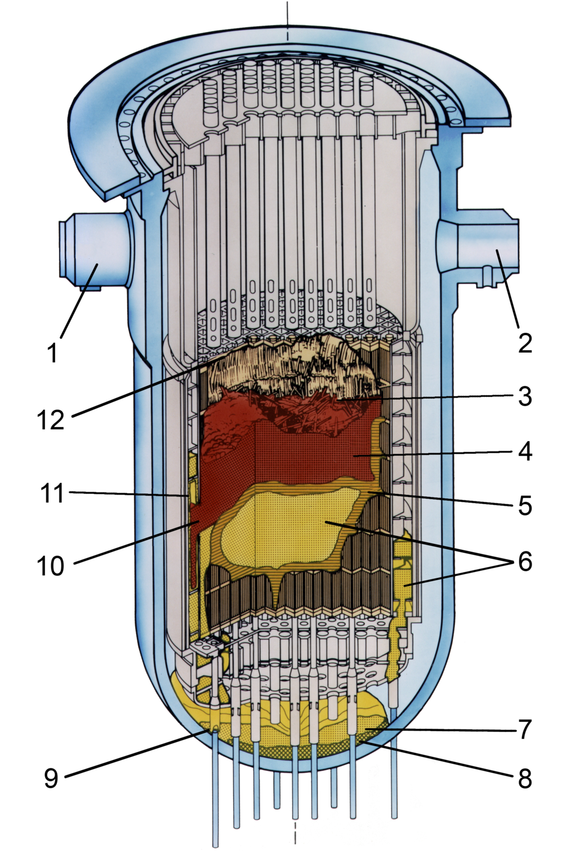
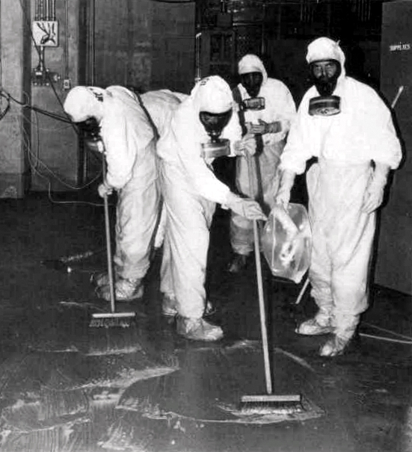
Failure: Three Mile Island (PA)
28 March 1979
A water pump in the cooling system failed (jammed valve) allowing coolant to escape. Operators were confused.
The reactor overheated.
A small amount of radioactive material was released into the atmosphere.
No immediate or anticipated health effects.
Small but not statistically signficant increase in cancer.
Energy Systems & Sustainability, 2/e, Chapter 10
https://en.wikipedia.org/wiki/Three_Mile_Island_accident

Slide 37
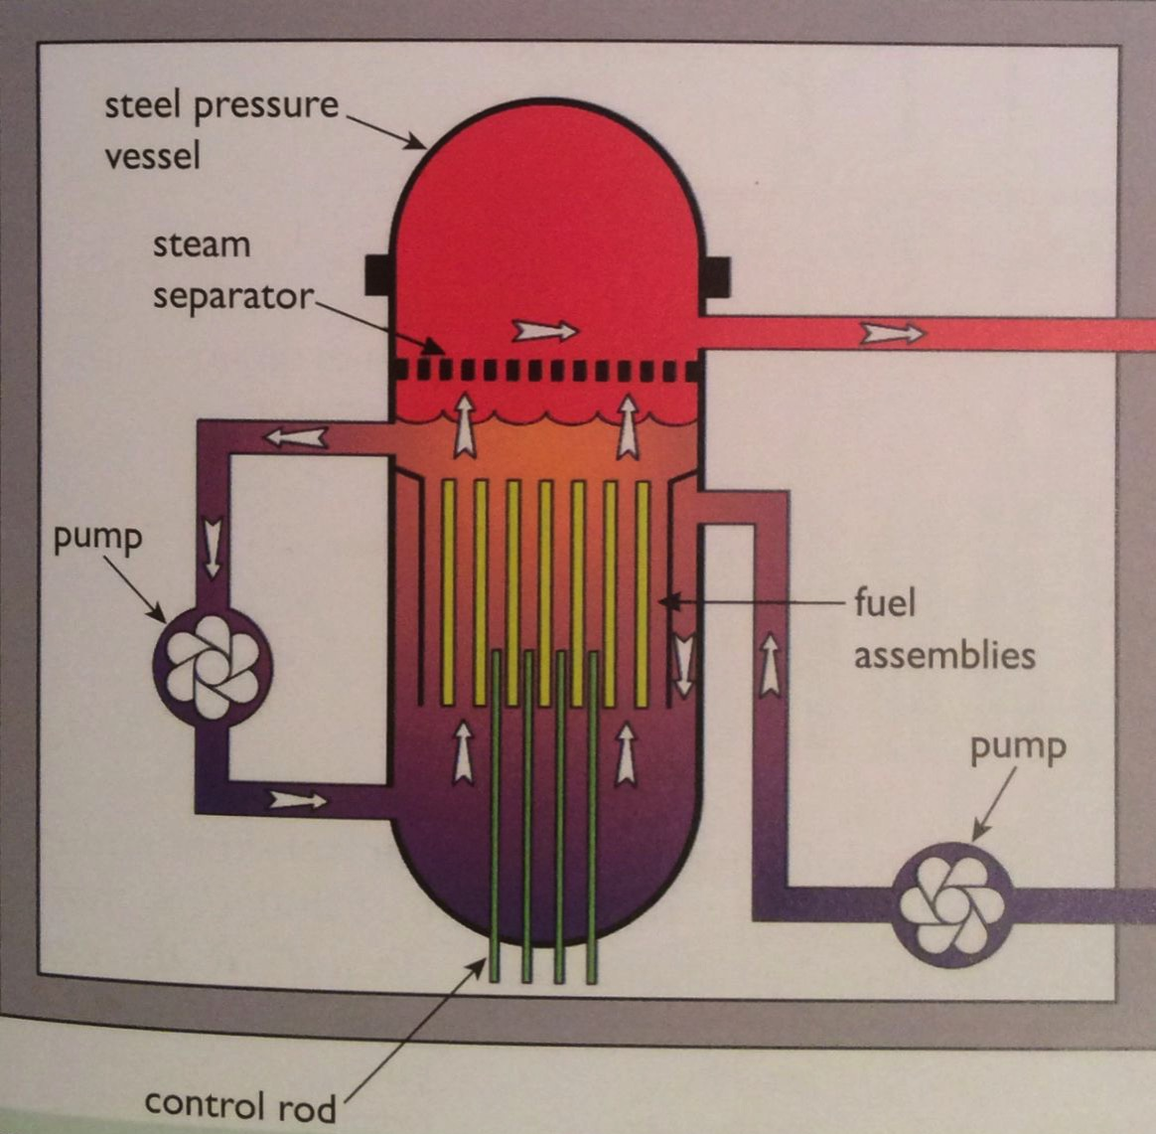
Light water boiling water reactor
Boiling water reactors (BWRs) developed in the US are next most common. Fukushima has BWRs.
Similar to PWR, except:
The water that flows through the fuel rods is allowed to boil to steam which is then used in the turbines.
Turbines are exposed to radioactivity.
Lower cost.
Energy Systems & Sustainability, 2/e, Chapter 10

Slide 38
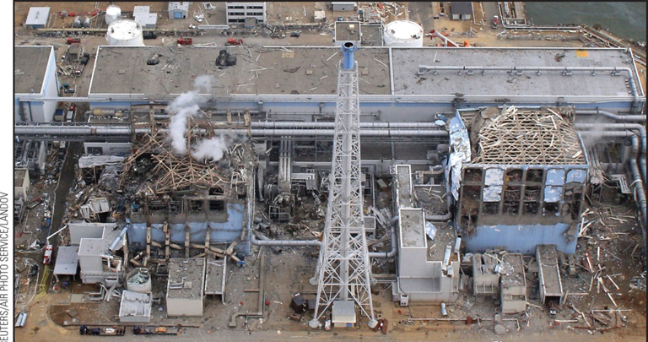
Failure: Fukushima (Japan)
11 March 2011
The plants electrical infrastructure was damaged by a tsunami.
Loss of coolant caused reactors to overheat, leading to explosions.
Radioactive material was released.
Estimated at 10-20% as much as at Chernobyl.
Long-term health effects have yet to be determined.
The site is closed.
Engineers are freezing ground- water to prevent it from running into the sea; not totally successful.
Energy Systems & Sustainability, 2/e, Chapter 10

Slide 39
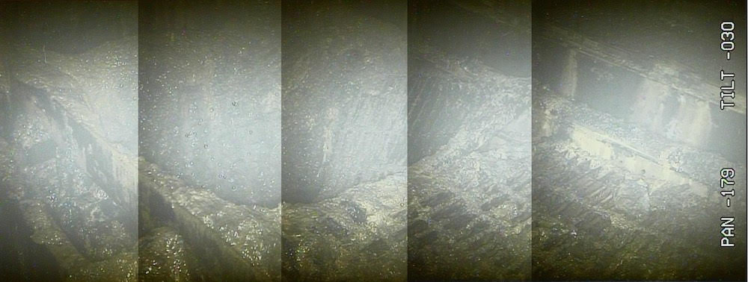
Failure: Fukushima (Japan)
Recently, TEPCO has sent robots into one of the Fukushima nuclear plants to assess damage and assess the possibility of cleanup.
High radiation levels have ‘fried’ the robots as quickly as 30’.
This image shows a hole in the floor of the reactor; may have been caused by meltdown of fuel.
Radiation levels are 210 SV/hour: fatal to humans within minutes.
Cleanup is expected to continue for at least 40 years.
https://voices.nationalgeographic.org/2017/02/22/after-alarmingly-high-radiation-levels-detected-what-are-the-facts-in-fukushima/

Slide 40
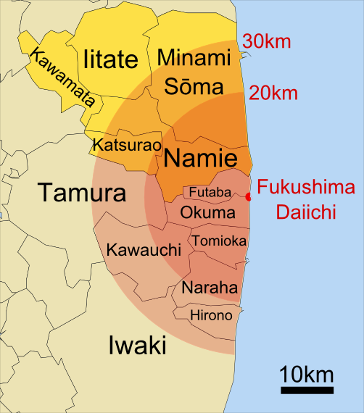
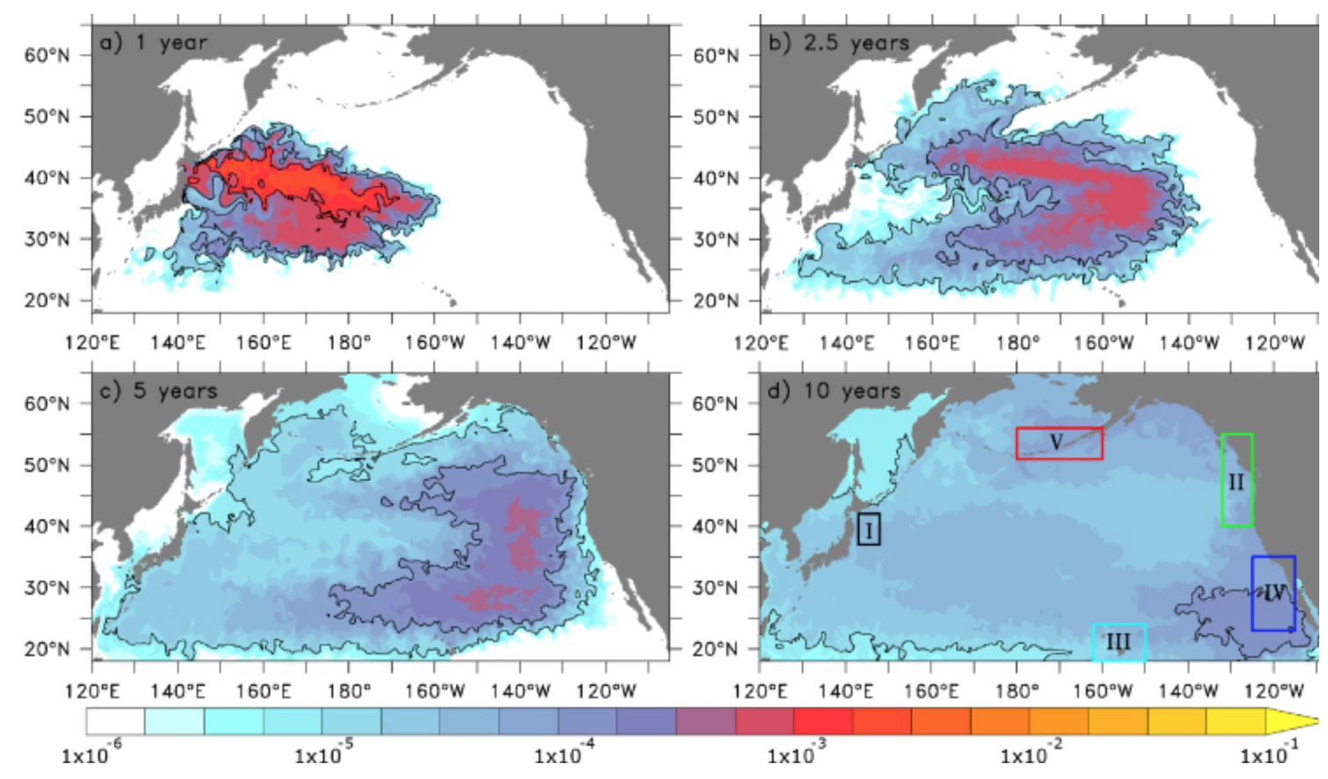
Extent of release
70,000 residents were evacuated
Most will be permanently resettled.
5-year modeling for movement of radio- active contamination.
Arrived WA, USA at end of 2016.
http://iopscience.iop.org/article/10.1088/1748-9326/7/3/034004; wikpedia

Slide 41
Gas-cooled reactors
Gas-cooled reactors were developed in the UK to use natural uranium.
Magnox reactors:
Graphite moderator
Carbon dioxide gas cooling
Magnesium alloy clad fuel rods
30% electric production efficiency
Core:
Solid graphite with vertical slots for fuel & control rods.
CO₂ coolant is pumped through the core at 40 atm.
Heat exchangers create steam for turbine.
Heavy concrete containment for cooling gas.
Energy Systems & Sustainability, 2/e, Chapter 10

Slide 42
Heavy water reactors
Canadian-deuterium-uranium (CANDU) reactors next most common (20).
Heavy water moderator & coolant at 300°C.
Coolant & moderator are separated.
Low thermal efficiency, but able to use a variety of fuels, including spent PWR fuels & surplus weapons-grade plutonium.
Now called pressurized heavy water reactors.
Energy Systems & Sustainability, 2/e, Chapter 10

Slide 43
RBMK reactors
High power channel-type reactor (RBMK) was developed in Russia.
Graphite moderator
Light water coolant.
Energy Systems & Sustainability, 2/e, Chapter 10
Chernobyl used this design.
None are being built but about a dozen are still operating.

Slide 44
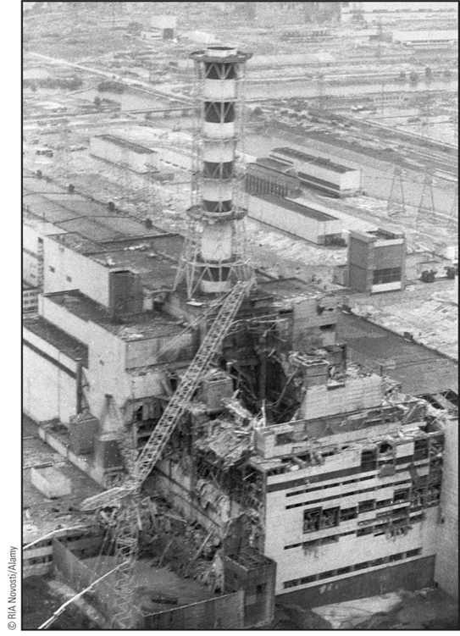
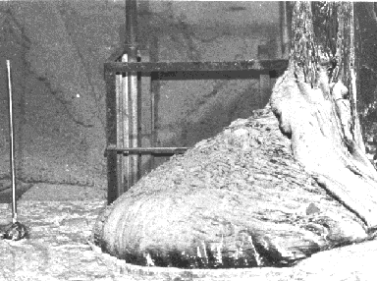
Failure: Chernobyl (Ukraine, USSR)
25 April 1986
The reactor became unstable as a result of tests run by the operators.
Overheating caused water to decompose, releasing hydrogen gas which then exploded.
The reactor core caught fire and melted.
Plumes of radioactivity spread across Europe.
The site 30 km in diameter is still closed & will be for 20,000 years.
https://en.wikipedia.org/wiki/Chernobyl_disaster

Slide 45
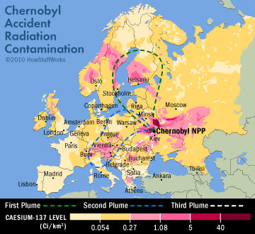
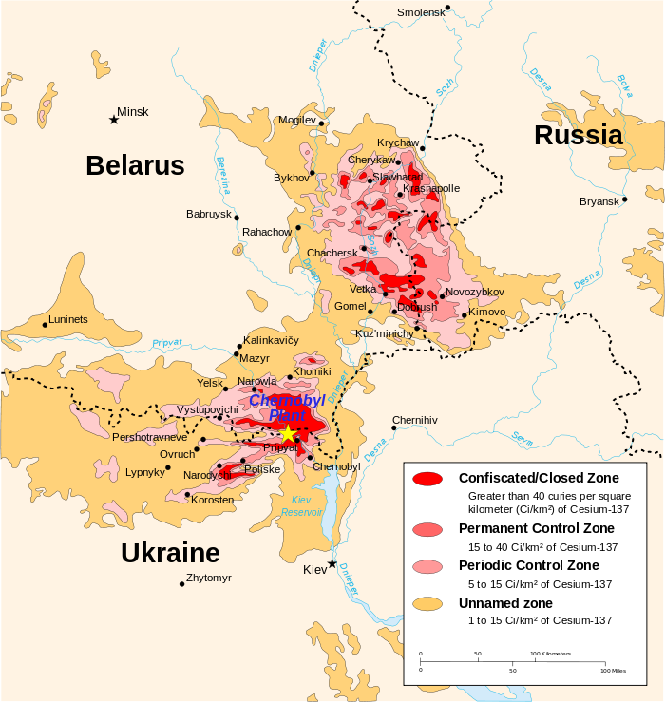
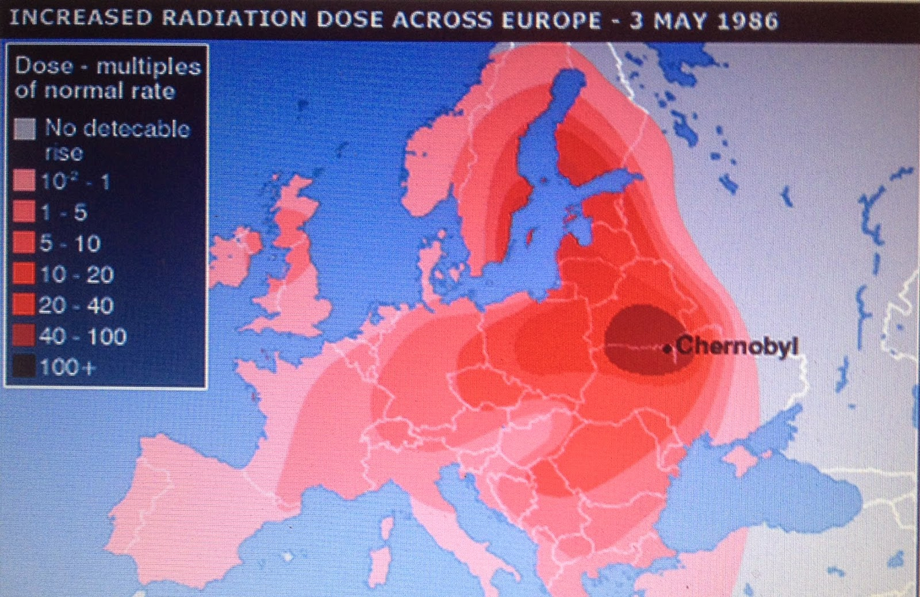
Extent of release
Wikipedia & BBC

Slide 46
6. Nuclear power
6.7: Nuclear fuel cycles

Slide 47
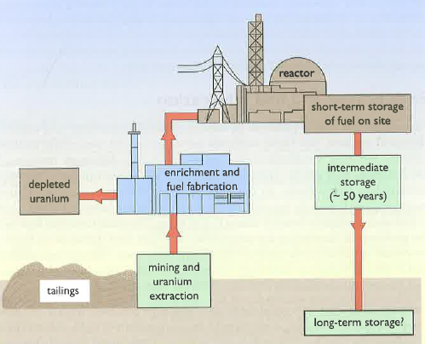
Nuclear fuel cycle
To assess nuclear power we must examine the entire nuclear fuel cycle.
Mining & extraction
Enrichment & fabrication
Reaction
Dealing with spent fuel.
Energy Systems & Sustainability, 2/e, Chapter 10

Slide 48
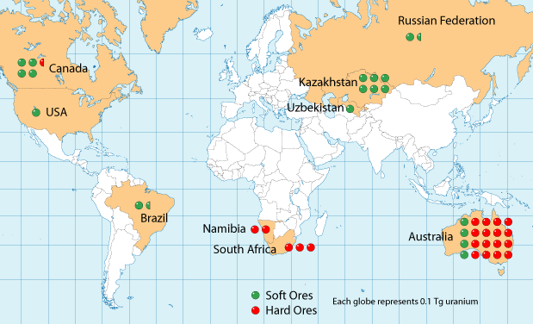
Uranium reserves
Global distribution of uranium reserves is pretty widespread.
Energy Systems & Sustainability, 2/e, Chapter 10;
watd.wuthering-heights.co.uk

Slide 49
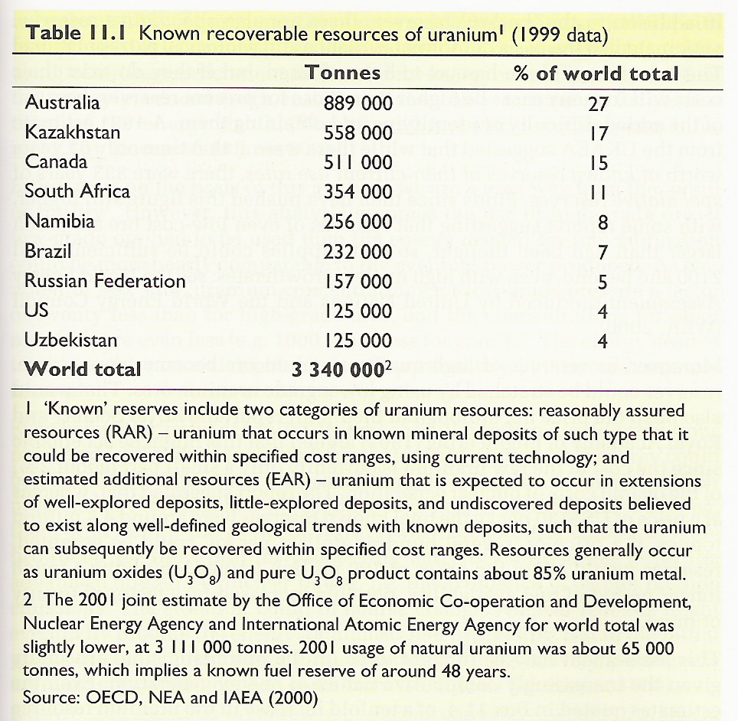
Uranium reserves quantified
Known global recoverable reserves.
Energy Systems & Sustainability, 2/e, Chapter 10

Slide 50
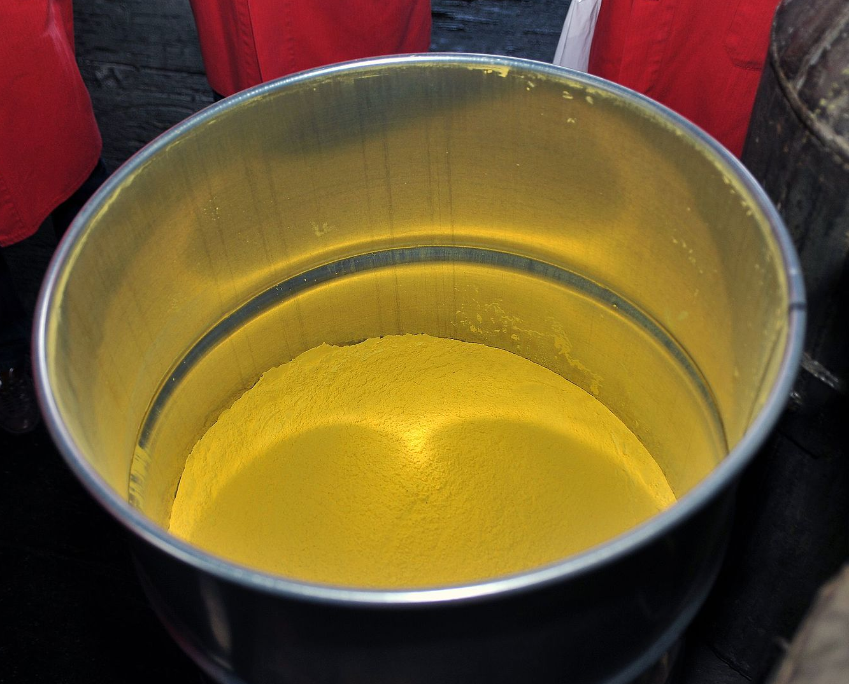
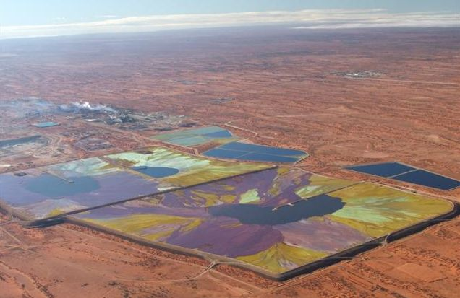
Uranium mining & extraction
Uranium ore is a mixture of uranium oxides, U₃O₈.
High-grad ore: a few percent
Low-grade ore: one part per thousand
Processed U₃O₈ is a yellow powder called yellowcake.
Yellowcake
Tailings, the material remaining after extraction of uranium from ore, is radioactive & must be stored to avoid impacting human health.
Uranium tailings ponds
Energy Systems & Sustainability, 2/e, Chapter 10

Slide 51
Uranium enrichment & fabrication
The only difference between the U-235 & U-238 isotopes is mass.
Gas diffusion:
Uranium oxide (U₃O₈) is converted to uranium hexafluoride (UF₆).
Becomes a gas when heated a bit.
Lighter isotope diffuses through a membrane faster.
1000X diffusion increases U-235 by 3-4%.
Gas centrifuge:
Uranium oxide (U₃O₈) is converted to uranium hexafluoride (UF₆).
Becomes a gas when heated a bit.
Spun at very high speed in gas centrifuges.
Multiple spins required to separate isotopes, but 50X more energy efficient than gas diffusion.
In either case, enrichment leaves large amounts (nearly all the starting material) that is depleted in U-235. This material is called depleted uranium and must be stored for future use. It’s still radioactive.
Its high density has caused some to be used in artillery.
Energy Systems & Sustainability, 2/e, Chapter 10

Slide 52
Nuclear fuel assembly
Pellets fill rods or pins.
Many pins create an assembly.
The core is a group of assemblies with space for coolant to circulate between them.
Energy Systems & Sustainability, 2/e, Chapter 10

Slide 53
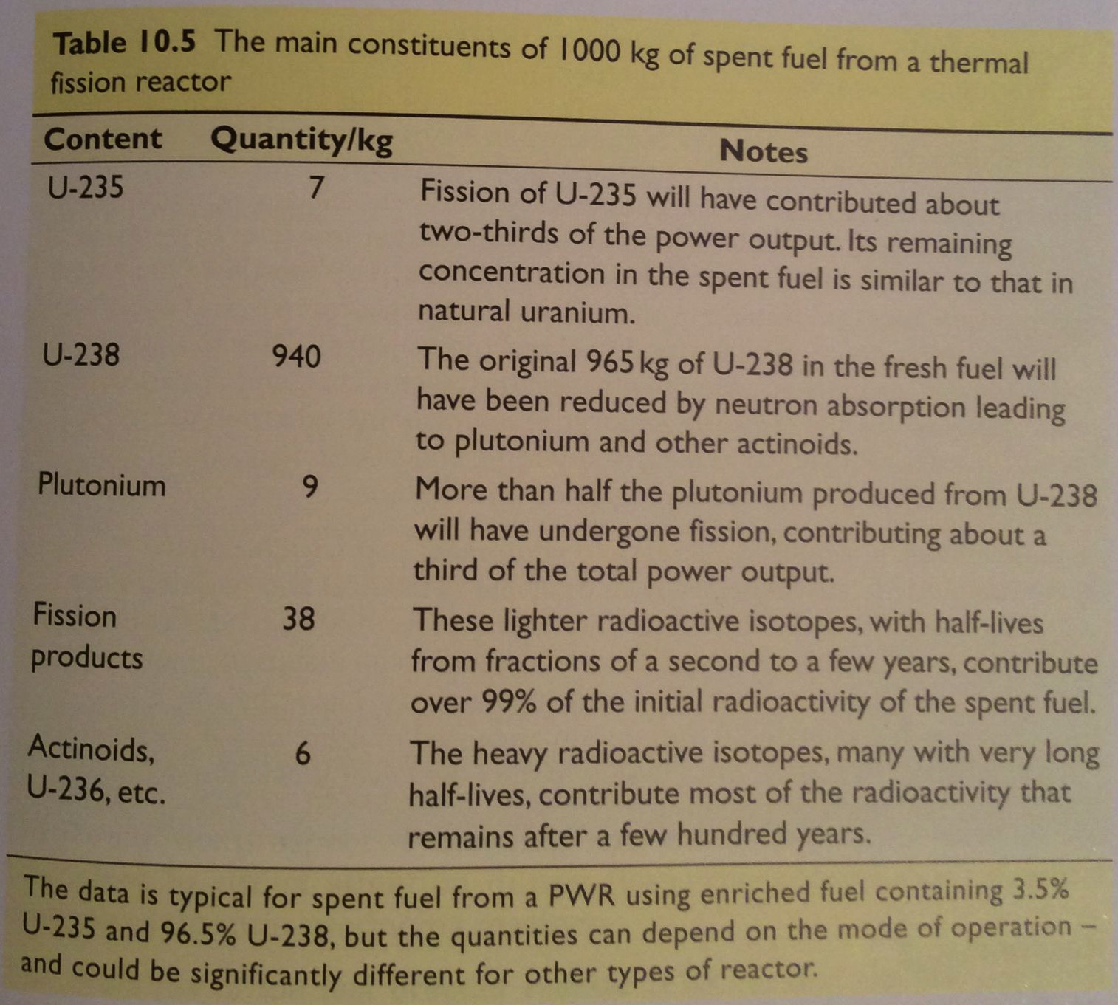
Spent fuel
As fission proceeds in fuel rods, fission products & actinoids build up & ‘poison’ the fuel because they lower heat output.
Typically, a fuel assembly functions for 3 years.
About 1/3 of assemblies are replaced each year.
Energy Systems & Sustainability, 2/e, Chapter 10

Slide 54
Spent fuel storage & disposal
Spent fuel is highly radioactive & is therefore stored in pools of water with active cooling systems for at least a year.
At Fukushima spent fuel cooling systems failed, causing fuel to heat, produce hydrogen gas, explode and burn.
Direct disposal: leaves spent fuel assemblies in pools for 40-50 years.
** Needs tens of thousands of years of stable, safe storage.**
Reprocessing: extracts remaining & new fissile elements for reuse.
5 years in cooling tanks.
Chemical separation of uranium, plutonium & waste.
Energy Systems & Sustainability, 2/e, Chapter 10

Slide 55
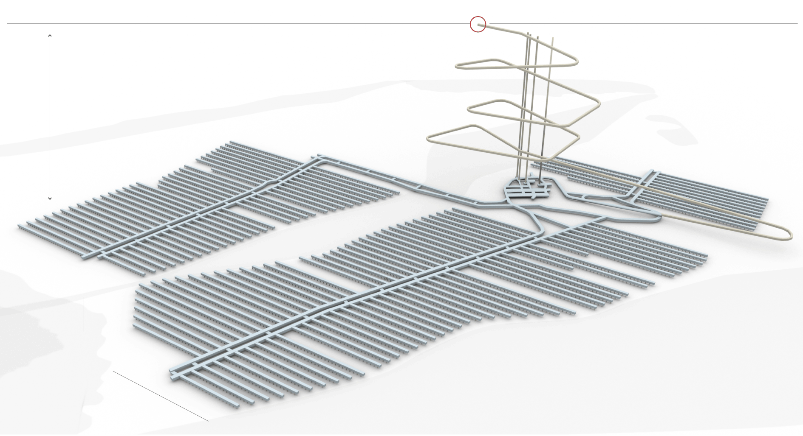
Finland: long-term nuclear storage leader
Finland is the world leader in long-term nuclear storage.
They have a plan & are in the 10-year construction phase; $3.9 b.
1,400-feet deep within granite bedrock, back-filled with clay.
Worked hard at community relations.
Energy Systems & Sustainability, 2/e, Chapter 10;
https://www.nytimes.com/2017/06/09/science/nuclear-reactor-waste-finland.html

Slide 56
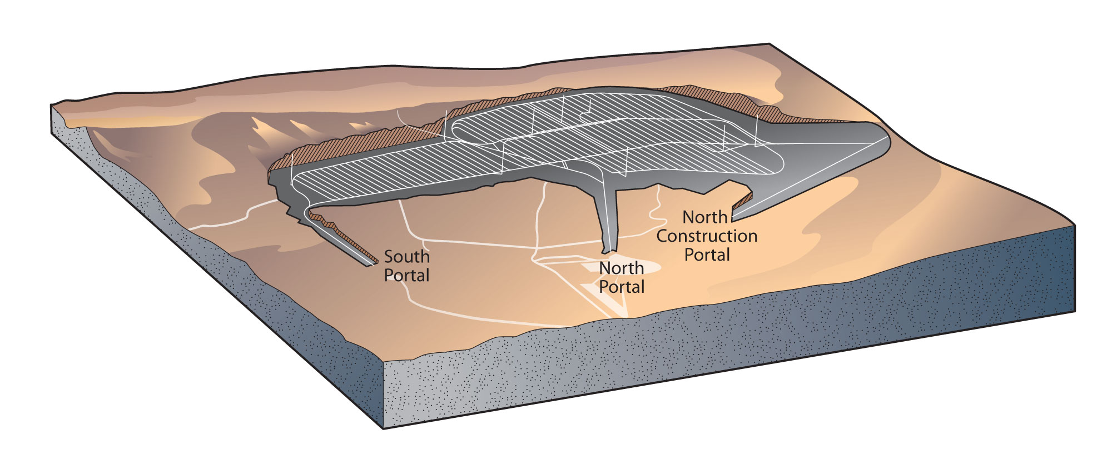
Yucca Mountain ?
The US has been debating plans to bury our nuclear waste below Yucca Mountain Nevada.
Funding for research about the site and planning ceased in 2011.
As of 2015, the US had 70,000 metric tonnes of waste to store.
Pros:
The US really needs a storage site.
Yucca Mountain is in a nuclear test area; already involved.
Yucca Mountain has been extensively studied by geologists.
Cons:
Yucca Mountain was formed by volcanic activity.
It’s volcanic tuff is fractured and sits above an aquifer.
Nevada has significant seismic activity; 4th in the US.
The Bow Ridge fault line is closer to Yucca Mountain than previously thought.
Energy Systems & Sustainability, 2/e, Chapter 10;
https://en.wikipedia.org/wiki/Yucca_Mountain_nuclear_waste_repository

Slide 57
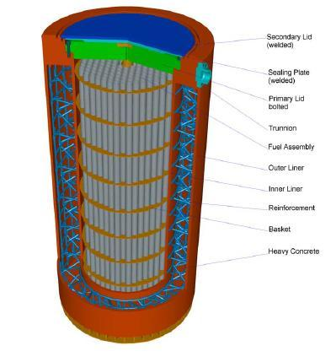
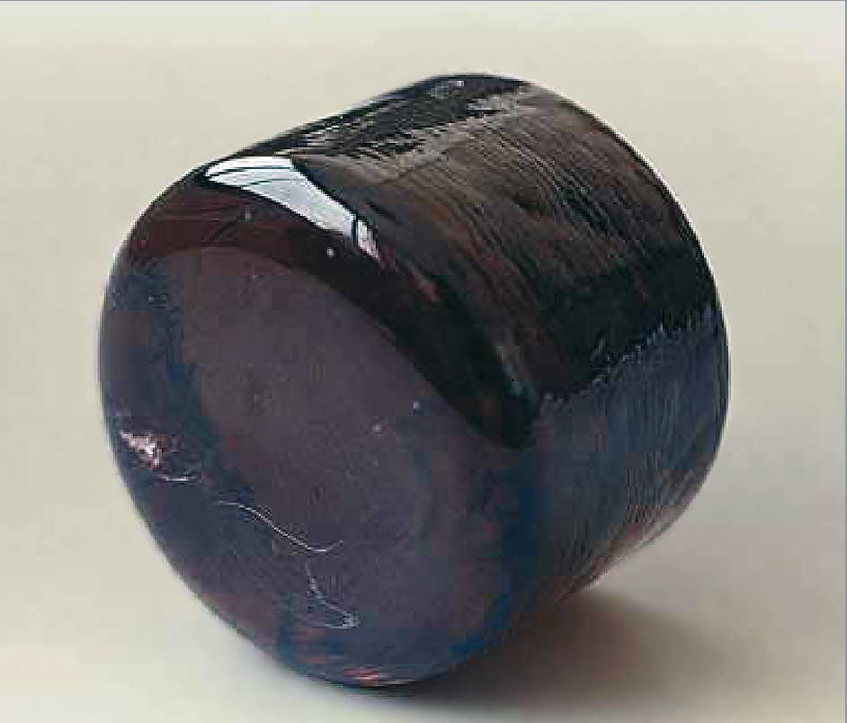
Current ‘long-term storage’ in the US
Without an underground storage facility – or the prospect of one in the near future – high level nuclear waste is stored in two ways.
Dry cask storage: sealed steel & concrete containers.
2009: 22% of US commercial waste.
1990s: repeated problems with bad welds
Vitrification: nuclear waste is melted with glass-forming chemicals to form a stable obsidian-like glass.
Stable & doesn’t leach.
Synroc: nuclear waste is mixed with elements to form a crystalline powder & compressed into a ceramic.
Energy Systems & Sustainability, 2/e, Chapter 10;
https://en.wikipedia.org/wiki/Yucca_Mountain_nuclear_waste_repository
https://en.wikipedia.org/wiki/Vitrification
https://en.wikipedia.org/wiki/Synroc

Slide 58
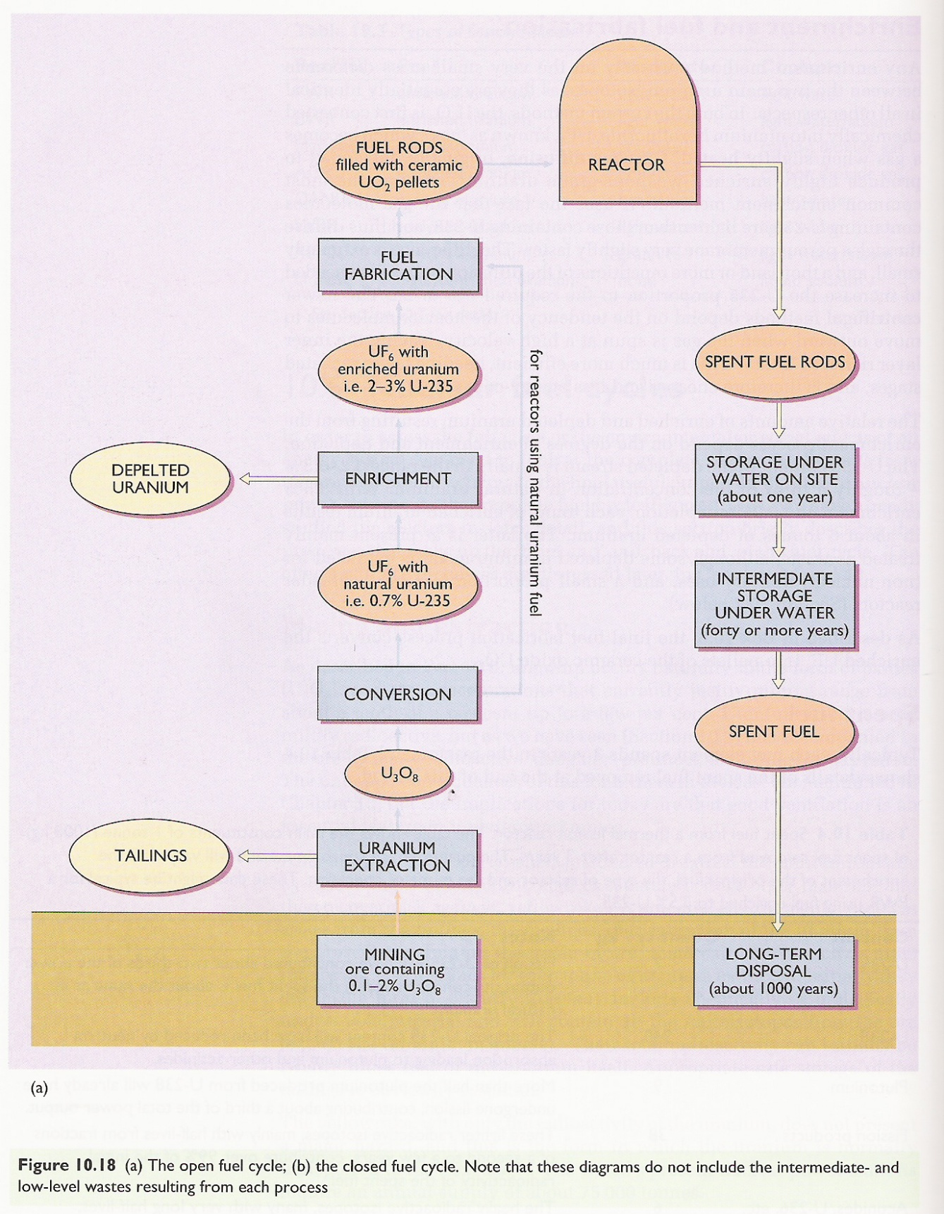
Summary of the nuclear fuel cycle
Energy Systems & Sustainability, 2/e, Chapter 10

Slide 59
6. Nuclear power
6.8: Fast neutron reactor

Slide 60
Fast neutron reactors
Fast neutron reactors (FNR):
Don’t use moderators to slow down neutrons. But fast neutron are less efficient at causing fission reactions.
Therefore, FNRs must use fuel which has greater enrichment for fissile elements, 10 – 30% vs. 2 - 5%.
FNRs are much less common than reactors that use moderators.
Fast breeder reactors (FBR) are a form of FNR that are operated to create plutonium or other novel fissile elements.
Reactors designed to use up fissile elements are sometimes called burners.
Energy Systems & Sustainability, 2/e, Chapter 10

Slide 61
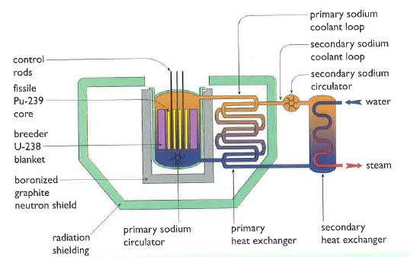
Liquid metal fast breeder reactors
All FBRs generate more heat, so cooling is a bigger concern.
The fission core of LMFB reactors is surrounded by a ‘blanket’ of U-238 in which ‘breeding’ occurs.
Liquid sodium coolant circulates through the system and transfers heat to create steam.
Sodium is neither a moderator nor an absorber.
Safety concerns?
Concentrated fuel could runaway.
Reprocessing is needed & is hazardous.
Pu can be used for weapons.
Energy Systems & Sustainability, 2/e, Chapter 10

Slide 62
6. Nuclear power
6.9: Newer reactor designs

Slide 63
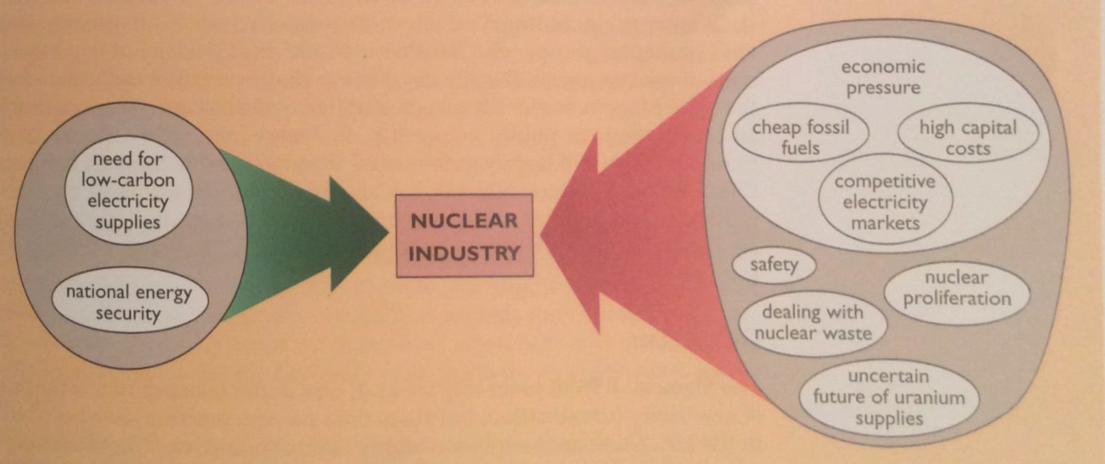
Factors in the decline of nuclear power
As we’ve seen, the construction of new nuclear plants slowed in the 1990s. Why?
Both the Thatcher & Regan governments supported the free market vs. government backing needed to prop up nuclear in an era of cheap fossil fuels.
Energy Systems & Sustainability, 2/e, Chapter 11

Slide 64
Costs & CO₂ emissions of nuclear power
Levelized costs of generation from EIA.
Median carbon dioxide values
Fuel | LCOE ($ / MWh) | Grams CO₂ / kWh
Coal (pulverized) | *140.0 | 820
NG (CCGT) | 57.3 | 490
biomass | 102.4 | 230
Solar PV (utility) | 66.8 | 48
geothermal | 46.5 | 38
Concentrated solar | 184.4 ??? | 27
hydropower | 66.2 | 24
Offshore wind | 145.9 | 12
Nuclear, advanced | 99.1 | 12
Onshore wind | 52.2 | 11
*EIA: 2016 levelized costs including capital, O&M, transmission, tax credits.
https://en.wikipedia.org/wiki/Life-cycle_greenhouse-gas_emissions_of_energy_sources; 2014 IPCC; EIA

Slide 65
Reducing the costs of nuclear power
To make nuclear power more competitive capital, operating & maintenance costs must be reduced &safety must be improved.
Design changes may lower costs and improve safety:
Modular design for factory construction and testing;
Simplified design with fewer components;
Simplified fuel handling to reduce O&M costs; &
Increasing operating temperatures for improved efficiency.
Energy Systems & Sustainability, 2/e, Chapter 11

Slide 66
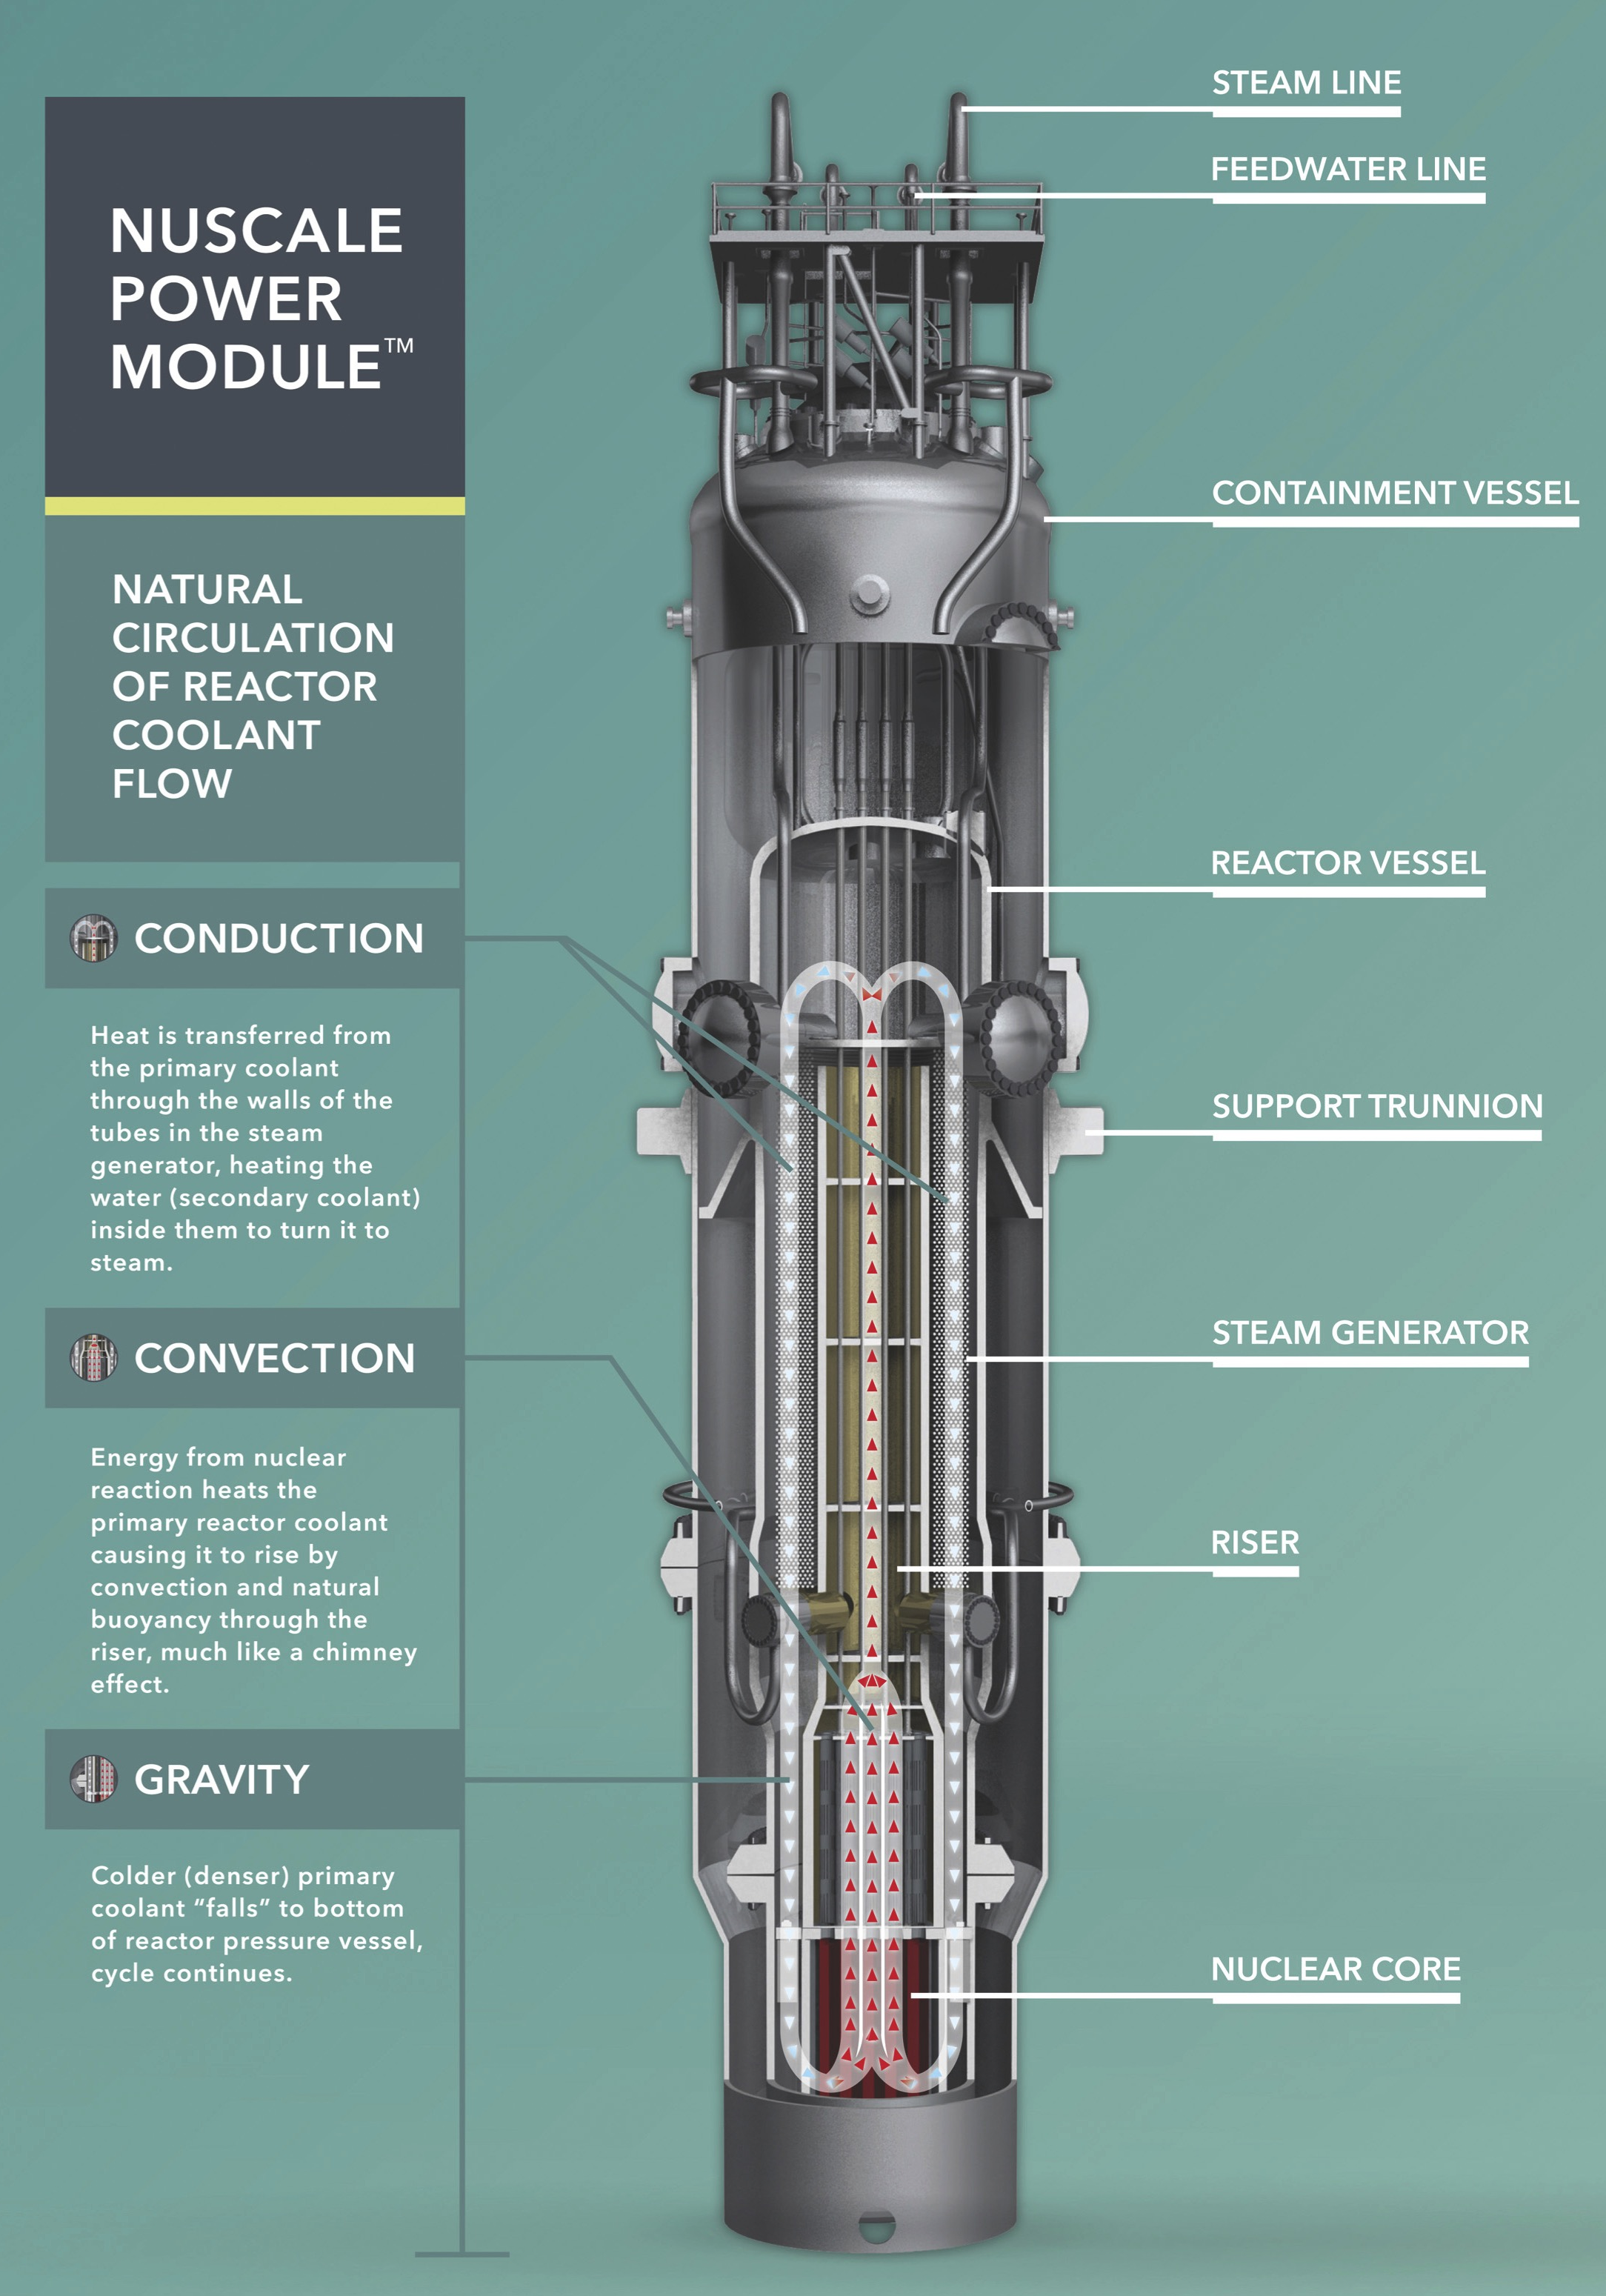
Shrink it: small modular reactor
Example: NuScale Power
Self-contained
65’ tall, 9’ diameter
Built in factory & shipped to site ready for installation in cooling pool
Passive coolant circulation operates without power
50 MWe electrical capacity
Cost ~ $5,100 / kW
http://www.nuscalepower.com/our-technology/design-advances

Slide 67
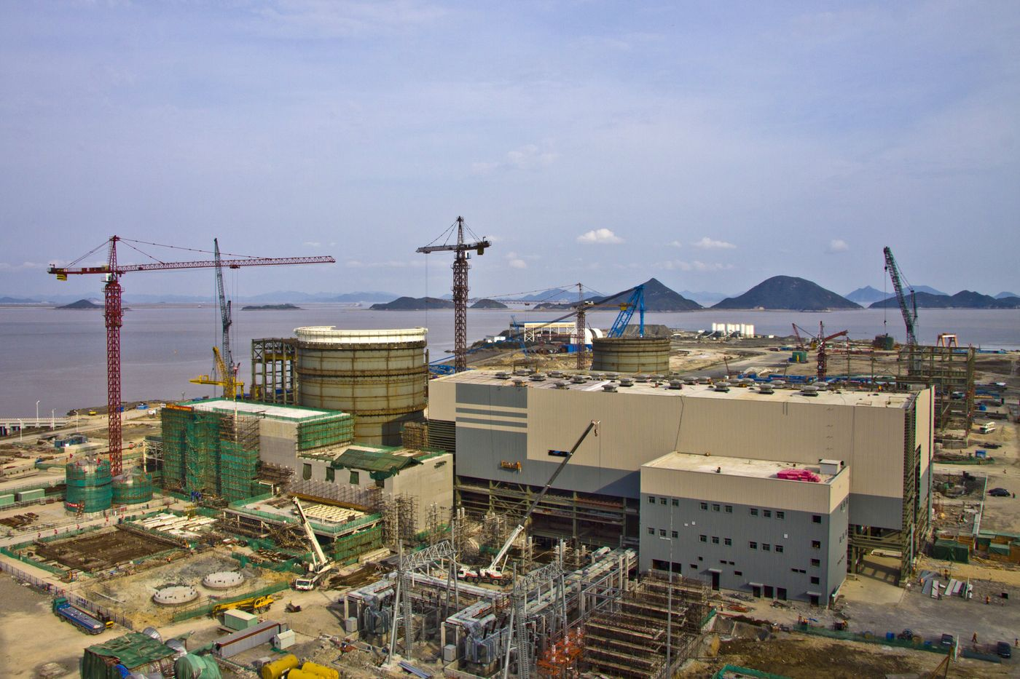
Westinghouse Advanced Passive AP1000
In the US, four plants of this design were under construction in Georgia & SC. Construction of the SC plants has been halted. The GA plants are under construction with issues.
China has built plants with the AP1000 design at Sanmen. Start-up is expected in late 2017.
AP1000 features:
Steel secondary containment;
Passive, gravity fed water cooling system;
Simplified design:
35% fewer pumps;
85% fewer control cables;
Also fewer safety system pumps;
Smaller size;
Modular construction.
Energy Systems & Sustainability, 2/e, Chapter 11;
https://www.bloomberg.com/news/articles/2017-04-26/nuclear-reactor-treasure-seen-buried-in-wreck-of-westinghouse

Slide 68
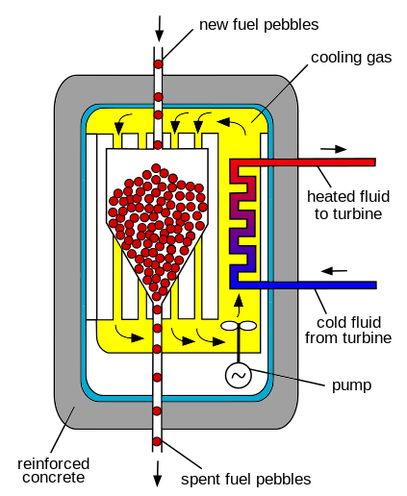
Pebble-bed high temperature reactor
Pebble-bed reactors have radically different fuel handling systems.
Pebbles: 1000s of small kernels of UO₂ coated with layers of graphite.
Combining many pebbles in a hopper achieves critical mass.
Cooled by pumping high-pressure He through the pebbles.
Operates at 900°C.
Drives a CCGT generation system.
Germany abandoned the design when a pebble jammed, was damaged & leaked.
China is building pebble-bed reactors.
Energy Systems & Sustainability, 2/e, Chapter 11;
https://en.wikipedia.org/wiki/Pebble-bed_reactor

Slide 69
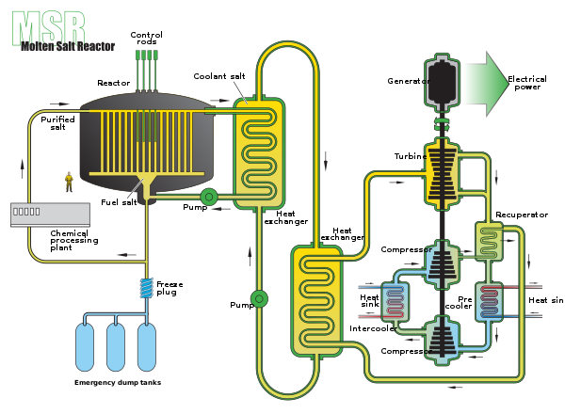
Molten-salt reactors
Molten-salt reactors use a radically different design in which the coolant – which may be the fuel itself – is a molten salt.
Advantages:
High temp & thermal efficiency.
Liquid UF4 is dissolved in coolant.
Circulation through graphite core causes criticality.
Safety:
Loss of coolant is loss of fuel, so stops criticality.
Overheating melts a safety plug, draining fuel into water cooling pond, solidifying fuel.
Energy Systems & Sustainability, 2/e, Chapter 11;
https://en.wikipedia.org/wiki/Molten_salt_reactor

Slide 70
6. Nuclear power
6.10: Nuclear power in Vermont

Slide 71
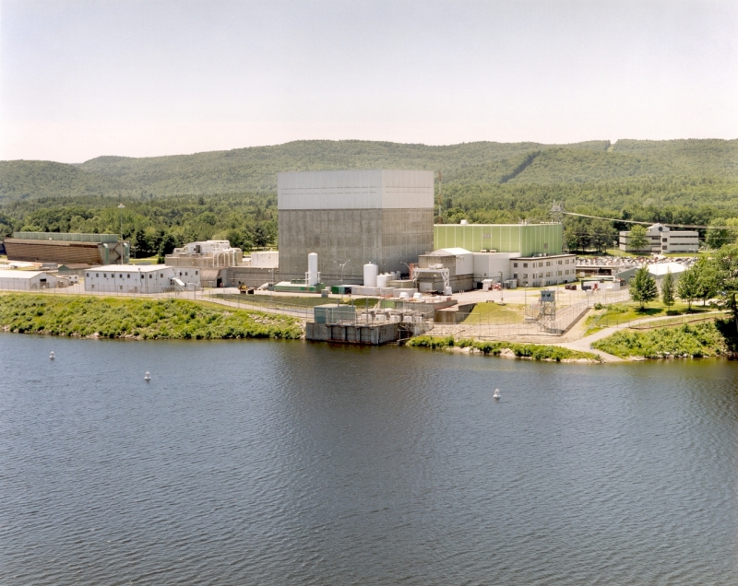
Vermont Yankee nuclear plant
Data
Location | Vernon, VT
Operator | Entergy
Start of commercial operation | February 28, 1973
Reactors
Reactor supplier | General Electric
Reactor type | BWR-4
Power
Capacity | 620 MW
Total power generation in 2007 | 4,703 GW·h
Average annual generation (last 5 yrs) | 4,436 GW·h
Energy Systems & Sustainability, 2/e, Chapter 10

Slide 72
Vermont Yankee nuclear plant
Vermont Yankee occupies a 125-acre site in Vernon, VT (Windham County)
September 2003: Entergy Nuclear Operations, the owner, submitted an application to the Nuclear Regulatory Commission (NRC) to increase the plant’s maximum power level by 20%.
There were questions and objections.
The plant was nearing the end of its licensing period.
And it needed to be refueled to increase power.
January 2007: Entergy applied for a 20-year license extension.
2014: Vermont Yankee closed… decomissioning dates uncertain
www.eia.doe.gov

Slide 73
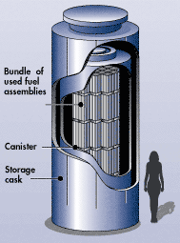
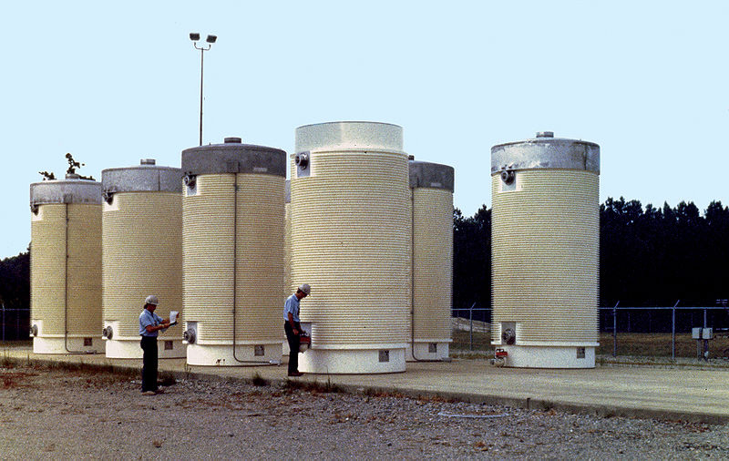
Dry cask storage of nuclear waste
Nuclear waste at Vermont Yankee is stored on site in ‘dry casks’.
Spent fuel is placed in a canister & flooded with inert gas.
The steel cylinder is bolted / welded shut.
Cylinders are surrounded by additional steel, concrete or other material to shield humans from radiation.
www.eia.doe.gov

Slide 74
6. Nuclear power
6.11: Power from fusion

Slide 75
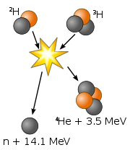
What is fusion?
Fusion of two isotopes of hydrogen, deuterium (²H) and tritium (³H), creates helium-4.
A neutron is freed.
17.59 MeV of energy is released when matter is converted to energy according to E = mc².
Fusion powers the sun, & thus is the ultimate source of power for life on our planet.
Products are not radioactive or hazardous.
Energy Systems & Sustainability, 2/e, Chapter 10
www.eia.doe.gov

Slide 76
Energy released by fusion
How much energy is released when one atom of deuterium fuses with one atom of tritium to create an atom of helium and a neutron?
particle | mass (atomic mass units)
deuterium atom | 2.0136
tritium atom | 3.0155
helium atom | 4.0015
neutron | 1.0087
²H + ³H → ⁴He + 1 n
2.0136 + 3.0155 → 4.0015 + 1.0087
5.0291 → 5.0102
Loss of 0.0189 amu
Energy = (0.0189 amu)(931 MeV/amu) = 17.6 MeV → 2.82 E-12 J / event
Fusion of 2 kg of deuterium & 3 kg of tritium → 350 TJ
Energy Systems & Sustainability, 2/e, Chapter 10
www.eia.doe.gov

Slide 77
Fuel for fusion
Deuterium occurs naturally at a very low abundance and can be extracted from large volumes of water.
Tritium is a radioactive isotope with a relatively short half-life of 12 years.
Produced by bombarding Li-6.
Energy Systems & Sustainability, 2/e, Chapter 10
www.eia.doe.gov

Slide 78
Barriers to fusion?
So if fusion is a better idea than fission, why aren’t we using it now?
It takes an enormous amount of energy to fuse two positively charged nuclei and initiate the fusion process.
Speed?
Heating atoms will increase their speed, but change their physical state to plasma.
How can plasma – the physical state of the sun – be contained?
And stabilized?
Energy Systems & Sustainability, 2/e, Chapter 10
www.eia.doe.gov

Slide 79
Tokamak
Tokamak: a machine that uses magnetic fields to contain plasma in a torus, or doughnut shaped space.
Breakthrough at MIT?
Adding small amounts of ³-He seems to stabilize plasma & increase efficiency.
Alcator C-Mod @ MIT
Energy Systems & Sustainability, 2/e, Chapter 10
http://www.popularmechanics.com/science/energy/a27961/mit-nuclear-fusion-experiment-increases-efficiency/
www.eia.doe.gov

Slide 80
Inertial petawatt laser confinement
Inertial confinement fusion (ICF): fusion fuel is placed in a sphere which is held in a hohlraum (hollow area) & then bombarded with many, many laser beams.
The laser beams compact & heat the fusion fuel…
... creating a shock wave which causes fusion to begin.
https://lasers.llnl.gov/science/icf/how-icf-works
https://www.youtube.com/watch?v=yixhyPN0r3g

Slide 81
Magnetized target fusion
Magnetized target fusion: fusion fuel is confined by a magnetic field while heated to plasma-producing temperatures. Then pistons are used to quickly squeeze the plasma, increasing density and initiating fusion.
Pistons synchronize to create repeated ‘hammering’.
Energy Systems & Sustainability, 2/e, Chapter 10;
https://youtube/b-LCfx9v4YQ

