Slide 1
SSC 2030: Energy Systems and Sustainability
Module 6. Nuclear power
6.1: Nuclear power: an introduction
6.2: Atoms, nuclei and radioactivity
6.3: Nuclear fission
6.4: Thermal fission reactors
6.5: Types of thermal fission reactors
6.6: Nuclear fuel cycles
6.7: Fast neutron reactors
6.8: Newer nuclear reactor designs
6.9: Nuclear power in France (and China)
6.10: Nuclear power in Vermont
6.11: Power from fusion?

Slide 2
Module 6. Nuclear power
6.1: Nuclear power introduction

Slide 3
Use of nuclear to generate electricity
2017: Nuclear power generation in
30 countries
449 reactors
60 new plants under construction in 15 countries
Country | nuclear as % power
France | 72.3
Slovakia | 54.1
Ukraine | 52.3
Belgium | 51.7
Hungary | 51.3
Sweden | 40.0
Slovenia | 35.2
Bulgaria | 35.0
Switzerland | 34.4
Finland | 33.7
Armenia | 31.4
South Korea | 30.3
Czech Rep. | 29.4
Total global nuclear generation:
2,476,671.2 GWh
Total US nuclear generation:
805,327.2 GWh
99 plants
19.7% of national generation
Nuclear Energy Institute; https://www.nei.org/Knowledge-Center/Nuclear-Statistics/World-Statistics

Slide 4
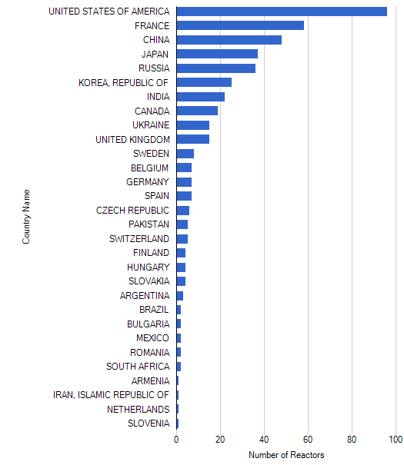
Global distribution of nuclear plants
2017: Nuclear power generation in
30 countries
449 reactors
60 new plants under construction in 15 countries
total 449
https://www.weforum.org/agenda/2019/11/countries-that-have-the-most-nuclear-power-alternative-energy-electricity-climate-change/

Slide 5
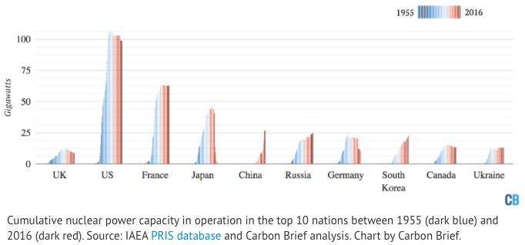
Cumulative global nuclear capacity
https://www.carbonbrief.org/mapped-the-worlds-nuclear-power-plants#:~:text=In%20terms%20of%20generating%20capacity,China%2C%20Russia%20and%20South%20Korea.

Slide 6
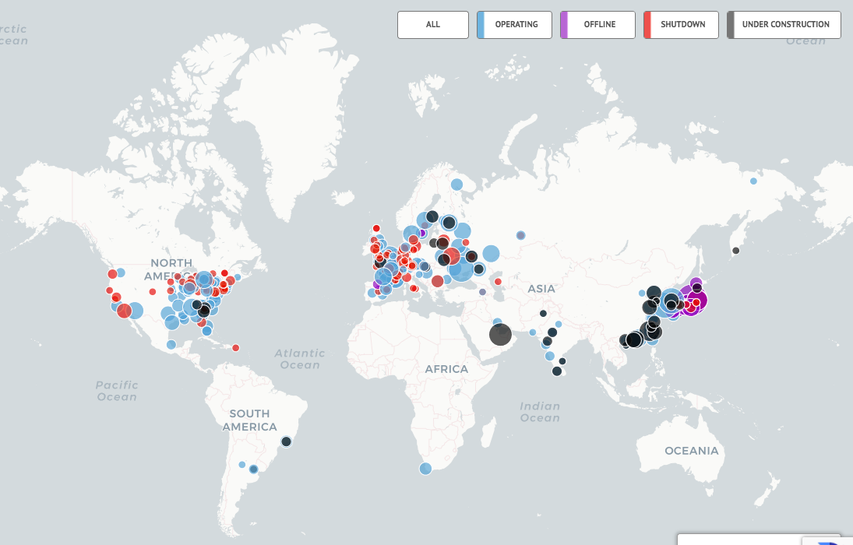
Global distribution of nuclear plants
total 449
size = MW
https://www.carbonbrief.org/mapped-the-worlds-nuclear-power-plants#:~:text=In%20terms%20of%20generating%20capacity,China%2C%20Russia%20and%20South%20Korea.

Slide 7
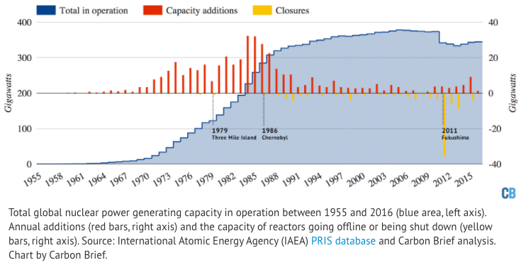
Fukushima changed nuclear’s trajectory
https://www.carbonbrief.org/mapped-the-worlds-nuclear-power-plants#:~:text=In%20terms%20of%20generating%20capacity,China%2C%20Russia%20and%20South%20Korea.

Slide 8
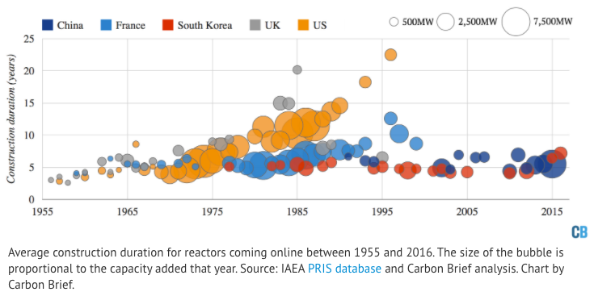
Nuclear plant construction time = cost
https://www.carbonbrief.org/mapped-the-worlds-nuclear-power-plants#:~:text=In%20terms%20of%20generating%20capacity,China%2C%20Russia%20and%20South%20Korea.

Slide 9
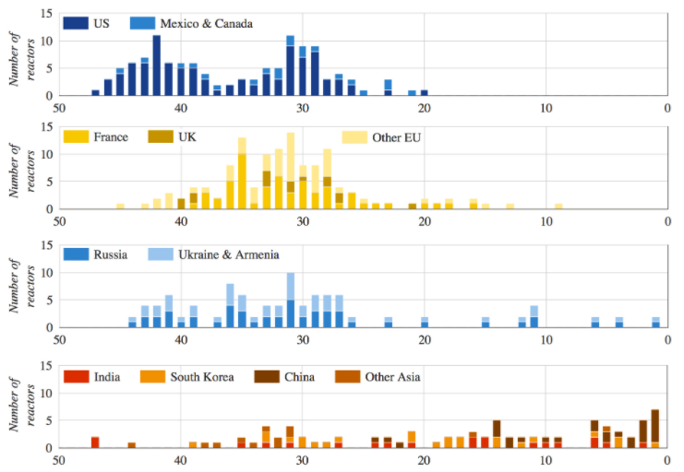
Nuclear fleets are aging out
https://www.carbonbrief.org/mapped-the-worlds-nuclear-power-plants#:~:text=In%20terms%20of%20generating%20capacity,China%2C%20Russia%20and%20South%20Korea.

Slide 10
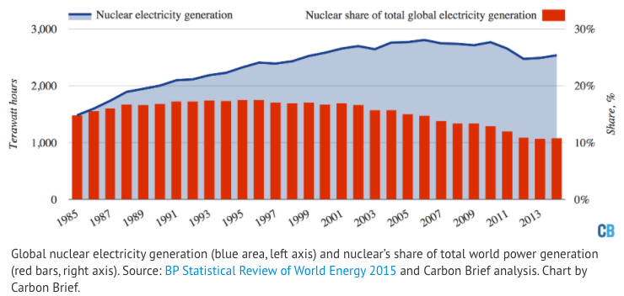
Nuclear’s share of global electricity as dropped
https://www.carbonbrief.org/mapped-the-worlds-nuclear-power-plants#:~:text=In%20terms%20of%20generating%20capacity,China%2C%20Russia%20and%20South%20Korea.

Slide 11
Module 6. Nuclear power
6.2: Atoms, nuclei and radioactivity

Slide 12
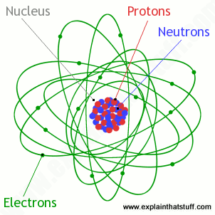
Atoms and their nuclei
Atomic nuclei: dense, central conglomeration of protons and neutrons
Protons: heavy, positively charged particles [# is unique atomic identifier]
Neutrons: heavy, uncharged particles [# varies in isotopes]
Atomic mass: ~ sum of protons + neutrons
Strong atomic force: holds protons and neutrons together in the nucleus
Energy Systems and Sustainability, 2/e, Chapter 10;
https://cdn4.explainthatstuff.com/atom.png

Slide 13
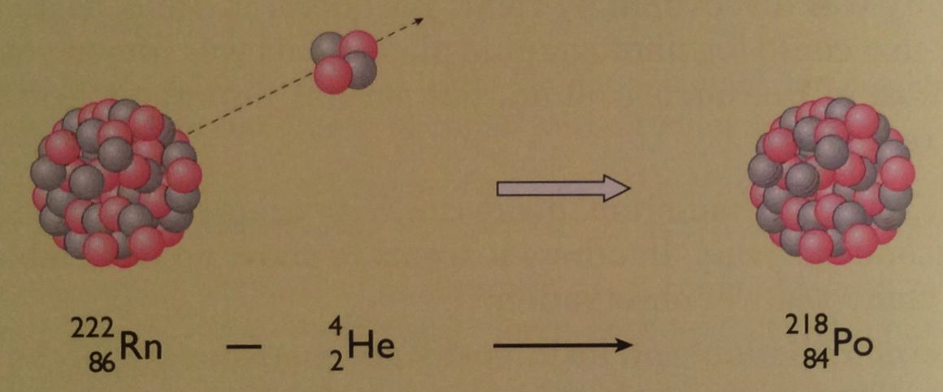
Heavy elements and radioactivity
The light elements in the upper four rows (or periods) of the periodic table have roughly equal numbers of protons and neutrons.
But heavier elements found in lower rows have far more neutrons than protons.
zB: Mercury (Hg) has 80 protons but 120 neutrons
The additional neutrons may add strong nuclear force needed to hold the large number of protons together (fighting repulsive force between crowded protons).
But beyond bismuth (Bi, 92) nuclei become unstable.
Elements beyond bismuth are radioactive: their nuclei emit high energy charged particles and thus become different elements
Energy Systems and Sustainability, 2/e, Chapter 10

Slide 14
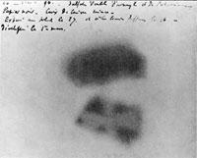
Radioactivity: caught on film
Henry Becquerel described radioactivity in 1896.
He found that uranium salts exposed a photographic plate (caused it to blacken) when the plate was completely protected from light.
The energy (radioactivity) given off by the uranium acted like light.
Uranium emits beta radiation.
Each element has its own characteristic type of radioactivity.
Physical and chemical changes to a radioactive element have no effect on its radioactivity.
Energy Systems and Sustainability, 2/e, Chapter 10

Slide 15
Radioactive elements
Marie and Pierre Curie found two more radioactive elements:
Polonium; and
Radium
The Curies coined the term radioactivity and isolated large enough amounts of radioactive elements to allow detailed study.
Sadly, this extensive exposure to radioactivity for many years ultimately proved fatal.
The Nobel Prize was awarded to the Curies and Becquerel in 1903.
Energy Systems and Sustainability, 2/e, Chapter 10

Slide 16
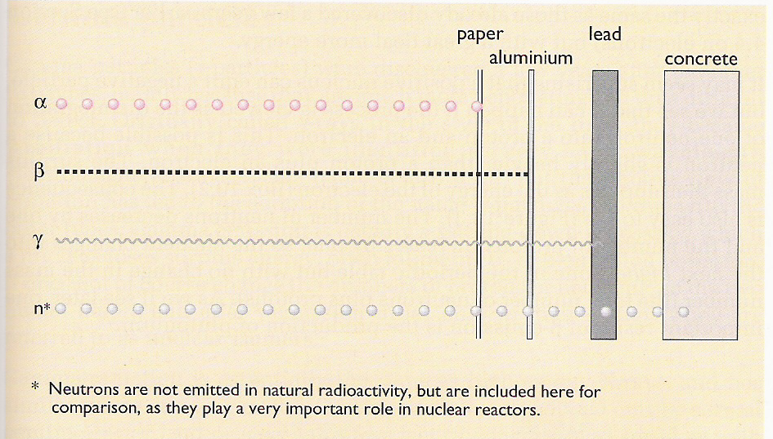
Types of radioactivity
Higher levels of activity allow radiation to penetrate more materials.
2+ nuclei
- electrons
energy w/o mass
neutrons
Energy Systems and Sustainability, 2/e, Chapter 10

Slide 17
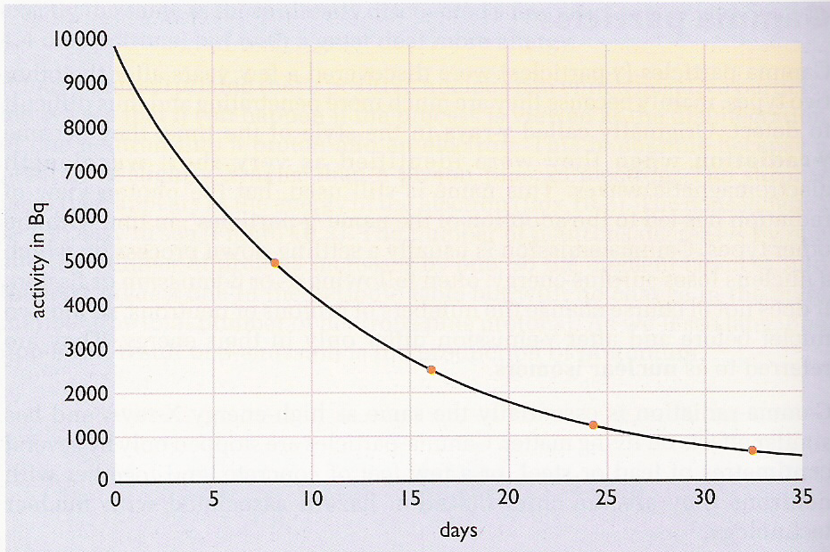
Radioactive decay
Rate of radioactive decay: rate at which the number of radioactive atoms decreases; proportional to the number present at any moment.
The half-life (time for half of the activity to decay) of elements involved in nuclear power and nuclear weapons is very long.
Energy Systems and Sustainability, 2/e, Chapter 10

Slide 18
Half-life
Half-life: the time required for half the sample to decay
Isotope | U-238 | U-235 | Pu-239 | Sr-90 | I-131
particle | α | α | α | β | β
half-life | 4.5 E9 years | 7.0 E8 years | 24,000 years | 28 years | 8.1 days
1 g | 12,000 Bq | 79,000 Bq | 2,300 MBq | 5.3 TBq | 4,600 TBq
10 kBq | 0.81 g | 0.13 g | 4.3 μg | 0.0019 μg | 2.2 pg
Energy Systems and Sustainability, 2/e, Chapter 10

Slide 19
Module 6. Nuclear power
6.3: Nuclear fission

Slide 20
Playing with radioactivity
Radioactivity became a tool that scientists could use to investigate atoms and atomic structure. Soon physicists were bombarding every known element with radioactive particles or neutrons.
Neutrons had the advantage of neutrality.
1930s: Enrico Fermi found that bombarding uranium with neutrons caused emission of β-particles as neutrons were changed into protons.
This creation of new protons created heavier elements, transuranic actinoids.
1938: Otto Hahn et al. found that Fermi’s bombardment of uranium had created a smaller element, barium.
Meitner realizes that the unstable uranium nucleus was split by the neutron’s impact: kernspaltung (nuclear fission).
Energy Systems and Sustainability, 2/e, Chapter 10

Slide 21
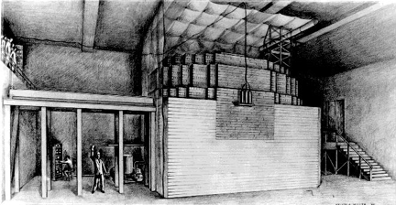
Fission, weapons and power
1941 Enrico Fermi develops a nuclear reactor (‘Fermi’s pile’) at the U. of Chicago
Oct 1941 President Roosevelt commits huge resources to developing an atomic bomb
Dec 1941 Japanese attack Pearl Harbor
1942 Fermi’s team demonstrates controlled chain reaction (fission)
1954 USSR claims the first nuclear power plant
Energy Systems and Sustainability, 2/e, Chapter 10;
http://static.newworldencyclopedia.org/c/c4/Atompile.gif
Fermi’s nuclear reactor

Slide 22
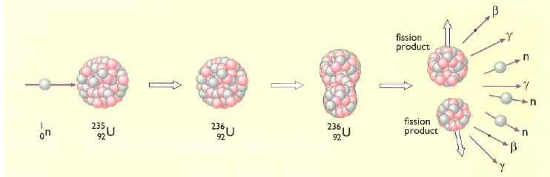
Kernspaltung
1939: (year that WWII began) Fermi realizes that fission will release free neutrons which will be able to split more atoms, releasing more neutrons → rinse, repeat
This is the nuclear chain reaction.
Slow neutron strikes U-235 and is absorbed to produce unstable U-236.
U-236 splits (=fission), due to instability and electrostatic repulsion.
Two new radioactive nuclei (and atoms) are produced, along with,
Energy!
More neutrons …. More kernspaltung so chain reaction
Energy Systems and Sustainability, 2/e, Chapter 10

Slide 23
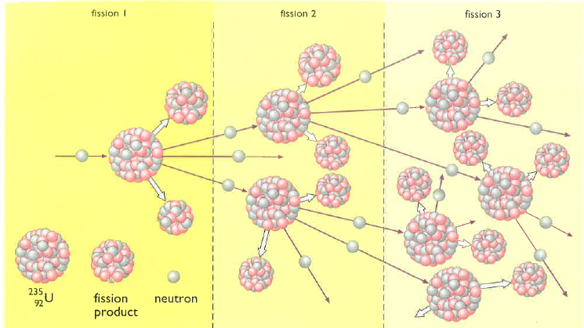
The fission chain reaction
Chain reaction: neutrons released by each fission event create new fission reactions.
Exponential amplification
Energy Systems and Sustainability, 2/e, Chapter 10

Slide 24
Fission products?
U-235 undergoes fission, producing two new nuclei.
If one is barium:
What is the other?
How many ‘surplus’ neutrons are produced?
Nucleus | # protons | # neutrons
U-235 | 92 | 143
Ba-138 | 56 | 82
Kr-86 | 36 | 50
Ba + Kr | 92 | 132
surplus |  | 11 + 1
However, the Ba and Kr produced are usually heavy isotopes, with more neutrons than average. This means that fewer of the surplus neutrons are actually free.
Generally 3-4 free neutrons are produced per fission event.
And the Ba and Kr are also radioactive, emitting β-particles.
Energy Systems and Sustainability, 2/e, Chapter 10

Slide 25
How much energy is released?
Calculations showed that fission of one atom of U-235 results in the loss of 0.21 amu.
E = (m)(amu)(931) = (1)(0.21 amu)(931) = 200 MeV [m = atoms]
E = 200 MeV = 3.2 E-11 J / atom
So how much energy would be released from fission of 1 kg of U-235?
Global primary energy use ~ 5.8 E8 TJ
= 7.26 E6 kg U
Each atom has a mass of 235 amu.
One amu = 1.660 E-27 kg.
1 kg 1 amu 1 atom = 2.5 E24 atoms / kg U-235
1.660 E-27 kg 235 amu
(2.5 E24 atoms / kg U-235)(3.2 E-11 J / atom) = 80 E12 J / kg
= 80 TJ / kg U-235
Energy: 1 kg U-235 = 3000 tonnes of coal
Energy Systems and Sustainability, 2/e, Chapter 10

Slide 26
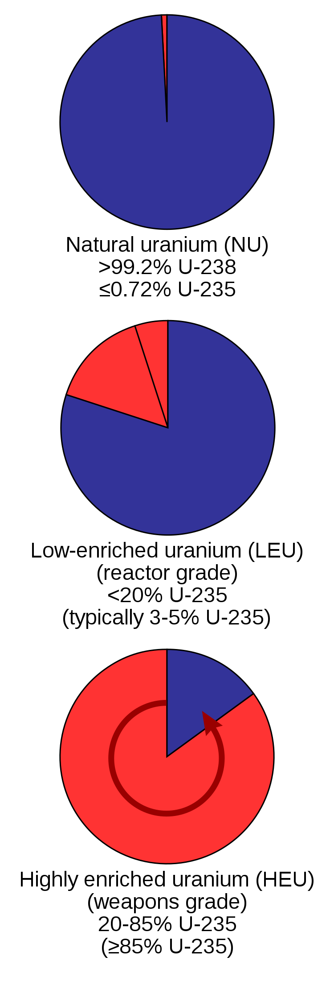
U-235 must be ‘enriched’
For every atom of U-235, uranium has 140 atoms of U-238.
If fission occurs in this unenriched uranium, U-238 will absorb most of the freed neutrons but will not undergo fission.
Chain fission won’t occur.
<1%
To make fission possible, uranium must be enriched for U-235.
Creating a critical mass of enriched uranium also helps fission to occur, as freed neutrons have a greater chance of causing another fission event when they travel through more uranium.
20%
Slowing the fast neutrons by colliding them with carbon (graphite) also increases the chance of more fusion events.
Graphite is a moderator of neutron speed.
85%
Energy Systems and Sustainability, 2/e, Chapter 10; https://en.wikipedia.org/wiki/Enriched_uranium

Slide 27
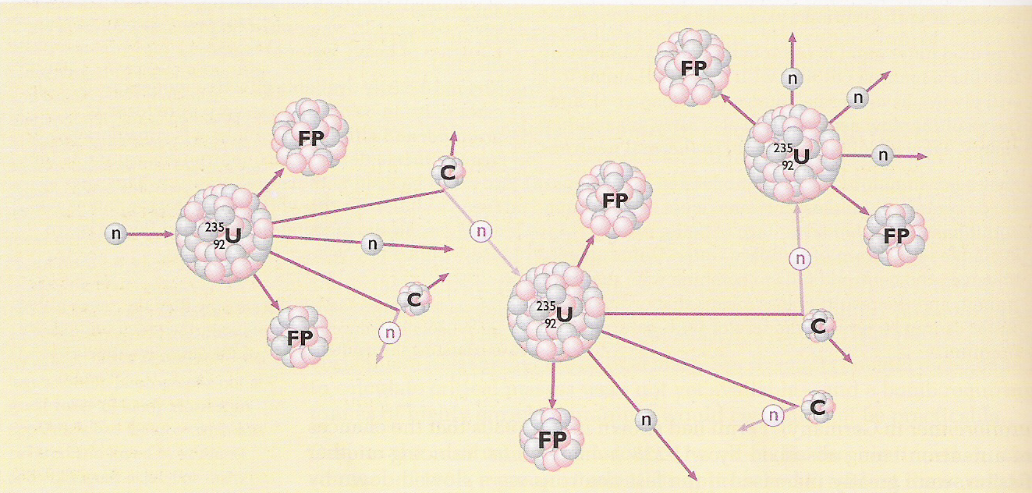
Controlling fission chain reactions
Graphite is added to the uranium; its carbon atoms don’t undergo fission.
When neutrons hit the carbon atoms they slow and the chain reaction occurs but is less amplified or controlled.
The slowed neutrons are warmed as kinetic energy is dissipated, so reactors that use moderators are called thermal fission reactors.
Energy Systems and Sustainability, 2/e, Chapter 10

Slide 28
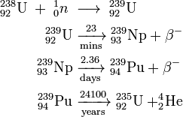
New elements produced by fission
Bombardment of natural uranium with neutrons caused β-emission converting either one or two neutrons into new protons and creating new elements:
93 neptunium
94 plutonium
the 2nd fissile element
U-238 and Np-239 have short half-lives, but Pu-239 has a longer half-life of 25,000 years and accumulates.
U-238 reactors that create Pu-239 are thus called breeder reactors.
Breeder reactors use fast (rather than slow) neutrons.
Energy Systems and Sustainability, 2/e, Chapter 10

Slide 29
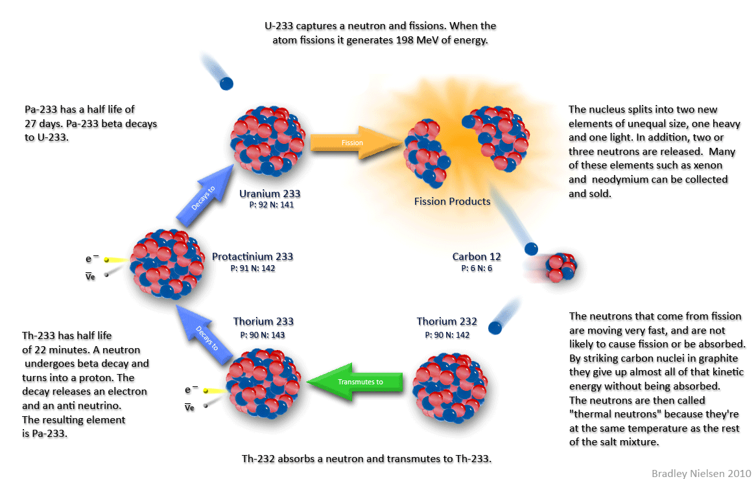
Thorium fuel cycle
Abundant
Less hazardous
Makes use of nuclear waste or unenriched uranium
India and China are interested

Slide 30
Module 6. Nuclear power
6.4: Thermal fission reactors

Slide 31
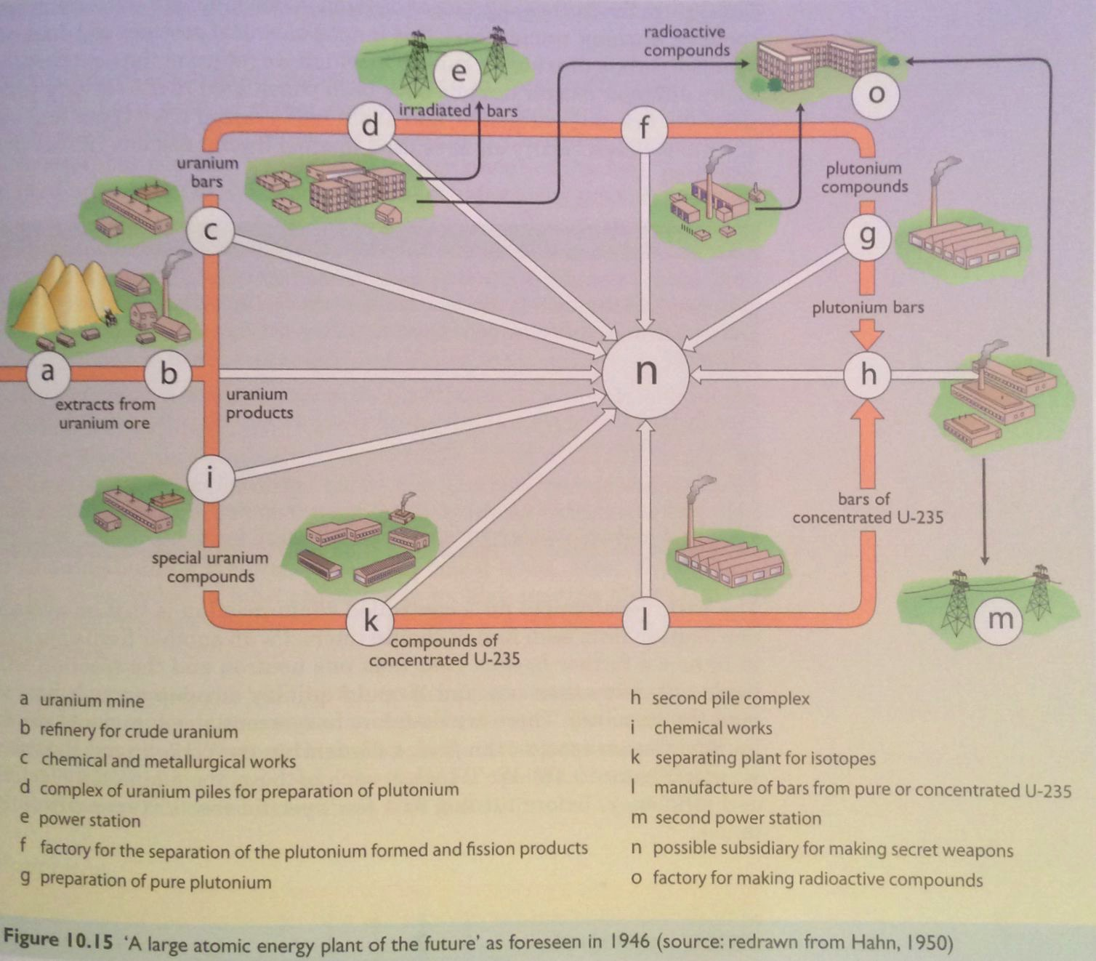
Nuclear power
All fission processes produce heat as a by-product.
The heat can be used to create steam, drive stream turbines and generate electricity.
Russia: first reactor in 1954
Energy Systems and Sustainability, 2/e, Chapter 10

Slide 32
Thermal fission reactors?
Nuclear reactors don’t burn fuel, rather their uranium undergoes fission giving off heat in the process. That’s one type of thermal.
There are two basic types of nuclear reactors:
Thermal reactors use moderators like graphite to slow neutrons and allow controlled chain reactions
The slowed neutrons carry lost energy as heat.
Fast neutron reactors don’t need moderators so the neutrons aren’t ‘thermalized’.
Energy Systems and Sustainability, 2/e, Chapter 10

Slide 33
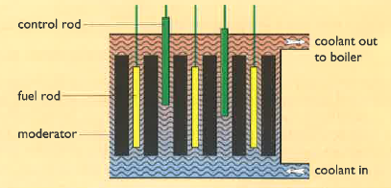
Thermal fission reactors: 4 essential components
Thermal fission reactors have four essential components:
Fuel = uranium;
Moderator, usually graphite;
Coolant to pick up and transfer heat; and
Control system.
Energy Systems and Sustainability, 2/e, Chapter 10

Slide 34
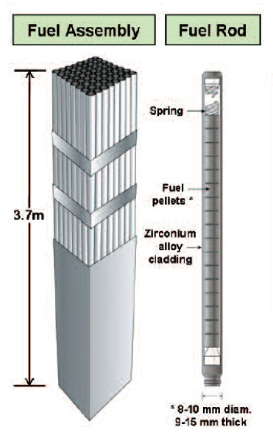
Fuel rods
Early nuclear plants used natural uranium, but recent plants use enriched uranium with 2-5% U-235.
Plutonium produced in breeder plants can be reprocessed and used as fuel.
Thorium can also be used as fuel.
Uranium oxide (UO₂) is a hard ceramic that can be formed into pellets.
Pellets are held in metal tubes.
The metal must not absorb neutrons.
Fuel rods are replaced every 12-18 months.
100 tonnes of fuel per reactor:
2-3 GW of heat
600 – 1000 MW of electricity
Energy Systems and Sustainability, 2/e, Chapter 10;
https://i.pinimg.com/originals/ae/a7/02/aea702d2b7bfdf48ae724853261c2456.jpg

Slide 35
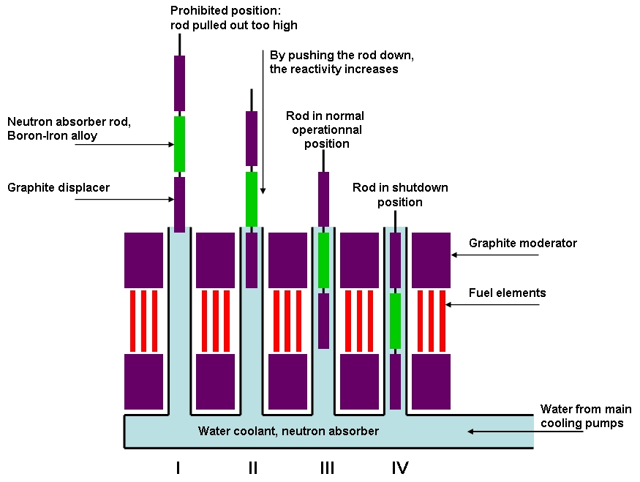
Moderator
Three types of moderator are common:
Light water (H₂O)
Heavy water (D2O)
Graphite (a form of carbon)
Remember that moderators are needed for fission to happen.
Energy Systems amd Sustainability, 2/e, Chapter 10;
http://consumedland.com/images/Control%20Rods_en.jpg

Slide 36
Coolants and control systems
Coolants absorb heat released by decaying fuel pellets and carry the heat to the steam generator.
Liquid moderators like light and heavy water can also act as the coolant.
Gas coolants like carbon dioxide can also be used.
Control rods are made of material that absorbs freed neutrons and slows or stops fission from continuing.
Good neutron absorbers:
Cadmium
Boron
When control rods are inserted between fuel rods fission is dampened or stopped.
Energy Systems & Sustainability, 2/e, Chapter 10

Slide 37
Nuclear plant safety
Design of a nuclear plant must store and use fuel at the correct densities and must have a robust coolant system that will continue to function under the most adverse circumstances.
Lack of cooling can cause the fuel in the reactor core to meltdown.
Shielding is needed to protect operators from radiation in the core.
1 E12 times the safe limit.
Safe distance without shielding would be 8 km.
Concrete and steel both absorb gamma radiation.
Containment is needed deal with high pressure and radioactive gases produced in the plant.
Energy Systems and Sustainability, 2/e, Chapter 10

Slide 38
Accidents
Most accidents result from loss of control of the nuclear chain reaction resulting in too much heat.
Water used as moderator or coolant can be turned to steam, react with the zirconium alloy fuel rods and produce explosive hydrogen gas.
Loss of cooling is a problem even if the fusion chain reaction is stopped because the fuel will continue to decay and produce heat. This can melt the fuel which can then escape containment.
Three Mile Island (1979, PA)
Fukushima (2011, Japan)
Loss of control would allow a runaway fission chain reaction.
Chernobyl (1986, Ukraine)
Passive response cause plants to safely shutdown if power or coolant systems failed.
Shutdown would be triggered without operator action.
Energy Systems and Sustainability, 2/e, Chapter 10

Slide 39
Module 6. Nuclear power
6.5: Types of thermal fission reactors

Slide 40
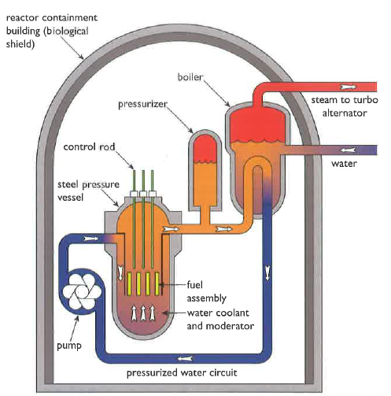
Light water pressurized water reactor
Most are pressurized water reactors (PWRs) developed in the US, or water-water-energy-reactors (VVER) from Russia.
Core:
100 fuel assemblies
Each 100s of UO₂ fuel rods
Water coolant/moderator flows through fuel at high pressure
Boiler:
Heated water (300°C) is pressurized to 100 atm to ensure that it remains liquid and can work as coolant.
Heat exchange in the boiler produces steam for electric generation.
Containment and safety:
Pressure vessel
Emergency coolant system
Energy Systems and Sustainability, 2/e, Chapter 10

Slide 41
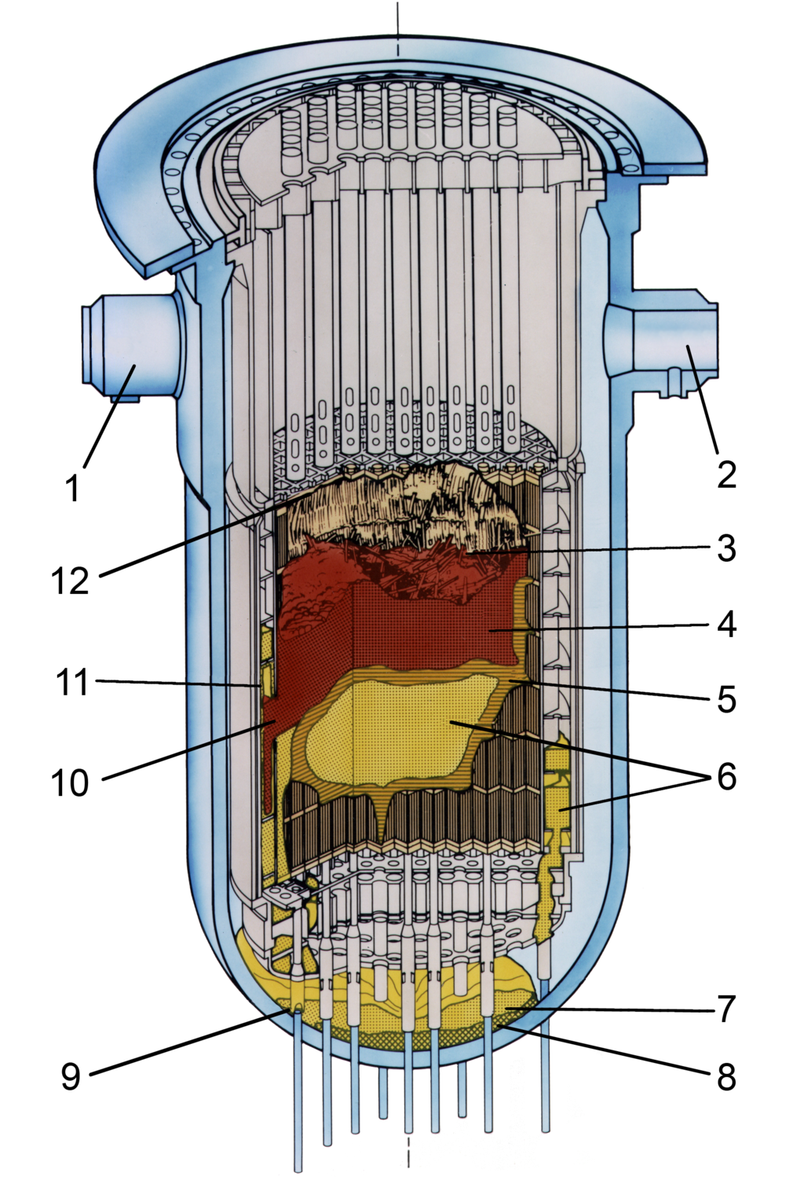
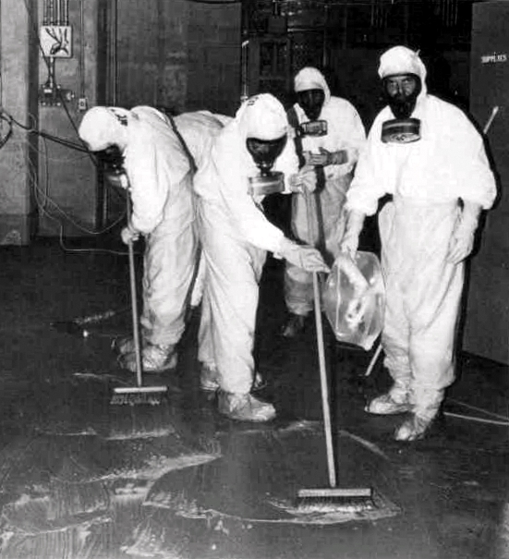
Failure: Three Mile Island (PA)
28 March 1979
A water pump in the cooling system failed (jammed valve) allowing coolant to escape. Operators were confused.
The reactor overheated.
A small amount of radioactive material was released into the atmosphere.
No immediate or anticipated health effects.
Small but not statistically significant increase in cancer.
Energy Systems and Sustainability, 2/e, Chapter 10
https://en.wikipedia.org/wiki/Three_Mile_Island_accident

Slide 42
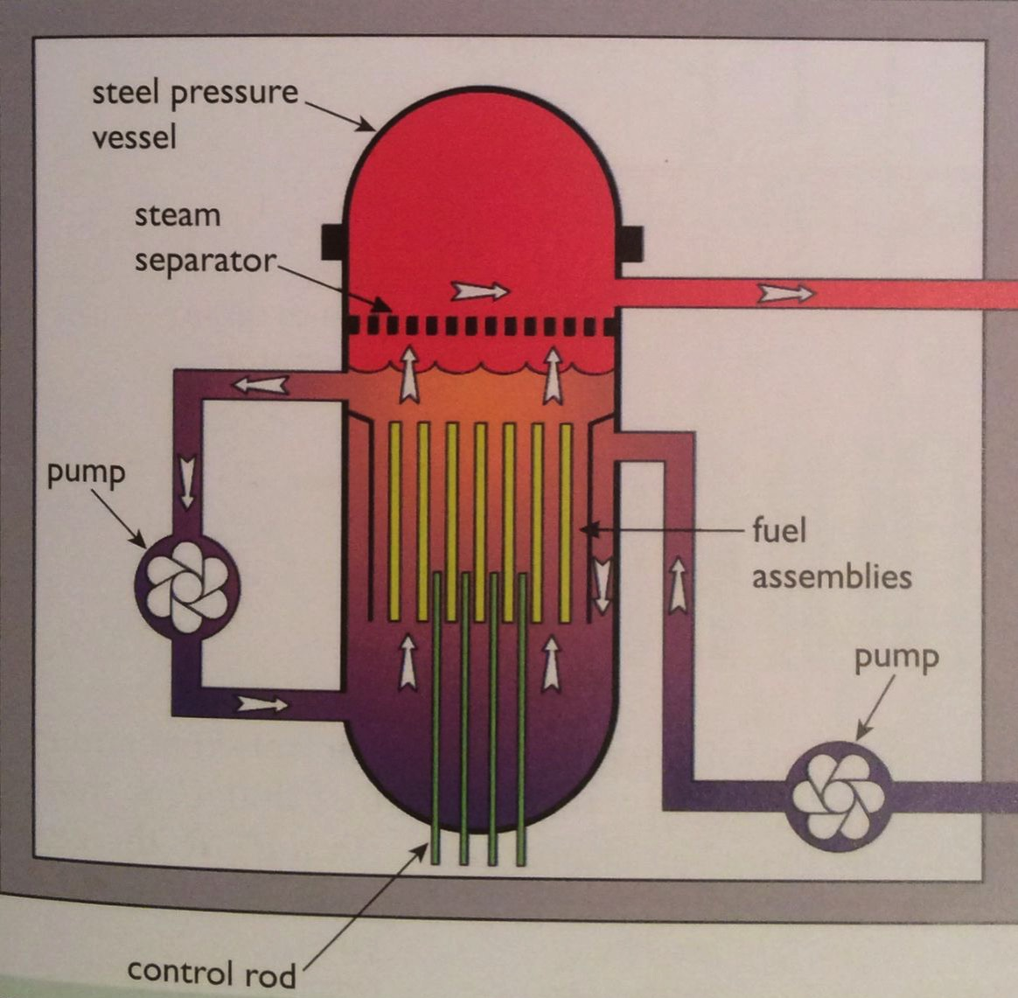
Light water boiling water reactor
Boiling water reactors (BWRs) developed in the US are next most common. Fukushima has BWRs.
Similar to PWR, except:
The water that flows through the fuel rods is allowed to boil to steam which is then used in the turbines.
Turbines are exposed to radioactivity.
Lower cost.
Energy Systems and Sustainability, 2/e, Chapter 10

Slide 43
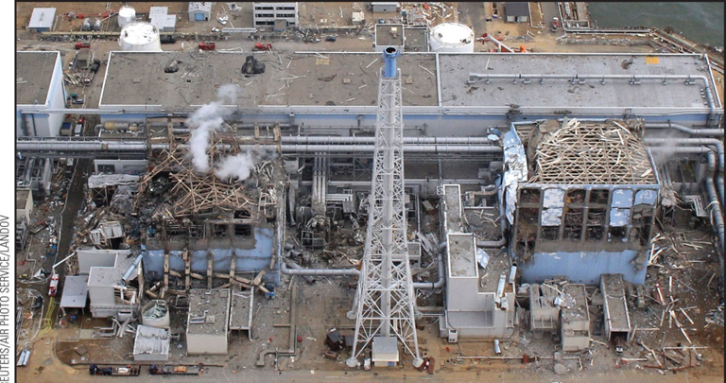
Failure: Fukushima (Japan)
11 March 2011
The plants electrical infrastructure was damaged by a tsunami.
Loss of coolant caused reactors to overheat, leading to explosions.
Radioactive material was released. Estimated at 10-20% as much as at Chernobyl.
Long-term health effects have yet to be determined.
The site is closed.
Engineers are freezing ground- water to prevent it from running into the sea; not totally successful.
Energy Systems and Sustainability, 2/e, Chapter 10

Slide 44
Fukushima flaws
Fukushima’s 6 reactors had two different types of design.
1 - 4: backup generators and electrical switching needed for the cooling system were in poorly protected turbine buildings; flooded by tsunami.
6: This equipment was located in the stronger reactor building and continued to function.
https://www.wsj.com/articles/SB10001424052702304887904576395580035481822#:~:text=in%20a%20global%20campaign%20to,in%20charge%20of%20design%20changes.&text=At%20that%20time%2C%20barely%20two,its%20own%20nuclear%2Dpower%20plants.

Slide 45
Common design flaws at Fukushima and other PWR
Spent fuel rods are stored in elevated pools of water that cool the rods.
Loss of power prevents water from being pumped up to replenish pools and if cooling fails the fuel rods can boil their cooling water off and catch on fire.
This happened at Fukushima and the fire released radionuclides.
Since Fukushima, reactors of the same design have taken steps to cope with this design flaw.
https://allthingsnuclear.org/dwright/spent-fuel-pools-at-fukushima

Slide 46
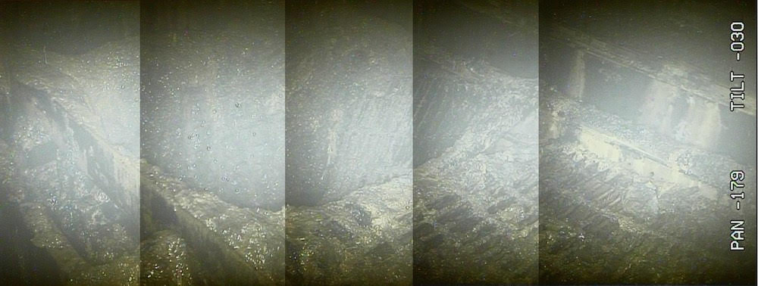
Failure: Fukushima (Japan)
Recently, TEPCO has sent robots into one of the Fukushima nuclear plants to assess damage and assess the possibility of cleanup.
High radiation levels have ‘fried’ the robots as quickly as 30’.
This image shows a hole in the floor of the reactor; may have been caused by fuel meltdown.
Radiation levels are 210 SV/hour: fatal to humans within minutes.
Cleanup is expected to continue for at least 40 years.
https://voices.nationalgeographic.org/2017/02/22/after-alarmingly-high-radiation-levels-detected-what-are-the-facts-in-fukushima/

Slide 47
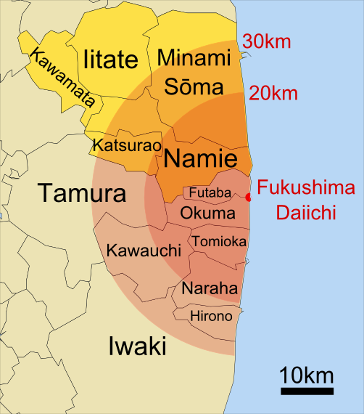
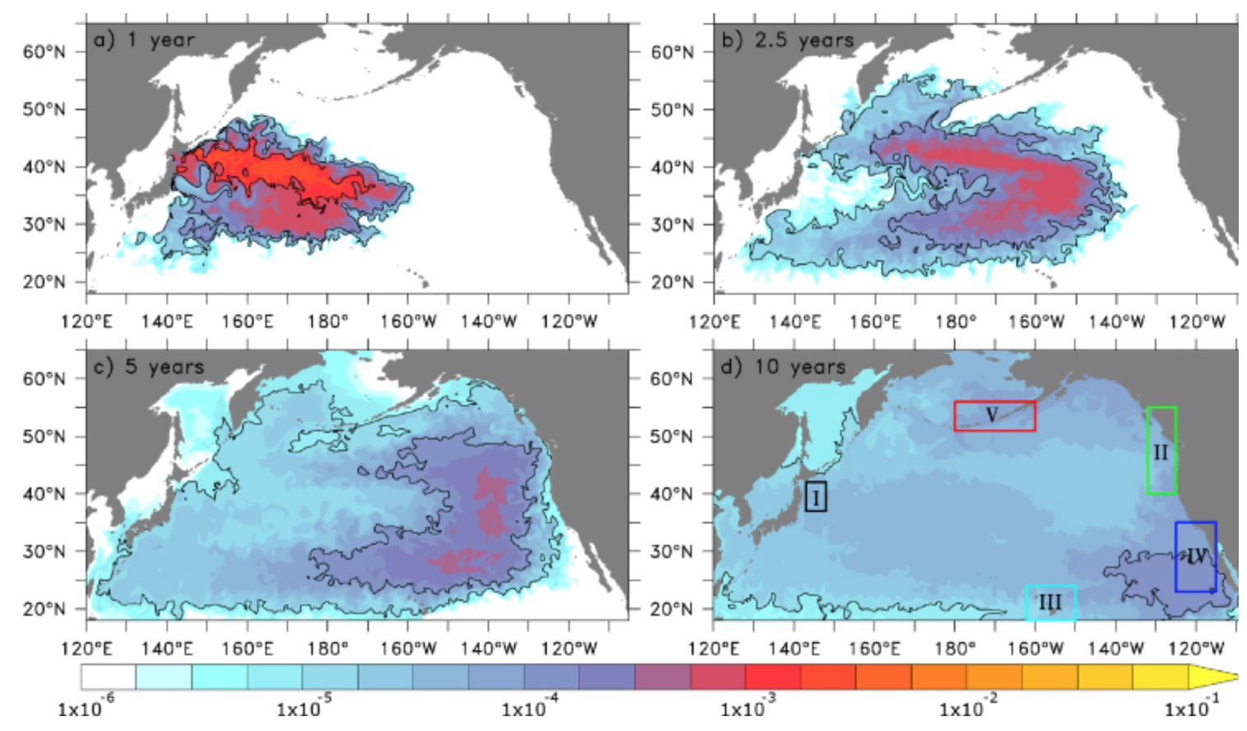
Extent of release
70,000 residents were evacuated
Most will be permanently resettled.
5-year modeling for movement of radio- active contamination.
Arrived WA, USA at end of 2016.
http://iopscience.iop.org/article/10.1088/1748-9326/7/3/034004; wikpedia

Slide 48
Gas-cooled reactors
Gas-cooled reactors were developed in the UK to use natural uranium.
Magnox reactors:
Graphite moderator
Carbon dioxide gas cooling
Magnesium alloy clad fuel rods
30% electric production efficiency
Core:
Solid graphite with vertical slots for fuel and control rods.
CO₂ coolant is pumped through the core at 40 atm.
Heat exchangers create steam for turbine.
Heavy concrete containment for cooling gas.
Energy Systems and Sustainability, 2/e, Chapter 10

Slide 49
Heavy water reactors
Canadian-deuterium-uranium (CANDU) reactors next most common (20).
Heavy water moderator and coolant at 300°C.
Coolant and moderator are separated.
Low thermal efficiency, but able to use a variety of fuels, including spent PWR fuels and surplus weapons-grade plutonium.
Now called pressurized heavy water reactors.
Energy Systems and Sustainability, 2/e, Chapter 10

Slide 50
RBMK reactors
High power channel-type reactor (RBMK) was developed in Russia.
Graphite moderator
Light water coolant.
Chernobyl used this design.
None are being built but about a dozen are still operating.
Energy Systems and Sustainability, 2/e, Chapter 10

Slide 51
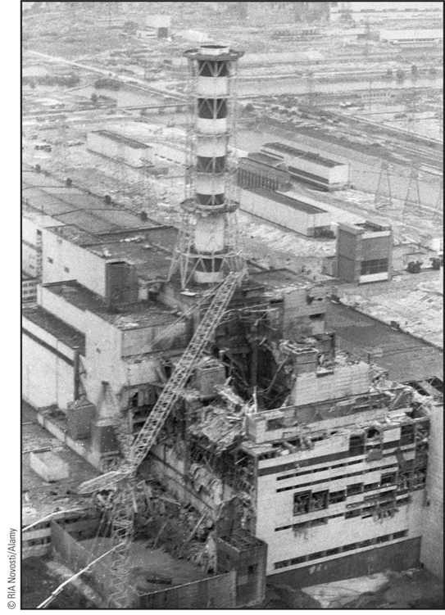
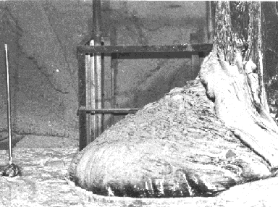
Failure: Chernobyl (Ukraine, USSR)
25 April 1986
The reactor became unstable as a result of tests run by the operators.
Overheating caused water to decompose, releasing hydrogen gas which then exploded.
The reactor core caught fire and melted.
Plumes of radioactivity spread across Europe.
The site 30 km in diameter is still closed and will be for 20,000 years.
https://en.wikipedia.org/wiki/Chernobyl_disaster

Slide 52
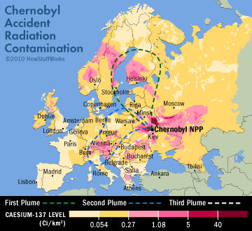
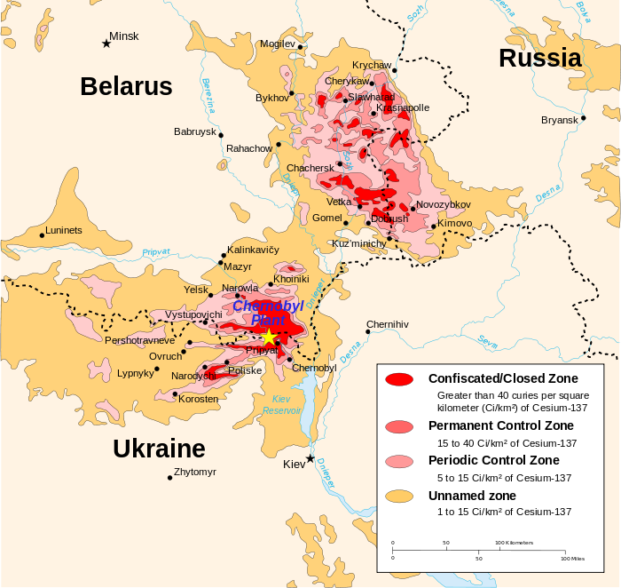
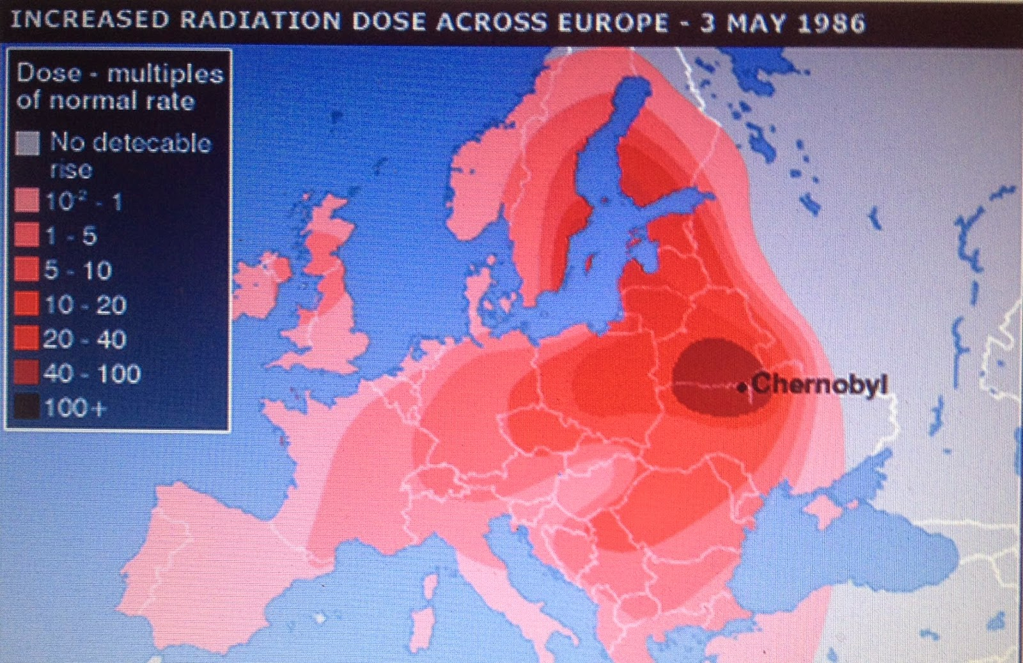
Extent of release
Wikipedia and BBC

Slide 53
Take-home message?
It’s the cooling system, stupid!
And a passive system is more likely to work during a disaster.
Wikipedia and BBC

Slide 54
Module 6. Nuclear power
6.6: Nuclear fuel cycles

Slide 55
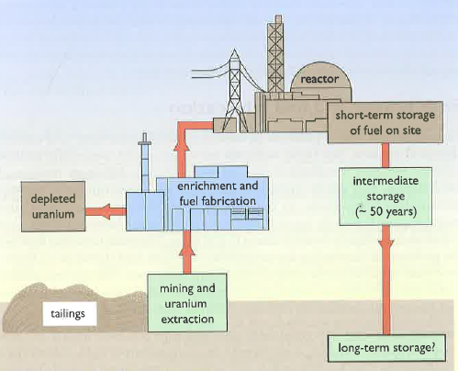
Nuclear fuel cycle
To assess nuclear power we must examine the entire nuclear fuel cycle.
Mining and extraction
Enrichment and fabrication
Reaction
Dealing with spent fuel
Energy Systems and Sustainability, 2/e, Chapter 10

Slide 56
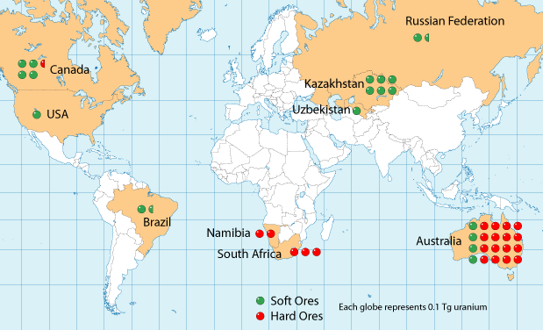
Uranium reserves
Global distribution of uranium reserves is pretty widespread.
Energy Systems and Sustainability, 2/e, Chapter 10;
watd.wuthering-heights.co.uk

Slide 57
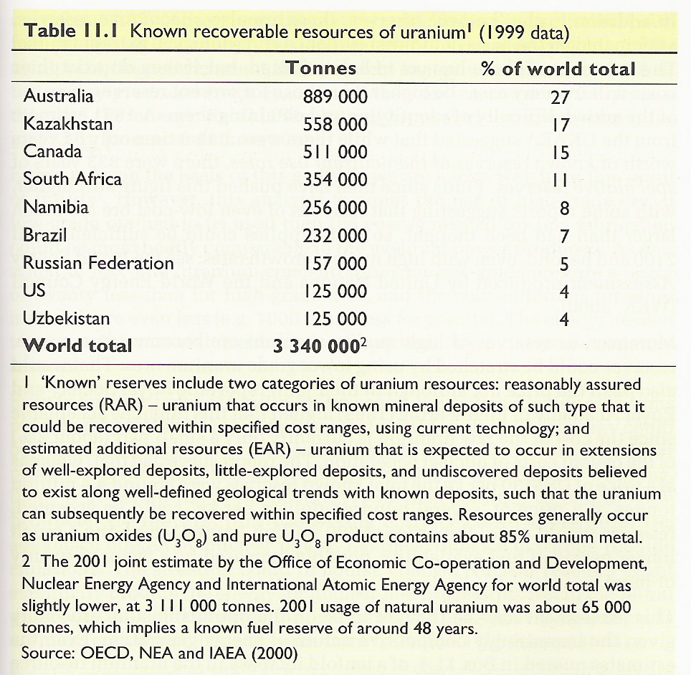
Uranium reserves quantified
Known global recoverable reserves of uranium.
Energy Systems and Sustainability, 2/e, Chapter 10

Slide 58
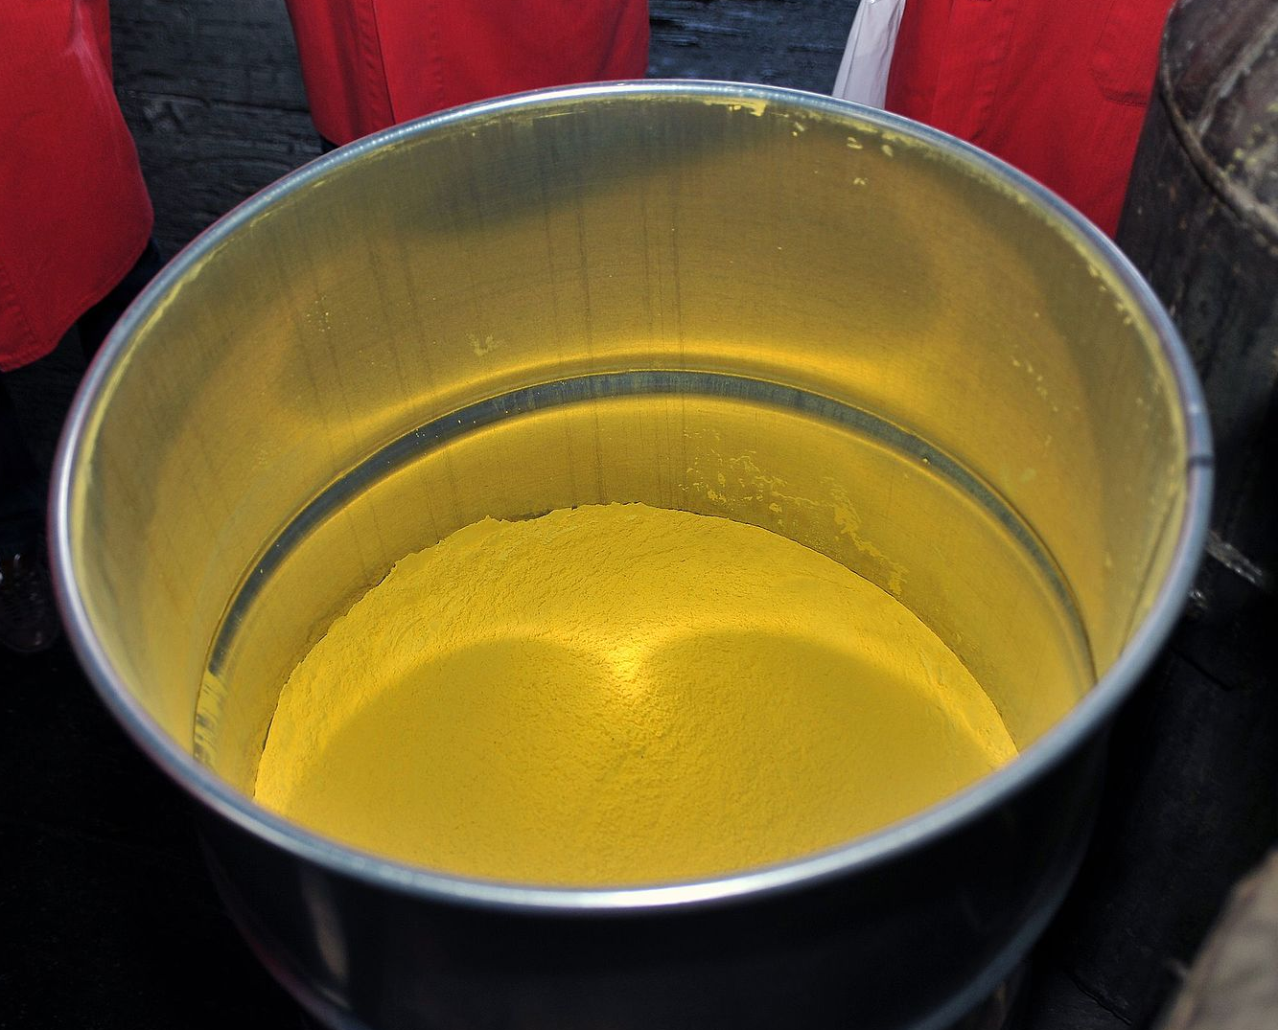
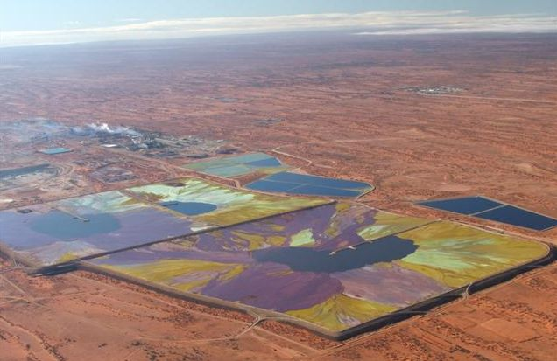
Uranium mining and extraction
Uranium ore is a mixture of uranium oxides, U₃O₈.
High-grad ore: a few percent
Low-grade ore: one part per thousand
Processed U₃O₈ is a yellow powder called yellowcake.
Yellowcake
Tailings, the material remaining after extraction of uranium from ore, is radioactive and must be stored to avoid impacting human health.
Uranium tailings ponds
Energy Systems and Sustainability, 2/e, Chapter 10

Slide 59
Uranium U-235 enrichment and fabrication
The difference between the U-235 and U-238 isotopes is number of neutrons and mass.
Gas diffusion:
Uranium oxide (U₃O₈) is converted to uranium hexafluoride (UF₆).
Becomes a gas when heated a bit.
Lighter isotope diffuses through a membrane faster.
1000X diffusion increases U-235 by 3-4%.
Gas centrifuge:
Uranium oxide (U₃O₈) is converted to uranium hexafluoride (UF₆).
Becomes a gas when heated a bit.
Spun at very high speed in gas centrifuges.
Multiple spins required to separate isotopes; 50X more energy efficient than diffusion.
In either case, enrichment leaves large amounts (nearly all the starting material) that is depleted in U-235. This material is called depleted uranium and must be stored for future use. It’s still radioactive.
Its high density has caused some to be used in artillery.

Slide 60
Nuclear fuel assembly
Pellets fill rods or pins.
Many pins create an assembly.
The core is a group of assemblies with space for coolant to circulate between them.
Energy Systems and Sustainability, 2/e, Chapter 10

Slide 61
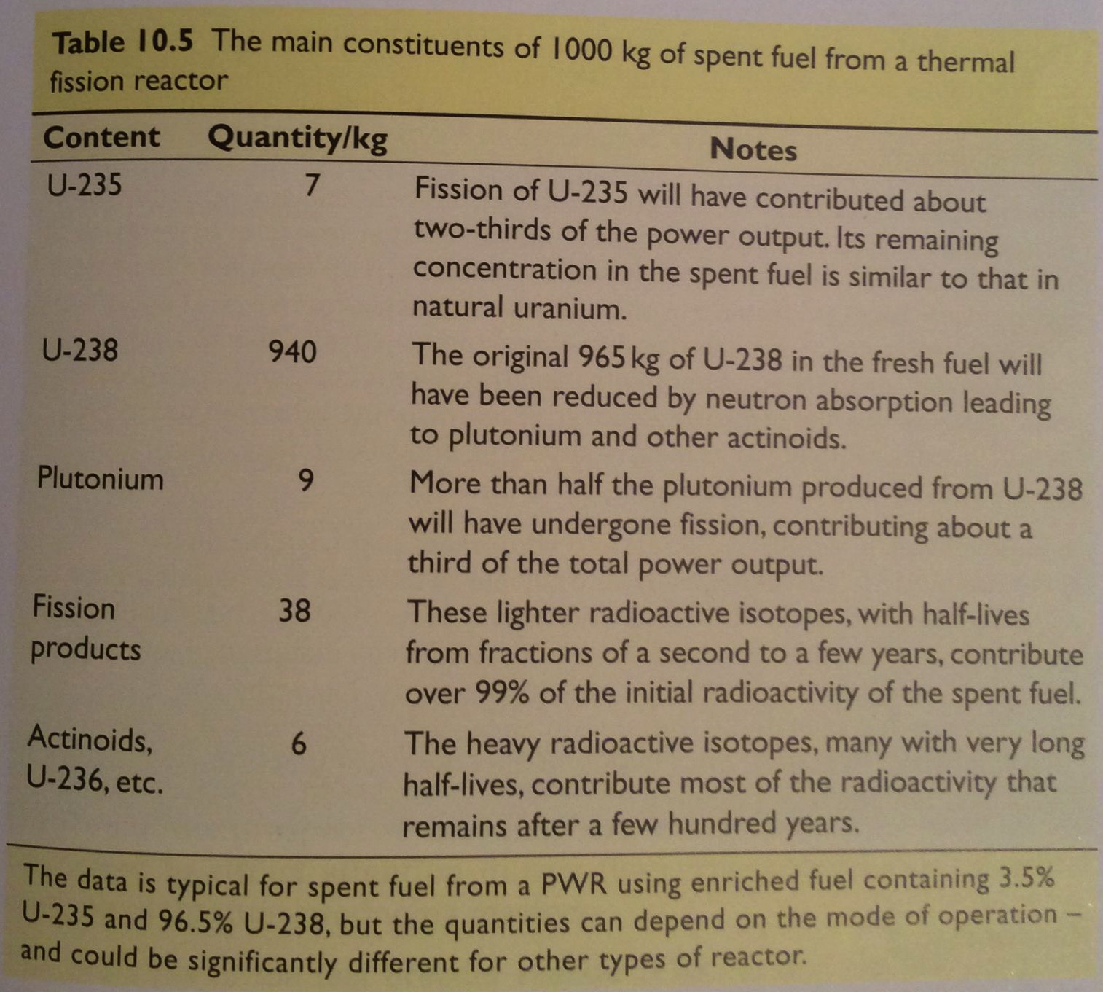
Refueling?
As fission proceeds in fuel rods, fission products and actinoids build up and ‘poison’ the fuel because they lower heat output.
Typically, a fuel assembly functions for 3 years.
About 1/3 of assemblies are replaced each year.
Energy Systems and Sustainability, 2/e, Chapter 10

Slide 62
Spent fuel storage and disposal
Spent fuel is highly radioactive and is therefore stored in pools of water with active cooling systems for at least a year.
At Fukushima spent fuel cooling systems failed, causing fuel to overheat, produce hydrogen gas, explode and burn.
Direct disposal: leaves spent fuel assemblies in pools for 40-50 years.
Note that this material needs tens of thousands of years of stable, safe storage.
Reprocessing: extracts remaining and new fissile elements for reuse
5 years in cooling tanks
Chemical separation of uranium, plutonium and waste
Energy Systems and Sustainability, 2/e, Chapter 10

Slide 63
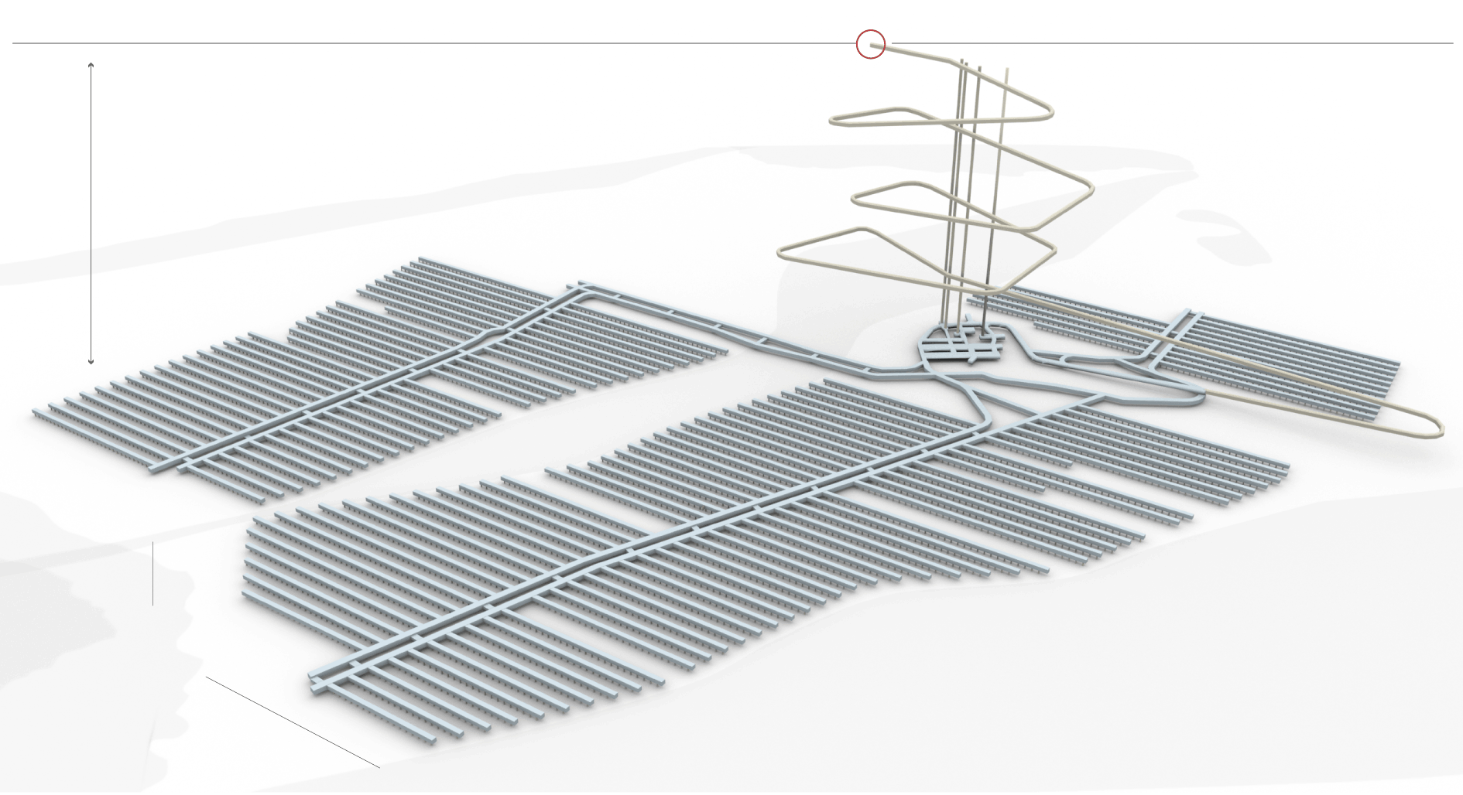
Finland: long-term nuclear storage leader
Finland is the world leader in long-term nuclear storage.
They have a plan and are in the 10-year construction phase of a $3.9 b project.
1,400-feet deep within granite bedrock, back-filled with clay
The government worked hard at community relations!
Energy Systems and Sustainability, 2/e, Chapter 10;
https://www.nytimes.com/2017/06/09/science/nuclear-reactor-waste-finland.html

Slide 64
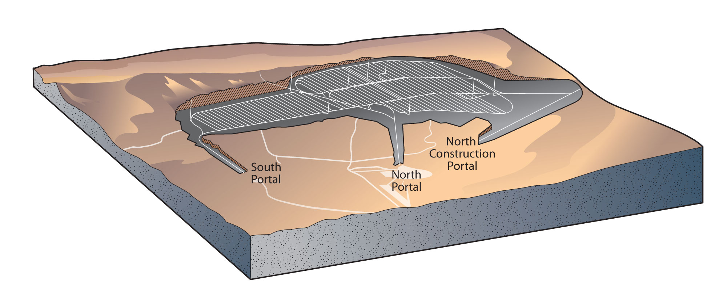
US: Yucca Mountain ?
The US has been debating plans to bury our nuclear waste below Yucca Mountain, NV.
Funding for research about the site and planning ceased in 2011.
As of 2015, the US had 70,000 metric tonnes of waste to store.
Pros:
The US really needs a storage site.
Yucca Mountain is in a nuclear test area; not pristine.
Yucca Mountain has been extensively studied by geologists.
Cons:
Yucca Mountain was formed by volcanic activity.
Volcanic tuff is fractured and sits above an aquifer.
Nevada has significant seismic activity; 4th in the US.
The Bow Ridge fault line is closer to Yucca Mountain than previously thought.
Energy Systems & Sustainability, 2/e, Chapter 10;
https://en.wikipedia.org/wiki/Yucca_Mountain_nuclear_waste_repository

Slide 65
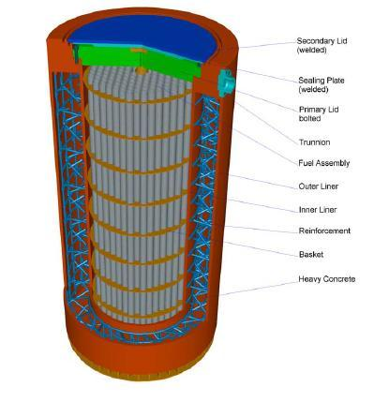
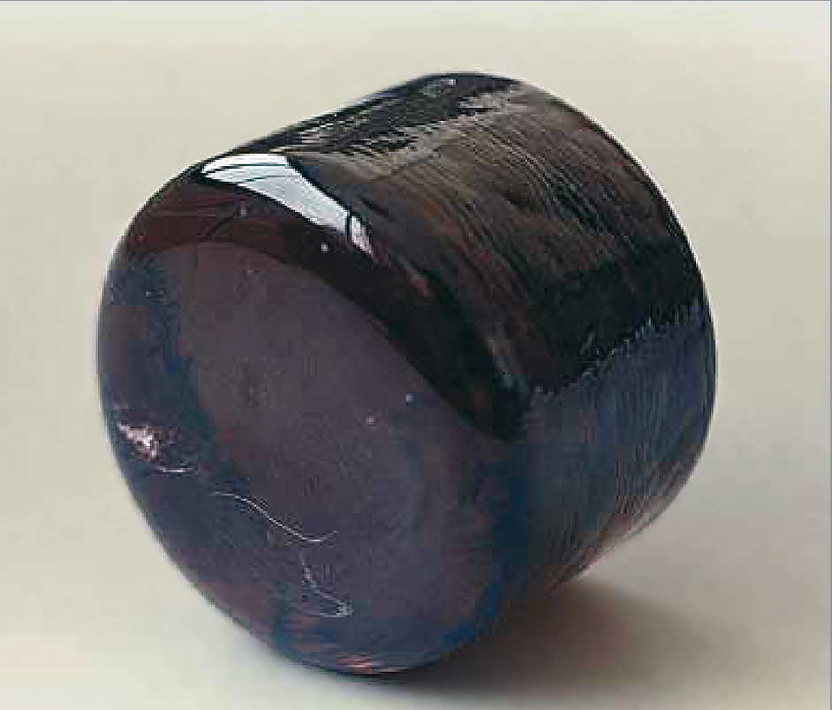
Current ‘long-term storage’ in the US
Without an underground storage facility, high level nuclear waste is stored in two ways.
Dry cask storage: sealed steel and concrete container
2009: 22% of US commercial waste
1990s: repeated problems with bad welds
Vitrification: nuclear waste is melted with glass-forming chemicals to form a stable obsidian-like glass
Stable and doesn’t leach
Synroc: nuclear waste is mixed with elements to form a crystalline powder and compressed into a ceramic
Energy Systems and Sustainability, 2/e, Chapter 10;
https://en.wikipedia.org/wiki/Yucca_Mountain_nuclear_waste_repository
https://en.wikipedia.org/wiki/Vitrification
https://en.wikipedia.org/wiki/Synroc

Slide 66
Module 6. Nuclear power
6.7: Fast neutron reactor

Slide 67
Fast neutron reactors
Fast neutron reactors (FNR):
Don’t use moderators to slow down neutrons. But fast neutron are less efficient at causing fission reactions.
Therefore, FNRs must use fuel which has greater enrichment for fissile elements, 10 – 30% vs. 2 - 5%.
FNRs are much less common than reactors that use moderators.
Fast breeder reactors (FBR) are a form of FNR that are operated to create plutonium or other novel fissile elements.
Reactors designed to use up fissile elements are sometimes called burners.
Energy Systems and Sustainability, 2/e, Chapter 10

Slide 68
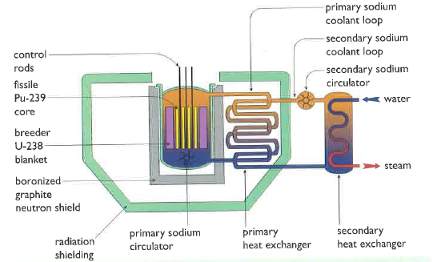
Liquid metal fast breeder reactors
All FBRs generate more heat, so cooling is a bigger concern.
The fission core of LMFB reactors is surrounded by a ‘blanket’ of U-238 in which ‘breeding’ occurs.
Liquid sodium coolant circulates through the system and transfers heat to create steam.
Sodium is neither a moderator nor an absorber.
Safety concerns?
Concentrated fuel could runaway.
Reprocessing is needed and is hazardous.
Pu can be used for weapons.
Energy Systems and Sustainability, 2/e, Chapter 10

Slide 69
Module 6. Nuclear power
6.8: Newer reactor designs

Slide 70
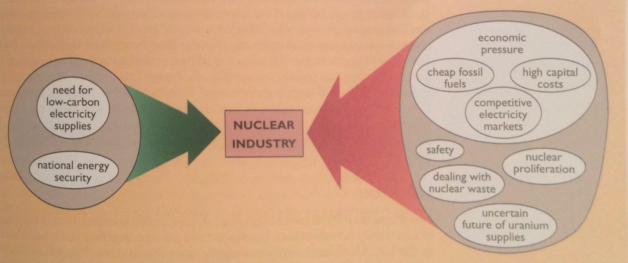
Factors in the decline of nuclear power
As we’ve seen, the construction of new nuclear plants slowed in the 1990s. Why?
Both the Thatcher and Regan governments supported the free market vs. government backing needed to prop up nuclear in an era of cheap fossil fuels.
Energy Systems and Sustainability, 2/e, Chapter 11

Slide 71
LCOE (Lazard, 2019)
g CO2/kWh
https://www.lazard.com/media/451086/lazards-levelized-cost-of-energy-version-130-vf.pdf
https://en.wikipedia.org/wiki/Life-cycle_greenhouse-gas_emissions_of_energy_sources;
48
27
38
11
12
12
820
490
nuclear
coal
CCGT
PV, rooftop
PV, utility
solar tower
geothermal
gas peaking
wind,onshore
PV, community
wind,offshore

Slide 72
Reducing the costs of nuclear power
To make nuclear power more competitive capital, operating and maintenance costs must be reduced and safety must be improved.
Design changes may lower costs and improve safety:
Modular design for factory construction and testing;
Simplified design with fewer components;
Simplified fuel handling to reduce O&M costs; and
Increasing operating temperatures for improved efficiency.
Energy Systems & Sustainability, 2/e, Chapter 11

Slide 73
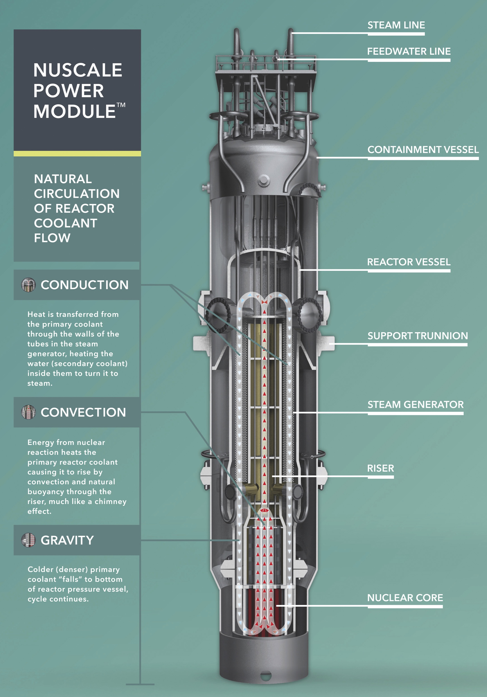
Small modular reactors (SMR)
Example: NuScale Power
Self-contained
65’ tall, 9’ diameter
Built in factory and shipped to site ready for installation in cooling pool
Passive coolant circulation operates without power
60 MWe electrical capacity (50K homes)
Cost ~ $5,100 / kW
Approved by the US NRC
$314 m investment from US DOE
http://www.nuscalepower.com/our-technology/design-advances

Slide 74
First NuScale project?
The NRC has just approved a plant that uses 12 NuScale modules to produce enough electricity to power a small city (size of Portland, OR). 720-MW capacity.
Contracted for 10 MW at a cost of $55/MWh
Operational in 2026
NuScale notes that these small nuclear plants can also be used to:
Produce hydrogen gas for powering vehicles; and
Produce clean water via powering reverse osmosis.
http://www.nuscalepower.com/our-technology/design-advances
https://www.eastidahonews.com/2019/08/a-comprehensive-look-at-the-nuscale-small-modular-reactor-project/

Slide 75
Can NuScale be cost competitive?
In 2020, NuScale offered to cap the cost of its SMR nuclear power at ¢6.5/kWh to incentivize a first crop of projects.
Also in 2020, the Los Angeles Department of Water and Power signed a contract for power at ¢2/kWh from renewables with storage that would guarantee power 24/7.
https://e360.yale.edu/features/when-it-comes-to-nuclear-power-could-smaller-be-better

Slide 76
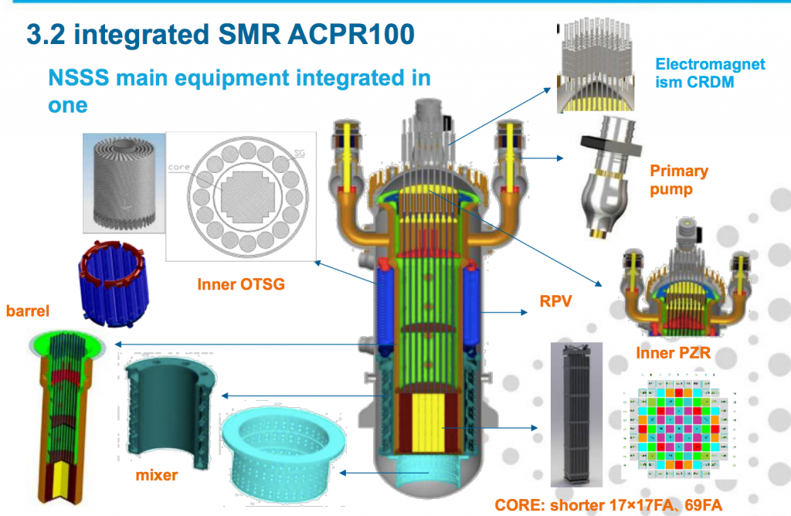
Other global SMR projects?
Russia has built a floating 80 MW SMR that will sail to and power remote mining projects.
China is also building a an SMR, the ACP1000 also called the Nimble Dragon.
Can be floated
Submersible version planned
Three Canadian provinces and the UK are also in the hunt for SMR.
https://e360.yale.edu/features/when-it-comes-to-nuclear-power-could-smaller-be-better
https://www.bbc.com/news/world-europe-49446235

Slide 77
Westinghouse Advanced Passive AP1000
In the US, four plants of this design were under construction in GA and SC.
Construction of the SC plants has been halted and cancelled due to cost overruns.
The GA plants are under construction with issues; one may startup in 2021.
China has built four plants with the AP1000 design.
Construction is complete
Becoming operational
AP1000 features:
Steel secondary containment;
Passive, gravity fed water cooling;
Simplified design:
35% fewer pumps;
85% fewer control cables;
Also fewer safety system pumps;
Smaller size;
Modular construction; and
Less expensive
Energy Systems and Sustainability, 2/e, Chapter 11;
https://www.bloomberg.com/news/articles/2017-04-26/nuclear-reactor-treasure-seen-buried-in-wreck-of-westinghouse

Slide 78
Pebble-bed high temperature reactor
Pebble-bed reactors have radically different fuel handling systems.
Pebbles: 1000s of small kernels of UO₂ coated with layers of graphite.
Combining many pebbles in a hopper achieves critical mass.
Cooled by pumping high-pressure He through the pebbles.
Operates at 900°C.
Drives a CCGT generation system.
Germany abandoned the design when a pebble jammed, was damaged and leaked uranium.
China is building a pebble-bed reactors and the US DOE has awarded grant money for R&D and implementation.
Energy Systems and Sustainability, 2/e, Chapter 11; https://en.wikipedia.org/wiki/Pebble-bed_reactor

Slide 79
Molten-salt reactors
Molten-salt reactors use a radically different design in which the coolant – which may be the fuel itself – is a molten salt.
Advantages:
High temp and thermal efficiency.
Liquid UF4 is dissolved in coolant.
Circulation through graphite core causes criticality.
Safety:
Loss of coolant is loss of fuel, so stops criticality.
Overheating melts a safety plug, draining fuel into water cooling pond, solidifying fuel.
Energy Systems & Sustainability, 2/e, Chapter 11;
https://en.wikipedia.org/wiki/Molten_salt_reactor

Slide 80
The road to SMR /new nuclear is littered with corpses
Enrico Fermi Atomic Power Plant in Newport MI was the first SMR design, 1963.
It operated for just 3 years and suffered a partial meltdown along the way.
See the ‘Spectrum IEEE’ article for the long and checkered history of SMRs.
Westinghouse worked on SMR for a decade before giving up in 2014.
A Babcock and Wilcox SMR design was abandoned in 2017.
Transatomic Power, a Cambridge/MIT startup focused on molten salt reactors, had a $111 million dollar investment from the US government but folded in 2018
https://e360.yale.edu/features/when-it-comes-to-nuclear-power-could-smaller-be-better
https://spectrum.ieee.org/tech-history/heroic-failures/the-forgotten-history-of-small-nuclear-reactors

Slide 81
Module 6. Nuclear power
6.9: Nuclear power in France

Slide 82
Nuclear power in France
The oil shocks (or oil crisis) of the early 1970s hit France especially hard because most of its electricity was generated with oil.
With no fossil fuel resources of their own, the French saw nuclear as their only way to energy independence.
Over the next 15 years France built 56 nuclear plants.
Electricity is now an export.
2017: 38 TWh exported
Consistency and scale:
All 56 plants are based on a Westinghouse design for pressurized water reactors.
Standard design lowered price of construction.
Lessons learned are applied across the fleet = ‘return (benefit) of experience’.
http://www.pbs.org/wgbh//pages/frontline///////shows/reaction/readings/french.html

Slide 83
How did France overcome fear and objections?
A 1997 Frontline report by PBS identified four reasons:
1. "no oil, no gas, no coal, no choice."
2. Culture: large, centrally managed technological programs are the norm in France.
High-speed trains
Supersonic jets (the Concorde)
3. Trust and respect for scientist, engineers and technical administrators is high.
4. They sold it: PR, tours, jobs, pride, openness
The French do have fears, but the government has worked to overcome them.
http://www.pbs.org/wgbh//pages/frontline///////shows/reaction/readings/french.html

Slide 84
French nuclear plants
Plants are located throughout the country.
Every region has nuclear.
https://en.wikipedia.org/wiki/Nuclear_power_in_France

Slide 85
EDF: French government owned and managed
Messmer plan (1974): build a fleet of 80 nuclear plants by 1985, expanding to 170 plants by 2000.
No parliamentary or public approval
"In France, we do not have oil, but we have ideas."
Electricité de France (EDF) owns most shares and manages France‘s nuclear system.
Typically in debt
Decommissioning is underfunded
French electricity is 12th least expensive in the EU (mid-level)
Baseload and peaking nuclear power:
Because nuclear supplies nearly all of France’s electricity, some nuclear plants provide baseload power and others provide peaking power.
And France uses a great deal of electrical heating, so weather affects demand.
https://en.wikipedia.org/wiki/Nuclear_power_in_France

Slide 86
Reactor design
All French plants are now PWR (pressurized water reactors).
900 MWe
34 plants built in 1970s – 1980s
All given 10-year extension in 2002
1300 MWe
20 plants
1500 MWe
2 plants built 1984 - 1991
Heat loops rebuilt before operation 2000 - 2002
1650 MWe (EPR plants)
Planned new generation of plants designed in collaboration with others.
None completed yet. Significant cost overruns and redesigns
https://en.wikipedia.org/wiki/Nuclear_power_in_France

Slide 87
Nuclear plant cooling and GCC
Five plants are located on the ocean, but the rest are cooled by river water.
Operational regulations set strict limits on acceptable water temperature.
Recent heat waves have shut down nuclear plants because water temperatures have risen above limits.
https://en.wikipedia.org/wiki/Nuclear_power_in_France

Slide 88
Fuel cycle
The French nuclear fleet recycles or reprocesses spent fuel while most other countries using nuclear power don’t.
France has also reprocessed fuel for the US and Japan.
France doesn’t mine uranium, but does control uranium resources in other countries like Canada, central Asia, Africa.
https://en.wikipedia.org/wiki/Nuclear_power_in_France

Slide 89
Accidents?
Yes! There have been a dozen accidents at nuclear power plants in France.
https://en.wikipedia.org/wiki/Nuclear_power_in_France

Slide 90
The problem of nuclear waste
When it came time to dispose of waste, the French public objected to burying it in their backyards.
In fact, French plants recycle much of their waste, excluding plutonium.
A change of approach to describe waste storage as ‘underground stocking’ of fuel and to propose establishment of labs dedicated to fuel recycling at four cites around France seems likely to be more successful.
However, the problem hasn’t been definitively solved.
The costs of decommissioning a fleet of plants within several decades will be massive and funding is thought to be insufficient.
http://www.pbs.org/wgbh//pages/frontline///////shows/reaction/readings/french.html

Slide 91
Response to Fukushima?
2006: Autorité de sûreté nucléaire (ASN) was created as the independent French nuclear
safety regulator.
2012: ASN report suggested safety and cooling upgrades at all French reactors.
Addition layers of safety to be built at all reactors
Elite deployment force to deal with accidents
Public opinion? Support for nuclear has dropped.
30% in favor
40% hesitant
17% against
2012: Sarkozy extended the life of existing nuclear plants beyond 40 years
Upgrades planned
Electricity costs forecast to rise 10-30%
https://en.wikipedia.org/wiki/Nuclear_power_in_France

Slide 92
Future? Less nuclear in France
2015: National Assembly voted to reduce nuclear electricity to 50% by 2025
Coal-fired plants will also be closed.
More wind and solar power will be developed.
2017: Environment minister rolled this date back to 2030 - 2035
2016: Discovery that steel fittings created by Le Creusot Forge for nuclear plants across
France had potential defects and weak points
There had been a coverup
Checks shut down reactors in rolling waves
This problem may prevent plant life extension
2018: Macron rolled back the 50% date to 2035
14 of the 900 MWe reactors will close
2021: Decision about building new nuclear will be made
https://en.wikipedia.org/wiki/Nuclear_power_in_France

Slide 93
Future? Less nuclear in France (2020 update)
2020: February – France began to shutdown its oldest, 43-year old nuclear plant at
Fessenheim
Another dozen of the oldest (> 40 yo)plants must shutdown to meet the goal of reducing nuclear power from 75% to 50%
A next-generation nuclear plant is being built (10 years behind) in Flamanville.
Scheduled to go online in 2022
EPR design (European Pressurized Reactor)
Plagued by problems with quality of steel components and massive cost overruns
May not be the last new nuclear plant
3 new plants EPR proposed but not finalized or funded in October of 2019
Each with two reactors
These would replace old plants without increasing nuclear capacity
Hoping that lessons learned at Flamaville will pay off for these new plants
https://bellona.org/news/nuclear-issues/2020-03-france-begins-winding-down-its-reliance-on-nuclear-power
https://www.technologyreview.com/2019/10/16/65172/why-france-is-eyeing-nuclear-power-again/

Slide 94
Nuclear power in China?
China has 46 nuclear plants and another 10 - 12 in the planning phase.
If these plans are built, China will overtake France.
Problems?
Public support has dropped since Fukushima.
Manufacturing slowing.
China’s massive push on RE has lowered their price.
Can nuclear still compete?
2016 -> no new
https://www.cnn.com/2019/09/13/business/china-nuclear-climate-intl-hnk/index.html

Slide 95
They appear to be hedging their bets
The government, and citizens, were very alarmed by Fukushima and it caused many in China to change the minds about betting the farm on nuclear power.
Their newest reactors, AP1000 and EPR, are designed to be much safer but have increased the price of nuclear power.
Renewables are now competitive with nuclear.
Nuclear plants only operated at 81% capacity in 2017, even as China plans to move away from coal.
If a Chinese-designed advanced technology reactor doesn’t lower the price of safer nuclear power, China may scale back its nuclear plans and fill the gap with renewables.
The two largest Chinese nuclear companies are investing heavily in renewables, signaling that nuclear’s place in China’s future isn’t’ a sure thing.
https://www.technologyreview.com/2018/12/12/138271/chinas-losing-its-taste-for-nuclear-power-thats-bad-news/

Slide 96
Module 6. Nuclear power
6.10: Nuclear power in Vermont

Slide 97
Vermont Yankee nuclear plant, stats
Data
Location | Vernon, VT
Operator | Entergy
Start of commercial operation | February 28, 1973
Reactors
Reactor supplier | General Electric
Reactor type | BWR-4
Power
Capacity | 620 MW
Total power generation in 2007 | 4,703 GW·h
Average annual generation (last 5 yrs) | 4,436 GW·h
Energy Systems and Sustainability, 2/e, Chapter 10

Slide 98
Vermont Yankee nuclear plant, status
Vermont Yankee occupies a 125-acre site in Vernon, VT (Windham County)
September 2003: Entergy Nuclear Operations, the owner, submitted an application to the Nuclear Regulatory Commission (NRC) to increase the plant’s maximum power level by 20%.
There were questions and objections.
The plant was nearing the end of its licensing period.
And it needed to be refueled to increase power.
January 2007: Entergy applied for a 20-year license extension.
2014: Vermont Yankee closed… decomissioning dates uncertain
2019: Vermont Yankee sold to North Star and decommissioning begun; to end in 2030
www.eia.doe.gov

Slide 99
Dry cask storage of nuclear waste
Nuclear waste at Vermont Yankee is stored on site in ‘dry casks’.
Spent fuel is placed in a canister and flooded with inert gas.
The steel cylinder is bolted / welded shut.
Cylinders are surrounded by additional steel, concrete or other material to shield humans from radiation.
www.eia.doe.gov

Slide 100
Dry casks at Vermont Yankee
Google maps

Slide 101
Module 6. Nuclear power
6.11: Power from fusion ?

Slide 102
What is fusion?
Fusion of two isotopes of hydrogen, deuterium (²H) and tritium (³H), creates helium-4.
A neutron is freed.
17.59 MeV of energy is released when matter is converted to energy: E = mc².
Fusion powers the sun, and thus is the ultimate source of power for our planet.
Products are not radioactive or hazardous.
Energy Systems and Sustainability, 2/e, Chapter 10
www.eia.doe.gov

Slide 103
Energy released by fusion
How much energy is released when one atom of deuterium fuses with one atom of tritium to create an atom of helium and a neutron?
particle | mass (atomic mass units)
deuterium atom | 2.0136
tritium atom | 3.0155
helium atom | 4.0015
neutron | 1.0087
Global primary energy use ~ 5.8 E8 TJ
= 8.29 E6 kg ²H, ³H
²H + ³H → ⁴He + 1 n
2.0136 + 3.0155 → 4.0015 + 1.0087
5.0291 → 5.0102
→ loss of 0.0189 amu
Energy = (0.0189 amu)(931 MeV/amu) = 17.6 MeV → 2.82 E-12 J / event
Fusion of 2 kg of deuterium & 3 kg of tritium → 350 TJ = 70 TJ/kg
Energy Systems and Sustainability, 2/e, Chapter 10
www.eia.doe.gov

Slide 104
Fuel for fusion
Deuterium occurs naturally at a very low abundance and can be extracted from large volumes of water.
Tritium is a radioactive isotope with a relatively short half-life of 12 years.
Produced by bombarding Li-6.
So, it’s a product of nuclear reactions.
Energy Systems and Sustainability, 2/e, Chapter 10
www.eia.doe.gov

Slide 105
Barriers to fusion?
So if fusion is a better idea than fission, why aren’t we using it now?
It takes an enormous amount of energy to fuse two positively charged nuclei and initiate the fusion process.
Speed?
Heating atoms will increase their speed, but change their physical state to plasma.
How can plasma – the physical state of the sun – be contained?
And stabilized?
Energy Systems and Sustainability, 2/e, Chapter 10
www.eia.doe.gov

Slide 106
Tokamak
Tokamak: a machine that uses magnetic fields to contain plasma in a torus, or doughnut-shaped space
Breakthrough at MIT?
Adding small amounts of ³-He seems to stabilize plasma and increase efficiency.
Alcator C-Mod @ MIT
Energy Systems and Sustainability, 2/e, Chapter 10
http://www.popularmechanics.com/science/energy/a27961/mit-nuclear-fusion-experiment-increases-efficiency/
www.eia.doe.gov

Slide 107
Inertial petawatt laser confinement
Inertial confinement fusion (ICF): fusion fuel is placed in a sphere which is held in a hohlraum (hollow area) and then bombarded with many, many laser beams
The laser beams compact and heat the fusion fuel…
... creating a shock wave which causes fusion to begin.
https://lasers.llnl.gov/science/icf/how-icf-works
https://www.youtube.com/watch?v=yixhyPN0r3g

Slide 108
Magnetized target fusion
Magnetized target fusion: fusion fuel is confined by a magnetic field while heated to plasma-producing temperatures
Then pistons are used to quickly squeeze the plasma, increasing density and initiating fusion.
Pistons synchronize to create repeated ‘hammering’.
Energy Systems and Sustainability, 2/e, Chapter 10;
https://youtube/b-LCfx9v4YQ

Slide 109
My nuclear power ‘take-homes’
Pros:
Hard to see how we will lower carbon emissions quickly without nuclear, particularly since asking people to change behavior is tough.
Overall safety record could be worse.
Cons:
Nuclear power is hard to disconnect from nuclear proliferation, nuclear weapons and dirty bombs.
And the world isn’t becoming safer or more stable. In fact, technologies are becoming accessible to even small, non-national groups.
Nuclear power is fairly safe, but when it goes wrong it goes very badly wrong. And we’ve not yet a full generation out from Chernobyl and Fukushima. All health effects aren’t yet apparent.
Settle on a few good designs and work their bugs out.
Nuclear is expensive though it has always been highly subsidized. It will take a carbon tax or even higher subsidizes to pay for new nuclear. See gilets jaunes protests in France.
Carbon footprint of electricity is already decreasing; transportation and industry are larger issues.

Slide 110
Hurdles for nuclear to overcome
In 2018, a group of scientists concerned about climate change published a study in PNAS asking whether nuclear power would have a role in a transformed energy system. While they support nuclear, here’s their take.
“There is no reason to believe that any utility in the United States will build a new large reactor in the foreseeable future. These reactors have proven unaffordable and economically uncompetitive. In the few markets with the will to build them, they have proven to be unconstructible. The combination of political instruments and market developments that would render them attractive, such as investment and production credits, robust carbon pricing, and high natural gas costs, is unlikely to materialize soon.”
1. US nuclear fleet is shrinking: aging out; expensive.
2. Existing nuclear technology is a dead-end.
3. Advanced design nuclear plants aren’t happening.
4. SMR: maybe not? Unlikely to be economically competitive so no market niche
5. A nuclear wedge may not exist once old plants retire
https://www.pnas.org/content/115/28/7184

