Slide 1
SSC 2030: Energy Systems & Sustainability
9. Wind energy
9.1: Introduction
9.2: The wind and wind resources
9.3: Wind turbines: types and components
9.4: Aerodynamics of wind turbines
9.5: Power and energy from wind turbines
9.6: Wind project scale and Vermont examples
9.7: Environmental impacts
9.8: Economics
9.9: Commercial development and potential
9.10: Offshore and ocean wind potential and development
Wind energy in Vermont discussed throughout
Main source: Boyle, Godfrey (ed) (2004) Renewable Energy: Power for a Sustainable Future, 2/e, Oxford University Press, UK

Slide 2
9. Wind energy
9.1: Introduction
Renewable Energy, 2/e, Chapter 7

Slide 3
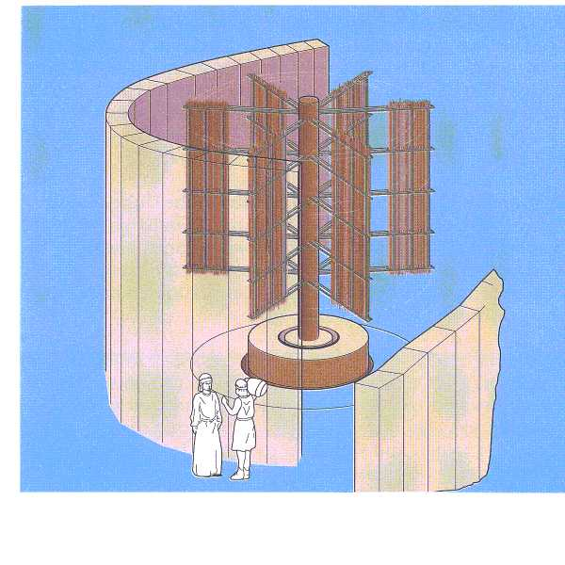
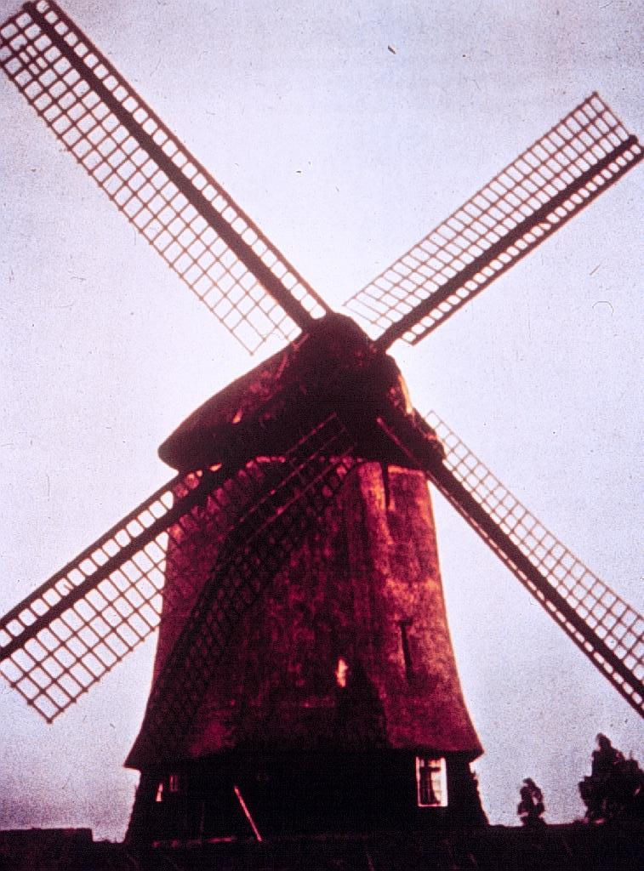
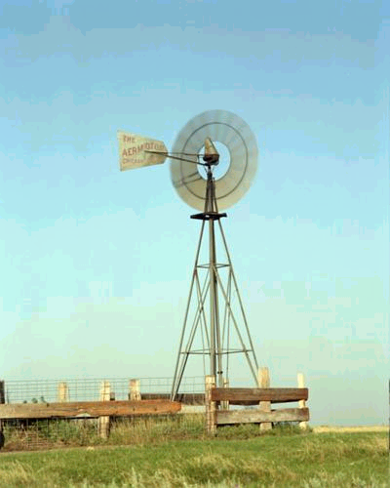
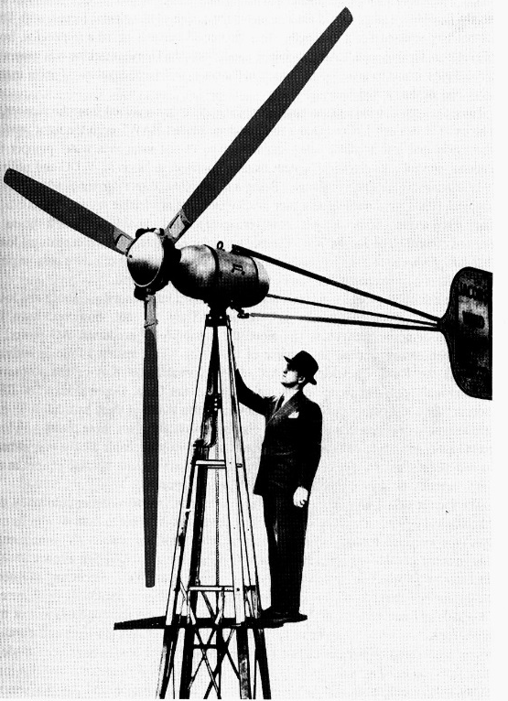
Wind: ancient & reinvented
1400 – 1800 years ago, in the Middle East
800 – 900 years ago in Europe
140 years ago water-pumping wind mills
70 years ago electric power
NREL

Slide 4
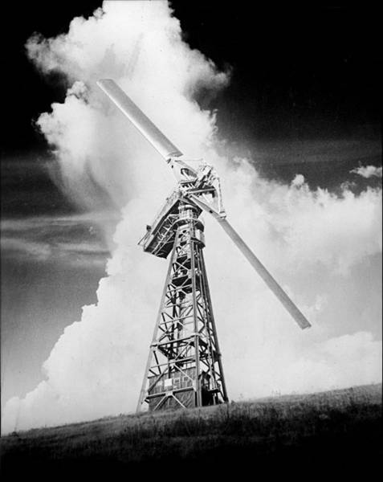
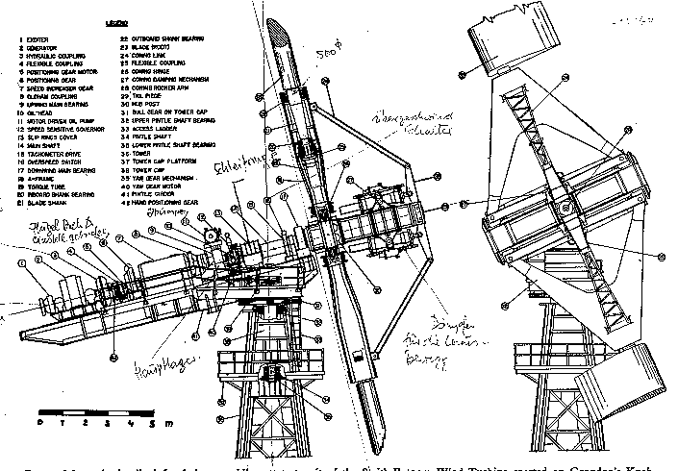
Vermont: early wind leader!
1941: Rutland VT, Grandpa’s Knob
1.25 MW Smith Putman Turbine
First grid-connected turbine in U.S.
World’s first MW-scale wind turbine
https://en.wikipedia.org/wiki/Smith-Putnam_wind_turbine

Slide 5
Modern wind : 1980s - present
Today wind power is one of the most cost-effective methods of making electricity.
In the UK, government support has caused the cost of large wind to drop by half in less than two years.
In 2017, the cost of wind electricity in the UK became less expensive than nuclear energy.
If costs continue to decrease it will be the least expensive form of energy by 2020.
Offshore wind is popular with UK citizens.
In the US, the cost of wind has dropped 66% over the last 6 years.
Lowest contract $0.02/kWh in 2016.
Historically less expensive than solar.
“Over the past five years, U.S. wind energy capacity grew from 25,000 megawatts (MW) to over 61,000 MW, a 140 percent growth rate, yet electricity generated from these wind turbines grew at a rate of 200 percent, exceeding capacity growth and making wind energy cheaper than ever.”
Renewable Energy, 2/e, Chapter 7; https://www.awea.org/generationrecords
https://www.theguardian.com/commentisfree/2017/sep/26/offshore-wind-power-energy-price-climate-change
https://www.theguardian.com/sustainable-business/2016/dec/21/solar-wind-energy-renewables-google-microsoft-amazon

Slide 6
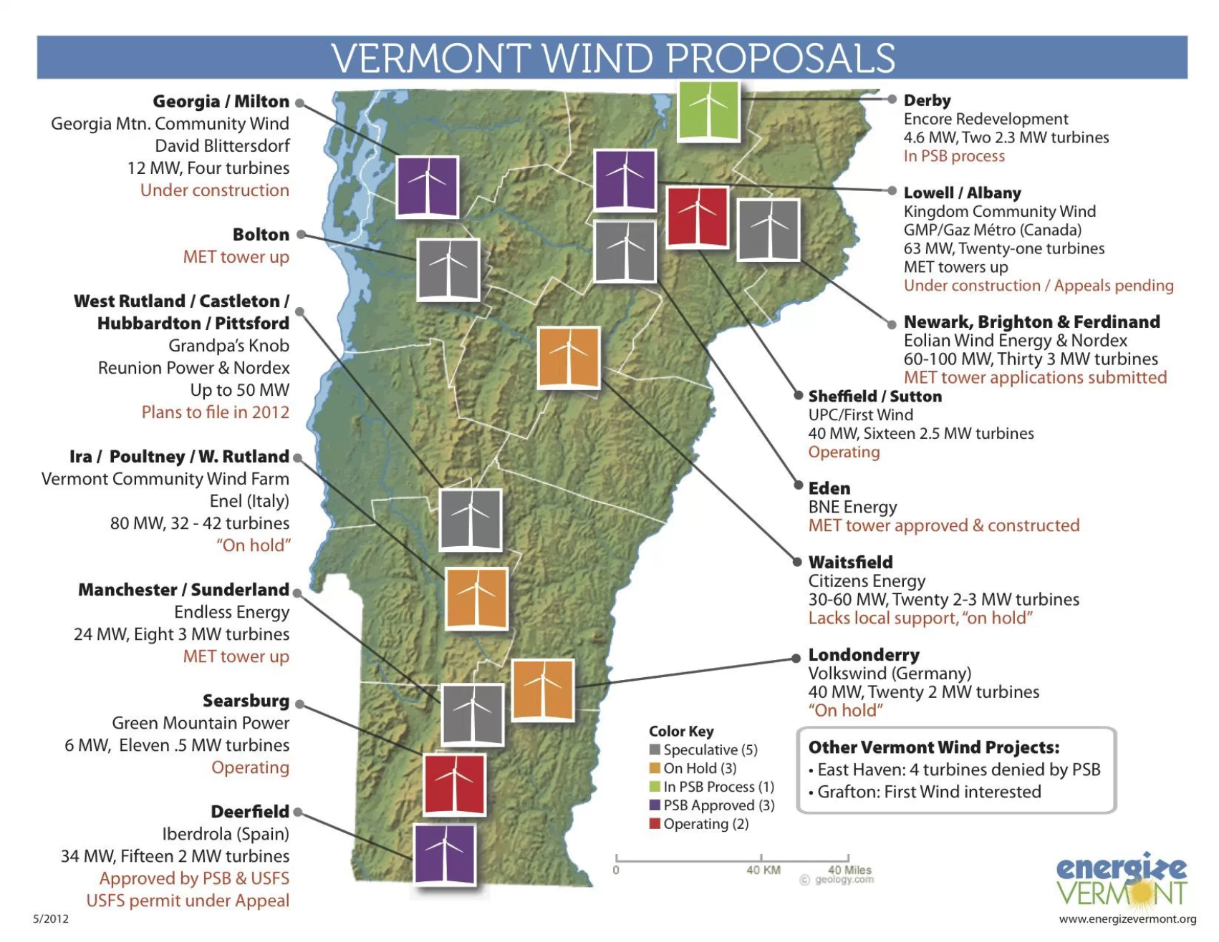
Wind power in Vermont today
2012

Slide 7
9. Wind energy
9.2: The wind
Renewable Energy, 2/e, Chapter 7

Slide 8
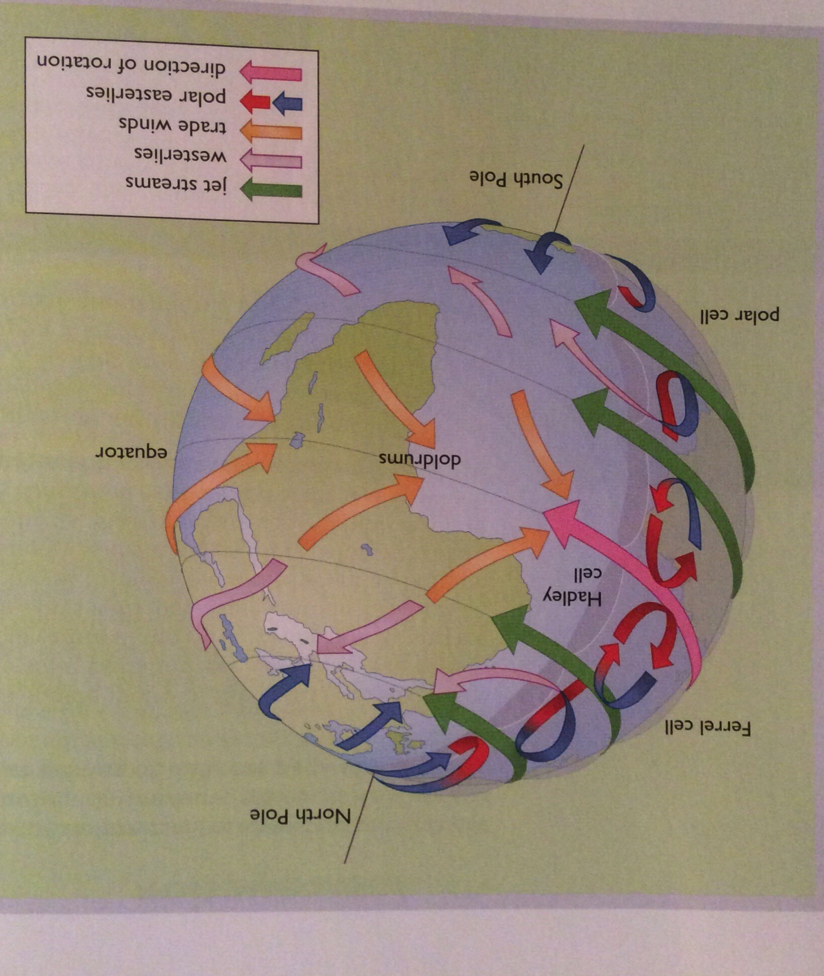
What is wind?
Wind is movement of atmospheric air masses that result from variations in atmospheric pressure. The variations in pressure result from solar heating of different parts of the earth’s surface.
Because the density of sunlight is highest at the equator and falls towards the poles, equatorial regions are warmer & poles cooler.
This difference in atmospheric temperatures causes the atmosphere to move.
Renewable Energy, 2/e, Chapter 7

Slide 9
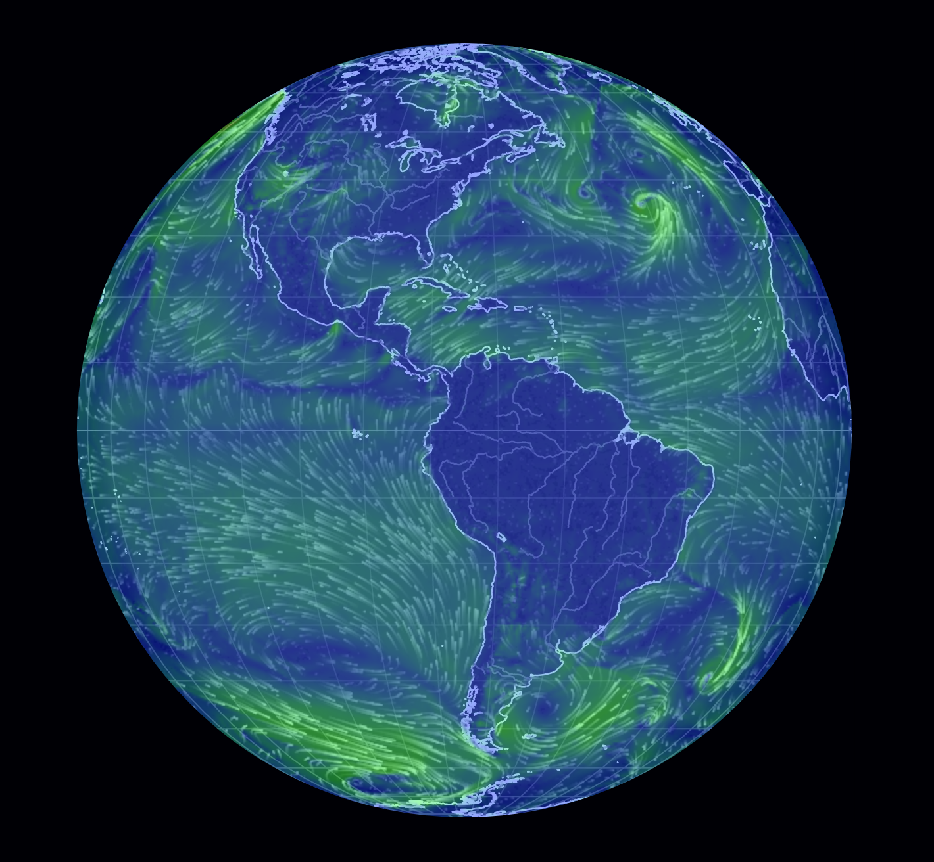
Global wind: predictable….mostly
Notice wind patterns.
Offshore wind & current are fairly predictable.
https://earth.nullschool.net/
https://www.youtube.com/watch?v=i4mBYwBNULk
https://www.youtube.com/watch?v=XOxXEvTDC1g

Slide 10
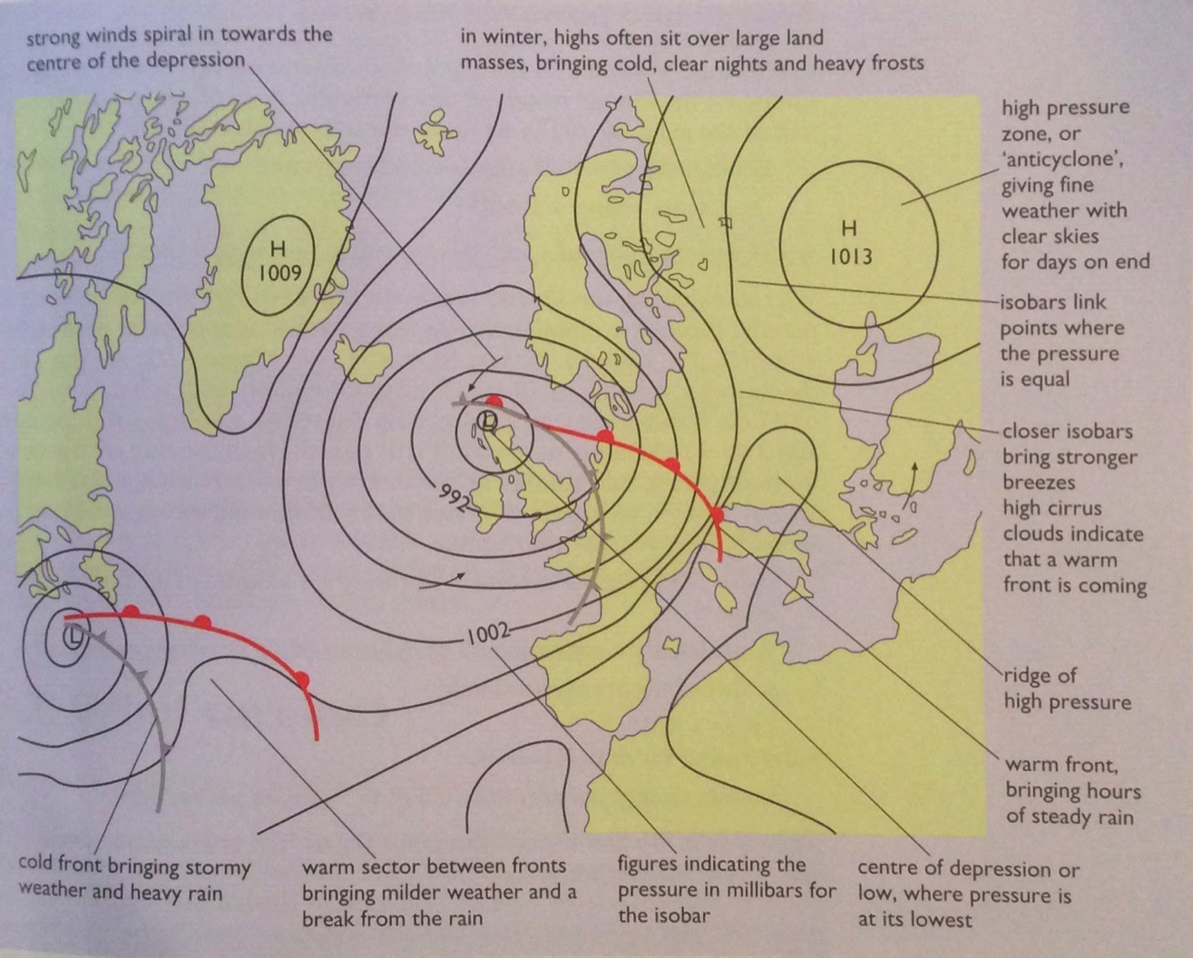
Pressure predicts weather & wind
High pressure predicts good (clear) weather while low pressure indicates changing, windy weather & precipitation.
Renewable Energy, 2/e, Chapter 7

Slide 11
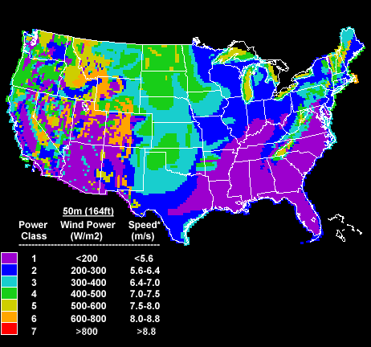
US wind resources
Wind resources vary, but wind has been installed in most state.
http://www.nrel.gov/wind/wind_potential.html

Slide 12
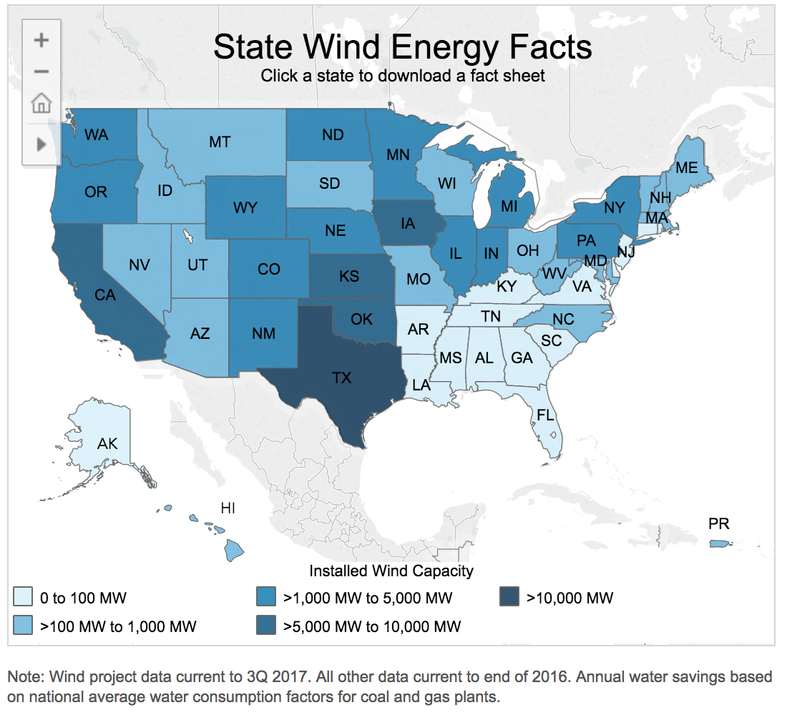
Installed wind power by state
Wind resources aren’t everything.
Note that Texas & Iowa don’t have optimal wind resources but are the national leaders in wind power.
https://www.awea.org/state-fact-sheets

Slide 13
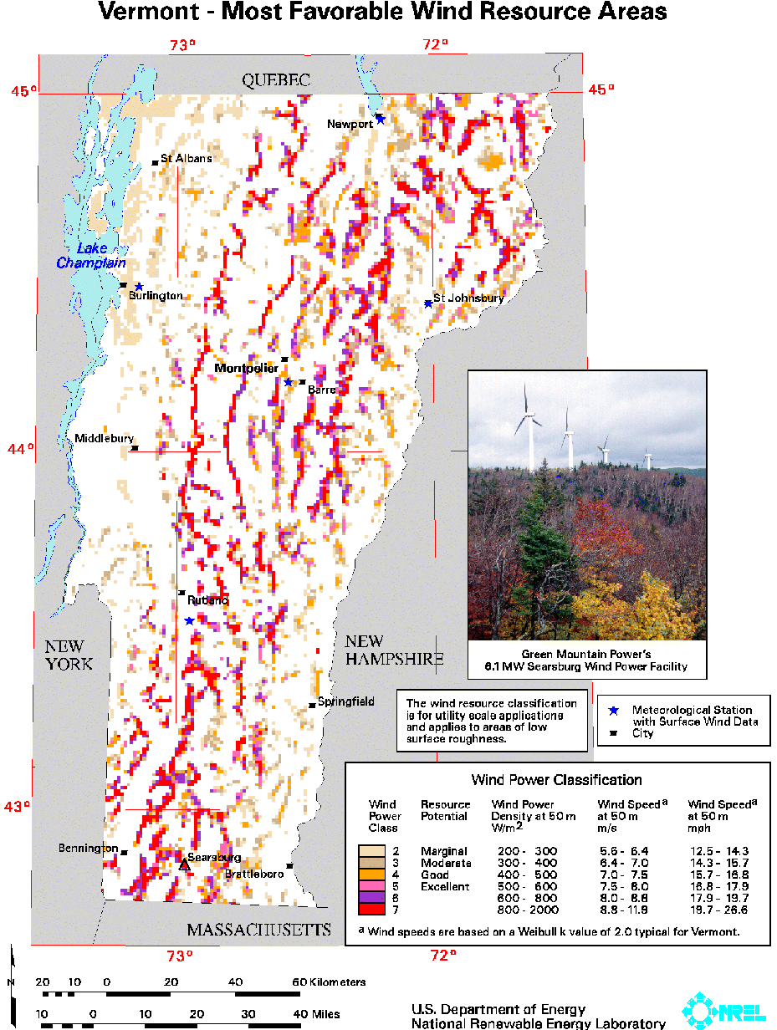
Vermont wind resources (1)
www.state.vt.us/psd/ee/wind/windclassap2-2.gif

Slide 14
Local winds
Sea breezes: result from differing heat capacities of land & water
Mountain-valley winds: from convection as warm air rises upslope
Renewable Energy, 2/e, Chapter 7

Slide 15
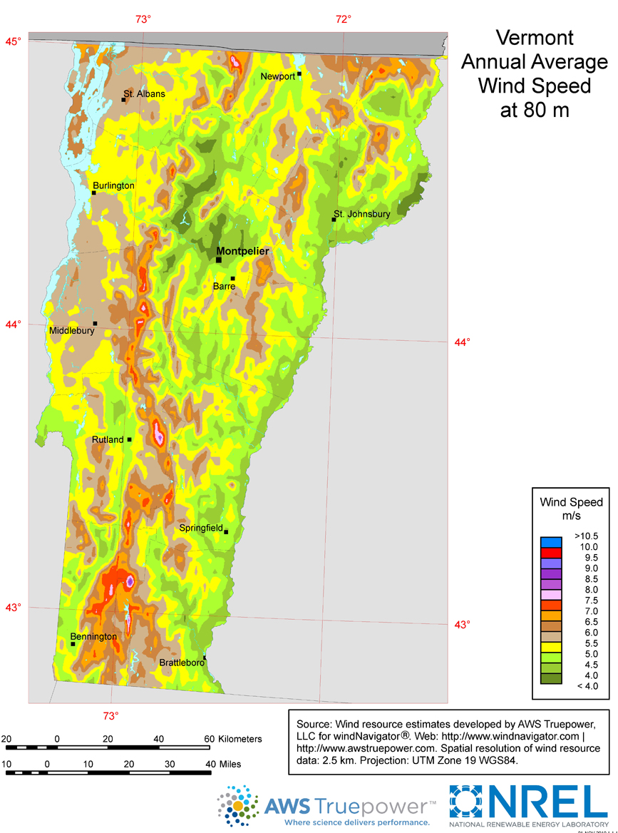
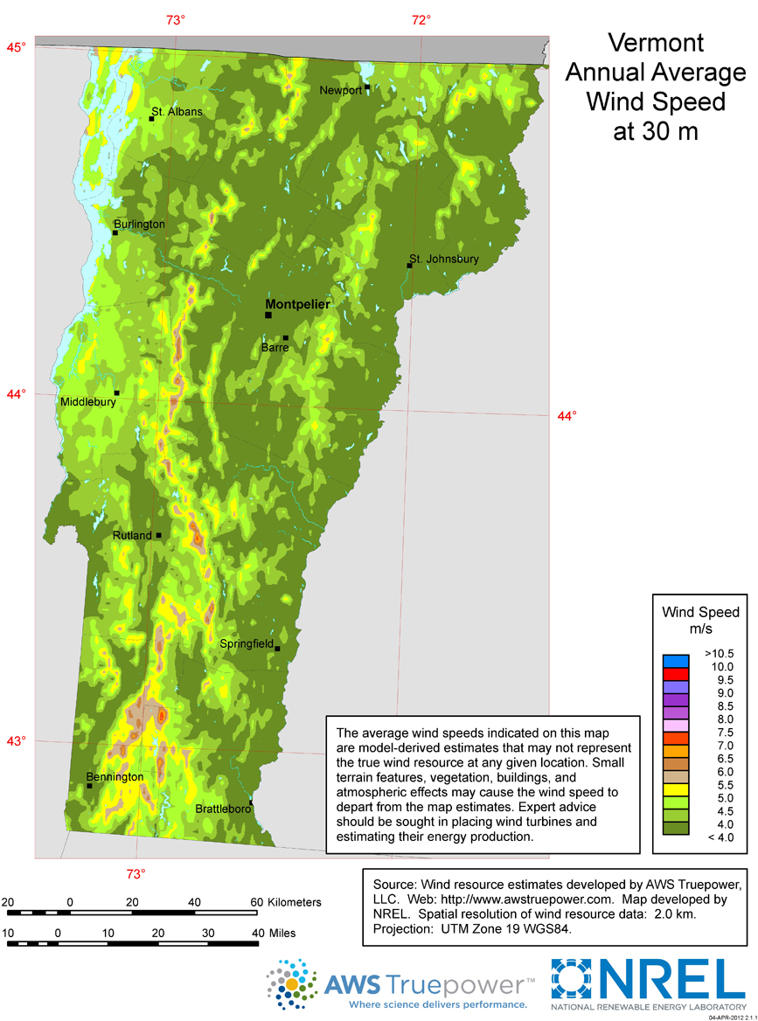
Vermont wind resources (2)
utility-scale wind map
residential-scale wind map
Dartmouth study: total VT capacity
5-6 million MW
https://windexchange.energy.gov/maps-data/130

Slide 16
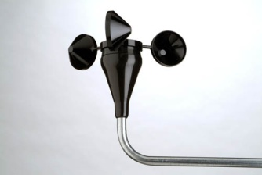
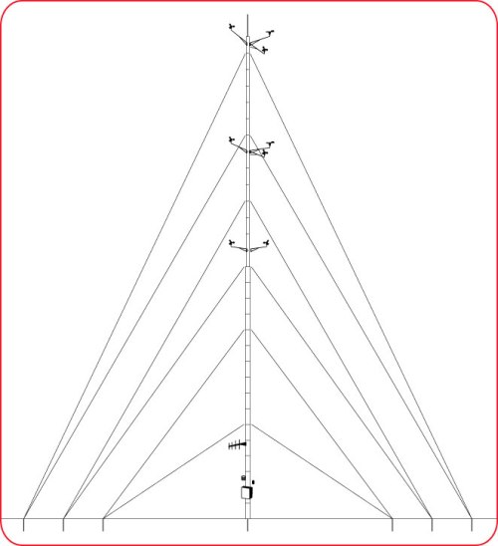
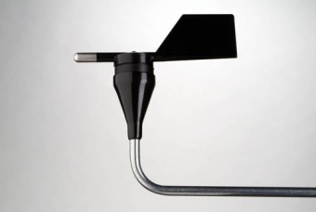
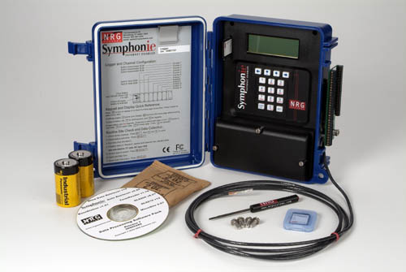
Assessing wind resources on site
NRG Systems (Hinesburg, VT) is a world leader.
cup
anemometer
vane
data logger
US D.O.E

Slide 17
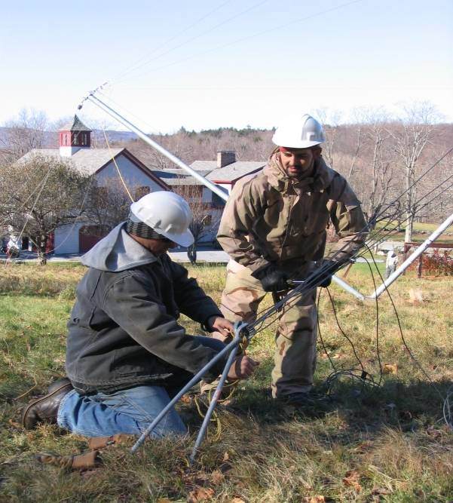
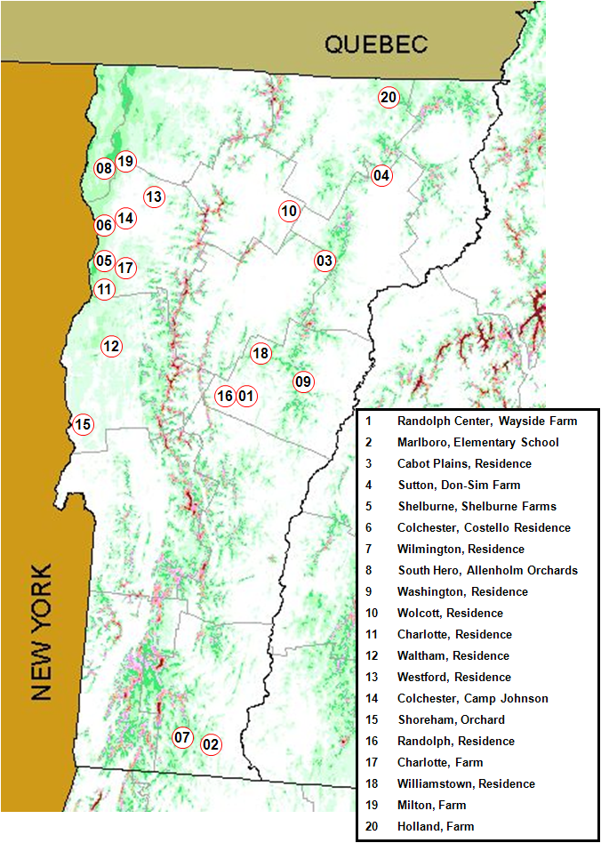
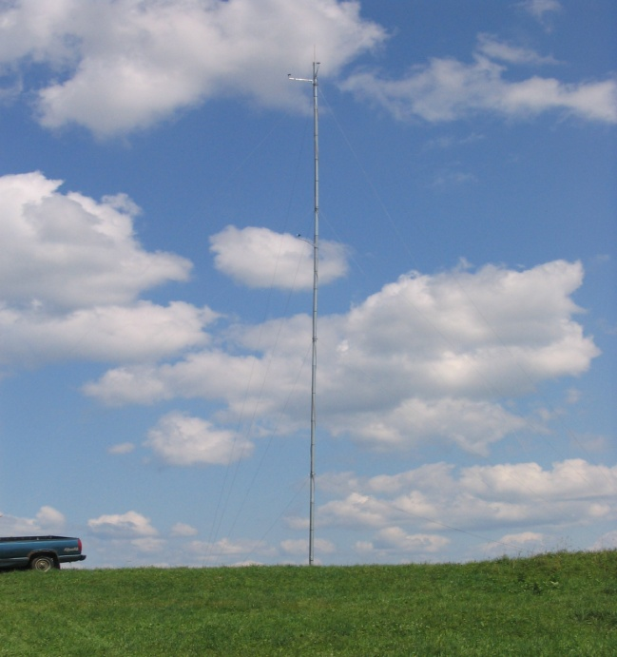
VT anemometer loan program
Residential-scale wind data?
It’s wise to measure wind resources at a site before installing a turbine.
30-m anemometer towers owned by the Vermont Tech.
Set up by students, faculty & staff.
Data made public.
http://web.vtc.edu/users/jnk06190/VTALP/index_files/Page348.htm

Slide 18
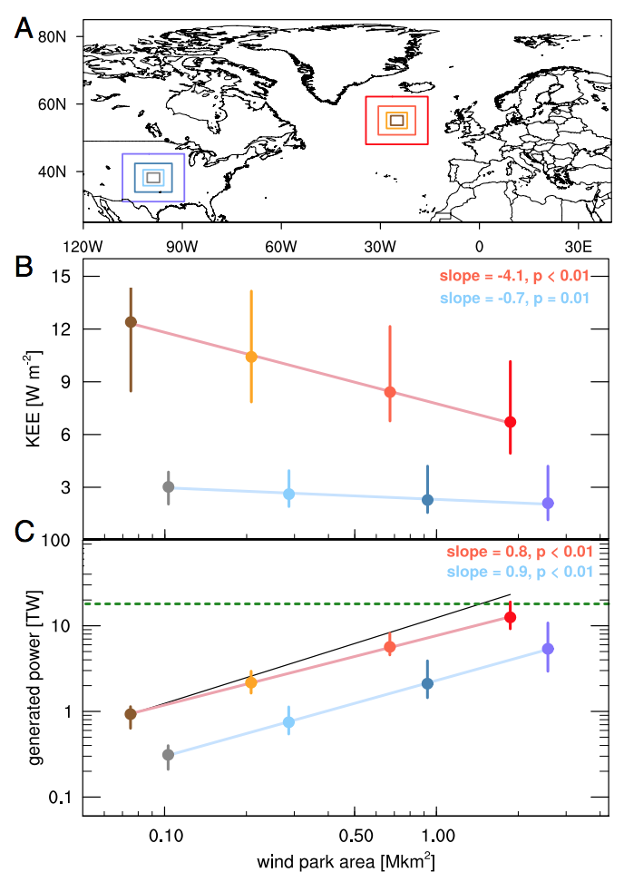
Potential of ocean (offshore) wind
A 2017 study showed that there is enough wind power over the oceans to power the world at current capacity, if that power could be harvested.
Wind turbines do remove energy from the wind, lowering ‘downstream’ wind potential & creating wind ‘shadows’.
However, for a number of reasons, ocean winds are more easily ‘replenished’.
“Nevertheless, even in the relative calm of summer, the upper geophysical
limit on sustained wind power in the North Atlantic alone could be sufficient to supply all of Europe’s electricity.
On an annual mean basis, the wind power available in the North Atlantic could be sufficient to power the world.” - Posner & Caldeira (2017)
https://www.theguardian.com/environment/2017/oct/15/wild-is-the-wind-the-resource-that-could-power-the-world
http://www.pnas.org/content/114/43/11338.full.pdf?with-ds=yes

Slide 19
9. Wind energy
9.3: Wind turbine types
Renewable Energy, 2/e, Chapter 7

Slide 20
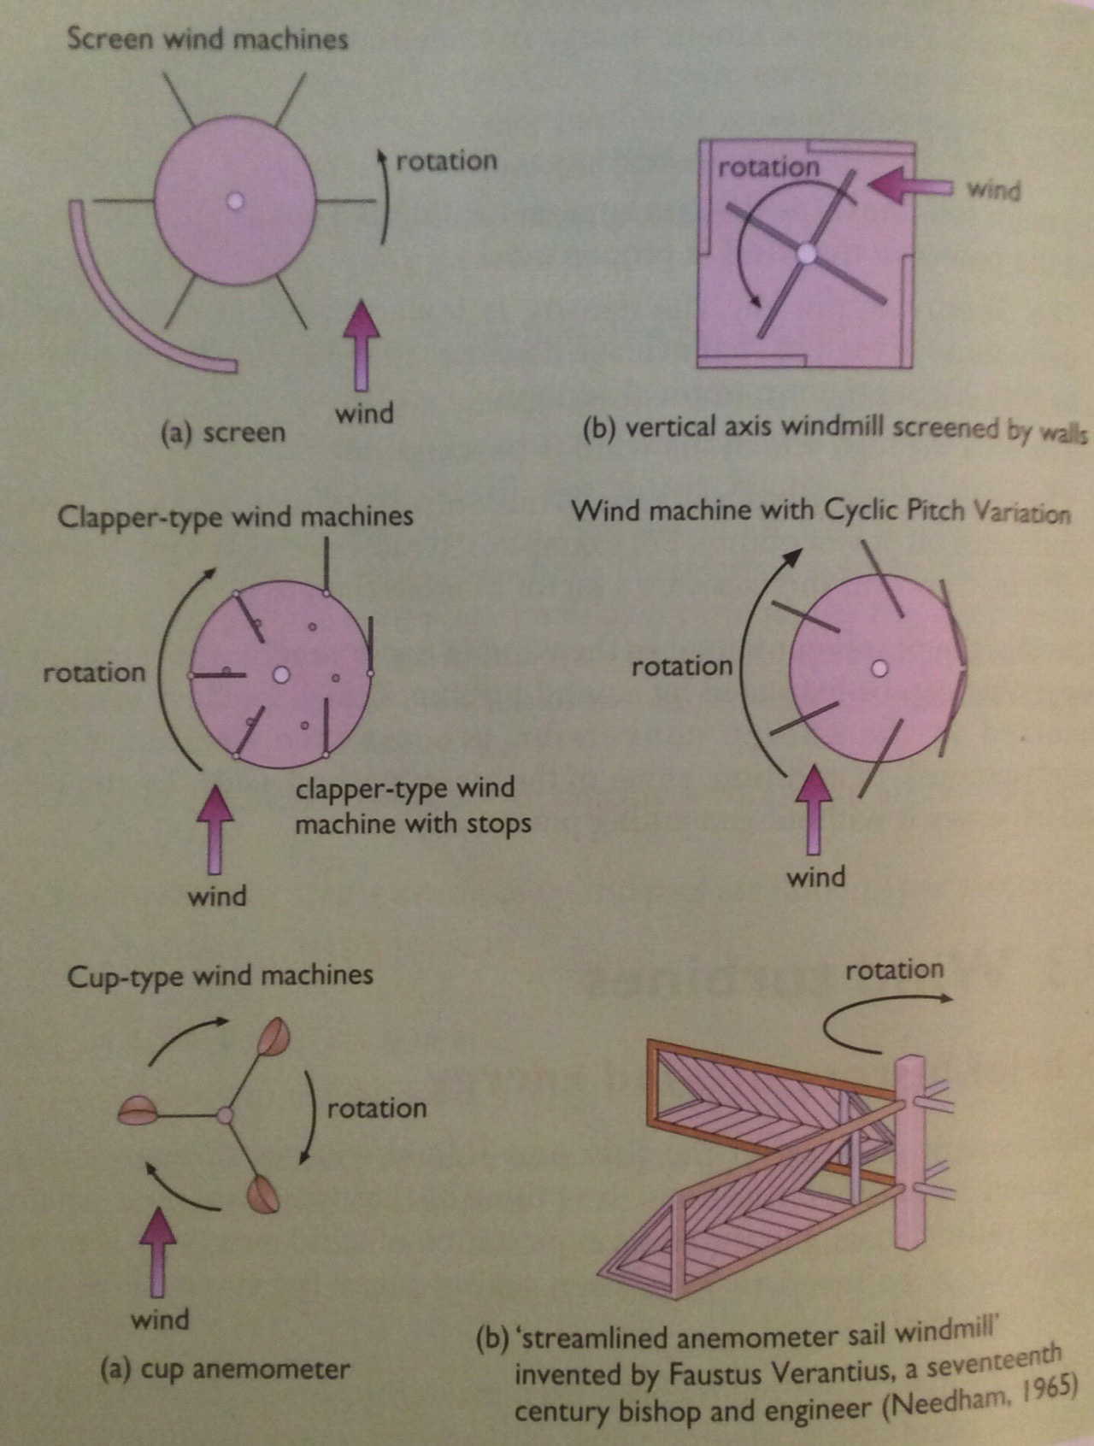
Windmills
Screened: screens (walls) shield the sails in the backward part of the cycle
Clapper: sails clap against stops to maximize their resistance forwards
Cyclically pivoting sail: progressive changes in sail pitch for resistance
Cup anemometer: wind catches cups
Renewable Energy, 2/e, Chapter 7

Slide 21
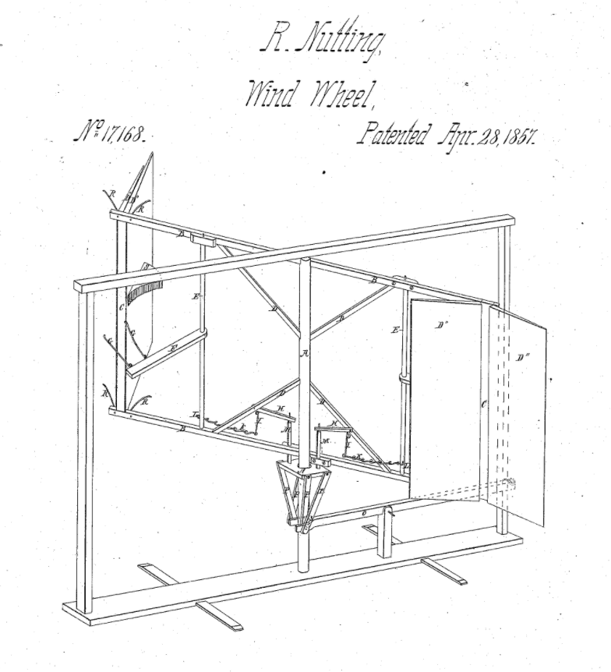
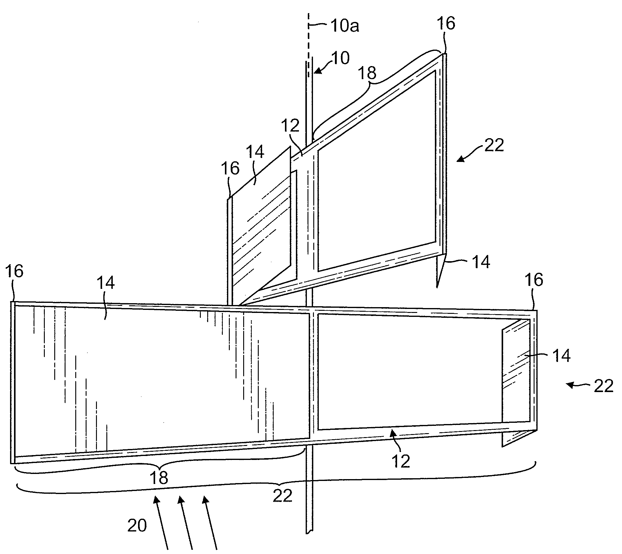
Nutting’s invention
https://www.google.com/patents/US20090169382
Rufus Nutting of Randolph Center
(Nutting Hall)
Patent granted 1857

Slide 22
Horizontal axis wind turbines
Called horizontal because the axis of their blades is horizontal, or parallel to the direction of the wind.
Renewable Energy, 2/e, Chapter 7

Slide 23
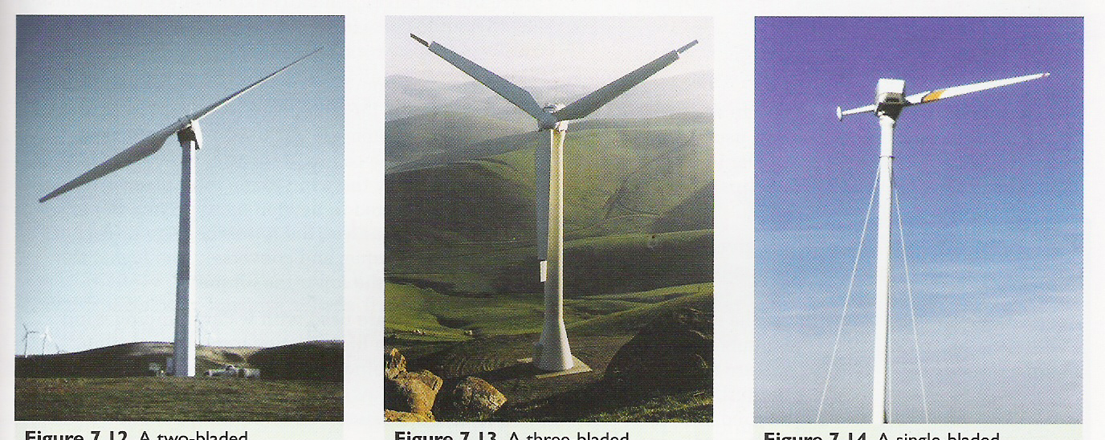
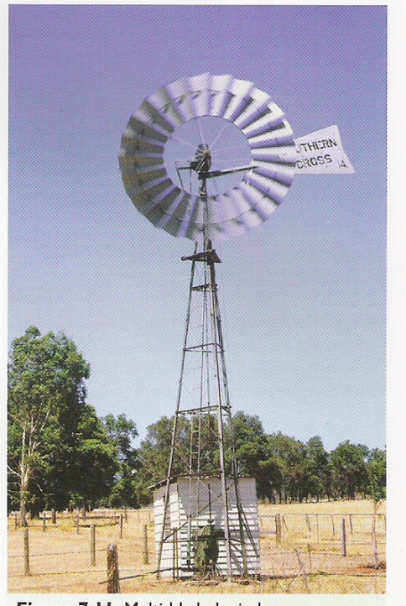
Horizontal axis wind turbines
Renewable Energy, 2/e, Chapter 7

Slide 24
Vertical axis wind turbines
Axis is vertical, or
perpendicular to the ground.
Renewable Energy, 2/e, Chapter 7

Slide 25
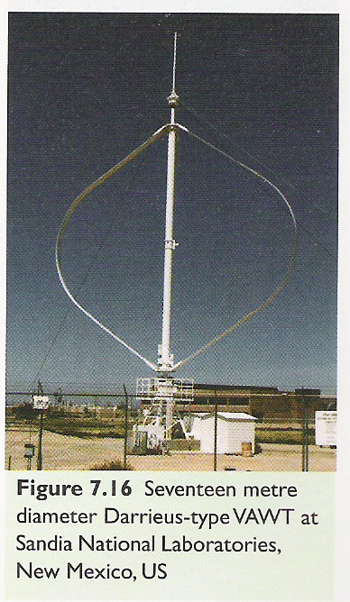
Vertical axis wind turbines
Renewable Energy, 2/e, Chapter 7

Slide 26
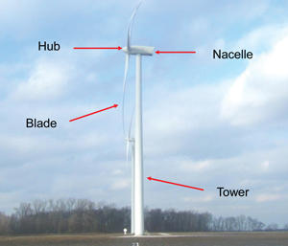
Wind power components
Renewable Energy, 2/e, Chapter 7

Slide 27
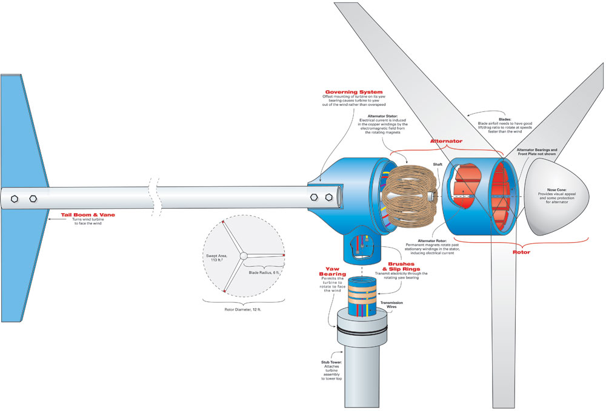
Wind power components
Renewable Energy, 2/e, Chapter 7

Slide 28
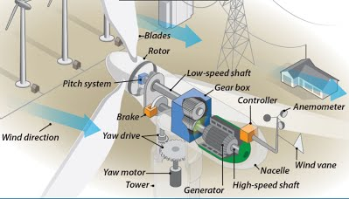
Wind power components
Renewable Energy, 2/e, Chapter 7

Slide 29
9. Wind energy
9.4: Aerodynamics of wind turbines
Renewable Energy, 2/e, Chapter 7

Slide 30
Lift & drag
Objects in air streams experience two perpendicular forces:
Drag: the push of the air stream against an object
Lift: force perpendicular to the direction of the air stream
A small angle of attack (the angle of the object relative to air stream) causes a zone of low pressure (suction) on the downstream or leeward side of the object because air on that side is flowing faster
The faster the air flow, the greater the suction or lift: the Bernoulli effect.
Renewable Energy, 2/e, Chapter 7

Slide 31
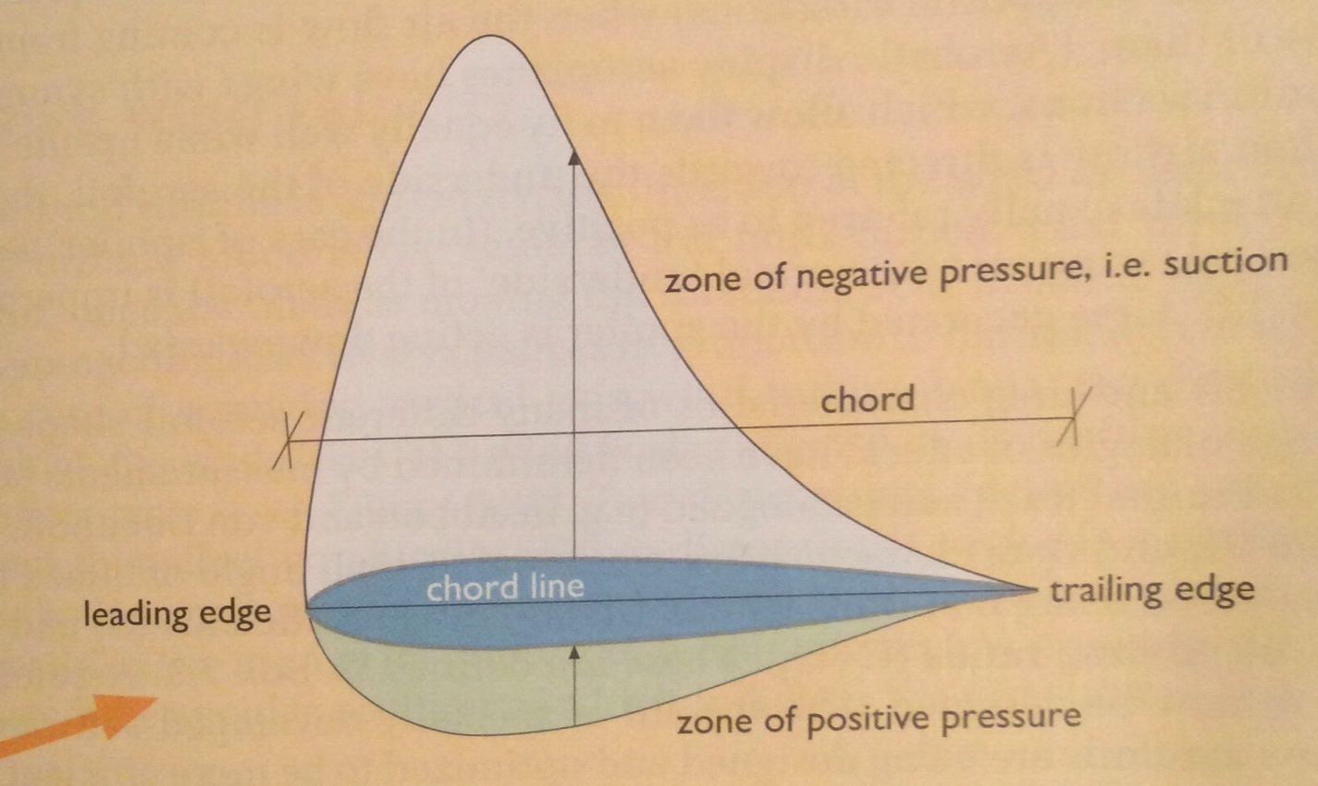
The Bernoulli effect
The Bernoulli effect can be maximized by adjusting the shape & contours of an object & optimizing its attack angle relative to the air stream.
Increasing ‘suction’ lifts or moves the object vertically relative to the air stream.
The faster the object moves, the greater the effect.
Renewable Energy, 2/e, Chapter 7

Slide 32
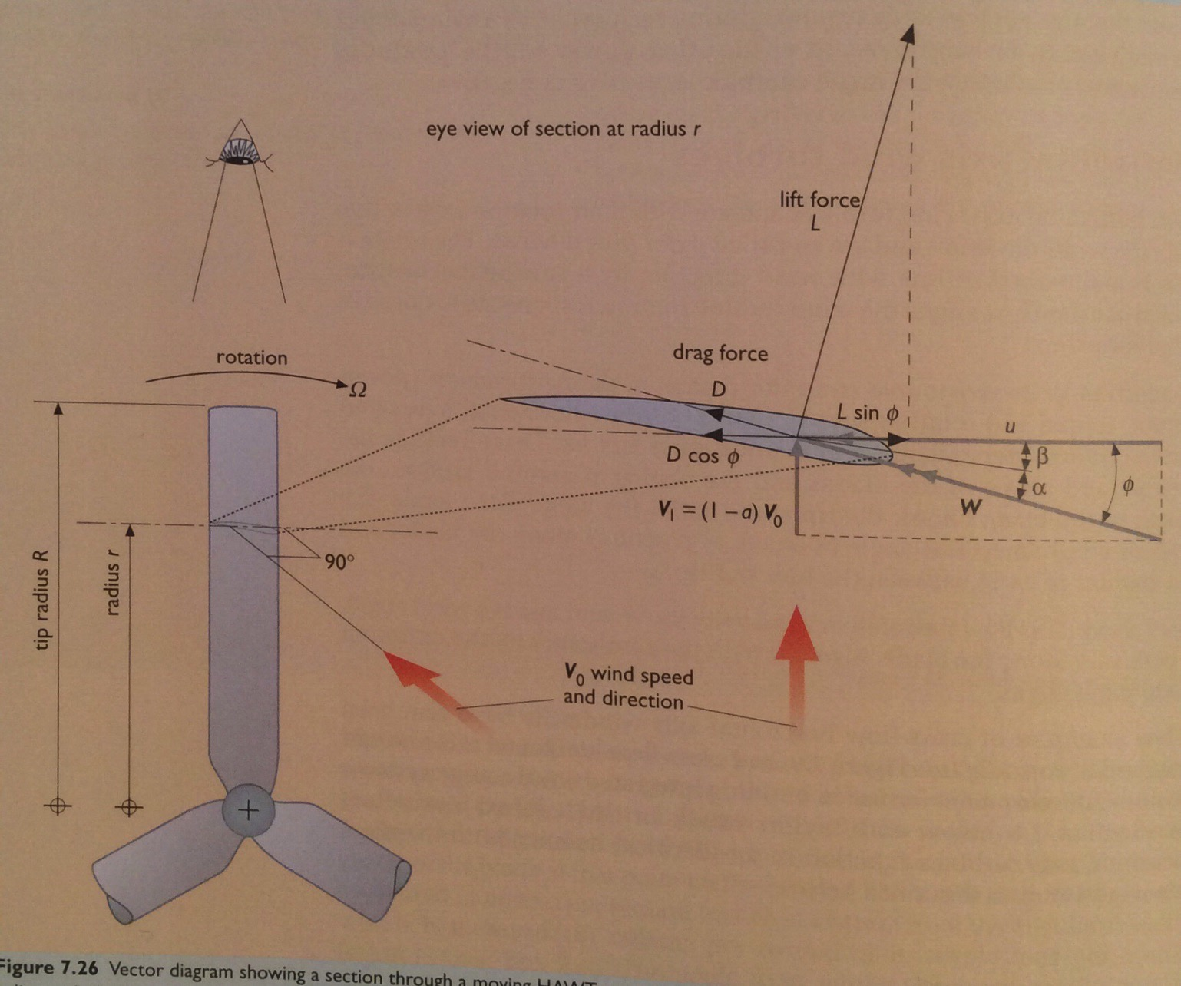
HAWT blades
A yawing mechanism keeps the horizontal axis of the rotor in line with wind direction.
Turbine performance depends on:
Wind speed; &
Blade
Length
Blade number
Blade shape and aerodynamic factors
Renewable Energy, 2/e, Chapter 7

Slide 33
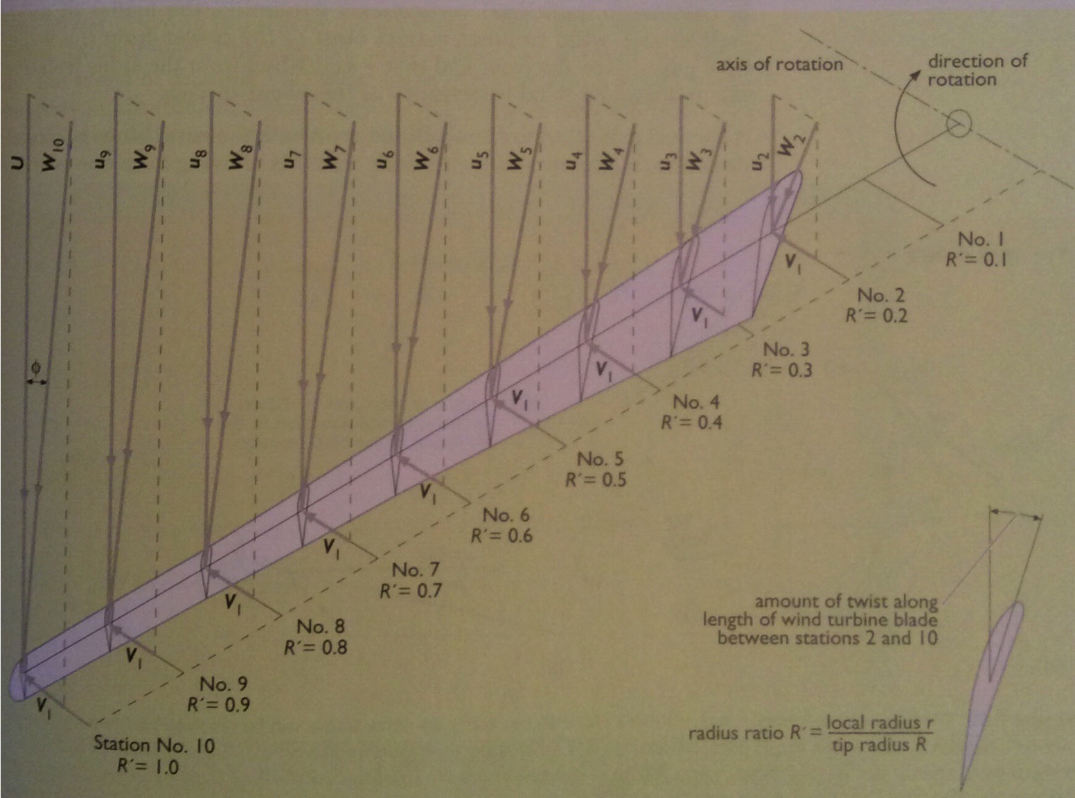
Progressive twist
In large wind, everything must be optimized for efficiency:
Creating a progressive twist along the length of turbine blades allows the blade to maintain a constant angle of attack relative to the decreasing tangential speed of the wind as it travels from blade tip toward the hub.
Renewable Energy, 2/e, Chapter 7

Slide 34
9. Wind energy
9.5: Power & energy from wind turbines
Renewable Energy, 2/e, Chapter 7

Slide 35
Energy & power of wind
Wind energy is kinetic, the energy of motion.
KE = (1/2)(m)(v²)
(m/s²)
where m = ρAV
J/s = W = (1/2)(ρ)(A)(V³)
(kg/m³)
(m²)
Wind’s power depends on:
Density (ρ)
Higher at lower alt.
Higher when colder.
Area of wind contact
Cube of velocity
Renewable Energy, 2/e, Chapter 7

Slide 36
Physics of wind power
swept area, A
Wind speed, v
Air density, r
C_{p ,} performance coefficient
(efficiency)
power in wind P = (½)(r)(A)(v³)
wind turbine power P = (½)(C_{p})(r)(A)(v³)
Cp – Power coefficient (efficiency)
Physical Limitation – Betz Law maximum C_{p} =0.59
Maximum of 59% of kinetic power in the wind can be converted by a wind machine
Renewable Energy, 2/e, Chapter 7

Slide 37
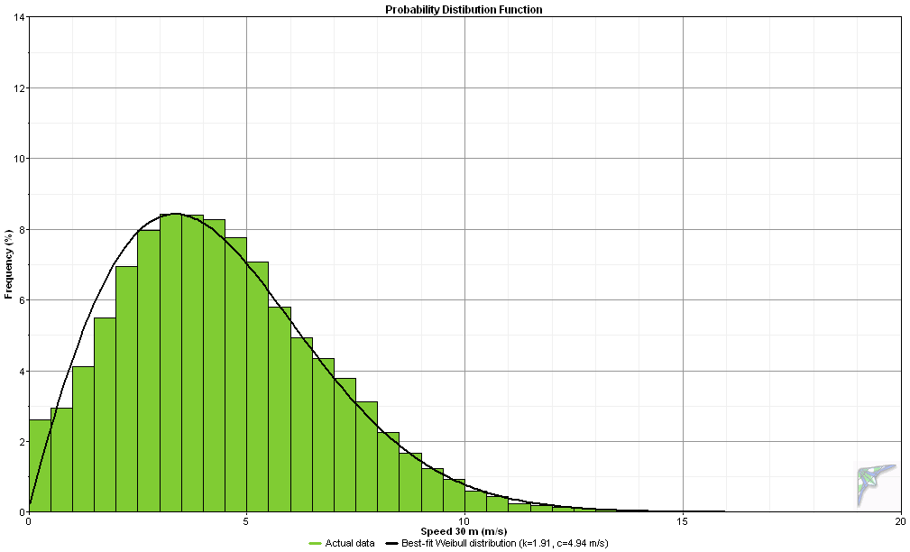
Wind speed distribution
South Hero, VT 2006-2007
Average wind speed at 30 m 4.4 m/s = 9.8 mph
Frequency (% of time)
Wind Speed (meters per second)

Slide 38
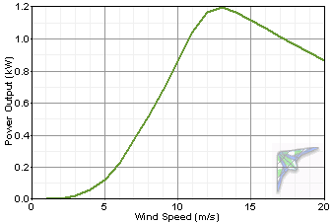
Power curve
Power curve for a Bergey XL1, rated at 1 kW

Slide 39
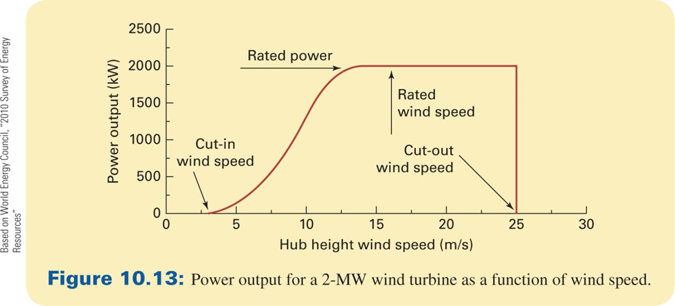
Power curve explained
Renewable Energy, 2/e, Chapter 7

Slide 40
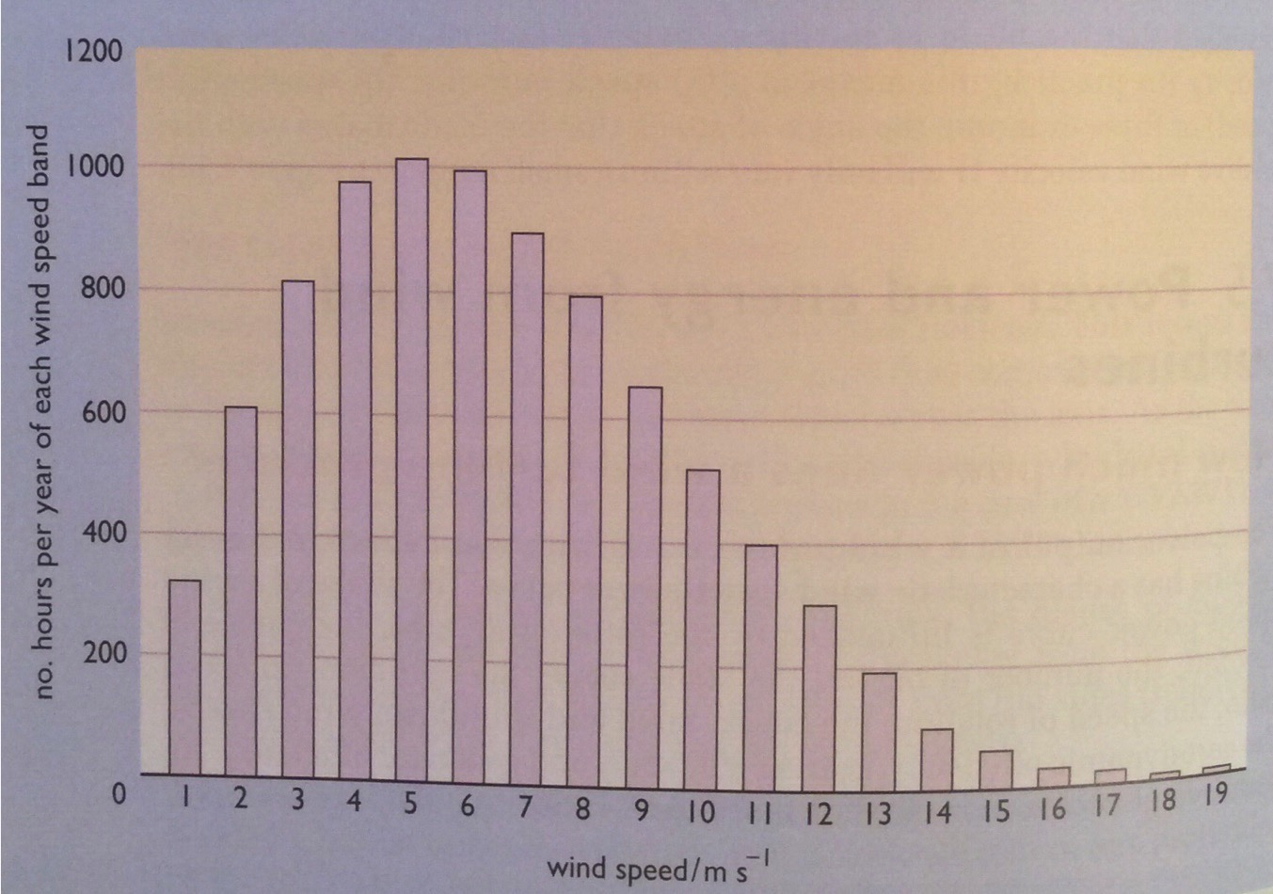
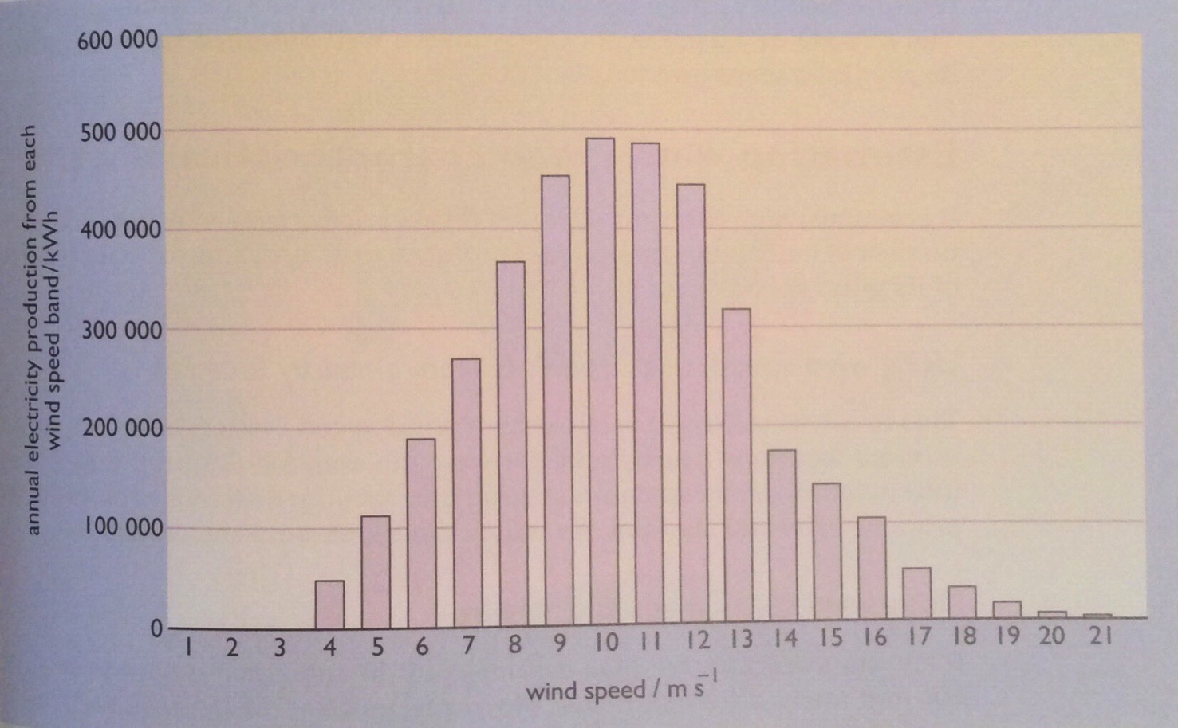
Estimating power production
If the annual wind speed at a site has been measured, estimated or modeled, a rough estimate of power generation can be made:
Annual electricity production = (K)(Vm³)(At)(T)
number turbines
3.2
swept area (m2)
annual wind speed (m/s)
Renewable Energy, 2/e, Chapter 7

Slide 41
9. Wind energy
9.6: Wind project scale and Vermont examples
Renewable Energy, 2/e, Chapter 7

Slide 42
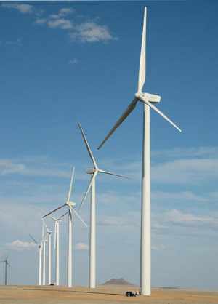
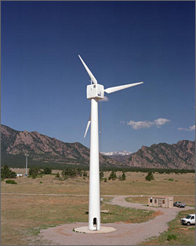
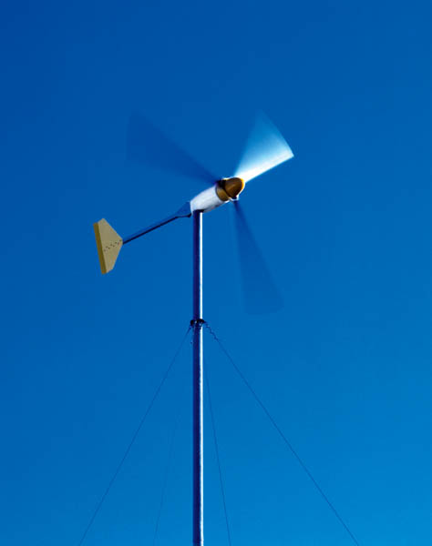
Wind power: scale
Utility-scale wind
> 1 MW
community wind
50 kW – 500 kW
small wind
1-10 kW
Renewable Energy, 2/e, Chapter 7

Slide 43
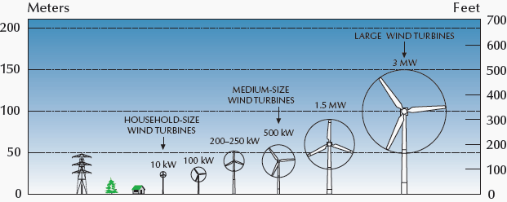
Wind power: scale, height & area
Wind power can be effective at many scales & heights, but:
Wind resources are steadier (more reliable) as height increases;
Larger turbine blades ‘harvest’ a larger area and more power;
Economy of scale so utility-scale most efficient, cost effective.
Renewable Energy, 2/e, Chapter 7

Slide 44
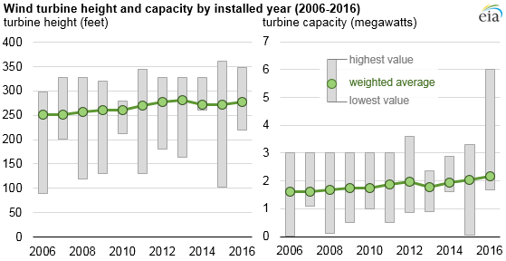
Utility-scale height and power
Turbine capacity is increasing faster than tower height.
This should continue with offshore wind development.
U.S. EIA

Slide 45
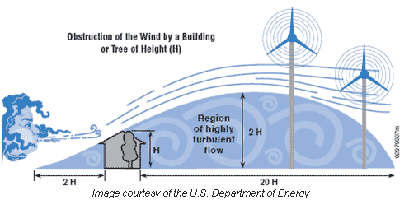
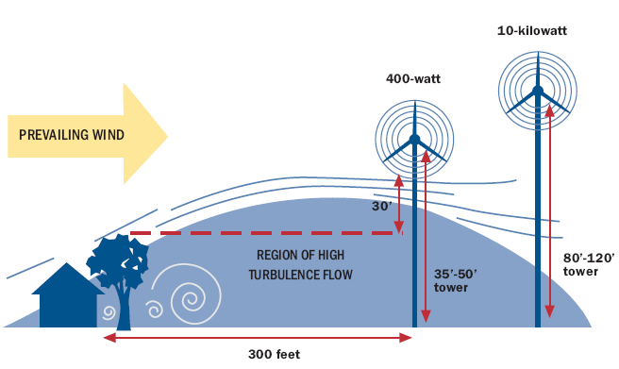
Siting, turbulence and height
Turbulence intensity: the standard deviation of wind speed divided by the mean wind speed.
This value allows for an overall assessment of a site’s turbulence.
Low levels indicated by values less than or equal to 0.10, moderate levels to 0.25, and high levels greater than 0.25.
US D.O.E

Slide 46
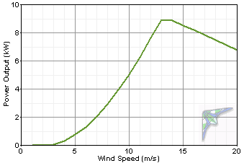
Aligning power curves, wind speed
power curve
10 kW Bergey
1.5 kW
wind speed distribution
South Hero, VT
5% of the hours in a year = 0.05 x 8760 hr = 438 hrs
438 hr x 1.5 kW = 657 kWh
Frequency %
5% of the time

Slide 47
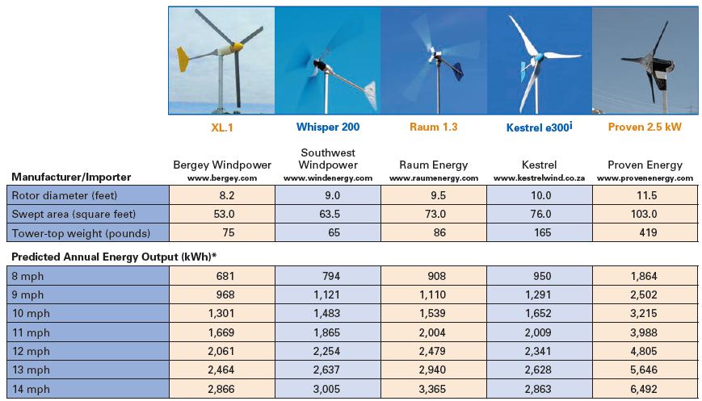
Small wind

Slide 48
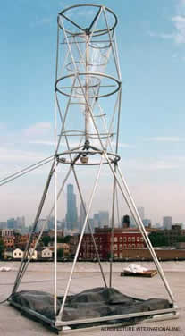
Innovative designs or siting
“The spread of the big turbines and a general fascination with all things green are helping to spur interest in rooftop microturbines, creating a movement somewhere on the border between a hobby and an environmental fashion statement. “ - NY Times 9/3/2008

Slide 49
Small rooftop turbines

Slide 50
Small wind: installation critical

Slide 51
Community wind
Northern 100
37 m hub height
21 m rotor diameter
6 m/s → 222 MWh/yr
8 m/s → 368 MWh/yr

Slide 52
Starwind turbines (Dorset, VT)
SWT 12, 24, & 36 kW models
blade diameter: 36 ft. (= 20 – 65 rpm) power: 12 kW at 14.7 mph
features:
full feathering articulating blades
low noise
efficient low-wind performance
hydraulic wind turbine tower

Slide 53
Starwind vs. Bergey
Bergey 10 kW
Starwind 12 kW

Slide 54
Skysteam vs. Bergey
Bergey 10 kW
6.7-m rotor diameter
Skystream 1.8 kW
3.7-m rotor diameter

Slide 55
Evolution: commercial-scale wind
The height and power capacity of large wind has been steadily increasing & will continue to increase with offshore wind.

Slide 56
Commercial wind
Vestas 3 MW
At 6 m/s →7,533 MWh
At 8 m/s →12,395 MWh

Slide 57
Wind power in Vermont

Slide 58
Searsburg, VT (commercial)

Slide 59
Georgia, VT (community)

Slide 60
Lowell, VT (community)

Slide 61
Lowell, VT (community)

Slide 62
9. Wind energy
9.6: Environmental effects of wind power
Renewable Energy, 2/e, Chapter 7

Slide 63
Environmental effects of wind
Noise: is a local concern for residents living within a kilometer or so of the wind turbine. Infrasonic sound has been raised as an issue.
2. Effect on wildlife (i.e. risk to birds, bats, etc.): studies have shown that other anthropogenic factors (power lines) vehicles, plate glass windows, etc.) are a greater concern.
3. Effect on land use: wind power is more compatible with dual land use than many other forms of energy. In many cases wind power and agriculture or solar energy can utilize common land. The low power density of wind means that substantial land area would be needed to replace current energy sources such as fossil fuels and nuclear.
4. Aesthetics: a concern associated with virtually all energy production methods.
5. Accidents: can result from turbine failure e.g. generator fires, tower collapse or blade breakage (or a combination of these).
Renewable Energy, 2/e, Chapter 7
http://www.ucsusa.org/clean-energy/renewable-energy/environmental-impacts-wind-power#.WiWxvbQ-eHo

Slide 64
Land use
Wind turbines require more land per MW than solar energy:
Wind: 30 – 141 acres / MW
Solar PV: ~8 acres / MW
Wind’s footprint is large (more so on flat land) because turbines need to be separated by 5-10 rotor diameters.
Less than one acre per MW is occupied or tied up by the turbine.
Less than 3.5 acres per MW is disturbed in installation.
‘Free’ land within the wind farm can be used for other purposes:
Agriculture, transportation, recreation
Renewable Energy, 2/e, Chapter 7
http://www.ucsusa.org/clean-energy/renewable-energy/environmental-impacts-wind-power#.WiWxvbQ-eHo

Slide 65
Do turbines increase crop growth?
Agricultural researchers are studying co-farming of wind & crops in the Midwest to determine whether the presence of turbines affects crops.
There is reason to think that wind power might help crops:
Turbines create wakes, or movement & mixing of air.
Wakes may:
Push consistent CO₂ to crops;
Dry humid air or dew, discouraging fungi & pests;
Cooler daytime; &
Warmer nightime temperature.
http://www.noaanews.noaa.gov/stories2011/images/vattenfall-image_300.jpg
https://news.nationalgeographic.com/news/energy/2011/12/111219-wind-turbines-help-crops-on-farms/

Slide 66
Wind does affect (local) climate
Both direct evidence and models suggest that large wind farms have slight effects on local, and to some extent, regional climate.
The effects appear to be tiny in comparison to GGC.
Direct measurement of temperatures within a large Texan wind farm showed a 0.5° increase in night-time temperatures.
Several modeling studies of large wind farms have come to similar conclusions.
Models were run many times both with & without wind farms.
Wind farms caused winds to divide & flow around the wind farm. This diversion caused:
about 0.5° temperature increases (to the north) & deceases (to the south); &
A few percent changes in precipitation.
Q: What mix of sustainable energy technologies will cause the least change to our climate?
theconversation.com/wind-power-affects-climate-cooling-and-warming-regions-around-farms-studies-claim-22988

Slide 67
Offshore wind effects on oceans?
The bases (and underwater) of offshore wind towers have the most immediate impact on ocean ecosystems.
Kaela Slavik, a German researcher, has shown that wind towers have beneficial impacts on marine ecosystems.
One tower can support the growth of 4 tonnes of blue mussels which filter water.
Blue mussels are usually found along the coasts.
Wind towers will introduce a population of mussels (equal to 20% of coastal populations) at sea
The longer-term results?
Mussels will concentrate nutrients & provide a foundation for the growth of a more complex ecosystem.
Towers ‘protect’ their locals from drag fishing, protecting this ecosystem.
These ‘new’ biodiverse ecosystems may provide habitat for alien species.
https://www.technologyreview.com/s/608930/first-evidence-that-offshore-wind-farms-are-changing-the-oceans/

Slide 68
Not all farmers like wind
In Iowa wind produces 36% of electricity and it’s still growing. Many farmers are affected, & some aren’t happy. The unhappy tend to be:
Neighbours of wind farms; or
Tenant farmers with wind.
In Iowa, 97% of wind is owned by utilities & large developers.
Only 3% is community wind.
Complaints?
Heavy equipment brought in to install turbines breaks drainage tiles, damaging crops or making it hard to crop.l
Towers interfere with crop dusting.
Worry about catastrophic turbine failure
Wind turbine syndrome
Wind operators seem more like overlords then neighbours.
Easements restrict what can be done on farms & properties.
http://www.slate.com/articles/technology/future_tense/2017/08/why_farmers_in_iowa_hope_wind_energy_ will_blow_over.html

Slide 69
Vermont’s attitude to wind power
Solar is popular & only the largest projects are opposed on the grounds that they look large & industrial & may occupy ag lands.
A 2016 survey showed that 75% of Vermonters want more solar to be built in their communities.
Democrats: 87%
Independents: 67%
Republicans: 56%
Wind is a bit less popular.
A 2013 survey showed that 66% of Vermonters support ridgeline wind development. Support was age dependent:
18 - 34: 73%
35 - 54: 68%
55 → : 61%
Support for government subsidies for RE split politically:
Democrats: 77%
Independents: 67%
Republicans: 49%
vtdigger.org/2016/02/19/survey-shows-75-percent-of-vermonters-want-more-solar/
www.castleton.edu/about-castleton/the-castleton-polling-institute/poll-results/castleton-poll-examines-vermonters-views-on-wind-power/

Slide 70
Vermont: Who should decide?
A Vermont Public Radio poll asked who should make decisions about large wind power development.
67% trust the Public Service Board (PSB)
12% say that the PSB should have final say on locating turbines
Is that contradictory? Not necessarily….
"It's just that their preference would be to have the decisions more local. Vermonters tend to think very well of their state government. But if you look there, they prefer the local to the state.” - Rich Clark, pollster
So who should make the final decision?
39% say landowners should decide
34% say communities should vote
← But 59% of Republicans
← But 42% of ‘left leaning’
PSB support depends on location & likelihood of local big wind.
Chittenden county more strongly supports PSB (local wind not likely)
Southern Vermont (large wind target) supports the PSB less.
http://digital.vpr.net/post/vpr-poll-large-scale-wind-vermonters-are-split-over-local-control#stream/0

Slide 71
Wind stirs passion in Vermont
‘People who hate wind power in Vermont really hate wind power. That is a statement I will ask you to remember.’
While surveys show that most Vermonters support wind, even large wind, some are passionately opposed. Issues:
Environmental damage to sensitive ridge-top habitats.
Aesthetics & property value concerns
Concerns about health effects
A woman broke into the property of a wind developer (caught on camera) and left a deer’s head at the gate. The developer saw this as a threat.
August 2015: Pownal fire department planed a 150-kW solar array, sited on on a 5-acre brownfield, to power a pumping station.
30 people ‘stormed’ the a project meeting demanding records.
They were concerned that the arrays would leach toxins into water.
Ironically, it was soon discovered that all wells in Pownal were contaminated… with PFOA from manufacture of coated wire.
https://cleantechnica.com/2017/05/24/whats-wind-power-vermont/

Slide 72
Causation: turbines or opponents?
Studies of the effects of wind turbines on human health have not conclusively shown an effect. More & better work needed.
However, several studies suggest that worry & anxiety about the possible health effects of wind can cause human health problems.
Example:
Sham-controlled, double-blind study of 54
Exposed to 10’ of infrasound or sham infrasound…
... After exposure to audio or internet presentations that suggested infrasound was either safe or hazardous
Results:
Those who were exposed to materials that suggested infrasound was dangerous experienced more frequent & intense symptoms when exposed to either infrasound or sham infrasound.
Those told that infrasound was not hazardous did not experience symptoms after exposure to infrasound or sham infrasound.
https://cleantechnica.com/2017/05/24/whats-wind-power-vermont/
http://psycnet.apa.org/record/2013-07740-001

Slide 73
Windham county says no
Developers have been looking at sites in Windham county Vermont for utility-scale wind development.
In response, the 27-town Windham region has created a draft regional energy plan that classifies large-scale wind as ‘unsuitable’.
Large-scale is defined as 75-m hub height or 2 MW capacity.
“Beyond the utility-scale wind project currently under development in Readsboro and Searsburg, as a matter of policy, utility-scale wind is deemed incompatible with the land-use policies contained within the regional plan,” the document says.
“Instead, we would encourage the development of solar energy generation that is compatible with our regional plan land-use policies.”
“Given the nature of utility-scale wind development, which involves considerable blasting, road building and other permanent alterations of the landscape and surface hydrology, it is deemed to be incompatible with the two aforementioned land use designations, [agriculture & resource]”
https://vtdigger.org/2017/12/03/big-turbines-incompatible-windham-region-plan-says/

Slide 74
Utilities aren’t buying new wind
In 2015 - 2017, Vermont’s utilities, Green Mountain Power (GMP) and Vermont Electric Cooperative declined to sign contracts for new wind power developments.
Why?
Felt they had enough wind in their power portfolios, & enough energy for customers.
Focused on small-scale generation close to need.
Buying more Vermont wind would force them to buy less from Hydro Quebec, a less expensive source.
Perhaps unwilling to take on projects with local opposition?
Developers may resort to PURPA, the federal Public Utilities Regulatory Act, which requires utilities to buy power from qualified developers at long-term contracts equal to prices the utility would pay elsewhere.
www.sevendaysvt.com/vermont/power-struggle-vermont-utilities-dont-want-new-wind-energy/Content?oid=2933555
www.wind-watch.org/news/2017/03/01/kidder-hill-wind-gmp-vec-dont-want-wind-power-now/

Slide 75
9. Wind energy
9.7: Economics of wind power
Renewable Energy, 2/e, Chapter 7

Slide 76
Wind is the hottest form of RE
Corporate customers prefer wind to solar when meeting renewable energy standards.
https://www.theguardian.com/sustainable-business/2016/dec/21/
solar-wind-energy-renewables-google-microsoft-amazon

Slide 77
Wind is the hottest form of RE
Corporate customers prefer wind to solar when meeting renewable energy standards.
https://www.theguardian.com/sustainable-business/2016/dec/21/
solar-wind-energy-renewables-google-microsoft-amazon

Slide 78
Wind’s cost is competitive
Note that this data comes from a pro-industry group!
https://www.windpowermonthly.com/article/1421836/wind-costs-heading-right-direction

Slide 79
Lifecycle analysis of wind power?
Critics argue that the analysis didn’t take properly factor in the intermittent nature of wind power.
‘US researchers have carried out an environmental lifecycle assessment of 2-megawatt wind turbines mooted for a large wind farm in the US Pacific Northwest. Writing in the International Journal of Sustainable Manufacturing, they conclude that in terms of cumulative energy payback, or the time to produce the amount of energy required of production and installation, a wind turbine with a working life of 20 years will offer a net benefit within five to eight months of being brought online.’
https://wattsupwiththat.com/2014/06/16/wind-turbine-payback-period-claimed-to-be-within-8-months/
Other work shows that payback ranges from 1 to 12 years depending on the size & age of the turbine and site issues.
Larger turbines have lower payback periods.
New, more efficient turbines have shorter payback periods.

Slide 80
9. Wind energy
9.8: Commercial wind development
(see 9.6 for scale & Vermont examples)
Renewable Energy, 2/e, Chapter 7

Slide 81
Global wind power capacity (2002)
Renewable Energy, 2/e, Chapter 7

Slide 82
Land-based wind resources
Renewable Energy, 2/e, Chapter 7

Slide 83
Land-based wind resources
Renewable Energy, 2/e, Chapter 7

Slide 84
9. Wind energy
9.9: Offshore & ocean wind potential and development
Renewable Energy, 2/e, Chapter 7

Slide 85
Off-shore commercial-scale wind
Offshore wind is expected to increase 40-fold by 2030.

Slide 86
Potential of ocean (offshore) wind
A 2017 study showed that there is enough wind power over the oceans to power the world at current capacity, if that power could be harvested.
Wind turbines do remove energy from the wind, lowering ‘downstream’ wind potential & creating wind ‘shadows’.
However, for a number of reasons, ocean winds are more easily ‘replenished’.
“Nevertheless, even in the relative calm of summer, the upper geophysical
limit on sustained wind power in the North Atlantic alone could be sufficient to supply all of Europe’s electricity.
On an annual mean basis, the wind power available in the North Atlantic could be sufficient to power the world.” - Posner & Caldeira (2017)
https://www.theguardian.com/environment/2017/oct/15/wild-is-the-wind-the-resource-that-could-power-the-world
http://www.pnas.org/content/114/43/11338.full.pdf?with-ds=yes

Slide 87
Block Island Wind (Rhode Island)
First offshore wind farm in the US, 3.8 miles off Block Island
Operations began in December of 2016
5 turbines with total 30 MW capacity (125,000 MW/year)
Includes a wildlife tracking station operated by US Fish & Wildlife, URI & UMass
Power sold to National Grid for $0.244/kWh
http://dwwind.com/project/block-island-wind-farm/

Slide 88
Hywind, Scotland: deep ocean wind
In October 2017, Hywind Scotland started to deliver power to the Scottish electricity grid.
25 km off Peterhead in Aberdeenshire, Scotland at Buchan Deep
Project of Statoil
Floating wind farm consisting of five turbines
30 MW installed capacity (power for ~ 20,000 households)
https://www.statoil.com/en/what-we-do/new-energy-solutions/our-offshore-wind-projects.html

Slide 89
9. Wind energy
Summary
Renewable Energy, 2/e, Chapter 7

Slide 90
Wind power summary
Wind turbines extract energy from moving air and convert it into electrical energy
Power from system is proportional to wind speed (to v³).
Different wind turbine geometries have different efficiencies
Available wind energy depends on location
Wind power systems can be residential, community, or utility scale
Large differences in the smaller and larger systems
Wind metrology is critical for site assessment – months or years
Generally available wind energy increases with altitude and distance offshore
Wind farms combine numerous turbines which can be placed to optimize power production

