Slide 1
SSC 2030: Energy Systems & Sustainability
Introduction to energy systems & sustainability
1.1: What is energy?
1.2: What is ‘conventional’ energy?
1.3: What is ‘sustainable’ energy?
1.4: What is a system?
1.5: Why is systems thinking important?

Slide 2
1. Introduction
1.2: What is ‘conventional’ energy?

Slide 3
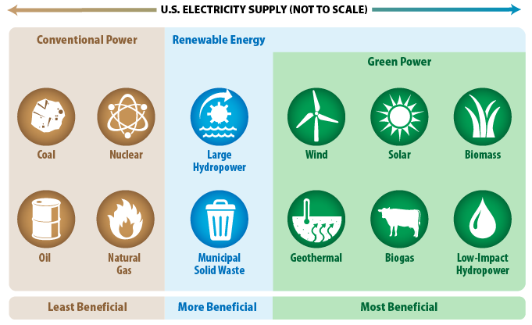
Conventional energy
Conventional energy: sources and forms of energy that are in widespread use today.
https://www.epa.gov/greenpower/what-green-power

