Slide 1
SSC 2030: Energy Systems & Sustainability
Introduction to energy systems & sustainability
1.1: What is energy?
1.2: What is ‘conventional’ energy?
1.3: What is ‘sustainable’ energy?
1.4: What is a system?
1.5: Why is systems thinking important?

Slide 2
1. Introduction
1.3: What is ‘sustainable’ energy?

Slide 3
What is sustainable energy?
Sustainable development meets the needs of the present generation without compromising the ability of future generations to meet their needs. - U.N.’s Brundtland Commission (1987)
Sustainable energy uses sources that meet these requirements:
1. Are not significantly depleted by continued use;
2. Do not emit pollutants or other hazards to humans or ecological and
climate systems on a significant scale; and
3. Do not perpetuate social injustice.
In this course, we’ll look at the argument that many forms of energy can be considered sustainable if they are used in a sustainable manner.
Energy Systems & Sustainability, 2/e, Chapter 1

Slide 4
Three linked ‘pillars’ of sustainability
Economic sustainability: encompasses requirements for strong & durable economic growth; preserving financial stability & a low & stable inflationary environment
Environmental sustainability: focuses on the stability of biological & physical systems and on preserving access to a healthy natural environment
Social sustainability: emphasizes the importance of well functioning labor markets & high employment, of adaptability to major demographic change & stability in social & cultural systems of equity and democratic participation in decision making
- IEA (2001); OECD (2001)
There are those who advocate for any sustainable change and those who believe climate change and other challenges require a much more rigorous approach to sustainability. [weak vs. strong sustainability]
Energy Systems & Sustainability, 2/e, Chapter 1

Slide 5
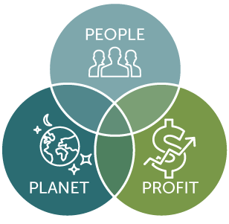
Three linked ‘pillars’ of sustainability
Social sustainability
culture
ethics
equity
Economic sustainability
growth
profit
costs
*
Environmental sustainability
ecosystems
aka ‘Triple Bottom Line’
https://sustain.wisconsin.edu/sustainability/triple-bottom-line/

Slide 6
Decarbonized? Low-carbon? Renewable?
There is no carbon-free fuel.
Low-carbon: processes or technologies that produce power [or heat] with substantially lower amounts of carbon emissions than is emitted from conventional (fossil fuel) power generation
Renewable: processes or technologies that produce power [or heat] from sources that are not depleted when used
*
Nuclear: processes or technologies that produce power from the fission or fusion of atoms
Nuclear is finite rather than renewable, but is low-carbon
https://sustain.wisconsin.edu/sustainability/triple-bottom-line/

Slide 7
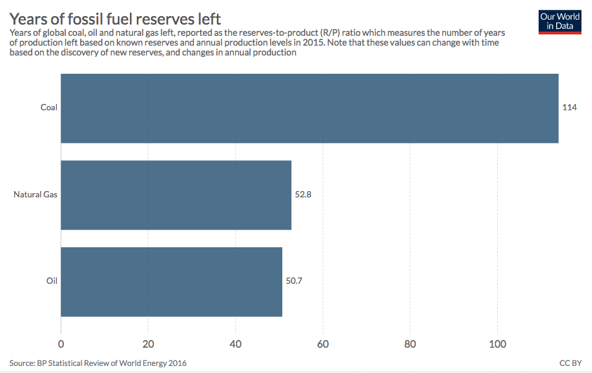
Sustainability of our energy resources?
These are global reserves.
https://ourworldindata.org/how-long-before-we-run-out-of-fossil-fuels

Slide 8
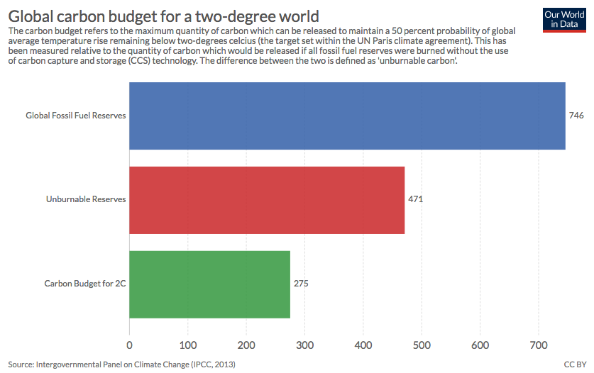
This changes if we mitigate GCC
These are global budgets.
https://ourworldindata.org/how-long-before-we-run-out-of-fossil-fuels

Slide 9
Why does sustainable energy matter?
There are three major reasons, each creating a point of view or perspective.
‘Growthist’
1. There is a very large unmet demand for energy in developing countries.
2. The supply of fossil fuels is finite and won’t meet these demands.
‘Peakist’
3. GCC requires us to dramatically reduce emissions of carbon dioxide.
‘Environmentalist’
Energy Systems & Sustainability, 2/e, Chapter 1

Slide 10
POV and perspective shape action
‘We’ve got plenty of options to solve climate change – but I am concerned that we are running out of cheaper energy supplies and this could impact on global economic growth rates.’
‘As we get richer, I’ve no doubt we’ll find ingenious ways of getting the remaining fossil fuel out of the ground and we have other options like nuclear power too – but how much more carbon dioxide can we dump into the atmosphere?’
growthist
peakist
environmentalist
‘Consumption is at the heart of the matter. We can’t go on comsuming as we do. The bad news is that we are changing the Earth’s climate. The good news is that we may be running out of cheap oil and gas, possibly coal’
‘Economic prosperity is the key to solving the twin problems of maintaining energy supply and combatting climate change.’

Slide 11
Global climate change
Coming to you next week in Module 2!

