Slide 1
SSC 2030: Energy Systems & Sustainability
Introduction to energy systems & sustainability
1.1: What is energy?
1.2: What is ‘conventional’ energy?
1.3: What is ‘sustainable’ energy?
1.4: What is a system?
1.5: Why is systems thinking important?

Slide 2
1. Introduction
1.4: What is a system?

Slide 3
What is a system?
System: ‘A system is an interconnected set of elements that is coherently organized in a way that achieves something (function or purpose)”
True systems have their own behavior, and that behavior can be predicted by studying the system.
Characteristics of systems:
Integrity (wholeness)
Adaptive
Resilient
Evolutionary
Goal-seeking
Self-preserving
Self-organizing
Donella Meadows, ‘Thinking in systems’

Slide 4
Example?
A football team is a system.
What are the components or elements?
What are the interconnections for flows?
What is the purpose?
coach
strategy
ball
rules
players
pressure?
physics
management
rules
field
physics
Purpose: winning, $.... Fun?
Donella Meadows, ‘Thinking in systems’

Slide 5
Sub-systems should be in harmony
Example: college or university
Purposes of students vs. faculty vs. administrators?
Donella Meadows, ‘Thinking in systems’

Slide 6
Diagramming the bathtub example
Bathtub: classic example for about systems diagrams and behavior
stock: elements that you can see or measure
- Changes with flows
source:
where it comes from
sink:
where it goes to
inflow
outflow
Donella Meadows, ‘Thinking in systems’

Slide 7
Bathtub behavior?
1. What happens when you pull the plug?
2. What happens when you don’t?
3. If inflow < outflow?
4. If inflow > outflow?
5. How can you reach equilibrium?
water level (inches)
time (minutes)
Donella Meadows, ‘Thinking in systems’

Slide 8
Most people focus on ‘stock’
Stock: the amount of a critical element of the system
Note that ‘critical’ is in the eye of the beholder
Change of stock takes time and that time is related to the rate of flows.
Changes in stock determine the dynamics of the system.
Most decision are designed to regulate levels of stock.
System thinkers see the world as a collection of stocks along with the mechanisms of regulating their levels by manipulating flows.
Donella Meadows, ‘Thinking in systems’

Slide 9
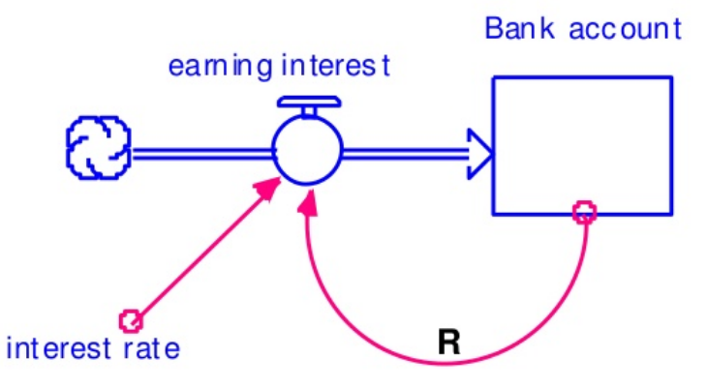
Feedback loops
Feedback loops: occur when a stock affects its own flows.
Feedback loops can cause stocks to remain constant, grow or shrink.
Positive (reinforcing) feedback loops amplify stock.
Positive: (1) interest rate;
(2) account balance (capital)
Donella Meadows, ‘Thinking in systems’

Slide 10
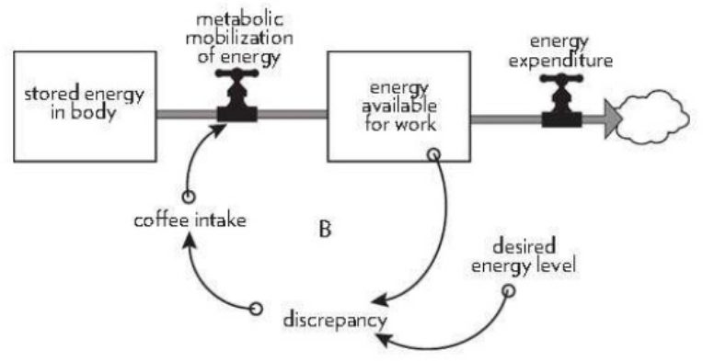
Feedback loops
Negative feedback loops regulate (temper) growth of stock.
Stabilizing loops
Balancing loops
Donella Meadows, ‘Thinking in systems’

Slide 11
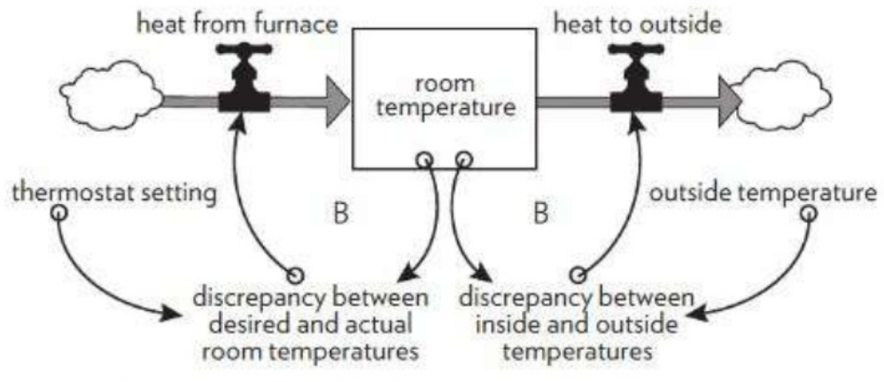
Competing balancing loops
Here two competing balancing loops control a system regulated by a thermostat and furnace.
Donella Meadows, ‘Thinking in systems’

Slide 12
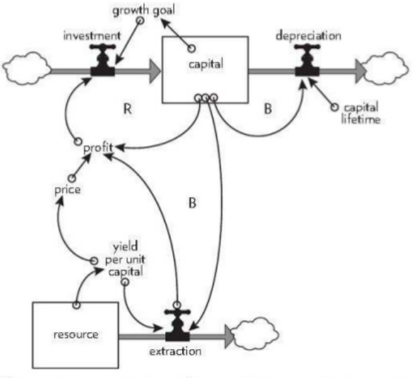
Non-renewable constraint
Here the reinforcing (+) loop for economic capital is constrained (balanced -) by a non-renewable resource, oil.
Donella Meadows, ‘Thinking in systems’

Slide 13
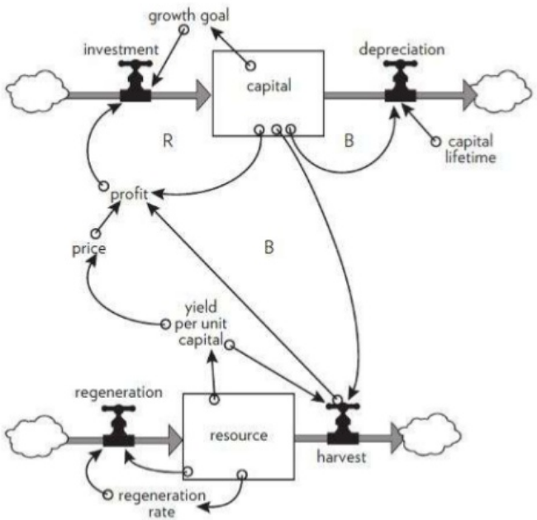
Renewable constraint
Here the reinforcing (+) loop for economic capital is constrained (balanced -) by a renewable resource, fish stocks.
Donella Meadows, ‘Thinking in systems’

