Slide 1
SSC 2030: Energy Systems & Sustainability
Introduction to energy systems & sustainability
1.1: What is energy?
1.2: What is ‘conventional’ energy?
1.3: What is ‘sustainable’ energy?
1.4: What is a system?
1.5: Why is systems thinking important?

Slide 2
1. Introduction
1.5: Why is system thinking important?

Slide 3
Why is systems thinking important?
“Systems thinking expands the range of choices available for solving a problem by broadening our thinking and helping us articulate problems in new and different ways. At the same time, the principles of systems thinking make us aware that there are no perfect solutions; the choices we make will have an impact on other parts of the system. By anticipating the impact of each trade-off, we can minimize its severity or even use it to our own advantage. Systems thinking therefore allows us to make informed choices.”
Micheal Goodman, ‘Systems thining: what, why, where, when, and how?’ Systems Thinker
https://thesystemsthinker.com/systems-thinking-what-why-when-where-and-how/

Slide 4
Lessons from systems thinking
1. We don’t pay enough attention from history. We focus on the events, but not the context, causes and results.
2. We aren’t great at understanding relationships. We want relationships to be linear and they often aren’t.
3. We don’t pay enough attention to sources and sinks.
4. Our minds seem to want to find single causes for single effects.
5. We don’t identify limiting factors.
6. We aren’t good at seeing true system boundaries and therefore
miss the true or full range of possible outcomes.
Donella Meadows, ‘Thinking in systems’

Slide 5
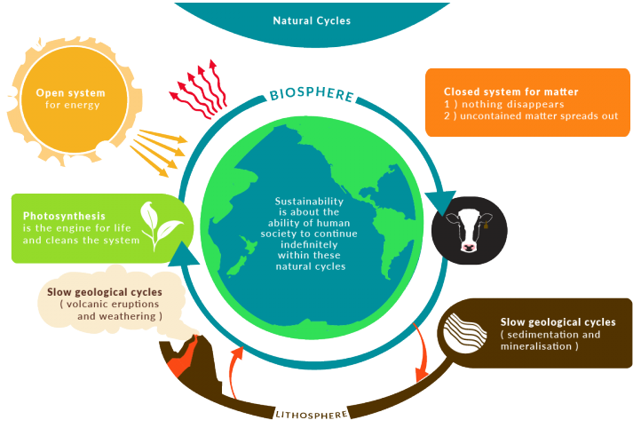
Earth is a system
Closed system: exchanges only matter with the surroundings
Open system: exchanges matter and energy with the surroundings
http://wikieducator.org/File:Natural_Cycles-01-1.png

Slide 6
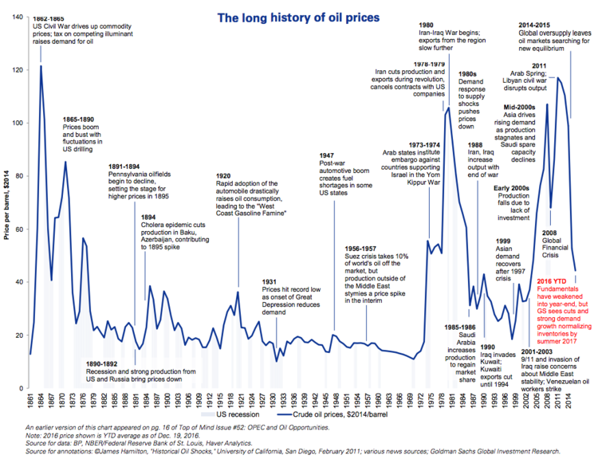
Need for energy systems?
Nations developed energy systems – and energy policy…
(1) once societies had become complex and dependent on energy;
(2) supplies and prices of that energy had become vulnerable & volatile.
Goldman Sachs

Slide 7
Need for energy systems?
Goldman Sachs

Slide 8
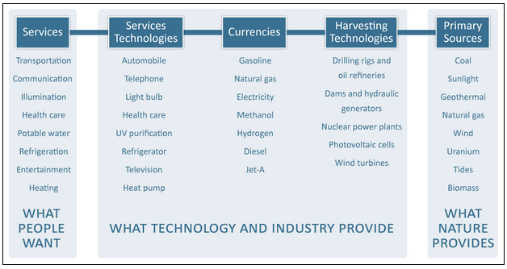
Energy systems are complex
Energy systems connect the energy resources that nature provides to the energy services that people want.
Sanborn etal. (2008) The hydrogen defense against climate catastrophe.
Canadian Energy Systems Analysis Research, https://www.cesarnet.ca/background-energy-systems

Slide 9
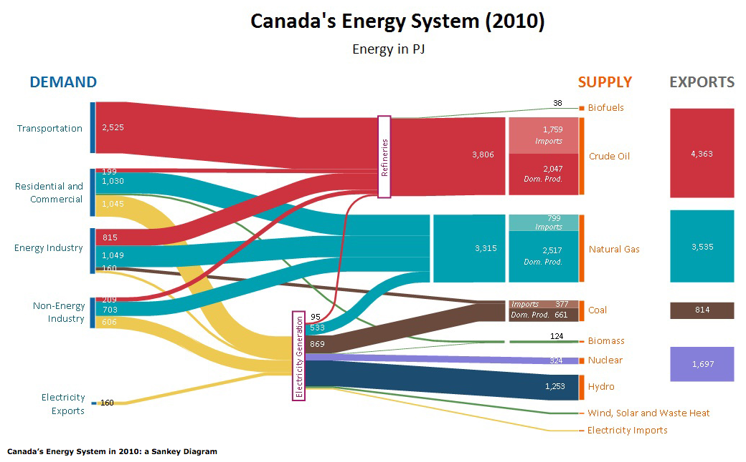
Analysis of system flows is critical
This Sankey diagram focuses on stocks and flows.
ISEEE/CanESS

Slide 10
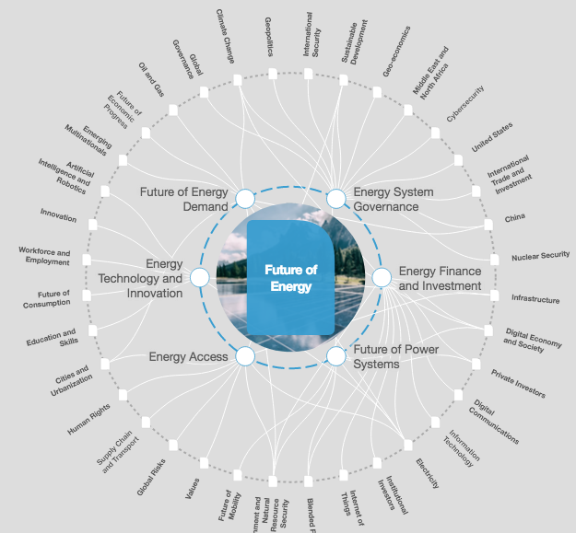
Broader view of energy systems
https://intelligence.weforum.org/topics/a1Gb00000038oN6EAI?tab=publications

Slide 11
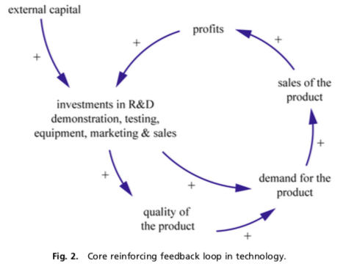
Reinforcing systems diagram: technology
Existing technologies are advantaged by their accelerating success.
Dangerman and Shellnhuber (2012) Energy systems transformation, PNAS.

Slide 12
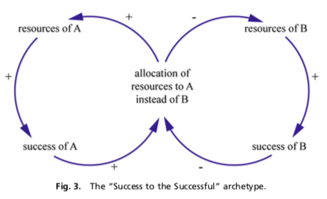
Success to the successful
Marketplace success gives ‘incumbents’ an advantage.
“…the conventional system has been in place successfully for a longer period of time, and during that period competition for the adoption of technologies by consumers has occurred, for example, among the steam engine, the (electric car) battery, and the combustion engine. Thus, the technology and products of the conventional energy system obviously have built up hardware infrastructures, know-how, and goodwill. The alter- native energy system lacks this historically accumulated position.”
Dangerman and Shellnhuber (2012) Energy systems transformation, PNAS.

Slide 13
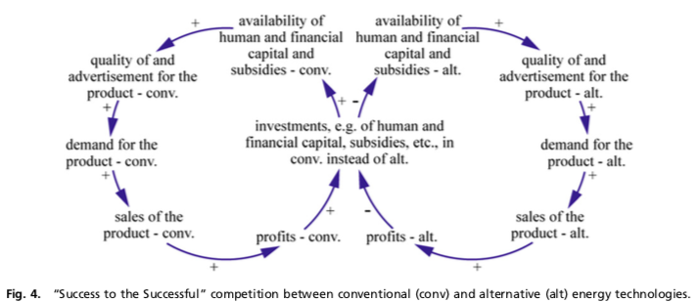
How to we shift the advantage?
“Policymakers aiming to change the status quo of the energy system therefore are faced with taking rather draconian measures, namely, not spreading their subsidies and loans over the different energy technologies— because doing so only reinforces the existing and dominating positive feedback loops—but focusing on those that solve the problems.”
“Problem-causing technologies should be addressed only by prohibitive laws, and problem-relieving technologies should be facilitated by stimulus laws..”
Dangerman and Shellnhuber (2012) Energy systems transformation, PNAS.

Slide 14
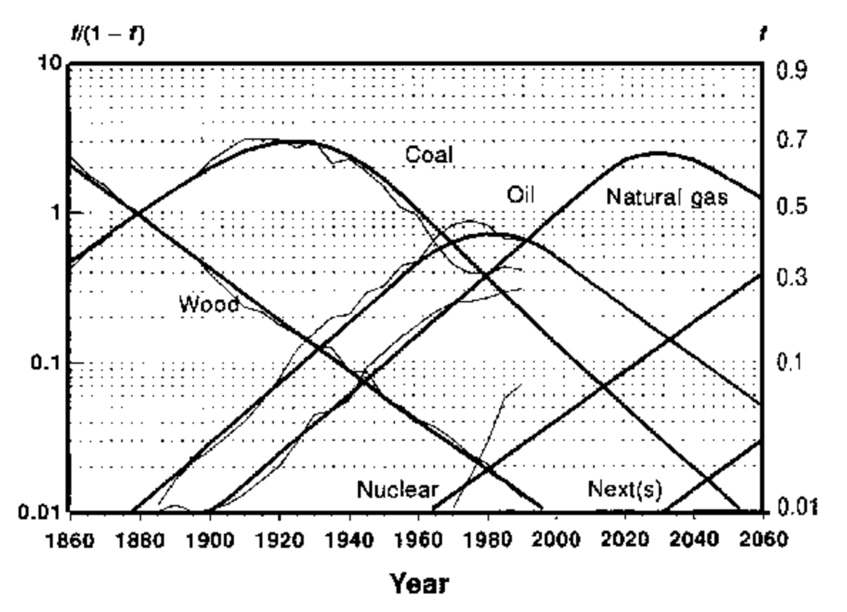
Energy cycles are business cycles
Adapted from Marchetti and Nakicenovic (1979)

