Slide 1
SSC 2030: Energy Systems and Sustainability
Introduction to energy systems and sustainability
1.1: What is energy?
1.2: What is ‘conventional’ energy?
1.3: What is ‘sustainable’ energy?
1.4: What is a system?
1.5: Why is systems thinking important?

Slide 2
Module 1: Intro to energy systems and sustainability
Big ideas?
All energy systems have some economic, societal and environmental costs
Only when we understand how energy systems work can we minimize those costs and approach sustainability while still serving our needs.

Slide 3
Module 1: Intro to energy systems and sustainability
1.1: What is energy?

Slide 4
What is energy?
Energy: the capacity to do work
To move an object against a resisting force
Measured in joules (J)
The word energy was first used in this modern context by Thomas Young, celebrated British physicist in 1807.
Energy is conserved: energy can be neither created nor destroyed.
Instead it is transferred (moved) or transformed (from one form to another.)
This course is concerned with the study of how humans transform energy from energy resources to useful energy, and how we transfer it from one entity or location to another until that energy reaches the consumer or end user.
And that’s not the end. Once ‘used’ most energy is transformed into low density, low temperature heat and dissipated or wasted.
Energy Systems and Sustainability, 2/e, Chapter 1

Slide 5
Energy as heat or electricity (power)
However, when studying energy systems, these terms are used differently.
Power: electricity, or a source of means of supplying electricity
Expressed in units of:
watts (W), kilowatts (kW), megawatts (MW), etc.
kilowatt hours (kWh: the amount of electricity used in 1 hour)
Heat: (1) the flow of energy from a hot object to a cooler object
(2) a form of energy resulting from the movement of atoms, molecules or ions in a substance
(3) the lowest, most diffuse or most disordered form of energy
Expressed in units of J, calories, British thermal units, etc.
Energy Systems and Sustainability, 2/e, Chapter 1

Slide 6
Module 1: Intro to energy systems and sustainability
1.2: What is ‘conventional’ energy?

Slide 7
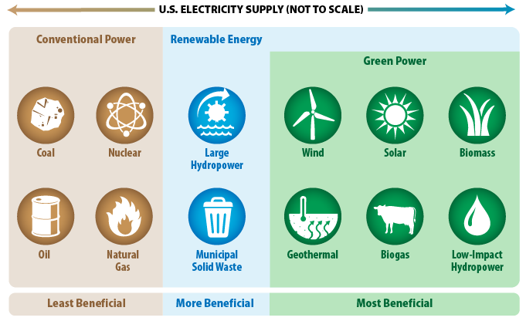
Conventional energy
Conventional energy: sources and forms of energy that are in widespread use today.
https://www.epa.gov/greenpower/what-green-power

Slide 8
Module 1: Intro to energy systems and sustainability
1.3: What is ‘sustainable’ energy?

Slide 9
Sustainable?
1: capable of being sustained
2a : of, relating to, or being a method of harvesting or using a resource so that the resource is not depleted or permanently damaged sustainable techniques sustainable agriculture
2b : of or relating to a lifestyle involving the use of sustainable methods sustainable society
- Merriam-Webster.com
“…sustainable development is development that meets the needs of the present without compromising the ability of future generations to meet their own needs.”
- Brundtland Commission, U.N., 1987
"We are looking ahead, as is one of the first mandates given us as chiefs, to make sure and to make every decision that we make relate to the welfare and well-being of the seventh generation to come. ... What about the seventh generation? Where are you taking them? What will they have?"
- Oren Lyons, Chief of the Onondaga Nation

Slide 10
What is sustainable energy?
Sustainable energy: uses sources that meet these requirements.
1. Are not significantly depleted by continued use;
2. Do not emit pollutants or other hazards to humans or ecological and climate systems on a significant scale; and
3. Do not perpetuate social injustice.
In this course, we’ll look at the argument that many forms of energy can be considered sustainable if they are used in a sustainable manner.
Energy Systems and Sustainability, 2/e, Chapter 1

Slide 11
Three linked ‘pillars’ of sustainability
Economic sustainability: encompasses requirements for strong and durable economic growth; preserving financial stability and a low & stable inflationary environment
Environmental sustainability: focuses on the stability of biological and physical systems and on preserving access to a healthy natural environment
Social sustainability: emphasizes the importance of well functioning labor markets and high employment, of adaptability to major demographic change and stability in social and cultural systems of equity and democratic participation in decision making
- IEA (2001); OECD (2001)
There are those who advocate for any sustainable change and those who believe climate change and other challenges require a much more rigorous approach to sustainability. [weak vs. strong sustainability]
Energy Systems and Sustainability, 2/e, Chapter 1

Slide 12
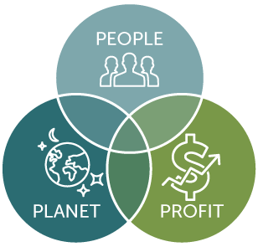
Three linked ‘pillars’ of sustainability
Social sustainability
culture
ethics
equity
Economic sustainability
growth
profit
costs
*
Environmental sustainability
ecosystems
aka ‘Triple Bottom Line’
https://sustain.wisconsin.edu/sustainability/triple-bottom-line/

Slide 13
Theory vs. reality?
Economy
Society
Environment
Theory
Economy
Society
Environment
Economy
Reality
Society
Change that needs to happen
Environment
W.M. Adams (2006) The Future of Sustainability
Re-thinking Environment and Development in the Twenty-first Century .
http://cmsdata.iucn.org/downloads iucn_future_of_sustanability.pdf

Slide 14
Decarbonized? Low-carbon? Renewable?
There is no carbon-free fuel.
Low-carbon: processes or technologies that produce power [or heat] with substantially lower amounts of carbon emissions than is emitted from conventional (fossil fuel) power generation
Renewable: processes or technologies that produce power [or heat] from sources that are not depleted when used
*
Nuclear: processes or technologies that produce power from the fission or fusion of atoms
Nuclear is finite rather than renewable, but is low-carbon
https://sustain.wisconsin.edu/sustainability/triple-bottom-line/

Slide 15
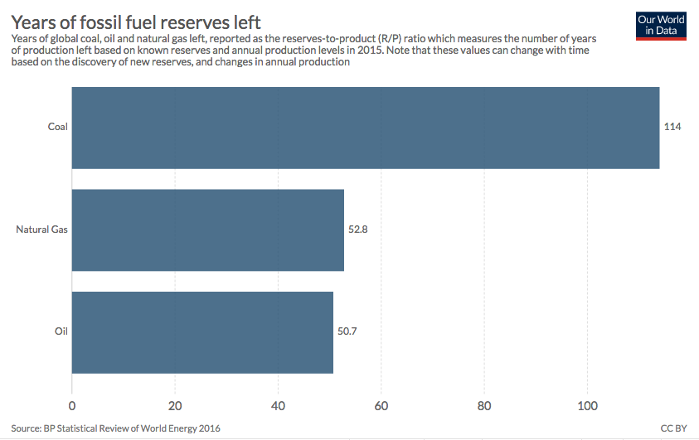
Sustainability of our energy resources?
These are global reserves.
https://ourworldindata.org/how-long-before-we-run-out-of-fossil-fuels

Slide 16
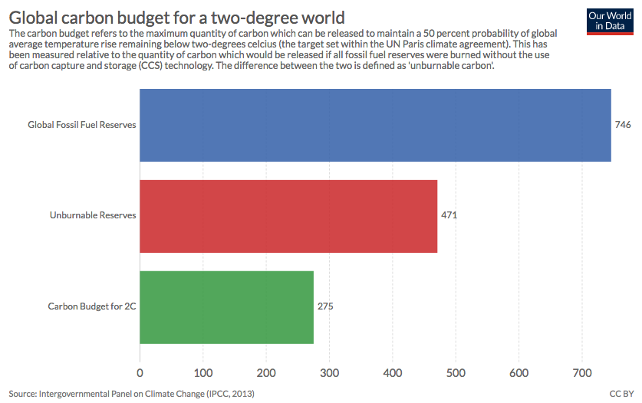
This changes if we mitigate GCC
These are global budgets.
https://ourworldindata.org/how-long-before-we-run-out-of-fossil-fuels

Slide 17
Why does sustainable energy matter?
There are three major reasons, each creating a point of view or perspective.
‘Growthist’
1. There is a very large unmet demand for energy in developing countries.
2. The supply of fossil fuels is finite and won’t meet these demands.
‘Peakist’
3. GCC requires us to dramatically reduce emissions of carbon dioxide.
‘Environmentalist’
Energy Systems and Sustainability, 2/e, Chapter 1

Slide 18
POV and perspective shape our actions
‘We’ve got plenty of options to solve climate change – but I am concerned that we are running out of cheaper energy supplies and this could impact on global economic growth rates.’
‘As we get richer, I’ve no doubt we’ll find ingenious ways of getting the remaining fossil fuel out of the ground and we have other options like nuclear power too – but how much more carbon dioxide can we dump into the atmosphere?’
growthist
peakist
environmentalist
‘Consumption is at the heart of the matter. We can’t go on consuming as we do. The bad news is that we are changing the Earth’s climate. The good news is that we may be running out of cheap oil and gas, possibly coal’
‘Economic prosperity is the key to solving the twin problems of maintaining energy supply and combatting climate change.’

Slide 19
Global climate change
Coming to you in Module 2!

Slide 20
Module 1: Intro to energy systems and sustainability
1.4: What is a system?

Slide 21
What is a system? (1)
1: a regularly interacting or interdependent group of items forming a unified whole a number system, such as:
a group of interacting bodies under the influence of related forces a gravitational system
(2) an assemblage of substances that is in or tends to equilibrium a thermodynamic system
- Merriam-Webster.com
“So what is a system? A system is a set of things-people, cells, molecules or whatever- interconnected in such a way that they produce a pattern of behavior over time. The system may be buffeted, constricted, triggered, or driven by outside forces. But the system's response to these forces is characteristic of itself, and that response is seldom simple in the real world.”
“The system, to a large extent causes its own behavior!”
- Donella Meadows, Thinking in systems: a primer

Slide 22
What is a system? (2)
System: ‘A system is an interconnected set of elements that is coherently organized in a way that achieves something (function or purpose)”
Characteristics of systems:
Integrity (wholeness)
Adaptive
Resilient
Evolutionary
Goal-seeking
Self-preserving
Self-organizing
Component 1
Component 2
Donella Meadows, ‘Thinking in systems’

Slide 23
Example?
A football team is a system.
What are the components or elements?
What are the interconnections for flows?
coach
What is the purpose?
strategy
ball
rules
players
pressure?
physics
management
rules
field
physics
Purpose: winning, $.... Fun?
Donella Meadows, ‘Thinking in systems’

Slide 24
Sub-systems should be in harmony
Example: college or university
Purposes of students vs. faculty vs. administrators?
Donella Meadows, ‘Thinking in systems’

Slide 25
Diagramming the bathtub example
Bathtub: classic example for about systems diagrams and behavior
stock: elements that you can see or measure; changes with flows
source:
where it comes from
sink:
where it goes to
inflow
outflow
Donella Meadows, ‘Thinking in systems’

Slide 26
Bathtub behavior?
1. What happens when you pull the plug?
2. What happens when you don’t?
3. If inflow < outflow?
4. If inflow > outflow?
5. How can you reach equilibrium?
4
Stop inflow and leave the plug in
Pull the plug and turn the tap on so that water is flowing in as fast as it flows out
2
water level (inches)
1
3
time (minutes)
Donella Meadows, ‘Thinking in systems’

Slide 27
Most people focus on ‘stock’
Stock: the amount of a critical element of the system
Note that ‘critical’ is in the eye of the beholder
Change of stock takes time and that time is related to the rate of flows.
Changes in stock determine the dynamics of the system.
Most decision are designed to regulate levels of stock.
System thinkers see the world as a collection of stocks along with the mechanisms of regulating their levels by manipulating flows.
Donella Meadows, ‘Thinking in systems’

Slide 28
Feedback loops: positive (R) and negative (B)
Feedback loops: occur when a stock affects its own flows.
Positive (reinforcing = R) feedback loops amplify stock.
Negative (balancing = B) feedback loops regulate or temper the growth of stock.
births (source)
increase population
deaths (sink)
decrease population
Donella Meadows, ‘Thinking in systems’
increased fertility increases births
(+) R loop
As population increases, the birth rate increases
(-) B loop
As population increases, the death rate increases
increased mortality increases deaths

Slide 29
Discrepancies: what we’ve got vs. what we want
By monitoring temperature discrepancies and using two balancing loops this system achieves steady state balance.
furnace (source)
outside (sink)
Donella Meadows, ‘Thinking in systems’
To control heating:
Compare room temp to the thermostat setting
Turn furnace on or off
To control cooling:
Compare room temp to the thermostat setting
Turn cooling system on or off

Slide 30
A more complex system in balance
Notice that human desires or intangibles play a larger role here.
Inventory: actual vs. desired
too few cars drive more orders
More cars drive more sales
Notice the effects of ’intangibles’ like human demand and perception
Donella Meadows, ‘Thinking in systems’

Slide 31
Delays: a really common complication
Unless a system is perfectly tuned with great communication, delays complicate balance.
Inventory: actual vs. desired
delay
delay
delay
Donella Meadows, ‘Thinking in systems’

Slide 32
Think about this
Which would have the greater affect on a system and its ability to find balance and why?
(a) a non-renewable source
(b) a renewable source
The non-renewable source would have a greater effect because once it was used up the source would be gone. And all of the processes and sinks that followed up would be disrupted until a source (renewable or not) could be found to substitute for the one that was depleted.
But a renewable source won’t run out if it’s well managed. So while disruption may occur as its supply rises and falls, the level of disruption will be less catastrophic.
Donella Meadows, ‘Thinking in systems’

Slide 33
Module 1: Intro to energy systems and sustainability
1.5: Why is system thinking important?

Slide 34
Why is systems thinking important?
“Systems thinking expands the range of choices available for solving a problem by broadening our thinking and helping us articulate problems in new and different ways. At the same time, the principles of systems thinking make us aware that there are no perfect solutions; the choices we make will have an impact on other parts of the system.
By anticipating the impact of each trade-off, we can minimize its severity or even use it to our own advantage. Systems thinking therefore allows us to make informed choices.”
Micheal Goodman, ‘Systems thining: what, why, where, when, and how?’ Systems Thinker
https://thesystemsthinker.com/systems-thinking-what-why-when-where-and-how/

Slide 35
Lessons from systems thinking
1. We don’t pay enough attention from history. We focus on the events, but not the context, causes and results.
2. We aren’t great at understanding relationships. We want relationships to be linear and they often aren’t.
3. We don’t pay enough attention to sources and sinks.
4. Our minds seem to want to find single causes for single effects.
5. We don’t identify limiting factors.
6. We aren’t good at seeing true system boundaries and therefore miss the true or full range of possible outcomes.
Donella Meadows, ‘Thinking in systems’

Slide 36
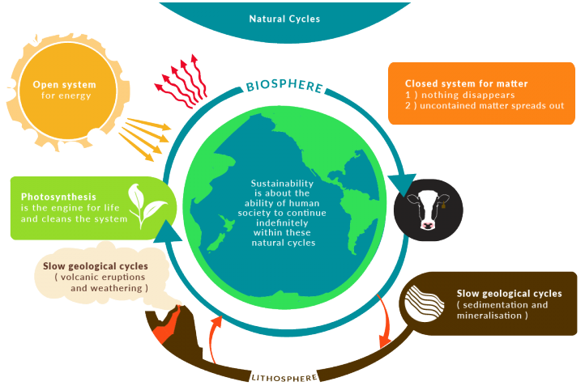
Earth is a system
Closed system: exchanges only matter with the surroundings
Open system: exchanges matter and energy with the surroundings
http://wikieducator.org/File:Natural_Cycles-01-1.png

Slide 37
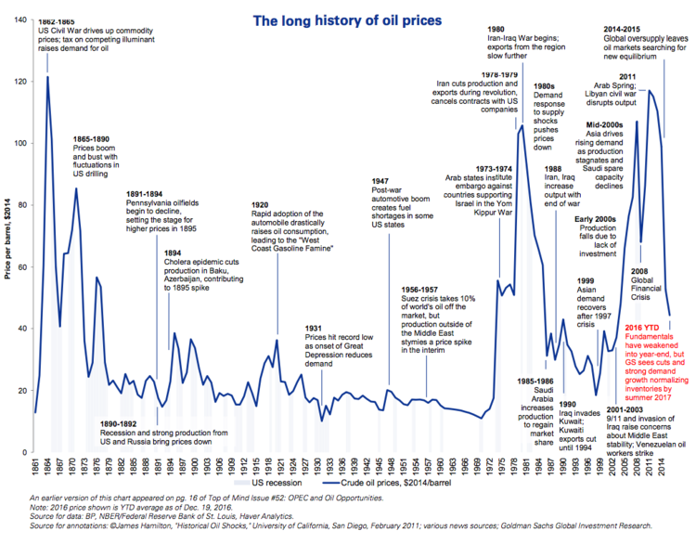
Need for energy systems?
Nations developed energy systems – and energy policy…
(1) once societies had become complex and dependent on energy;
(2) supplies and prices of that energy had become vulnerable & volatile.
Goldman Sachs

Slide 38
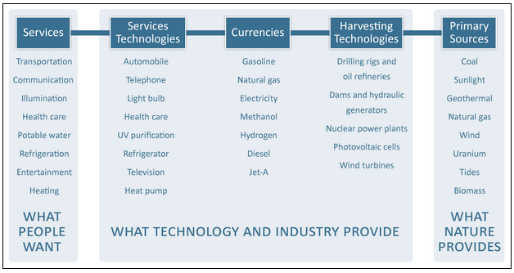
Energy systems are complex
Energy systems: connect the energy resources that nature provides to the energy services people want.
Sanborn etal. (2008) The hydrogen defense against climate catastrophe.
Canadian Energy Systems Analysis Research, https://www.cesarnet.ca/background-energy-systems

Slide 39
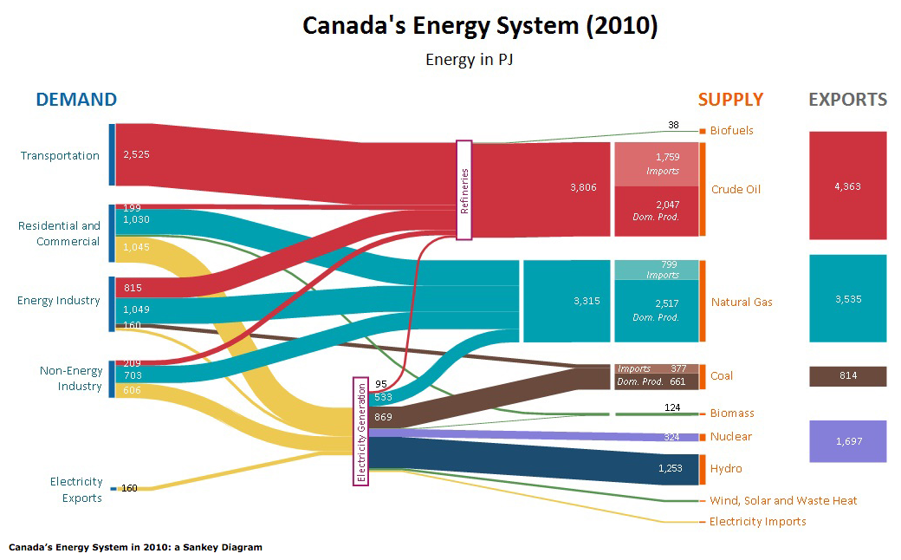
Analysis of system flows is critical
This Sankey diagram focuses on stocks and flows.
ISEEE/CanESS

Slide 40
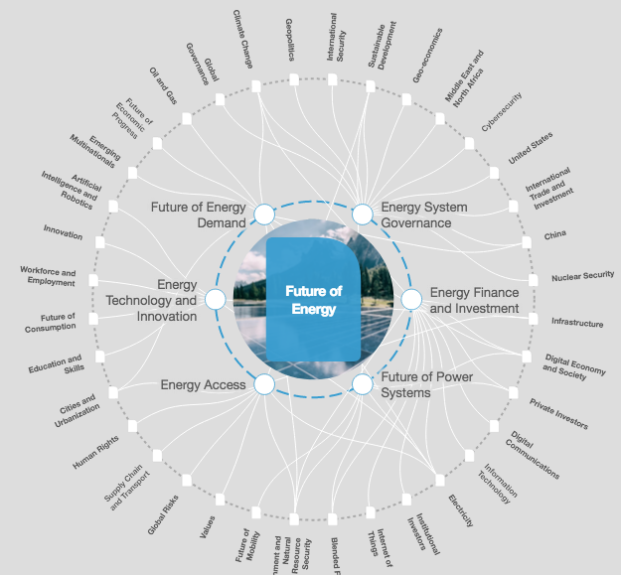
Broader view of energy systems
https://intelligence.weforum.org/topics/a1Gb00000038oN6EAI?tab=publications

Slide 41
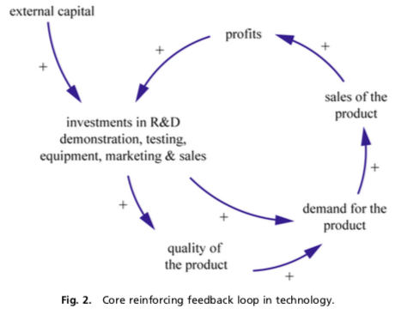
Reinforcing systems diagram: technology
Existing technologies are advantaged by their accelerating success.
Dangerman and Shellnhuber (2012) Energy systems transformation, PNAS.

Slide 42
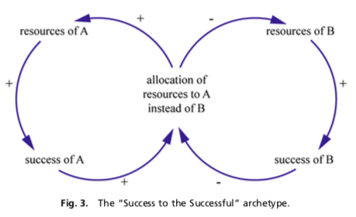
Marketplace success gives ‘incumbents’ an advantage
“…the conventional system has been in place successfully for a longer period of time, and during that period competition for the adoption of technologies by consumers has occurred, for example, among the steam engine, the (electric car) battery, and the combustion engine. Thus, the technology and products of the conventional energy system obviously have built up hardware infrastructures, know-how, and goodwill. The alternative energy system lacks this historically accumulated position.”
Dangerman and Shellnhuber (2012) Energy systems transformation, PNAS.

Slide 43
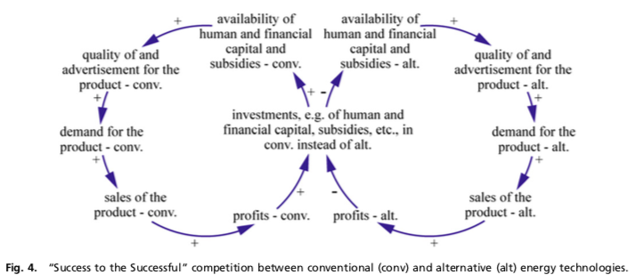
How do we shift the advantage?
“Policymakers aiming to change the status quo of the energy system therefore are faced with taking rather draconian measures, namely, not spreading their subsidies and loans over the different energy technologies— because doing so only reinforces the existing and dominating positive feedback loops—but focusing on those that solve the problems.”
“Problem-causing technologies should be addressed only by prohibitive laws, and problem-relieving technologies should be facilitated by stimulus laws..”
Dangerman and Shellnhuber (2012) Energy systems transformation, PNAS.

Slide 44
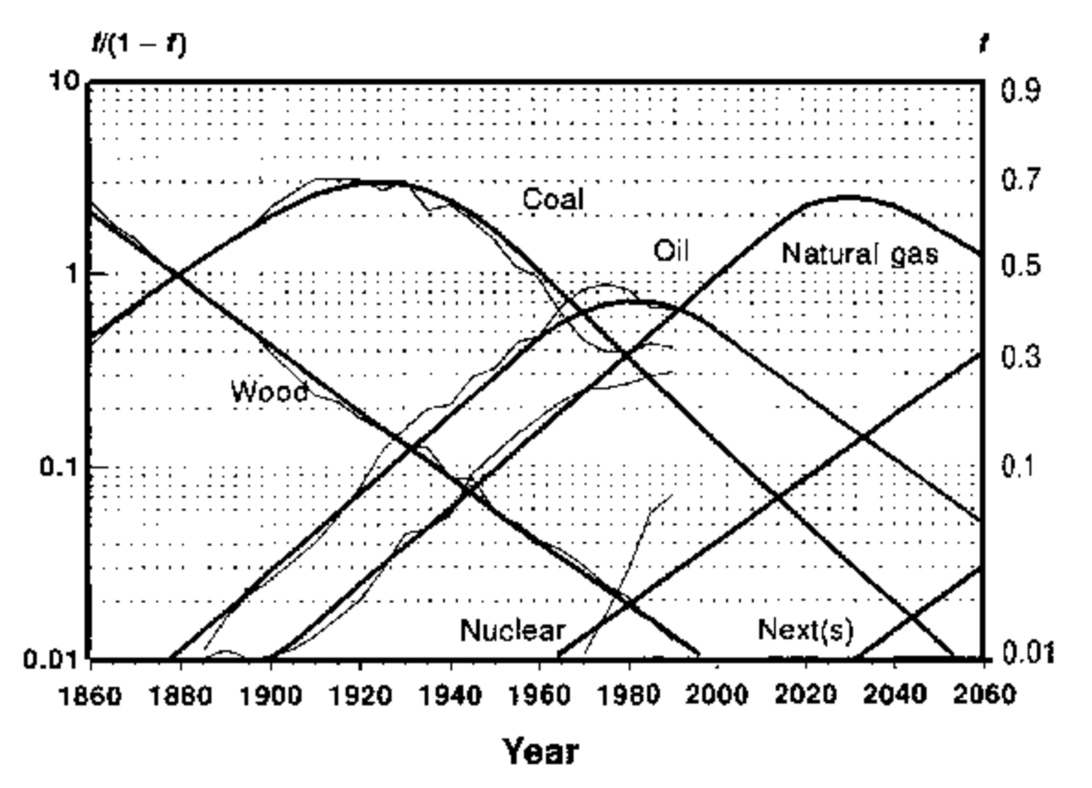
Energy cycles are business cycles
Adapted from Marchetti and Nakicenovic (1979)

Slide 45
Module 1: Intro to energy systems and sustainability
Big ideas?
All energy systems have some economic, societal and environmental costs
Only when we understand how energy systems work can we minimize those costs and approach sustainability while still serving our needs.

