Slide 1
SSC 2030: Energy Systems & Sustainability
2. Global climate change
2.1: The elephant in the room: What is GCC?
2.2: What is the evidence of GCC?
2.3: What are the cause(s) of GCC?
2.4: Paradigms, change, revolutions and transitions
2.5: Decarbonization and the energy trilemma

Slide 2
2. Global climate change
2.1: The elephant in the room
What is GCC?

Slide 3
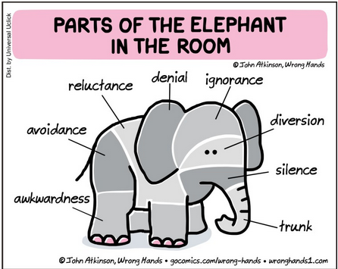
The elephant in the room (???)
“Five blind people encounter an elephant. One pats the stubbly flank, another feels the hot breath, a third grasps a bony tusk, another the bristly tail, and yet another the soft winding trunk.
They find that their
individual observations
give completely
different impressions
of the thing they are
trying to describe.
I recently talked to a
scientist and a
corporate official
about climate change,
and it reminded me of
the story about the
blind people
describing an elephant.”
https://www.northeastipm.org/about-us/publications/ipm-insights/climate-change-is-the-elephant-in-the-room/
http://northsideforum.org.au/forum-71-climate-change-the-election-the-elephant-in-the-room/

Slide 4
What’s in a name?
Pre-1975: the term of art was “inadvertent climate modification”
Scientists knew that human-caused emissions were likely to cause climate change. But would it be warming or cooling from aerosols?
1975: geochemist Wallace Broecker of Columbia University published an article titled, ”Climatic change: Are we on the brink of a pronounced global warming?”
Described an increase in average global surface temperatures from greenhouse gases emitted by human activity.
1979: National Academy of Sciences report also used the term ”climate change” to describe other, non-warming effects likely to occur.
Today: We know that emissions will cause a host of changes around the globe. Warming and increased precipitation are just two of the effects. So, global climate change is the most inclusive and descriptive term.
https://pmm.nasa.gov/education/articles/whats-name-global-warming-vs-climate-change

