Slide 1
SSC 2030: Energy Systems & Sustainability
2. Global climate change
2.1: The elephant in the room: What is GCC?
2.2: What is the evidence of GCC?
2.3: What are the cause(s) of GCC?
2.4: Paradigms, change, revolutions and transitions
2.5: Decarbonization and the energy trilemma

Slide 2
2. Global climate change
2.3: What are the cause(s) of GCC?

Slide 3
The earth is a greenhouse
“Life on Earth depends on energy coming from the Sun.
About half the light reaching Earth's atmosphere passes through the air and clouds to the surface, where it is absorbed and then radiated upward in the form of infrared heat.
About 90 percent of this heat is then absorbed by the greenhouse gases and radiated back toward the surface, which is warmed to a life-supporting average of 59 degrees Fahrenheit (15 degrees Celsius).“
https://climate.nasa.gov/evidence/

Slide 4
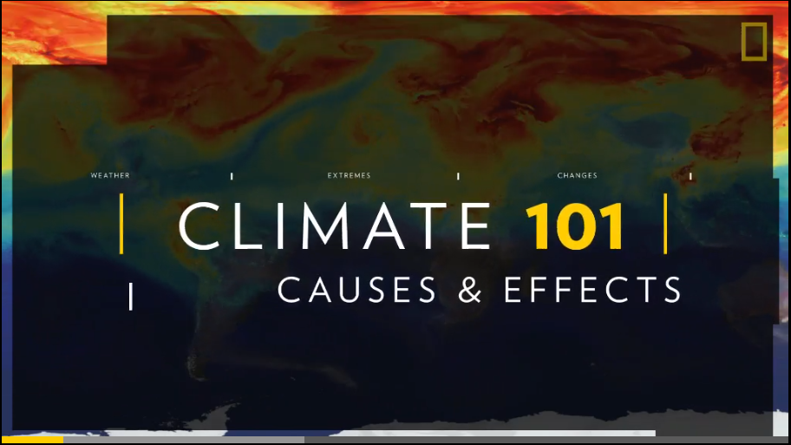
A quick overview
https://www.nationalgeographic.com/environment/global-warming/global-warming-effects/

Slide 5
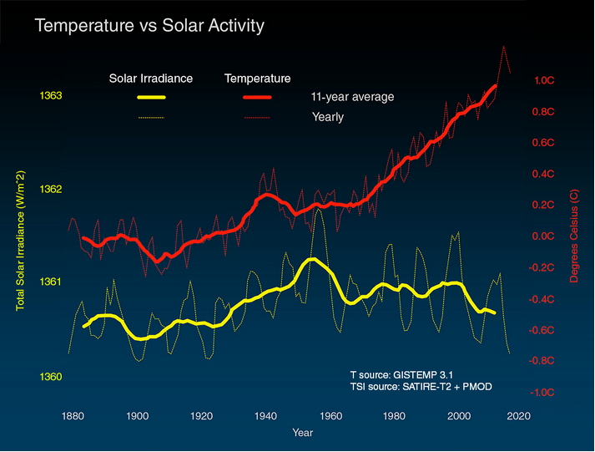
It’s not just the sun
https://climate.nasa.gov/evidence/

Slide 6
Is it natural?
Yes!
GCC is a natural climatic response to increasing levels of CO₂ and other GHGs (greenhouse gases) in the atmosphere.
gas | formula | GWP* | ** % increase | increased forcing*** | contribution to GCC %
carbon dioxide | CO₂ | 1 | 41.2 | 1.88 | 9 - 26
methane | CH₄ | 84 | 151 - 170 | 0.49 | 4 - 9
nitrous oxide | N₂O | 264 | 20 | 0.17
ozone | O₃ |  | 42 | 0.4 | 3 - 7
water | H₂O |  |  |  | 36 – 72
Industrial HCs | many | 5K – 17.5K |  | 0.36
GWP* = 20-year global warming potential
**% increase = atmospheric increase since 1750
Increased forcing*** = W/m2
https://climate.nasa.gov/evidence/
https://en.wikipedia.org/wiki/Greenhouse_gas

Slide 7
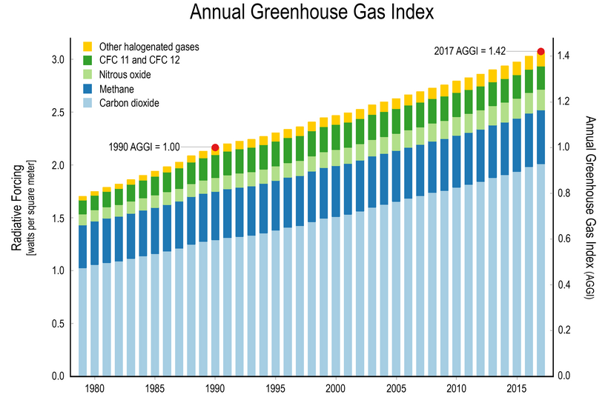
GHG concentration are rising…
… as is their ‘radiative forcing’ effect, aka warming effect.
https://www.globalchange.gov/browse/indicators/indicator-annual-greenhouse-gas-index

Slide 8
Consensus about the cause of GHG
“Multiple studies published in peer-reviewed scientific journals show that 97 percent or more of actively publishing climate scientists agree*: Climate-warming trends over the past century are extremely likely due to human activities. In addition, most of the leading scientific organizations worldwide have issued public statements endorsing this position. The following is a partial list of these organizations, along with links to their published statements and a selection of related resources.”
*Technically, a “consensus” is a general agreement of opinion, but the scientific method steers us away from this to an objective framework. In science, facts or observations are explained by a hypothesis (a statement of a possible explanation for some natural phenomenon), which can then be tested and retested until it is refuted (or disproved).
https://climate.nasa.gov/scientific-consensus/

Slide 9
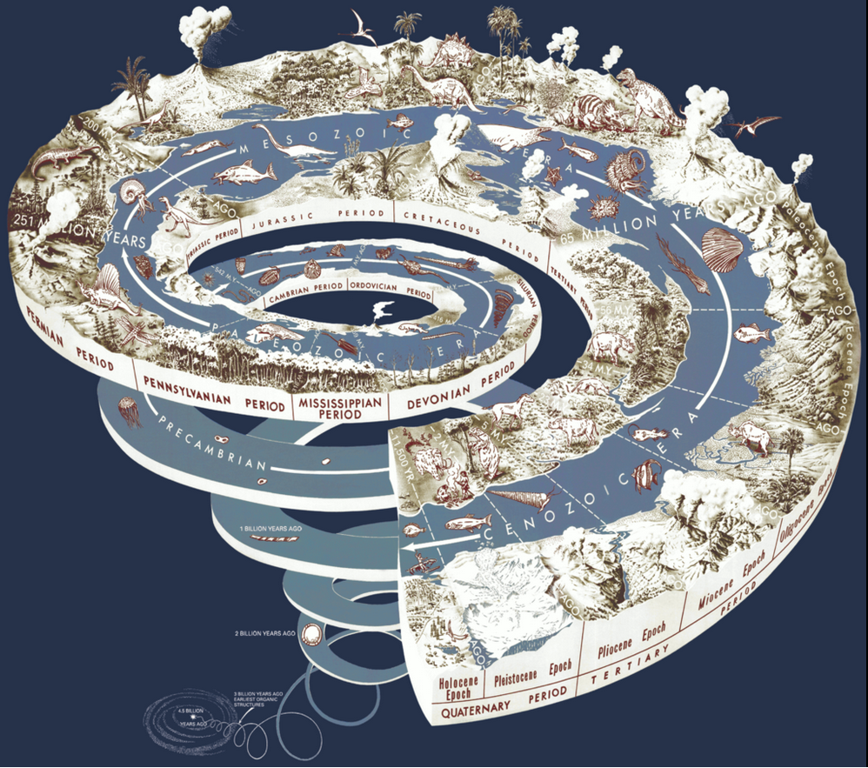
We’re living in the Anthropocene age
Human activity has increased the concentration of GHGs in the atmosphere since the start of the industrial revolutions.
Thus, GCC is
anthropogenic.
Holocene since the end of the last glacial era
en.wikipedia.org/wiki/Geologic_time_scale#/media/File:Geological_time_spiral.png
Anthropocene age of human-caused GCC

Slide 10
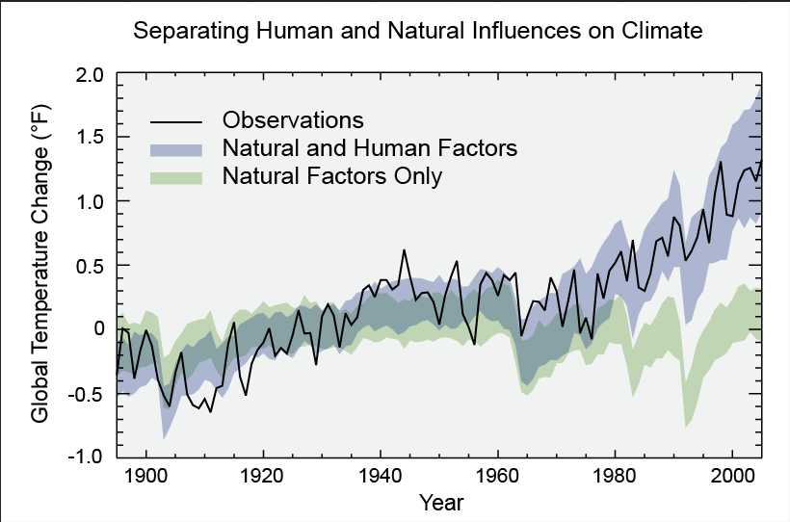
Modeling: natural vs. anthropogenic
https://archive.epa.gov/epa/climate-change-science/causes-climate-change.html

