Slide 1
SSC 2030: Energy Systems & Sustainability
2. Global climate change
2.1: The elephant in the room: What is GCC?
2.2: What is the evidence of GCC?
2.3: What are the cause(s) of GCC?
2.4: Paradigms, change, revolutions and transitions
2.5: Decarbonization and the energy trilemma

Slide 2
2. Global climate change
2.4: Paradigms, change, revolutions and transitions

Slide 3
Change: needed, constant… not popular
Change is needed, but it’s not easy and it’s seldom popular.
Change is nothing new and it’s one of the few things we can count on.
Change is said to be constant, but to us (human society) change often appears episodic.
Nothing big happens for a while… then boom! Big change.
Scientists use the term ‘punctuated’.
Historians and anthropologists use terms like ‘revolution’ or ‘transition’.

Slide 4
Technical revolutions in Western culture
Technical revolution: is a period in which one or more technologies is replaced by another technology in a short amount of time.
It is an era of accelerated technological progress characterized by new innovations whose rapid application and diffusion cause an abrupt change in society.
1600 - 1740 Financial-agricultural revolution
1780 – 1840 Industrial revolution
1870 – 1920 Technical or second industrial revolution
1940 – 1970 Scientific-technical revolution
1975 – on Information and telecommunications (digital) revolution
Now? Energy system transition, aka energy decarbonization
https://en.wikipedia.org/wiki/Technological_revolution

Slide 5
Resistance to technological change?
When we look back on the the agricultural revolution, or the first industrial revolution, it’s hard to believe that the technologies involved didn’t catch on right away.
Indeed, there is nearly always a lag period before good ideas are widely adopted.
We’ve known this for years::
“Although the inventor often times drunk with the opinion of his own merit, thinks all the world will invade and incroach upon him, yet I have observed that the generality of men will scarce be hired to make use of new practices, which themselves have not been thoroughly tried... for as when a new invention is first propounded, in the beginning every man objects, and the poor inventor runs the gantloop of all petulent wits...not one [inventor] of a hundred outlives this torture... and moreover, this commonly is so long a doing that the poor inventor is either dead or disabled by the debts contracted to pursue his design.”
- William Petty, 1679
Mokyr (1977) The Political Economy of Technological Change: Resistance and Innovation in Economic History

Slide 6
Entrenched interests and inertia
Why do societies resist technological change?
Incumbents who fear a threat to their power and economic rents (perceived market advantage)
Concern about broader social and political repercussions ("unintended ripple effects")
Risk and loss aversion: new technologies often have "unanticipated and unknowable consequences"
"These three motives often merge and create powerful forces that use political power and persuasion to thwart innovations. As a result, technological progress does not follow a linear and neat trajectory. It is, as social constructionists have been trying to tell us for decades, a profoundly political process."
He also finds that a critical factor in the ability of a society or nation to change, or to be held back by inertia, is the ‘suitability of institutions to the successful adoption of new ideas’.
How suited to change are today’s American institutions?
Mokyr (1977) The Political Economy of Technological Change: Resistance and Innovation in Economic History
https://en.wikipedia.org/wiki/Joel_Mokyr
http://eh.net/book_reviews/innovation-and-its-enemies-why-people-resist-new-technologies/

Slide 7
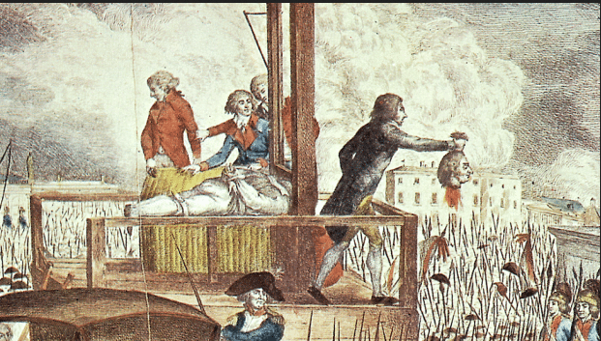
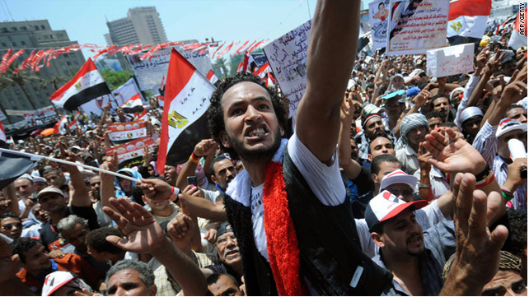
Revolutions are messy
https://en.wikipedia.org/wiki/Technological_revolution

Slide 8
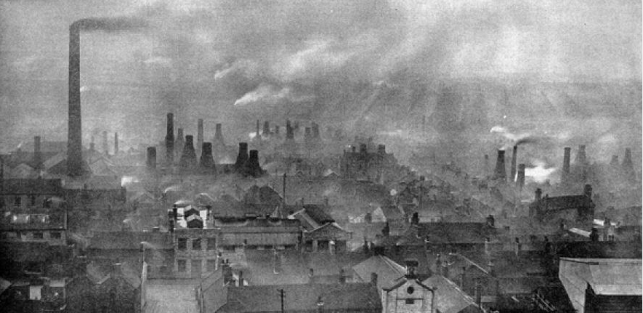
And technical revolutions are too
Consider the effects of the Industrial Revolution of the mid-1800s:
Pro:
Economic growth
Development of machines
Mechanization of agriculture
Faster communication and transportation
Slow (reactive) improvements in sanitation
Con:
Widened class divides (social and economic inequity)
Systemic child labor
Increased environmental pollution, particularly urban
Overcrowding of cities
Poor sanitary conditions that led to epidemics of infectious disease, particularly in poor areas of cities
https://en.wikipedia.org/wiki/Technological_revolution
https://www.cam.ac.uk/research/news/industrial-revolution-damaging-psychological-imprint-persists-in-todays-populations

Slide 9
Today, we need a carbon paradigm shift
Technical revolutions sometimes involve full-scale paradigm shifts.
Paradigm: a theory or group of ideas about how something should be done, made or thought about
Paradigm shift: important change that happens when the usual way of thinking about or doing something is discarded and replaced by a new and different way
Let’s look at a few examples of paradigm shift from history and how well they were received.
https://en.wikipedia.org/wiki/Technological_revolution
https://www.cam.ac.uk/research/news/industrial-revolution-damaging-psychological-imprint-persists-in-todays-populations

Slide 10
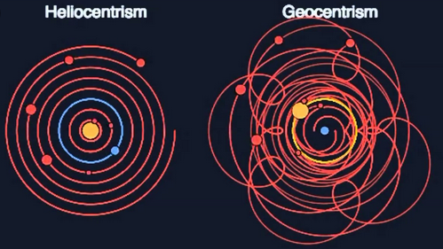
Copernican revolution
The sun, not the earth, the center of the solar system.
Resistance?
This new idea was contrary to Church doctrine that held that the Earth, created by God, was the center of the universe.
Although Copernicus dedicated his book (1543) to the pope, the church later banned it (1616).
https://www.space.com/15684-nicolaus-copernicus.html

Slide 11
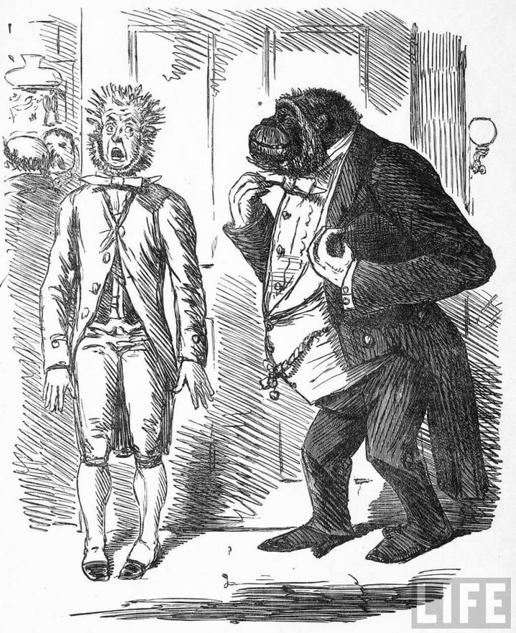
Darwin: evolution
Organisms evolve from gradual modification of ancestors; each organism wasn’t specifically created by God.
Resistance?
Again, resistance came from organized religion.
"Man's derived supremacy over the earth; man's power of articulate speech; man's gift of reason; man's free-will and responsibility [...] are all equally and utterly irreconcilable with the degrading notion of the brute origin of him who was created in the image of God."
- Bishop Samuel Wilberforce,
Opponent of Evolution
http://39769227.weebly.com/opposition.html

Slide 12
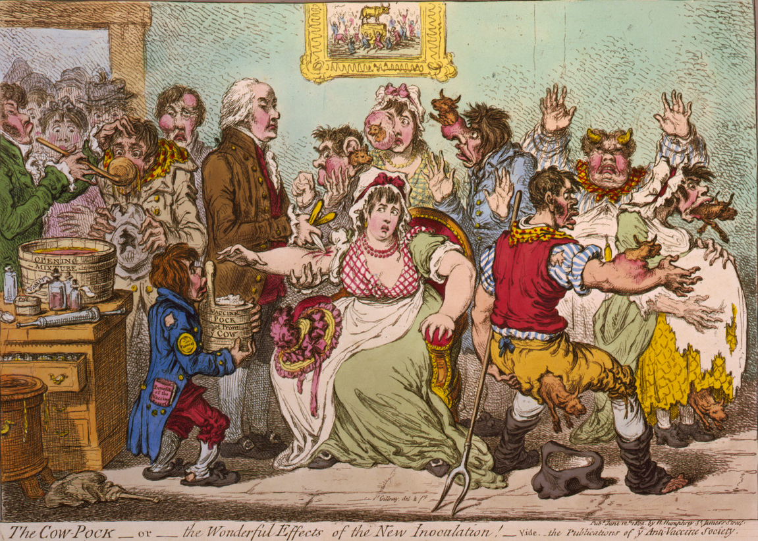
Jenner: vaccination
Inoculation with dead, weakened or related microbes would protect people from disease caused by that microbe.
Resistance?
Jenner adapted a process started by the Chinese and protected people from deadly smallpox by inoculation with the weaker and related cowpox.
https://en.wikipedia.org/wiki/Smallpox_vaccine

Slide 13
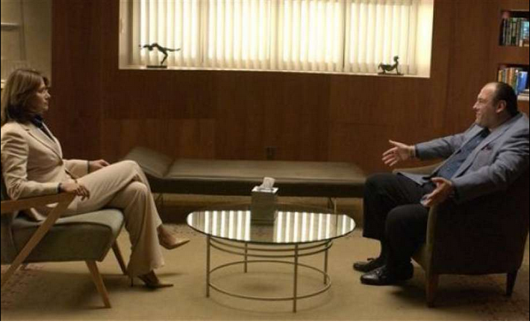
The Tony Soprano problem?
Tony claimed that he wanted to leave murder and extortion behind and went to therapy. His therapist helped him see that he wanted to change, and gave him suggestions.
Did he change?
https://www.digitaltonto.com/2016/3-paradigm-shifts-that-will-drive-how-we-compete-in-the-21st-century/

