Slide 1

SSC 2030: Energy Systems and Sustainability
2. Global climate change
  2.1: The elephant in the room: What is GCC?
  2.2: What is the evidence of GCC?
  2.3: What are the cause(s) of GCC?
  2.4: Paradigms, change, disruptions, revolutions and transitions
  2.5: Decarbonization and the energy trilemma

Slide 2
Module 2. Global climate change
  2.1: The elephant in the room: what is GCC?

Slide 3
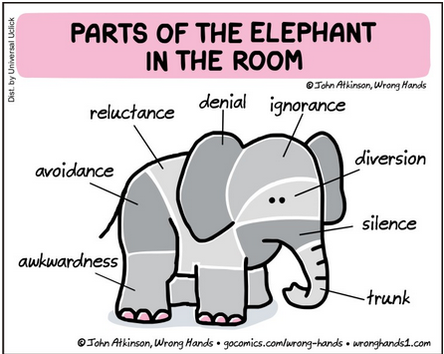
The elephant in the room
“Five blind people encounter an elephant. One pats the stubbly flank, another feels the hot breath, a third grasps a bony tusk, another the bristly tail, and yet another the soft winding trunk.
They find that their individual observations give completely different impressions of the thing they are trying to describe.
I recently talked to a scientist and a corporate official about climate change, and it reminded me of the story about the blind people describing an elephant.”
https://www.northeastipm.org/about-us/publications/ipm-insights/climate-change-is-the-elephant-in-the-room/
http://northsideforum.org.au/forum-71-climate-change-the-election-the-elephant-in-the-room/

Slide 4
What’s in a name?
Pre-1975: the term of art was “inadvertent climate modification”
Scientists knew that human-caused emissions were likely to cause climate change. But would it be warming or cooling from aerosols?
1975: Geochemist Wallace Broecker of Columbia University published an article titled,
”Climatic change: Are we on the brink of a pronounced global warming?”
Described an increase in average global surface temperatures from greenhouse gases emitted by human activity.
1979: National Academy of Sciences report also used the term ”climate change” to describe other, non-warming effects likely to occur.
Today: We know that emissions will cause a host of changes around the globe. Warming and increased precipitation are just two of the effects.
So, global climate change is the most inclusive and descriptive term.
https://pmm.nasa.gov/education/articles/whats-name-global-warming-vs-climate-change

Slide 5
Module 2. Global climate change
  2.2: What is the evidence of GCC?

Slide 6
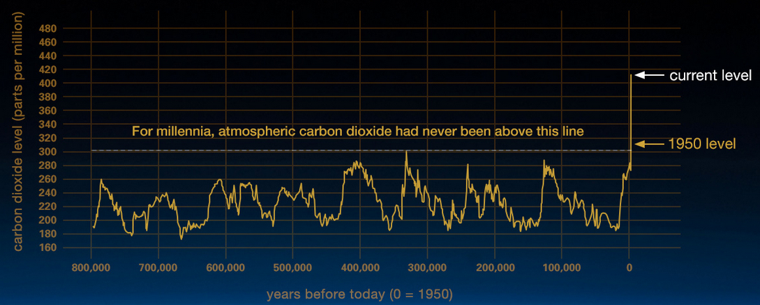
Atmospheric carbon is way up
Our current spike in atmospheric carbon dioxide (CO₂) levels follows both:
  The rise of human civilization; and
  A number of revolutions, driven by extraction and combustion of fossil fuels.
Human civilization?
https://climate.nasa.gov/evidence/

Slide 7
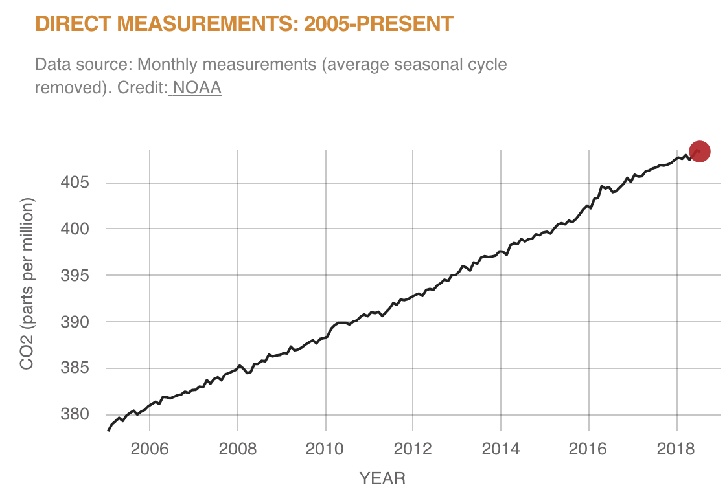
Vital signs: CO₂ levels
https://climate.nasa.gov/evidence/

Slide 8
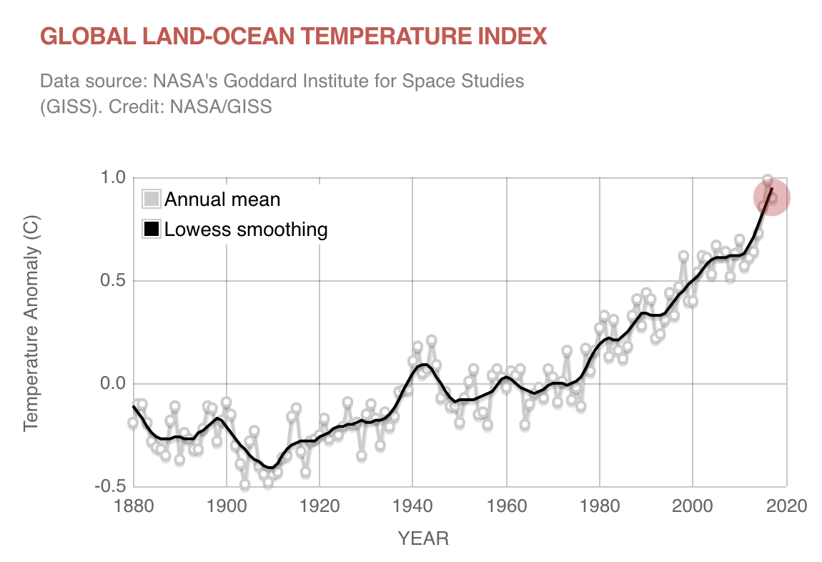
Vital signs: global temperature
https://climate.nasa.gov/evidence/

Slide 9
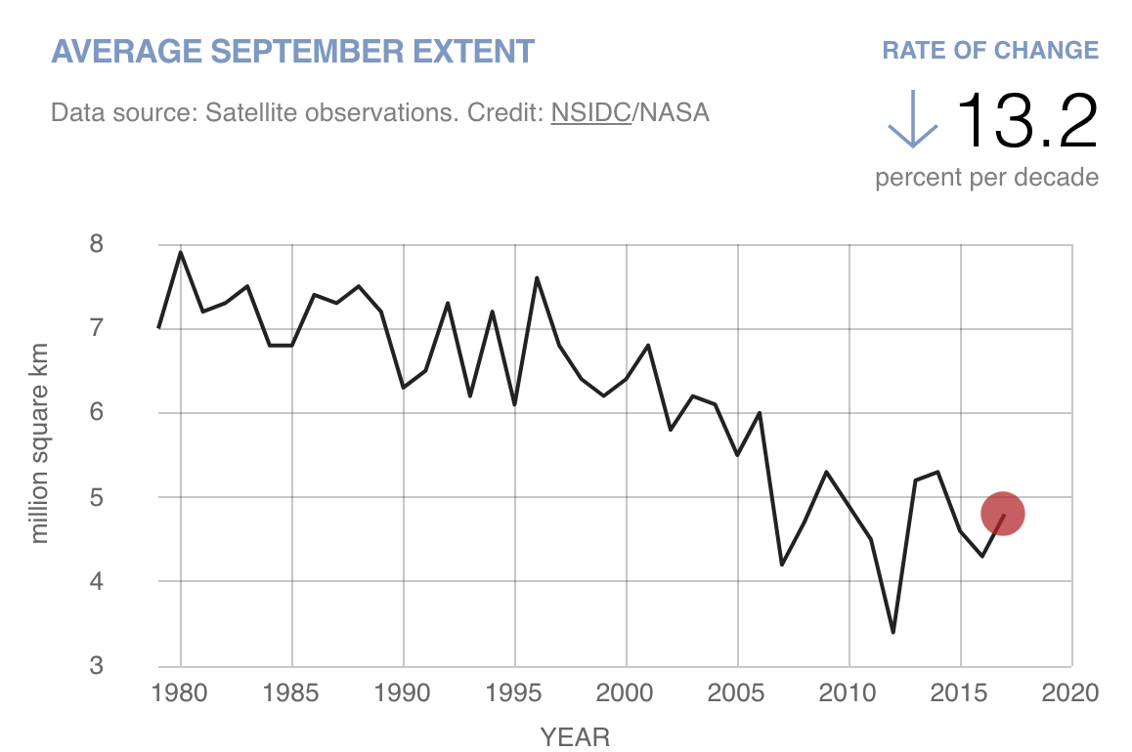
Vital signs: Artic sea ice
https://climate.nasa.gov/evidence/

Slide 10
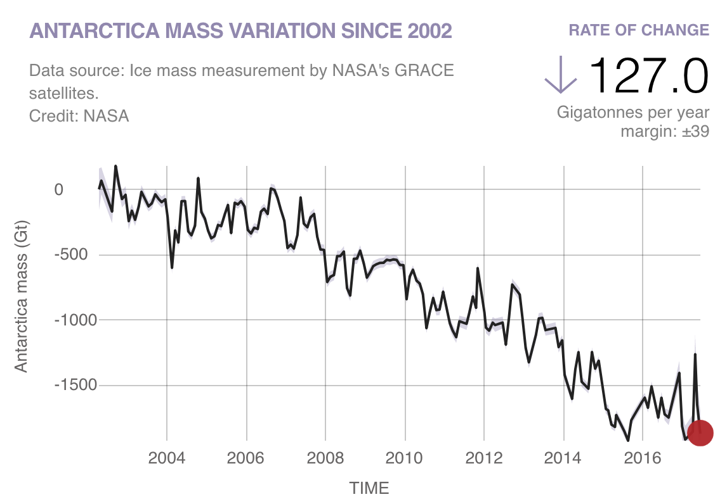
Vital signs: ice sheets
https://climate.nasa.gov/evidence/

Slide 11
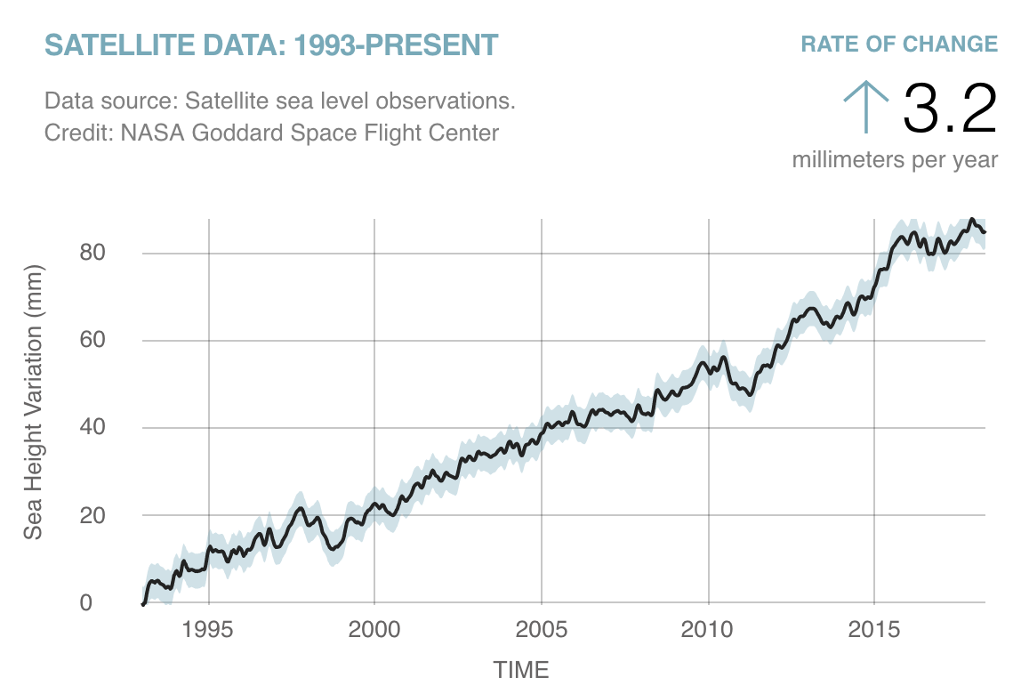
Vital signs: sea level
https://climate.nasa.gov/evidence/

Slide 12
Example: Glacier National Park, MT
Montana’s Glacier National Park
1910: 150 glaciers
Globally, glaciers store ¾ of the world’s freshwater.
2019: 30 glaciers
National Geographic: Effects of global warming

Slide 13
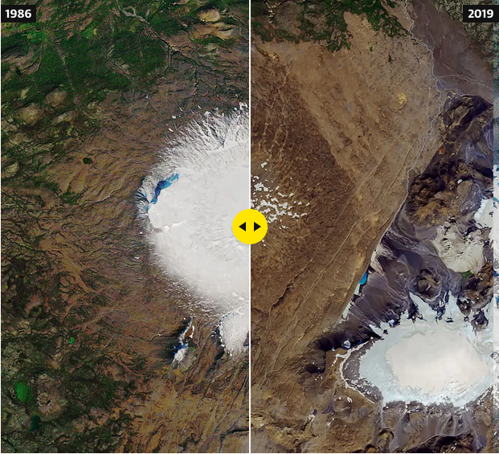
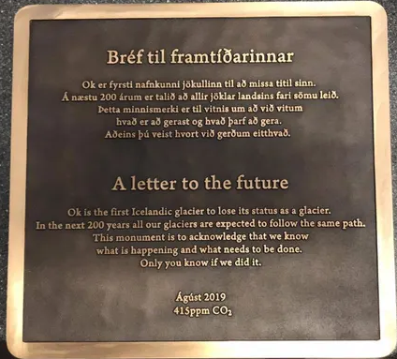
Iceland’s first glacier has disappeared
And a memorial plaque has been placed at the site.
1986
2019
https://www.theguardian.com/environment/2019/jul/22/memorial-to-mark-icelandic-glacier-lost-to-climate-crisis

Slide 14
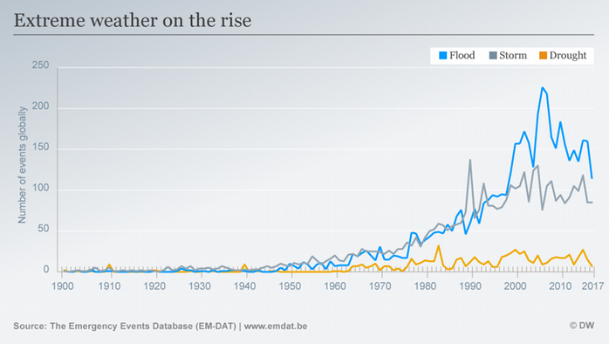
Extreme weather events
Increasing:
  Record high temperature events (decreasing lows);
  Intense rainfall and storm events.
https://climate.nasa.gov/evidence/
https://www.dw.com/en/climate-change-and-extreme-weather-science-is-proving-the-link/a-43323706

Slide 15
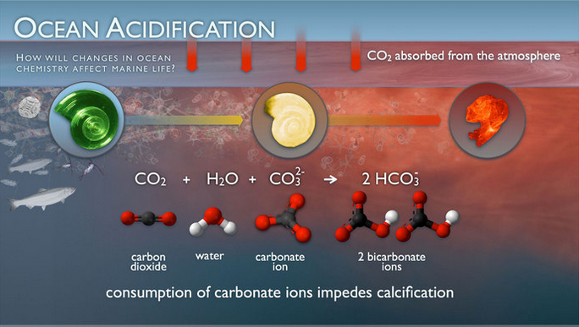
Ocean acidification
Since the industrial revolution (starting in the 1860’s) acidity of surface waters has increased by 30% due to increased carbon emissions.
  CO2 absorbed by the ocean has increased by 2 b tons/year
https://climate.nasa.gov/evidence/
https://www.pmel.noaa.gov/co2/story/Ocean+Acidification

Slide 16
Ecosystems are changing
And species are moving.
Adelie penguin populations are collapsing
N
mosquitos
ticks
jellyfish
crop pests
diseases
butterflies
foxes
alpine plants
National Geographic: Effects of global warming

Slide 17
Summary of today’s planetary vital signs
 | 2019 | 2020
Atmospheric CO2 | 412 ppm | 415 ppm
Temperature up* | 0.8 ºC | 0.95 ºC
Arctic sea ice down | 12.8%
Ice sheets down | 127.0%
Antarctic ice mass down |  | 148.0 b tonnes/yr
Greenland ice mass down |  | 279.0 b tonnes/yr
Sea levels up | 3.3% | 3.3%
* Since 1880
https://climate.nasa.gov/evidence/

Slide 18
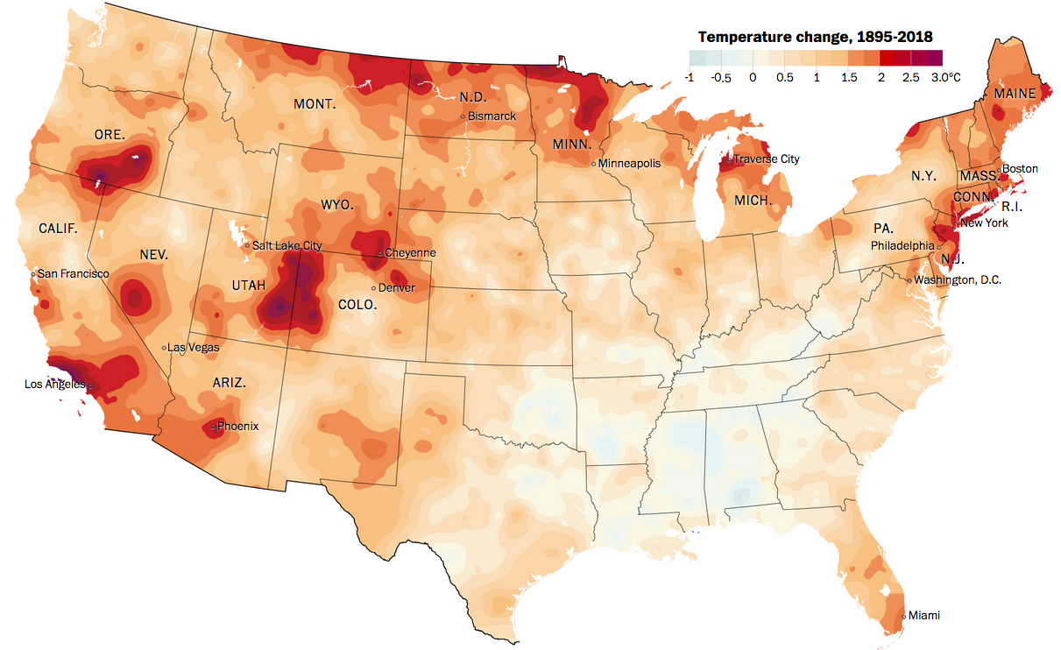
US: warming more quickly than expected
NB: The Paris Accord suggested a maximal 2ºC increase.
Alaska is warming most quickly.
Washington Post analysis of more than a century of NOAA temperature data across the Lower 48 states and 3,107 counties.
https://www.washingtonpost.com/graphics/2019/national/climate-environment/climate
-change-america/?wpisrc=nl_most&wpmm=1

Slide 19
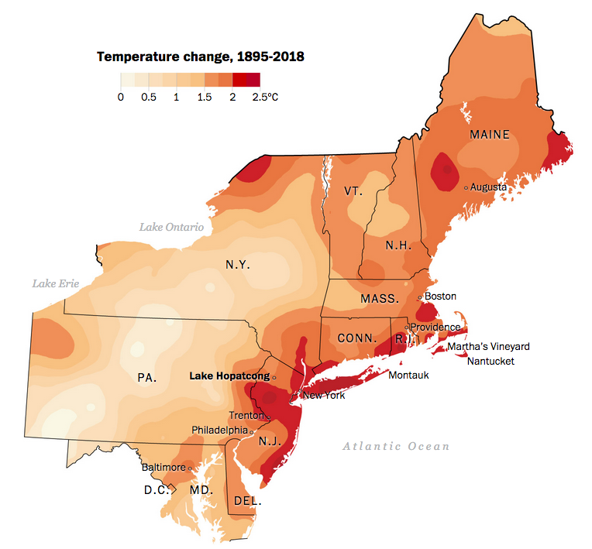
NE is a hotspot: many areas already over 2ºC rise
Why?
Losing winters that lower our average annual temperatures.
Loss of the albedo effect.
Warming waters along the coast.
https://www.washingtonpost.com/graphics/2019/national/climate-environment/climate
-change-america/?wpisrc=nl_most&wpmm=1

Slide 20
Predictions of future change in the US?
Change will continue through 2100…. And on.
Temperatures will continue to rise.
Growing seasons will lengthen.
Northern US: more winter and spring precipitation
Southwest US: less precipitation
Droughts in the Southwest
Heatwaves will increase across the country.
Hurricanes will become stronger and more intense.
Sea level will rise 1 - 4 feet by 2100.
Arctic Sea will become ice-free in summer by ~2050.
https://climate.nasa.gov/evidence/

Slide 21
Regional predictions
Northeast: heat waves
heavy downpours
sea-level rise
Northwest: reduced supplies of freshwater
sea-level rise
erosion and inundation
effects from increasing ocean acidity
increasing wildfire, insect damage to forests
ecosystems
agriculture
fisheries
water supplies
health
Infrastructure
economy
Southeast: sea-level rise
extreme heat
decreased availability of freshwater
Midwest: extreme heat
heavy downpours and flooding
many changes and risks to Great Lakes
Southwest: increased and extreme heat
drought
wildfires and insect outbreaks
https://climate.nasa.gov/evidence/

Slide 22
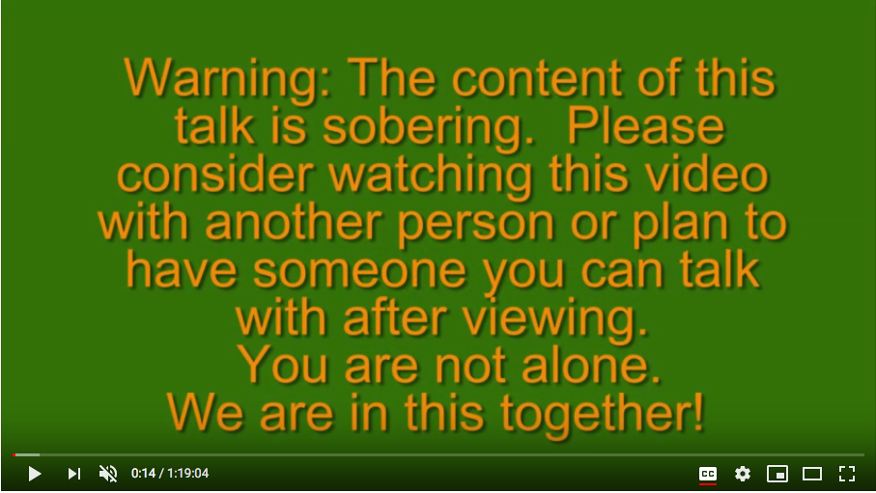
Predictions for Vermont
Roger Hill, longtime Vermont weather forecaster, recently gave a talk about the what Vermont can expect to see from climate change.
100 years storms may come every 10 years
Within 20 years, summers will be like those in Kentucky though we will still have some winter snows.
Weather chaos is the first phase of change, so heavy snowfalls – perhaps 6 – 10 feet on occasion, will still occur
Significant increases in flooding, particularly in river valleys
Roger Hill, Climate change comes to Vermont: https://www.youtube.com/watch?v=5A03kOcTLdA

Slide 23
Module 2. Global climate change
  2.3: What are the cause(s) of GCC?

Slide 24
The earth is a greenhouse
“Life on Earth depends on energy coming from the Sun.
About half the light reaching Earth's atmosphere passes through the air and clouds to the surface, where it is absorbed and then radiated upward in the form of infrared heat.
About 90 percent of this heat is then absorbed by the greenhouse gases and radiated back toward the surface, which is warmed to a life-supporting average of 59 degrees Fahrenheit (15 degrees Celsius).“
https://climate.nasa.gov/evidence/

Slide 25
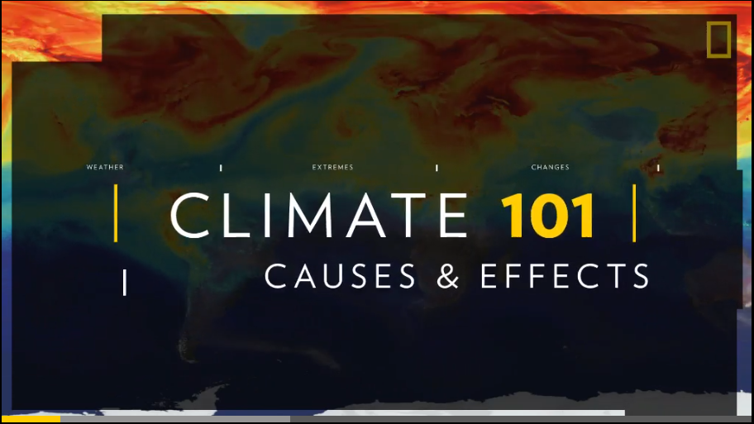
A quick overview
https://www.nationalgeographic.com/environment/global-warming/global-warming-effects/

Slide 26
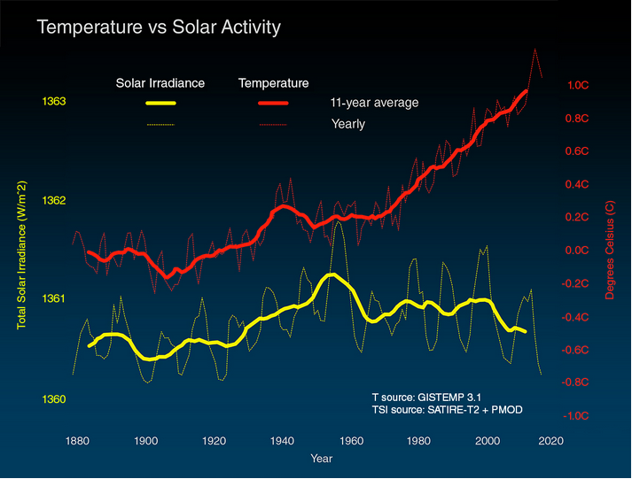
It’s not just the sun
https://climate.nasa.gov/evidence/

Slide 27
Is it natural?
Yes! GCC is a natural climatic response to increasing levels of CO₂ and other GHGs (greenhouse gases) in the atmosphere.
gas | formula | GWP* | ** % increase | increased forcing*** | contribution to GCC %
carbon dioxide | CO₂ | 1 | 41.2 | 1.88 | 9 - 26
methane | CH₄ | 84 | 151 - 170 | 0.49 | 4 - 9
nitrous oxide | N₂O | 264 | 20 | 0.17
ozone | O₃ |  | 42 | 0.4 | 3 - 7
water | H₂O |  |  |  | 36 – 72
industrial HCs | many | 5K – 17.5K |  | 0.36
GWP* = 20-year global warming potential
**% increase = atmospheric increase since 1750
Increased forcing*** = W/m2
https://climate.nasa.gov/evidence/
https://en.wikipedia.org/wiki/Greenhouse_gas

Slide 28
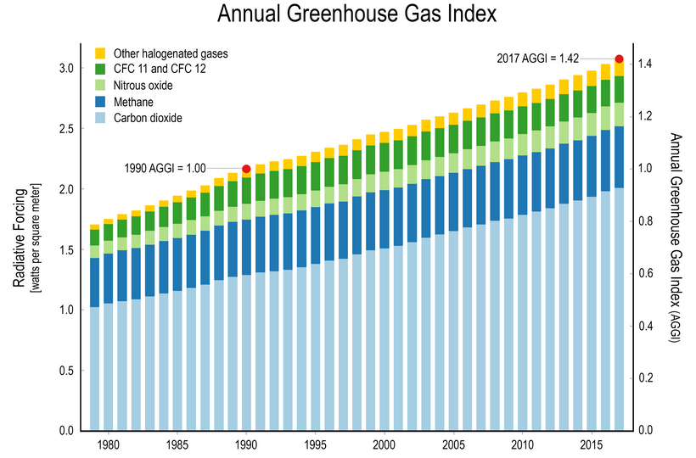
GHG concentration are rising…
… as is their ‘radiative forcing’ effect, aka warming effect.
https://www.globalchange.gov/browse/indicators/indicator-annual-greenhouse-gas-index

Slide 29
Consensus about the cause of GHG
“Multiple studies published in peer-reviewed scientific journals show that 97 percent or more of actively publishing climate scientists agree*: Climate-warming trends over the past century are extremely likely due to human activities. In addition, most of the leading scientific organizations worldwide have issued public statements endorsing this position. The following is a partial list of these organizations, along with links to their published statements and a selection of related resources.”
*Technically, a “consensus” is a general agreement of opinion, but the scientific method steers us away from this to an objective framework. In science, facts or observations are explained by a hypothesis (a statement of a possible explanation for some natural phenomenon), which can then be tested and retested until it is refuted (or disproved).
https://climate.nasa.gov/scientific-consensus/

Slide 30
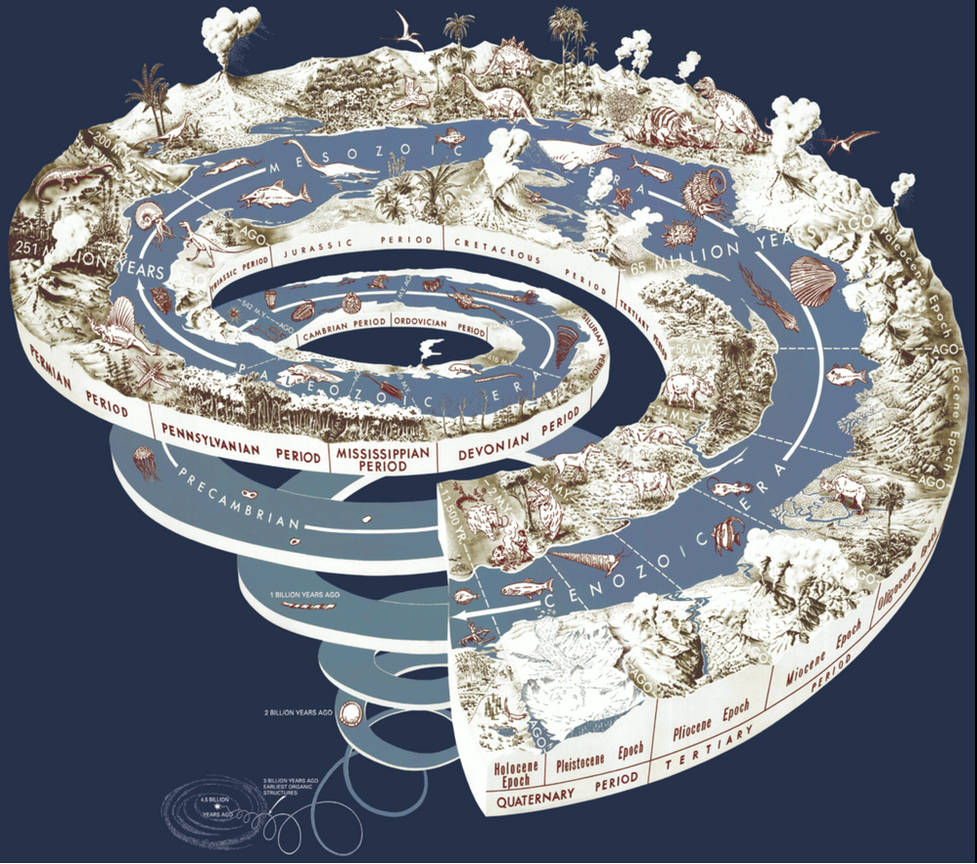
We’re living in the Anthropocene age
Human activity has increased the concentration of GHGs in the atmosphere since the start of the industrial revolutions.
Thus, GCC is anthropogenic.
Holocene: since the end of the last glacial era
Anthropocene: age of human-caused GCC
en.wikipedia.org/wiki/Geologic_time_scale#/media/File:Geological_time_spiral.png

Slide 31
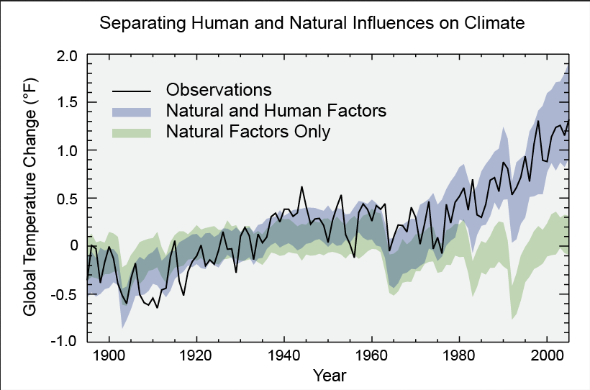
Modeling: natural vs. anthropogenic
https://archive.epa.gov/epa/climate-change-science/causes-climate-change.html

Slide 32
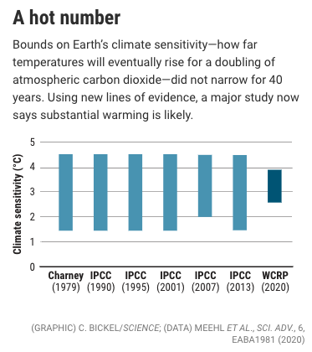
The latest forecast
In 2020, a study by the World Climate Research Programme (WCRP) used three types of evidence to narrow the bounds of climate sensitivity, the likely warming caused if we double atmospheric carbon levels to 560 ppm.
We’re already at 415 ppm and could reach 560 ppm by 2060.
Study draws on three lines of evidence:
Trends in contemporary warming;
Latest understanding of feedback effects; and
Lessons from ancient climates.
https://www.sciencemag.org/news/2020/07/after-40-years-researchers-finally-see-earths-climate-destiny-more-clearly

Slide 33
Module 2. Global climate change
  2.4: Paradigms, change, revolutions and transitions

Slide 34
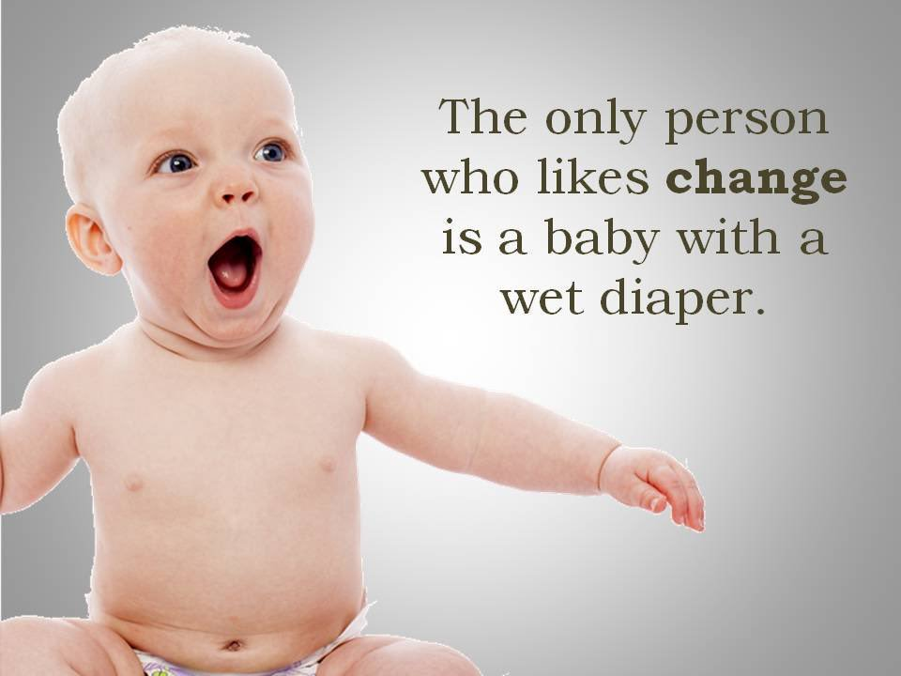
Change: needed, constant… not popular
Change is needed, but it’s neither easy nor popular.
Change is nothing new and it’s one of the few things we can count on.
Change is said to be constant, but to us
(human society) change often appears episodic.
Nothing big happens for a while… then boom! Big change.
Scientists use the term ‘punctuated’.
Historians and anthropologists use terms like ‘revolution’ or ‘transition’.

Slide 35
Technical revolutions in Western culture
Technical revolution: is a period in which one or more technologies is replaced by another technology in a short amount of time.
It is an era of accelerated technological progress characterized by new innovations whose rapid application and diffusion cause an abrupt change in society.
1600 - 1740 Financial-agricultural revolution
1780 – 1840 Industrial revolution
1870 – 1920 Technical or second industrial revolution
1940 – 1970 Scientific-technical revolution
1975 – present Information and telecommunications (digital) revolution
Next? Energy system transition, aka energy decarbonization
https://en.wikipedia.org/wiki/Technological_revolution

Slide 36
Resistance to technological change?
When we look back on the the agricultural revolution, or the first industrial revolution, it’s hard to believe that the technologies involved didn’t catch on right away.
Indeed, there is nearly always a lag period before good ideas are widely adopted.
We’ve known this for years.
“Although the inventor often times drunk with the opinion of his own merit, thinks all the world will invade and incroach upon him, yet I have observed that the generality of men will scarce be hired to make use of new practices, which themselves have not been thoroughly tried... for as when a new invention is first propounded, in the beginning every man objects, and the poor inventor runs the gantloop of all petulent wits...not one [inventor] of a hundred outlives this torture... and moreover, this commonly is so long a doing that the poor inventor is either dead or disabled by the debts contracted to pursue his design.”
- William Petty, 1679
Mokyr (1977) The Political Economy of Technological Change: Resistance and Innovation in Economic History

Slide 37
Entrenched interests and inertia
Why do societies resist technological change?
Incumbents fear a threat to their power and economic rents (perceived market advantage).
Concern about broader social and political repercussions ("unintended ripple effects")
Risk and loss aversion: new technologies often have "unanticipated and unknowable consequences"
"These three motives often merge and create powerful forces that use political power and persuasion to thwart innovations. As a result, technological progress does not follow a linear and neat trajectory. It is, as social constructionists have been trying to tell us for decades, a profoundly political process."
A critical factor in the ability of a society or nation to change, or to be held back by inertia, is the ‘suitability of institutions to the successful adoption of new ideas’.
How suited to change are today’s American institutions?
Mokyr (1977) The Political Economy of Technological Change: Resistance and Innovation in Economic History
https://en.wikipedia.org/wiki/Joel_Mokyr
http://eh.net/book_reviews/innovation-and-its-enemies-why-people-resist-new-technologies/

Slide 38
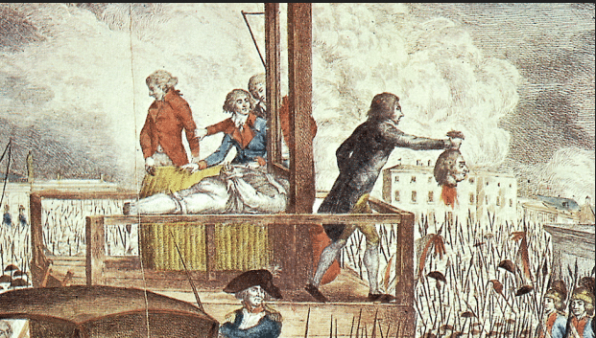

Revolutions are messy
https://en.wikipedia.org/wiki/Technological_revolution

Slide 39
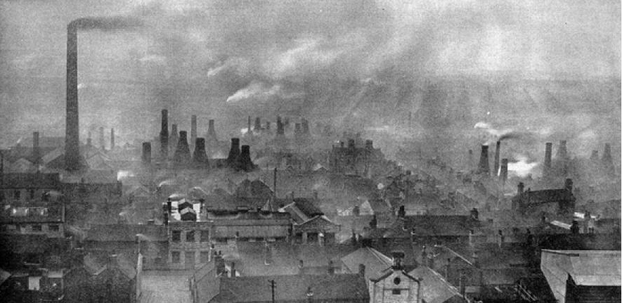
And technical revolutions are too
Consider the effects of the Industrial Revolution of the mid-1800s:
Pro:
Economic growth
Development of machines
Mechanization of agriculture
Faster communication and transportation
Slow (reactive) improvements in sanitation
Con:
Widened class divides (social and economic inequity)
Systemic child labor
Increased environmental pollution, particularly urban
Overcrowding of cities
Poor sanitary conditions that led to epidemics of infectious disease, particularly in poor areas of cities
https://en.wikipedia.org/wiki/Technological_revolution
https://www.cam.ac.uk/research/news/industrial-revolution-damaging-psychological-imprint-persists-in-todays-populations

Slide 40
Today, we need a carbon paradigm shift
Technical revolutions sometimes involve full-scale paradigm shifts.
Paradigm: a theory or group of ideas about how something should be done, made or thought about
Paradigm shift: important change that happens when the usual way of thinking about or doing something is discarded and replaced by a new and different way
Let’s look at a few examples of paradigm shift from history and how well they were received.
https://en.wikipedia.org/wiki/Technological_revolution
https://www.cam.ac.uk/research/news/industrial-revolution-damaging-psychological-imprint-persists-in-todays-populations

Slide 41
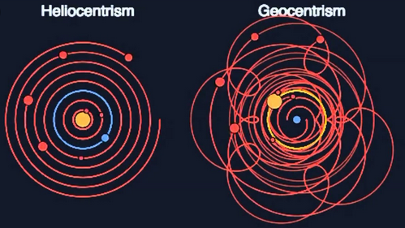
Copernican revolution
The sun, not the earth, the center of the solar system.
Resistance?
This idea was contrary to Church doctrine that held that the Earth, created by God, was the center of the universe.
Although Copernicus dedicated his book (1543) to the pope, the church later banned it (1616).
https://www.space.com/15684-nicolaus-copernicus.html

Slide 42
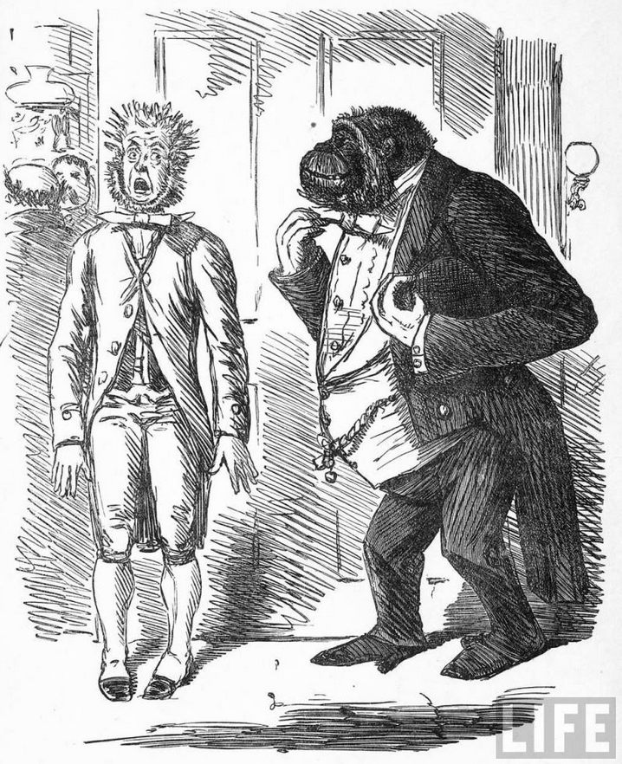
Darwin: evolution
Organisms evolve from gradual modification of ancestors; each organism wasn’t specifically created by God.
Resistance?
Again, resistance came from organized religion.
"Man's derived supremacy over the earth; man's power of articulate speech; man's gift of reason; man's free-will and responsibility [...] are all equally and utterly irreconcilable with the degrading notion of the brute origin of him who was created in the image of God."
- Bishop Samuel Wilberforce,
Opponent of Evolution
http://39769227.weebly.com/opposition.html

Slide 43
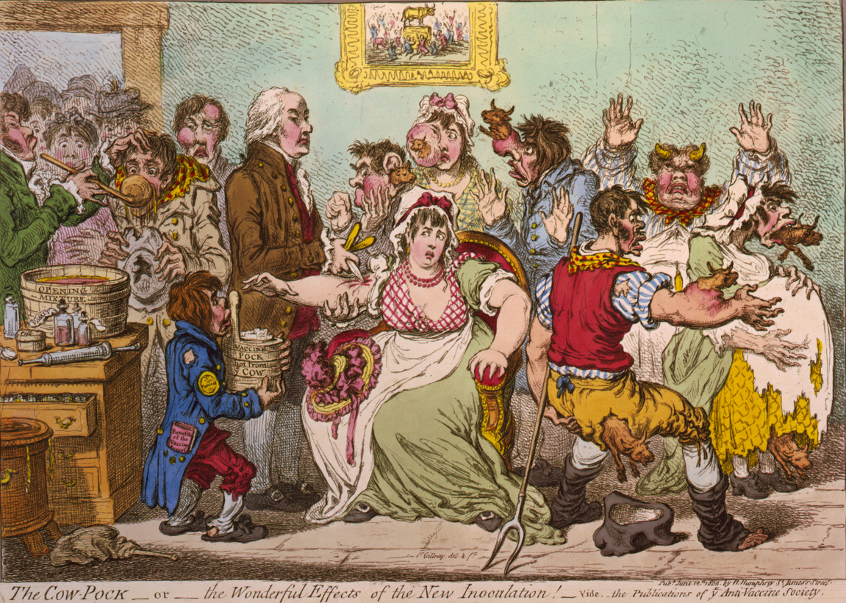
Jenner: vaccination
Inoculation with dead, weakened or related microbes would protect people from disease caused by that microbe.
Resistance?
Jenner adapted a process started by the Chinese and protected people from deadly smallpox by inoculation with the weaker and related cowpox.
https://en.wikipedia.org/wiki/Smallpox_vaccine

Slide 44
Our lack of response to GCC is typically human
What’s the scariest part about our response to GCC?
“For as long as I’ve followed global warming, advocates and activists have shared a certain faith: When the impacts get really bad, people will act.”
“From this perspective, the scary possibility is that the moment of reckoning will come too late.”
“But there is a scarier possibility, in many ways more plausible: We never really wake up at all.”
“No moment of reckoning arrives. The atmosphere becomes progressively more unstable, but it never does so fast enough, dramatically enough, to command the sustained attention of any particular generation of human beings. Instead, it is treated as rising background noise.”
- David Roberts in Vox, July 2020
https://www.vox.com/energy-and-environment/2020/7/7/21311027/covid-19-climate-change-global-warming-shifting-baselines

Slide 45
This is a phenomenon called ‘shifting baselines’
Take the example of a fishery in which a species, once very abundant, goes extinct over 100 years.
The first generation of fisherman see an abundant stock. And they do notice that the abundance drops during their fishing careers. Levels are lower when they retire.
The second generation of fisherman see that less abundant stock when they start fishing and assume it’s normal. They no nothing else. Stocks are a bit lower when they retire.
The third generation of fisherman start thinking this even lower level is normal. They keep fishing, and in fact fish harder. Fish stocks keep dropping.
The fourth generation of fisherman knows they will have to work hard and they do. They are driven to maintain the way of life their grandparents reminisce about. It’s their heritage and losing it is losing their identity. They fish so hard the stocks are unable to recover and the fish goes extinct.
Putting a frog in cold water and then turning on the heat.
https://www.vox.com/energy-and-environment/2020/7/7/21311027/covid-19-climate-change-global-warming-shifting-baselines

Slide 46
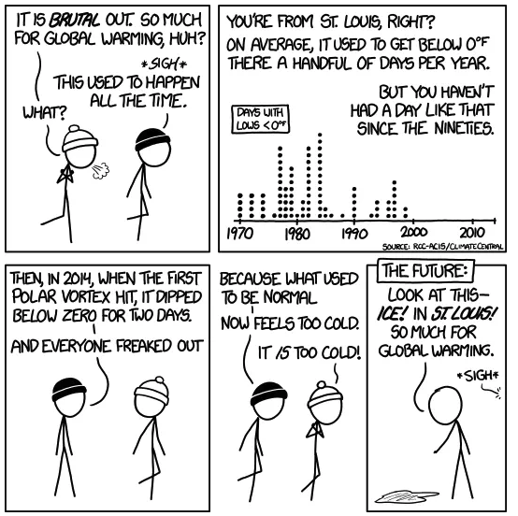
Hedonic adaptation …
Humans view the future through the lens of the recent past.
A recent study suggests that our reference point for ‘normal’ weather is based on only the last 2 – 8 years!
To fight this we’ve got to change our lens and use data and documentation to ‘see’ history and therefore perceive change and argue against it.
https://www.vox.com/energy-and-environment/2020/7/7/21311027/covid-19-climate-change-global-warming-shifting-baselines

Slide 47
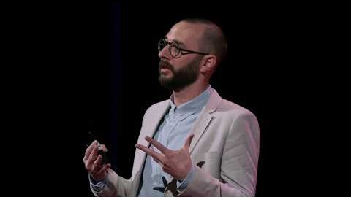
Visualizing generational change
https://www.youtube.com/watch?v=InWEC4oxBW0

Slide 48
So what do we do as the pot gets warmer?
The responses must be collective and positive.
Encode the public’s values and aspirations into law and practice through politics.
Make people feel that action and change are possible, or anxiety fatigue will set in.
In today’s America these are massive challenges!
https://www.vox.com/energy-and-environment/2020/7/7/21311027/covid-19-climate-change-global-warming-shifting-baselines

Slide 49
Module 2. Global climate change
  2.5: Decarbonization and the energy trilemma

Slide 50
Any solution must lower carbon emissions
Transitioning to low-carbon fuels – or using abundant fuels without emitting carbon - will address the concerns of growthists, peakists and environmentalists.
1. Manage human population levels (speeding the demographic shift).
2. Accept & adapt to lower growth in per capita gross domestic product.
3. Reduce the amount of energy required per unit of GDP.
4. Reduce the amount of carbon emitted per unit of energy produced.
Increase energy efficiency to maximize GDP per unit of energy
Transition to renewable energy and / or nuclear power.
Reduce CO₂ emission from fossil fuels.
Energy Systems & Sustainability, 2/e, Chapter 1

Slide 51
Kaya identity
… a simple formula used to explore the options we have for reducing carbon dioxide emissions from energy production and use.
primary energy consumption
gross domestic product
CO2 emissions from human sources
CO₂ emissions =
population
GDP . population
energy. GDP
CO₂ emissions. primary energy
per capita GDP
energy intensity
energy’s carbon intensity
Energy Systems & Sustainability, 2/e, Chapter 1

Slide 52
Embodied energy and lifecycle emissions
While no energy source is carbon-free, renewable energy included, a recent study of life-cycle analysis of energy technologies used to produce electricity shows that some have significantly lower carbon footprints than others.
Embodied energy: energy need to build plants, supply fuel and input.
Here expressed as a % of lifetime electricity production.
*
Lifecycle emissions: carbon emissions produced by the energy system from building to energy use
Direct (operational)
Indirect (non-operational lifecyle
https://www.carbonbrief.org/solar-wind-nuclear-amazingly-low-carbon-footprints
Pehl et al. (2017) Understanding future emissions from low-carbon power systems …Nature Energy

Slide 53
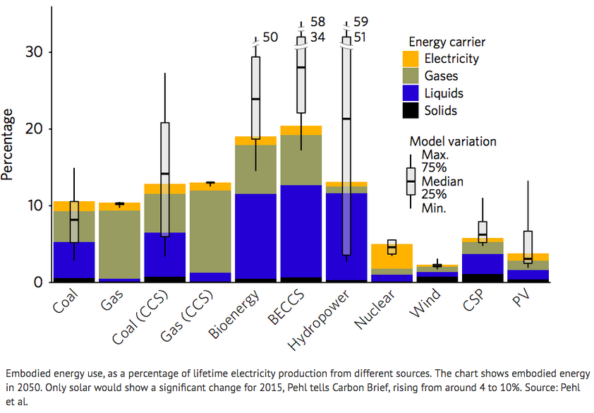
Comparing embodied energy
*

Slide 54
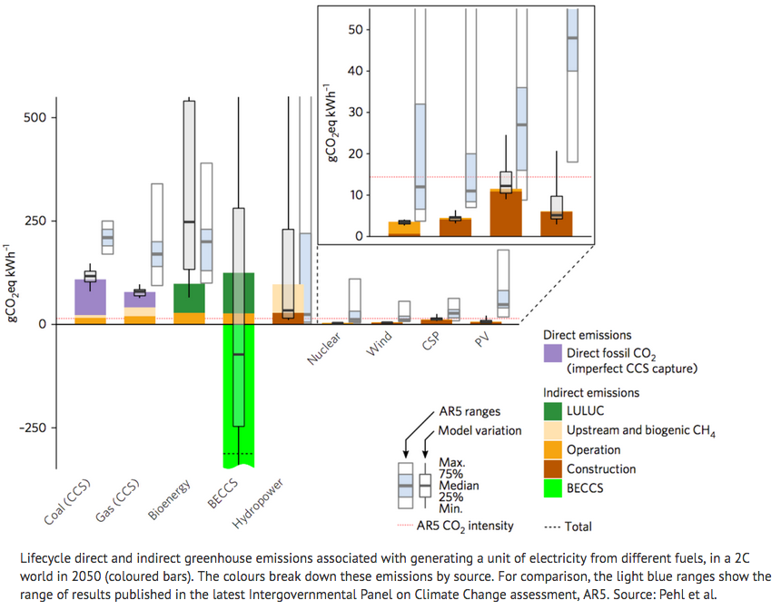
Comparing lifetime carbon emissions
*

Slide 55
Conclusions
This study makes a strong case for nuclear, wind and solar at the expense of bioenergy, hydropower and CCS.
CCS:
  Emissions continue during fuel extraction (mining).
  Capture assumed to be 90% efficient, so 10% emissions continue.
Hydropower:
  Very variable emissions due to trapped, rotting organics.
  Avoid shallow dams in warm regions with variable flow.
*
Bioenergy:
  Very variable footprint; depends on current state of land.
  Avoid transitioning land out of forest.
“There is no panacea to the energy transition. Coal and gas with CCS will perhaps play a role in certain regions that don’t have ready access wind and solar. But their share in the overall power mix will be much smaller than that of the renewables.”
https://www.carbonbrief.org/solar-wind-nuclear-amazingly-low-carbon-footprints
Pehl et al. (2017) Understanding future emissions from low-carbon power systems …Nature Energy

Slide 56
Change: who’s in and who’s out?
The Paris Agreement is an agreement within the United Nations Framework Convention on Climate Change (UNFCCC), dealing with GHG-emissions mitigation, adaptation, and finance, signed in 2016.
Long-term goal:
to keep the increase in global average temperature to well below 2 °C above pre-industrial levels; and
to limit the increase to 1.5 °C, since this would substantially reduce the risks and effects of climate change
*
While it is widely agreed that an climate agreements are vital, the effectiveness of the Paris Agreement is debated.
Intent matters;
Compromise and a roadmap are essential.
Following the Trump administration’s declaration of intention to withdraw (effective 2020), only the US has not agreed to or signed onto the accord.
https://en.wikipedia.org/wiki/Paris_Agreement
https://www.nytimes.com/2017/11/07/climate/syria-joins-paris-agreement.html

Slide 57
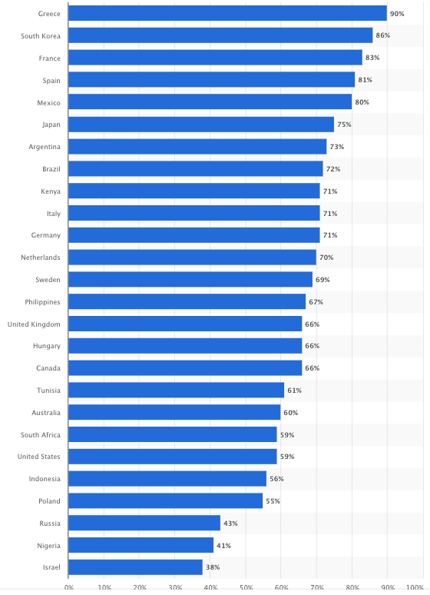
Global concerns about GCC?
Share of respondents who considers GCC as a major threat to their countries as of 2018.
*
US = 59%
https://www.statista.com/statistics/992779/share-population-naming-climate-change-major-threat-by-country/

Slide 58
What do American’s think?
Studies by the Yale Program on Climate Communications and the Pew Center for Research show that:
Americans overwhelmingly believe that global warming is happening;
That carbon emissions should be scaled back; but
Fewer believe that GCC will affect them personally.
'Beliefs’ about GCC are divided along partisan lines. [See coming maps]
Economics of GCC?
  Failure to address GCC will have greater costs: D 63%; R 35%
  More concerned GCC regulations will increase costs : R 48%, D 25%.
*
Young Republicans are far more concerned about GCC:
“It is time for us to get real messaging on environmental and climate issues. And I don't think that we have to sacrifice our values and our roots in, you know, markets and private-sector innovations helping us get across the finish line. And also, like, we are the future of the GOP, and it matters to this growing voting bloc.
And it's not going to go away by denial.”
https://www.nytimes.com/interactive/2017/03/21/climate/how-americans-think-about-climate-change-in-six-maps.html?_r=0
http://climatecommunication.yale.edu/visualizations-data/partisan-maps-2016/?est=happening&group=rep&type=value&geo=cd
https://www.forbes.com/sites/bowmanmarsico/2019/04/19/democrats-and-republicans-divided-on-climate-change/#78119c233198
https://www.npr.org/2019/04/28/717970463/young-republicans-and-climate-change

Slide 59
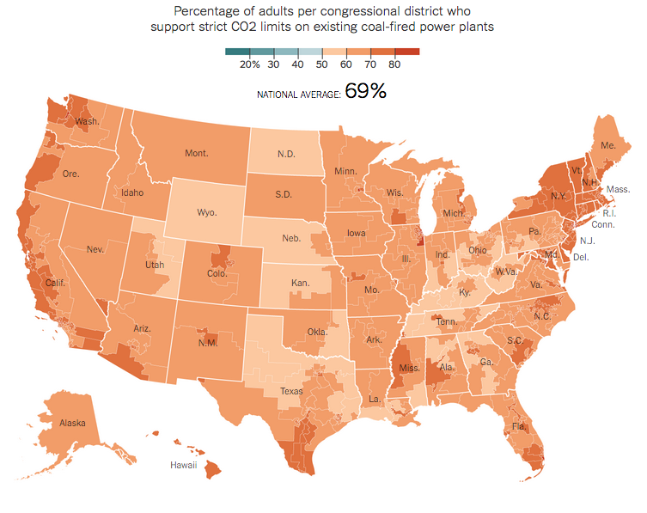
(1) Americans want to restrict carbon
https://www.nytimes.com/interactive/2017/03/21/climate/how-americans-think-about-climate-change-in-six-maps.html?_r=0

Slide 60
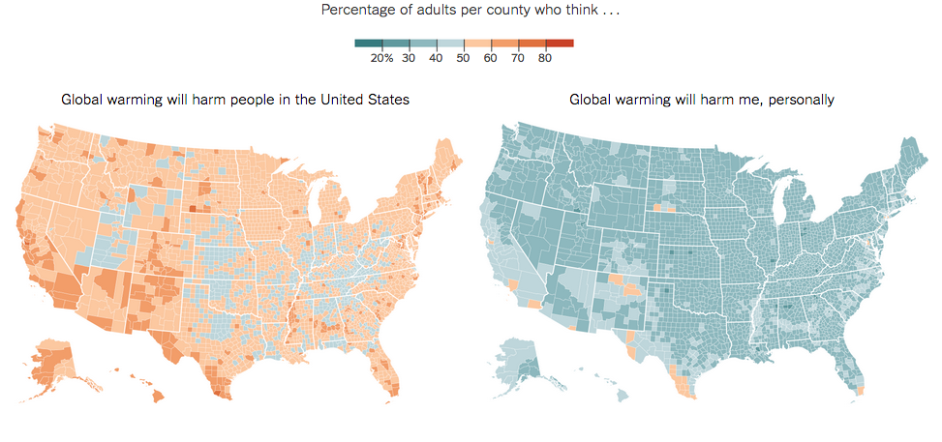
(2) GCC: a problem… but not for me!
*
https://www.nytimes.com/interactive/2017/03/21/climate/how-americans-think-about-climate-change-in-six-maps.html?_r=0

Slide 61
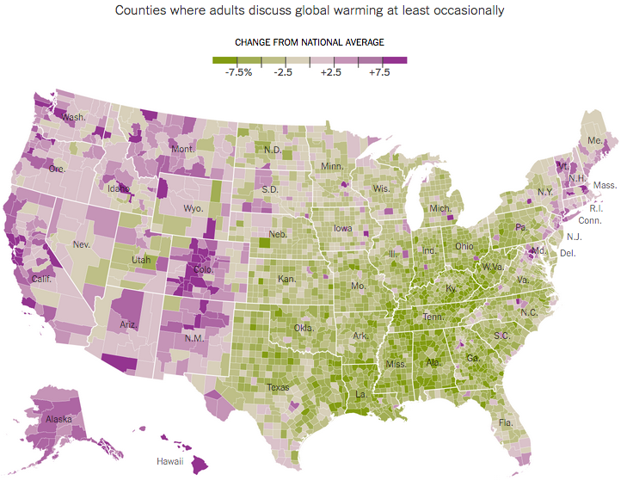
(3) Do we talk about climate and weather?
https://www.nytimes.com/interactive/2017/03/21/climate/how-americans-think-about-climate-change-in-six-maps.html?_r=0

Slide 62
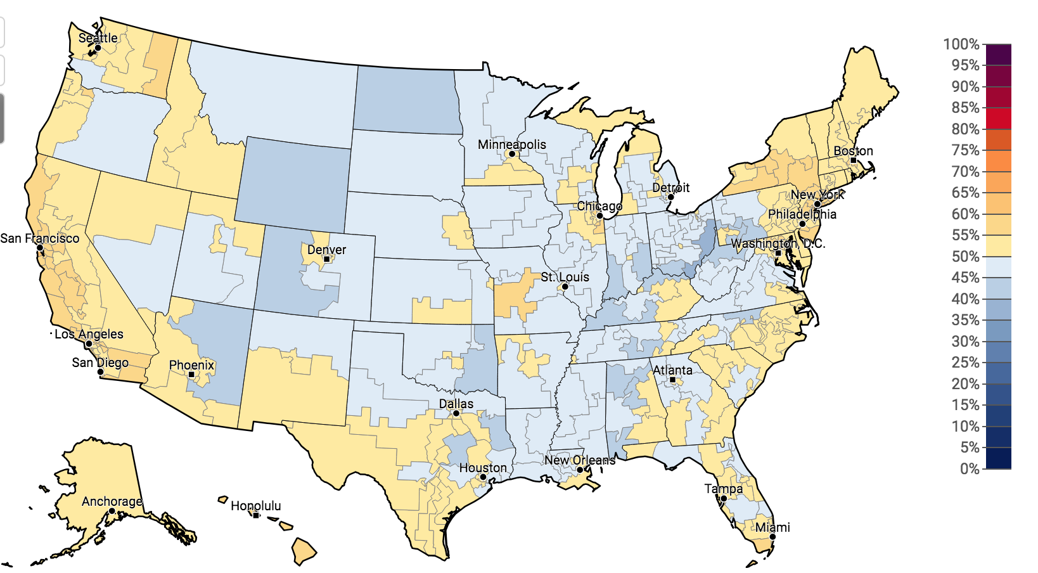
Partisan divide on GCC
Republicans who think GCC is happening, 2016
http://climatecommunication.yale.edu/visualizations-data/partisan-maps-2016/?est=happening&group=rep&type=value&geo=cd

Slide 63
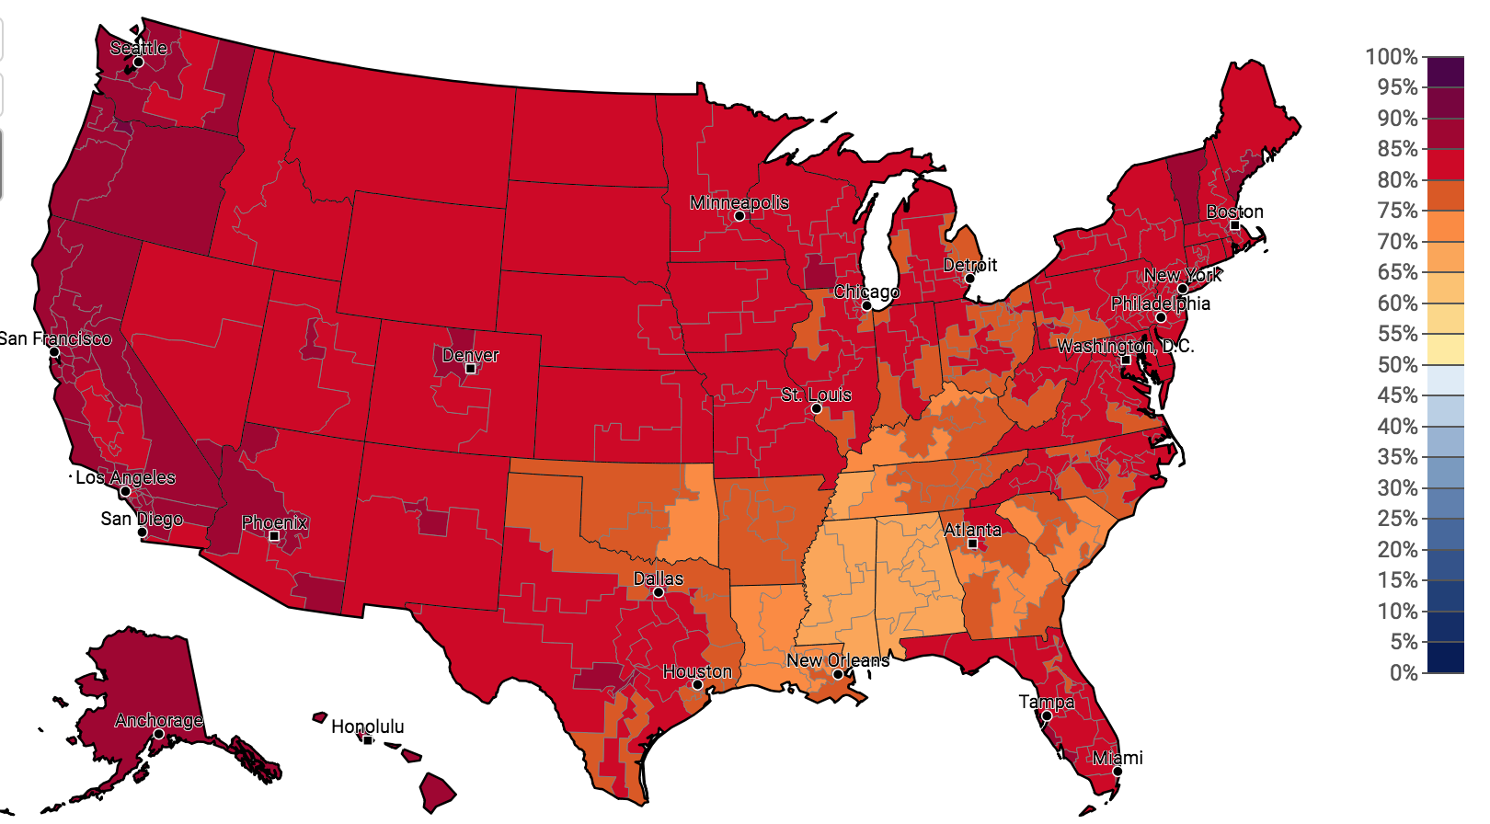
Partisan divide on GCC
Democrats who think GCC is happening, 2016
http://climatecommunication.yale.edu/visualizations-data/partisan-maps-2016/?est=happening&group=rep&type=value&geo=cd

Slide 64
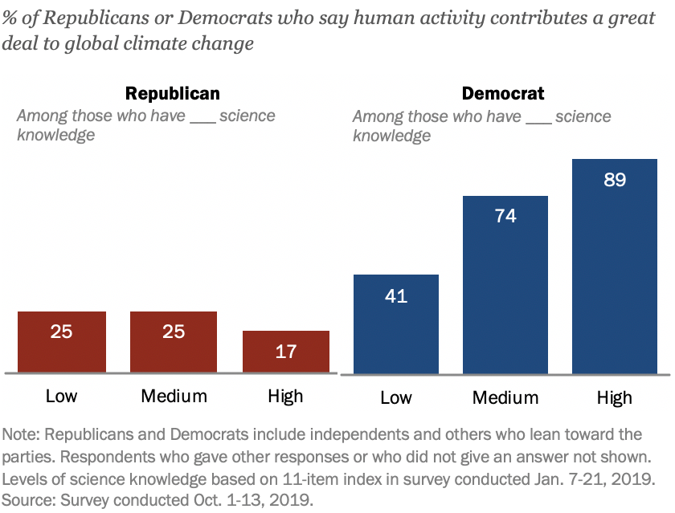
Partisanship trumps science
Most Democrats with high science knowledge say that human activity contributes a great deal to climate change, but there is no parallel among the GOP.
*
https://www.pewresearch.org/fact-tank/2020/04/21/how-americans-see-climate-change-and-the-environment-in-7-charts/

Slide 65
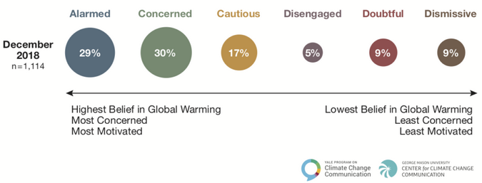
Global warming’s ‘six Americans’
Research by the Yale Program on Climate Communications identifies six ’audiences’ or attitudes toward GCC in America.
*
https://climatecommunication.yale.edu/about/projects/global-warmings-six-americas/

Slide 66
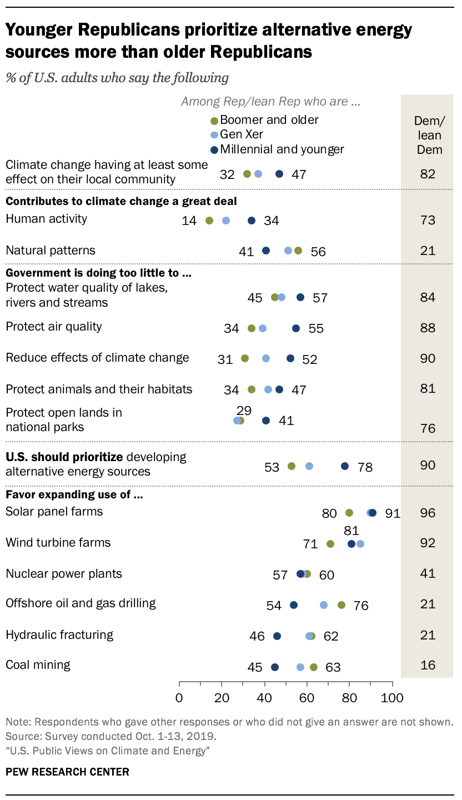
Generational change?
Millennial and younger Republicans (born 1981 or later) are more likely to think that the government needs to do more about GCC.
*
https://www.pewresearch.org/fact-tank/2020/04/21/how-americans-see-climate-change-and-the-environment-in-7-charts/

Slide 67
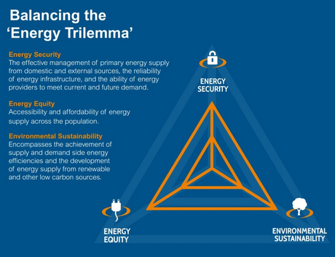
The energy trilemma
Dilemma: tough choice between two difficult options
Trilemma: tough choice between three unfavorable options
’Impossible trinity’ where two goals are pursued at the expense of the third
*
https://www.carbonbrief.org/climate-rhetoric-whats-an-energy-trilemma
https://www.worldenergy.org/work-programme/strategic-insight/assessment-of-energy-climate-change-policy/

Slide 68
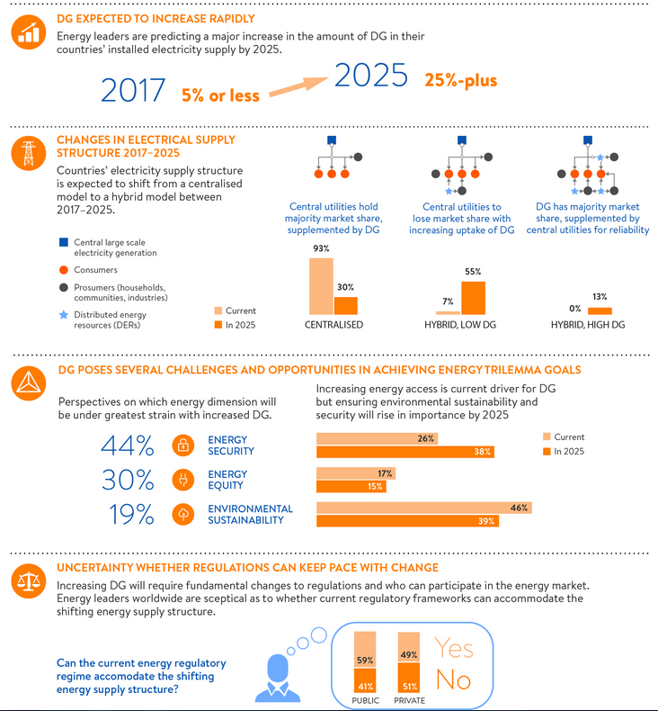
Example: DG trilemma
*
https://trilemma.worldenergy.org/

Slide 69
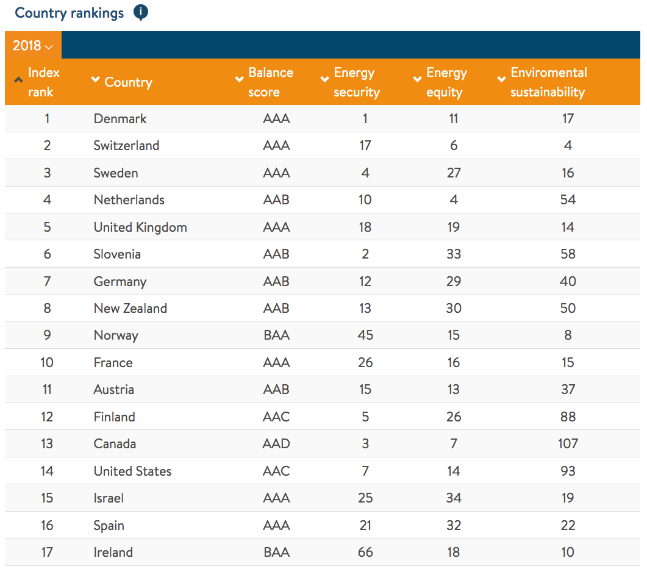
Energy trilemma index
AAA
security
equity
environment
*
https://trilemma.worldenergy.org/

Slide 70
Where do the true challenges lie?
In a 2008 book about what is preventing the US from transitioning to clean power, Sovacool argues that we face “The big four energy challenges”:
Rising fossil fuel costs
Increasing pollution / carbon emissions
Inefficient transmission networks
Increasing systems vulnerability to natural disasters, sabotage, financial manipulation
He also identifies “The big four clean solutions”:
RE
EE
DC
CHP
*
Sovacool’s overall conclusion: the biggest barriers are institutional, not technological.
Sovacool (2008) The dirty energy dilemma: what’s blocking clean power in the United States

Slide 71
Adapt or….. adapt
“Most writing about technology and climate change still concentrates on mitigation – ie. Reducing emission by means of clean energy sources, electric vehicles and so on … While we should never give up on mitigation, it’s time to start talking more about adaptation and suffering – about the technologies the human race will need in a catastrophically altered world, and about the economic, political and social realities of living in it.”
If we stopped emitting GHGs today, we’d still have 30 years of climate disruption to deal with.
Change is inevitable, and so must be our adaptation.
*
Adaptive capacity: the ability of a system (human, natural or managed) to adjust to climate change (including climate variability and extremes) to moderate potential damages, to take advantage of opportunities, or to cope with consequences.
  As a property, adaptive capacity is distinct from adaptation itself.
https://www.technologyreview.com/s/613350/welcome-to-climate-change/

Slide 72
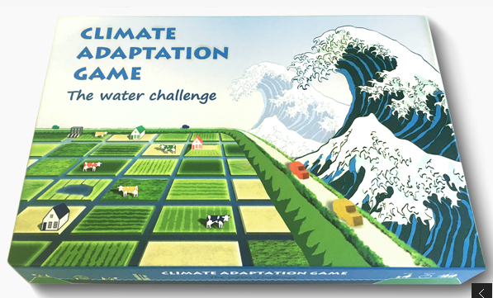
Everybody play the game
*
http://d.efac.to/en/urbanism/climate-adaptation-game

Slide 73
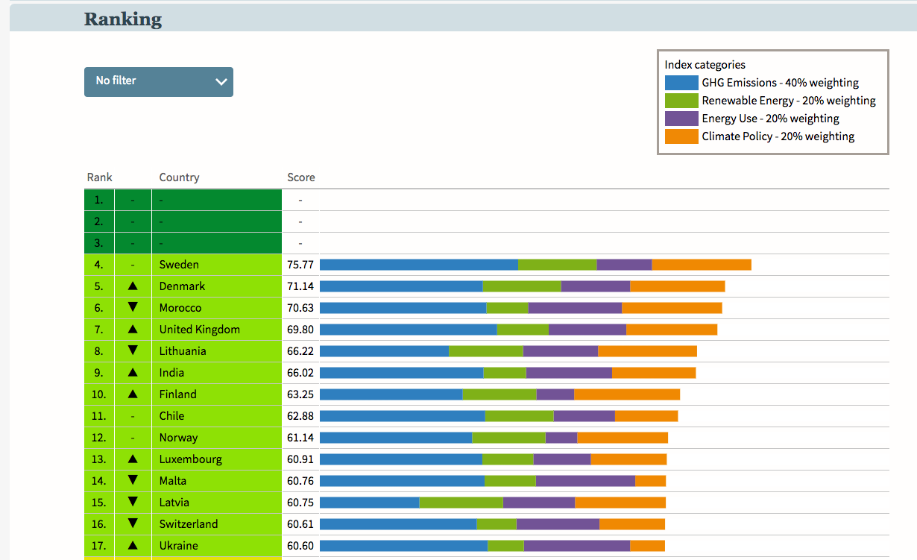

Who’s winning?
*
https://www.climate-change-performance-index.org/

Slide 74
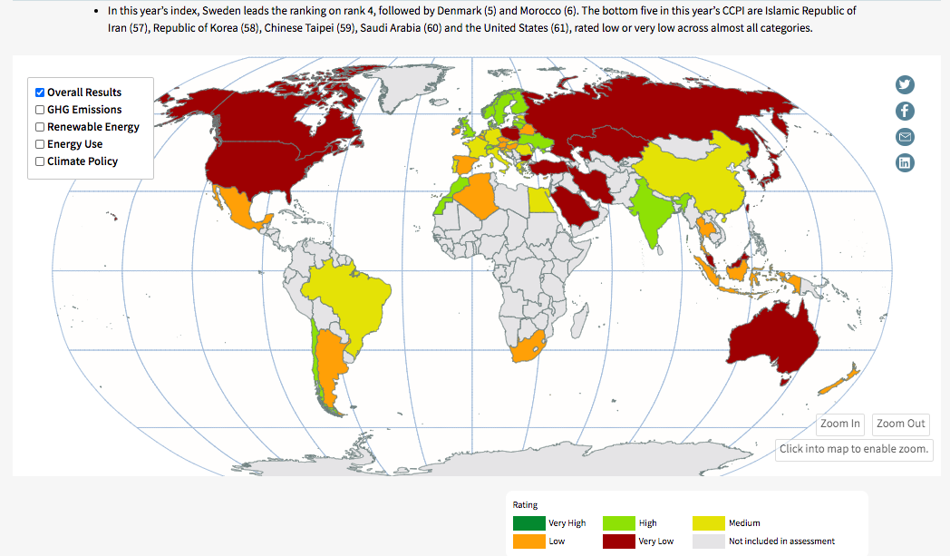
Who’s winning?
*
https://www.climate-change-performance-index.org/

Slide 75
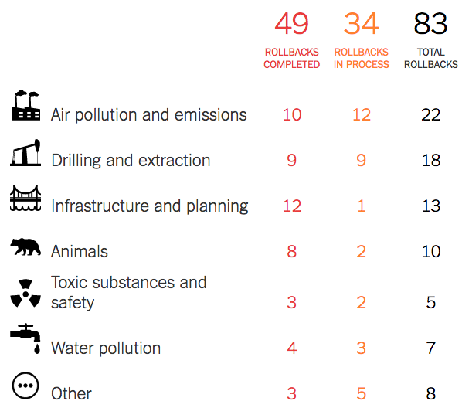
US institutions: GCC is just a game
Since 2017, the current US administration has acted to weaken, rollback or overturn regulations in a number of environmental areas.
Many will slow or reverse action that might mitigate GCC or encourage transition of our energy system.
Withdrew from Paris Accord
Repealed Clean Power Plan
Limiting methane emissions
Reporting of methane emissions
Weaker pollution permitting for power plants
New coal-fired plants won’t have to capture carbon
Weakened calculation of social cost of carbon
Removed GHG emissions from environmental reviews
Rolled back auto fuel efficiency
Opened more public lands to fossil fuel extraction
  Arctic National Wildlife Ref.
  US coastal waters
*
https://www.nytimes.com/interactive/2019/climate/trump-environment-rollbacks.html

Slide 76
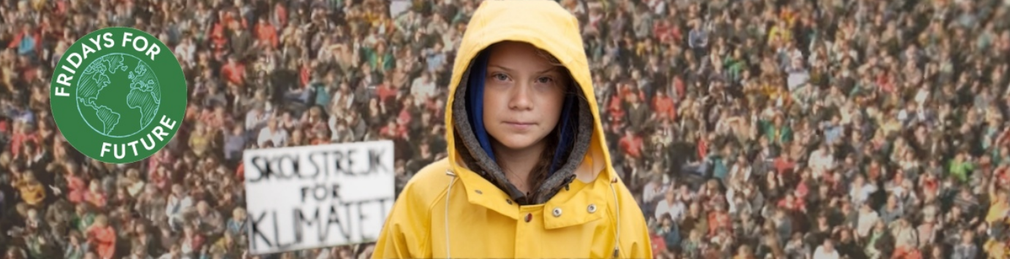
Generational change?
Younger generations are more motivated to insist on changes that can mitigate climate change, like changing our energy systems.
*
On 15 March 2019, roughly 1.4 m students in 123 countries skipped school to demand changes to address GCC.
Fridays for the future are expected to continue.
https://www.vox.com/energy-and-environment/2019/3/15/18267156/youth-climate-strike-march-15-photos
https://www.fridaysforfuture.org/
On 15 March 2019, roughly 1.4 m students in 123 countries skipped school to demand changes to address GCC.

Slide 77
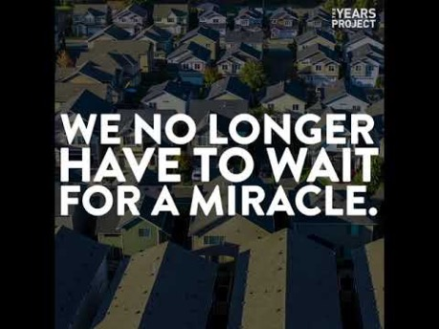
Rewiring America?
This organization believes that rapid decarbonization and shift to an electric energy currency could create 15 – 20 million jobs over the decade with 5 million permanent jobs.
*
70 – 80% decarbonization by switch to electricity by 2035.
And limit change to 1.5C.
https://www.rewiringamerica.org/https://www.fridaysforfuture.org/

Slide 79
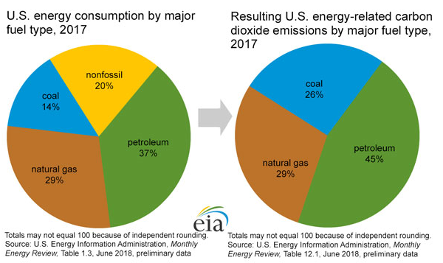
Current energy sources and emissions
*
https://www.eia.gov/energyexplained/index.php?page=environment_where_ghg_come_from

Slide 80
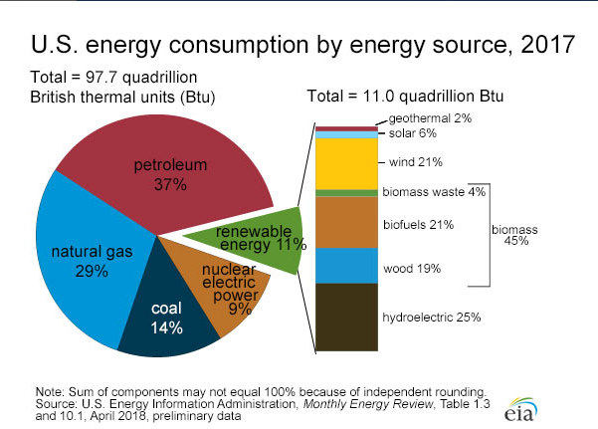
Low-carbon ~ 20% of energy
And about half of renewable energy is biomass.
*
https://www.eia.gov/energyexplained/?page=us_energy_home

Slide 81

Use: transportation is critical
*
https://www.eia.gov/energyexplained/index.php?page=environment_where_ghg_come_from

Slide 82
To date: tiny change – electricity sources
*
https://en.wikipedia.org/wiki/Energy_in_the_United_States

Slide 83
To date: tiny change – electricity sources
*
https://en.wikipedia.org/wiki/Energy_in_the_United_States

