Slide 1
SSC 2030: Energy Systems & Sustainability
3. Primary energy forms and uses
3.1: Primary energy consumption (conservation!)
3.2: Units of energy and energy data
3.3: Energy density (aka heat content)
3.4: Global and regional sources of energy
3.5: UK energy use today
3.6: Primary energy: UK vs. Denmark vs. US
3.7: Primary energy: France vs. India vs. China
3.8: Trends in US energy use
3.9: Vermont energy statistics

Slide 2
3. Primary energy forms and uses
3.1: Energy ‘consumption’
Remember that energy is conserved.
Humans transfer & transform energy.
Transformation from primary energy to used energy is inefficient
Human energy use has increased through time

Slide 3
Energy ‘consumption’
We say that, “The US consumes more energy per capita than any other nation on earth.”
But, that’s incorrect.
The 1st law of thermodynamics:
Energy is neither created nor destroyed, but transformed or transferred.
So, the US transforms or converts more energy…
How? For example:
Combustion: fuel → heat energy electricity
chemical energy
Hydroelectric: potential energy → kinetic energy → electricity
Wind power: kinetic energy → electricity
Energy Systems & Sustainability, 2/e, Chapter 2

Slide 4
Let’s start with the fuels
We say that, “The US consumes more energy per capita than any other nation on earth.”
But, that’s incorrect.
The 1st law of thermodynamics:
Energy is neither created nor destroyed, but transformed or transferred.
So, the US transforms or converts more energy…
Primary energy
How? For example:
Combustion: fuel → heat energy electricity
chemical energy
Hydroelectric: potential energy → kinetic energy → electricity
Wind power: kinetic energy → electricity
Energy Systems & Sustainability, 2/e, Chapter 2

Slide 5
Primary energy
Primary energy:
Total energy content of the energy source.
Naturally occurring energy stores or energy carriers.
Primary energy is the fuel that we convert to make the electricity, heat or work that we use.
“Energy in the form that it is first accounted for in a statistical energy balance, before any transformation to secondary or tertiary forms of energy.
For example, coal can be converted to synthetic gas, which can be converted to electricity; in this example, coal is primary energy, synthetic gas is secondary energy, and electricity is tertiary energy.”
Energy Systems & Sustainability, 2/e, Chapter 2 / EIA

Slide 6
Conversion of primary to useful energy
Transformation of energy, from one form to another, and transfer of energy from generator to user, both result in losses.
Overall, this process is inefficient, particularly for electricity.
60-70%
waste heat
7% loss
transmission
10% used
90% wasted
2.5% used
in mining
32 MJ CFL light
948 MJ waste heat
1 GJ
primary
secondary
tertiary
delivered
used
wasted
Energy Systems & Sustainability, 2/e, Chapter 3

Slide 7
Energy flow maps sources to uses
waste heat
EIA, 2011
https://flowcharts.llnl.gov/content/energy/energy_archive/energy_flow_2013/2013USEnergy.png

Slide 8
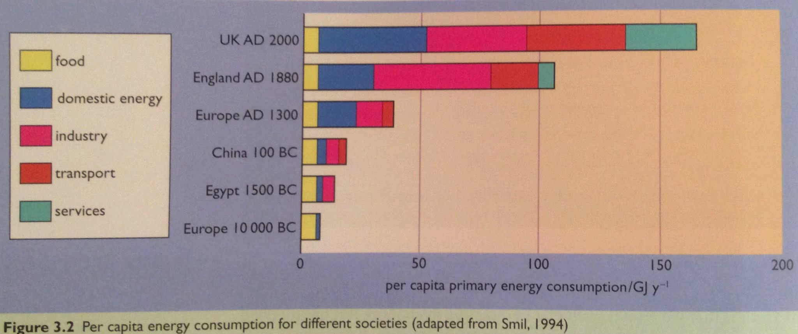
Energy use has increased over time
Why?
New technologies: fire → steam → electricity → etc.
New uses: ‘services’ include our computers & nifty new devices
Rapidly growing human population
Energy Systems & Sustainability, 2/e, Chapter 3

