Slide 1
SSC 2030: Energy Systems & Sustainability
3. Primary energy forms and uses
3.1: Primary energy consumption (conservation!)
3.2: Units of energy and energy data
3.3: Energy density (aka heat content)
3.4: Global and regional sources of energy
3.5: UK energy use today
3.6: Primary energy: UK vs. Denmark vs. US
3.7: Primary energy: France vs. India vs. China
3.8: Trends in US energy use
3.9: Vermont energy statistics

Slide 2
3. Primary energy forms and uses
3.3: Energy density (aka heat content)

Slide 3
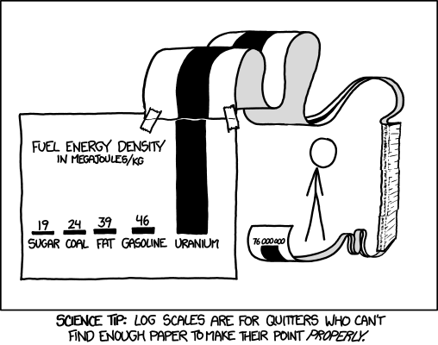
Relative energy densities
Energy Systems & Sustainability, 2/e, Chapter 4; http://xkcd.com/1162

Slide 4
Chemical energy density
Storing energy is ‘expensive’ in terms of quantities of chemical or potential energy needed.
pounds to store 10 gas gallon equivalents
22
52
68
105
191
6,578
11,440
762,667
fuel (=chemical energy) | MJ/kg
hydrogen gas | 130
natural gas | 55
gasoline | 45
oil | 42
coal | 28
ethanol | 27
wood | 15
lead-acid batteries
water at 80c
pumped storage (h = 370 m)
Energy Systems & Sustainability, 2/e, Chapter 4

Slide 5
HHV vs. LHV heat values?
There are two ‘flavors’ of heat values (or energy densities) for combusted fuels.
HHV (high heat values) used when the steam is condensed after use; condensing steam to water releases additional energy.
Aka HCV or GCV
LHV (low heat values) used when the steam is not condensed after use.
Aka LCV or NCV
Fuel | HHV (MJ/kg) | LHV (MJ/kg)
hydrogen | 141.80 | 119.96
methane | 55.50 | 50.00
propane | 50.35 | 46.35
diesel | 44.80 | 43.40
wood | 21.20 | 17.0
Energy Systems & Sustainability, 2/e, Chapter 4; wikipedia

Slide 6
Comparing heat contents (energy density)
 | Btu/gallon (gross) | Btu/gallon (net)
Auto gasoline | 125,000 | 115,400
hydrogen | 134,200 | 113,400
Diesel fuel | 138,700 | 128,700
biodiesel | 126,206 | 117,093
methanol | 64,600 | 56,560
ethanol | 84,600 | 75,670
gasohol | 120,900 | 112,417
Aviation gas | 120,200 | 112,000
propane | 91,300 | 83,500
butane | 103,000 | 93,000
Jet fuel (naptha) | 127,500 | 118,700
Jet fuel (kerosene) | 135,000 | 128,100
Crude petroleum | 138,100 | 131,800
Residual fuel oil | 149,700 | 138,400
Distillate fuel oil | 138,700 | 131,800
Gaseous & solid fuels | Btu/_____
Natural gas, wet | 1,109 Btu/ft3
Natural gas, dry | 1,027 Btu/ft3
Natural gas, compressed | 20,551 Btu/lb
Liquid natural gas | 90,800 Btu/gallon
Anthracite coal | 21.7 E6 Btu/short ton
Lignite/bit coal | 21.0 E6 Btu/short ton
Net = water’s heat of vaporization is subtracted from gross energy content
Energy Systems & Sustainability, 2/e, Chapter 2 / wikipedia

