Slide 1
SSC 2030: Energy Systems & Sustainability
3. Primary energy forms and uses
3.1: Primary energy consumption (conservation!)
3.2: Units of energy and energy data
3.3: Energy density (aka heat content)
3.4: Global and regional sources of energy
3.5: UK energy use today
3.6: Primary energy: UK vs. Denmark vs. US
3.7: Primary energy: France vs. India vs. China
3.8: Trends in US energy use
3.9: Vermont energy statistics

Slide 2
3. Primary energy forms and uses
3.4: Global and regional sources of energy
Current global use and projections
Energy inequity
Use of renewable energy?

Slide 3
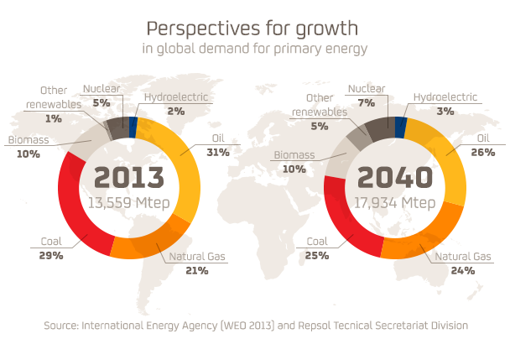
Predicted growth
1 quad
= 1 E15 Btu
= 1.06 E18 J
= 25.2 Mtep
Energy Systems & Sustainability, 2/e, Chapter 2 / repsol.com

Slide 4
The 14%
A small part of the world’s population uses most of its energy resources.
 | Population (global %) | Energy produced (%) | Energy consumed (%) | Primary energy consumption per capita** | GDP per capita**
Wealthiest* | 14% | 31% | 41% | 3.1 | 3.4
Others | 86% | 69% | 59% | 0.7 | 0.5
* USA, Canada, Western Europe, Australia, New Zealand, Japan
** As a multiple of the global average
Energy Systems & Sustainability, 2/e, Chapter 2 / Table 2.3

Slide 5
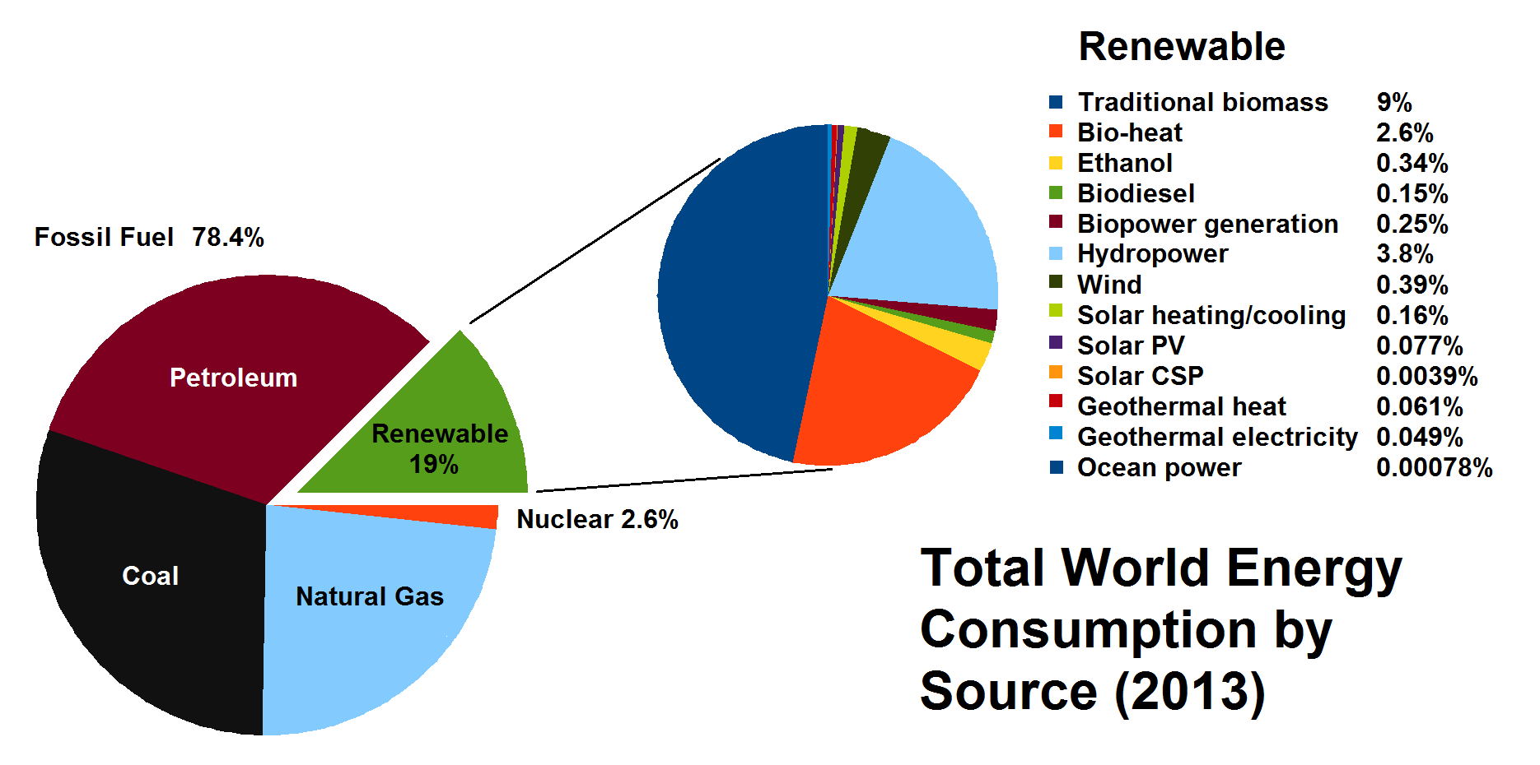
Global use of renewable energy resources
Breaking out renewable energy.
Energy Systems & Sustainability, 2/e, Chapter 2 / wikiwand.com

