Slide 1
3. Primary energy forms and uses
3.5: UK energy use today

Slide 2
UK energy use today
UK total primary energy consumption in 2009: 9000 PJ (9000 E15 J)
UK population was 62 million in 2009
So, per capita energy use: 145 GJ per person
We’re about to dive into some data that demonstrates:
8840 PJ of energy is provided
6021 PJ of energy is delivered
There’s a discrepancy of 2819 PJ
5% (141 PJ) is used for shipping
95% is lost in conversion & delivery
Electricity generation is only 35% efficient
Energy Systems & Sustainability, 2/e, Chapter 3

Slide 3
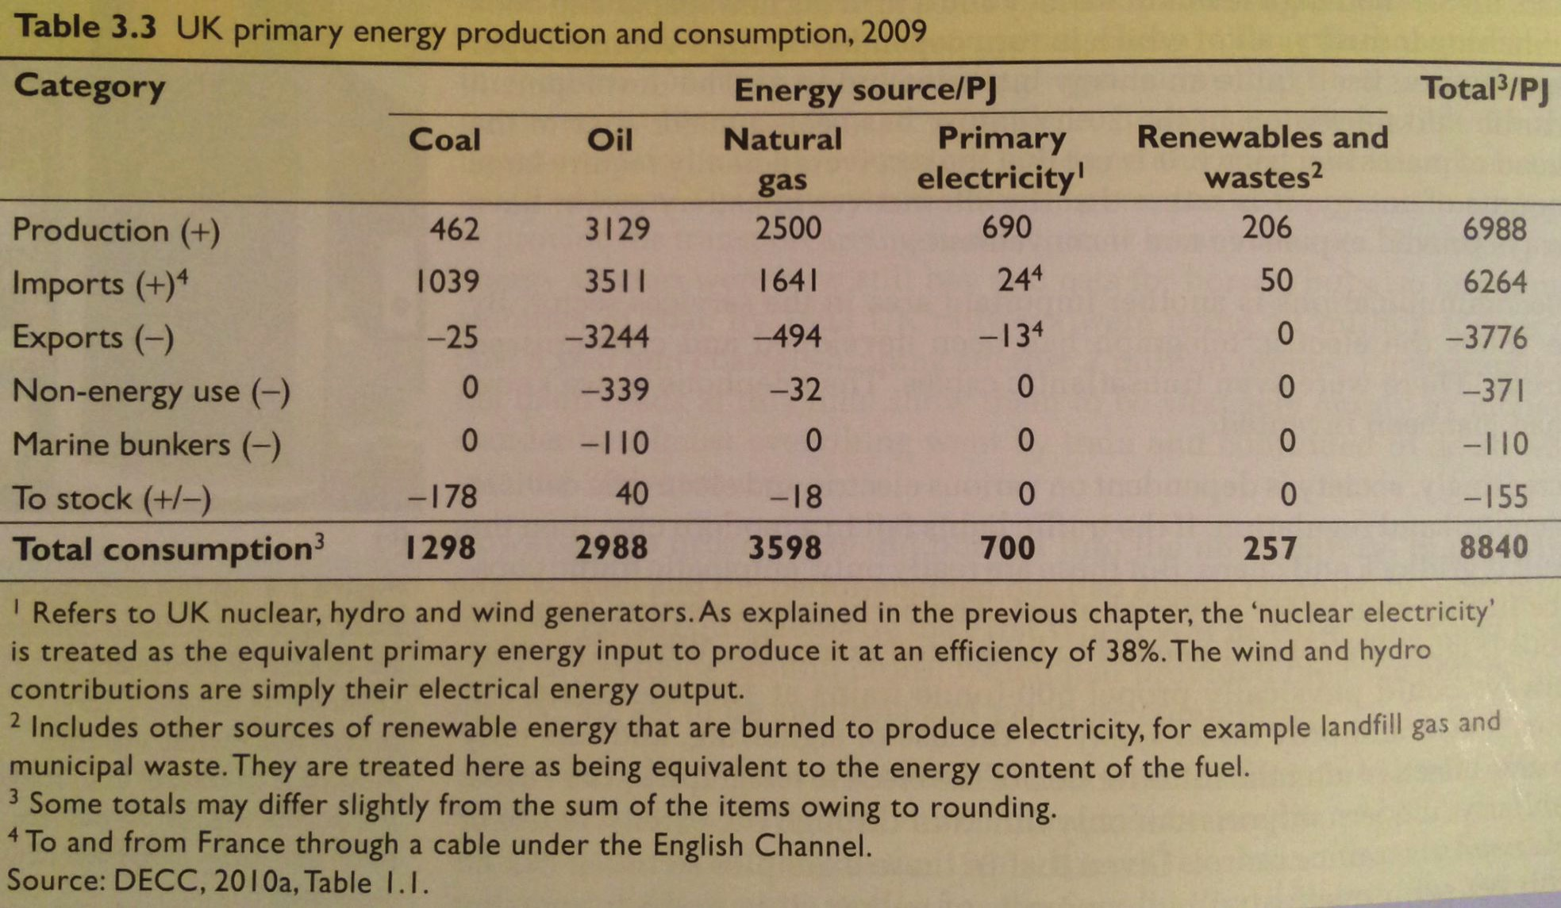
UK primary energy use & consumption
Energy Systems & Sustainability, 2/e, Chapter 3

Slide 4
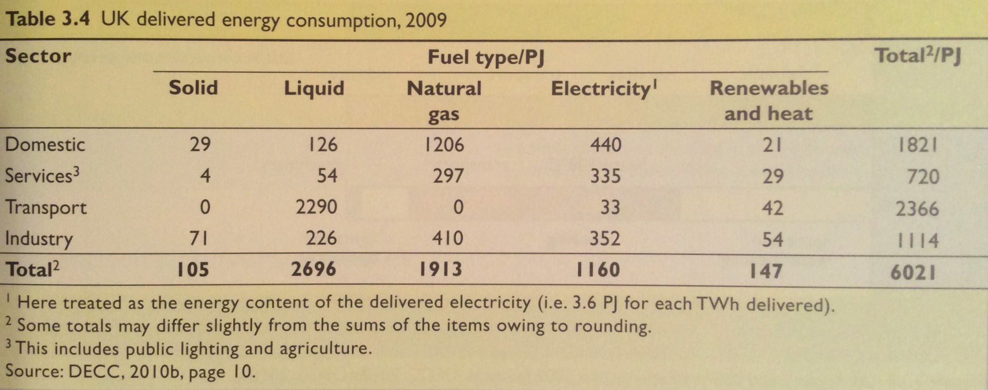
UK delivered energy consumption
Here we can look at the types and amounts of fuels used by each sector in the UK.
What stands out to you?
Energy Systems & Sustainability, 2/e, Chapter 3

Slide 5
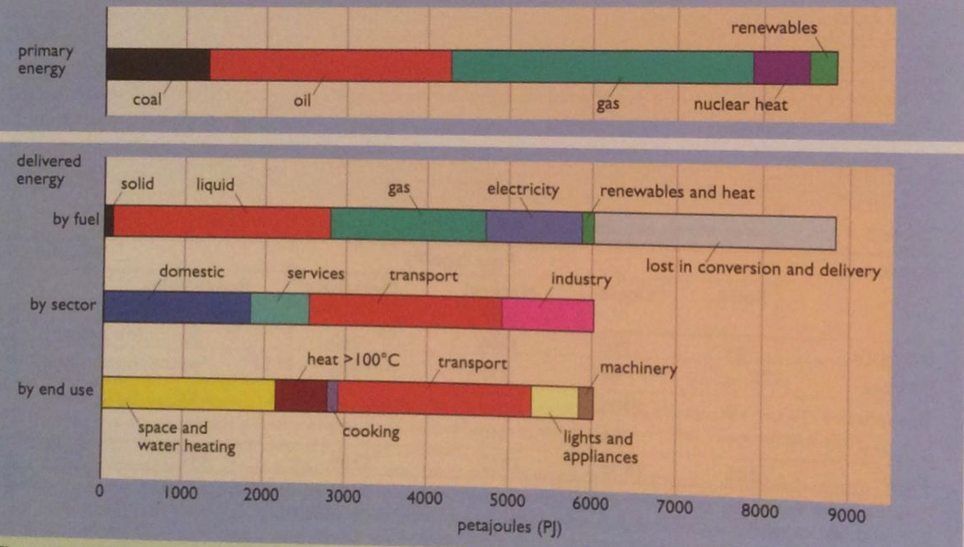
UK primary vs. delivered energy
~30% loss
~30% loss
Energy Systems & Sustainability, 2/e, Chapter 3

Slide 6
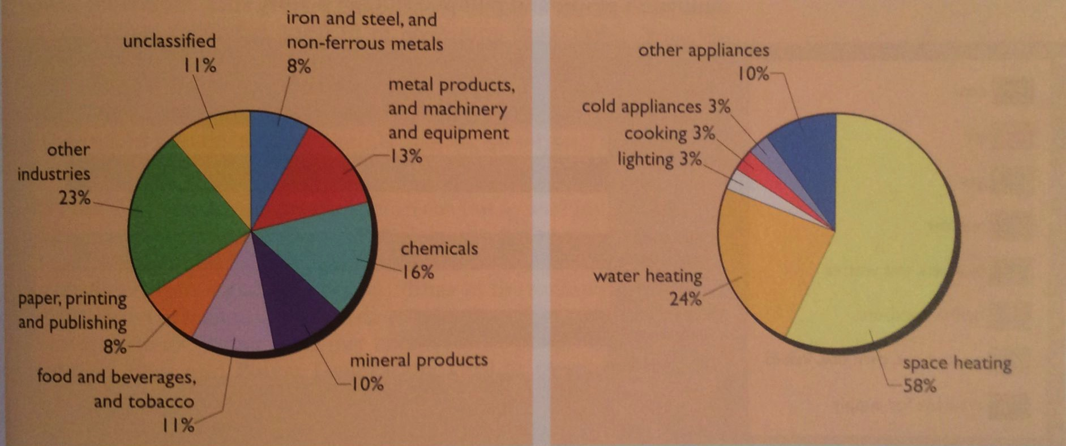
UK industrial vs. domestic use
UK industrial use
UK domestic use
Energy Systems & Sustainability, 2/e, Chapter 3

Slide 7
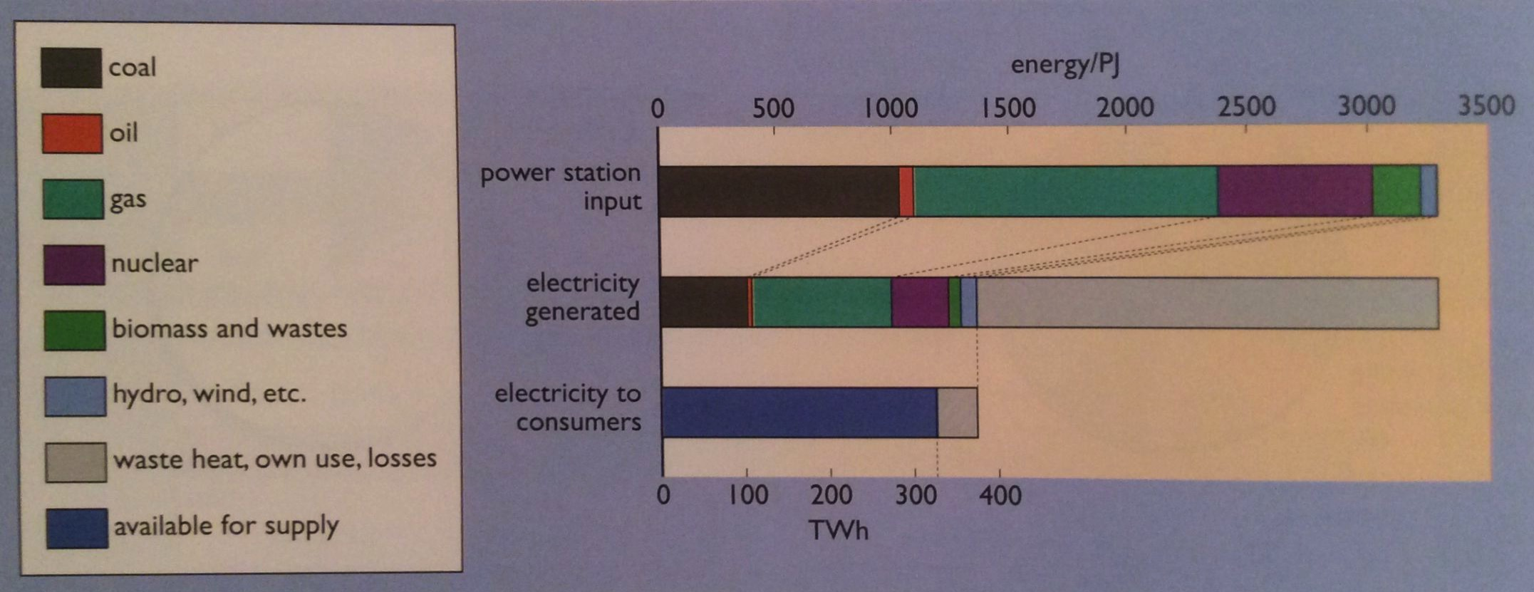
UK generation & distribution of electricity
~10% used
Energy Systems & Sustainability, 2/e, Chapter 3

Slide 8
UK trends in energy use by sector
Energy use per capita has only increased by about 50% over the last 100 years.
Industry has become more efficient.
Transportation has doubled energy use; more autos.
Energy Systems & Sustainability, 2/e, Chapter 3

