Slide 1
SSC 2030: Energy Systems & Sustainability
3. Primary energy forms and uses
3.1: Primary energy consumption (conservation!)
3.2: Units of energy and energy data
3.3: Energy density (aka heat content)
3.4: Global and regional sources of energy
3.5: UK energy use today
3.6: Primary energy: UK vs. Denmark vs. US
3.7: Primary energy: France vs. India vs. China
3.8: Trends in US energy use
3.9: Vermont energy statistics

Slide 2
3. Primary energy forms and uses
3.6: Primary energy: UK vs. Denmark vs. US
What’s self-sufficiency?
UK
Denmark
US

Slide 3
The ideal primary energy profile?
What should a country’s (or a region’s or planet’s) primary energy profile look like?
1. Self-sufficient: a good match between primary energy production & consumption. Self-sufficiency (%) = primary energy production (100)
primary energy consumption
2. Low-carbon & low polluting
3. Sustainable & local
Energy Systems & Sustainability, 2/e, Chapter 2 / wikiwand.com

Slide 4
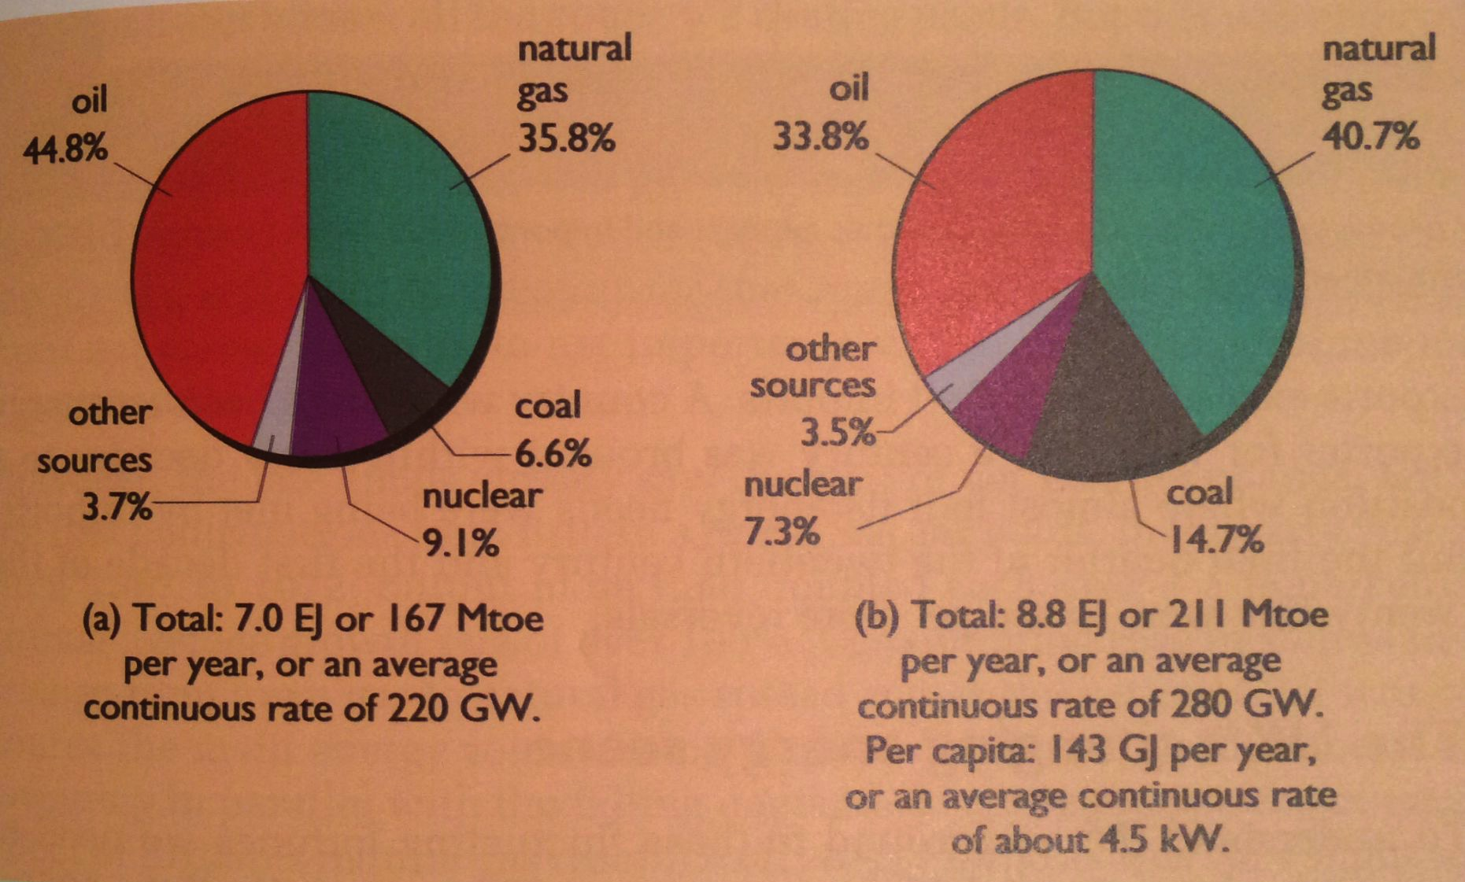
Primary energy in the UK
Production
Consumption
Compared to other industrialized countries: less biomass; little hydro.
When North Sea oil & gas was at its peak (1970-80s) UK was a net oil & NG exporter. Now past peak and importing.
Still consuming residual coal reserves.
Energy Systems & Sustainability, 2/e, Chapter 2

Slide 5
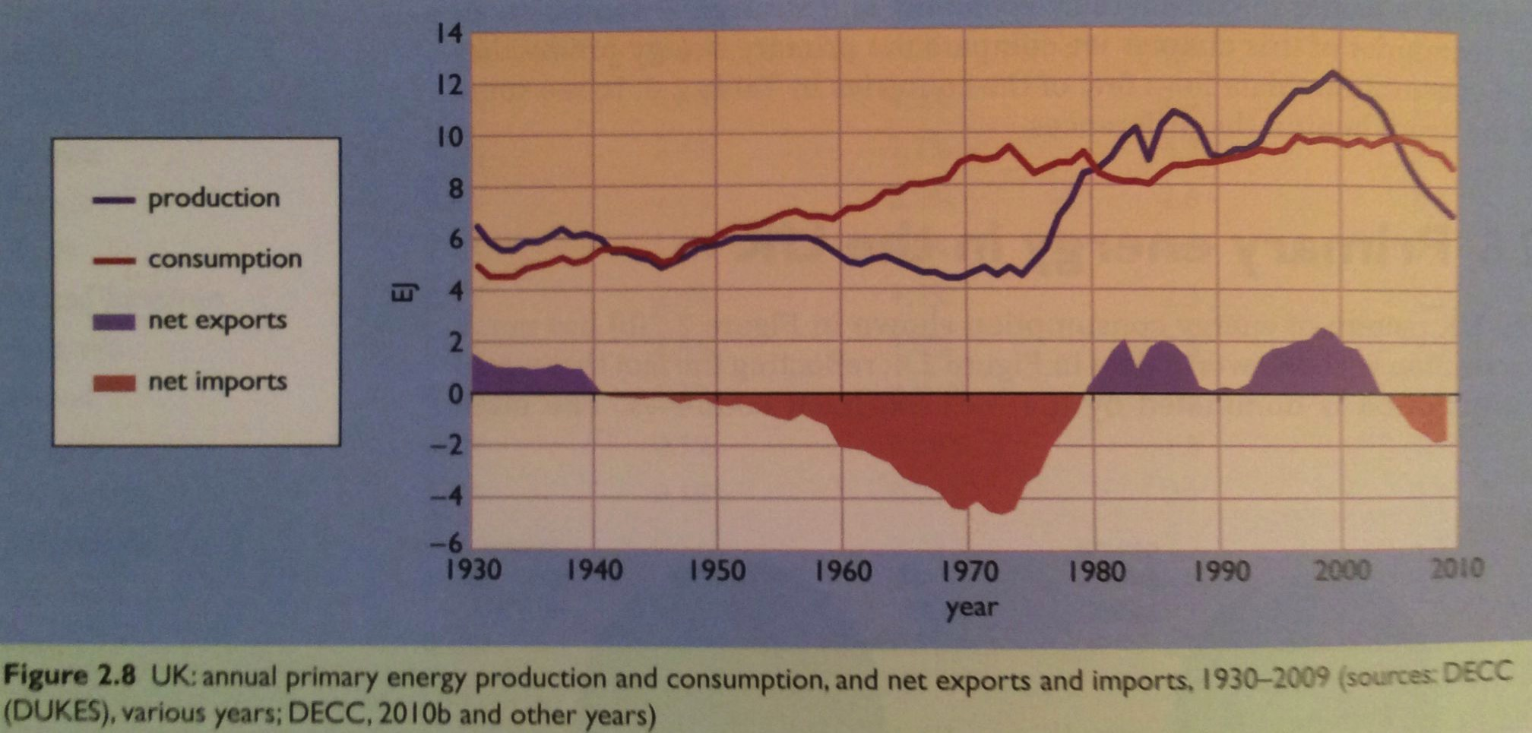
Changes in UK primary energy use
This graph of UK primary energy production & use shows how UK production & consumption have determined whether the country is a net importer or exporter.
WWII
North Sea oil & NG
depleted
Coal exports
Energy Systems & Sustainability, 2/e, Chapter 2

Slide 6
Influence of energy insecurity
The UK has been fuel secure; first coal, then North Sea oil & gas.
However, prior to 1970, Denmark imported nearly all its fuel, 95% oil
When oil prices soared in the 1970s & 1980s Demark was forced to act and make changes:
Extreme energy conservation;
Power stations switched from oil to coal;
Expansion of use of CHP (combined use of heat & power);
Favored district heat over individual heating systems;
Requirements for insulation and building standards; &
More renewable energy, particularly wind & biomass.
waste heat
Results? (2007)
Energy use in Denmark has been stable since 1980.
District heat was used in 60% of homes & made up 12% of delivered energy.
CHP kept waste down to 22% vs. 32% in the UK.
Renewable energy rose to 14%.
Still dependent on oil, particularly for transportation.
Energy Systems & Sustainability, 2/e, Chapter 3

Slide 7
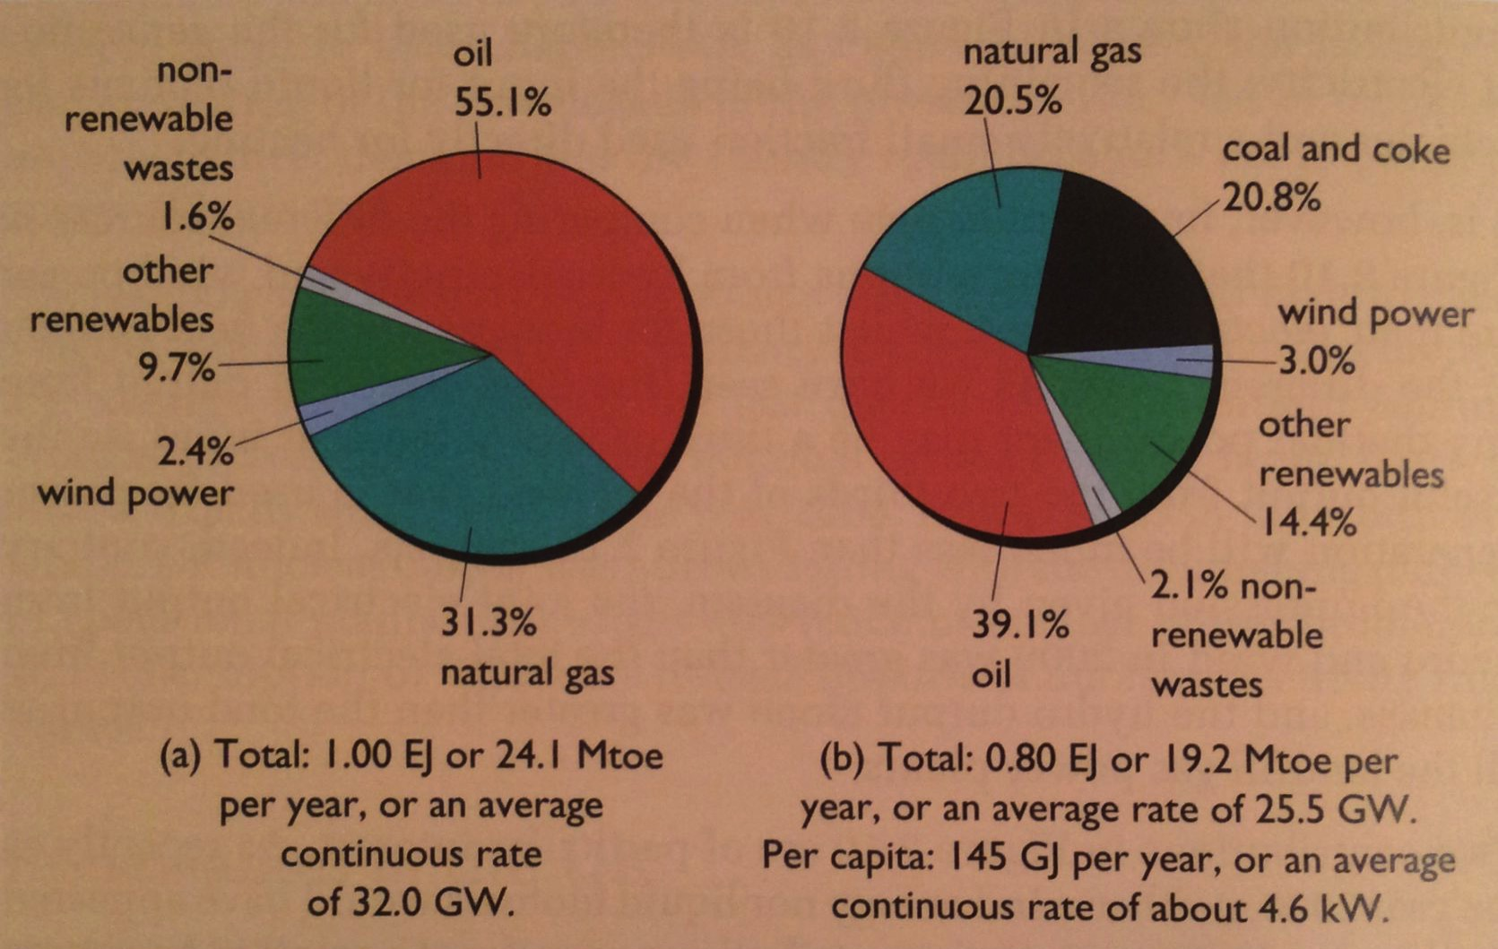
Primary energy in Denmark
Production
Consumption
Like UK, ff dominate use and production.
Per capita energy use is very similar the UK & Denmark.
Unlike the UK, Denmark was self-sufficient in 2009.
Denmark had very little native ff energy resources.
Denmark has halved oil consumption since 1970.
Energy Systems & Sustainability, 2/e, Chapter 2

Slide 8
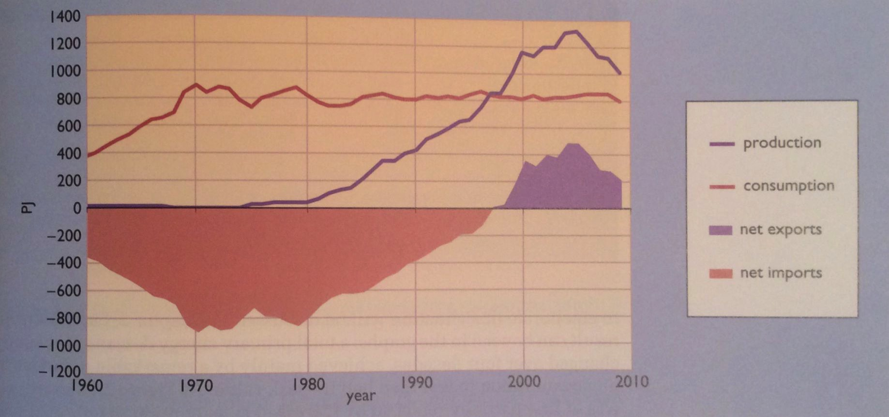
Changes in Denmark’s primary energy use
Denmark had little coal, and when they got North Sea oil & NG they made it last.
To Denmark, it’s obvious that the future is RE and conservation.
Notice that consumption has remained flat even while production has risen.
RE = 14% of production
= 20% of consumption
North Sea oil & NG
Demark relied on imported
ff energy until ….
Energy Systems & Sustainability, 2/e, Chapter 2

Slide 9
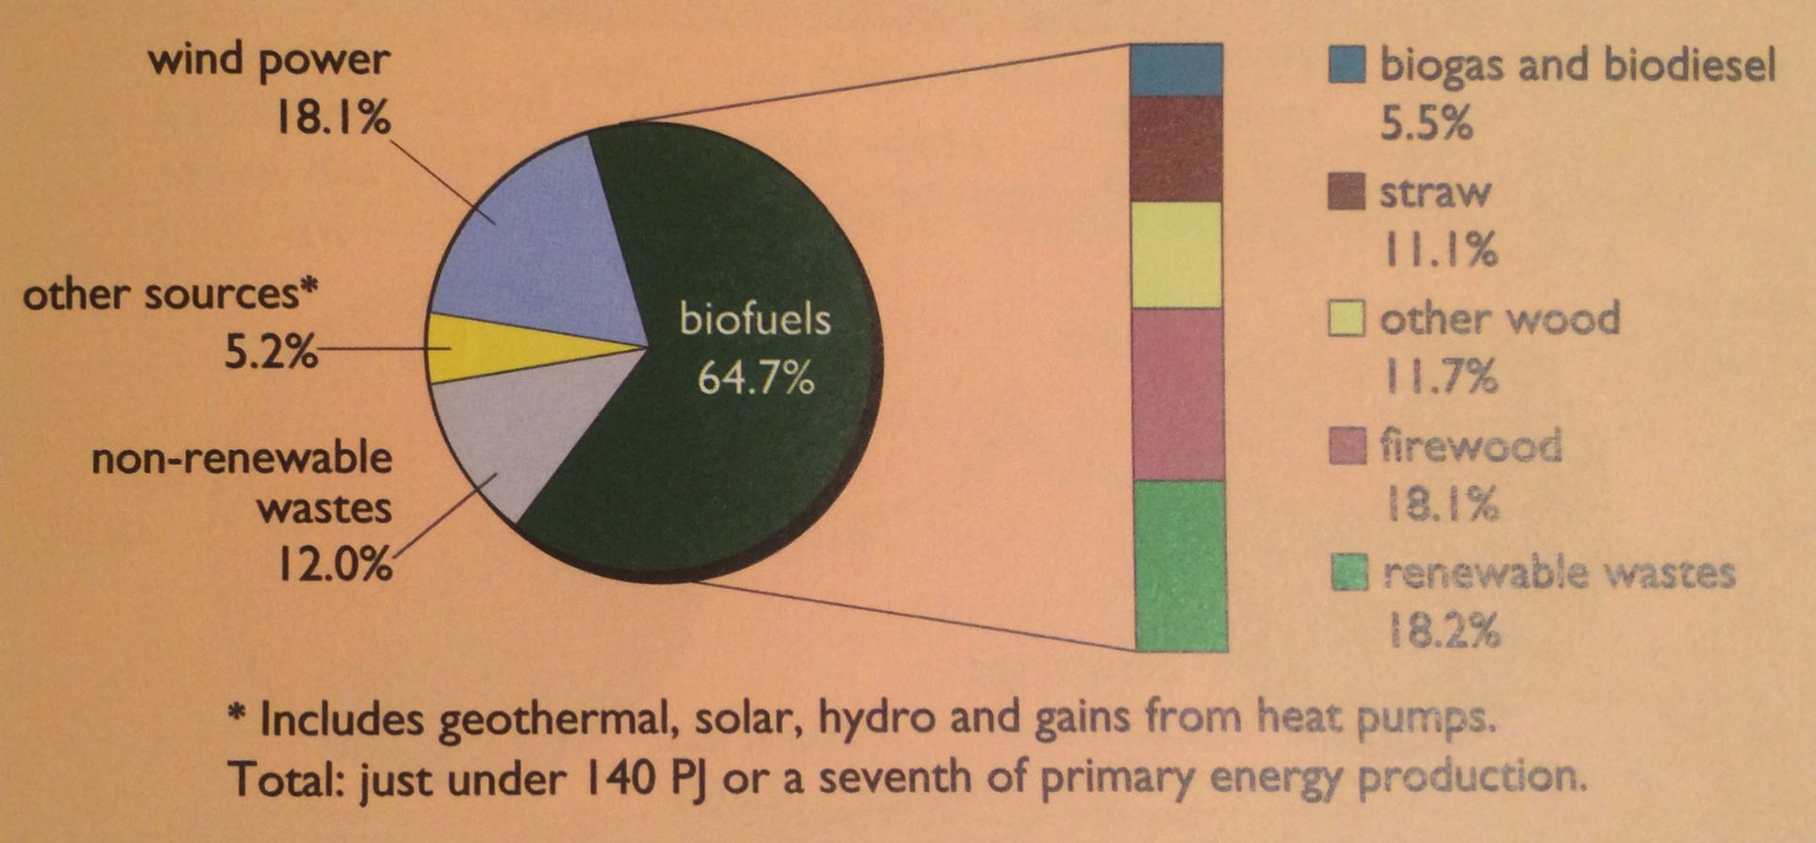
RE in Denmark
By 2008, Denmark had made much greater use of renewable energy than the UK.
Use of heat pumps for space heating has contributed to conservation of fossil fuels and electricity.
Energy Systems & Sustainability, 2/e, Chapter 2

Slide 10
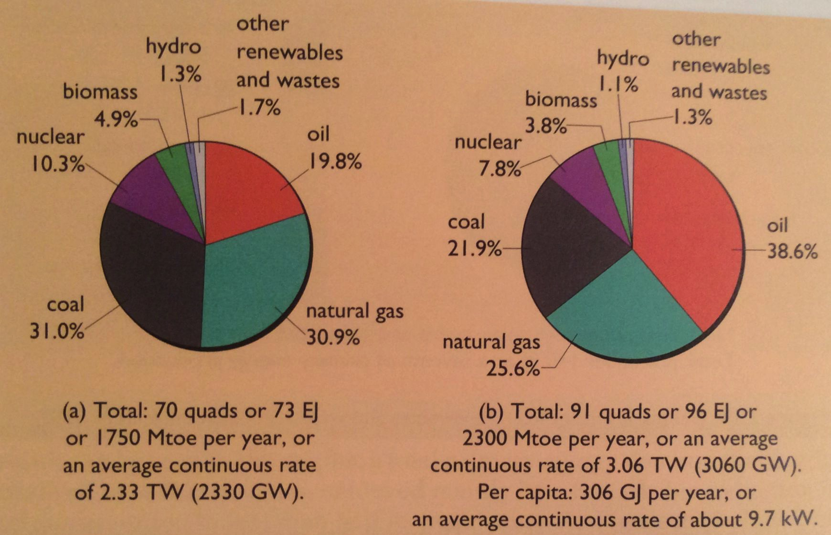
Primary energy in the US
Production
Consumption
Note that the US prefers oil to NG and coal.
The US is a net exporter of coal, mainly to Europe, though coal mining & exporting are falling.
The US is also a net exporter of NG (gas by pipeline, liquid by tanker) to Canada, Mexico, Argentina, Barbados, Brazil, Chile, China, India, Japan, Portugal, Taiwan & the UAE.
Self sufficiency was 61% in 2013.
Energy Systems & Sustainability, 2/e, Chapter 2

Slide 11
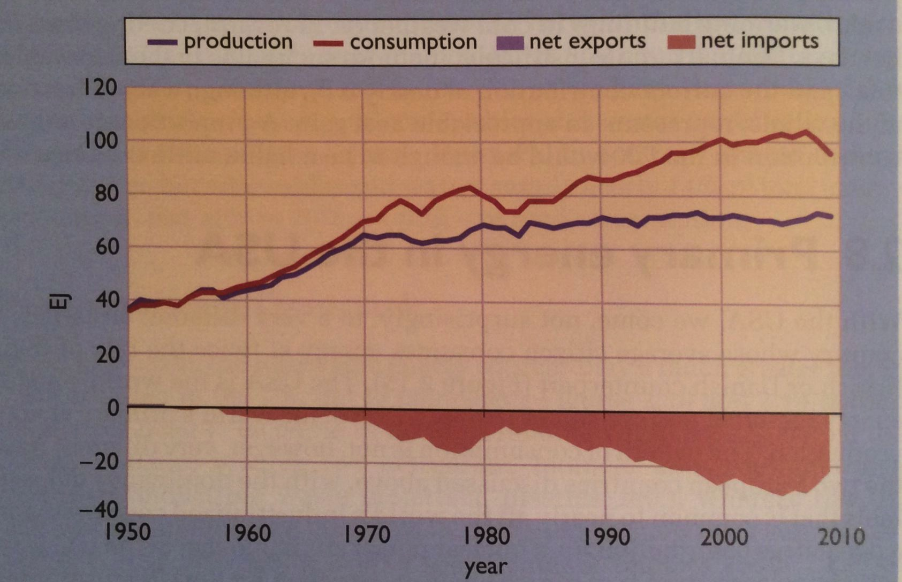
Changes in US primary energy use
Our consumption has continued to rise.
Recently (not shown here) fracking has increased exports.
US has been a net energy importer since 1950.
Energy Systems & Sustainability, 2/e, Chapter 2

Slide 12
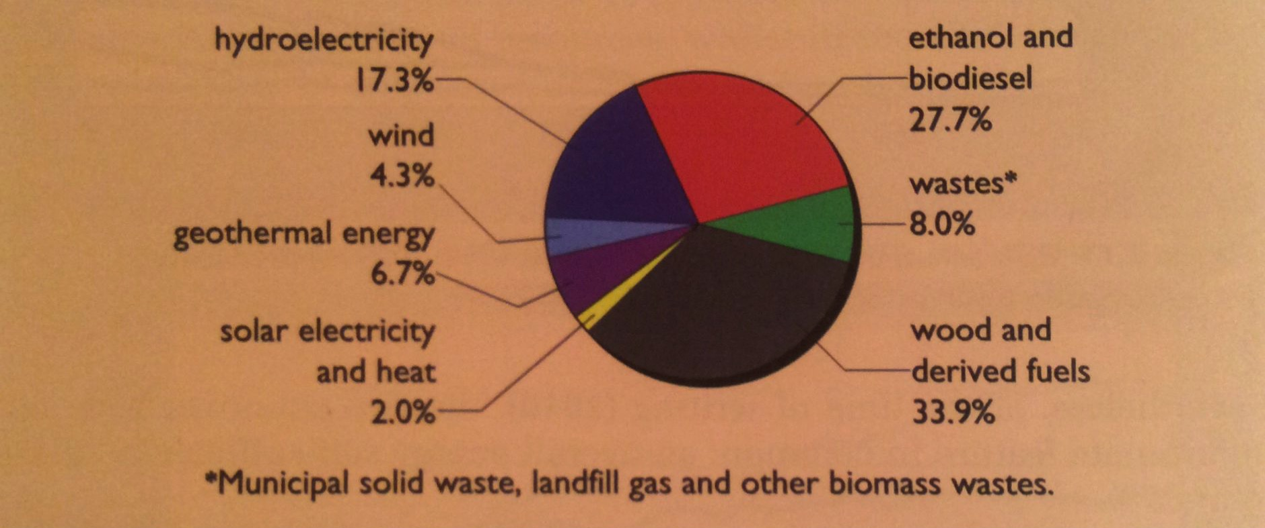
RE in the US
By 2009, the US produce about 8% of energy with renewable resources.
Ethanol use is a result of government subsidies and the farm lobby.
2019: RE up to 11% in the US
Energy Systems & Sustainability, 2/e, Chapter 2

Slide 13
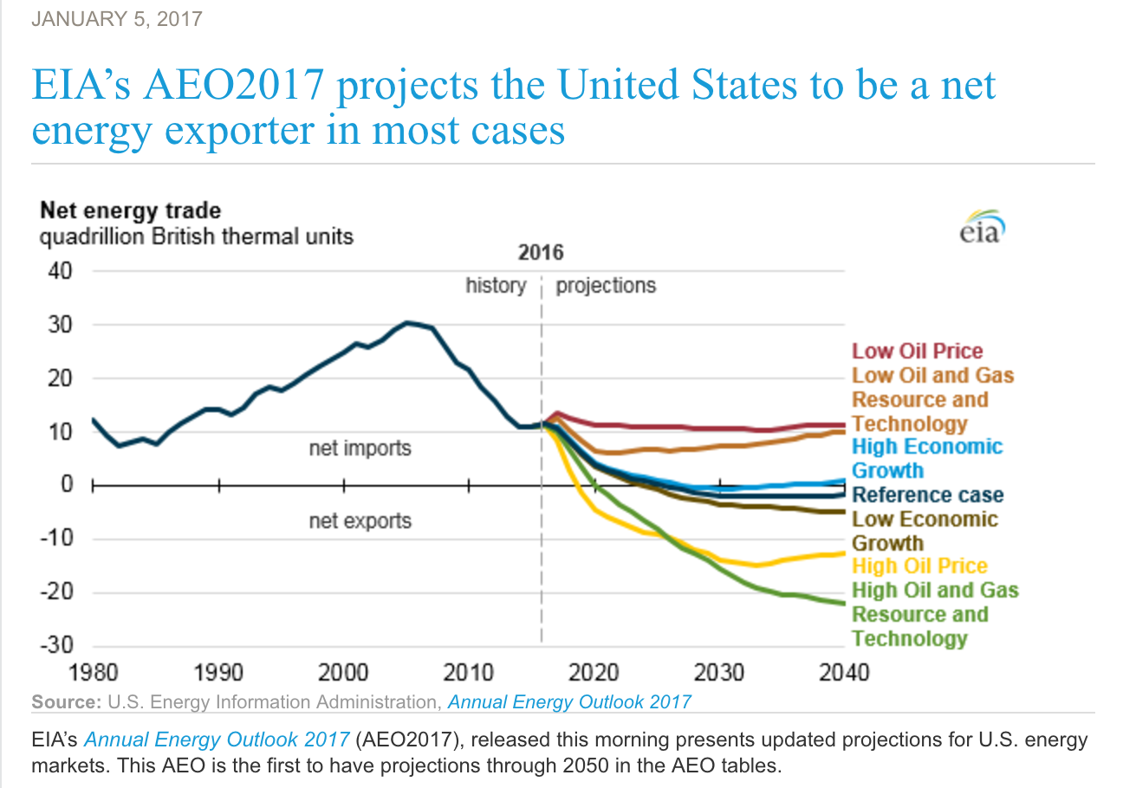
US predicted net energy exporter: 2017
Dec 2018: net oil exporter
2019: $12 b in LNG exports
EIA predicts that the US could be energy self-sufficient by 2035.
US has been a net energy importer since 1950.
https://www.eia.gov/todayinenergy/detail.php?id=29433

Slide 14
Recent energy use in the US
https://www.eia.gov/energyexplained/?page=us_energy_home
Energy Systems & Sustainability, 2/e, Chapter 1

Slide 15
Comparing the UK, Denmark & US
Fossil fuel use is similar across the board.
Consumption much higher in the US.
Only Denmark is self-sufficient.
Denmark produces and uses more renewable energy.
 | Fossil fuels (% primary consumption) | Per capita use (GJ/year) | Self-sufficiency (%) | RE (% produc.) | RE (% consump.)
UK | 89.2 | 143 | 79.5 | 3.7 | 3.5
Denmark | 80.4 | 145 | 125.0 | 13.7 | 19.5
US | 86.1 | 306 | 76.9 | 7.9 | 6.2
Energy Systems & Sustainability, 2/e, Chapter 2

