Slide 1
SSC 2030: Energy Systems & Sustainability
3. Primary energy forms and uses
3.1: Primary energy consumption (conservation!)
3.2: Units of energy and energy data
3.3: Energy density (aka heat content)
3.4: Global and regional sources of energy
3.5: UK energy use today
3.6: Primary energy: UK vs. Denmark vs. US
3.7: Primary energy: France vs. India vs. China
3.8: Trends in US energy use
3.9: Vermont energy statistics

Slide 2
3. Primary energy forms and uses
3.8: Trends in US energy use
Some increases in use and in efficiency
Gains in efficiency lost to increased use for electronics
Heating may be returning to electricity
Manufacturing has become more efficient
Transportation is a huge FF user

Slide 3
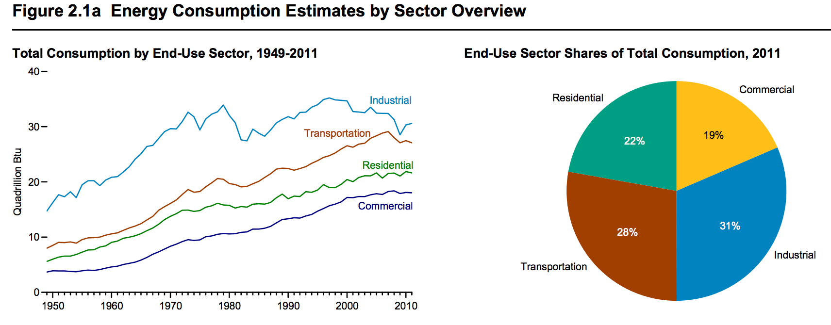
Growth of consumption by sector
Not surprisingly, energy use most sectors has increased since WWII.
Why does industrial use seem to be leveling off more than other uses?
What was going on with industrial use in the late 1970s, early 1980s?
waste heat
https://www.eia.gov/totalenergy/data/annual/pdf/sec2.pdf

Slide 4
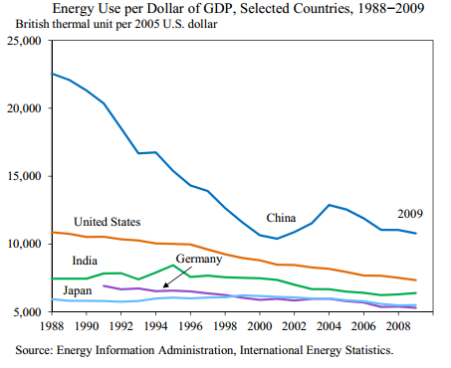
But efficiency evolves as well
Energy use / $GDP is a measure of a nation’s energy efficiency or of the nature of the nation’s economy.
By the 1990s, the US was manufacturing less than China, but increasing energy costs and scarcity were causing the Chinese economy to become more efficient.
EIA

Slide 5
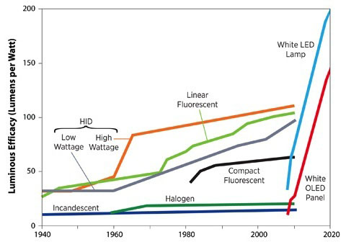
Evolution of lighting technologies
Lighting technology continues to become more energy efficient.
http://www.led-evolution.com/Technology/benefits-of-LED.html

Slide 6
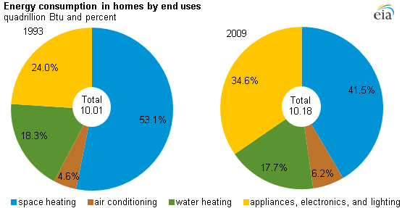
Domestic energy use
Energy use in homes hasn’t changed dramatically, but use has shifted.
Efficiency has increased, lowering energy use for heating and cooling.
But energy use for ‘electronics’ has increased.
https://www.eia.gov/todayinenergy/detail.php?id=10271

Slide 7
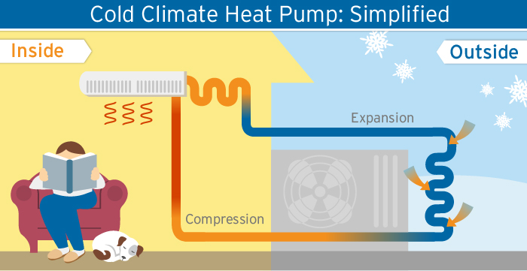
Heating fuels have also changed
Heating fuels have changed… and changed back!
wood → coal → oil → electricity → natural gas → (RE) electricity
antiquity
1900 -
1970s
1920 -
2000s
1700 - 1900
Efficiency Vermont

Slide 8
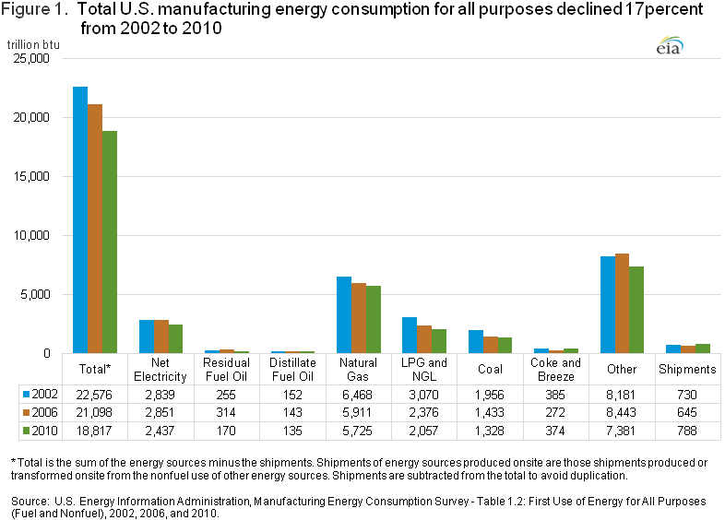
Manufacturing energy use down
https://www.eia.gov/consumption/manufacturing/

Slide 9
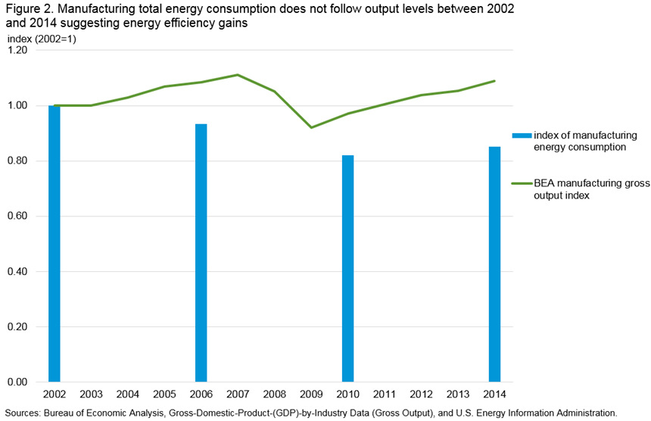
Manufacturing output, not so clearly
EIA: https://www.eia.gov/consumption/manufacturing/reports/2014/pre_estimates/

Slide 10
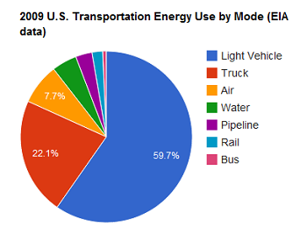
Transportation in the US
In the US, transportation is dominated by the private auto.
http://news.thomasnet.com/imt/2012/03/12/the-damage-done-gas-addiction-edition-how-detrimental-is-petrol

Slide 11
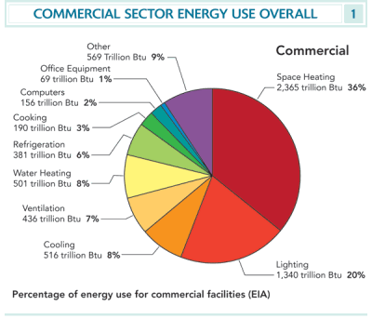
Commercial services
Note that heating & lighting account for 2/3 of all energy use.
Energy Systems & Sustainability, 2/e, Chapter 3; EIA

