Slide 1

SSC 2030: Energy Systems & Sustainability
3. Primary energy forms and uses
3.1: Primary energy consumption (conservation!)
3.2: Units of energy and energy data
3.3: Energy density (aka heat content)
3.4: Global and regional sources of energy
3.5: UK energy use today
3.6: Primary energy: UK vs. Denmark vs. US
3.7: Primary energy: France vs. India vs. China
3.8: Trends in US energy use
3.9: Vermont energy statistics

Slide 2
3. Primary energy forms and uses
  3.9: Vermont energy statistics
  RE accounts for ~25% of primary energy
  Most electricity supply is RE
  Transportation and heating are FF dependent
  Energy production and consumption are low.
  Energy costs are high
  Vermont‘s Comprehensive Energy Plan is agressive

Slide 3
Vermont primary energy use (2015)
24.8% RE
71.4%
fossil fuels
EIA State Energy Profiles & Estimates

Slide 4
Vermont primary energy use (2015)
193,000 MWh
EIA State Energy Profiles & Estimates

Slide 5
Vermont energy use by sector (2015)
EIA State Energy Profiles & Estimates

Slide 6
Vermont energy stats (2015)
One in 6 Vermont households uses wood products as their primary heating source.
Vermont produces less than 35% of its electricity & depends on power from the New England grid and Canada.
In 2016, nearly all of Vermont's in-state net electricity generation was produced by renewable energy, including hydroelectric, biomass, wind, and solar resources.
In the years 2011 through 2016, Vermont installed 59.2 megawatts of commercial-scale solar photovoltaic capacity, 26.8 megawatts in 2016 alone.
Vermont has enacted the nation's first integrated renewable energy standard (RES), which makes utilities responsible both for supplying renewable electricity and for supporting reductions in customers' fossil fuel use.
EIA State Energy Profiles & Estimates

Slide 7
Vermont energy stats (2015)
 | value | US ranking
Population | 600,000
Labor force | 300,000
GDP | $31.1 billion | 51
Average temperature | 44.7 F | 43
Average rainfall | 39.1 inches | 24
Per capita income | $50,321 | 20
Total energy consumption |  | 50
Energy consumption per capita | 211 million Btu/year | 44
Energy cost per capita | $4,273 | 9
Energy production |  | 47
Electricity production |  | 50
RE production | 204,000 MWh
RE consumption | 24.9% of all energy consumption | 8
Electricity costs |  | 8
Energy intensity | 8,1000 Btu/$ GDP
Total carbon emissions | 6 millionn metric tonnes CO₂ | 50
EIA State Energy Profiles & Estimates

Slide 8
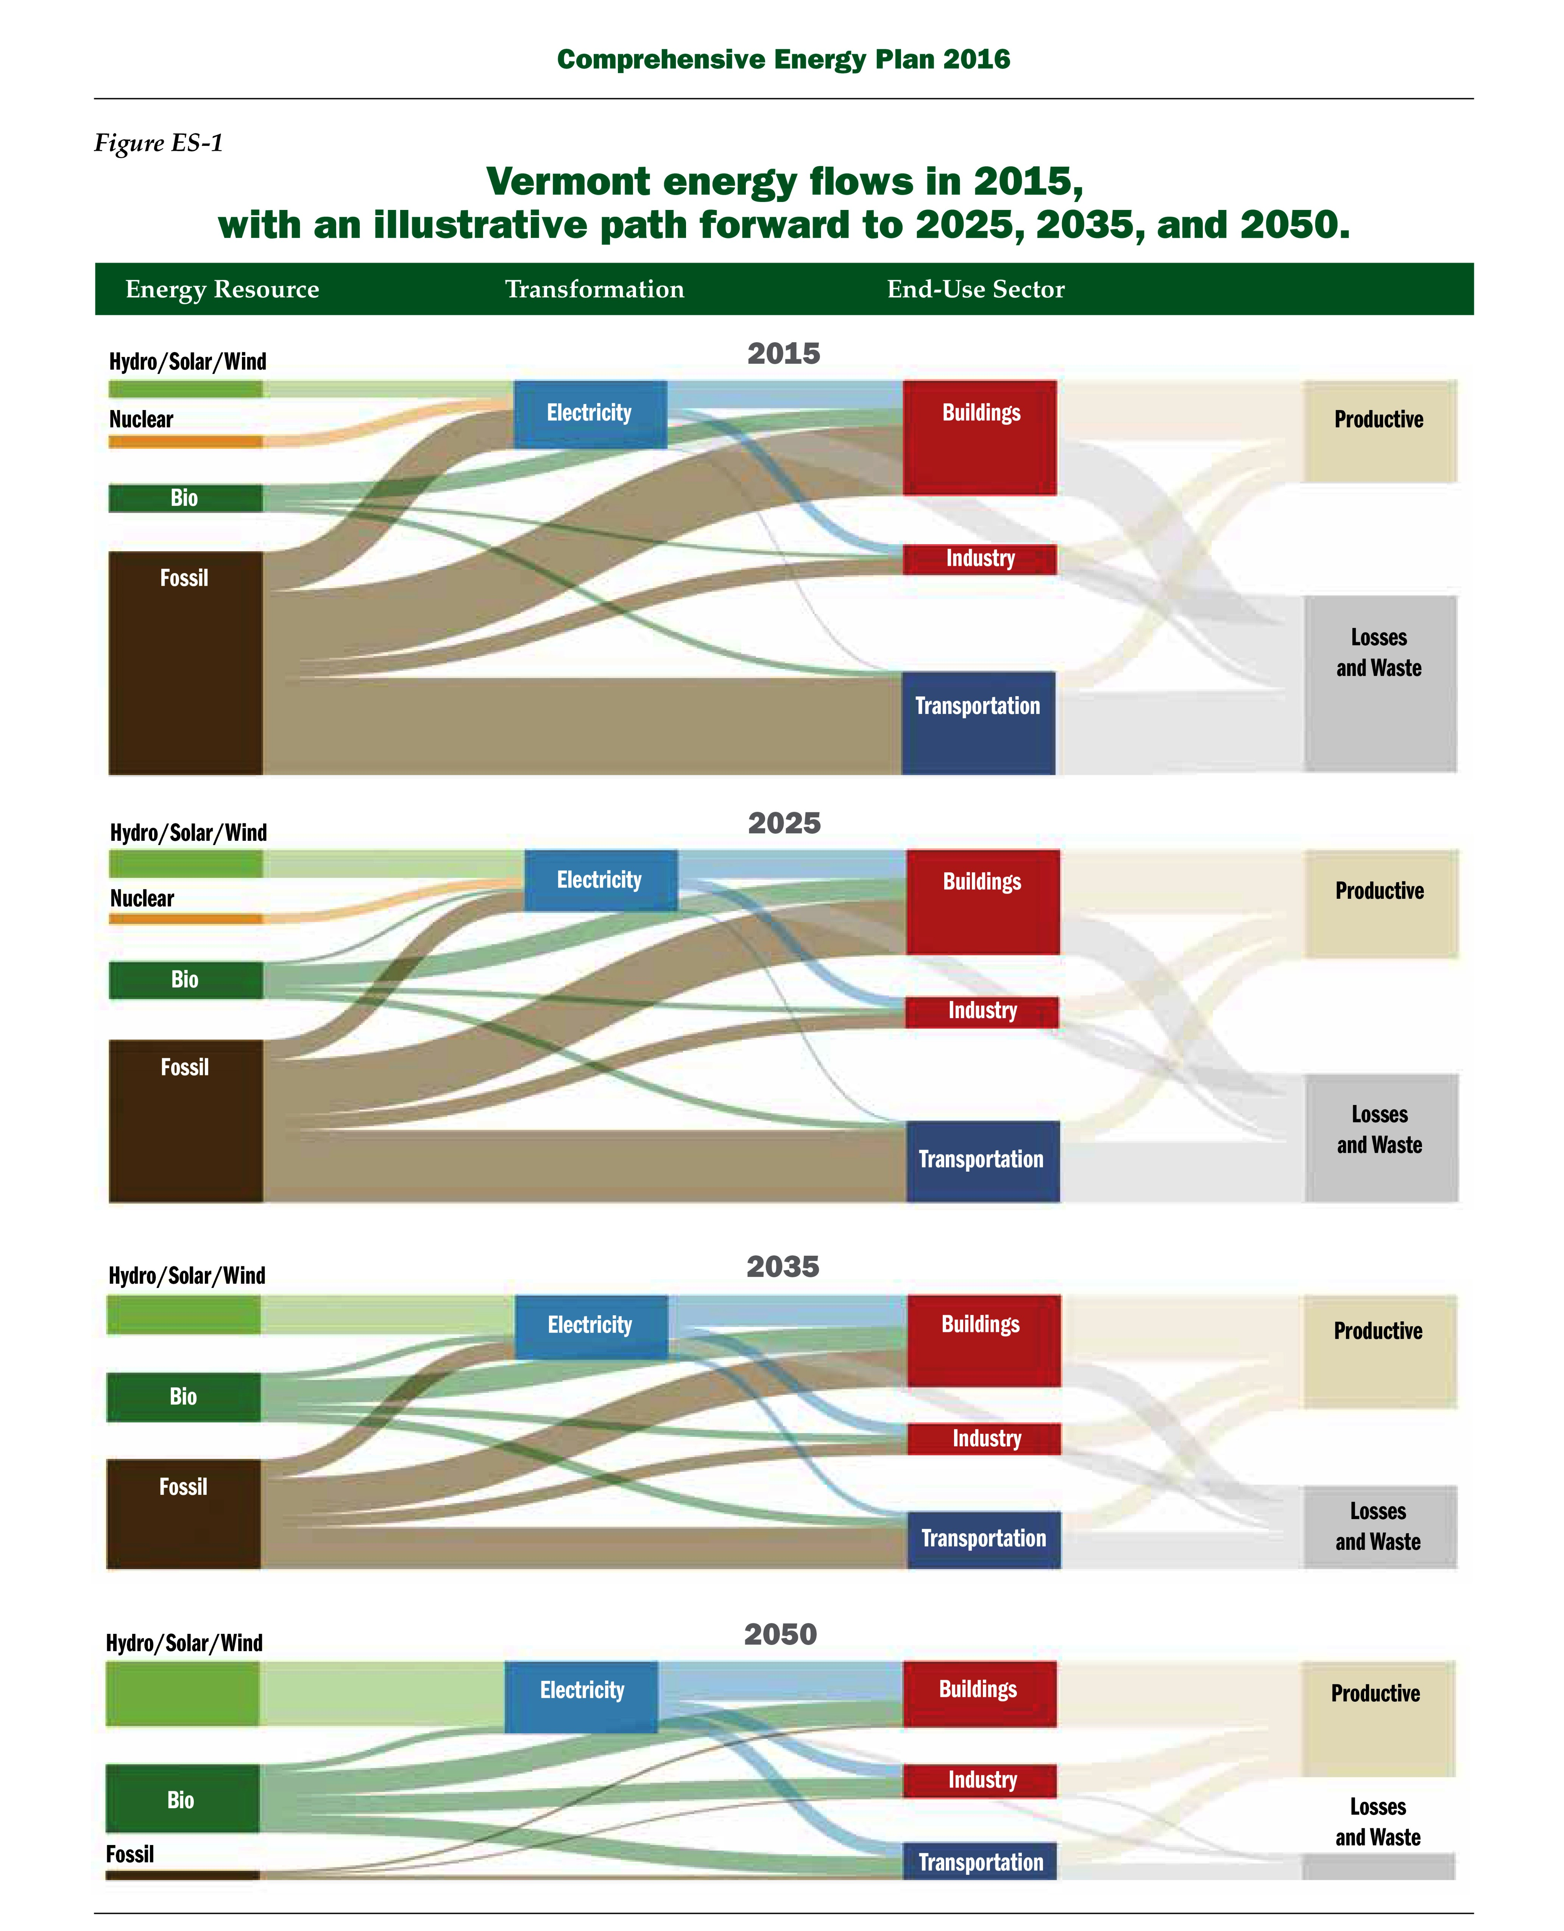
Vermont Comprehensive Energy Planning
http://www.vtenergydashboard.org/90-by-2050/detail/2016-comprehensive-energy-plan

