Slide 1

SSC 2030: Energy Systems & Sustainability
4. Coal
4.1: Coal: an introduction
4.2: Fuel of the industrial revolution
4.3 : Formation & composition
4.4: Modern extraction & current uses
4.5: Coal deposits, reserves & production
4.6: Global coal resources & reserves
4.7: Coal combustion & emissions
4.8: Alternative uses of coal
4.9: Carbon sequestration & clean coal

Slide 2
4. Coal
  4.1: Introduction to coal

Slide 3
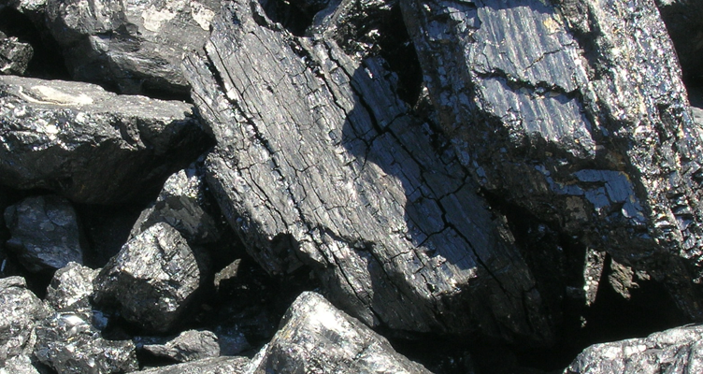
Comparing coal, oil & NG
How does coal compare to oil and natural gas?
Abundant: huge, globally distributed reserves;
Extraction has large environmental impacts (stip-mining);
  And is a health hazard;
More difficult to transport (less dense);
Produces twice as much carbon dioxide;
Produces large amounts of ash when burned;
  Ash can leach sulfuric acid & arsenic into ground water;
  Coal ash ponds and floods; &
Produces SOx and NOx in flue gasses.
For these reasons, coal is sometimes called the ‘ignoble’ fuel.
Yet coal production is up 4-fold from 1920 – 2009;
Even as its contribution to energy production is down from 60 – 25%
Energy Systems & Sustainability, 2/e, Chapter 5

Slide 4
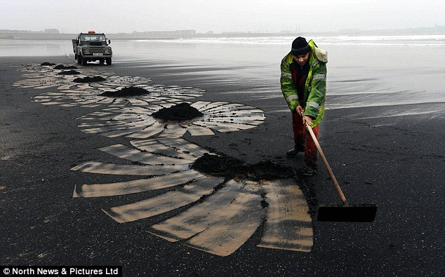
History of coal use
Wood was man’s first fuel and has been used for 3000 – 4000 years.
Charcoal is partially combusted (pyrolysis) wood that is more energy dense than wood.
Coal has been used for 2000 years in China & the Middle East.
‘Sea coal’ washes ashore from underwater deposits and was traditionally collected as a highly valued fuel along the coasts.
Hampton Court (1500s)
Mining started in the Roman era.
Brick chimneys allowed wood and
coal to be combusted indoors & withstood the corrosive flue gases.
  By 1680 1400 ships were used to transport coal in Britain.
Sea coal on the beaches of Scotland
Energy Systems & Sustainability, 2/e, Chapter 5; Daily Mail

Slide 5
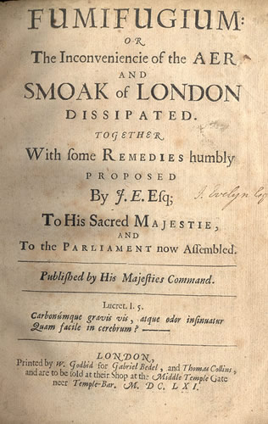
Air quality problems arose quickly
Air quality suffered as use of coal boomed. In this era British coal was ‘brown’ and high in sulfur. Air emissions resulted in huge amounts what we now call ‘smog’.
By 1661, London was cloaked in:
"Such a cloud of sea-coal, as if there be a resemblence of hell upon earth, it is in this volcano in a foggy day: this pestilent smoak, which corrodes the very yron [iron], and spoils all the moveables, leaving a soot on all things that it lights: and so fatally seizing on the lungs of the inhabitants, that cough and consumption spare no man."
- John Evelyn petitioning Charles II for zoning to move industry out of the city and improve air quality
Energy Systems & Sustainability, 2/e, Chapter 5; wikipedia

