Slide 1

SSC 2030: Energy Systems & Sustainability
4. Coal
4.1: Coal: an introduction
4.2: Fuel of the industrial revolution
4.3 : Formation & composition
4.4: Modern extraction & current uses
4.5: Coal deposits, reserves & production
4.6: Global coal resources & reserves
4.7: Coal combustion & emissions
4.8: Alternative uses of coal
4.9: Carbon sequestration & clean coal

Slide 2
4. Coal
  4.2: Fuel of the Industrial Revolution

Slide 3
Industrial revolution: coal, iron & steel
The industrial revolution was made possible by coal, and one of its products, steel.
Iron ore is actually iron oxide.
Iron is purified by the process of smelting, that removes oxygen.
iron ore
coke
iron
flue gases
Fe₂O₃, Fe₃O₄ + C → Fe + CO₂ + CO
Coke: created by pyrolysis (combustion in limited oxygen) of coal at high temperatures (2000°F).
Nearly pure carbon as most impurities (O, S) are ‘driven off’
Coking works at night
Energy Systems & Sustainability, 2/e, Chapter 5

Slide 4
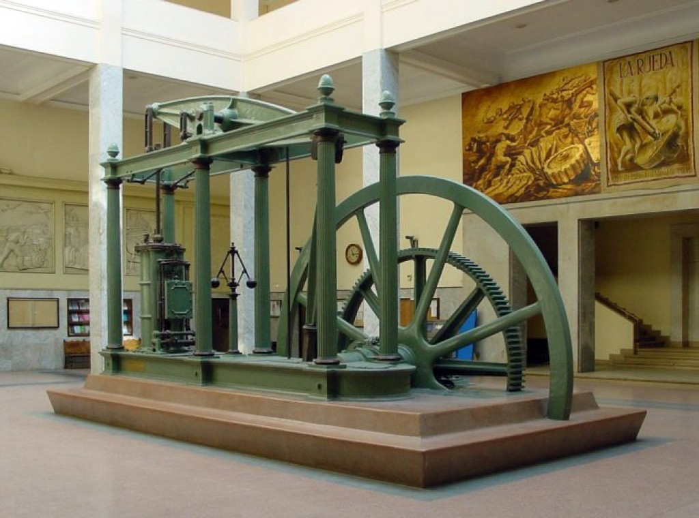
Industrial revolution: coal, iron & steel
James Watt’s steam engine (1769) converted the energy of coal to heat (steam) and then mechanical work.
Heralded the true start of England’s industrial revolution.
Made possible by coal and steel.
Steel: an alloy of iron & other elements, mainly carbon
Harder and stronger than iron
Carbon provided by adding coke
A Watt double-acting steam engine (1859)
Energy Systems & Sustainability, 2/e, Chapter 5; wikipedia

Slide 5
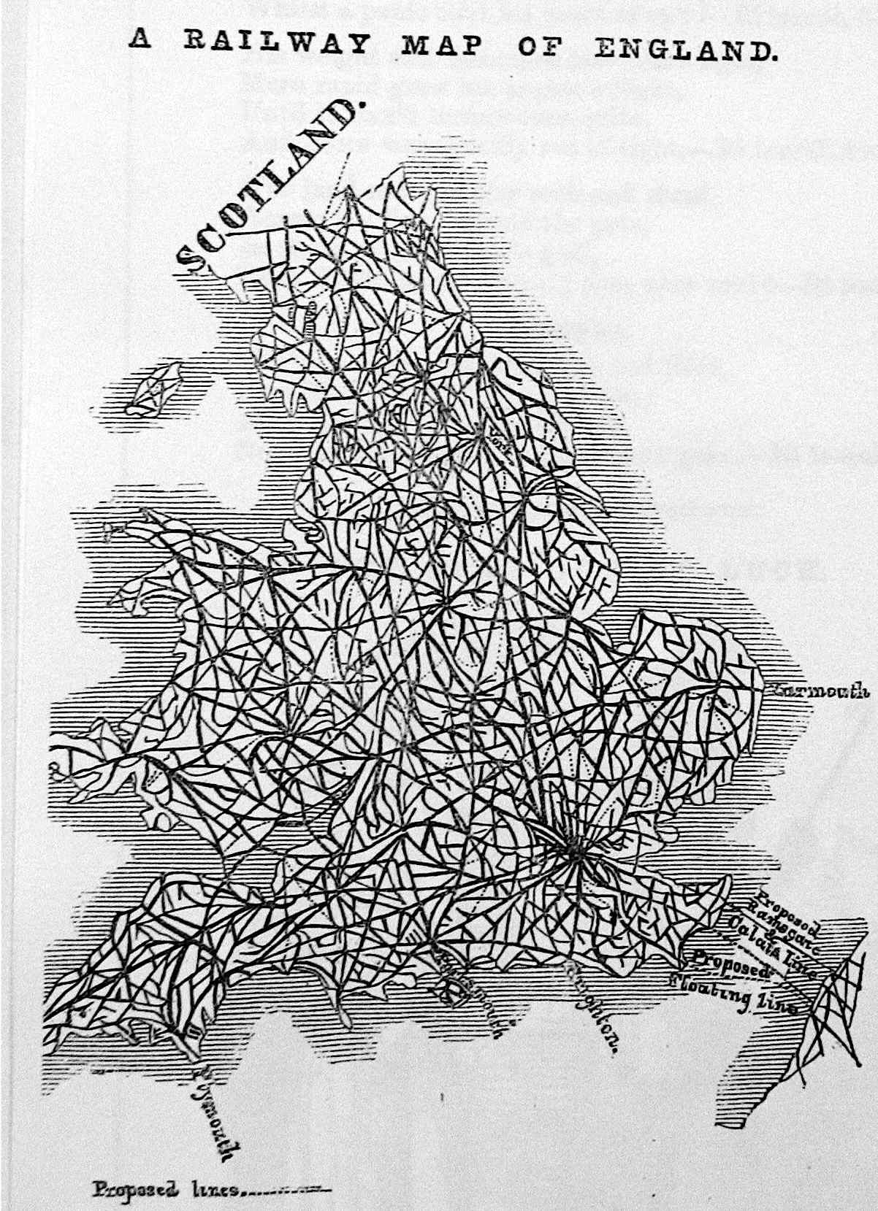
By 1800, coal was essential
By the 1800s coal was an essential commodity in England.
Coal powered mills;
Was essential for smelting & ironworks;
Was used in domestic heating.
1845
Over the next 100 years coal’s role
expanded to include:
Powering ships;
Driving railways;
Lighting cities; and
Providing feedstock for synthetic
fertilizer and chemical production
Energy Systems & Sustainability, 2/e, Chapter 5
https://ragpickinghistory.co.uk/2012/10/04/meta-ornament-railway-tracks/

Slide 6
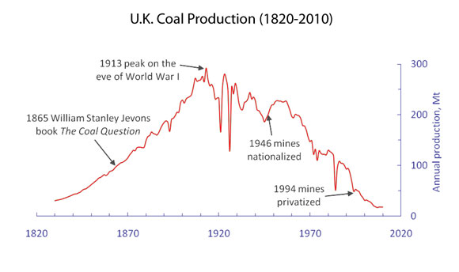
Coal production in England
1/3 exported
1900
UK & US: 300 Mtonnes
Germany: 100 Mtonnes
Global: 1 billion tonnes
https://blogs-images.forbes.com/williampentland/files/2011/09/UK-Coal-History2.jpg

