Slide 1
SSC 2030: Energy Systems & Sustainability
4. Coal
4.1: Coal: an introduction
4.2: Fuel of the industrial revolution
4.3 : Formation & composition
4.4: Modern extraction & current uses
4.5: Coal deposits, reserves & production
4.6: Global coal resources & reserves
4.7: Coal combustion & emissions
4.8: Alternative uses of coal
4.9: Carbon sequestration & clean coal

Slide 2
4. Coal
4.3: Formation & composition

Slide 3
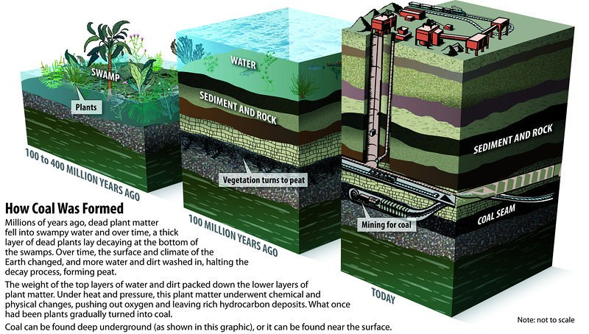
Chemical composition of coal
organics
partially
decompose
peat
heat, pressure & time
coal (older is better)
Energy Systems & Sustainability, 2/e, Chapter 5; pmfias.com

Slide 4
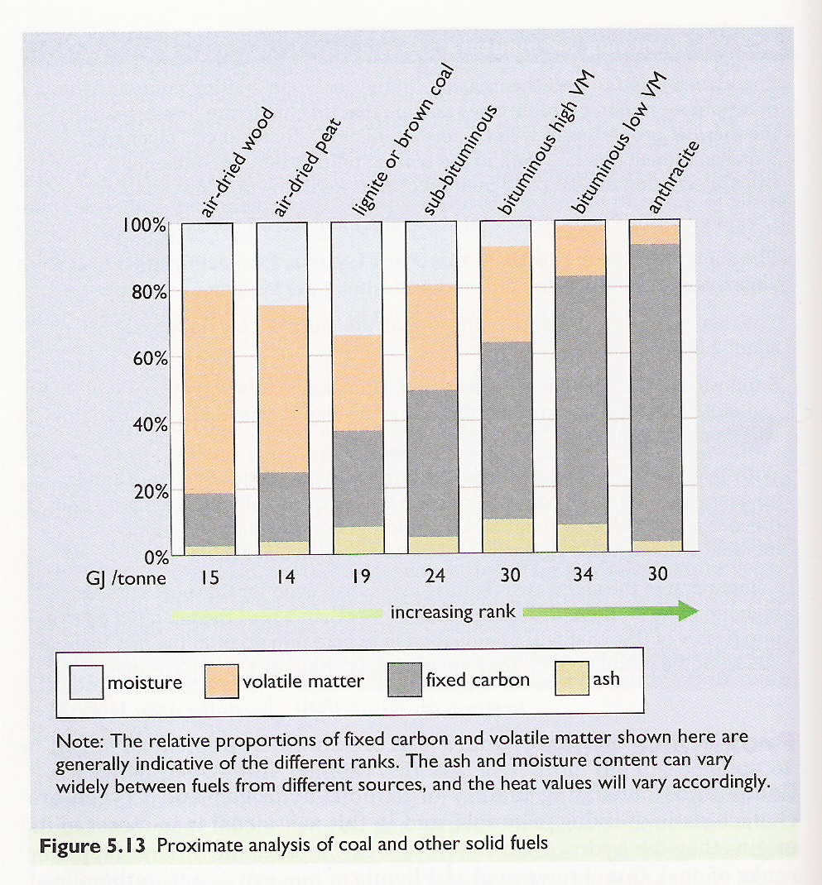
Chemical composition of coal
Proximate analysis: Quality of coal increases with increasing carbon content.
smokeless fuel
coke / steam
coke
steam
Elements:
C
H
N
S
O
Energy Systems & Sustainability, 2/e, Chapter 5

Slide 5
Combustion of coal
Ash remains: silicates & oxides of iron & aluminum.
Fixed carbon (coke) combines with oxygen to produce carbon dioxide flue gases (emissions) and heat.
smokeless fuel
coke / steam
coke
increasing temperature
Volatile matter (hydrocarbons) are boiled off into gases: H₂, CO, CH₄, C₂H₄, C₂H₂.
The gases combust, releasing heat.
steam
Water is heated & evaporated using a tiny fraction of coal’s energy.
Energy Systems & Sustainability, 2/e, Chapter 5

Slide 6
Why does coal produce more CO₂?
Coal is often referred to as a dirty fuel because of its emissions.
And it’s said to produce more carbon dioxide than other fossil fuels. Why?
The higher the C:H ratio of fuels, the more carbon dioxide they produce.
fuel | C:H ratio | Energy (MJ/kg) | CO₂ (mol/MJ)
coal | 1:1 | 39.3 | 2.0
oil | 2:1 | 43.6 | 1.6
ethanol | 3:1 | 27.3 | 1.6
natural gas | 4:1 | 51.6 | 1.2
hydrogen gas | 100% H | 120.0 | 0
smokeless fuel
coke / steam
coke
increasing temperature
steam
https://www.wou.edu/las/physci/GS361/Energy_From_Fossil_Fuels.htm

