Slide 1
SSC 2030: Energy Systems & Sustainability
4. Coal
4.1: Coal: an introduction
4.2: Fuel of the industrial revolution
4.3 : Formation & composition
4.4: Modern extraction & current uses
4.5: Coal deposits, reserves & production
4.6: Global coal resources & reserves
4.7: Coal combustion & emissions
4.8: Alternative uses of coal
4.9: Carbon sequestration & clean coal

Slide 2
4. Coal
4.4: Coal deposits, reserves & production

Slide 3
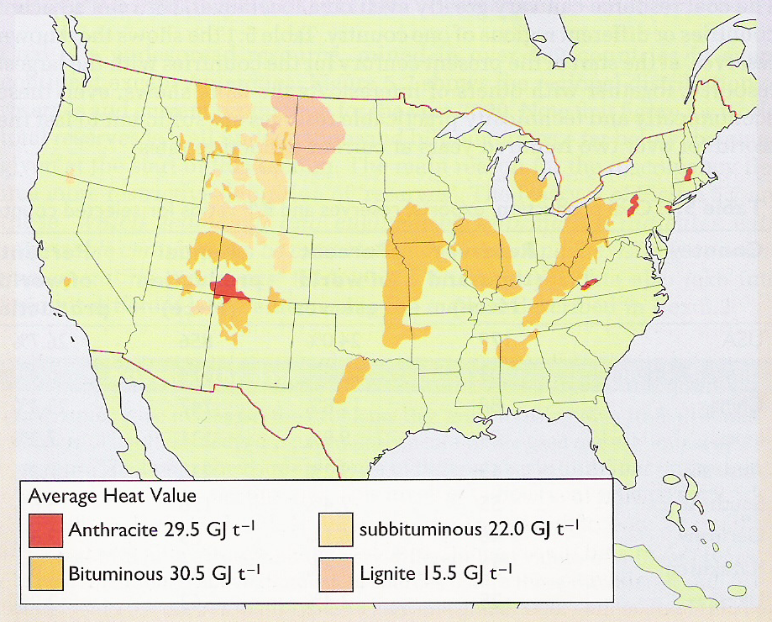
US coal deposits
Higher grade:
Hard coal
Black coal
Anthracite
Bituminous
Lower grade:
Brown coal
Lignite
Sub-bituminous
Energy Systems & Sustainability, 2/e, Chapter 5

Slide 4
Global coal reserves & production
Reserves
Production
Energy Systems & Sustainability, 2/e, Chapter 5

Slide 5
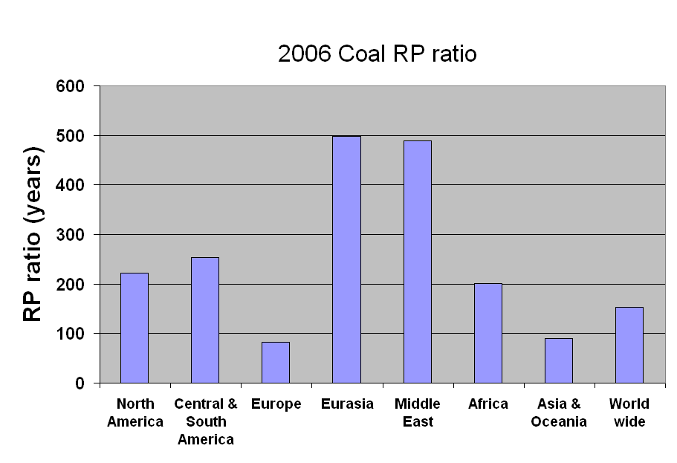
Global coal R/P ratios (2006)
Australia exporting
Russia: coal displaced by NG
India importing
UK mines down from 3000 to 13
China’s R/P 38 y
Energy Systems & Sustainability, 2/e, Chapter 5

Slide 6
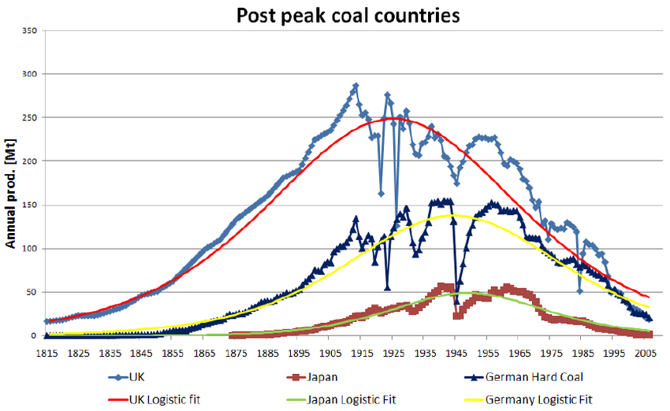
Some countries are well past peak
In fact, some have nearly null R/P ratios.
Figure 5.4
A Watt double-acting steam engine (1859)
https://www.researchgate.net/profile/Kjell_Aleklett/publication/228838239/figure/fig1/AS:300666963677184@1448695998872/Figure-1-The-peaking-of-several-countries-with-a-long-history-of-coal-mining-The-two.png

