Slide 1
SSC 2030: Energy Systems & Sustainability
4. Coal
4.1: Coal: an introduction
4.2: Fuel of the industrial revolution
4.3 : Formation & composition
4.4: Modern extraction & current uses
4.5: Coal deposits, reserves & production
4.6: Global coal resources & reserves
4.7: Coal combustion & emissions
4.8: Alternative uses of coal
4.9: Carbon sequestration & clean coal

Slide 2
4. Coal
4.5: Modern coal extraction methods & current uses

Slide 3
Mining automation: pit mines
Automation has changed pit mining dramatically over the past 70 years.
Fewer workers.
More production.
UK, 1953
Washington DNR
Today’s pit mine
Energy Systems & Sustainability, 2/e, Chapter 5

Slide 4
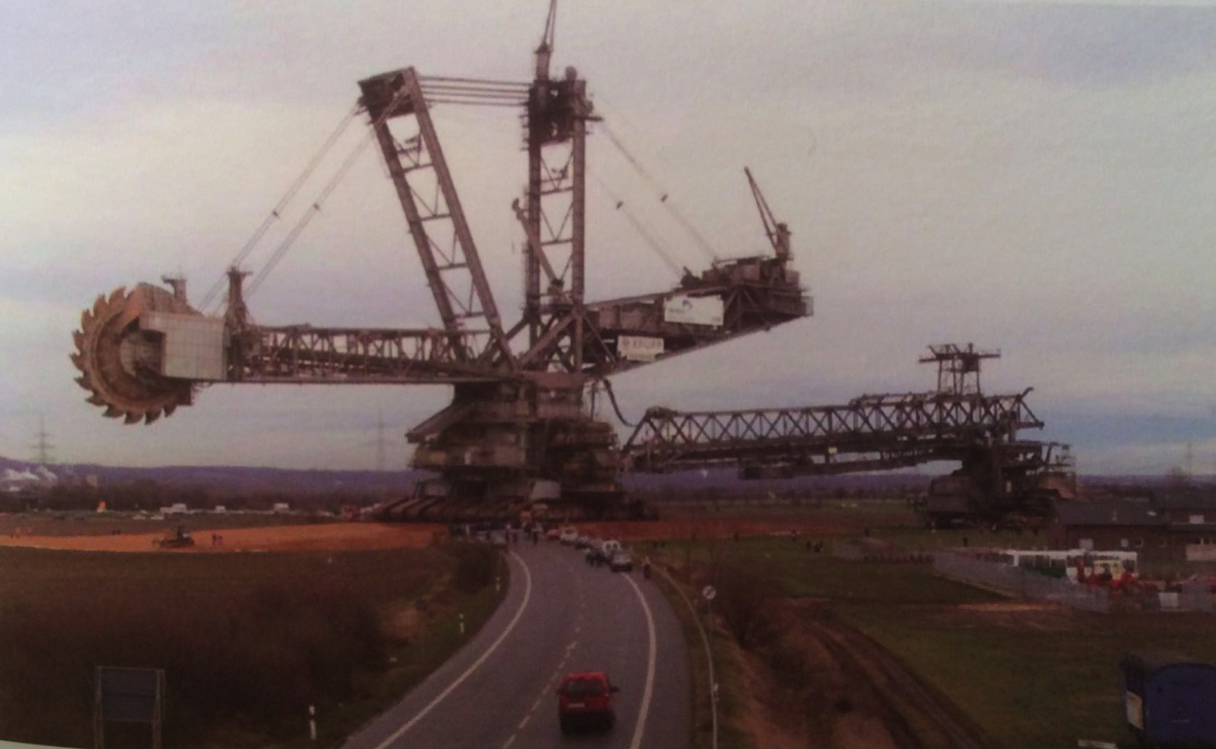
Mining automation: open mines
Bagger 288 bucketwheel excavator is used to remove overburden.
Weighs 13,500 tonnes
Moves 240,000 cubic meters per day
Washington DNR
A Watt double-acting steam engine (1859)
Energy Systems & Sustainability, 2/e, Chapter 5

Slide 5
Deep mining
Deep (aka underground) mines, use shafts & tunnels up to 1000 m deep.
The longwall method is still used, exposing a long, horizontal surface of a coal seam.
Now very mechanized, using huge cutting loaders and long conveyer belts to carry the coal for transport out of the mine.
Advantages & disadvantages?
Able to access deep deposits of coal.
Environmental impacts:
land subsidence;
Toxic tailing piles & sludge;
Health impacts:
Black lung; &
Accidents (Today in the US 1/50 lifetime risk for miners)
Washington DNR
msha.gov
A Watt double-acting steam engine (1859)
Energy Systems & Sustainability, 2/e, Chapter 5

Slide 6
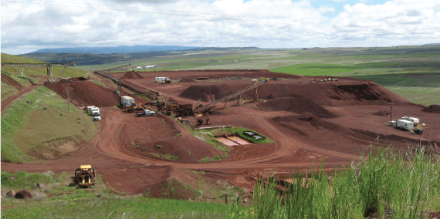
Surface (strip) mining
Surface mines, aka open cast mines, aka strip mining
The surface (aka ‘overburden’) is removed first to get to the coal beneath it. Explosives & mechanical methods are used.
Mountain top removal is an extreme form of strip mining.
In 2008-9, 70% of US coal & 60% of UK coal was strip-mined.
Advantages & disadvantages?
Relative to deep mining:
Simpler;
Less expensive, so more efficient;
Safer for miners.
However, the environmental effects of surface mining are extreme.
Laws sometimes require rehabilitation of closed mines, but are not always completely enforced.
Washington DNR
A Watt double-acting steam engine (1859)
Energy Systems & Sustainability, 2/e, Chapter 5

Slide 7
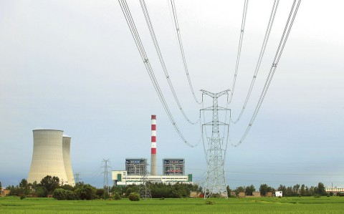
Current uses of coal
As of 2008, two-thirds of global coal was used for producing electricity.
In the UK, 80%.
To avoid transporting bulky coal from mines to distant population centers, electric generating plants are often located near mines and electricity is transmitted to urban centers: ‘coal by wire’.
2-6% losses.
As of 2017, coal is used to produce <31% of electricity.
Coke is still used for smelting and steel production.
Global coke use was 800 million tonnes in 2009.
Nearly half of coke was used in China.
A Watt double-acting steam engine (1859)
Energy Systems & Sustainability, 2/e, Chapter 5

