Slide 1
SSC 2030: Energy Systems & Sustainability
4. Coal
4.1: Coal: an introduction
4.2: Fuel of the industrial revolution
4.3 : Formation & composition
4.4: Modern extraction & current uses
4.5: Coal deposits, reserves & production
4.6: Global coal resources & reserves
4.7: Coal combustion & emissions
4.8: Alternative uses of coal
4.9: Carbon sequestration & clean coal

Slide 2
4. Coal
4.6: Global coal resources & reserves

Slide 3
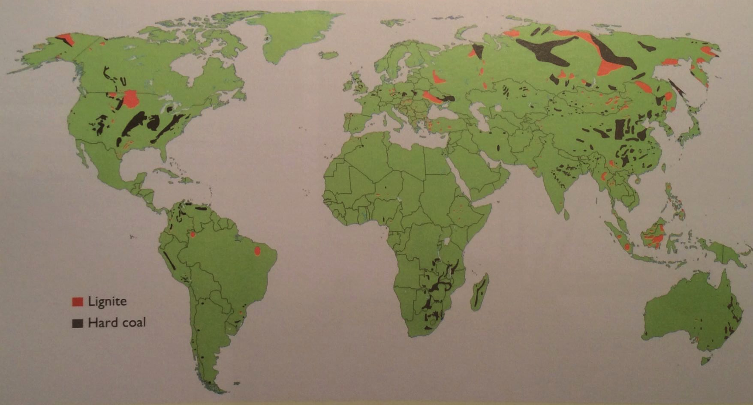
Global coal deposits (2009)
Coal is found on every continent except Antarctica.
Hard coal has 1.5 times as much energy as lignite.
A Watt double-acting steam engine (1859)
Energy Systems & Sustainability, 2/e, Chapter 5

Slide 4
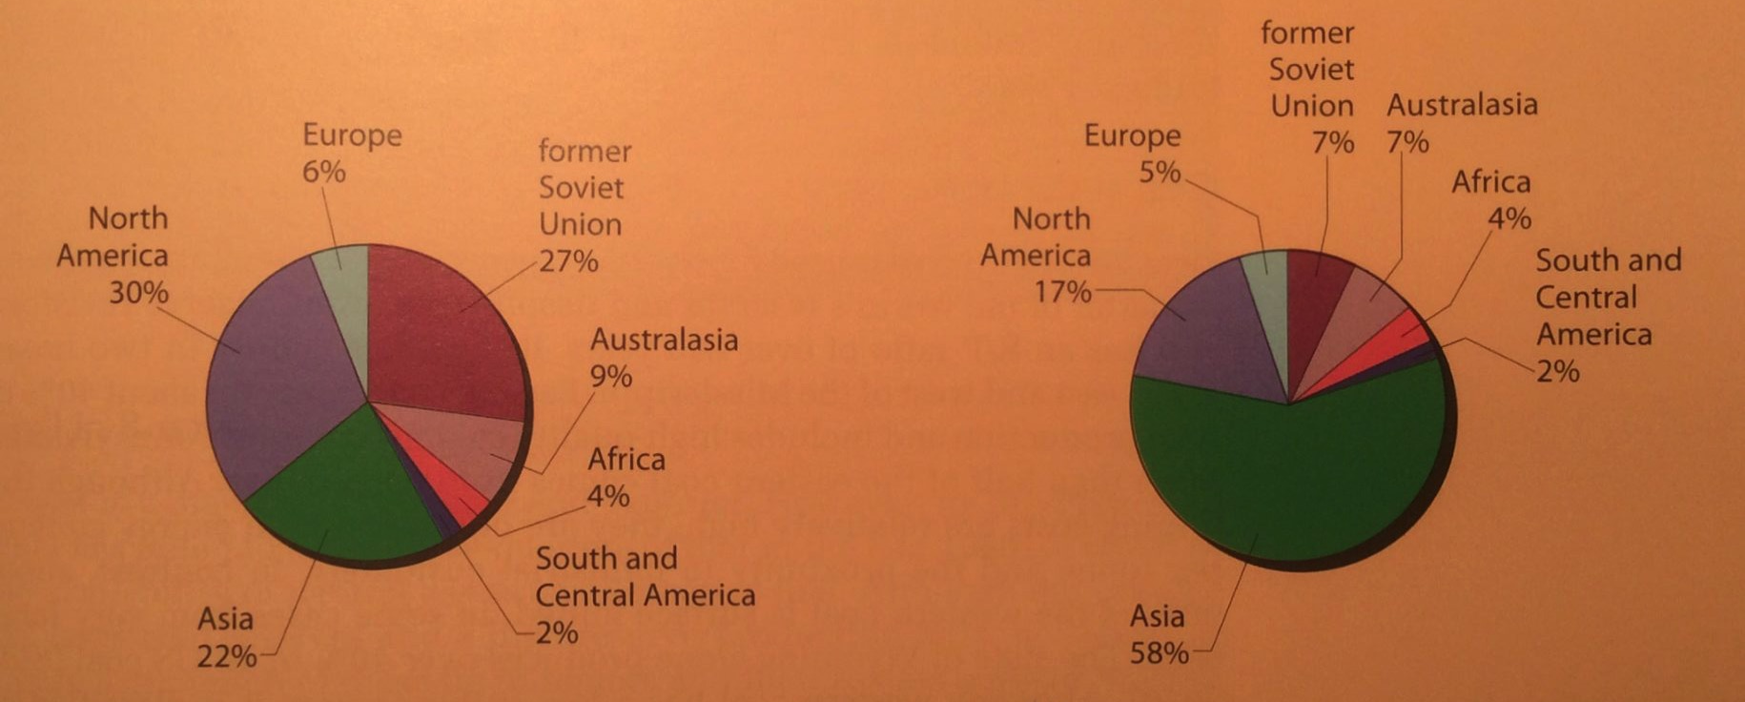
Global reserves & deposits (2010)
Note that areas of highest production are not the areas with the largest reserves.
Coal reserves
Coal production
A Watt double-acting steam engine (1859)
Energy Systems & Sustainability, 2/e, Chapter 5

Slide 5
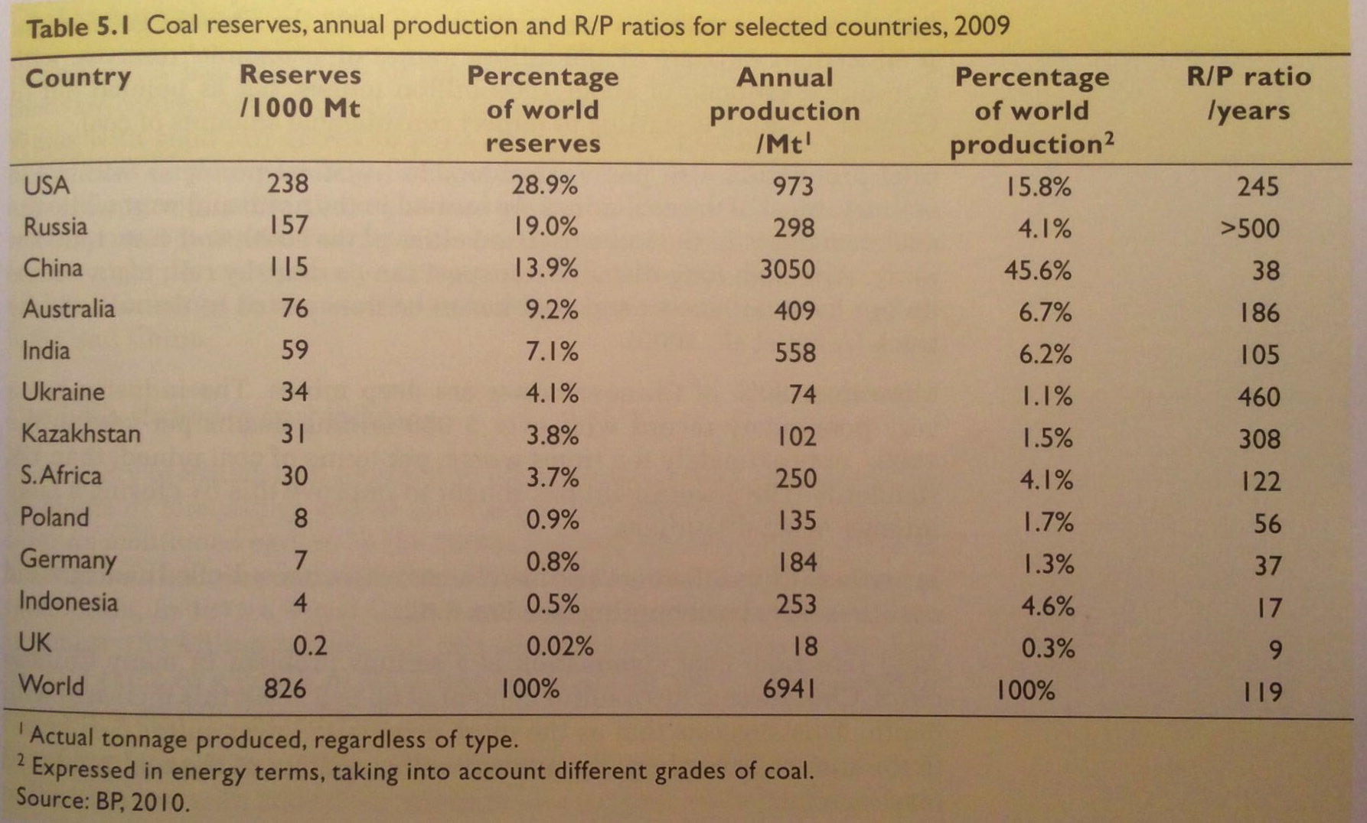
Global reserves & R/P ratios (2009)
A Watt double-acting steam engine (1859)
Energy Systems & Sustainability, 2/e, Chapter 5

Slide 6
Coal in the US
The US has 25% of global coal reserves.
R/P of 245 years
Eastern coal
Deep pits
High-quality coking coal
Western coal
Surface mined
Sub-bituminous, so low heat content
Must be transported to areas with high need, increasing cost
A Watt double-acting steam engine (1859)
Energy Systems & Sustainability, 2/e, Chapter 5

Slide 7
Coal in China
Use of coal in China has been expanding rapidly, but…
R/P of 38 years
Coal is found in the north & west, but need is in the south & east.
Transported by truck and rail
Nearly all mines are deep pits.
Poor safety: 5,00o deaths in the 1990s
10X worse than the UK
Uncontrolled underground mine fires occur.
Chinese coal has > 5% sulfur.
Acid rain is a problem in many cities
A Watt double-acting steam engine (1859)
Energy Systems & Sustainability, 2/e, Chapter 5

Slide 8
Coal elsewhere
Russia
R/P of >500 years
But production has fallen because of abundant NG
Coal in Siberia can be considered a conditional reserve.
India
4th largest reserves
R/P of 105 years
Poor quality: low heat content & high ash
Imports high-quality coal from Australia
Australia
Less than 10% of global reserves
R/P of 186 years
Surface mines are located near railways to cities of need.
Australia’s largest export:
40% to Japan
Coking coal to Europe
Middle East, Asia (India, China)
A Watt double-acting steam engine (1859)
Energy Systems & Sustainability, 2/e, Chapter 5

Slide 9
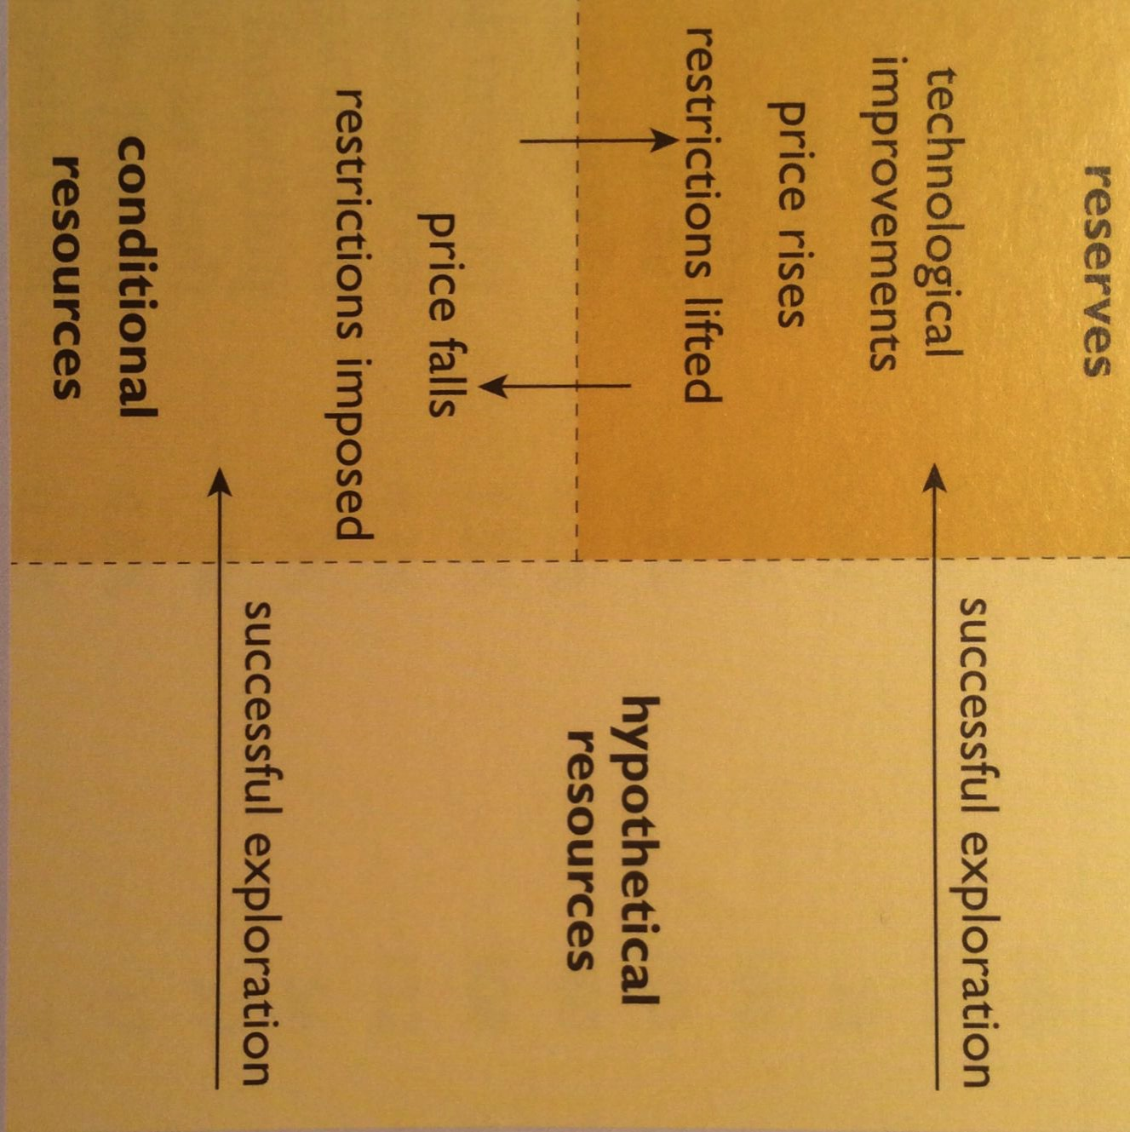
Reserves & R/P ratios can change…
…as technology and economic conditions change.
previously unknown
Resources: deposits likely to exist
Conditional resources: deposits that are not now reserves because their extraction isn’t economically or politically feasible now
Reserves: deposits that can be economically extracted now
McKelvey diagram
A Watt double-acting steam engine (1859)
Energy Systems & Sustainability, 2/e, Chapter 5

