Slide 1
SSC 2030: Energy Systems & Sustainability
4. Coal
4.1: Coal: an introduction
4.2: Fuel of the industrial revolution
4.3 : Formation & composition
4.4: Modern extraction & current uses
4.5: Coal deposits, reserves & production
4.6: Global coal resources & reserves
4.7: Coal combustion & emissions
4.8: Alternative uses of coal
4.9: Carbon sequestration & clean coal

Slide 2
4. Coal
4.7: Combustion of coal & emissions

Slide 3
Combustion
Moisture evaporates in the first stages of combustion.
Volatile matter is turned to gas like CO, CH₄ and other hydrocarbons.
These gases combust to create heat.
Fixed carbon combines with oxygen gas to produce carbon dioxide flue gas.
Ash is any material that remains.
Best quality coal has ~10% ash.
Lower quality may produce 15-30%.
A Watt double-acting steam engine (1859)
Energy Systems & Sustainability, 2/e, Chapter 5

Slide 4
Combustion: newer technologies
Pulverized fuel boilers create a fine carbon powder that is blown into the combustion chamber with air.
90% efficient
Problem: fine fly ash in flue gases.
Fluidized bed boilers combust small coal particles in a bed of sand. ‘Bubbles’ of coal and air heat the entire bed.
Very efficient
Lower combustion temps, so less NOx
A Watt double-acting steam engine (1859)
Energy Systems & Sustainability, 2/e, Chapter 5

Slide 5
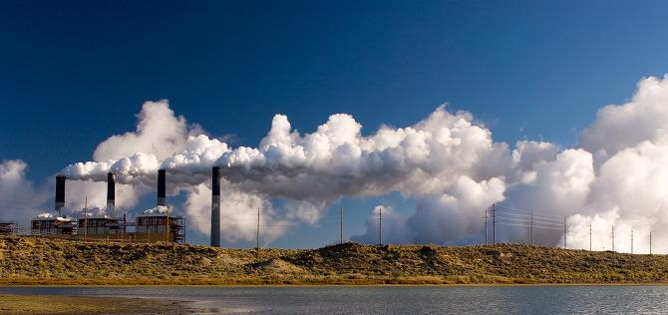
Combustion flue gases
Emissions: NOx, CO₂, H₂O, SOx, fly ash & particulates
Coal’s challenges?
Hot, dirty & corrosive
Volume: 3000 tonnes/hour!
Very high levels of:
Moisture
SOx; &
Particulates
Wyoming Public Media
A Watt double-acting steam engine (1859)
Energy Systems & Sustainability, 2/e, Chapter 5

Slide 6
Making emissions real
Let’s look at some numbers to bring home the scale of emissions from coal-fired power plants.
A power plant burns 250 tonnes of coal per hour to produce 500 MW.
Emission | tonnes | problem?
N₂ (from air for combustion) | 2000 | little harm
CO₂ | 650 | GHG !
Steam (H₂O) | 150 | harmless (energy loss)
NOx | 1 | acid-rain, health
SOx | 1 - 20 | acid-rain, health
Fly ash | 20 | health
Mercury vapor | 30 g | health
A Watt double-acting steam engine (1859)
Energy Systems & Sustainability, 2/e, Chapter 5

Slide 7
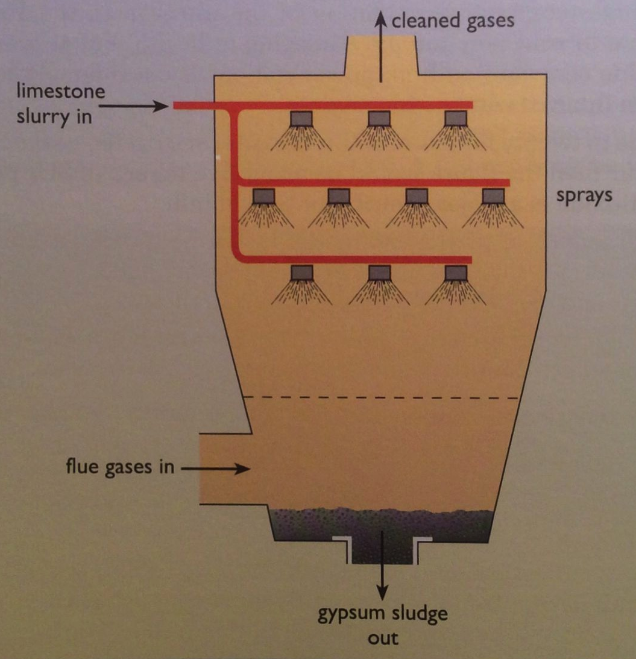
Lowering SOx
SOx can be reduced by using limestone (CaCO₃) or seawater to precipitate the 90-95% of sulfur out of the flue gases.
CaCO₃ + SO₂ → CaSO_{3/4} ⬇+ CO₂
Energy Systems & Sustainability, 2/e, Ch 5

Slide 8
Lowering NOx
NOx can be reduced by:
Decreasing combustion temperatures (a la fluidized bed);
Selective catalytic reduction (removal of O from N); or
Gas reburn via added natural gas to remove oxygen.
4NH₃ + 6NO → 5N₂ + 6H₂O
W (tungsten) or V (vanadium) catalyst
A Watt double-acting steam engine (1859)
Energy Systems & Sustainability, 2/e, Chapter 5

Slide 9
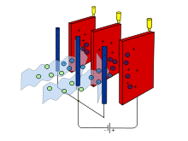
Lowering particulates and ash
Particulates and ash can be reduced using:
Cyclone;
Bag filter; or
Electrostatic precipitator:
Particles are ionized (charged) & then attracted to charged filters / plates.
Disposing of the ash?
Ash is toxic because of metal contaminants.
Landfill; or
Use as a ‘filler’ in concrete where toxins are fixed.
A Watt double-acting steam engine (1859)
Energy Systems & Sustainability, 2/e, Chapter 5; wikipedia

