Slide 1
SSC 2030: Energy Systems & Sustainability
4. Coal
4.1: Coal: an introduction
4.2: Fuel of the industrial revolution
4.3 : Formation & composition
4.4: Modern extraction & current uses
4.5: Coal deposits, reserves & production
4.6: Global coal resources & reserves
4.7: Coal combustion & emissions
4.8: Alternative uses of coal
4.9: Carbon sequestration & clean coal

Slide 2
4. Coal
4.8: Alternative uses of coal

Slide 3
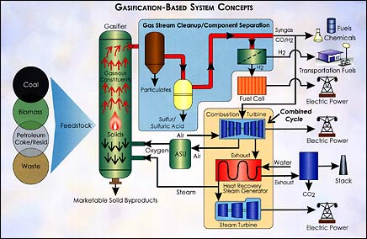
Gasification to syngas
Gasification converts hydrocarbons like coal into gases using heat, pressure and steam. Oxygen levels are controlled to prevent combustion.
Syngas:
CO & H₂
Wyoming Public Media
A Watt double-acting steam engine (1859)
Energy.gov

Slide 4
Gasification to syngas
Integrated gasification combined-cycle:
Cleaned syngas is combusted to drive a combustion turbine that drives a generator;
Exhaust heat is used to create steam, to drive a second steam turbine-generator.
Combined turbines generate electricity very efficiently: 40%
Compatible with carbon capture & storage
If oxygen is used in place of air, carbon dioxide is produced in a concentrated stream that is easier to capture and sequester.
Other uses of syngas?
Chemical building blocks for the chemical industries
Fuel for fuel-cell systems
Source of hydrogen
Wyoming Public Media
A Watt double-acting steam engine (1859)
Energy.gov

Slide 5
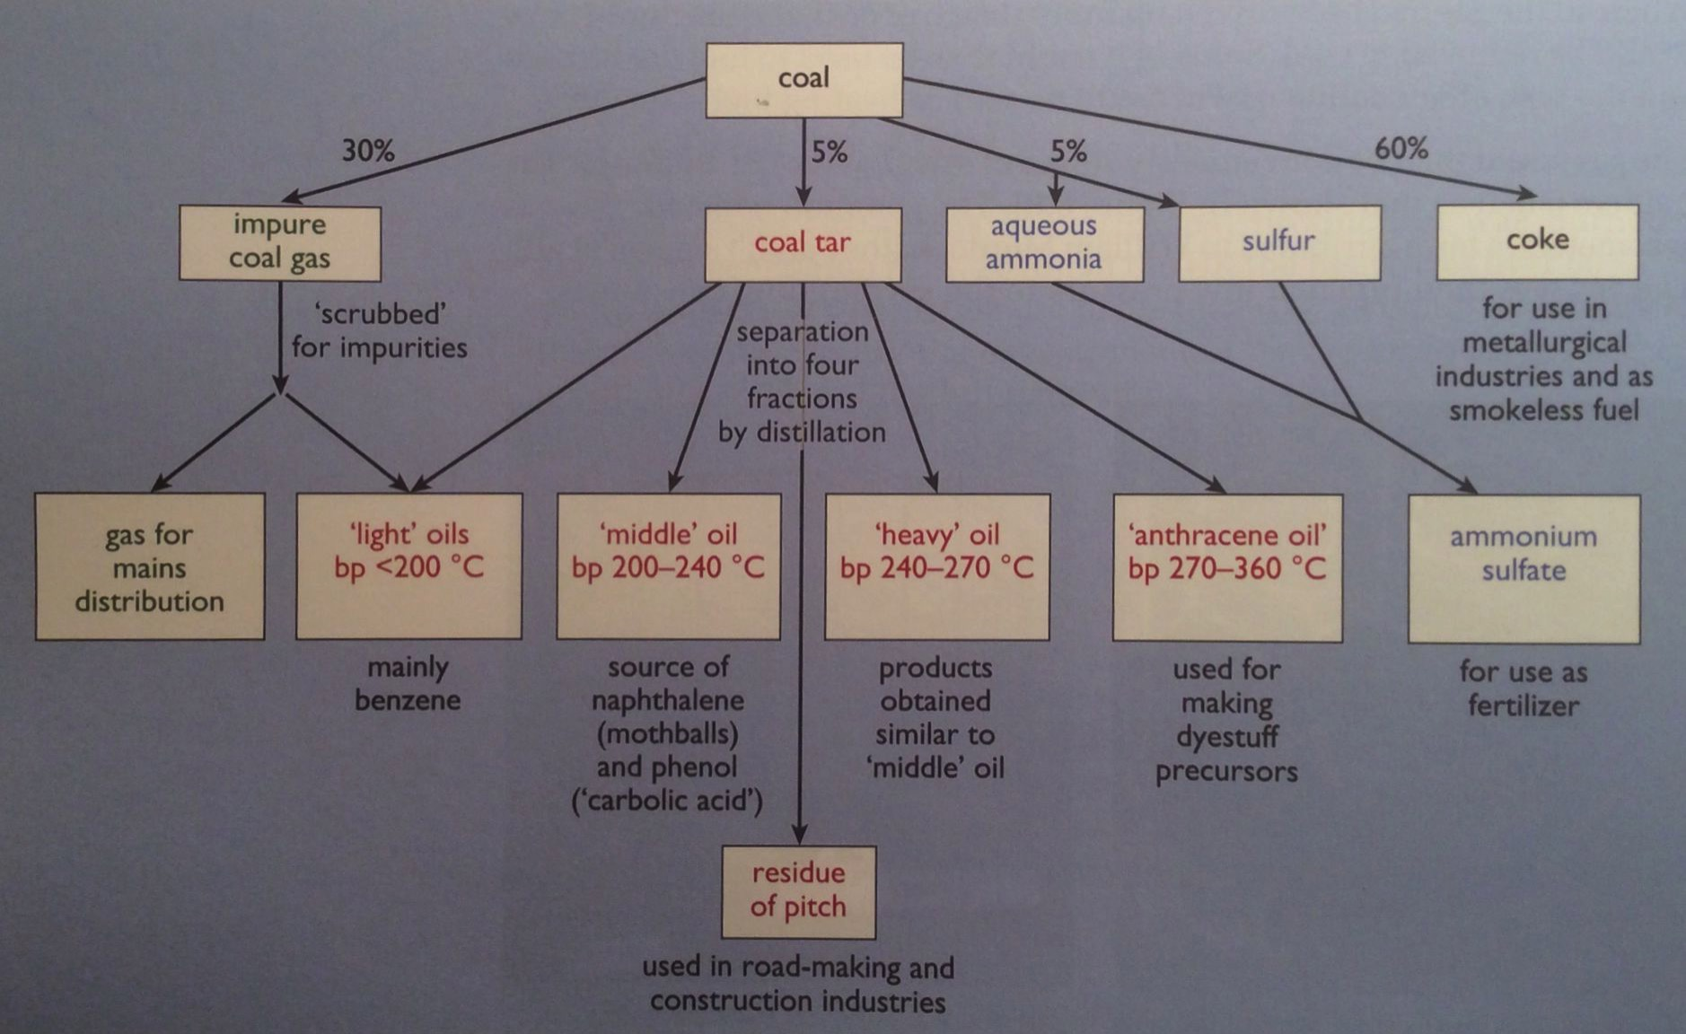
Gasification products & co-products
Wyoming Public Media
A Watt double-acting steam engine (1859)
Energy Systems & Sustainability, 2/e, Chapter 5

Slide 6
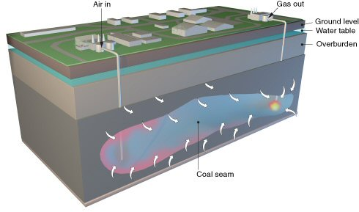
Underground coal gasification
Uses conventional gasification technology, put performed underground.
Air & water are injected into the coal seam;
Ignited under low-oxygen conditions to partially oxidize coal into:
H₂, CO, CO₂, CH₄, H₂S
Gases piped to the surface for combustion.
The UK will not use this technology because its CO₂ emissions are significantly higher than those from NG.
Wyoming Public Media
Energy Systems & Sustainability, 2/e, Chapter 5

